Slide 1
Incorporating Travel Time Reliability Data in Travel Path Estimation Sam Granato, Ohio DOT Rakesh Sharma, Belomar Regional Council

Slide 2
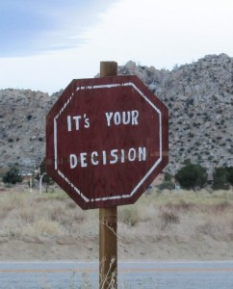
Which travel path to take?
Not much to do with “equilibrium” (latest exp. GPS study - only 1/3 of travelers on shortest time path, none on the shortest distance path - unless the same as shortest time path).
Why? Plenty of day-to-day variability in both link-level volumes and travel delays (as well as differences in traveler perceptions).
Use of variability of travel times in models born out of a sense that delay should somehow get more “weight” than other travel time for impatient drivers (but I never followed thru on some initial ideas for “off-line” weighting via static (& 1-off) link penalties).

Slide 3
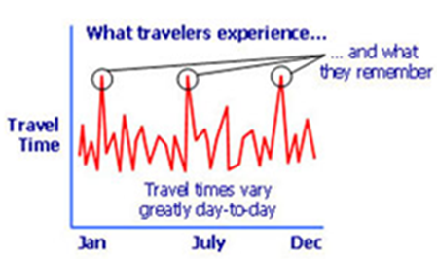
How do people select a travel path?
Distance (fixed)
Travel time (average)
Travel time (variability/reliability)
Pavement condition
Safety (perceived, both on and off-road)
“Fear of merging”
The “scenic route?”

Slide 4
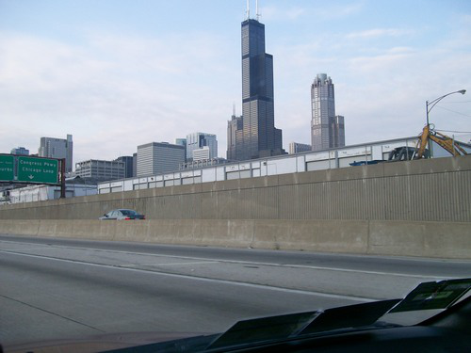
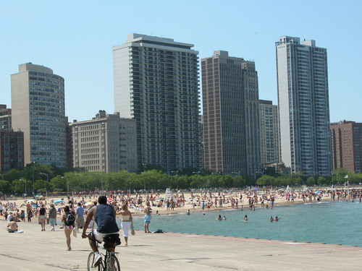
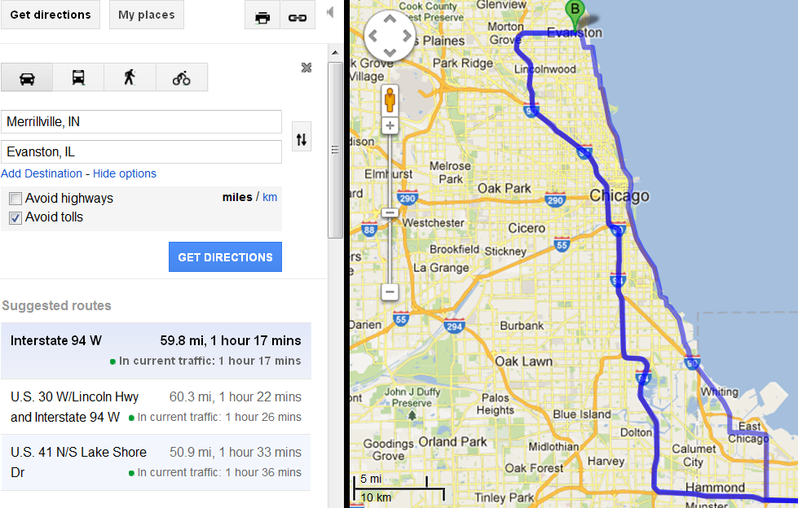
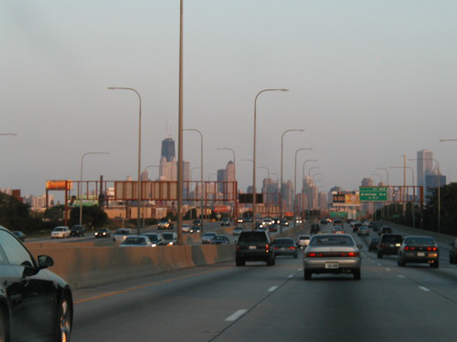
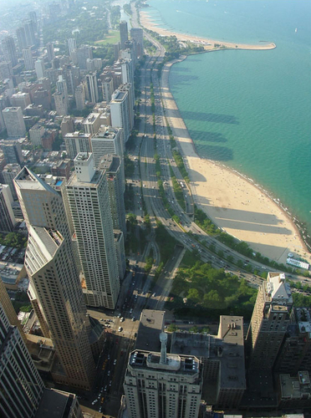
The occasional scenic diversion . . .

Slide 5
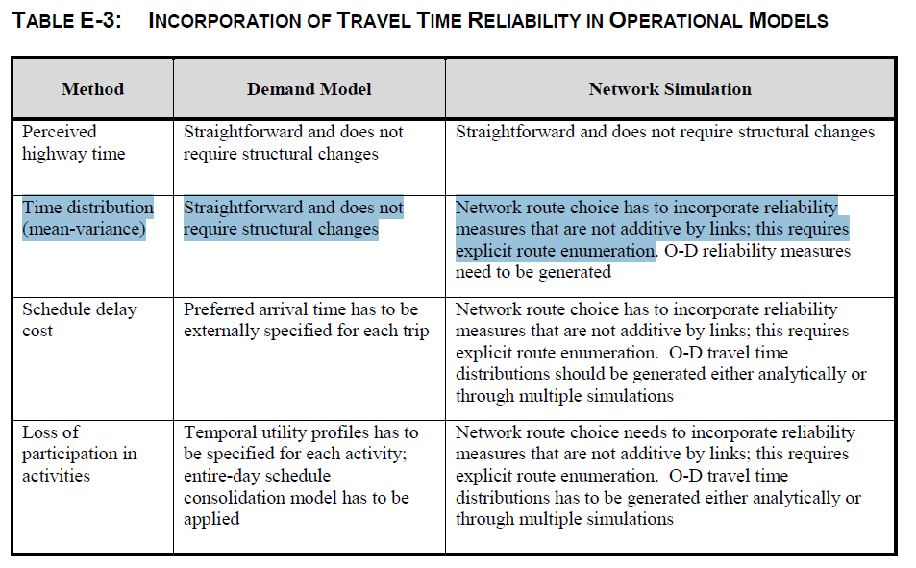

Slide 6
Forecasting framework using “not your father’s QRSII” DTA is integrated within 4-step process as a feedback loop instead of a “stand-alone” process, while a separate (3^{rd)} loop estimates the “reliable” travel paths - if non-additive by link.

Slide 7
Implementing Reliability in Path Building step:
Total Path Impedance (RR = reliability ratio)
Variance of Path Travel Time
Thru movements on successive links are correlated.
Marginal change in travel time standard deviation from selecting the next link:
So that for any path between an origin and destination:

Slide 8
Details of the Link-level Reliability calcs:
Path correction using MSA, vine building necessary.
Convergence found in a finite number of steps (via calculation of “path error” term).
Link travel time includes intersection delay, while standard deviation derived from the coefficient of variation equation
“Free” travel time t₀ includes intersection delays under low-flow conditions. (L=link length)
Calibration coefficients can vary by road type

Slide 9
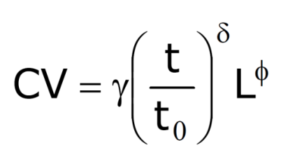
Reliability Parameters
Link Impedance = all other components + (reliability ratio)*t*CV

Slide 10
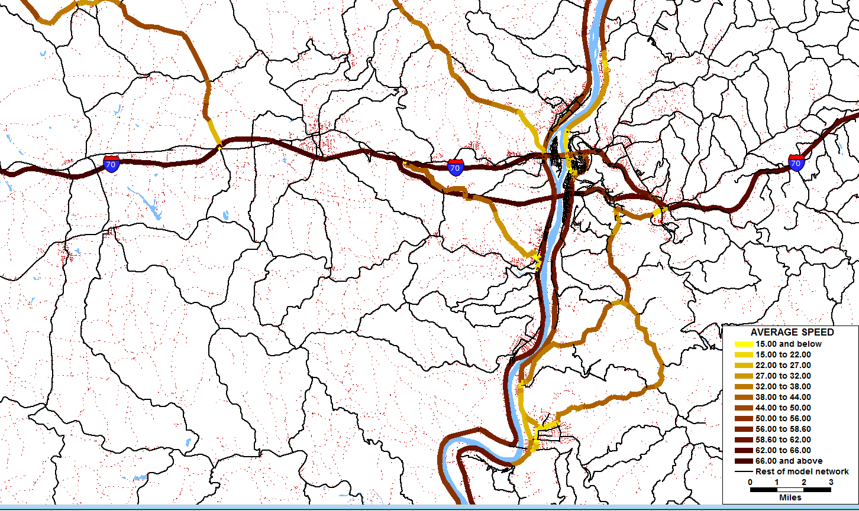
Wheeling Area Travel Demand Model
150,000 metro population, 900 modeled intersections (125 signalized), validated to local travel time surveys as well as counts

Slide 11
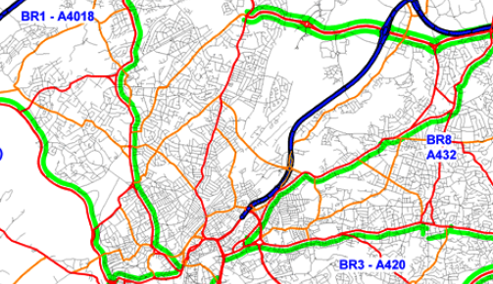
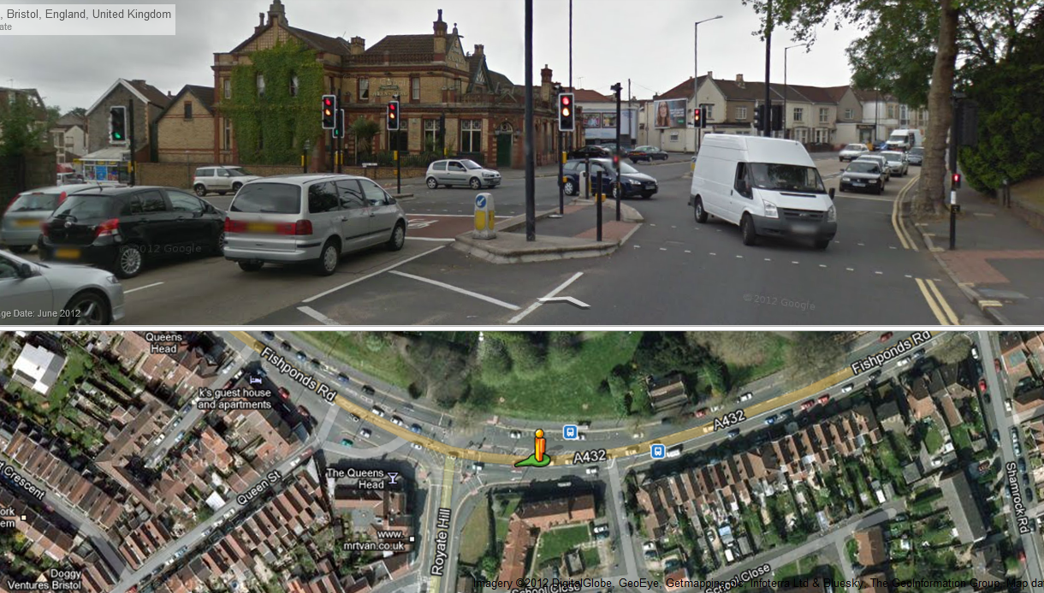
Initial CV estimates (by route) from research in UK

Slide 12
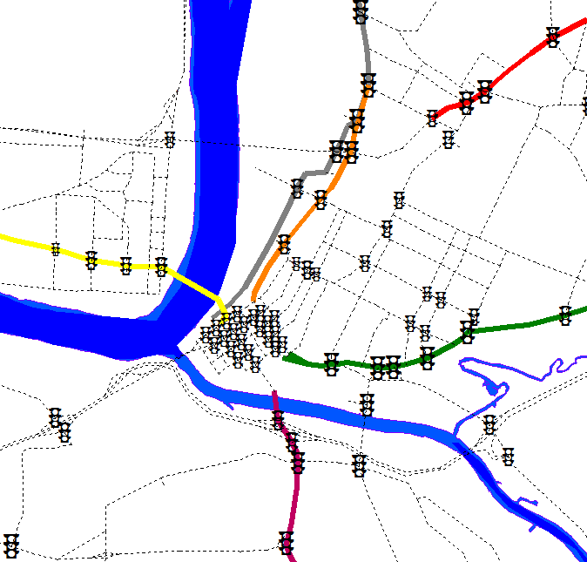
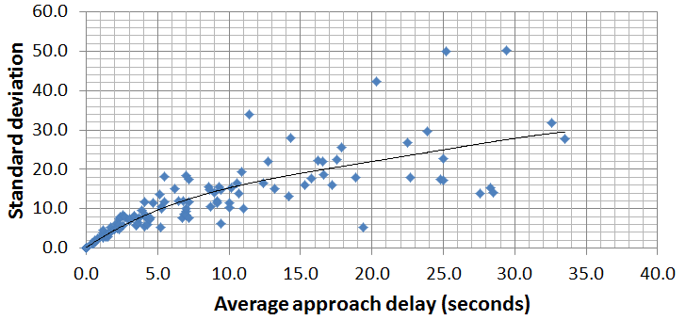
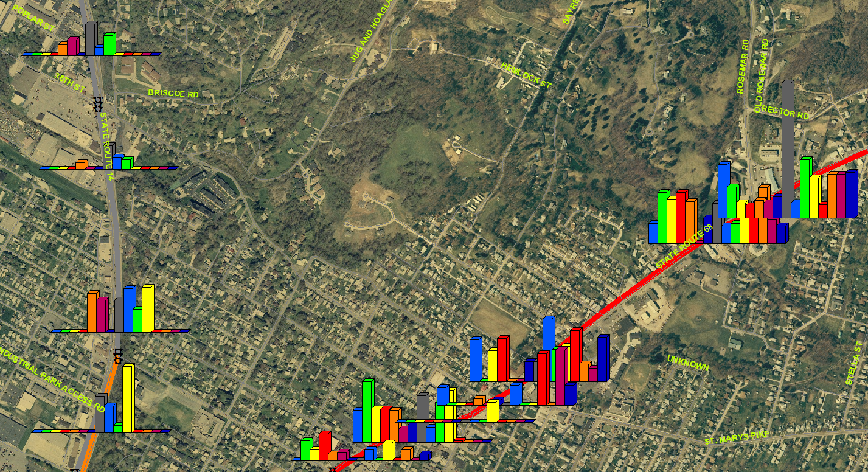
Variability in intersection delay from travel time survey with large sample sizes from nearby MPO region
From “local” floating-car surveys:

Slide 13
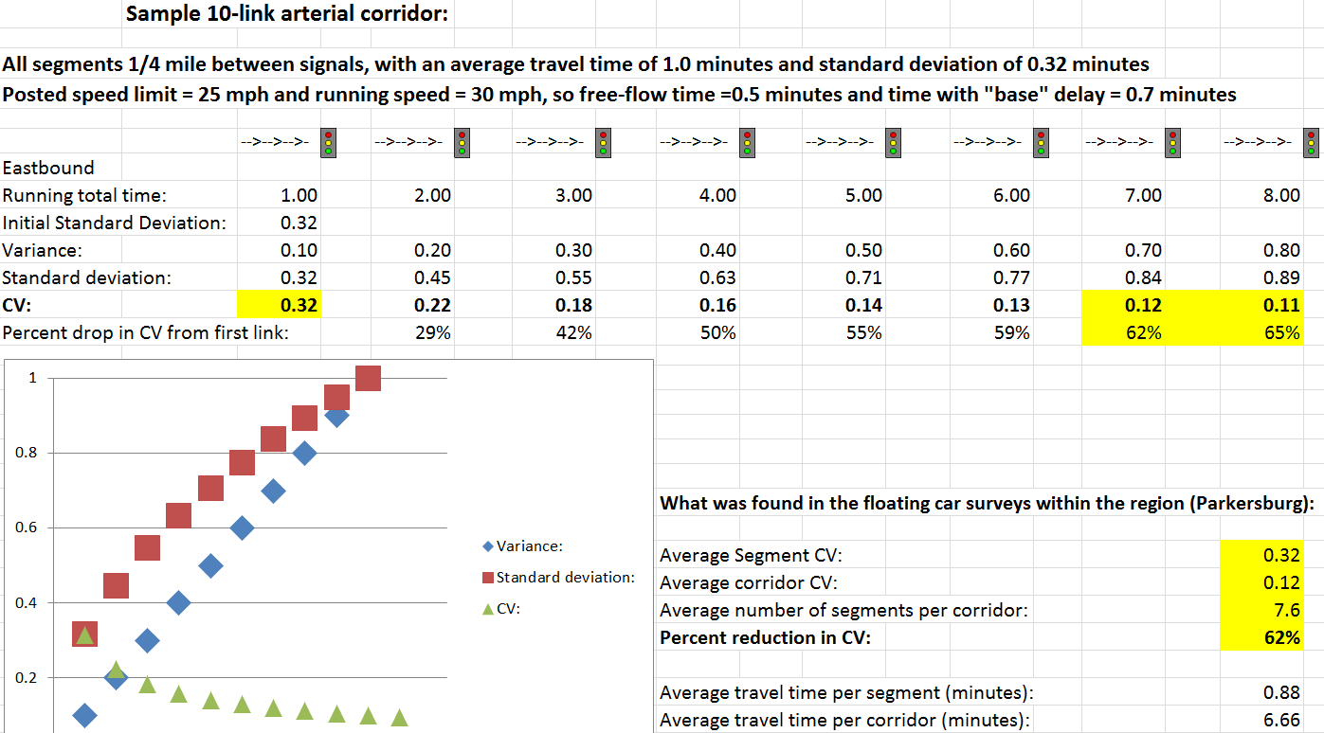
Travel time variability as a function of route length, or number of intersections

Slide 14
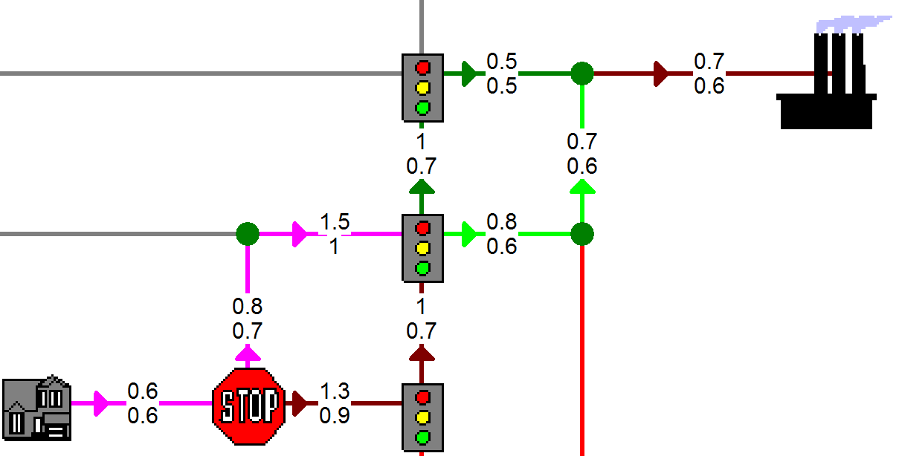
Simplified Example (average time/”free-flow” time): (All links are 0.25 miles with running speed=30 mph so “running” time=0.5 minutes)

Slide 15
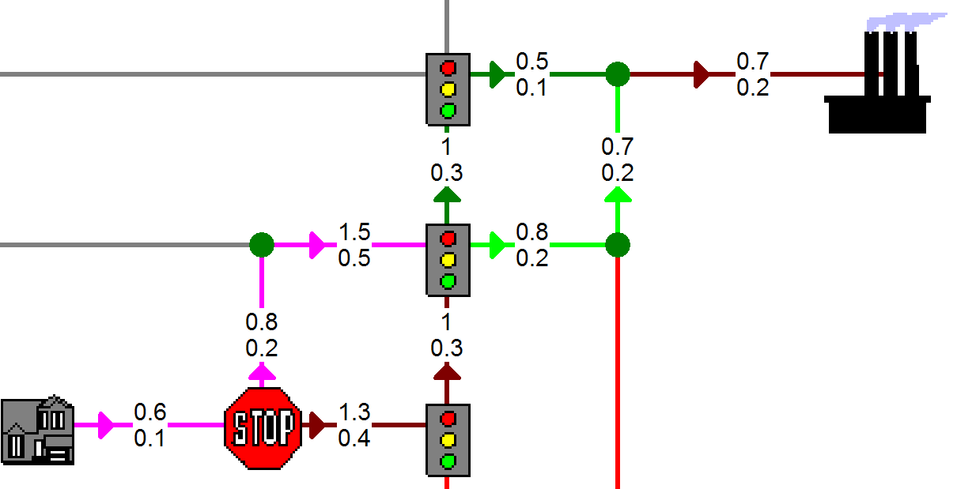
Path impedance with reliability (additive) (Posted: Average time / standard deviation)

Slide 16
Path impedance with reliability (NON-additive) (Posted: Average time / standard deviation)

Slide 17
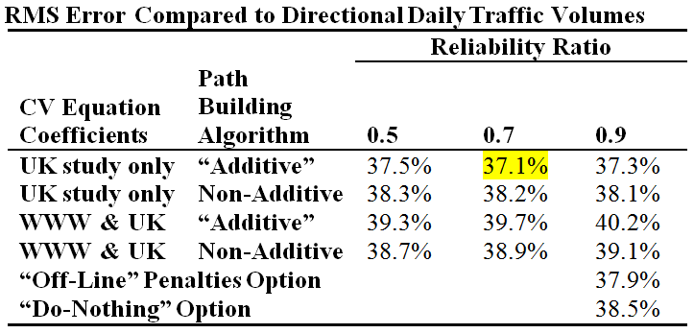
Results
Number of Path building iterations has clear impact on model volumes but mixed on validation
Procedures reduce impact of “worst” intersections
Counter-intuitively (?), equation values from UK study worked better than nearby (WWW region) surveys
Virtually no differences among options for local travel time error (table shows “bottom line” for volume)

Slide 18
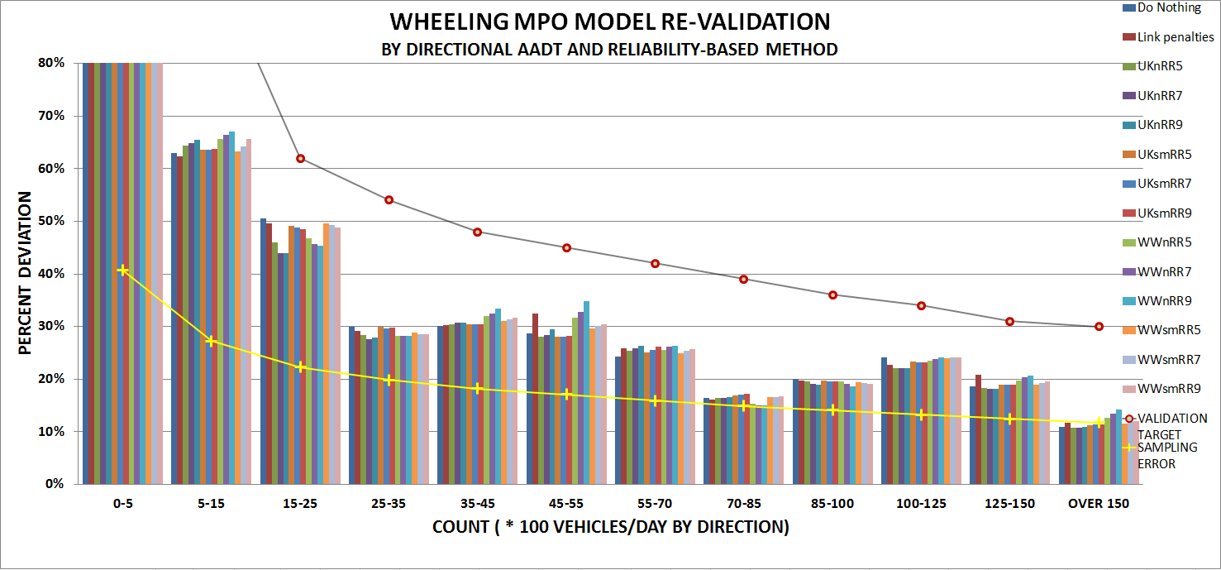
Overall Impact of Incorporating Reliability in the Model Update?
Little impact on overall validation v. counts or travel times
Regardless of option taken, superior validation
Few differences overall due to relative lack of congestion

Slide 19
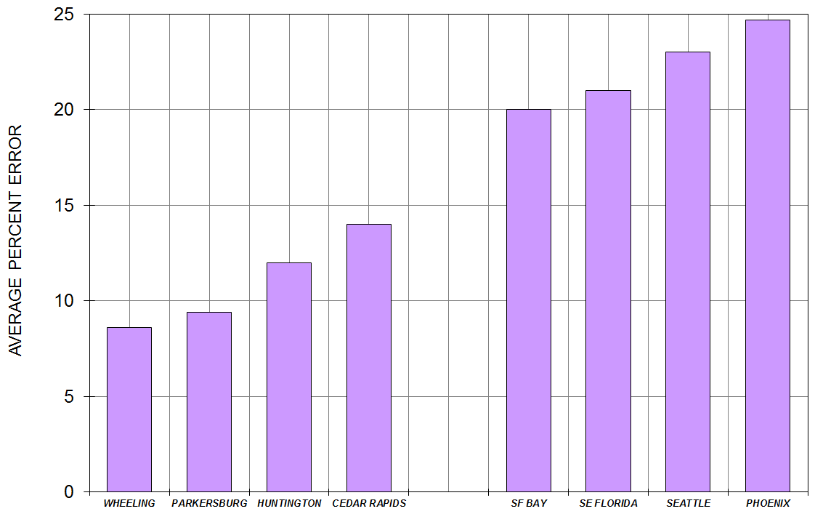
Modeled Travel Time with Procedures
Urban street travel time errors (average of 8%) lower than models from other regions (esp. those still relying on fixed capacities & vdfs).
Errors even less on freeways (2%) and rural roads (4%)

Slide 20
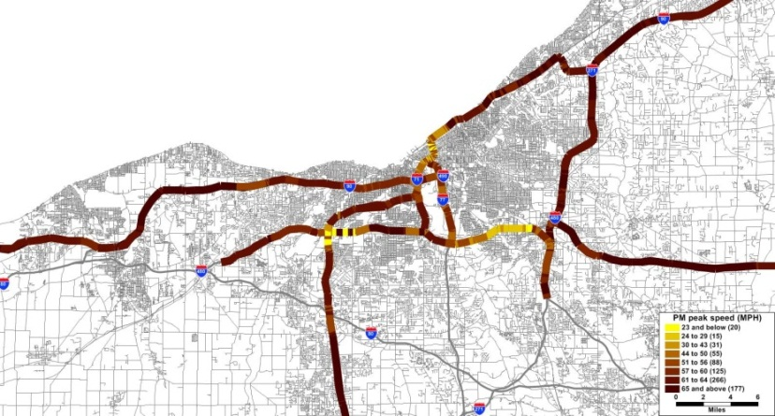
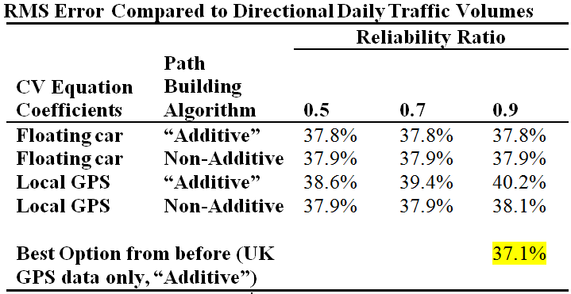
Impact of using new data sources:
Freeway floating car (Cleveland)
Local GPS data (Columbus sample)
Generated new sets of CV equation coefficients
No impact on model’s
Validation (so far)
Statewide GPS data on curves/grades/RR crossings found less delay than expected
Demand-side in future?

Slide 21
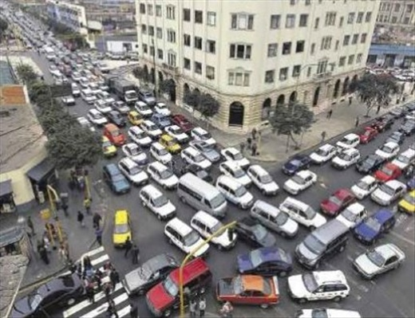
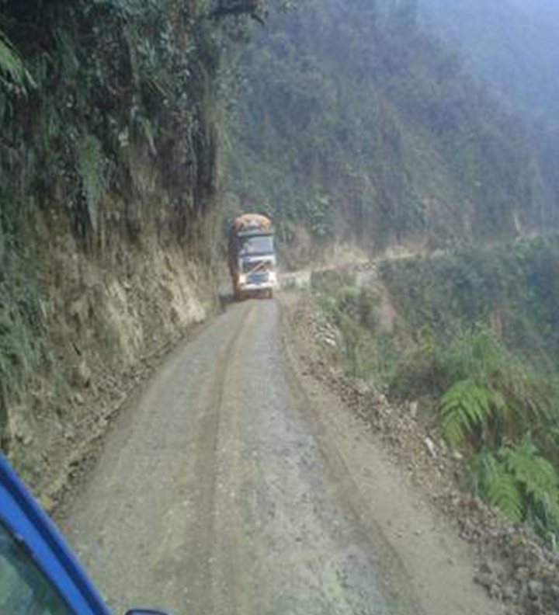
Questions?
sam.granato@dot.state.oh.us
rsharma@belomar.org

