Slide 1
Challenge 5: Transportation Economics
Development of an Enhanced User Benefit and Cost Calculator for Ohio
Vince Bernardin, RSG
Chris Beard, BLA
Greg Giaimo, ODOT

Slide 2
The Big Picture
The Big Questions:
Bang for your Buck: B/C ratio
The Bottom Line: Job creation
ODOT’s TRAC project selection process may consider both
Currently re-evaluating economic measures
Many alternatives: development/redevelopment potential, ROI, economic distress, etc.
ODOT’s Statewide Planning & Research group has been developing and enhancing tools to quantify these answers for more than a decade (CMSCost, UCOST, EIM, QEIM, etc.)
Tools did not all play well together / with all models – concerns about consistency, and lacked sensitivity to some issues ODOT was interested in: maintenance vs. capital costs, reliability improvements, etc.

Slide 3
Review of ODOT’s Initial System
Consistency of Demand Model Utility Measures, Path Building Impedances with Economic Assumptions
Different values of time, differing impedances
Simple length term in generalized cost not necessarily tracking operating costs, crash costs
Model Stability: Simulation Variation & Assignment Convergence
Simulation variation limited precision ($100k), but manageable
Assignment convergence / stability found to be a major issue
Induced Demand, Mode Shift & Travel/Land Use Redistribution
Ignored in initial system
Considered Rule of Half vs. Expected Utilities Methods
Comparison of QEIM vs. T-PICS
Compared economic impacts of 4 projects from QEIM & T-PICS
SEE YOUR FLASH DRIVE FOR THE FULL REPORT (EC-1_REPORT.PDF)!

Slide 4
QEIM vs. T-PICS
Job creation was similar
Because driven by construction costs
Slightly higher net multiplier offset by lower labor productivity
Direct Benefits very different
QEIM missing effects:
Consumer Surplus
Commodity Value of Time
Travel Time Reliability
Market Access & Productivity Effects
Possible bias towards more costly projects over projects with more actual benefits
SEE YOUR FLASH DRIVE FOR A
SPREADSHEET COMPARISON
(Project Testing Summary.xlsx)!
Project | Economic Effect | QEIM | T-Pics
144 Freeway Widening | Employment | 1,362 | 1,385
 | Net Multiplier | 1.80 | 1.56
 | Direct Benefits | $566,907 | $38,659,000
139 New Roadway | Employment | 632 | 640
 | Net Multiplier | 1.75 | 1.66
 | Direct Benefits | $1,349,638 | $17,438,500
117 New Interchange | Employment | 1,136 | 1,435
 | Net Multiplier | 1.75 | 1.56
 | Direct Benefits | $180,282 | $62,632,000
113 Reconstruct Freeway | Employment | 10,112 | 10,425
 | Net Multiplier | 1.73 | 1.66
 | Direct Benefits | $805,471 | $267,088,500

Slide 5
Recommendations
Improvements to Assignment (presented later in this workshop)
Improve convergence
Consistency of generalized cost
Improve Economic Impact Calculator (in early stages of development)
Enhanced Market Access / New Economic Geography Effects
Feedback new employment into land use components of statewide model
Improve User Benefit Calculator (presented here)
Apply Consumer Surplus Theory
Add Commodity Values of Time
Add Travel Time Reliability Impacts
Add Work Zone Impacts
Incorporate Asset Deterioration / Maintenance Costs

Slide 6
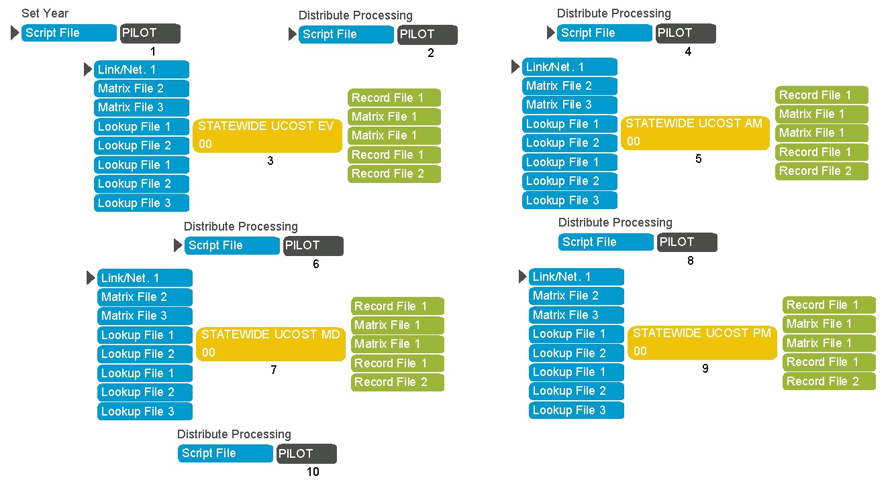
Improved User Benefit Calculator
UCOST2 Tools
Integrated with Ohio Statewide TDM
Compatible with standard Ohio Medium & Small MPO Models
Analysis also improves Travel Demand Model Results
Developed as a set of 3 Utilities in CUBE script
AGEASSET
PRECOST
UCOST2

Slide 7
AGEASSET Utility
Goal: Incorporate Asset Deterioration Impacts & Maintenance Costs in Benefit Cost Analysis
Most Major Projects Include Significant Rehabilitation Components in Their Cost Yet Travel Demand Model Based User Benefit Analysis Only Measures Mobility Benefit
Example: Replacing a major bridge could be a major project costing hundreds of millions yet if it had the same number of lanes the model based method would indicate zero benefit
Most Major Projects are Hybrids Containing Both Capacity Enhancement and Rehabilitation

Slide 8
AGEASSET Utility
Tool is Not a Detailed Asset Management Tool, Rather a Planning Level Analysis Based on Averages
Maintenance Strategies Are Simplified as:
Deferred Maintenance
Status Quo Maintenance
Complete rehabilitation/reconstruction
Focused on project area, ignores deterioration elsewhere
Key Outputs Play to Strengths of Travel Demand Model Allowing Mobility Impacts of Deteriorated Assets to be Quantified (Detailed Asset Management Tools Can’t do This)
Load limits/closures due to deterioration
Speed reductions due to poor pavement conditions
ODOT maintenance costs by year

Slide 9
AGEASSET Utility
Measures of Asset Conditions
Pavement: International Roughness Index (IRI)
Structures: Organizational Performance Indicator (OPI)
Key Factors
Baseline conditions of Pavement & Structures
Maintenance unit costs per lane mile (e.g., to re-deck structure)
Average Annual Freeze Index Factor
Utility Operation
Steps through time
At each step, calculates deterioration from baseline IRI/OPI based on traffic, climate
Takes action (or none) based on specified strategy
Determines any speed reduction, load limits/closures – for assignment
Notes:
OPI is ODOT specific measure

Slide 10
PRECOST Utility
Goal: Incorporate Vehicle Operating Costs and Crash Costs & Delays in Assignment
Avoid potential inconsistency between costs used to select best route in assignment and costs in economic analysis
Methods: Vehicle Operation & Crash Costs
HERS Methods for most VOCs
AASHTO Red Book for most safety
Considered Highway Safety Manual but left for future
Published OSU research for work zones
Utility Operation
Calculate Costs & Delays on Mainlines & at Intersections
Based on ‘bootstrapped’ traffic levels
Linearization necessary – economic models not monotonic
Apply to TDM network for Assignment
Notes:
Grades, truck percentage and congestion key factors why operating and crash costs not simply length based

Slide 11
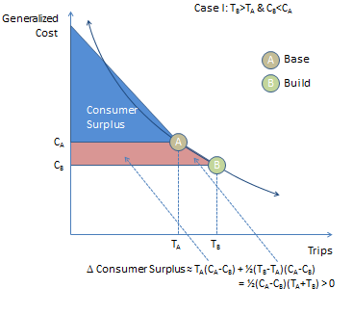
UCOST2 Utility – Consumer Surplus
Goal: Apply Consumer Surplus Theory & Incorporate Additional Cost Factors
Consumer Surplus Theory
Commodity Value of Time
Travel Time Reliability
Work Zone Delays & Costs
Consumer Surplus Theory
Necessary when induced travel / land use are significant
Applied to total user costs not just travel time
Used linearization “Rule of Half”
Expected Utility proved problematic
Numerical integration possible but time consuming

Slide 12
UCOST2 Utility – Commodity Value of Time
Commodity Value of Time & Truck Classes
Considered logistics-based truck classes related to commodity values
Variation in value of commodity time much less than truck size
Truck classes based on # of axles & service vs. goods-carrying
Dovetails better with toll classifications
Includes wage & benefits + commodity VOT
Commodity value of travel time reliability may prove more critical
SEE YOUR FLASH DRIVE FOR ADDITIONAL COMPARISONS IN SPREADSHEET (ODOT_Truck_VOT_Summary.xlsx)!
 | PRIVATE | FOR-HIRE
 |  | LONG-TERM | SHORT-TERM | ON THE SPOT
Average Value ($/ton) | $1.02 | $1.97 | $1.31 | $0.85
Average Value of Time ($/hr/ton) | $0.78 | $0.87 | $0.86 | $0.58
Truck Class | Total Value of Time
Four Tire Service Vehicle | $25.87 / hr
Four Tire Goods Vehicle | $21.14 / hr
SU Truck (2-4 Axle) | $22.42 / hr
MU Truck (5+ Axle) | $34.24 / hr

Slide 13
UCOST2 – Travel Time Reliability
Travel Time Reliability
Considered buffer time vs. mean-variance approach
Buffer time doesn’t require VOR – good or bad?
Opted for buffer time approach
ODOT purchased INRIX data statewide on speed, reliaiblity
Reliability clearly related to average delay
VDFs do poor job of predicting delay
Estimated new VDFS, better, but still poor
Source: Sam Granato, ODOT
Source: RSG

Slide 14
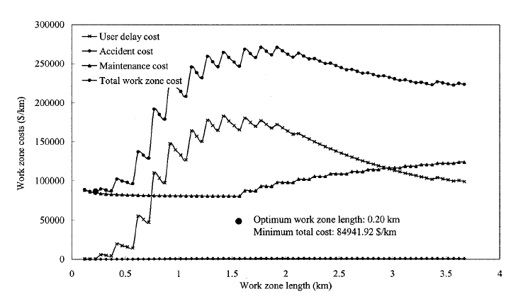
UCOST2 Utility – Work Zone Delay & Cost
Work Zone Delays & Costs
Implemented methods from research at OSU published in JTE
Work zone delay, crashes and additional vehicle operating costs as a function of traffic, length of closure
Source: Jiang, X. and H. Adeli (2003) “Freeway Work Zone Traffic Delay and Cost Optimization Model”, JTE

