Slide 1
Making advanced travel forecasting models affordable through model transferability
14th TRB Conference on
Transportation Planning Applications
May 5-9, 2013, Columbus, Ohio
John L Bowman, Mark Bradley,
Joe Castiglione, Supin Yoder

Slide 2
Acknowledgments
Sponsored by FHWA under the STEP program
Data provided by
  California DOT
  Fehr & Peers
  Florida DOT
  Fresno County COG
  Sacramento Area COG
  San Joaquin County COG
  San Diego Association of Governments

Slide 3
Outline
Introduction
Transferability testing methods
Results

Slide 4
Objective
Empirically test and demonstrate the transferability of activity-based (AB) models between regions
Why? Reduce AB development costs
  large household survey
  estimating entirely new models

Slide 5
Six regions in study
Sacramento
Northern
San Joaquin Valley
Fresno
San Diego
Jacksonville
Tampa

Slide 6
AB Model Framework

Slide 7
Fifteen tested model components
Model Type | Number of coefficients
Usual work location | 48
Auto ownership | 24
Person-day tour generation | 126
Exact number of tours | 86
Work tour time of day | 69
Work tour mode (detailed LOS) | 58
Work tour mode (combined LOS) | 31
Work-based subtour generation | 14
School tour mode | 32
Other tour destination | 62
Other tour time of day | 86
Other tour mode | 41
Intermediate stop generation | 100
Intermediate stop location | 66
Trip time of day | 45
Total | 888

Slide 8
Seven untested model components
Model Type
Usual school location
Work tour destination
Escort tour mode
Work-based subtour mode
School tour time of day
Work-based subtour time of day
Trip mode

Slide 9
Eleven variable types
Variable Type | Number of coefficients
A-constant | 192
P-person | 184
H-household | 149
D-day pattern | 76
T-tour/trip | 199
I-impedance | 110
U-land use | 99
W-time window | 45
C-logsum | 24
G-size variable | 35
L-log size multiplier | 3
Total | 1116

Slide 10
Transferability testing: two approaches
Application-Based
  Apply model system developed for another region
  Compare predictions to observed aggregate outcomes
Estimation-Based
  Estimate coefficients for both regions
  Compare them for statistical differences

Slide 11
Strengths of the estimation-based approach
Explicit statistical tests
  Can address a wide variety of hypotheses
  Can test transferability of specific variable types and model components

Slide 12
Data issues
Data problems can confound transferability test results
  Inconsistent data
  Small samples

Slide 13
Estimability questions
What estimation sample size is adequate?
How does combining samples improve estimability?
Which models are more estimable at the regional level?

Slide 14
Transferability
Hypothesis 1
Variables that apply to population segments defined by characteristics of individuals and/or their situational context (i.e. segment-specific variables) will tend to be more transferable than variables that are more generic and apply to all individuals.

Slide 15
Transferability
Hypothesis 2
Variables that are segment-specific will tend to be more transferable than alternative-specific constants.

Slide 16
Transferability
Hypothesis 3
Models that deal with social organization (activity generation and scheduling) will be more transferable than models that deal mainly with spatial organization (mode choice and location choice)

Slide 17
Transferability
Hypothesis 4
Models for different regions within the same state will tend to be more transferable than models for regions in different parts of the country

Slide 18
Outline
Introduction
Transferability testing methods
Results

Slide 19
Testing method overview
Prepare data
Estimate separate models
Estimate comparison models
Tabulate and analyze results

Slide 20
Data preparation overview
For each region:

Slide 21
NHTS Sample Sizes
Region | Number of Households
Fresno | 380
Northern San Joaquin Valley | 660
Sacramento | 1,310
San Diego | 6,000
California Total | 8,350
Jacksonville | 1,050
Tampa | 2,500
Florida Total | 3,550
Two-state total | 11,900

Slide 22
Testing method overview
Prepare data
Estimate separate models
Estimate comparison models
Tabulate and analyze results

Slide 23
Estimating separate models
Generate base model specs
Estimate 90 separate models
(15 models x 6 regions)
Constrain inestimable coefficients

Slide 24
Testing method overview
Prepare data
Estimate separate models
Estimate comparison models
Tabulate and analyze results

Slide 25
Estimating comparison models
For each of the 15 models:
Combine data for all regions
Estimate 36 versions of each model
  12 base model versions
  24 difference model versions

Slide 26
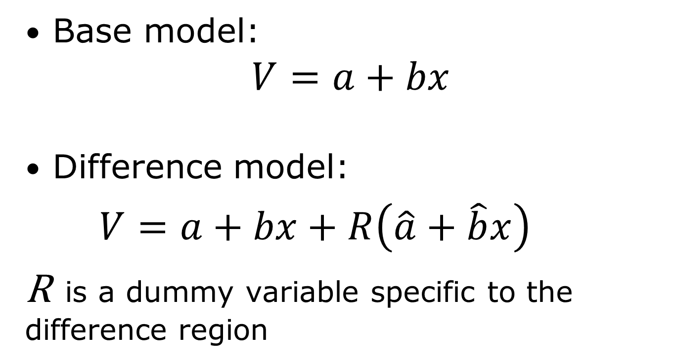
Utility functions
Base model:
$V=a+bx$
Difference model:
$V=a+bx+R\left(\hat{a}+\hat{b}x\right)$
R is a dummy variable specific to the difference region

Slide 27
Testing Method Overview
Prepare data
Estimate separate models
Estimate comparison models
Tabulate and analyze results

Slide 28
Outline
Introduction
Transferability testing methods
Results
  Hypotheses tested
  Most important conclusion

Slide 29
Transferability hypotheses
(Hypothesis 1) Segment-specific variables will tend to be more transferable than variables that are more generic and apply to all individuals. (accepted)
(Hypothesis 2) Variables that are segment-specific will tend to be more transferable than alternative-specific constants. (rejected)

Slide 30
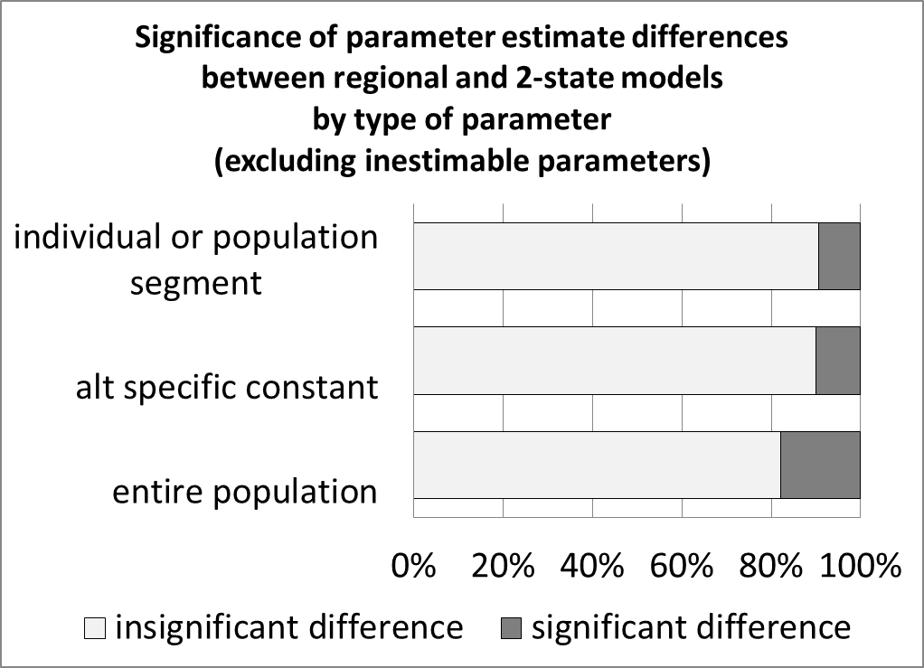

Slide 31
Transferability hypotheses
(Hypothesis 3) Models that deal with social organization (activity generation and scheduling) will be more transferable than models that deal mainly with spatial organization (mode choice and location choice)
(accepted)

Slide 32
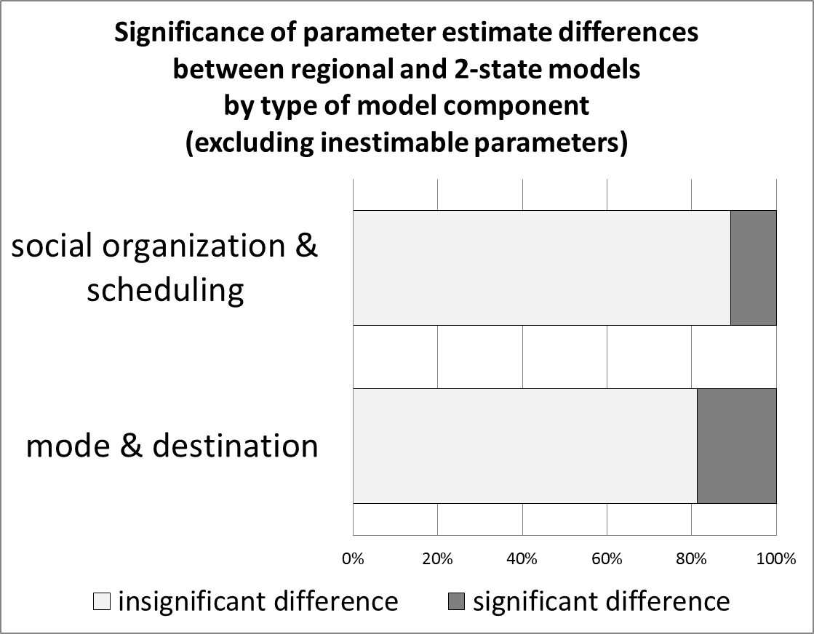
1

Slide 33
Transferability hypotheses
(Hypothesis 4) Models for different regions within the same state will tend to be more transferable than models for regions in different parts of the country
California—accepted (weakly)
Florida—rejected, Jacksonville more transferable with California than with Tampa

Slide 34
Outline
Introduction
Transferability testing methods
Results
  Hypotheses tested
  Most important conclusions

Slide 35
Most Important Conclusions
  evidence of broad comparability among all the regions, with one region, Tampa, standing out as less comparable than the others
  sample sizes of 6,000 households or more provide much better information for estimating coefficients than samples of 2,500 or less.
  Better to transfer models based on large sample from comparable region than to estimate new models using a much smaller local sample

Slide 36
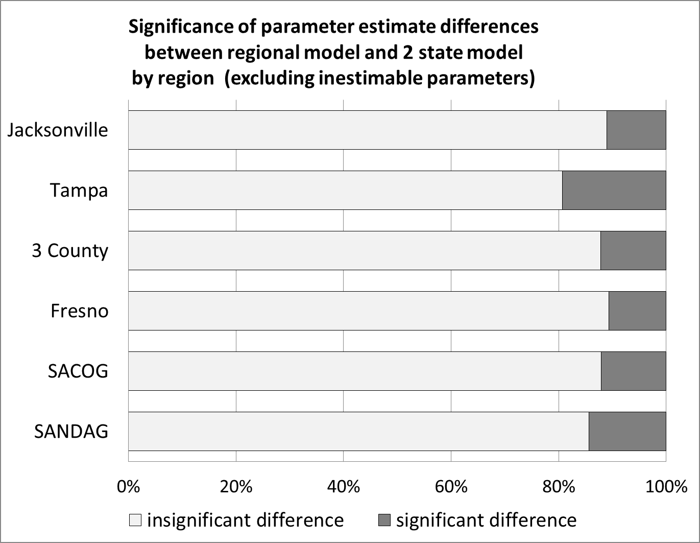
Comparability—2 state

Slide 37
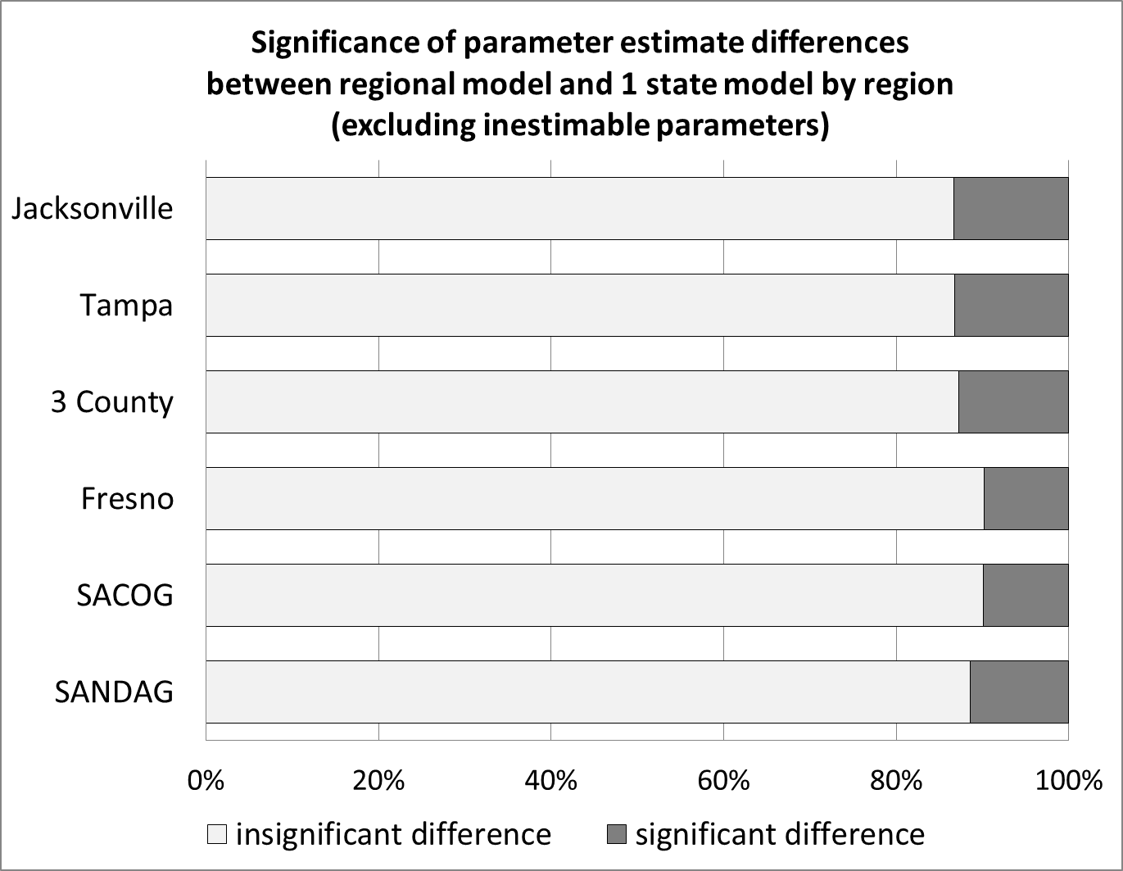
Comparability within state

Slide 38
Most Important Conclusions
  evidence of broad comparability among all the regions, with one region, Tampa, standing out as less comparable than the others
  sample sizes of 6,000 households or more provide much better information for estimating coefficients than samples of 2,500 or less.
  Better to transfer models based on large sample from comparable region than to estimate new models using a much smaller local sample

Slide 39
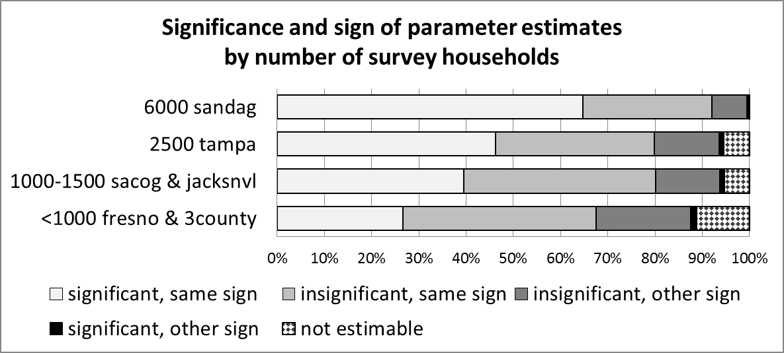
Need for large samples

Slide 40
Most Important Conclusions
  evidence of broad comparability among all the regions, with one region, Tampa, standing out as less comparable than the others
  sample sizes of 6,000 households or more provide much better information for estimating coefficients than samples of 2,500 or less.
  Better to transfer models based on large sample from comparable region than to estimate new models using a much smaller local sample

Slide 42
12 Base model versions
6 region-specific versions
2 2-state versions
  With region-specific ASCs
  Without region-specific ASCs
2 FL versions (with & without region ASCs)
2 CA versions (with & without region ASCs)

Slide 43
24 Difference model versions
Four versions for each region
each with difference variables relative to a base version
  2 state base
  2 state base with region-specific ASCs
  1 state base
  1 state base with region-specific ASCs

Slide 44
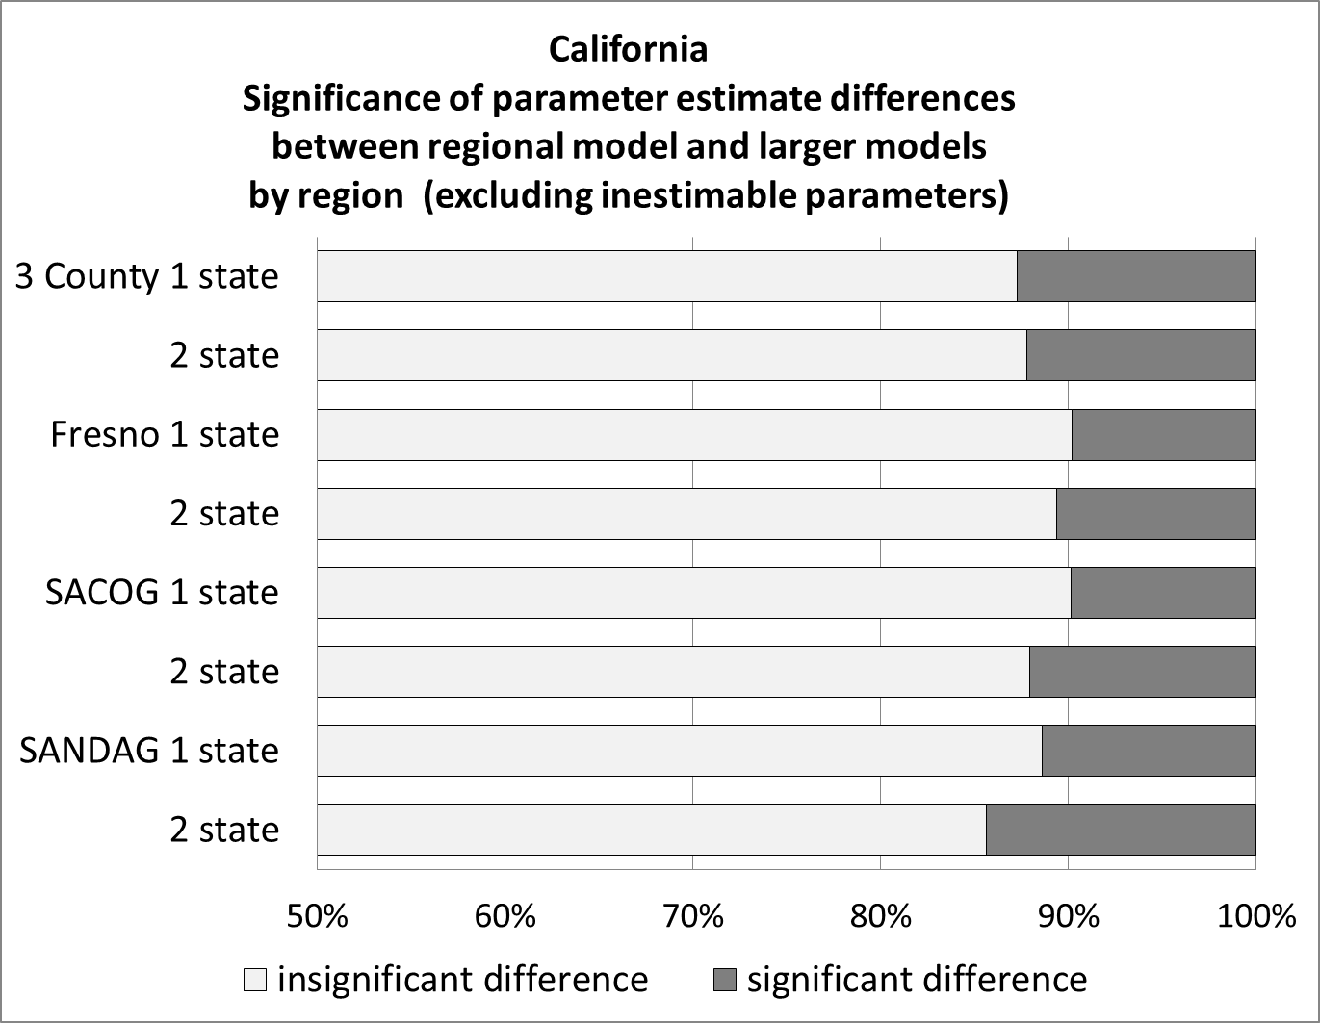

Slide 45
