Slide 1
Data Expansion Procedure for Weighting Air Passenger Survey Records
MAG 2012 Airport Ground Survey and Modeling Project
TRB Transportation Planning Application Conference Attendees
Rachel Copperman
Kevin Tierney
Arun Kuppam (CS)
Michael E. Gorton (HDR)
Ted Brown (MAG)
Vladimir Livshits (MAG)
Roger Roy (MAG)
Tuesday, May 7th, 2013

Slide 2
Airport Ground Survey and Modeling Project Team
Maricopa Association of Governments
HDR Consulting
Cambridge Systematics
West Group Research
Kevin Tierney
Partnership With:
City of Phoenix Aviation Department
Phoenix-Mesa Gateway Airport Authority
City of Mesa

Slide 3
Project Motivation
Two Growing
Passenger Airports
Phoenix Sky Harbor International Airport (PHX) is the nation’s sixth-busiest passenger airport
Update 2008
Airport Sub-Model
Changes in regional travel demand, the socioeconomic environment, and regional transportation networks
Phoenix-Mesa Gateway Airport (AZA) grew 33% from 2011 to 2012
Desired integration with new regional activity-based model

Slide 4
Project Overview
Airport Ground Survey Collection
Data Expansion and Analysis
Model Design and Development
Model Calibration and Validation

Slide 5
Air Passenger Survey Overview
Sampling Strata
Airport
Final Useable Survey Totals
PHX: 5,247 Surveys
1,644 long-form
3,603 short-form
AZA: 424 Surveys
78 long-form
346 short-form
Terminal (type of airlines)
Primary Destination
Time period of travel
Survey Location

Slide 6
PHX Expansion Targets: Market Segments
Day of Week
Weekday
Saturday
Time-of-Day: Departure Time
Midday: 9am – 4pm
PM Peak: 4pm – 8pm
Final Destination
Short-domestic
Long-domestic
Sunday
AM Peak: 5am – 9am
Night: 8pm – 5am
Terminal
Terminal 2
Terminal 3
Terminal 4 Southwest
Terminal 4 U.S. Airways
Terminal 4 International
International

Slide 7
PHX Expansion Control Totals: Data
PHX Enplanements
Monthly enplanements for April 2012
airline
Flight Schedule
Data on each Flight departing from PHX in April 2012
departure day
scheduled departure time
departure terminal
destination location
number of seats
U.S. DOT 10% Ticket Sample
Number of passengers departing from PHX for April-June of 2011
next airport location
final airport destination
departure terminal
airline

Slide 8
Flight Schedule Data Aggregation
Day | Departure time | Destination | Arrival Time | Airline | Flight Number | Equipment | Terminal | # of Seats
Monday | 6:20 AM | DFW | 10:30 | AA | 1514 | M80 | 3 | 130
Monday | 7:27 AM | DFW | 11:45 | AA | 1770 | M80 | 3 | 130
Monday | 8:40 AM | DFW | 13:00 | AA | 1364 | M80 | 3 | 130
Monday | 10:02 AM | DFW | 14:20 | AA | 2222 | M80 | 3 | 130
Monday | 11:00 AM | DFW | 15:20 | AA | 1492 | M80 | 3 | 130
Monday | 12:55 PM | DFW | 17:15 | AA | 1894 | M80 | 3 | 130
Monday | 2:30 PM | DFW | 18:50 | AA | 1518 | M80 | 3 | 130
Monday | 4:10 PM | DFW | 20:25 | AA | 1802 | M80 | 3 | 130
Total monthly number of seats by:
airline
next airport
day of week
departure hour

Slide 9
10% Ticket Sample Data Aggregation
Origin | Dest | AirportGroup | TkCarrierGroup | Passengers
PHX | SJU | PHX:ATL:SJU | FL:FL | 1
SJU | SAN | SJU:TPA:PHX:SAN | FL:US:US | 1
PHX | RSW | PHX:ATL:RSW | FL:FL | 1
PHX | SRQ | PHX:ATL:SRQ | FL:FL | 1
PHX | SRQ | PHX:ATL:SRQ | FL:FL | 1
PHX | SRQ | PHX:ATL:SRQ | FL:FL | 1
PHX | SRQ | PHX:ATL:SRQ | FL:FL | 1
PHX | STL | PHX:ATL:STL | FL:FL | 1
PHX | MKE | PHX:MKE | FL | 1
Monthly number of trips by:
airline
next airport
originating vs. connecting flight
long-domestic vs. short-domestic location

Slide 10
Combining Datasets
Flight Schedule Data:
Total monthly number of seats by airline, next airport, day of week, and departure hour
Monthly number of trips by:
airline (converted to terminal)
day of week
departure time
long-domestic vs. short-domestic final location
originating vs. connecting next location
10% Ticket Sample Data:
Monthly number of trips by airline, next airport, originating vs. connecting, and long-domestic vs. short-domestic final location

Slide 11
Further Processing
Monthly number of trips by segment
Factor to match total enplanements by terminal
Remove Passengers connecting in PHX
Convert to average number of Weekday, Saturday, and Sunday Trips
Average number of daily trips by:
day of week
departure time-of-day
final destination
terminal

Slide 12
Process Survey Data
Number of Surveys segmented by:
day of week
departure time-of-day
final destination
terminal
Identify market combinations with low survey numbers (< 10 surveys)
Weight survey record by Party Size

Slide 13
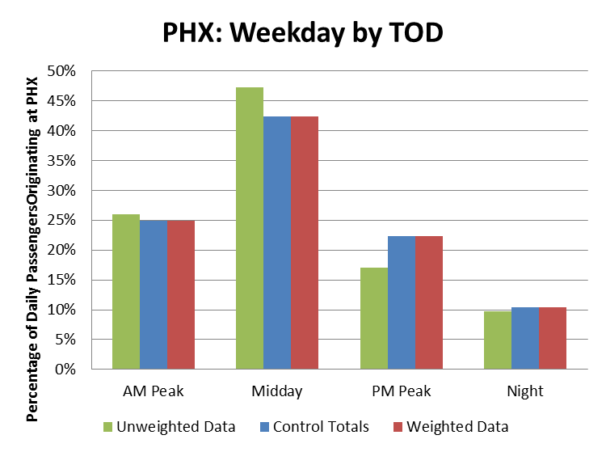
Distribution of the Unweighted Surveys, Control Totals, and Weighted Surveys

Slide 14
Additional Shuttle Surveys by Mode and Market Segmentation
Survey Location | Mode | Market Segmentation Characteristics | Number of Surveys
LRT shuttle | LRT | weekday, non-hotel | 23
 | Private Car | N/A | 3
 | City Bus | weekday, non-business, private home | 3
Parking shuttle | Private Car | weekday, residents, non-hotel, AM and midday start times | 43
 | Private Car | non-resident | 5
 | Private Car | night start time | 1
 | Rental Car | N/A | 2
Rental car shuttle | Private Car | N/A | 3
 | Rental Car | weekday, visitors, no PM start times | 76
Outside Security | Private Car | N/A | 1

Slide 15
Expansion Process
Identified Gate Surveys with matching mode and market characteristics of shuttle surveys
Control totals:
Weighted time-of-day distributions of Gate surveys
Reweight Gate Surveys + Shuttle Surveys, controlling for Party Size

Slide 16
AZA Expansion Targets: Market Segments
Day of Week
Weekday
Saturday
Time-of-Day:
Departure Time
(Weekday Only)
Midday: 9am – 4pm
PM Peak: 4pm – 8pm
Sunday
AM Peak: 5am – 9am
Night: 8pm – 5am

Slide 17
Conclusion
Focused on surveying and modeling passengers at two airports
Developed a multi-dimensional sampling and weighting procedure
Various datasets were used in conjunction to expand air passenger surveys
Survey data collection was successful in developing and hitting sampling targets

Slide 18
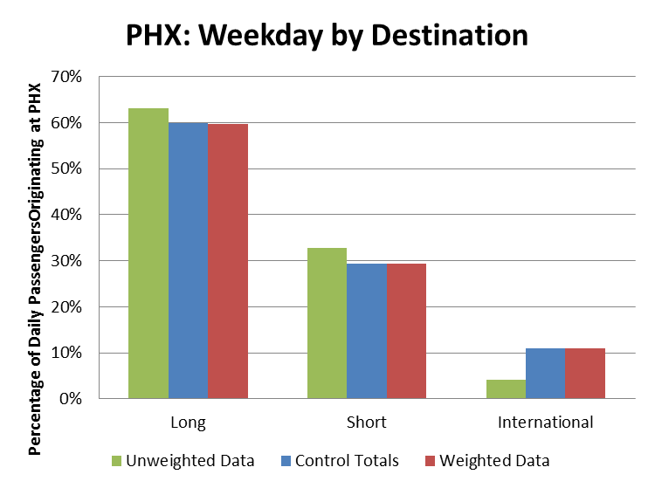
Distribution of the Unweighted Surveys, Control Totals, and Weighted Surveys

Slide 19
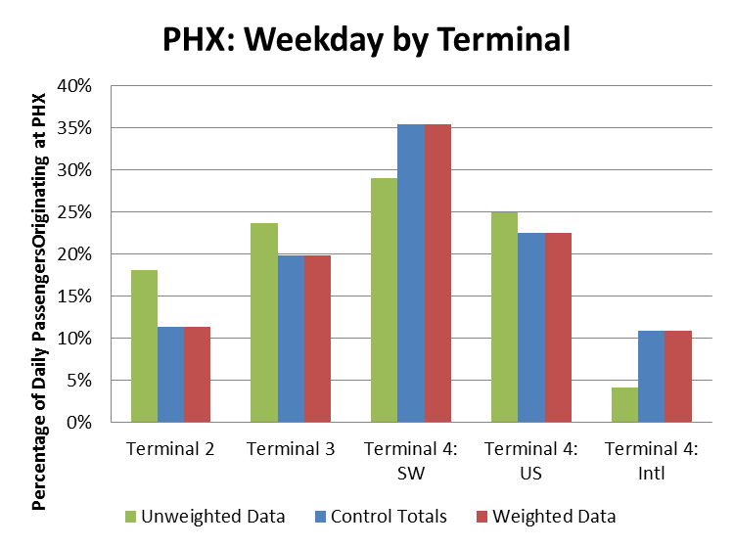
Distribution of the Unweighted Surveys, Control totals, and Weighted surveys

Slide 20
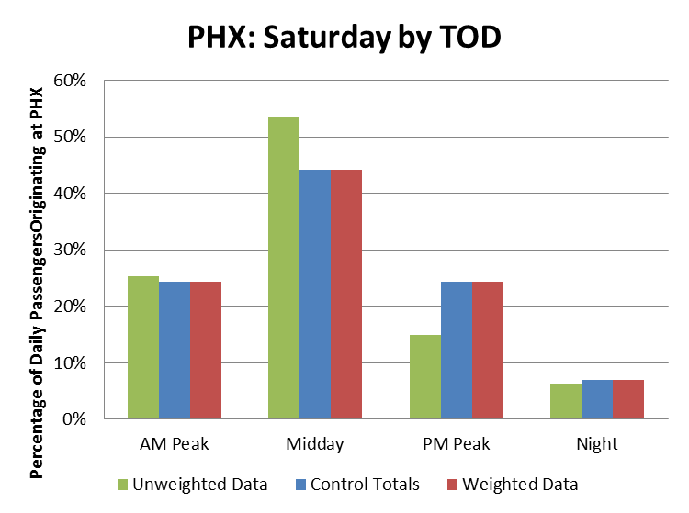
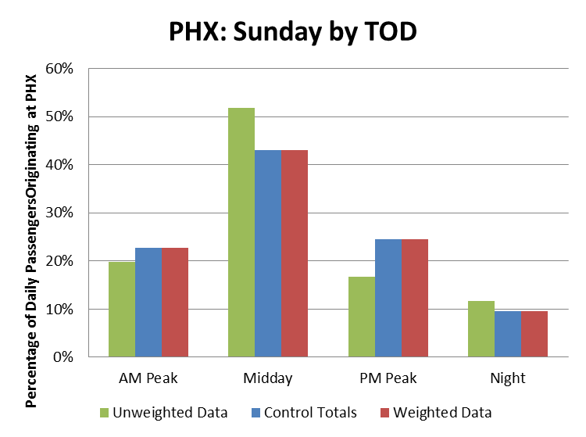
Distribution of the Unweighted Surveys, Control totals, and Weighted surveys

Slide 21
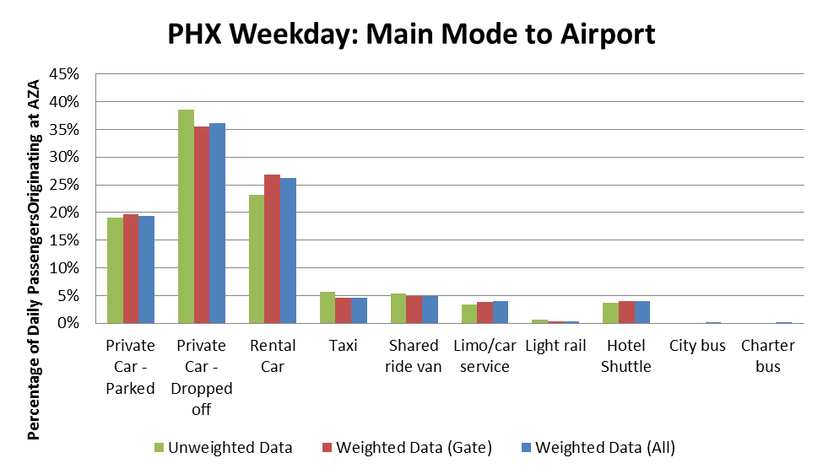
Unweighted, Weighted (gate only), and Weighted (all) Survey Records

Slide 22
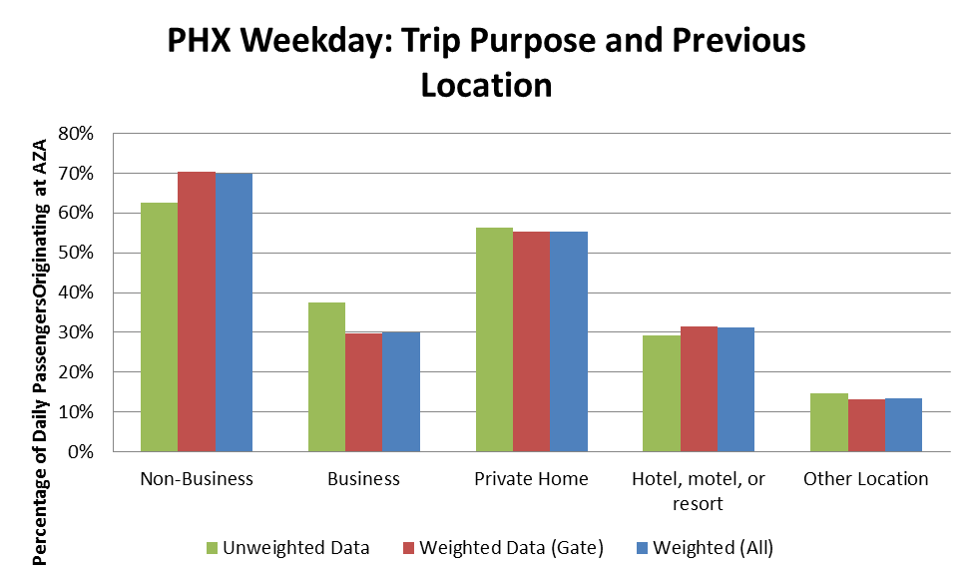
Unweighted, Weighted (gate only), and Weighted (all) Survey Records

Slide 23
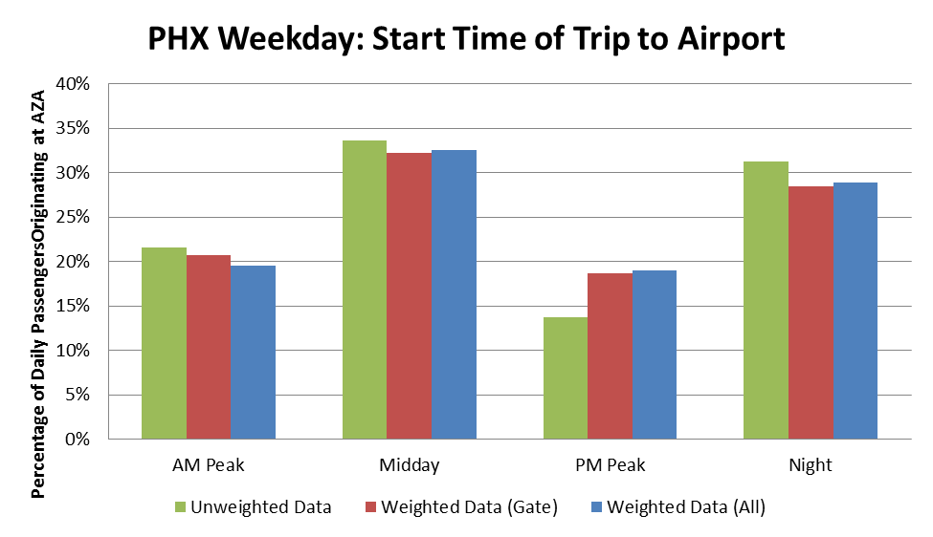
Unweighted, Weighted (gate only), and Weighted (all) Survey Records

Slide 24
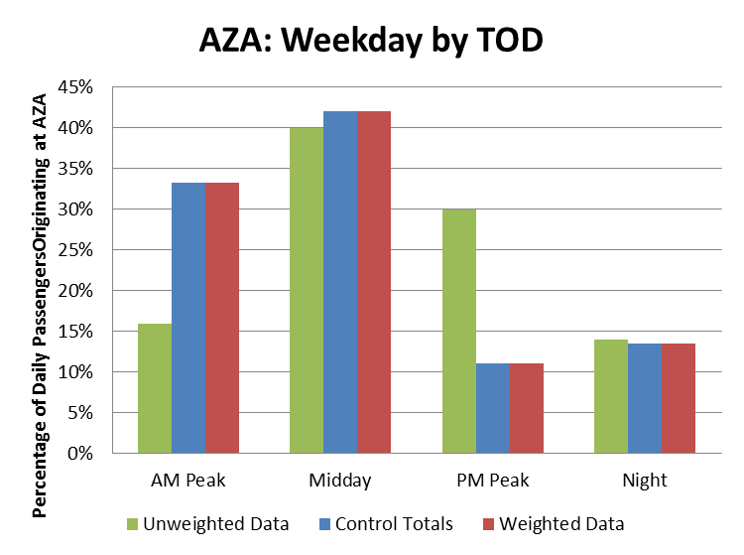
Distribution of the Unweighted Surveys, Control Totals, and Weighted Surveys

Slide 25
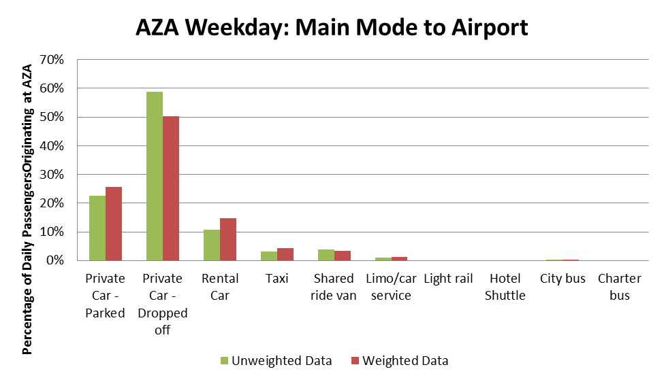
Distribution of the Unweighted and Weighted Surveys

Slide 26
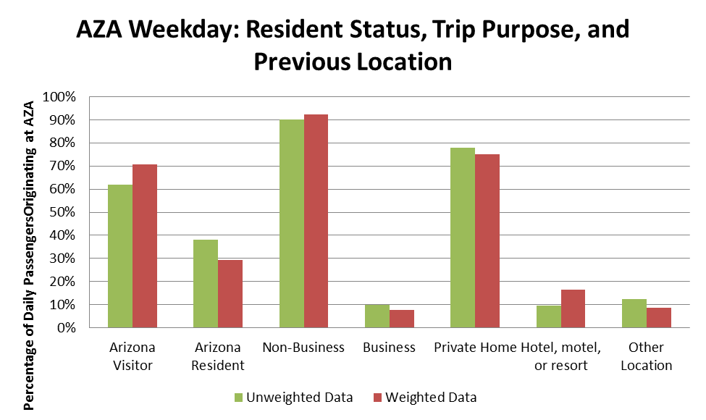
Distribution of the Unweighted and Weighted Surveys

Slide 27
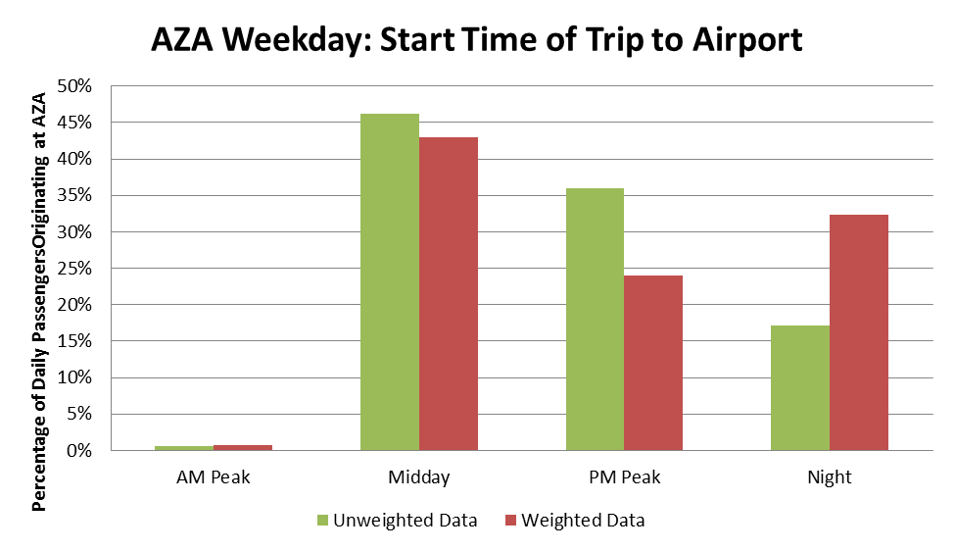
Distribution of the Unweighted and Weighted Surveys

