Slide 1
NCHRP 8-83:Traffic Forecasting Guidelines for the 2010s
Rob Bostrom
Alan Horowitz
Tom Creasey
May 7, 2013
Planning Applications Conference

Slide 2
Presentation Overview
NCHRP 8-83 Project Background
Deliverables
  Interim Report
  Draft Final Report
What’s Next?
Notes:
We want our clients to notice and understand this important difference.
We want them to see that together, we have more to offer them.
And we can offer these services in an integrated way. Across the entire project life cycle.
Our brand must convey this transformation to our clients.

Slide 3
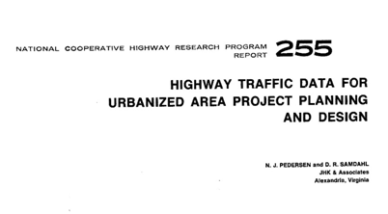
Project Background
Need
  Produce traffic forecasts for design, planning and operational project analysis
  Models and other tools produce results that need smoothing or factoring
  NCHRP 255 used since 1982 refining traffic forecasts
NCHRP 8-83
  Started in March, 2011
  Due to be finished at end of July
Notes:
We want our clients to notice and understand this important difference.
We want them to see that together, we have more to offer them.
And we can offer these services in an integrated way. Across the entire project life cycle.
Our brand must convey this transformation to our clients.

Slide 4
Project Background
Program Manager: Nanda Srinivasan
Team
  CDM Smith: Rob Bostrom, Principal Investigator
  Alan Horowitz of University of Wisconsin at Milwaukee
  Tom Creasey of Stantec
  Ram Pendyala of Arizona State University
  Mei Chen of University of Kentucky
Panel
  Chair: Mike Bruff of NC DOT
  Sarah Sun, Kermit Wies, Eric Pihl, Robert Winnick, Doug Laird, Jeff Shelton, Subrat Mahapatra, Derek Miura, Matthew Hardy, Phillip Cox, Dan Lamers
Notes:
We want our clients to notice and understand this important difference.
We want them to see that together, we have more to offer them.
And we can offer these services in an integrated way. Across the entire project life cycle.
Our brand must convey this transformation to our clients.

Slide 5
NCHRP 8-83 Scope
Task 1: Prepare a detailed plan to conduct a review of project-level forecasting procedures
Task 2: Prepare a technical memo that synthesizes current use and facilitates implementation of subsequent tasks
Task 3: Conduct a critical and informed review of NCHRP 255 to identify methods and tools to be included in the Guidebook
Task 4: Prepare an Interim Report
Notes:
Rob

Slide 6
NCHRP 8-83 Scope
Task 5 - Develop/Document Methods and Tools for Project-Level Analysis in Addition to Those Contained in NCHRP 255
Task 6 - Improvements to Traditional Models
Task 7 - Review Advanced Techniques
Task 8 – Prepare the Guidebook with an Executive Summary
Notes:
Rob

Slide 7
Deliverables
Interim Draft Report
  Covers tasks 1-4 of work plan and submitted on 1/20/12
  Sections:
    Traffic forecasting state-of-the-practice
    Traffic forecasting process, tools and methodologies
    NCHRP Report 255 review and other tools/methodologies
    Appendices
Final Draft Report
  11 chapters, 11 appendices, 400 pages and counting
  Includes interim report contents
  Web contents
  6 case studies
Notes:
We want our clients to notice and understand this important difference.
We want them to see that together, we have more to offer them.
And we can offer these services in an integrated way. Across the entire project life cycle.
Our brand must convey this transformation to our clients.

Slide 8
Interim Report: Traffic Forecasting State-of-the Practice
Source Documents
Survey
Expert Panel
Traffic forecasting process review
  Process, users, policy/complexity, result communication
Travel forecasting model ideal
  blended TDM/microsimulation
Travel forecasting models
  4-step; 4-step enhancements; advanced modeling
Model data inputs/outputs
Notes:
We want our clients to notice and understand this important difference.
We want them to see that together, we have more to offer them.
And we can offer these services in an integrated way. Across the entire project life cycle.
Our brand must convey this transformation to our clients.

Slide 9
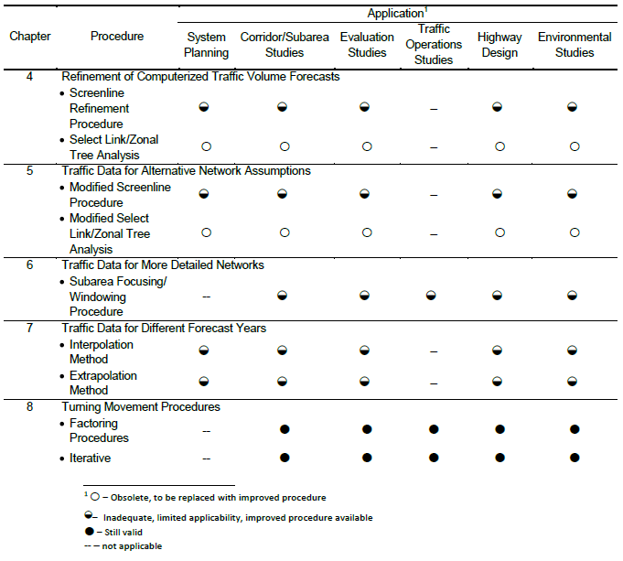
Interim Report: NCHRP 255 Review
Notes:
We want our clients to notice and understand this important difference.
We want them to see that together, we have more to offer them.
And we can offer these services in an integrated way. Across the entire project life cycle.
Our brand must convey this transformation to our clients.

Slide 10
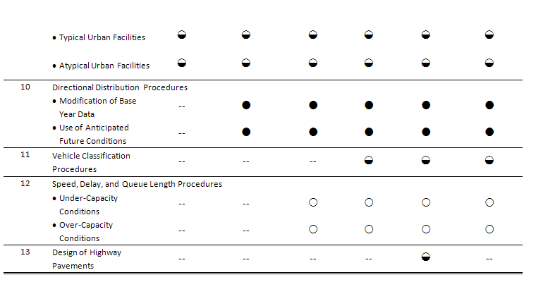
Interim Report: NCHRP 255 Review
Notes:
We want our clients to notice and understand this important difference.
We want them to see that together, we have more to offer them.
And we can offer these services in an integrated way. Across the entire project life cycle.
Our brand must convey this transformation to our clients.

Slide 11
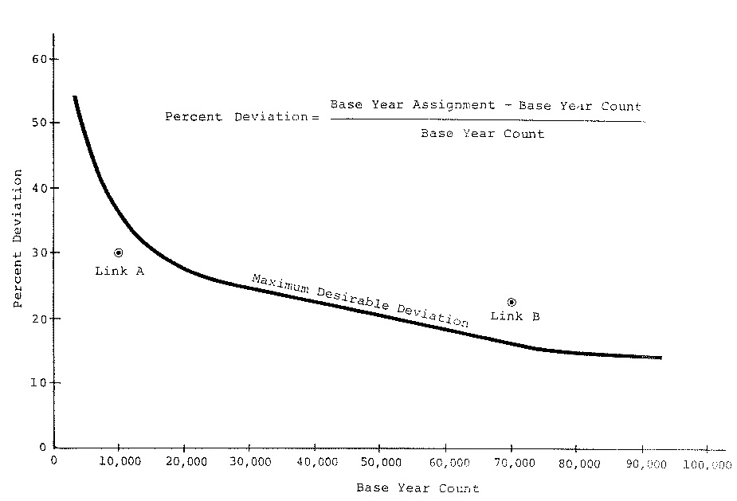
Interim Report: Other Tools & Methodologies
Non-modeling tools
  Manual gravity procedure (KYTC)
  NCHRP 255 spreadsheets
  Turning movement tools
  OD matrix growth factoring
  Time series models
  Traffic impact study tools
  Elasticity methods
Notes:
We want our clients to notice and understand this important difference.
We want them to see that together, we have more to offer them.
And we can offer these services in an integrated way. Across the entire project life cycle.
Our brand must convey this transformation to our clients.

Slide 12
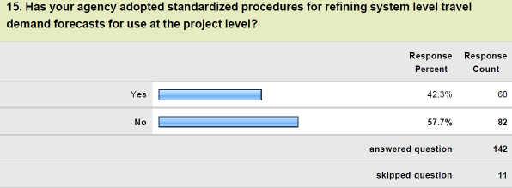
Interim Report: Appendices
Source documents
Survey Questionnaire
Expert Team Comments
Road Map
Notes:
We want our clients to notice and understand this important difference.
We want them to see that together, we have more to offer them.
And we can offer these services in an integrated way. Across the entire project life cycle.
Our brand must convey this transformation to our clients.

Slide 13
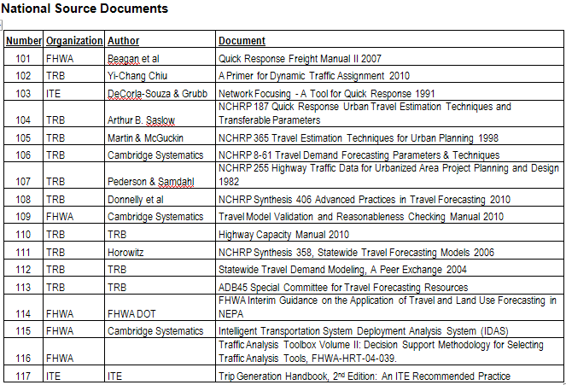
Interim Report: Appendices
Notes:
We want our clients to notice and understand this important difference.
We want them to see that together, we have more to offer them.
And we can offer these services in an integrated way. Across the entire project life cycle.
Our brand must convey this transformation to our clients.

Slide 14
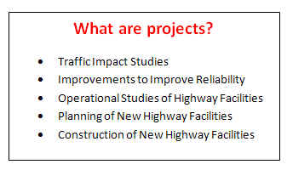
Final Draft Report: Chapter 1 Introduction
What are projects?
History/context/significance of NCHRP 255
Chapter by chapter review of NCHRP 255
Survey and source documents
Traffic forecasting guidelines
Organization of report
Notes:
We want our clients to notice and understand this important difference.
We want them to see that together, we have more to offer them.
And we can offer these services in an integrated way. Across the entire project life cycle.
Our brand must convey this transformation to our clients.

Slide 15
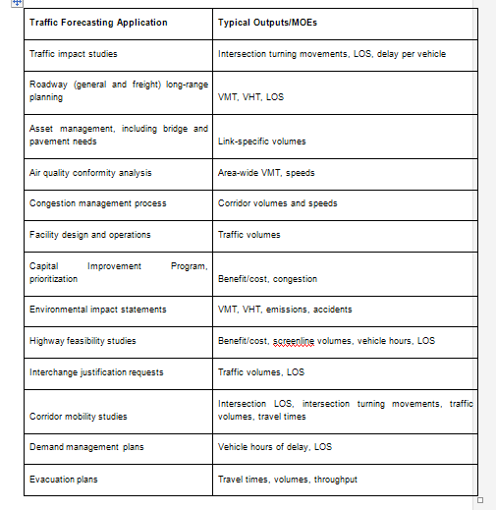
Chapter 2: Fundamental Traffic Forecasting Overview
Traffic forecasting parameters and source data - e.g. ADT, DHV
Traffic forecasting tools - TDMs and more
Measures of effectiveness - see graphic
Essential bookshelf – must reads for forecasters
Notes:
We want our clients to notice and understand this important difference.
We want them to see that together, we have more to offer them.
And we can offer these services in an integrated way. Across the entire project life cycle.
Our brand must convey this transformation to our clients.

Slide 16
Chapter 3: Overview of Traffic Forecasting Tools and Methodologies
The travel forecasting model ideal
State-of-the-practice travel forecasting models
SOP of data inputs for travel forecasting models
SOP of outputs for travel forecasting models
Defaults vs. locally specific parameters
Other traffic forecasting tools and methodologies
Travel demand model computational issues
Notes:
We want our clients to notice and understand this important difference.
We want them to see that together, we have more to offer them.
And we can offer these services in an integrated way. Across the entire project life cycle.
Our brand must convey this transformation to our clients.

Slide 17
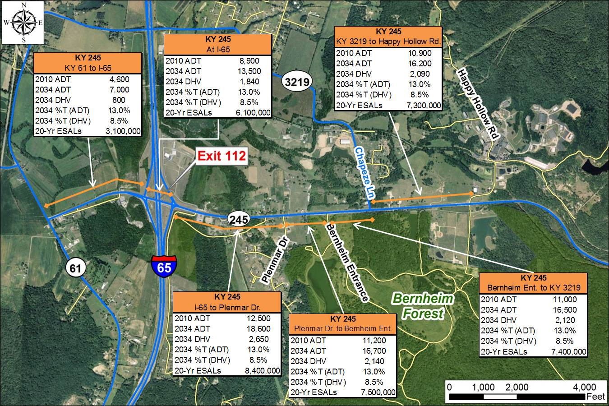
Chapter 4: Project Level Forecasting Process
Traffic forecasting context
Traffic forecasting steps
Key Traffic Forecasting Considerations
  Accuracy
  Judgment
  Traffic forecasting rules of thumb
Notes:
We want our clients to notice and understand this important difference.
We want them to see that together, we have more to offer them.
And we can offer these services in an integrated way. Across the entire project life cycle.
Our brand must convey this transformation to our clients.

Slide 18
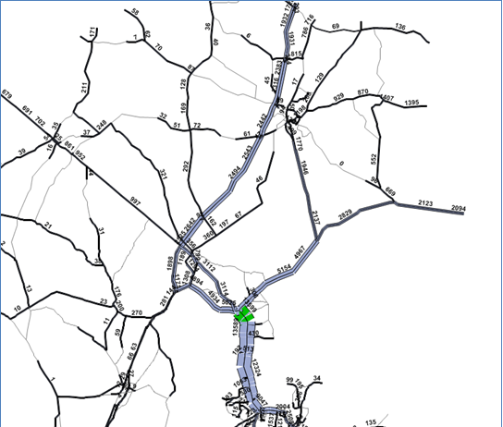
Chapter 5: Work with a Travel Model
Understanding your model
Validation methods and standards
Errors and variability in speed and volume data
Fixing issues in input or validation data
Understanding travel model outputs
Dealing with outliers in model outputs
Notes:
We want our clients to notice and understand this important difference.
We want them to see that together, we have more to offer them.
And we can offer these services in an integrated way. Across the entire project life cycle.
Our brand must convey this transformation to our clients.

Slide 19
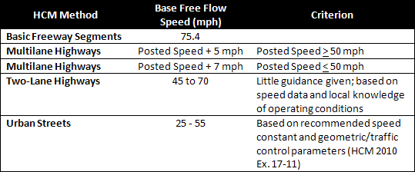
Chapter 5: Work with a Travel Model
Default free flow travel times for a TDM:

Slide 20
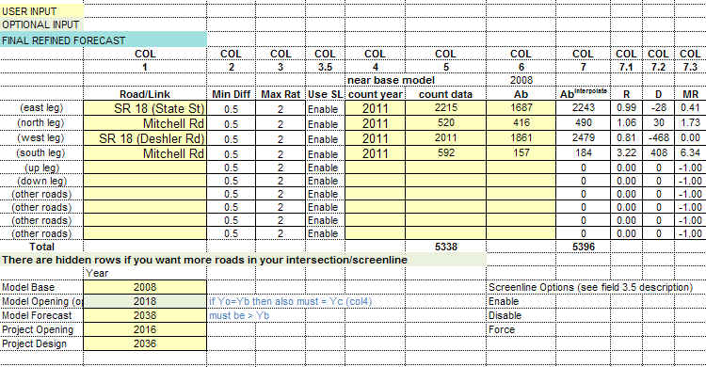
Chapter 6: Model Output Refinements
Screenline refinement and base volumes
Refining turning movement outputs of travel models
Refining directional splits from travel models
Refining speed and travel time outputs of travel models
Model refinement with origin-destination matrix estimation
Notes:
We want our clients to notice and understand this important difference.
We want them to see that together, we have more to offer them.
And we can offer these services in an integrated way. Across the entire project life cycle.
Our brand must convey this transformation to our clients.

Slide 21
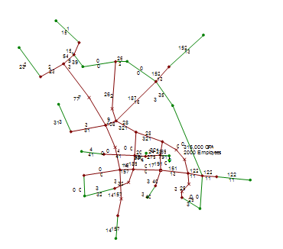

Chapter 7: Increasing spatial detail of traffic models
Focusing: enhancing detail in regional or statewide models
Windowing (subarea model)
Custom subarea focused models
Multi-resolution modeling systems
Hybrid models
Refining E-E trip tables
Case studies
Notes:
We want our clients to notice and understand this important difference.
We want them to see that together, we have more to offer them.
And we can offer these services in an integrated way. Across the entire project life cycle.
Our brand must convey this transformation to our clients.

Slide 22
Chapter 8: Improving temporal accuracy of traffic forecasts
Activity and tour-based model systems
Dynamic traffic assignment
Peak spreading
Pre-assignment factoring
Post-assignment factoring
Day of week
Month of year
Vehicle class considerations
Case studies
Notes:
We want our clients to notice and understand this important difference.
We want them to see that together, we have more to offer them.
And we can offer these services in an integrated way. Across the entire project life cycle.
Our brand must convey this transformation to our clients.

Slide 23
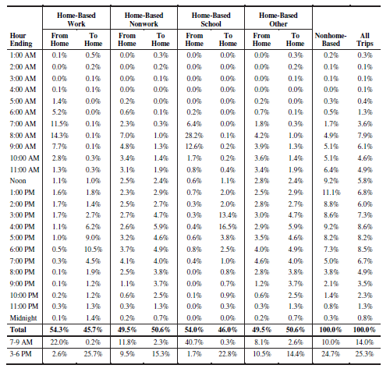
Chapter 8: Pre-assignment table (NCHRP 716)
Notes:
We want our clients to notice and understand this important difference.
We want them to see that together, we have more to offer them.
And we can offer these services in an integrated way. Across the entire project life cycle.
Our brand must convey this transformation to our clients.

Slide 24
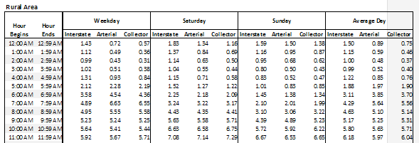
Chapter 8: Post-assignment table
Hourly factors derived from ATRs for post-assignment ADT processing.
Categories: urban area small/medium/large, rural area; ½ of table below

Slide 25
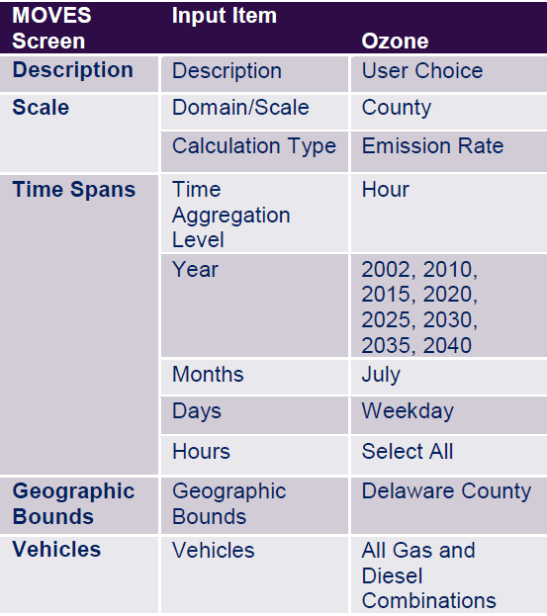
Chapter 9: Traffic Forecasting Methods for Special Purpose Applications
Basic forecasts w/ ADT, DHV and turning movements
Data extrapolations
Vehicle mix & MOVES
ESALs
Benefit-cost analysis
Toll/revenue forecasts
Work zone congestion
Incident management
Non-recurring congestion
Environmental justice
Traffic impact studies
Case studies
Notes:
We want our clients to notice and understand this important difference.
We want them to see that together, we have more to offer them.
And we can offer these services in an integrated way. Across the entire project life cycle.
Our brand must convey this transformation to our clients.

Slide 26
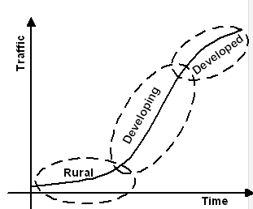
Chapter 10: Tools Outside of Travel Models
When to use non-TDM methods
Time series of traffic volume data
Sketch planning and spreadsheet techniques
Elasticity methods
Post processing using HCM 2010
Stitching a model together
Case studies
Notes:
We want our clients to notice and understand this important difference.
We want them to see that together, we have more to offer them.
And we can offer these services in an integrated way. Across the entire project life cycle.
Our brand must convey this transformation to our clients.

Slide 27
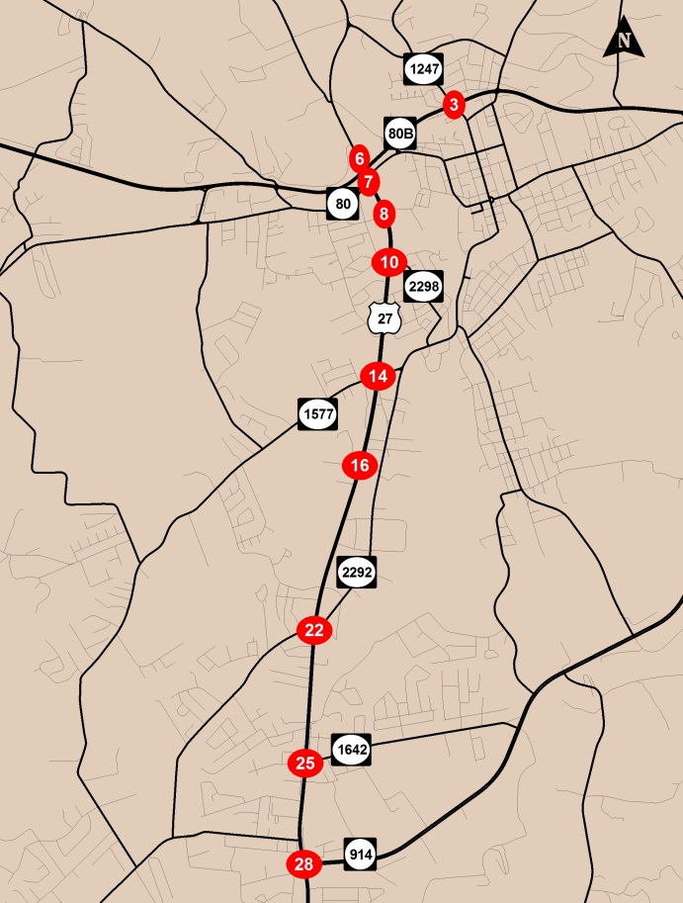
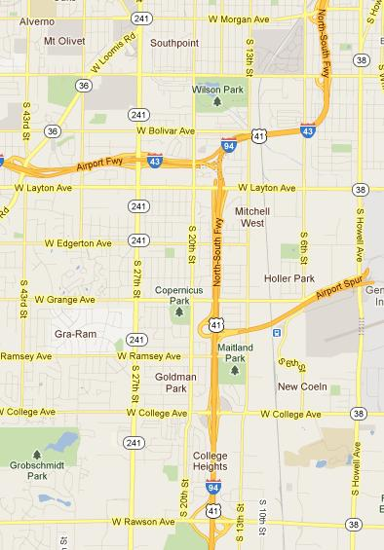
Chapter 11: Case Studies
Arterial network
Network window
Small city (Charleston, SC)
Large City (Atlanta)
Time series on a link
Multi-resolution modeling (Phoenix)
Notes:
We want our clients to notice and understand this important difference.
We want them to see that together, we have more to offer them.
And we can offer these services in an integrated way. Across the entire project life cycle.
Our brand must convey this transformation to our clients.

Slide 28
Appendices
Glossary/acronyms
Survey/expert panel/NCHRP 255 detailed review
Modeling source documents
Examples
  Traffic forecasting
  Trend line analysis
  Turning movement
  Model spreadsheet
Modeling checklist
Notes:
We want our clients to notice and understand this important difference.
We want them to see that together, we have more to offer them.
And we can offer these services in an integrated way. Across the entire project life cycle.
Our brand must convey this transformation to our clients.

Slide 29
Recommendations
Project-level forecasting, for the most part, use travel models and/or time series.
Many traffic forecasts for projects need some sort of refinement.
  Ratios/deltas
  ODME
Lots of judgment allowed/required.
Notes:
We want our clients to notice and understand this important difference.
We want them to see that together, we have more to offer them.
And we can offer these services in an integrated way. Across the entire project life cycle.
Our brand must convey this transformation to our clients.

Slide 30
What’s Next?
Draft Final Report – June 17th
Final Report – July 31st
Publication – end of year
Web content
  Spreadsheet demos
  Methodologies
Training – after publication
ADB45 – Traffic forecasting Wiki
Questions/comments?
Notes:
We want our clients to notice and understand this important difference.
We want them to see that together, we have more to offer them.
And we can offer these services in an integrated way. Across the entire project life cycle.
Our brand must convey this transformation to our clients.

