Slide 1

Using INRIX-supplied Time-varying Speed Data to Validate a Wide-area Microscopic Traffic Simulation Model
Daniel Morgan
Zheng Wei
Caliper Corporation
14th TRB National Transportation Planning Applications Conference
May 7, 2013
Columbus, OH

Slide 2
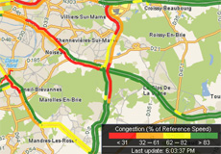
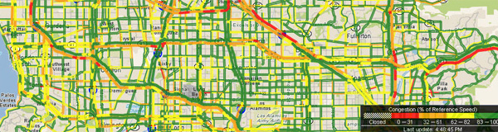
What are INRIX Data?
Who is INRIX?
  Provider of proprietary traffic data, tools, and solutions
  Real-time, predictive, and historical traffic flow data
  Data aggregated from GPS-enabled and mobile devices, traditional road sensors and “hundreds of other sources”
Of particular interest for modeling purposes
  Historical speed data
  Offered by time of day, day of week
Image source: http://www.inrix.com

Slide 3
How are Data Aggregated Spatially?
TMCs – “Traffic Message Channels” – are the spatial unit of INRIX data
TMCs are a standard for delivering traffic (e.g., incident) information to travelers
Developed for FM radio broadcast
While “standard,” how they are used and how data are attributed to them varies between vendors
Coverage is not universal
TMCs are non-uniform
Maintained by commercial vendors, not available publically

Slide 4
How are Data Aggregated Temporally?
Source (“raw”) data
  5-minute increments
  Generally purposed for real-time feed to online applications
  Available to “developers,” who may query the data in real time
Average historical speeds
  Day of week, monthly, annually
  Time of day (as fine as 15-minutes, to the best of our knowledge)
  Available for purchase

Slide 5
How are the Data Summarized?
Methods are generally trade secrets, undisclosed
What we can probably safely assume about the historical average speeds: Data are…
  Averaged across multiple days
  Imputed where it is limited or missing
  Murky where position information from mobile devices is unreliable/obfuscated by heavy foot traffic
Incidents
  Road closure information available directly from the source data
  Incident information available and can be cross-reference with the speed data

Slide 6
What We Know about the Data
Or can glean from documentation provided to developers

Slide 7
What We Also Know about the Data
That the data’s potential is alluring is not in dispute
That the methods by which the data are scrubbed or imputed cannot be scrutinized should give pause
That averaging across days
  Presumes there is such a thing as an average day
  Introduces noise from a thousand variables: weather, incidents, holidays, vacation weeks, …
  Might represent expected travel conditions on a given link well, but taken collectively for a wide area may not “look like” any single day that was ever observed
  Poses interesting challenges for calibration/validation

Slide 8
Our Research Experiment
Background: Bottlenecks are born out of the complex interplay between spatial and temporal trip patterns, posing immense challenges to conventional model calibration/estimation approaches
Problem Statement: Conventional model calibration/estimation approaches that rely solely on sparse count data fall woefully short of answering said challenge
Proposed Solution: Use the INRIX data to improve upon the calibration/estimation of an extant wide-area microsimulation model

Slide 9
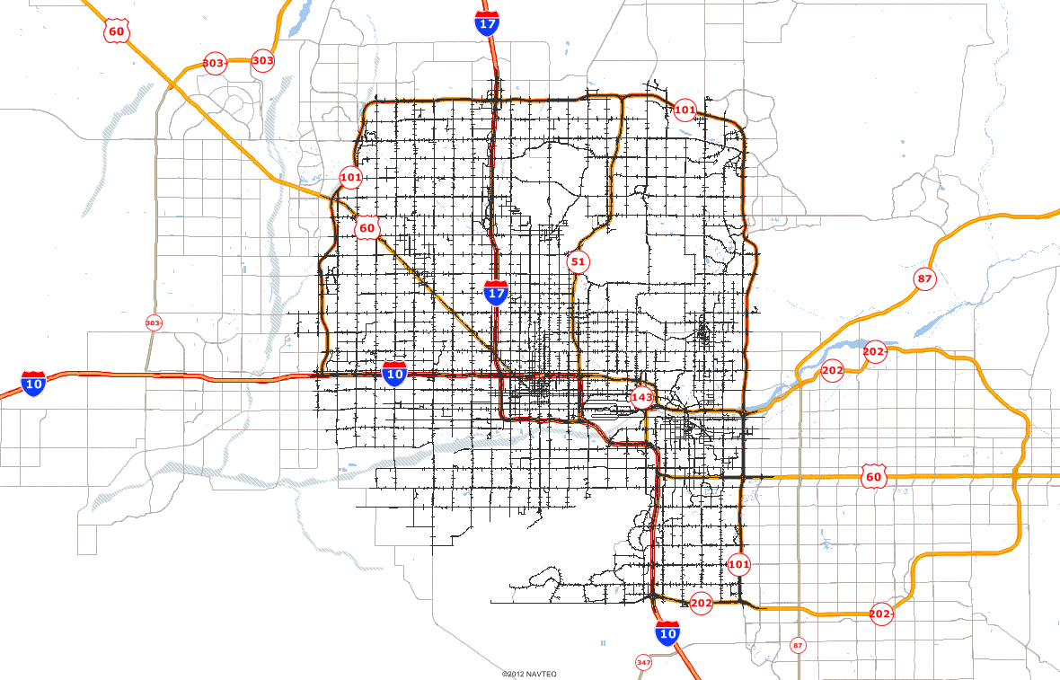
Case Study: Central Phoenix
Notes:
Something about the MAG network
Something about MAG’s very cursory audit/reasonableness check of the speed maps

Slide 10
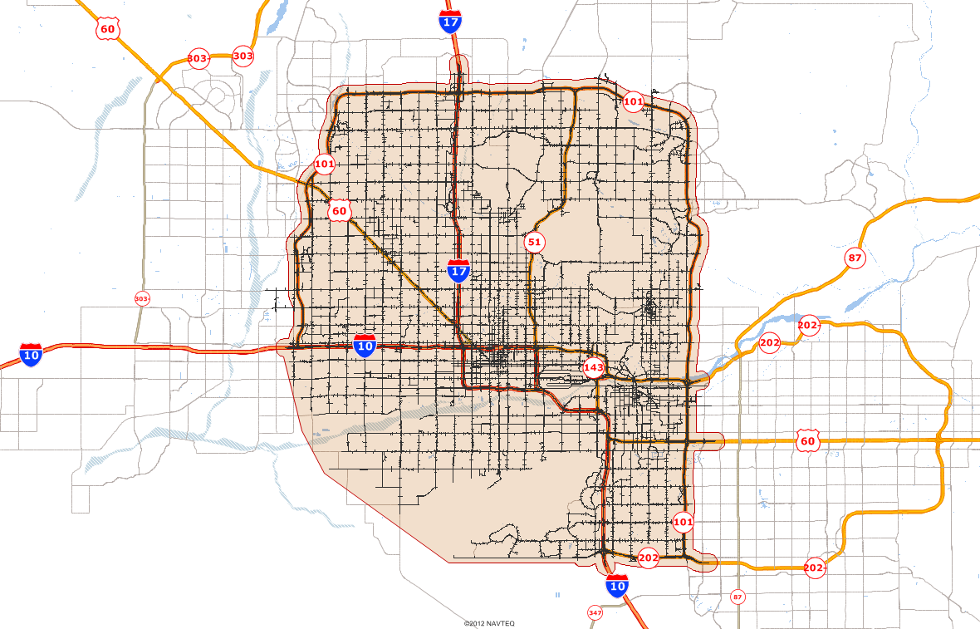
Case Study: Central Phoenix
530 square miles
Notes:
Something about the MAG network
Something about MAG’s very cursory audit/reasonableness check of the speed maps

Slide 11
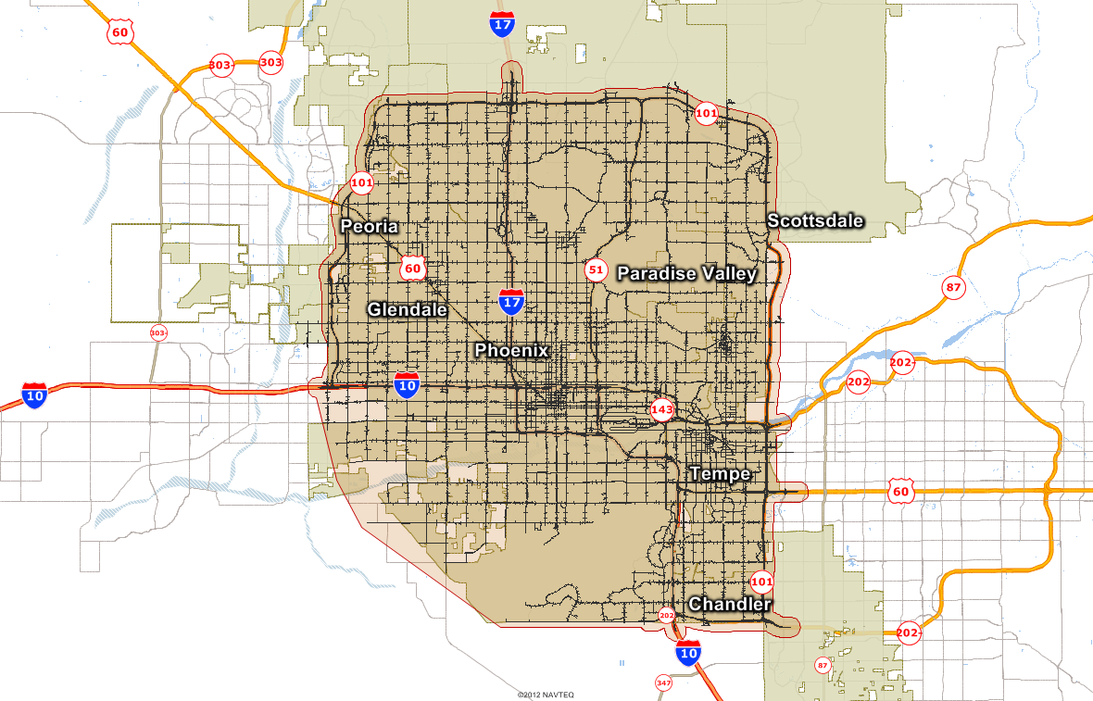
Case Study: Central Phoenix
530 square miles covering
Central Phoenix and six surrounding cities and towns
…and more than 1,800 signalized intersections and 90 bus and light rail routes
Notes:
Something about the MAG network
Something about MAG’s very cursory audit/reasonableness check of the speed maps

Slide 12
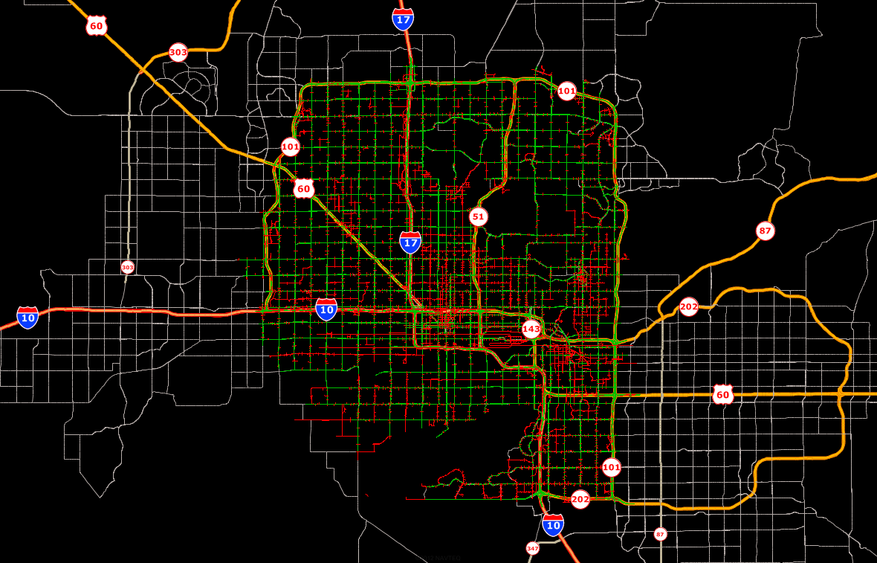
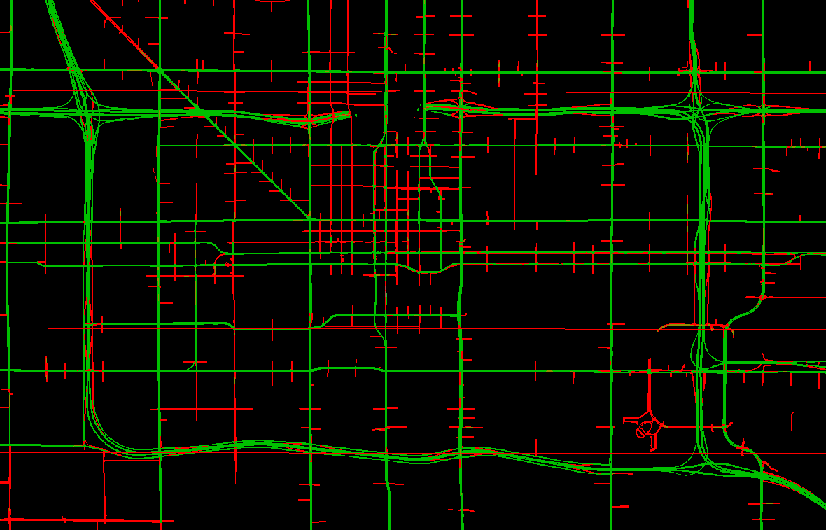
Case Study: INRIX Coverage
36 % of links are represented by one or more TMC codes
OR
60% of mileage
All freeways and major thoroughfares (i.e., all of Phoenix’s 1-mile arterial grid)
Notes:
Something about the MAG network
Something about MAG’s very cursory audit/reasonableness check of the speed maps

Slide 13
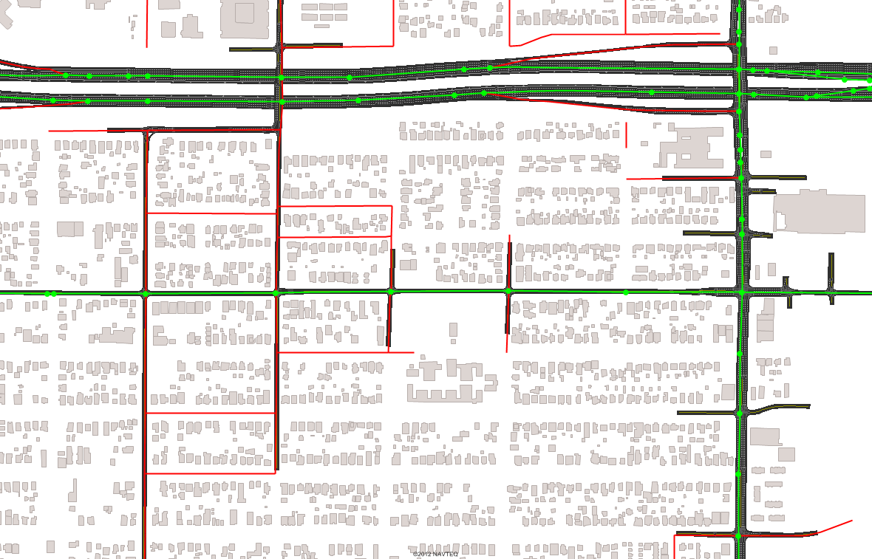
Case Study: The Conflation Challenge
One-to-many, many-to-one, overlapping, and underlapping in others
In Summary:
Matching TMCs to model links is non-trivial
Once matched, (further) aggregation (or disaggregation), of the data is necessary
Doable, but thought and care are required
Automated utilities were developed to match with a high degree of accuracy
Perfect coincidence between TMCs and model links in some places
Notes:
Something about the MAG network
Something about MAG’s very cursory audit/reasonableness check of the speed maps

Slide 14
Calibration to Counts
Travel Model
Subarea Analysis
Seed Matrix
Simulation-based Dynamic Traffic Assignment
Simulated Traffic Counts
Historical Travel Times & Delays
Simulation-based Dynamic Matrix Adjustment
Satisfactory Match?
Traffic Counts
No
Yes
Finished

Slide 15
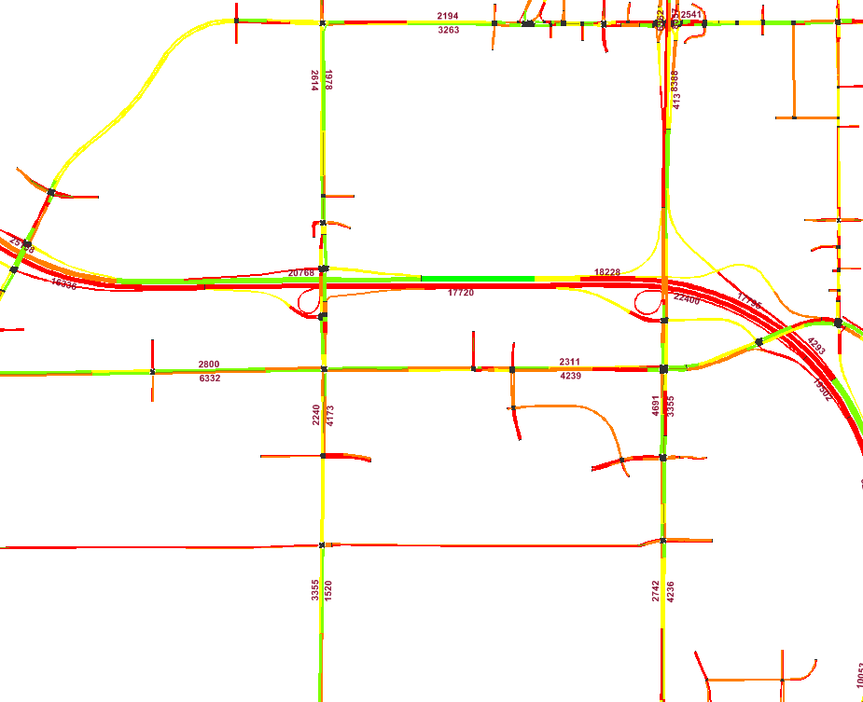
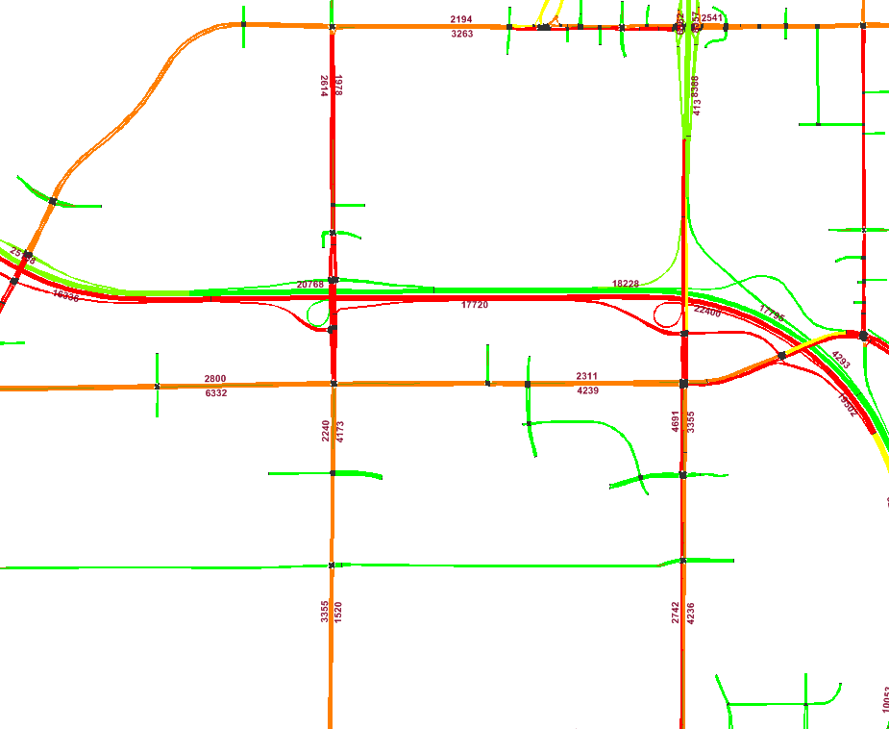
Validation of the Model
Visual side-by-side comparison of dynamic (15-min.) color-coded maps
Manual, targeted adjustments to dynamic (15-min.) trip tables to improve match with bottleneck location and extent, start time and duration
Successful, but:
Labor-intensive
Subjective
Wanted:
Systematic/Automated
Objective

Slide 16
Calibration to Counts
Travel Model
Subarea Analysis
Seed Matrix
Simulation-based Dynamic Traffic Assignment
Simulated Traffic Counts
Historical Travel Times & Delays
Simulation-based Dynamic Matrix Adjustment
Satisfactory Match?
Traffic Counts
No
Yes
Finished

Slide 17
Calibration to Counts and Speeds
Travel Model
Subarea Analysis
Seed Matrix
Simulation-based Dynamic Traffic Assignment
15-min. INRIX Speeds
Simulated Traffic Counts
Historical Travel Times & Delays
Simulation-based Dynamic Matrix Adjustment
Satisfactory Match?
No
Yes
Finished
Traffic Counts

Slide 18
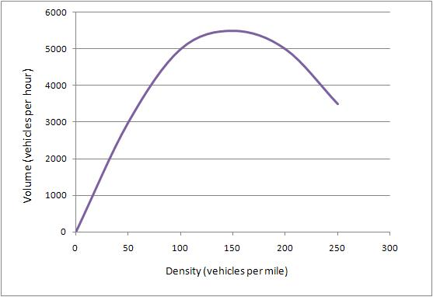
How Speeds Inform the Calibration
For each trip:
  Compute an indicator of how well counts were matched along its path based on the volume in the time interval in which each count was passed
  Simultaneously compute an indicator for the interval preceding and following
  Reschedule the trip for the preceding or following interval, delete the trip, clone the trip, or do nothing
Use speeds to corroborate the counts based on the principles of the fundamental diagram

Slide 19
How Speeds Inform the Calibration
For each trip:
  Compute an indicator of how well counts were matched along its path based on the volume in the time interval in which each count was passed
  Simultaneously compute an indicator for the interval preceding and following
  Reschedule the trip for the preceding or following interval, delete the trip, clone the trip, or do nothing
Use speeds to corroborate the counts based on the principles of the fundamental diagram
Low Density,
High Speed
High Density,
Low Speed

Slide 20
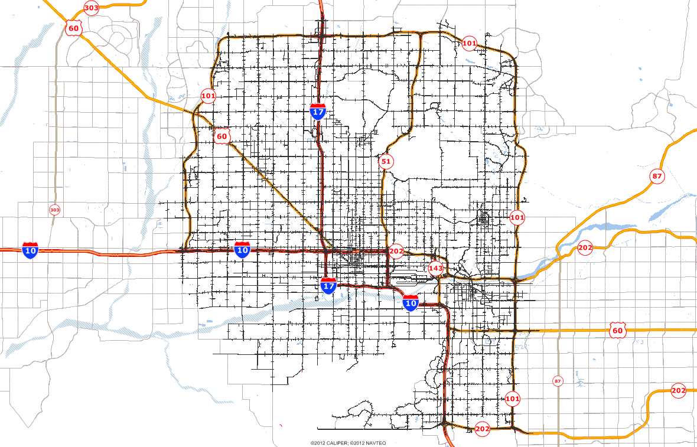
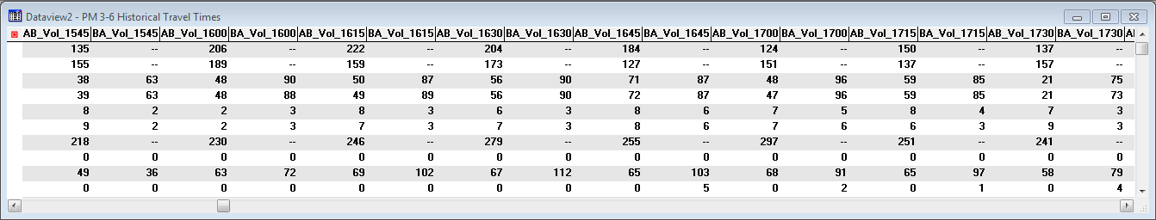
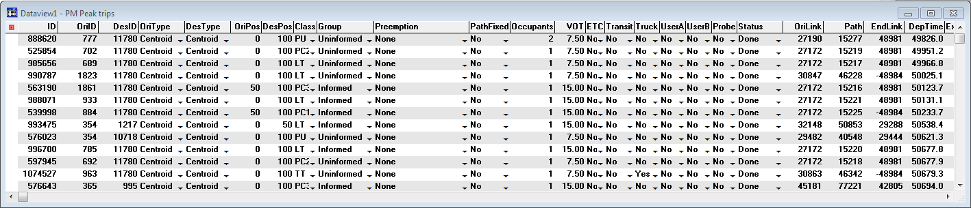
Case Study: Central Phoenix
This is a map
This is a dynamic volume table
This is a trip data table
Notes:
Something about the MAG network
Something about MAG’s very cursory audit/reasonableness check of the speed maps

Slide 21
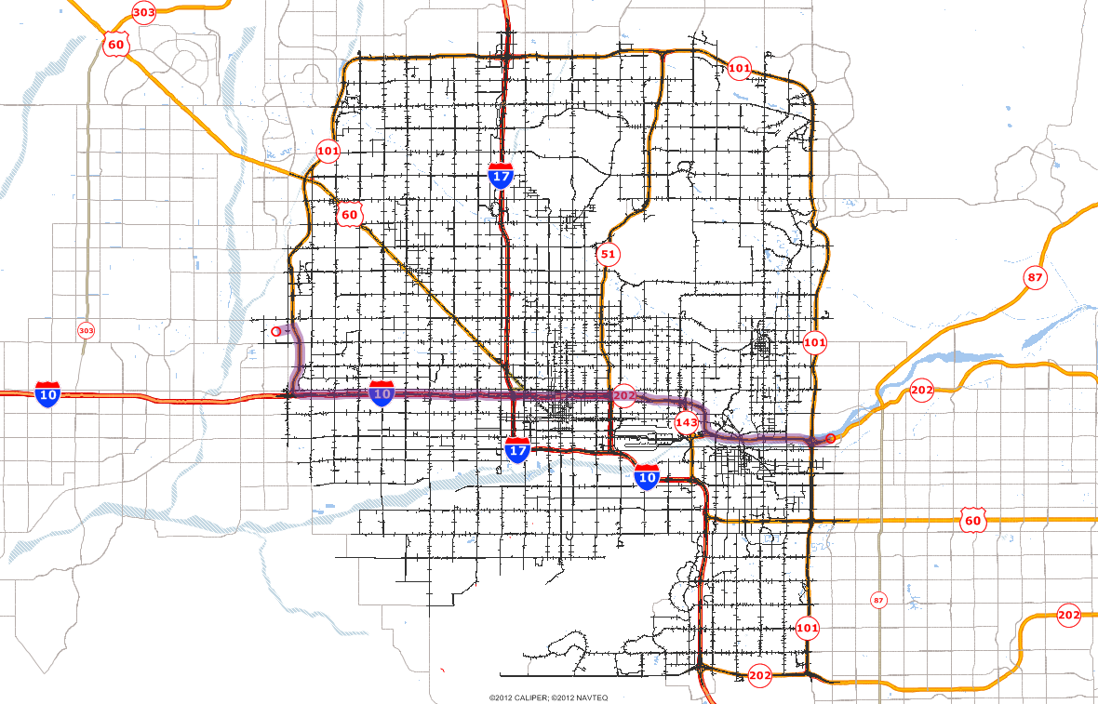
Case Study: Central Phoenix
This is a trip
This is its departure time
This is its path
Notes:
Something about the MAG network
Something about MAG’s very cursory audit/reasonableness check of the speed maps

Slide 22
Case Study: Central Phoenix
These are the volumes recorded in the time intervals in which the vehicle arrived at each station
These are segments matching the measurement stations
These are measurement stations
Notes:
Something about the MAG network
Something about MAG’s very cursory audit/reasonableness check of the speed maps

Slide 23
Outcome
A Bi-Criterion (Count and Speed) Dynamic ODME
  Trip-based
  Simulation-based
  Operable at any time resolution
Early experiments have yielded promising results
  Improvements of 2-3 percentage points in %RMSE in a single trial application
  Experiments with different sets of speed-based rules continue
Status
  Not likely to see commercialization soon
  Deployable on a project basis

