Slide 1

Reconciliation of regional travel model and passive device tracking data
14th TRB Planning Applications Conference
Leta F. Huntsinger
Rick Donnelly

Slide 2
Introduction
Passively collected mobile phone data has shown promise as a low cost option for obtaining travel data:
  Speed data (Using Cell Phone Technology to Collect Travel Data, Kyle Ward)
  Trip tables (Origin Destination Study using Cellular Technology for Mobile, Al, Kevin Harrison)
  Freight Data (Freight Data Collection Technique and Algorithm using Cellular Phone and GIS Data, Ming-Heng Wang, et. al.)
  other
Comparison of passively collected data against traditionally collected survey data

Slide 3
Challenges
Household surveys
  behaviorally rich, but small sample size at TAZ to TAZ level
  Small TAZ to TAZ observations limit our understanding of flows at the sub-district level
  Many small MPOs cannot afford household surveys
  Trip distribution parameters are the most challenging to transfer
Passively collected data
  Large sample size, but lacks behavioral richness

Slide 4
Data – Air Sage

Slide 5
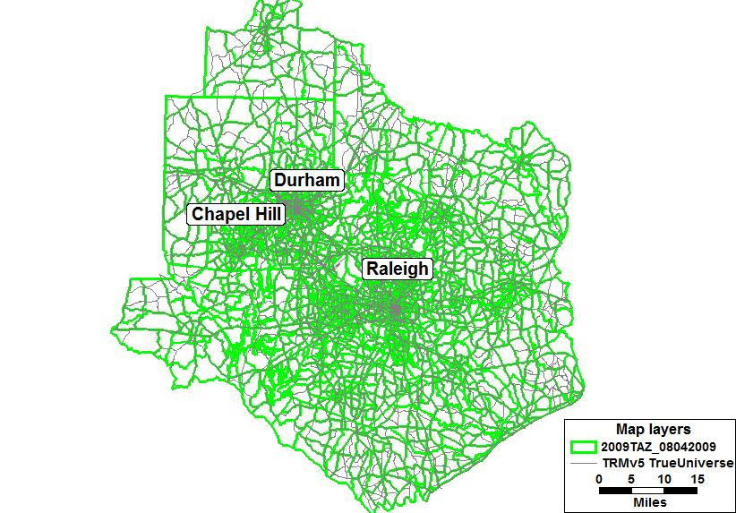
Triangle Regional Model

Slide 6
Process
Disagg to TAZ
Apply factors to AirSage matrix
Add IE, EI, and EE trips to AirSage matrix
Develop AM factors from TRM data
Apply AM factors to AirSage matrix
Convert AirSage person trips to vehicle trips
AM peak hour assignment of AirSage
AM peak hour assignment of TRM
Summarize MOEs and compare

Slide 7
Results – travel time comparisons
TRM – slightly higher % of shorter trips
Average Trip Length (TT)
TRM | 14.42
Air Sage | 15.51

Slide 8
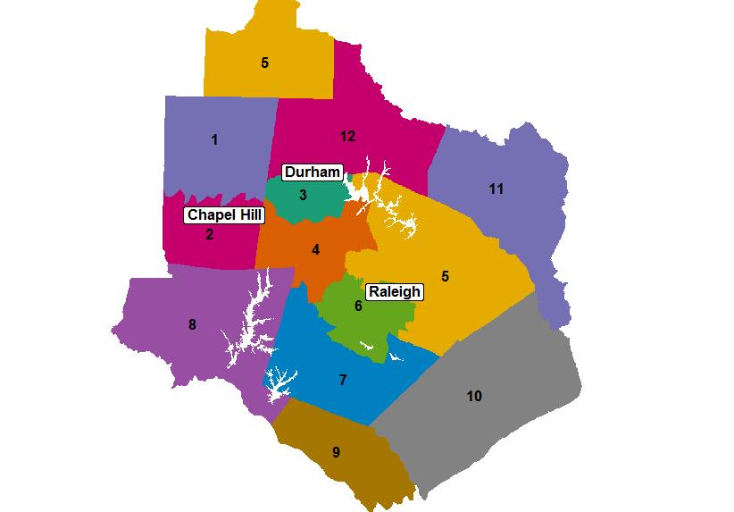
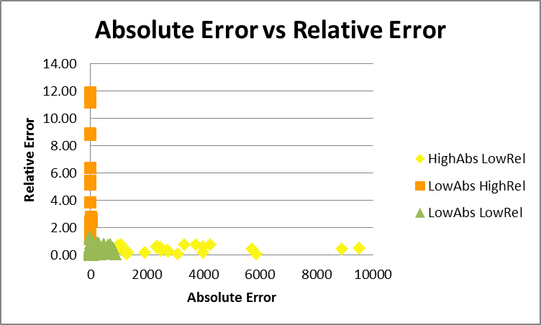
Results – district to district flows
District Map
District Trip Table Color Coded by Absolute and Relative Error

Slide 9
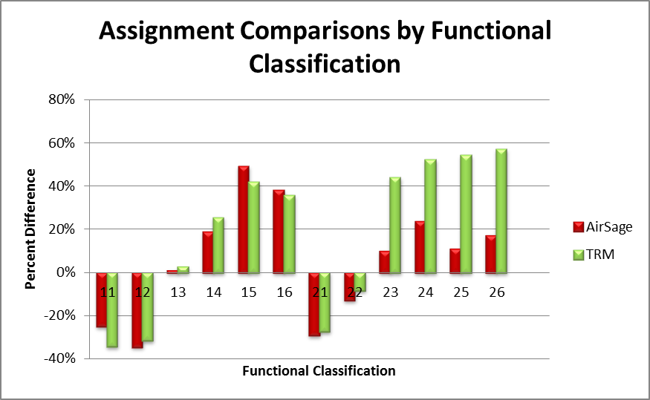
Results – Assignment MOEs
Functional Classification 23 – 26 are rural facilities

Slide 10
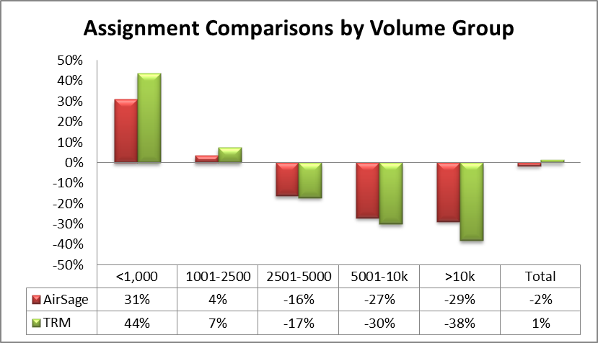
Results – Assignment MOEs

Slide 11
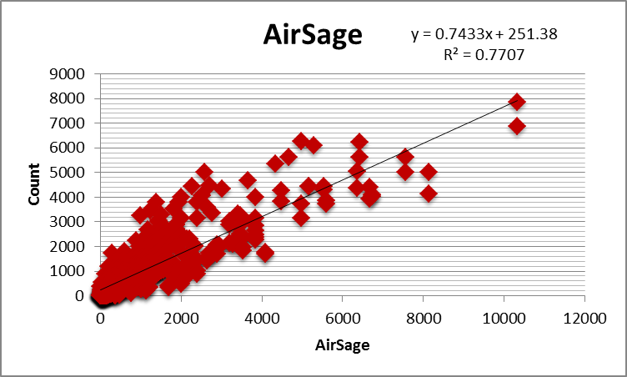
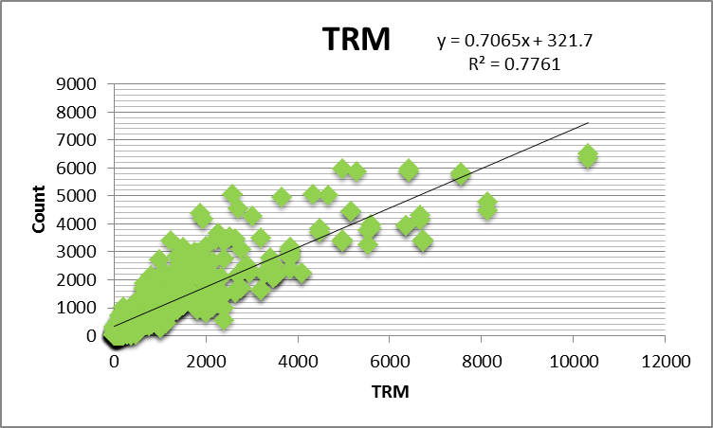
Results – Assignment MOEs

Slide 12
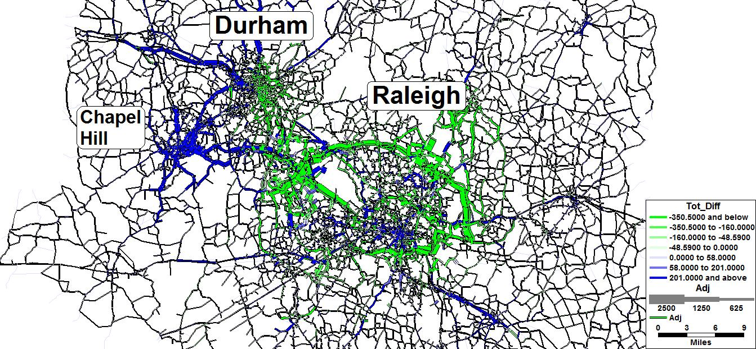
Results – Assignment MOEs

Slide 13
Findings and Recommendations
Early data set – includes Sprint data only
Great source of validation data
Low cost option
Lacks behavioral richness of household survey
Larger sample than household survey
Continuing improvements are needed
Useful to validate an estimated trip table
Add to toolbox

Slide 14
Acknowledgements
Co-author – Rick Donnelly
Kyle Ward, CAMPO
Air Sage

