Slide 1
The Codebase is the Deliverable: Collaborative Software Development for Modelers
Lisa Zorn, Elizabeth Sall, Dan Tischler – SFCTA
Renee Alsup, Gregory Erhardt – Parsons Brinckerhoff
14th TRB National Planning Applications Conference
Columbus, OH May 5-May 9, 2013
Notes:
Abstract
When the San Francisco County Transportation Authority developed the citywide dynamic traffic assignment (DTA) model for San Francisco# (see submitted abstract, Modeling Every Hill, Bus, Traffic Signal, and Car ... or http://dta.googlecode.com), the DTA team had a second goal: to share the tools developed for the process with other cities and regions that might be interested in developing a DTA model. As a result, the team has created an open source project called DTA Anyway to facilitate the creation of DTA networks and scenarios. The code performs the following tasks:
Imports the static model network and adds shape;
Imports transit lines from their static model format;
Imports traffic signal phasing and timing plans;
Imports stop signs from a GIS layer;
Attaches count data from a separate database; and
Writes all files in a format ready to be run by the DTA model.
Automating these processes allows a new DTA scenario to be run each time the static model (SF-CHAMP) is run, which facilitates testing with future demand and different scenarios, rather than being constrained to a single scenario.
The development team designed the API before implementation with two primary objectives: making it (1) easy to use and (2) extensible. DTA Anyway consists of an object-oriented python library with objects that represent the dynamic network, nodes, links, movements, etc. The library does not include any San Francisco-specific code; rather, these local elements are encapsulated in the scripts that use the library. While the San Francisco static network is in the Citilabs Cube format and the output dynamic network is in the INRO Dynameq format, the library design attempts to decouple the read/write methods from the data structures as much as possible, for easier future extension to other static and dynamic network formats.
This presentation will include some of the lessons learned by the DTA Anyway team, including the value of source control, using google code to track tasks, the utility of short development cycles and small tasks, the emphasis on useful documentation, and using code review to ensure code clarity and documentation quality.

Slide 2
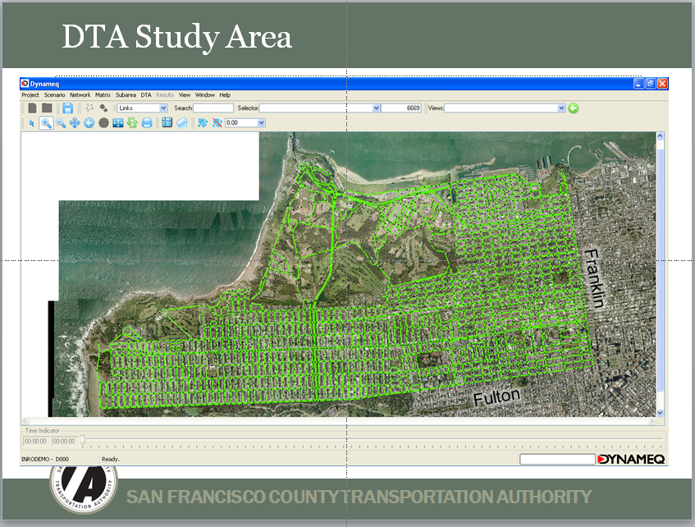
Why is the codebase the deliverable?
Some history…
Fall 2009: Initial DTA model developed for Doyle Drive ramp closure study
Notes:
Four years ago at Planning Apps in Houston…
Task order states that the deliverables include: Prepared networks and demand, assembled traffic count data for validation, and calibration and validation documentation.
Source: Q:\Model Documentation\Presentations\DTA.Doyle.BrownBag_Feb2010.ppt

Slide 3
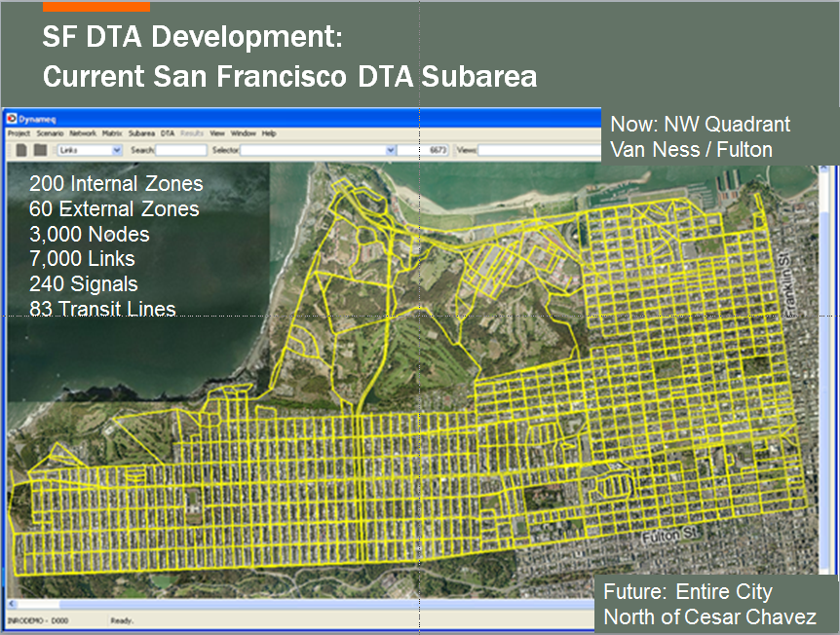
Why is the codebase the deliverable?
Some history…
Summer 2010-2011: DTA Model Expansion for Geary DTA
Notes:
Two years ago at Planning Applications in Reno, NV…
Deliverables in this task order now include:
Model development
Standardized datasets for network and validation data.
Scripts that parse the standardized datasets and translate it to the DTA.
Analysis Tools
Weekly pushes of data development scripts to online project repository
Weekly pushes of output summary and validation scripts to online project repository
Weekly pushes of visualization scripts to online project repository
Sphinx generated HTML documentation of any code pushed to the online project repository

Slide 4
Why is the codebase the deliverable?
Some history…
Notes:
In general, things worked out pretty well!
We got a useful results and insights out of both our models
We still use the Geary DTA model today, as well as all of the scripts and analysis tools devised for it
But there are some drawbacks.
The codebase and scripts are a little inscrutable –
Not documented for users
Not designed with the flexibility we would have liked
Included a bunch of code written for other clients/purposes
In short, they were written by one person
This is not a criticism! They met our requirements! And they helped us to update our requirements…
So for the next round, we decided to try a different approach. HAHA!
The codebase would be the deliverable again, but more so this time! And this time, it would be
Easy to use & maintain
Extensible: Retaining flexibility in the future for minor or major changes in the input network and/or output network
To do this, we would have to be more involved on the staff level.

Slide 5
New Approach
Previously | Now
owner: consultant | owner: me
development: 1 consultant | development: 50/50 team
audience: staff | audience: any interested parties (you?)
CompSci degree not required
Notes:
In short, we needed to be much more involved at the staff level!

Slide 6
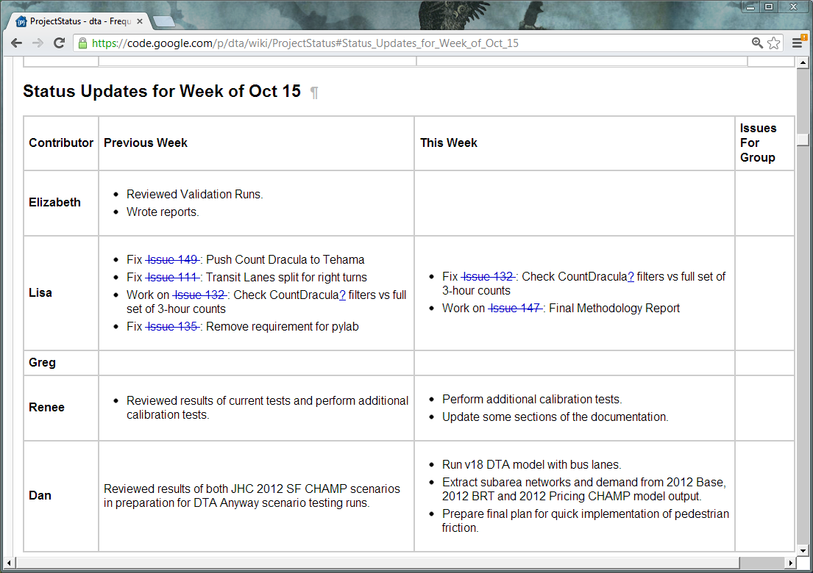
OPEN SOURCE
Notes:
Why open source then?
No reason not to make it open source. Funded by sales tax dollars & federal highway administration dollars -- public money. Why should we spend public funds doing something more than once?
Also, it allows us to be flexible with consultants since the codebase won’t be proprietary to the consultants we work with. Can't anticipate future needs. More reason to try not to be vendor specific.
Also:
Importance of documentation and deliberate API structure for open source code.
It's an algorithmic and project reference even if we don't have collaborators. All of our trials and tribulations are public. See status updates!

Slide 7
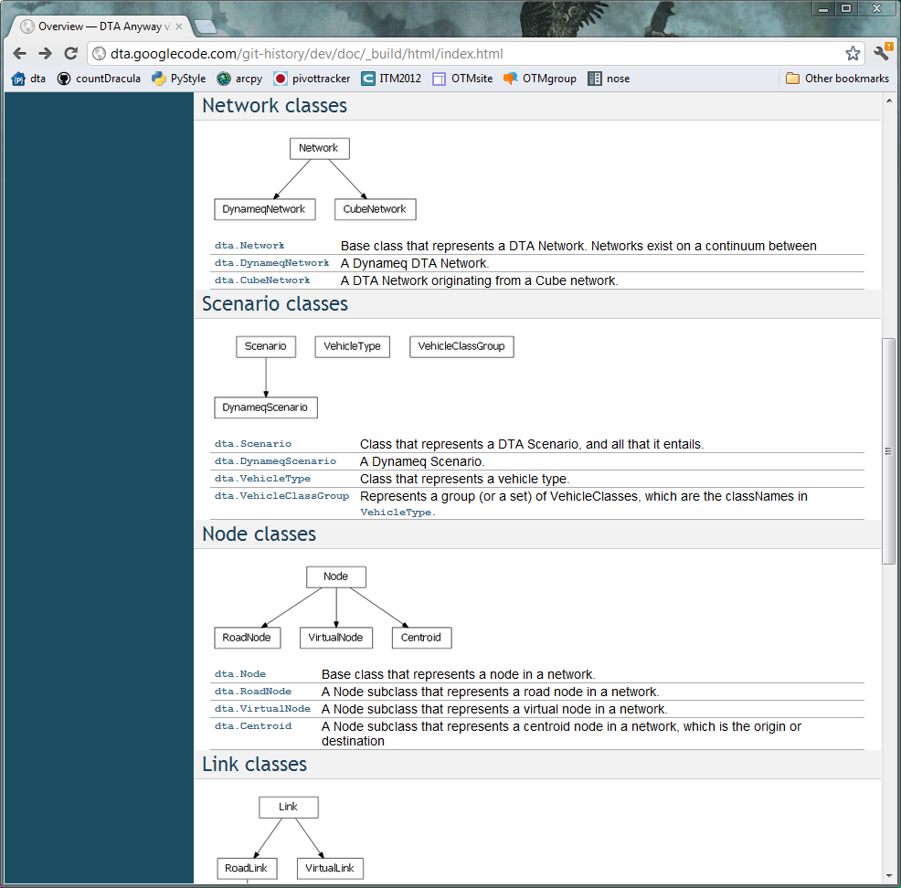
API
Class Structure
http://dta.googlecode.com/git-history/dev/doc/_build/html/index.html
Notes:
Simple class structure.
Where the complexity was higher, subclass for vendor-specific code.
For simpler cases, vendor-specific methods.
We will adapt this more when the code is extended beyond Cube & Dynameq

Slide 8
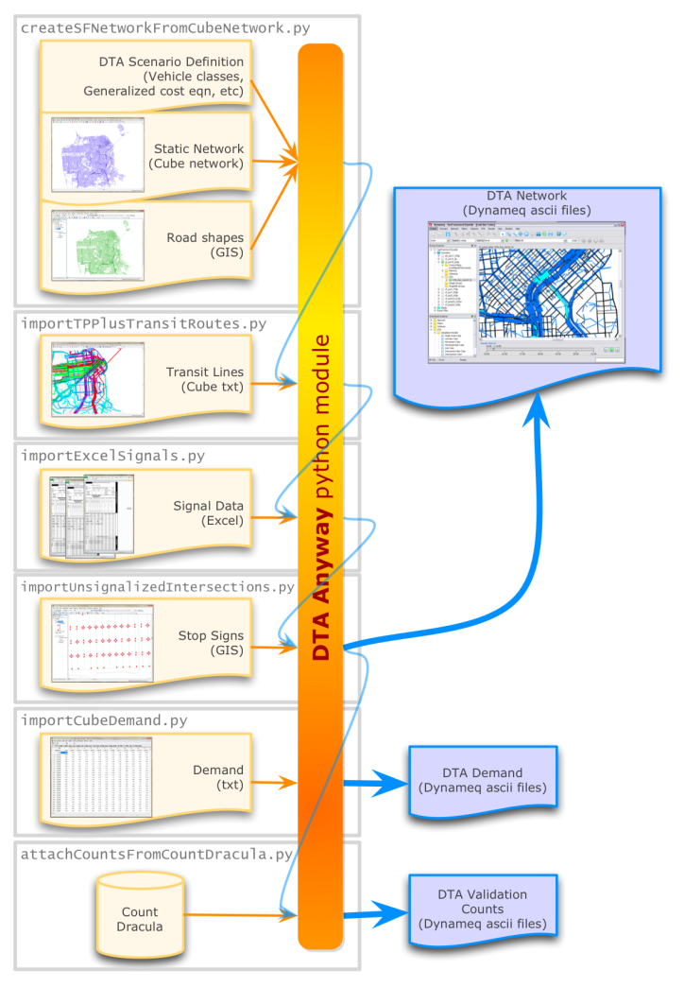
San Francisco
Network Development
Notes:
Grey boxes = scripts
Orange = library
Kept San Francisco-specific code in scripts (including where we do things that are just our convention but we have no reason to think anyone else uses these conventions)

Slide 9
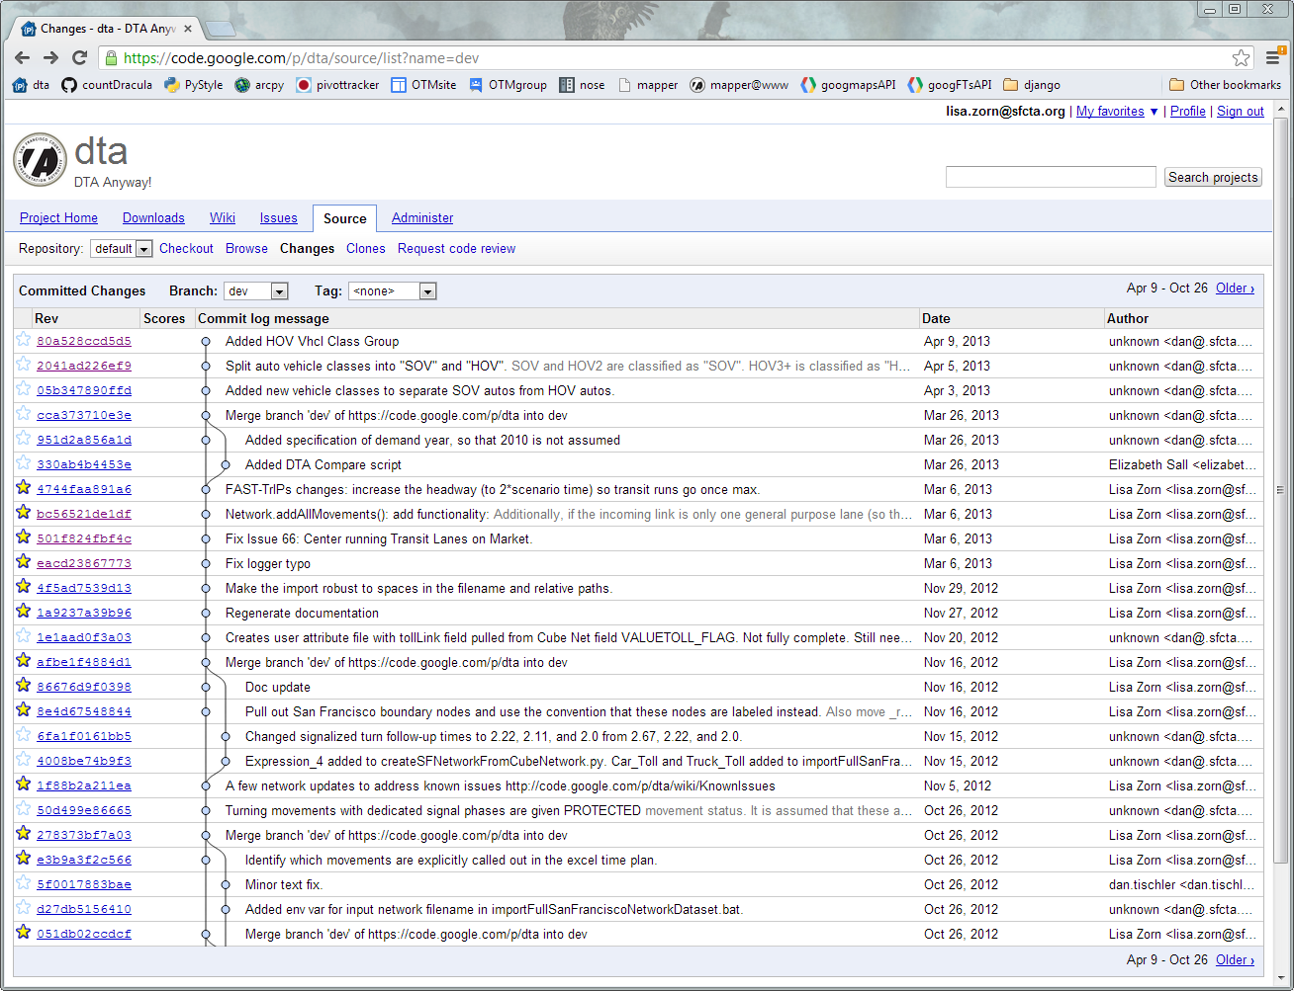
Git & Google Code

Slide 10
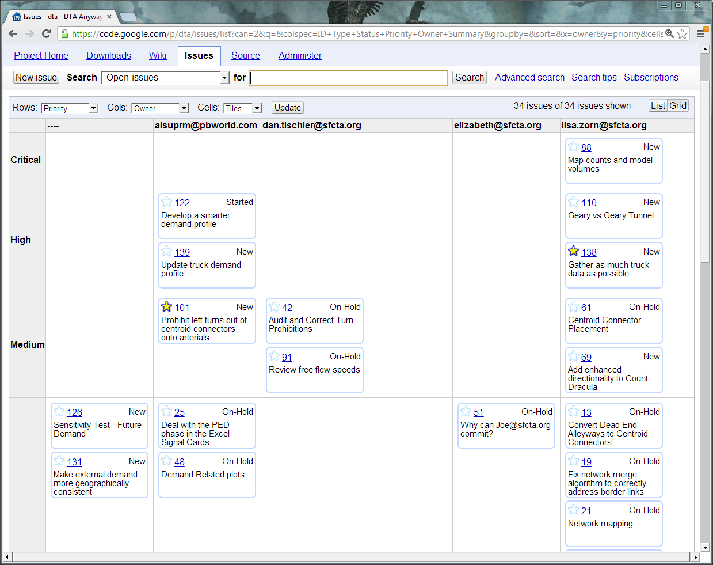
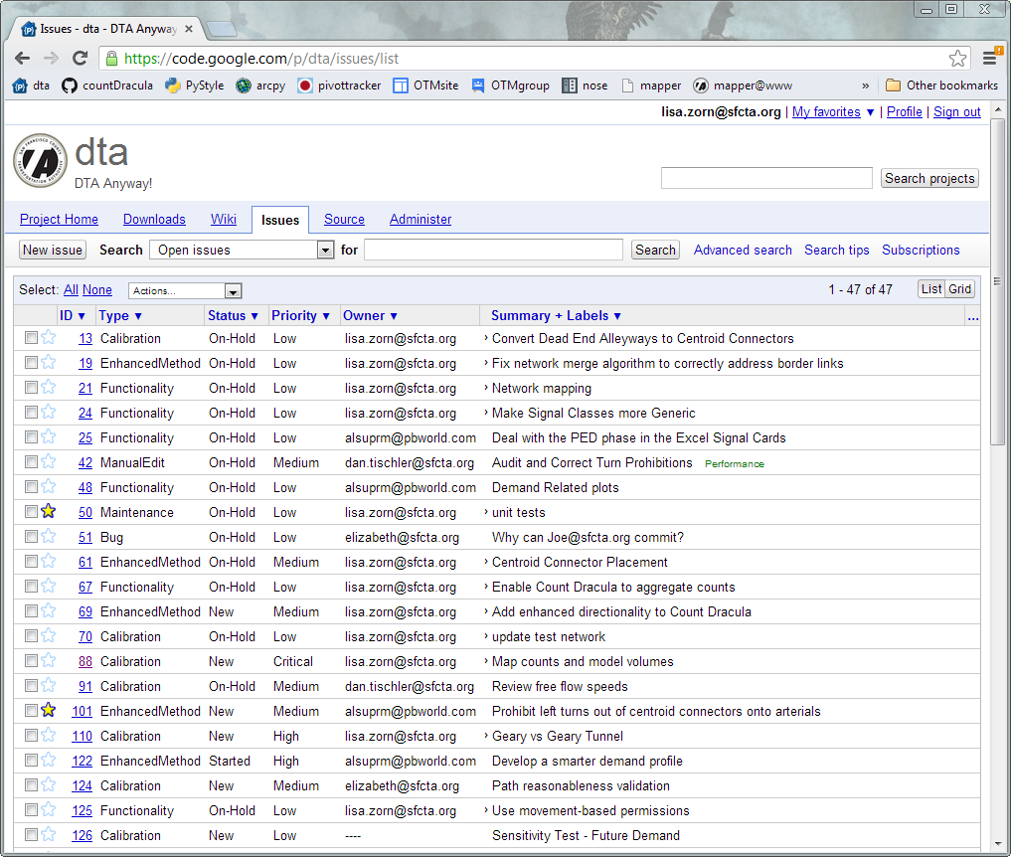
Issue Tracking & Google Code

Slide 11
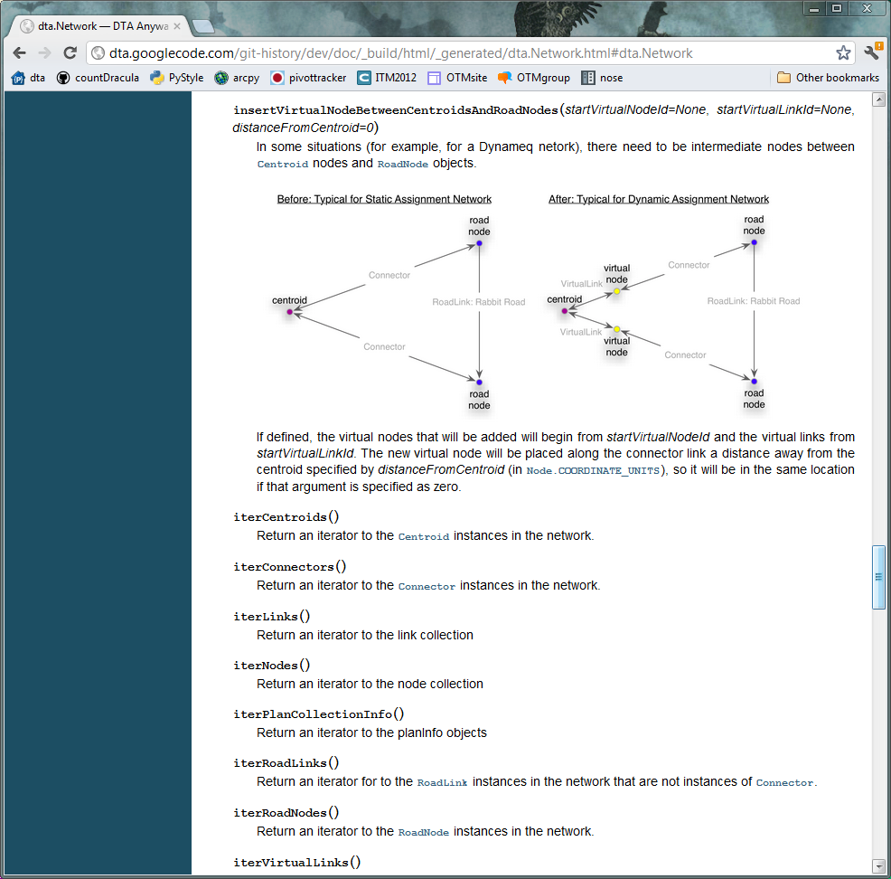
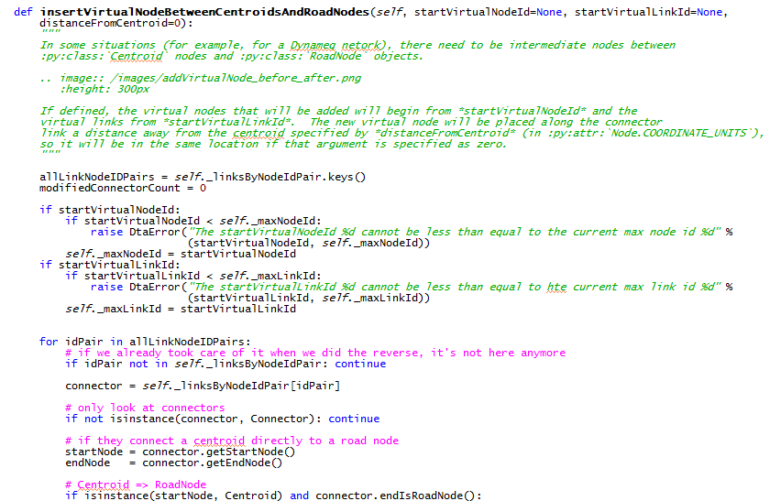
Sphinx for Documentation

Slide 12
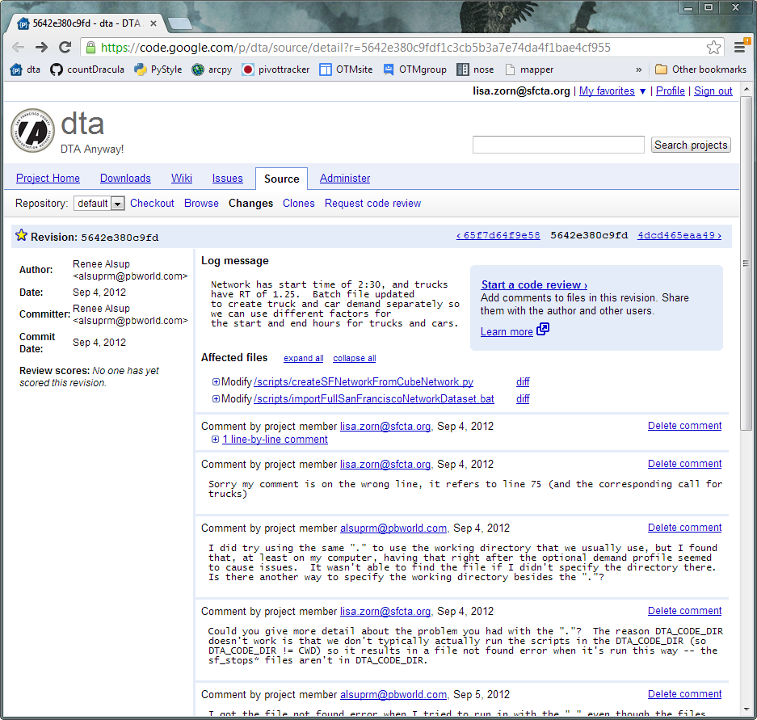
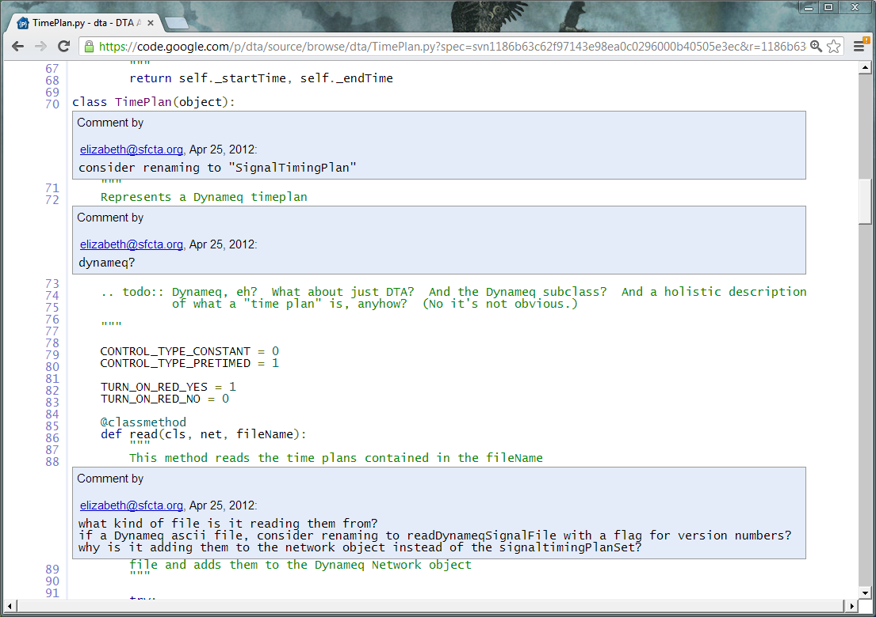
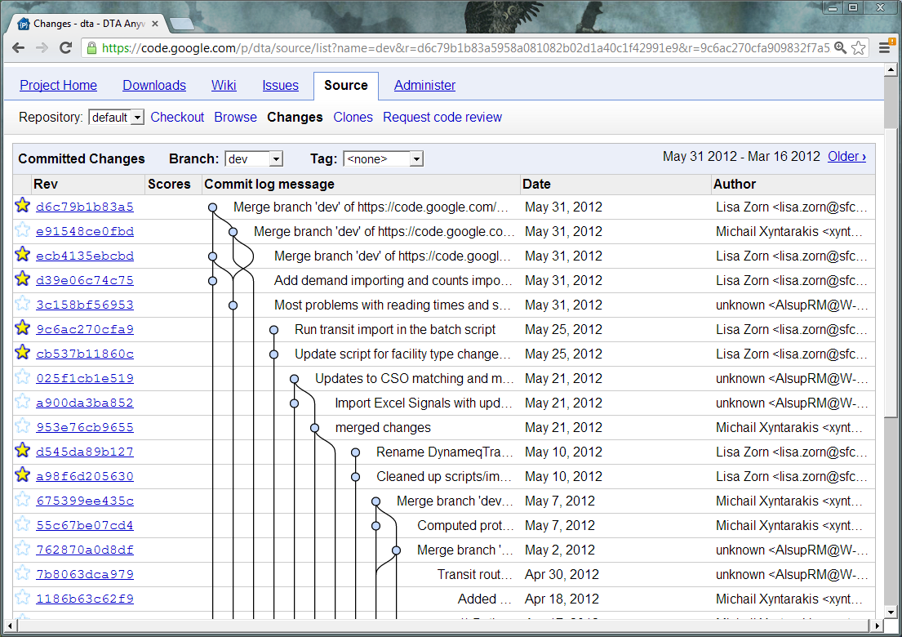
Code Review
Notes:
Code review in google code has some positives but some negatives
Handy for commenting in code, but attached to a single revision so easily lost
In practice, we ended up handling it by reading commit log email
But this really broke down when there was a lot of activity by many people

Slide 13
Unit Tests
???

Slide 14
Questions/Ideas/Suggestions?
http://dta.googlecode.com
Email: lisa.zorn@sfcta.org

