Slide 1


www.pontiaclivability.org

Slide 2
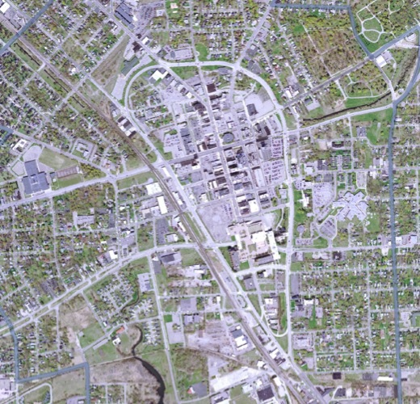

Public
Safety
Housing
Revenues
Schools
Transportation
Environment
Jobs
Services
Recreation
Pontiac’s Challenges
Transportation Connectivity

Slide 3
Background:
Oakland County Planning & Economic Development Services (OCPEDS), in partnership with the City of Pontiac, applied for and was awarded a Sustainable Communities Challenge Grant in October, 2010.
The grant provides $300,000 to develop a plan to address livability and connectivity in downtown Pontiac and surrounding neighborhoods.
OCPEDS manages the project and provides $104,000 in in-kind match to the project, consisting of professional planning staff time.
RFP for consultant services issued in May 2011 and consultant interviews held in July 2011.
Parsons Brinckerhoff Team selected in August 2011.

Slide 4
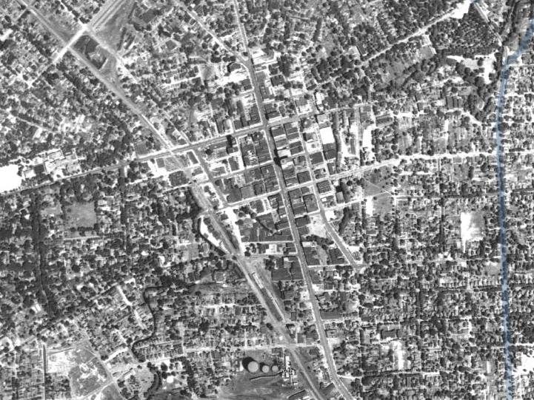
HURON
SAGINAW
1940

Slide 5
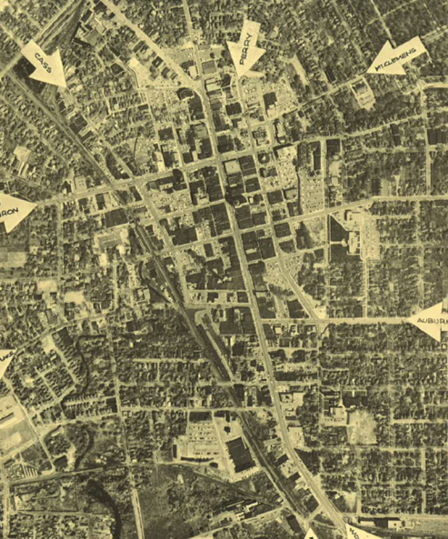
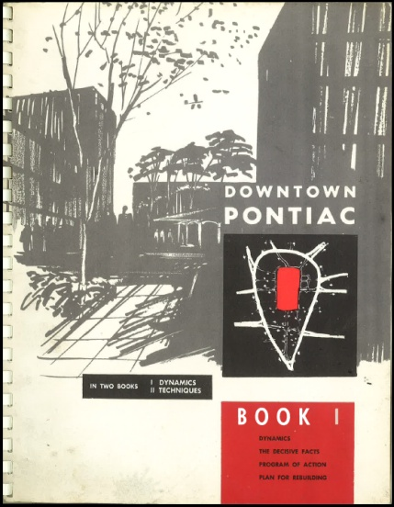
Downtown Pontiac Book 1
April 18, 1962

Slide 6
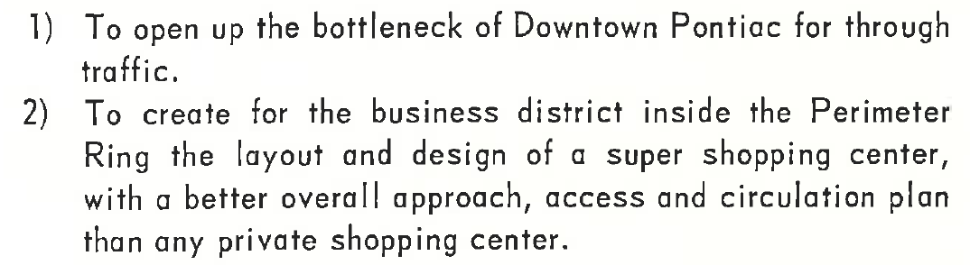
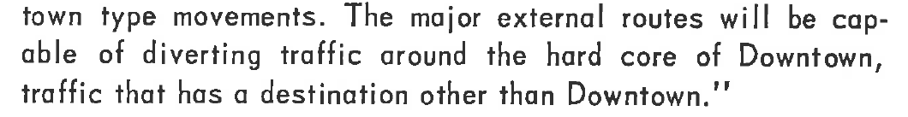
Downtown Pontiac Book 1
April 18, 1962
bottleneck of Downtown
super shopping center
diverting traffic around the hard core of Downtown,
155,000 vehicles a day by 1980.

Slide 7

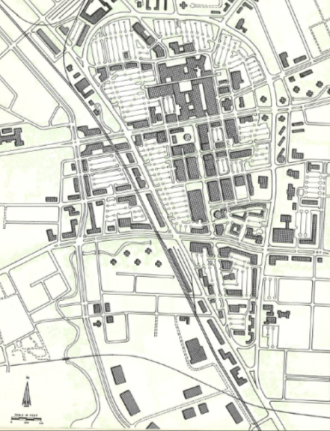
Downtown Pontiac Book 1
April 18, 1962

Slide 8
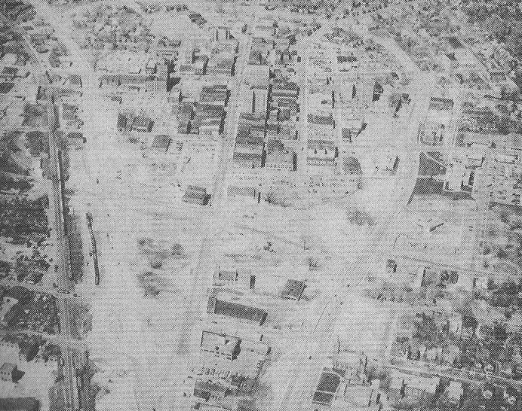
Land acquired
River enclosed
Buildings torn down
Loop built
Neighborhoods cut off from their downtown
25,000 residents lost
30,000 jobs lost
1940
Notes:
Pontiac township 3,465
1940 66,226
1950 73,681

Slide 9
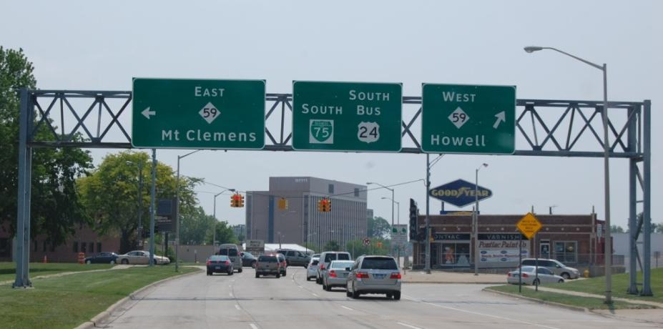
Downtown Pontiac Transportation Assessment
Building Connections between Downtown and Neighborhoods
Everywhere but Pontiac

Slide 10
The purpose of this study to find the best ways to better connect downtown, neighborhoods and the broader community by readapting the Woodward Loop and improving the street, sidewalk and bike path system.
Project Purpose

Slide 11
It can’t do it all, but…
what it can do
It is envisioned that improving this network will improve livability and the long term economic health of the downtown and surrounding neighborhoods.

Slide 12
Major Components
1 Previous Studies and Reports
2 Current and Future Traffic Conditions
3 Stakeholder Input, Ideas and Concerns
4 Plan and Recommendations

Slide 13
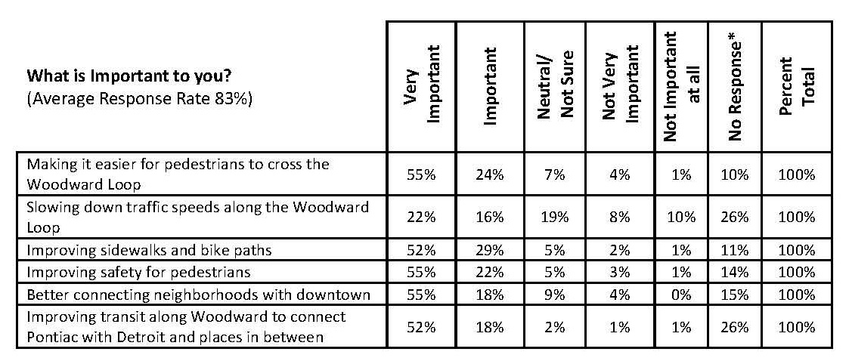
What is important to you?
79
5
38
18
81
3
77
4
73
4
70
2

Slide 14
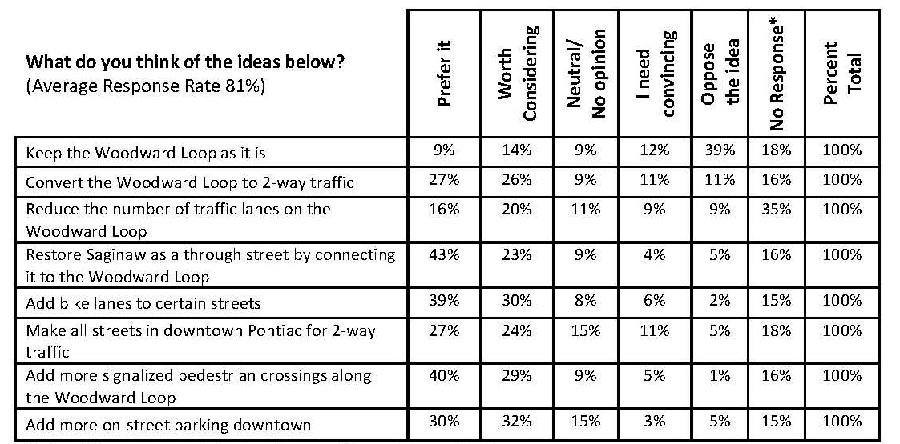
What do you think of the ideas below?
23
51
53
22
36
18
66
9
69
8
51
16
69
6
62
8

Slide 15
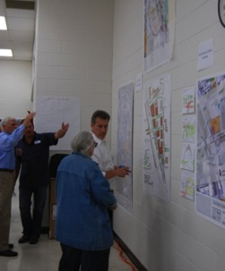
Stakeholder Input
Make it easier and safer for pedestrians to cross
Improve sidewalks and bike paths
Better connect the neighborhoods and downtown
Improve transit
Convert the Loop to two-way traffic
Connect Saginaw to the Loop
Drivers have a hard time navigating into and out of downtown
The loop serves the interest of pass through drivers better than local drivers

Slide 16
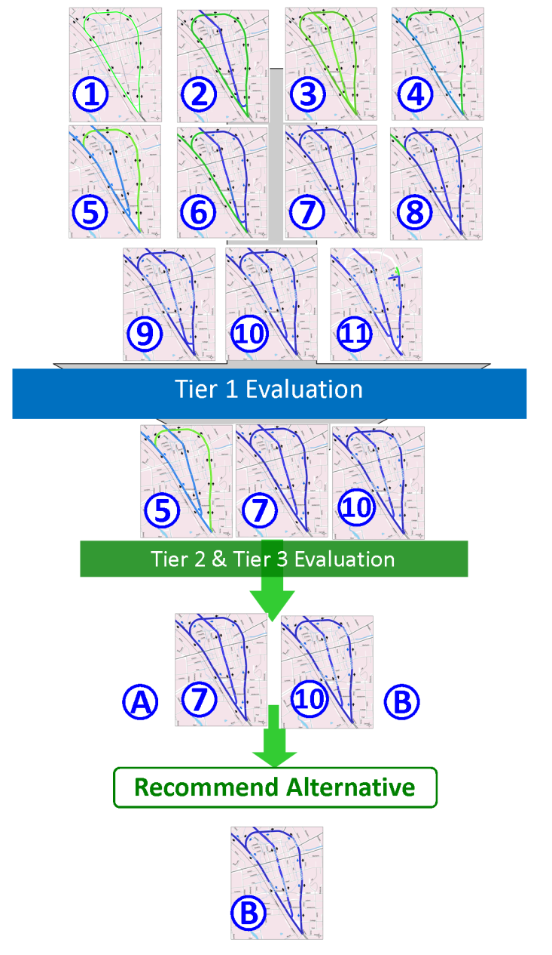
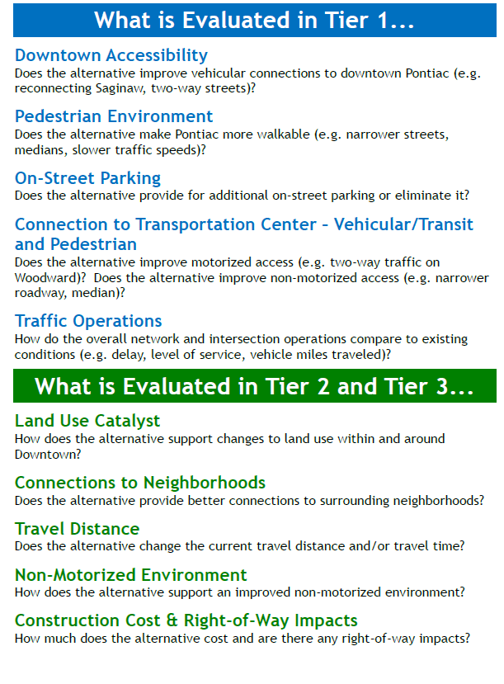
Narrowing down the Alternatives…

Slide 17
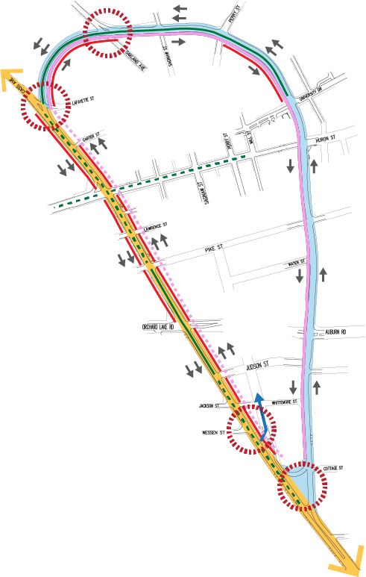
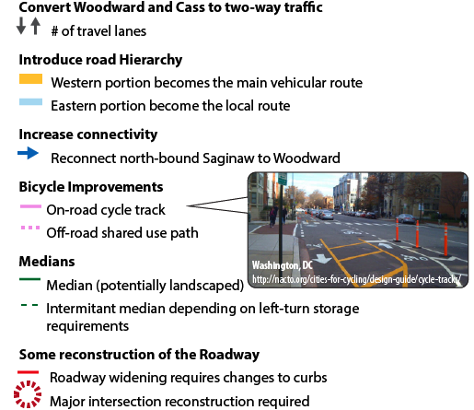
Recommended Alternative
4
Recommended Alternative
3
5
2
Woodward
Parke
1

Slide 18
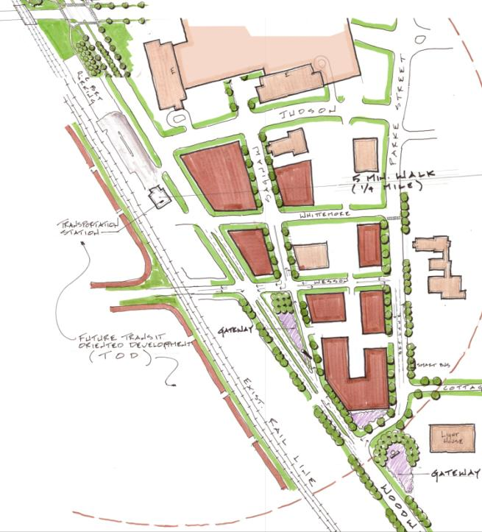
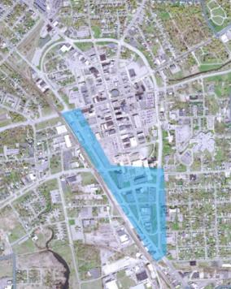

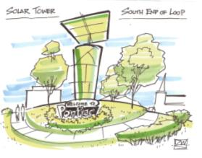

Slide 19
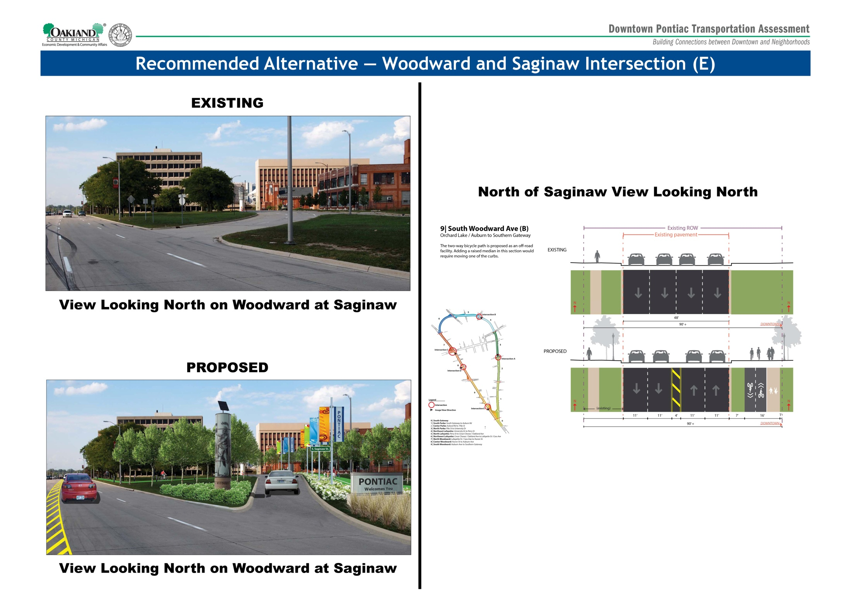


Slide 22
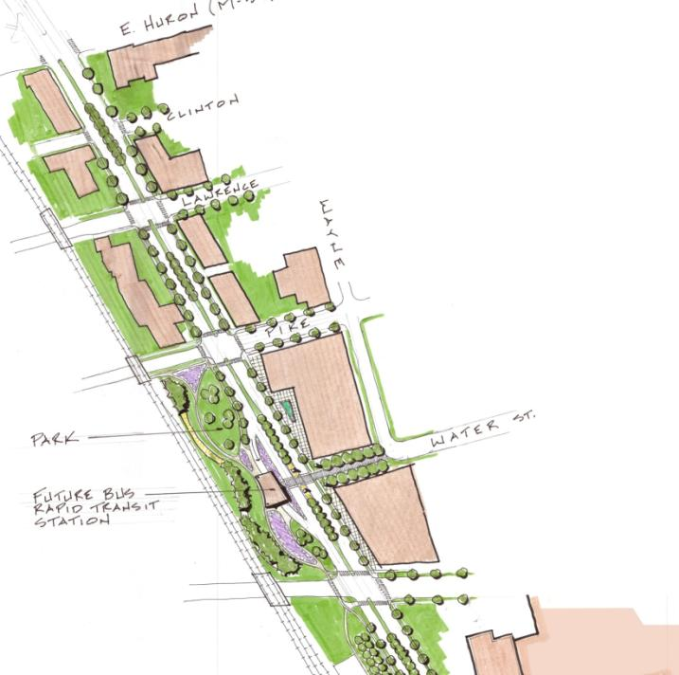



Slide 23
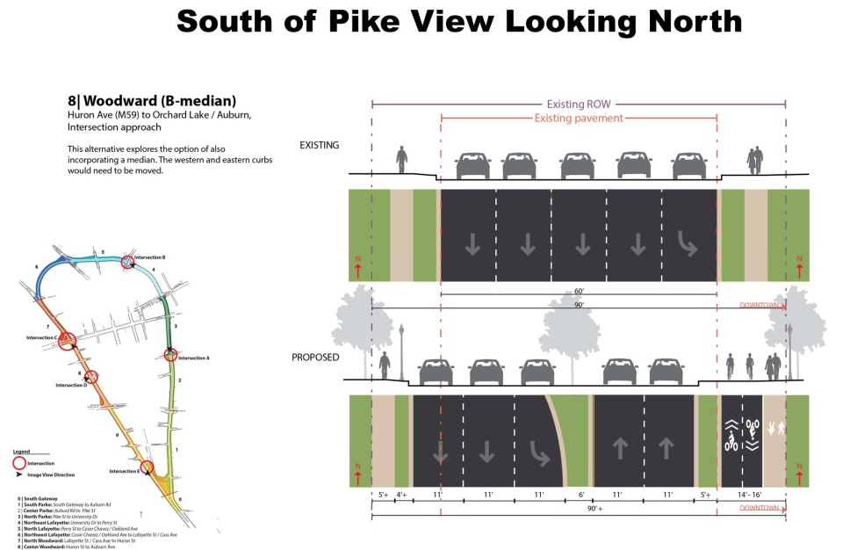

Slide 24


Slide 26
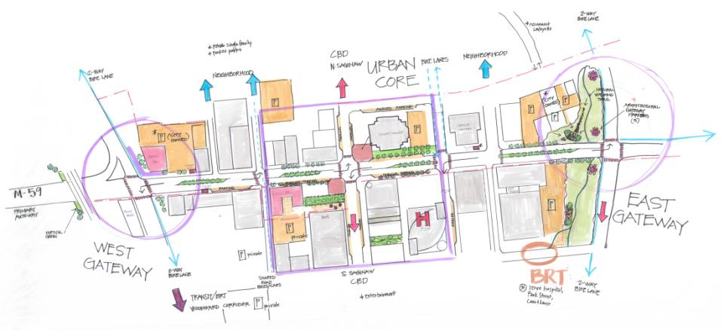
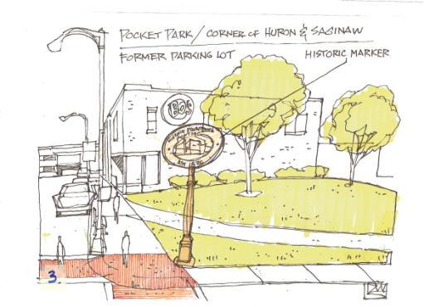
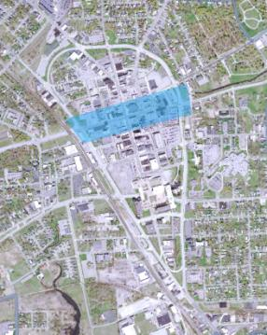

Slide 27
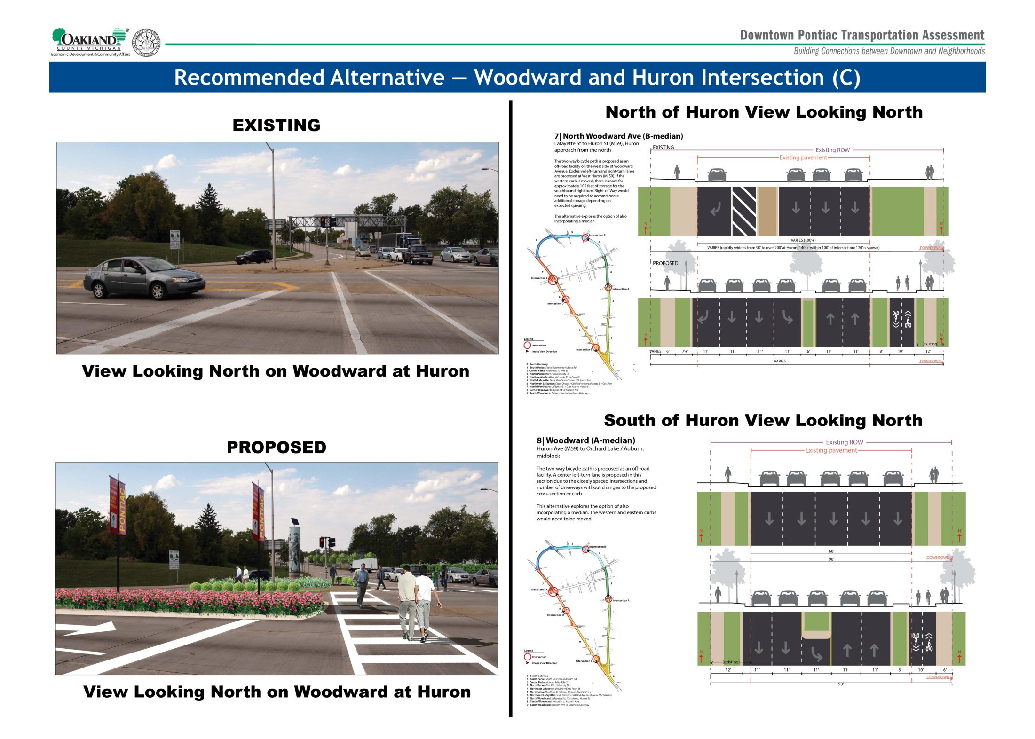

Slide 30
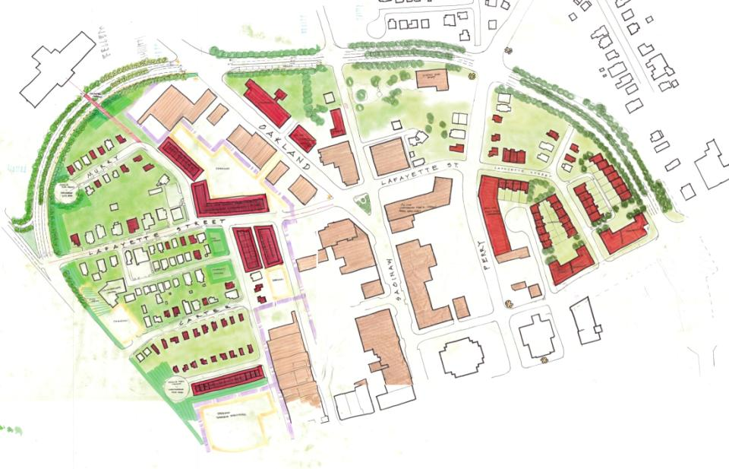
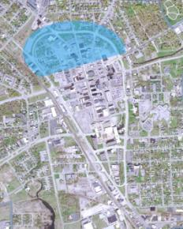

Slide 31
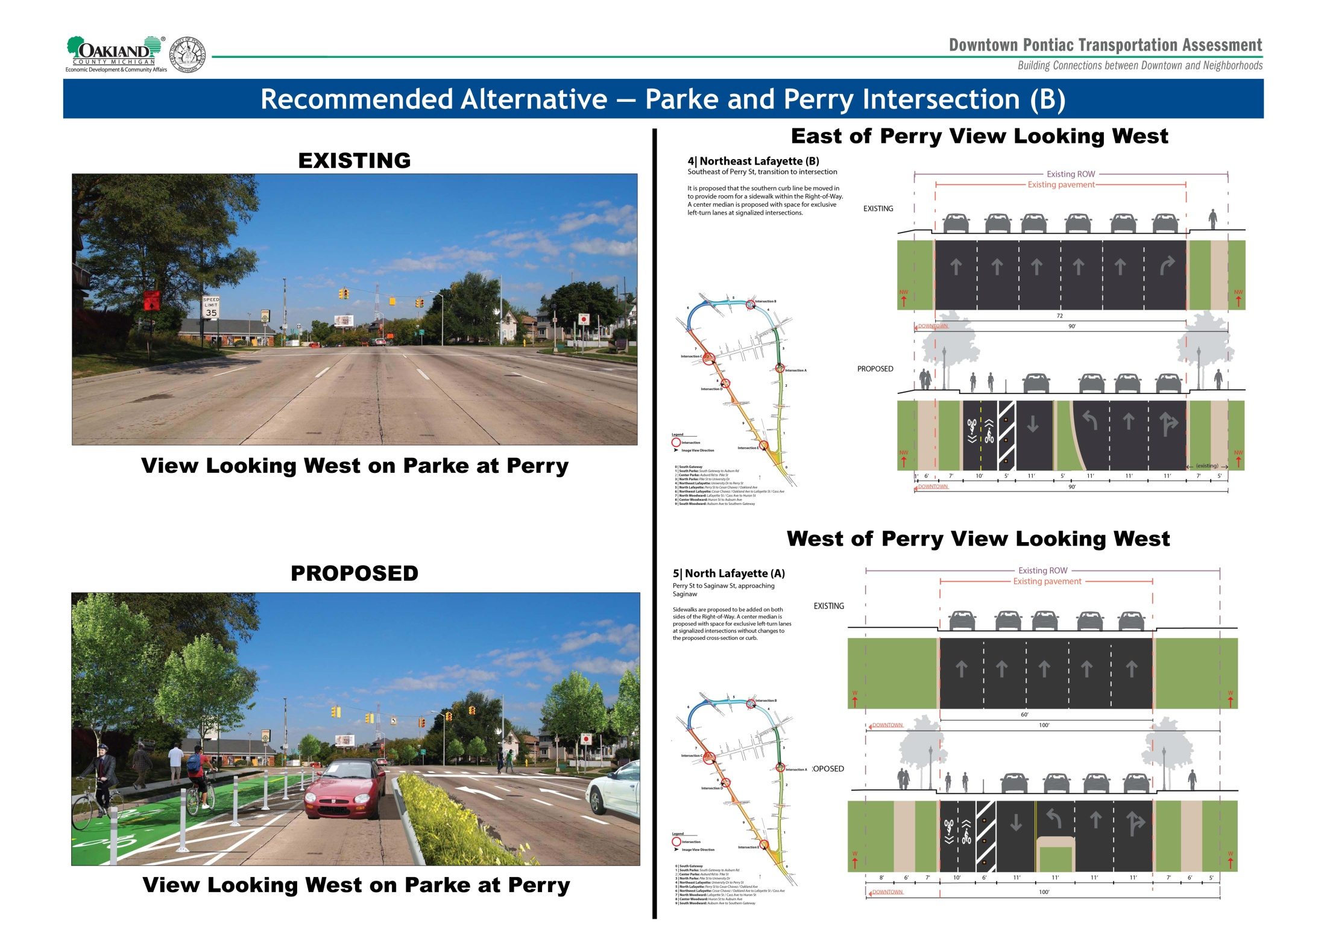

Slide 34
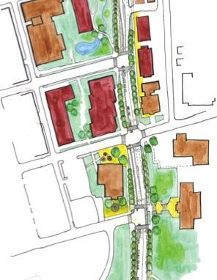
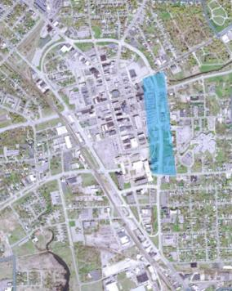

Slide 35
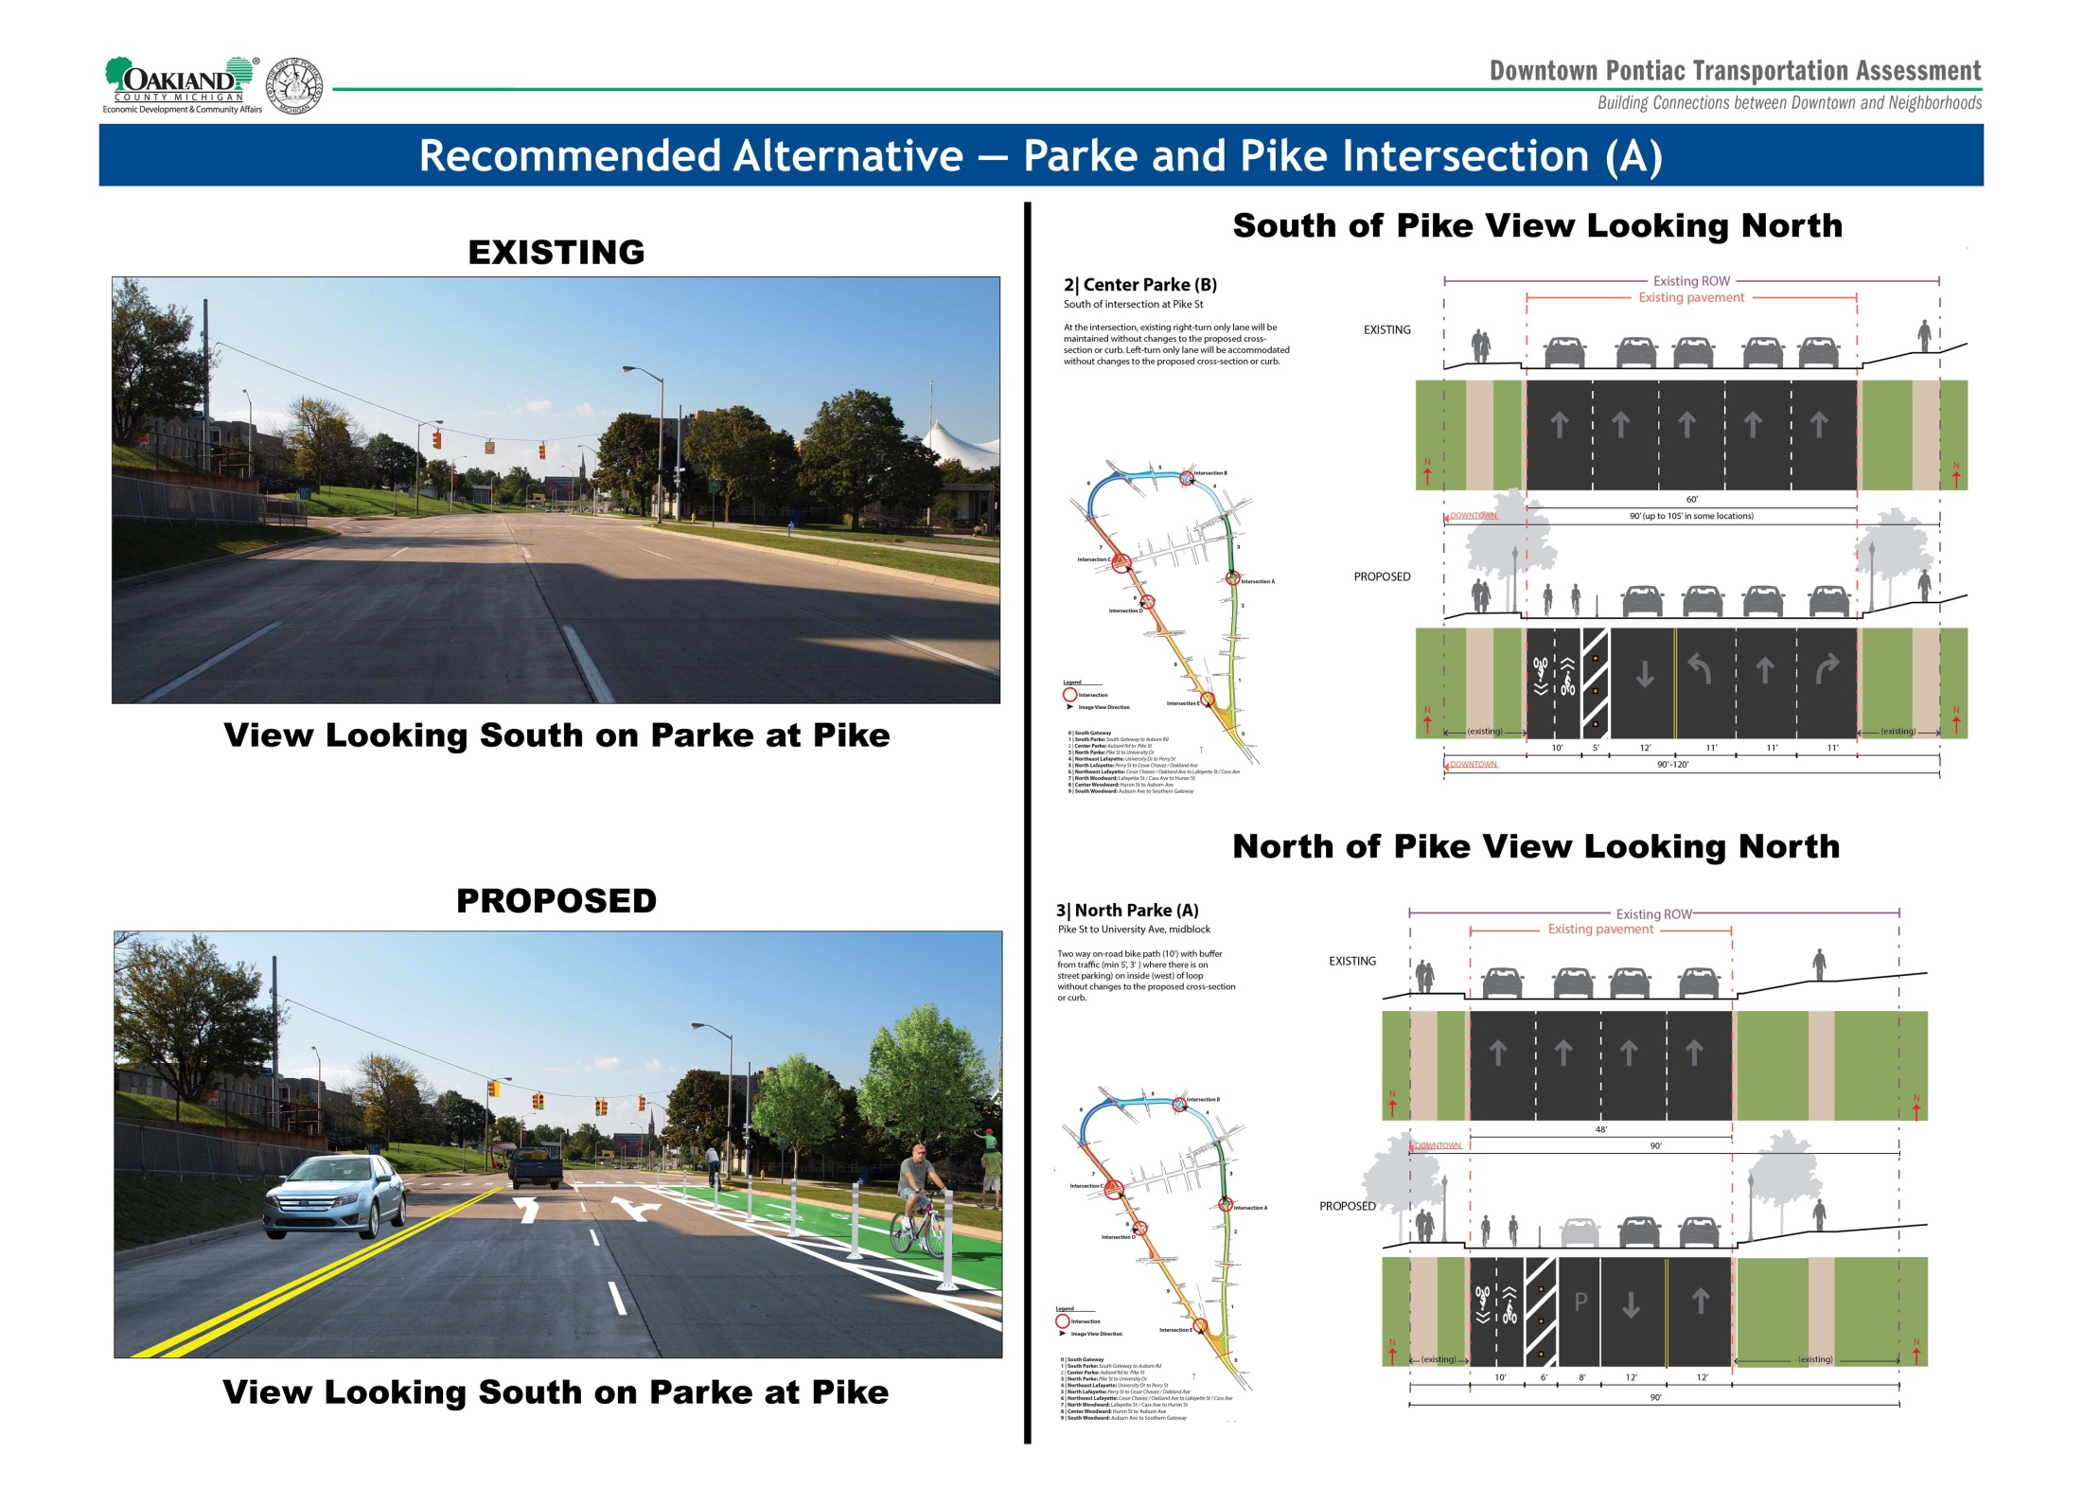

Slide 39
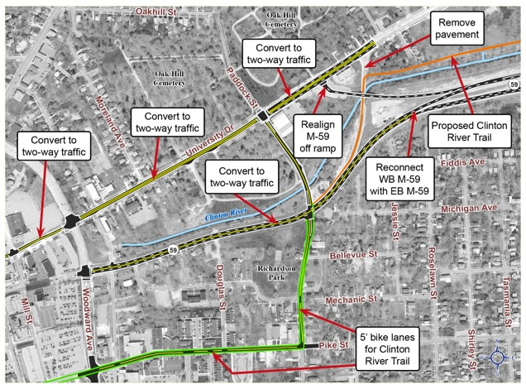
Proposed Huron Street and Clinton River Trail Alignment
  Proposal:
    Clinton River Trail proposed on Pike Street and Paddock Street
      Better access to downtown
      Lower speed roads
    University Dr. converted to 2-way
    Huron Street converted to 2-way between Mill Street and freeway portion of M-59
    2-way conversion allows existing structure to be used by Clinton River Trail to cross river
This area is outside the study area of the Downtown Pontiac project. Traffic evaluation not performed for this proposed alignment.

Slide 40
One-way Streets
Conversion to two-way as part of larger Loop project
Huron
University
Lafayette
Conversion to two-way independent of larger Loop project
Mill
Lawrence
Pike
Feneley Ct. remain one-way

Slide 41
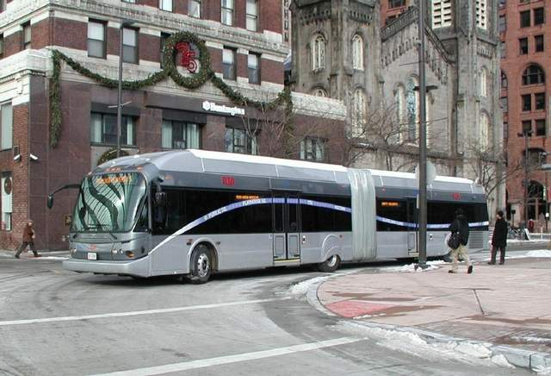
Bus Rapid Transit
Pike Street

Slide 42
Implementation Process
Project included in SEMCOG regional and state plans
Project in queue for future funding consideration
Project development generally proceeds in
three phases:
Phase I. Preliminary Engineering and Environmental Study
Phase II. Contract Plan Preparation and ROW Acquisition
Phase III. Construction

Slide 43
Construction Phases and Costs
Short Term (1 to 3 years)
Medium Term (3 to 10 years)
Long Term (10 to 12 years)

Slide 44
Short Term (1 to 3 years)
Internal one-way to two-way street conversion costs in downtown Pontiac (inside the Loop)
Roadway conversion one-way to two-way:
  Mill Street between Huron and Water
  Lawrence Street from Woodward to Mill Street
  Pike Street from Mill to Woodard
Three Signals:
  Pike at Mill
  Saginaw at Lawrence
  Pike at Woodward
Pavement markings, intersections, signs, and ADA ramps
Total estimated cost: $900,000

Slide 45
Medium Term (3 to 10 years)
Woodward two-way from South Gateway to Cesar Chavez
Curbs
Medians
Road diet
Turn lanes
Sidewalks
Two way bike path
Signals
Landscaping
Signage
Total estimated cost: $3,000,000

Slide 46
Long Term (10 to 12 years)
Parke Street two-way from South Gateway to Cesar Chavez
Curbs
Medians
Road diet
Turn lanes
Sidewalks
Cycle Track
Signals
Landscaping
Signage
Total estimated cost: $3,000,000

Slide 47
Total Estimated Construction Costs
$6.9 Million (2012 dollars)
Based on an estimated cost per mile for curb reconstruction, excavation, drainage, full-depth lane construction, and sidewalk and median construction.
Cost for 400’linear feet ROW at Woodward and Huron TBD
Design Costs not included = 10%
2035 dollars = 15.6 Million (4% inflation)

Slide 48
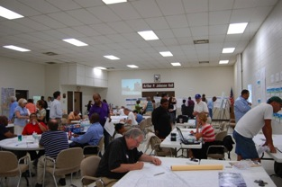
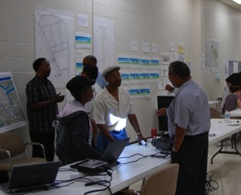
Next Steps
Finalize and circulate the Executive Summary
Finalize the full report
Establish a Coalition to champion the project (city, county & state)
Obtain the endorsement of the City Council, Mayor and Planning Commission
Obtain the endorsement of County and State

Slide 49
Downtown Pontiac Transportation Assessment
Building Connections between Downtown and Neighborhoods
Everywhere but Pontiac

Slide 50
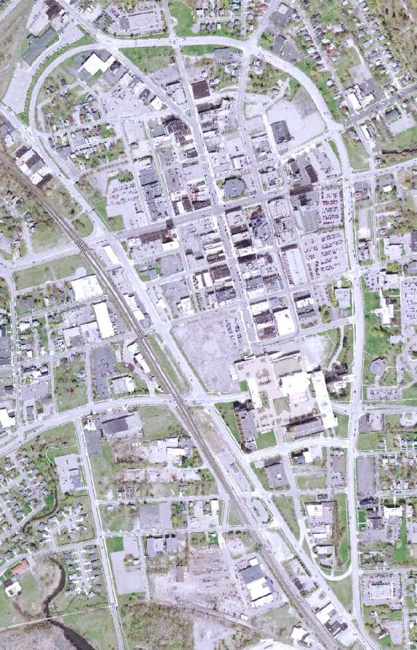
1
6
DOWNTOWN
Huron St
NEXT INTERSECTION
DOWNTOWN
Perry St
NEXT INTERSECTION
6
5
1
5
2
DOWNTOWN
Pontiac
DOWNTOWN
Pontiac
2
3
4
4
DOWNTOWN
Pike St
NEXT INTERSECTION
3
DOWNTOWN
Pike St
NEXT INTERSECTION
MDOT Signage Recommendations

Slide 51
www.pontiaclivability.org

