Slide 1
An Empirical Comparison of Microscopic and Mesoscopic Traffic Simulation Paradigms
Ramachandran Balakrishna
Daniel Morgan
Qi Yang
Caliper Corporation
14th TRB National Transportation Planning Applications Conference Columbus, OH • 8th May, 2013

Slide 2
Outline
Motivation
Dynamic Traffic Assignment
Challenges for model comparison
Methodology
TransModeler overview
Case study: Phoenix, AZ
Conclusion

Slide 3
Motivation
Dynamic Traffic Assignment (DTA)
Demand: short departure time intervals (5-15 min)
Supply: microscopic, mesoscopic, analytical, etc.
Microscopic (micro) vs. mesoscopic (meso)
Micro: Detailed driving behavior, network response
Meso: Aggregate/approximate traffic dynamics, control, queues
Need for objective comparison of micro, meso DTAs
Emissions modeling, etc. require micro fidelity
However, DTA often used interchangeably with meso
Hardware, software advances facilitate micro DTA

Slide 4
Dynamic Traffic Assignment (1/2)
General DTA framework
[Source: Ben-Akiva, Koutsopoulos, Antoniou and Balakrishna (2010) “Traffic Simulation with DynaMIT”. In Barcelo (ed.) “Fundamentals of Traffic Simulation”, Springer.]

Slide 5
Dynamic Traffic Assignment (2/2)
Network loading (supply)
Microscopic
Small time steps (0.1 second)
Car following, lane changing, reaction times
Explicit models of traffic control, lane utilization
Routing utilizes lanes, intersection geometry and delays
Outputs: Detailed trajectories, realized capacities
Mesoscopic
Large time steps (several minutes)
Macroscopic traffic dynamics e.g. speed-density functions
Approximate models of signals, lanes, capacities
Routing based on link-node representation
Outputs: Aggregate link performance

Slide 6
Challenges for Model Comparison (1/2)
Traffic simulation tools differ significantly
Software architecture
Data structures, loop implementation, procedures
Modeling features, assumptions, simplifications
Vehicle and user classes, value of time (VOT)
Network representation
Lanes, lane groups, turn bays
Shortest path, vehicle propagation algorithms
Default parameters
Visualization and output generation

Slide 7
Challenges for Model Comparison (2/2)
Literature review indicates diverse tool-dataset combinations
Comparison of existing studies is difficult
Need for calibration to common traffic data
Unclear methodologies for prior calibration
Differing performance measures, thresholds
Often impossible to replicate datasets across tools
Limited documentation of algorithms, assumptions
Missing data
Example: “stick” network, missing lane geometry info
Incompatible modeling assumptions
Example: single VOT, restricted signal timing plans

Slide 8
Methodology
Eliminate errors due to tool differences
Common platform for micro and meso
Shared software architecture
Consistent network representation logic
Identical input formats
Directly comparable outputs
Common dataset
Highway network
OD matrices, vehicle classes
Historical travel times, turn delays
Common model settings
Route choice model parameters, turn penalties, etc.

Slide 9
TransModeler Overview
Scalable micro, meso, hybrid simulation
Built-in Geographic Information System
Network accuracy, model fidelity, charting
Explicit handling of complex traffic control
Intelligent Transportation Systems (ITS)
High Occupancy Vehicle/Toll (HOV/HOT)
Electronic tolls (ETC)
Variable/Changeable Message Signs (VMS/CMS)
Dynamic Traffic Assignment (DTA)

Slide 11
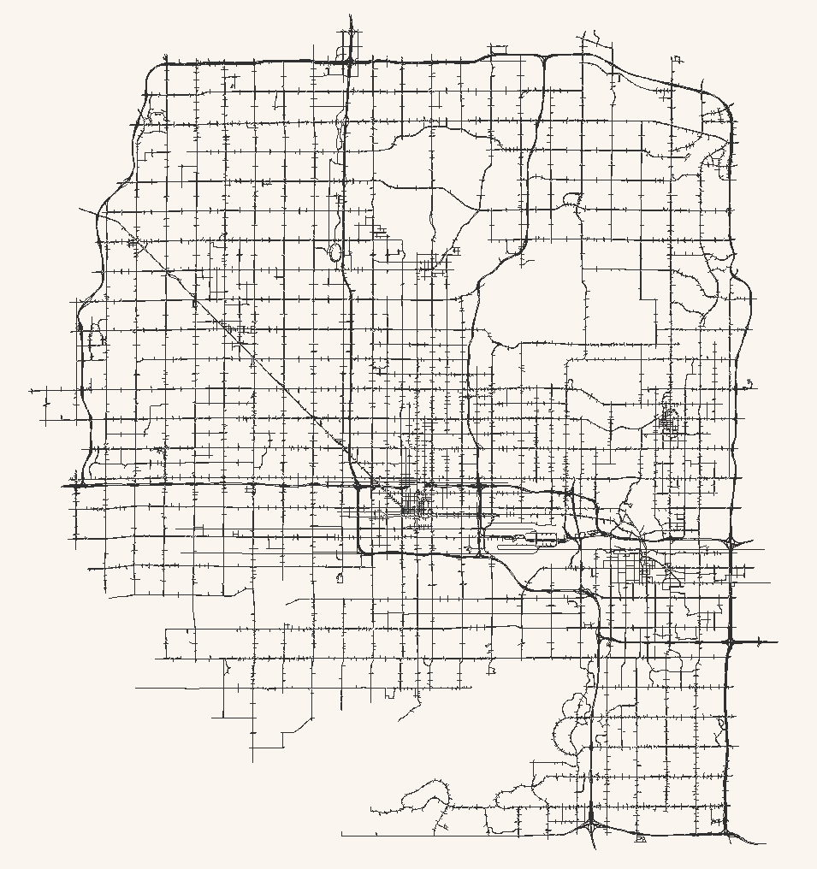
Case Study: Phoenix, AZ (1/5)
Central Phoenix
Maricopa Association of Governments (MAG)
Spatial extent
530 sq. miles; 890 zones
17,000 nodes
23,000 links; 35,000 segments
1,800 signalized intersections
AM peak period
6:00-9:00 AM
812,000 trips

Slide 12
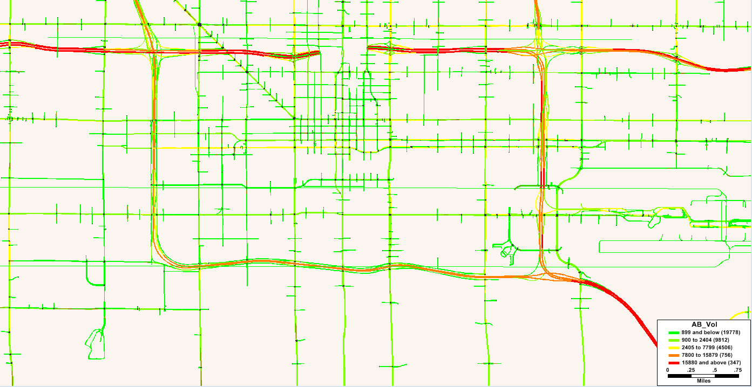
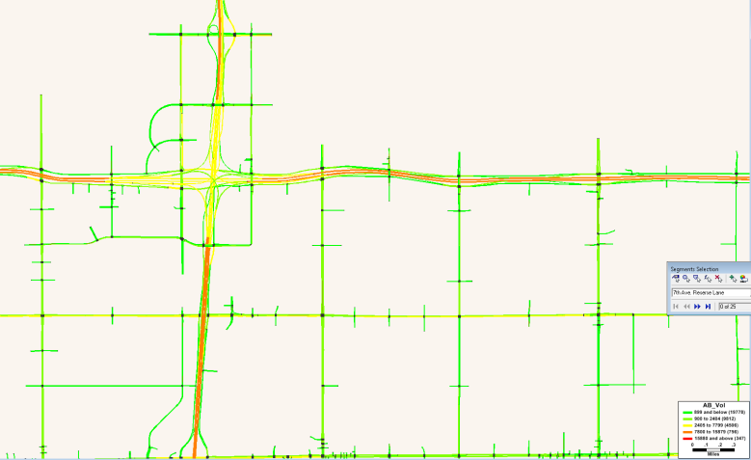
Case Study: Phoenix, AZ (2/5)
Micro model calibrated to match dynamic traffic count data
Time-varying demand
Congested travel times
Turn delays
Validated against INRIX speeds
Calibration and validation in subsequent presentation

Slide 13
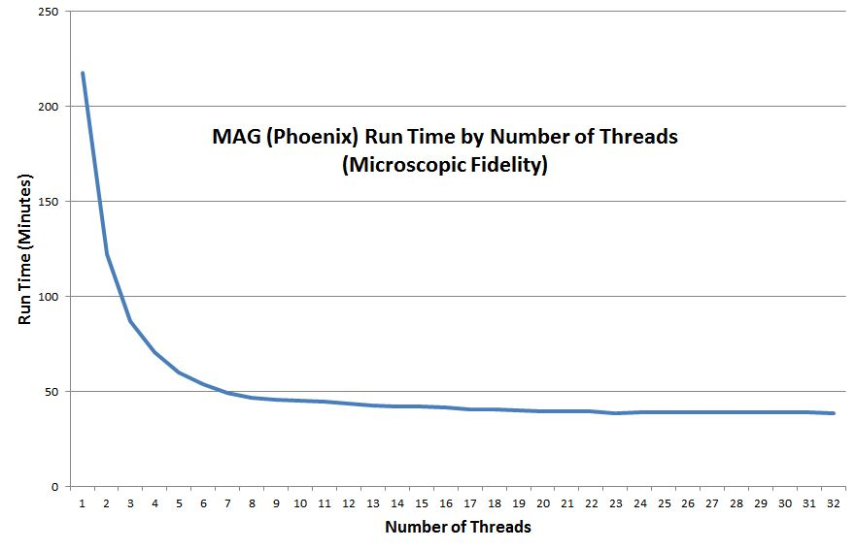
Case Study: Phoenix, AZ (3/5)
Micro fidelity run times
3.1 GHz Intel Xeon Dual Core 64-Bit CPU, 64 GB RAM
Averages from five replications

Slide 14
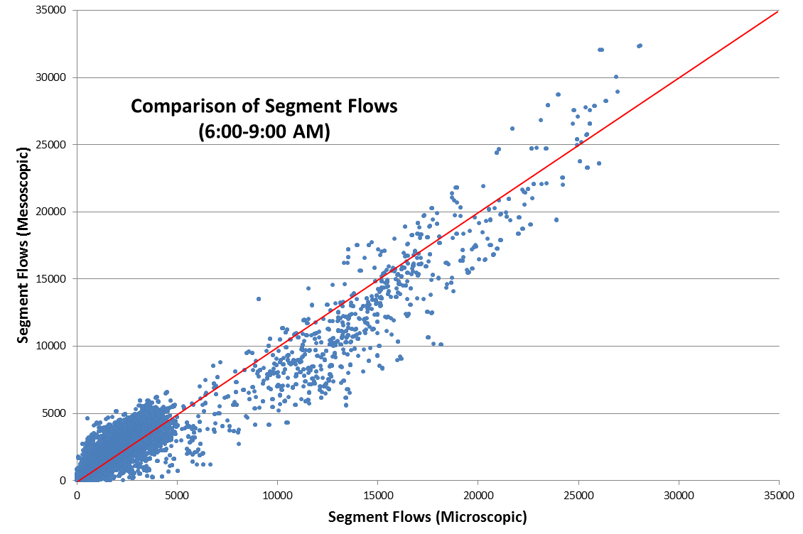
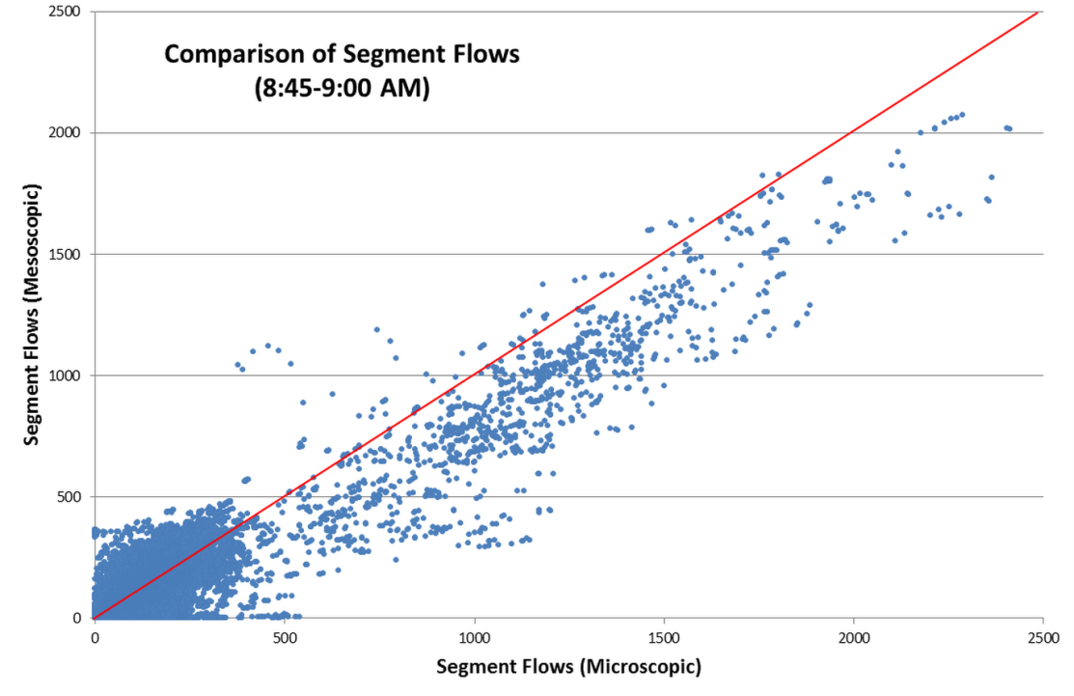
Case Study: Phoenix, AZ (4/5)
Comparison of segment flows
Default node delay calculations in meso
Indicates need for further capacity calibration in meso

Slide 15
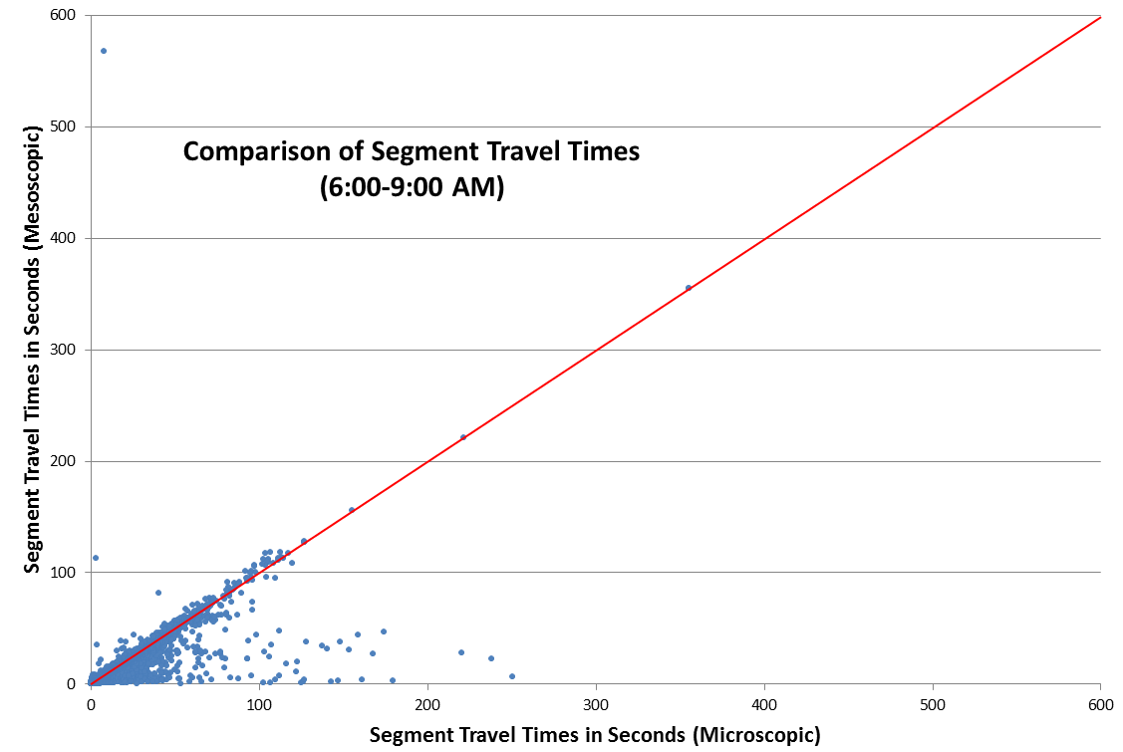
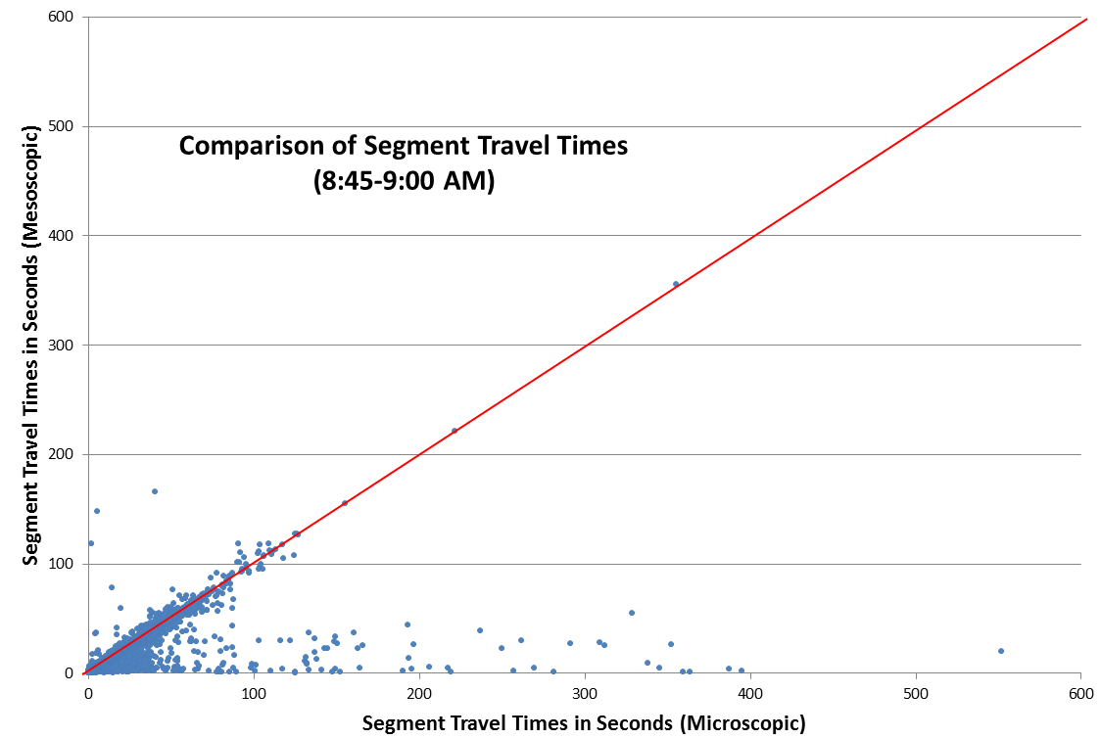
Case Study: Phoenix, AZ (5/5)
Comparison of segment travel times
While meso is close, micro provides output fidelity

Slide 16
Conclusion
TransModeler
Objective platform for comparing fidelities
Microscopic fidelity
Feasible for planning applications
Practical run times on desktop hardware
Provides detail for modeling emissions, tolls, etc.
Additional calibration burden for meso
Needs more work to bring supply closer to reality
Next steps: more tests
Compare queue lengths, point-to-point travel times
Test different meso delay models
Quantify variance from multiple runs

