Slide 1
Real-Time Speed and Delay Data Comparisons Using Hand Held Devices, Mobile Applications, and Web Published Maps
TRB National Transportation Applications Conference
Bryson Koziell, GISP
Ram Maddali, PE
Yagnesh Jarmarwala, PMP
May 6, 2013

Slide 2
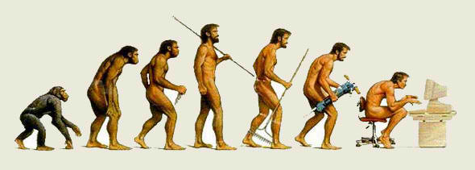
Technology is Evolving Rapidly…
GIS and Mobile Applications Capabilities Growing
Feed Data to “Any” Device in Any Location
Collect Data and Analyze in GIS
Key Tools to Support Travel Demand Modeling

Slide 3
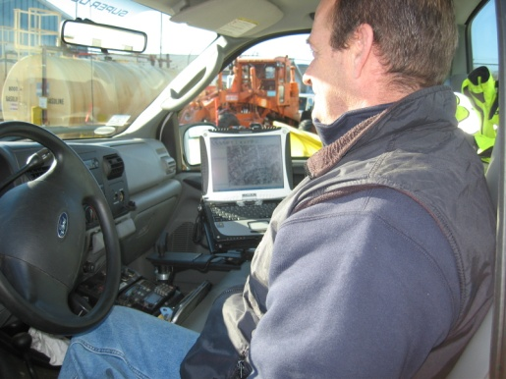
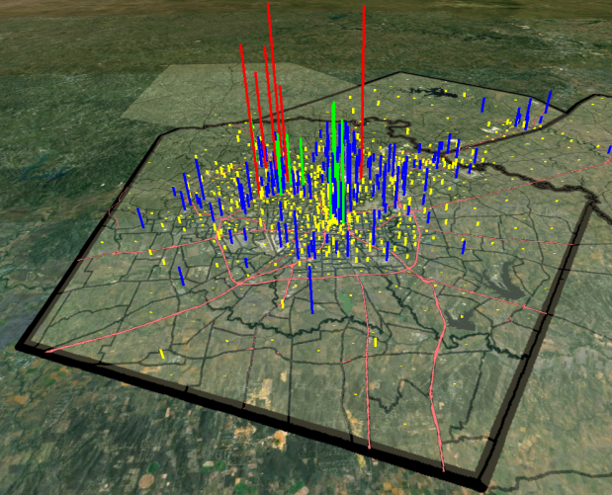
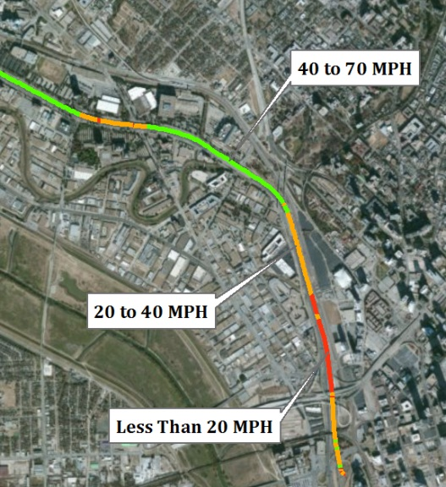
This Evolution Opens Up New Opportunities… Beyond Mapping
Real-Time Data Collection
Historical and current data availability
Enhanced Data Display and Analysis
Feed models
Planning
Population
Workforce Statistics

Slide 4
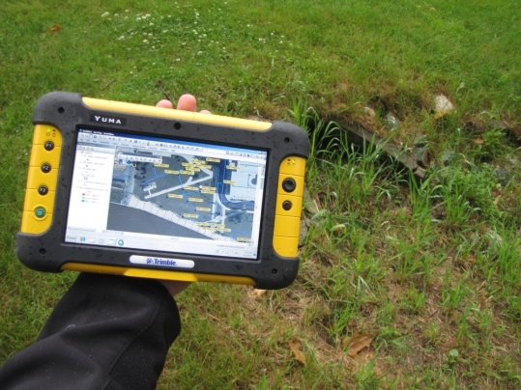
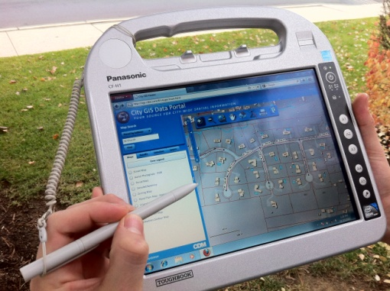
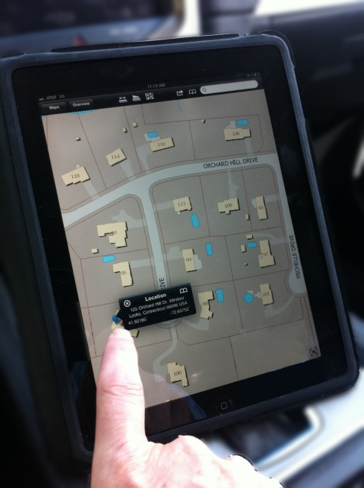
Hardware Trends Supporting Data Collection
Many New Devices
GPS Receivers, Trimble Yuma
iPad, iPad Mini, iPhone applications
Ruggedized Field Computers
Smart Phones
Choose Your Weapon Carefully
Considerations: Users, Field Conditions, GPS Accuracy

Slide 5
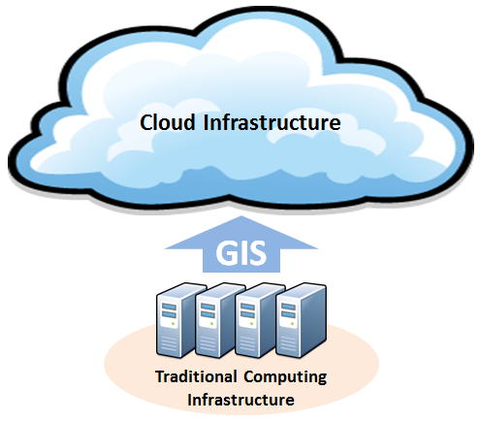
Applications Supporting Traffic Data Collection
ArcGIS Online
Maps and Applications
World Traffic Service
Store and Collect Data
Use on any platform

Slide 6
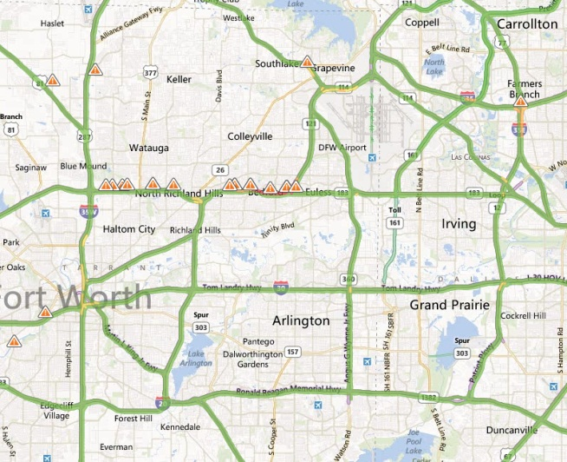
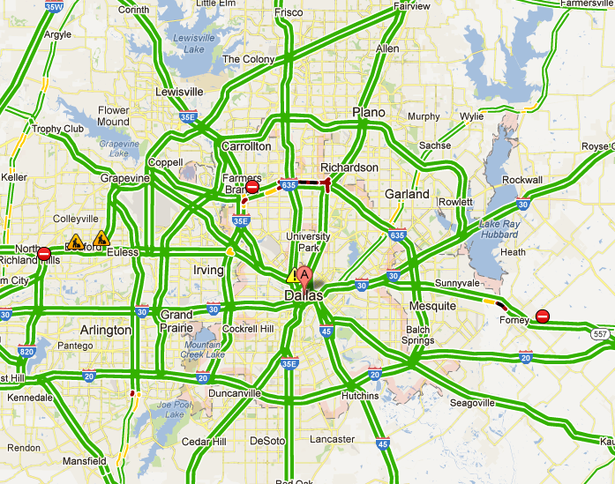
Applications Supporting Traffic Data Collection
Bing
Google
Waze

Slide 7
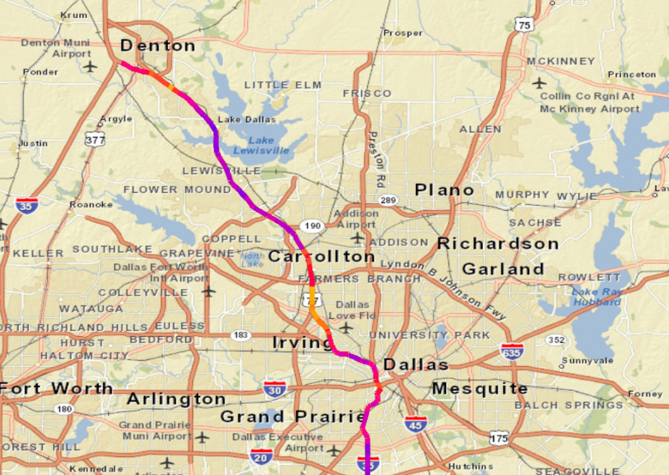
Data Sources Supporting Traffic Data Collection
INRIX
Historic Traffic Data
.csv format
Easily converted into GIS
Waze
Data collected by users
Current traffic conditions

Slide 8
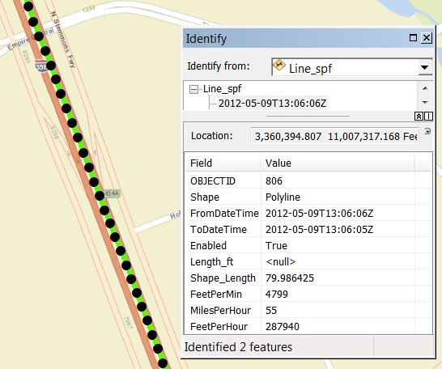
Case Study – Dallas Texas
Mobile Application Used to Collect Traffic Data
Drivers sent out in intervals
Traffic Data Fed to GIS
GIS Used to Analyze and Display
Results Compared
INRIX
Google
Field data compared to model results

Slide 9
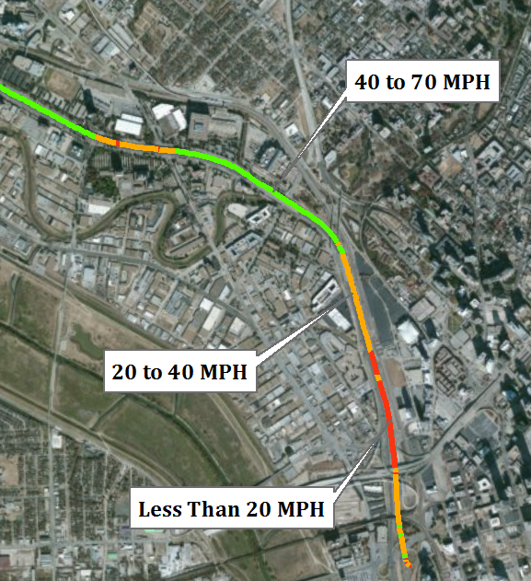
Case Study – Dallas Texas
Mobile Application Used to Collect Traffic Data
Drivers sent out in intervals
Traffic Data Fed to GIS
GIS Used to Analyze and Display
Results Compared
INRIX
Google
Field data compared to model results

Slide 10
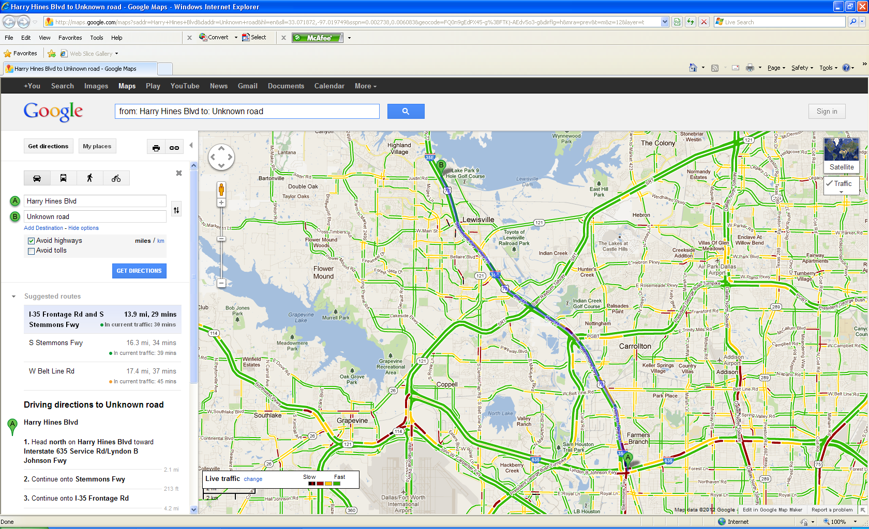
Case Study – Dallas Texas Data Comparison
Google – May 9, 2012, 8:00 AM

Slide 11
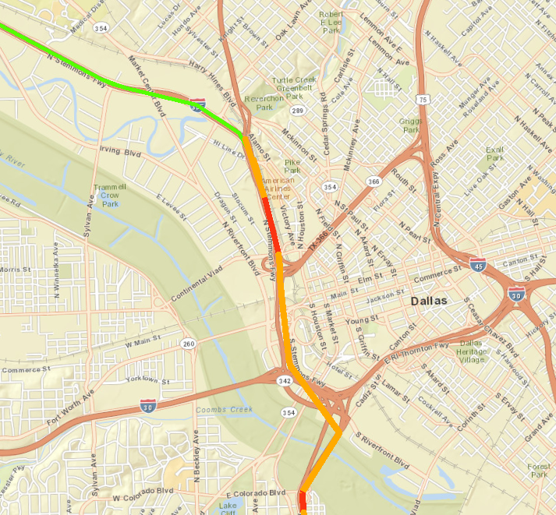
Case Study – Dallas Texas Data Comparison
INRIX – May 9, 2012, 8:00 AM

Slide 12
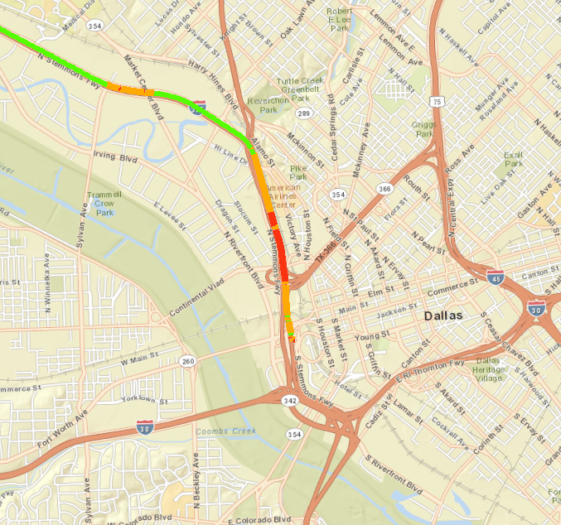
Case Study – Dallas Texas Data Comparison
CDM Smith Application – May 9, 2012, 8:00 AM

Slide 13
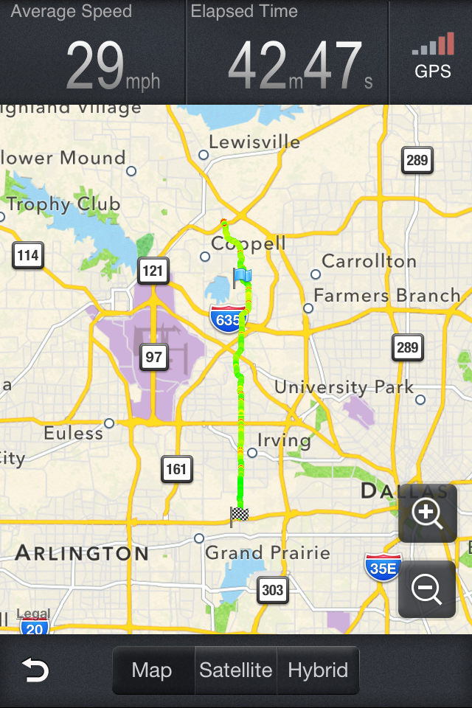
Advantages/Disadvantages of Different Data Collection Methods
Google/Bing
Historical Data
ArcGIS Online
“Out of Box” and Custom Applications

Slide 14
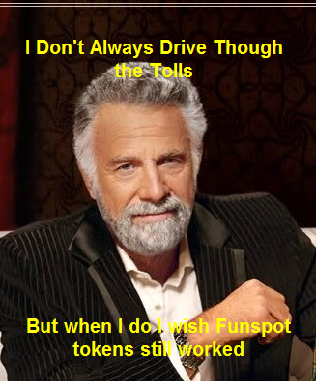
Comments and Opinions
Typically “Small Investment, High Return”.
This is Not Rocket Science
Base GIS Software Has These Capabilities
Leverage GIS to Enhance Model Accuracy

Slide 15
Questions and Contact
Contacts: Bryson Koziell, GISP Group Leader/Project Manager
Koziellbj@cdmsmith.com
Ram Maddali, P.E., Project Manager
maddalirs@cdmsmith.com
Yagnesh Jarmarwala, PMP, Project Manager
jarmarwalaym@cdmsmith.com

Slide 16
Speed and delay data collection planning

