Slide 1
Dynamic assignment with departure time choice
Steve Perone, Portland
Chetan Joshi, Portland
Jingtao Ma, Portland

Slide 2
outline
Macroscopic Dynamic Assignment Model
Departure Time Choice
Application – Portland Metro Area
Remarks

Slide 3
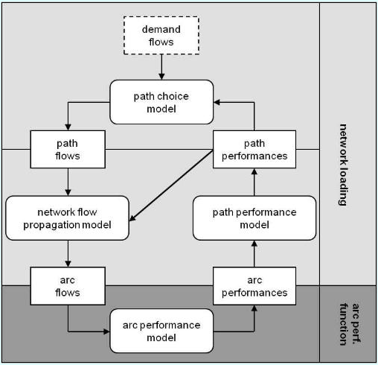
overview
Macroscopic Dynamic Assignment Model
Aimed at solving the Within-Day Dynamic Traffic Assignment (WDDTA) on link networks addressing explicitly the simulation of queue spillovers
Temporal profile approach: Value variables determined as a function of time for the entire period of analysis
Spill-back can be modeled explicitly simply by switching between two alternative network performance models
The path choice model can adopt either a deterministic view or a Probit view to reflect subjective user perceptions
- Gentile G., Meschini L., Noekel K. (2006) Dynamic User Equilibrium – DUE

Slide 4
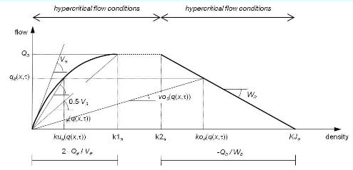
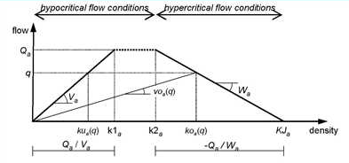
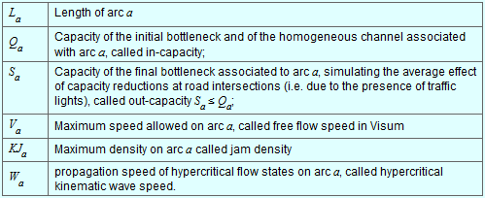
Traffic flow model
Macroscopic Dynamic Assignment Model
Based on Simplified Theory of Kinematic Waves (STKW) with parabolic-trapezoidal and trapezoidal fundamental diagrams
Links are characterized by:

Slide 5
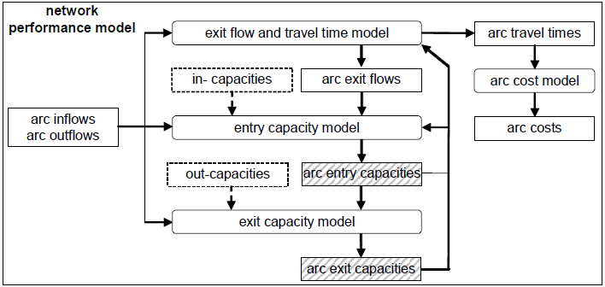
Junction capacity and queuing
Macroscopic Dynamic Assignment Model
Network performance model captures queuing (FIFO) and spillback and is specified as circular chain of three models solved iteratively:
- Fixed point network performance model

Slide 6
Model specification
Departure Time Choice
Departure time choice model based on original specification by Vickrey and integrated into the overall assignment process.
Cost = a*toll + b*journey time[h] + c*DeltaT(early)[h] + d*DeltaT(late)[h]
where:
a = coefficient for road toll
b = coefficient for travel time
c = coefficient for an early arrival
d = coefficient for a late arrival

Slide 7
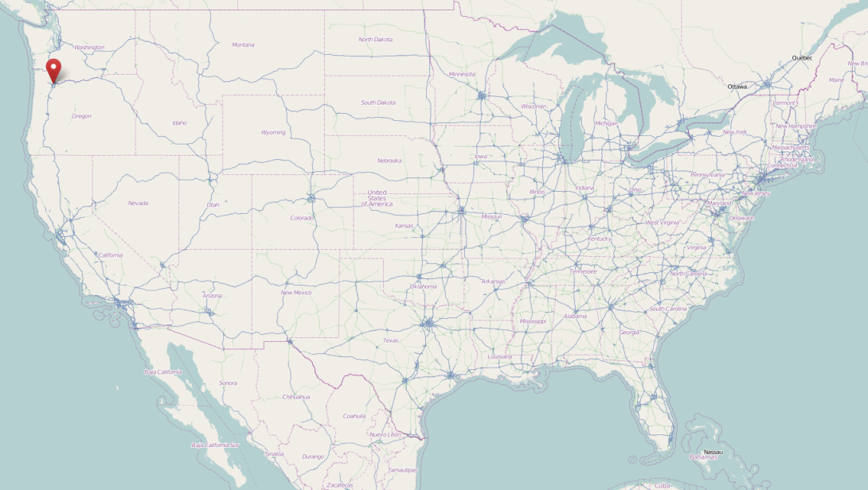
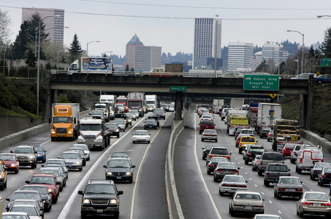
Model area
Application – Portland Metro Area
Portland Metro Area (Oregon)
Area(City): 145.09 sq mi
Population (Metro): 2,260,000
Major Highways: I-5, I-84, I-205, I-405, US 26

Slide 8
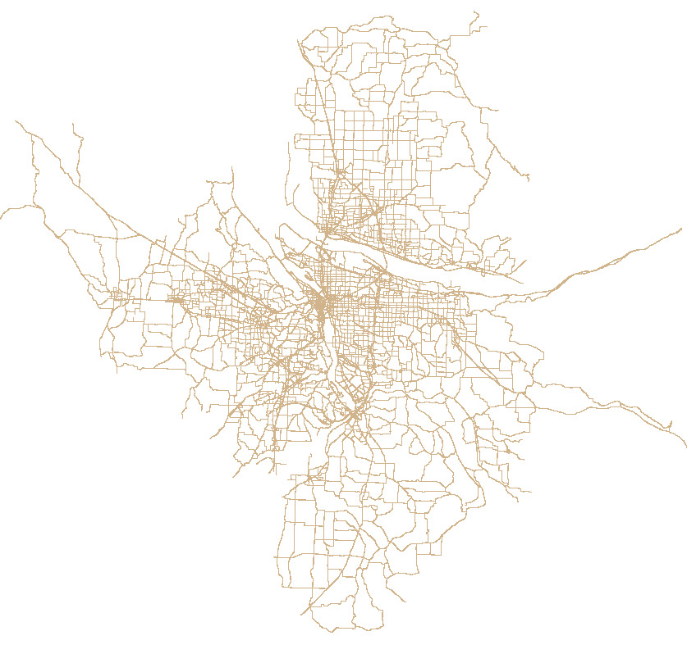
Model network and demand
Application – Portland Metro Area
Base network and demand developed by Portland Metro (Peter Bosa et al.)
Network summary:
Zones: 2,162
Links: 38,228
Nodes: 15,638
Intersection control:
    Two way stops/yields: 1751
    All-way stops: 395
    Signals + ramp meters: 2221
Demand summary:
Demand classes: HOV, SOV
Total PCE demand: 833,130
Modeling period: 4:00 pm to 6:00 pm
Analysis intervals: 10 minutes

Slide 9
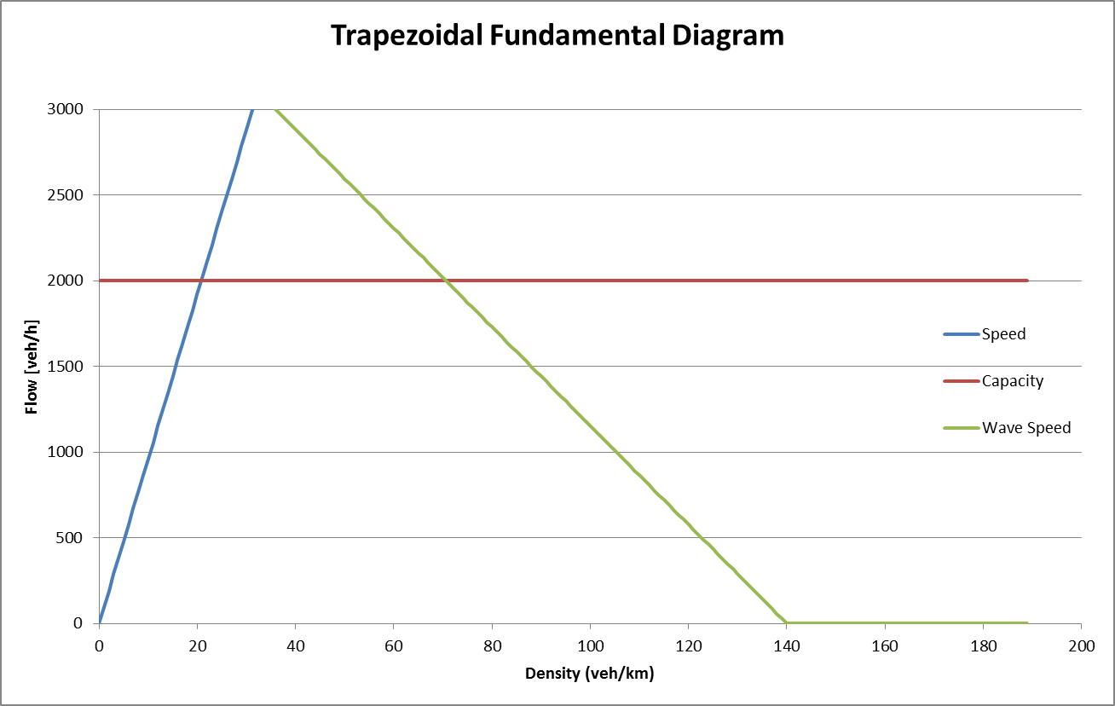
Network capacities
Application – Portland Metro Area
Link capacities (max flow rate) based on link speeds (posted speed limits):

Slide 10
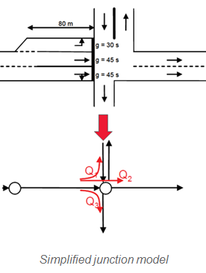
Network capacities
Application – Portland Metro Area
Approach/Exit capacity model:
Signals:
  Exit capacity = Approach link capacity * (0.55) [factor]
All-way/Two-way stops:
  Exit capacity (stopped leg) = Approach link capacity *(0.5) [factor]
  **factor typically lower for stop controlled intersections due to acceleration/deceleration involved in compulsory stopping

Slide 11
Network capacities
Application – Portland Metro Area
Approach/Exit capacity model:
Signals:
  Exit capacity = Approach link capacity * (0.55) [factor]
All-way/Two-way stops:
  Exit capacity (stopped leg) = Approach link capacity *(0.5) [factor]
  **factor typically lower for stop controlled intersections due to acceleration/deceleration involved in compulsory stopping

Slide 12
Departure time choice parameters
Application – Portland Metro Area
Literature on previous work done by Vickrey, Small, Mahmassani…
Generalized cost given by:
Cost = {a*toll + b*journey time[h] + c*DeltaT(early)[h] + d*DeltaT(late)[h]}*
where:
a = coefficient for road toll (not used)
b = coefficient for travel time (6.4 $/h**)
c = coefficient for an early arrival (3.9$/h**)
d = coefficient for a late arrival (15.21$/h**)
*Vickrey W.S
**Small K.A, Noland R.B

Slide 13
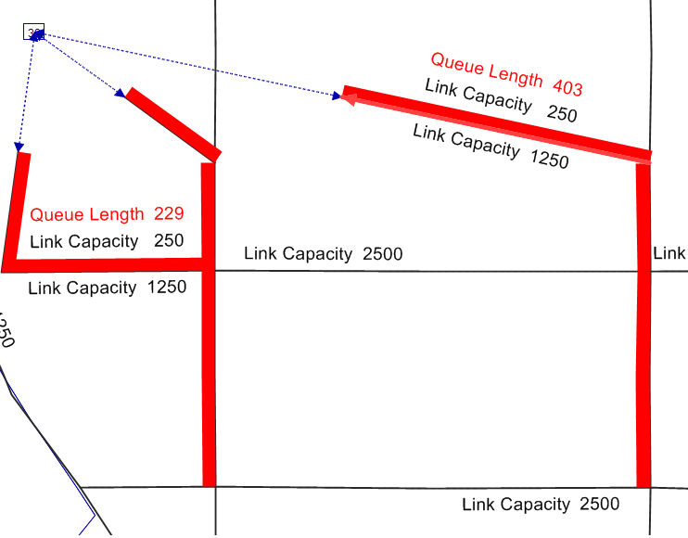
Model troubleshooting and validation
Application – Portland Metro Area
Vertical queuing allows identification of bottlenecks and possible gridlocks…

Slide 14
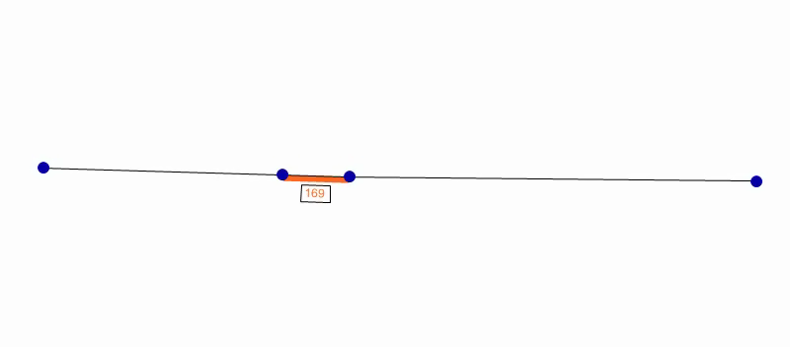
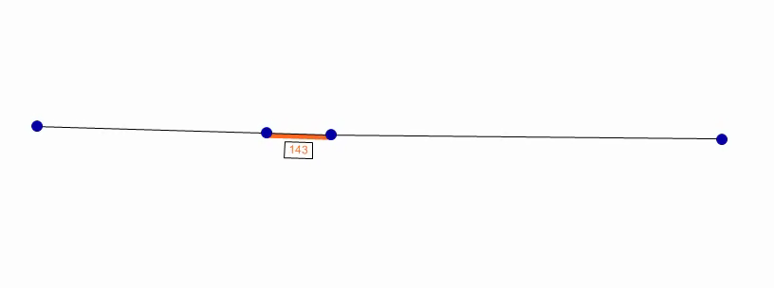
Model troubleshooting and validation
Application – Portland Metro Area
Vertical queuing allows identification of bottlenecks and possible gridlocks…
Vertical Queue
Horizontal Queue

Slide 15
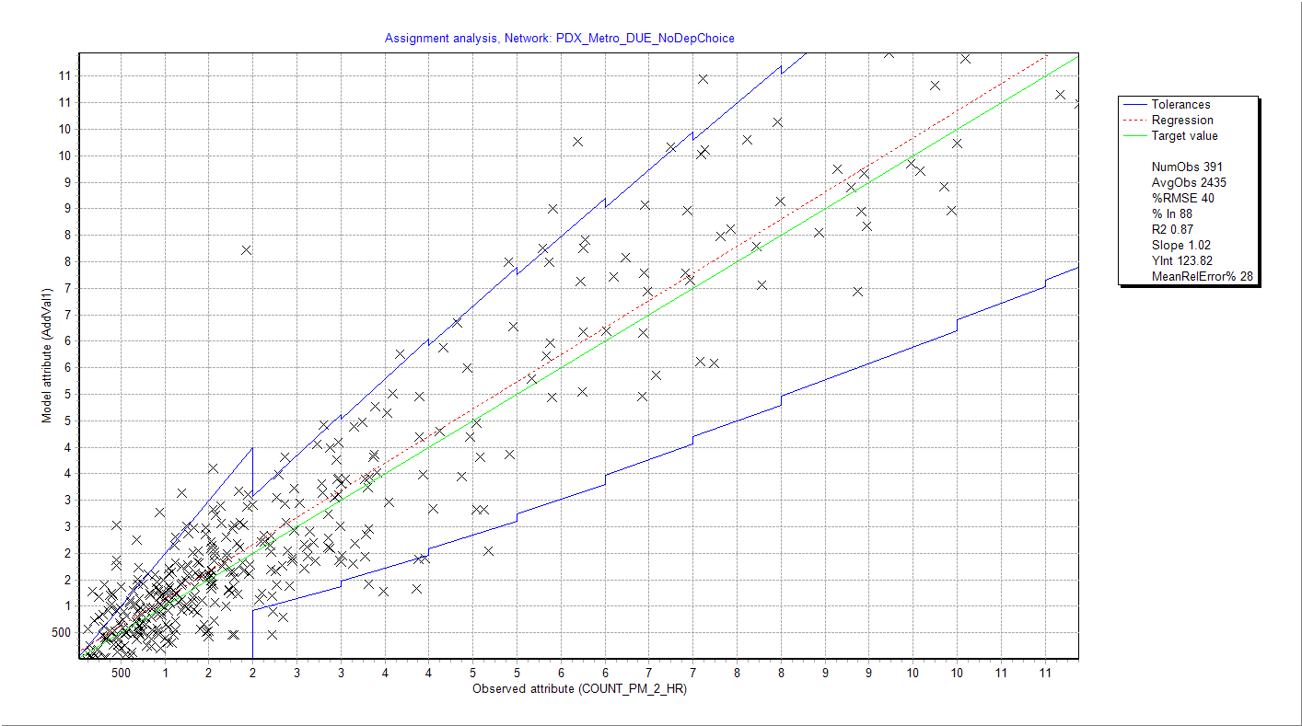
Model troubleshooting and validation
Application – Portland Metro Area
Overall flows for 2 hr period across key freeway/ramp locations were validated

Slide 16
scenarios
Application – Portland Metro Area
Two scenarios tested against a base condition
Base, no departure time choice with flat demand profile
Departure time choice with no early departure shoulder
Departure time choice with early departure shoulder starting 1 hr before peak

Slide 17
scenarios
Application – Portland Metro Area

Slide 18
Assignment convergence
Application – Portland Metro Area

Slide 19
remarks
Subline/Navigation
Network coding effort significantly less (close to static assignment network coding)
Implicit path enumeration requires significantly less resources (max memory footpint for the PDX network < 3GB)
Capacity calculation methods are scalable
Demand classes need to be defined differently to capture flexibility in schedules (eg. based on employment type)
Departure time choice integration is possible within assignment, but equilibrium is difficult to achieve given the degrees of freedom.
Assignment method is not multi-threaded, multi-threaded version of the assignment method will be much quicker.

Slide 20
credits
Subline/Navigation
Base network and demand data:
Portland Metro (Peter Bosa et al.)
Assignment parameters (explanation of math):
Klaus Noekel, Ingmar Hofsäß, Anett Ehlert

Slide 21
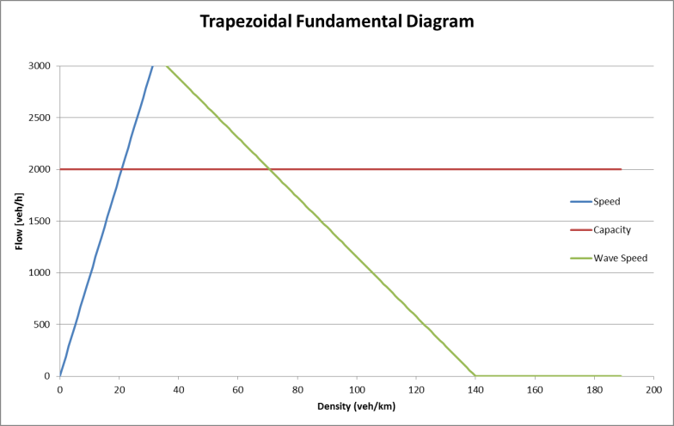
Network capacities
Application – Portland Metro Area
Link capacities (max flow rate) based on link speeds :
Approach/Exit capacity model:
Signals/All-way stops:
  Exit capacity = Approach link capacity * factor
Two-way stops/yields:
  Exit capacity (stopped leg) = Approach link capacity * factor
  **factor typically lower for all-way stops due to acceleration/deceleration involved in compulsory stopping

Slide 22

www.ptvag.com

