Slide 1
The Evolving Needs Challenges and Experiences in Statewide Modeling
Alan Horowitz
University of Wisconsin -- Milwaukee

Slide 2
Some Personal Hands-On
Involvement
Wisconsin RADIUS
Two large networks
  I-39 from N Central IL to Madison WI
  I-94 from NE IL through Milwaukee past
  Madison
Simulated dynamically, using a “refined”
OD table (by hourly traffic counts)
from a 3-step model based on
NCHRP 365.

Slide 3
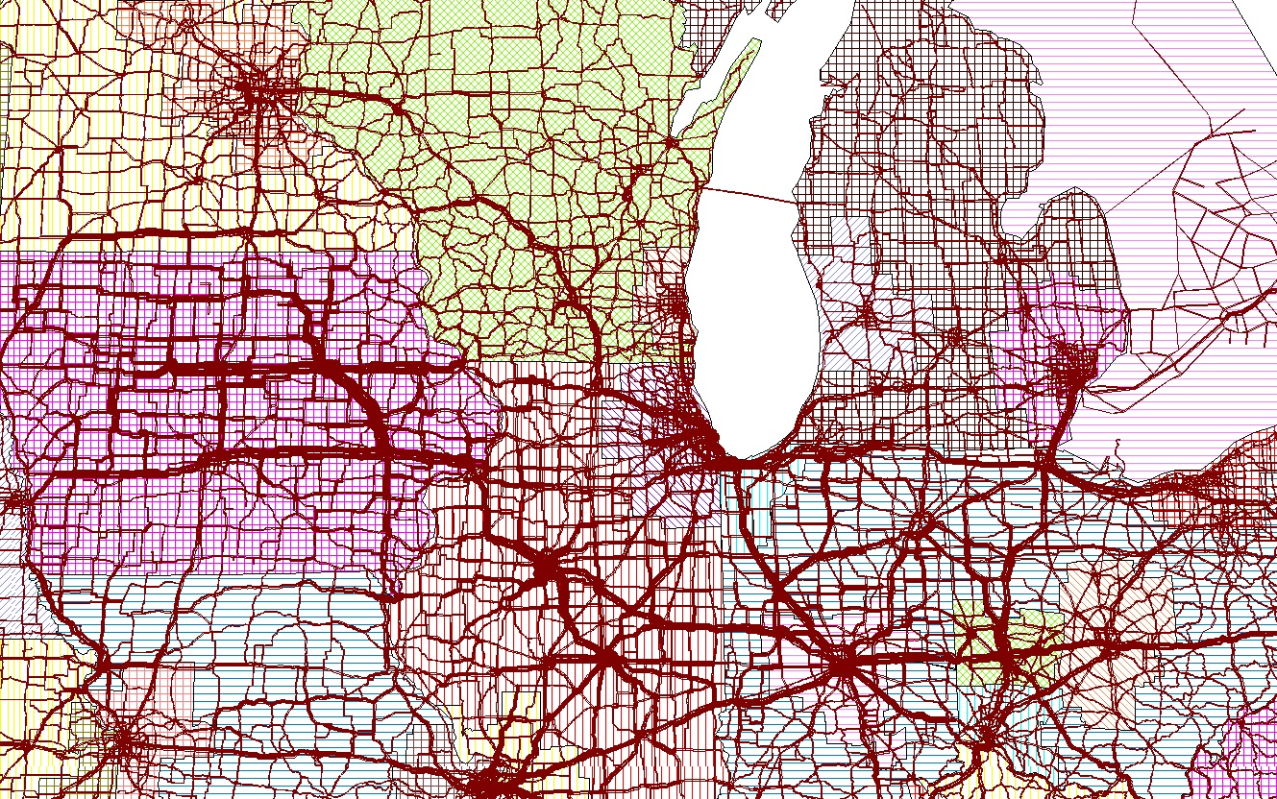
And…
MAFC Microsimulation Truck Model
Basic unit is a shipment “tour”
Exceptionally high degree of
precision:
  Actual establishment locations
  for origins and destinations
  (no TAZs)
  Commodities at 3-digit SCTG
  Industries at 5-digit NAICS
  DTA at 1 hour time slices

Slide 4
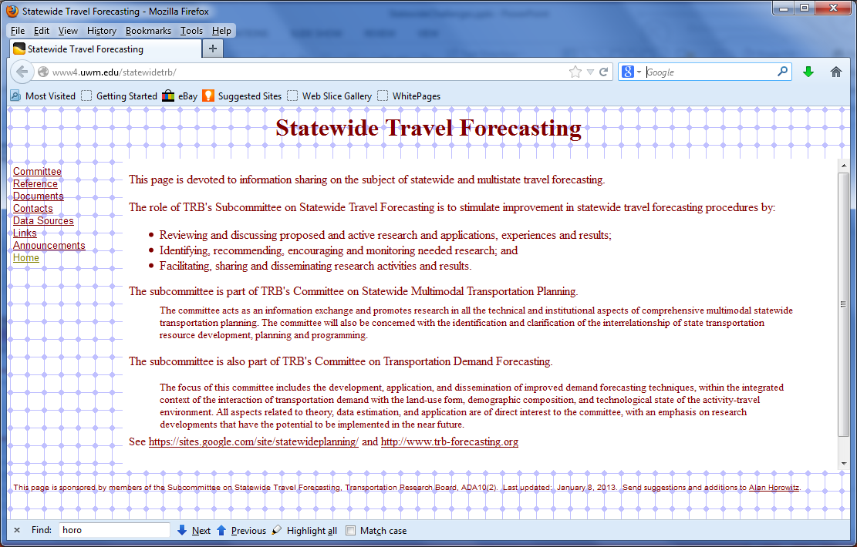
Statewide Travel Forecasting Web Page

Slide 5
Resources: Recent NCHRP Studies
NCHRP Report #735: Long-Distance and Rural Travel Transferable Parameters for Statewide Travel Forecasting Models
NCHRP Report #716: Travel Demand Forecasting: Parameters and Techniques
NCHRP Project 836-B Task 91 Final Report: Validation and Sensitivity Considerations for Statewide Models
NCHRP Project 08-36 Task 70: National Travel Demand Forecasting Model
NCHRP Synthesis 358: Statewide Travel Forecasting Models
NCHRP Report 606: Forecasting Statewide Freight Toolkit

Slide 6
FHWA Follow-up on National Model
National long distance OD matrix
  100 miles or greater
  Multimodel: bus, air, rail, auto
  Forecasts to 2040
  Maybe about 240 zones
  Contact for more info: Tianjia Tang, Danny Jenkins, presentations here.
Exploratory study for a National Travel Model
  Contact for more info: Tianjia Tang, Brad Gudzinas
Exploratory study for a new long distance travel survey
  Contact for more info: Tianjia Tang, Patrick Zhang

Slide 7
Latest Whitepaper
NCHRP Project 08-36, Task 76c White Paper: Statewide Travel Demand Forecasting, Prepared for: “Meeting Federal Surface Transportation Requirements in Statewide and Metropolitan Transportation Planning: A Conference”, 2008. (Modest update to NCHRP Synthesis 358)

Slide 8
Status of Statewide Models, 2008

Slide 9
Many, many unfinished agenda items
Most major recommendations from the Peer Exchange in Longboat Key have been accomplished, see TRB E-C075.
  Follow-on to the Irvine Conference in 1999, TRB E-C011
  Recommendations related to validation, national model, repeat of ATS, update of QRFM.
  The QRFM II update for rural and commercial: Did include some intercity data, but may have fallen short of transferable parameters; not much on commercial trip making.

Slide 10
Research Agenda Items from Synthesis
Because of long rural trips, most current models are incapable of correctly modeling peak periods, so traffic assignments require improved ways of dealing with traffic dynamics. (Alan’s comment: tools available, but slow)
Better methods are needed to overcome the lack of precision from coarse zone systems. (Alan’s comment: we have seen models with multiple zone structures)
Computation time continues to constrain what can be accomplished in a statewide model; faster algorithms, particularly at the traffic assignment step, are desirable. (Alan’s comment: faster algorithms have been formulated recently, all have issues; parallel computing always helps.)
Statewide models still rigidly segregate freight by mode. Research is needed regarding how to best handle intermodal shipments that span multiple modes.
Improvements are needed in knowledge of mode choice for long-distance freight, particularly in the costs of transporting freight by varying modes. (Alan’s comment: some progress, e.g., CFIRE Cost Model.)

Slide 11
More Research Agenda Items from Synthesis
There is increased interest in obtaining origin-destination tables from ground counts, but the sizes of statewide networks are daunting. Better methods, suitable for large-scale, highly detailed and multiclass models, are needed. (Alan’s comment: seriously large, parallel computers are now necessary)
Innovative methods are needed for combining existing data sources and economic models for filling-in the gaps in the Commodity Flow Survey. The potential of FHWA’s Freight Analysis Framework (FAF) for providing better commodity flow information should continue to be explored. (Alan’s comment: FAF is a valuable resource.)
There is a need for a National Business Travel Survey, analogous to the NHTS, that can shed light on business logistics practices and provide information that can lead to default commercial trip making characteristics for the QRFM.
University transportation planning curricula should be upgraded to meet the challenges of integrated transportation/land-use/economic-activity models. (Alan’s comment: TRB committees are still working on this.)

Slide 12
TRB Conference on Freight Demand Modeling
Create a national freight flow model, presumably a later generation of FAF2
Develop a freight-data architecture, leading toward a coordinated data collection effort
Create examples and case studies of how to best use secondary data sources
Make available a “microdata” set of freight-related demographic information
Update freight databases more frequently
Determine best practices in truck origin-destination collection methodologies
Create a safety post-processor.

Slide 13
Other Items from TRB’s Subcommittee on Statewide Travel Forecasting
Identify the existence, characteristics and location of data on freight movements for use in statewide travel forecasting (Alan’s comment: University of Toledo repository is a good example)
Improve passenger travel demand estimation in multimodal, statewide passenger travel forecasting models for use in the statewide transportation planning process (Alan’s comment: recent papers seen in air travel; recreational travel);
Critically review the analytical tools available to states for estimating and depicting the movement of freight over major transportation facilities
Review both current and potentially novel ways of generating both base year and forecast origin-to-destination, statewide freight movement matrices (Alan’s comment: discussed as a possible NCHRP synthesis project)

Slide 14
Most Recent Subcommittee Priorities
Update the NCHRP Synthesis
Research or update knowledge on non-household travel for statewide modeling
OD table estimation from ground counts for statewide modeling (held back pending NCHRP 8-83)

Slide 15
CFIRE’s Current Initiatives Relating to Statewide Travel Forecasting
RI-01 A Multi-Modal Freight Safety, Security, and Environmental Routing Tool
RI-04 Mining Automatic Identification Systems (AIS) Data for Improved Vessel Trip Analysis Capabilities
RI-05 Estimating the Effects of Climate Change on Transportation Infrastructure
RI-06 Realigning Multimodal Freight Networks in Response to International Capacity Expansion
RI-07 Enhancing Rail Connectivity to Underserved Rural Communities

Slide 16
My Personal Wish List
A highly detailed highway passenger vehicle OD matrix for freight routing purposes.
Methods for exploiting newer speed data bases
  Free travel time
  Volume/speed relationships;
  Understanding intersection delays; turning movement delays;
  Understanding travel time reliability.
  Convert bi-directional volumes to directional volume
  Convert 24-hour counts to single-hour counts
More research on rural path choice, particularly near work zones.

