Slide 1
Testing NCHRP 775 on a Real Dataset
Andrew Rohne
TRB Transportation Planning Applications Conference
May 20, 2015

Slide 2
What is NCHRP 775 (AKA 08-89)
Applying GPS Data to Understand Travel Behavior
Looks at using GPS Data with travel surveys
Provides code to impute trip end, mode, purpose

Slide 3
Disclaimer
This is one data point – use caution with results

Slide 4
Motivation
1st Large-Scale GPS-Only HHTS
In 2010
New NCHRP 775 in 2014

Slide 5
That Survey…
ODOT Research
2,051 Usable HHs – AI method
3 Days GPS
600 HHs Prompted Recall – 1 Day
1 Calendar Year Collection Period
August 2009-2010
2 Datasets: PR and “AI”

Slide 6
The Question…
Do the algorithms in NCHRP 775
provide better data?

Slide 7
Methodology
Get PR Data Day
Get “AI” Data for PR Day
Narrow Raw GPS data to PR Day
Run PR Day through NCHRP 775 Methods
Compare Trip Counts
Notes:
Re #5: if we got into mode, there would be 64 alternatives to look at… and we don’t want to be here all day!

Slide 8
Six Comparisons…
Filtering Algorithms
Stopher
Schussler-Axhausen
Lawson
Trip Identification Algorithms
Schussler-Axhausen
Wolf
There are mode change, mode choice, and trip purpose algorithms in NCHRP 775
Notes:
Filtering is important because if the GPS ran just 20% of the day, there would be over 17,000 points. There would be jumps, drifts, and other issues. Some of this would be known by the GPS Device – points with fewer than 3 satellites, points where the horizontal dilution of position is too great, etc.
Trip ID because if we can’t get the correct number of trips, there is no way MC can be correct.

Slide 9
The Methods: Filtering
Stopher
Remove points with <3 satellites and HDOP>=5
Remove no-movement points
Schussler-Axhausen
Remove if Altitude not within the study area
Notes:
As HDOP increases, positional precision decreases
S-A may be an issue, since elevation range in Cincinnati is around 520 feet AMSL to 900 feet (or more) AMSL

Slide 10
The Methods: Lawson Filtering
Remove if…
HDOP > 5
Num Satellites < 3
Speed < 3 m/s (6.7 MPH) (!!!)
Less than 0.00005° of movement
In Cincinnati: 18’ Latitude, 14’ Longitude
In Tampa: 18’ Latitude, 16’ Longitude
In Calgary: 18’ Latitude, 11.5’ Longitude
In Fairbanks: 18’ Latitude, 7’ 10” Longitude
Here: 18’ Latitude 14’ Longitude
Notes:
6.7 MPH is a pace of 8:57 minutes per mile. That’s a pretty decent run!
All per an Internet calculator at http://www.csgnetwork.com/degreelenllavcalc.html

Slide 11
The Methods: Trips
Schussler-Axhausen
Dwell time and activity detection based on point density
Wolf
Dwell time of 120s

Slide 12
The Methods: OKI “AI”
Proprietary method
Used PR data to train models
2 minute stop duration used in filtering
Likely Stopher method

Slide 13
NCHRP Code
Uses R for Filtering and Trip ID
Mode Change and Choice outside of R
Code is open, on Github
Easy to use once data is formatted
https://github.com/msimas/NCHRP08-89

Slide 14
R Setup
Added functions to read & format PR data
Added loop to read GPS (3+ days) and subset to trip day
Adjust to time zone & daylight savings
Wrapped in a function to run algorithms
Clustered across processor cores
Output summaries, visualizations, etc.

Slide 15
Assumptions
That the PR data is always right
That calculated values (acceleration) are OK
Notes:
The mother of all mess ups
#1 is a dangerous assumption, as is #2
The meme is Nute Gunray, a Neimoidan that was in episode I: The Phantom Menace and was blocking a trade route and ultimately unleashed the clone war on Naboo, the planet inhabited by both the Gungans (Jar Jar Binks) and humans, led by Queen Padme Amidala.

Slide 16
Filtered Out-liers
Method | |Δ Trips|>25 | is NA
AI | 0 | 0
SA.L | 2 | 2
SA.S | 13 | 0
SA.SA | 5 | 3
W.L | 1 | 2
W.S | 5 | 0
W.SA | 8 | 3
N=989 people
Notes:
What I’m about to show are many charts. The charts filter out the outlier data points. These are the outliers.

Slide 17
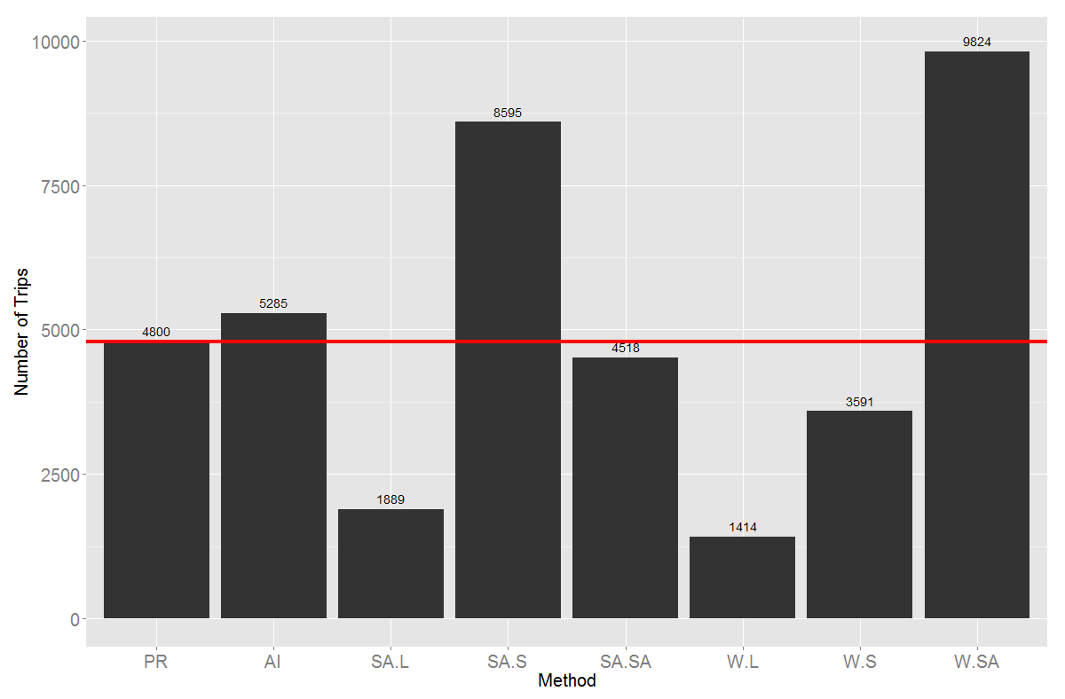
Total Trips by Method

Slide 18
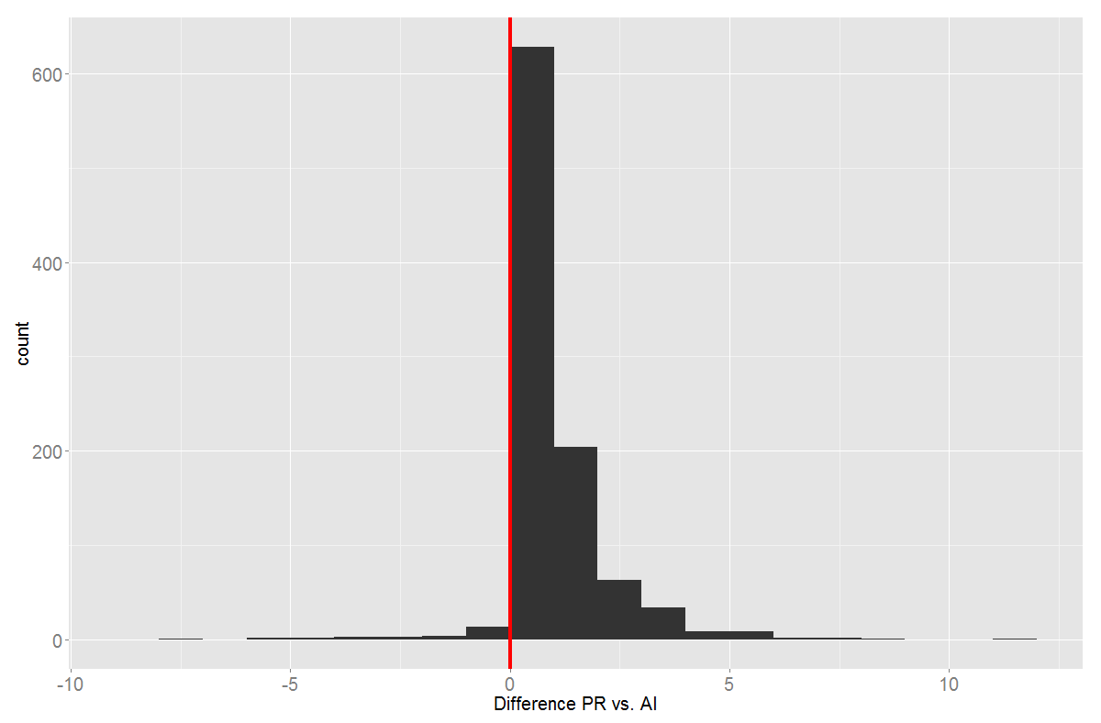
PR vs. AI
Notes:
Likely looks good because of the AI matched with intense ‘non-A and possible I’.

Slide 19
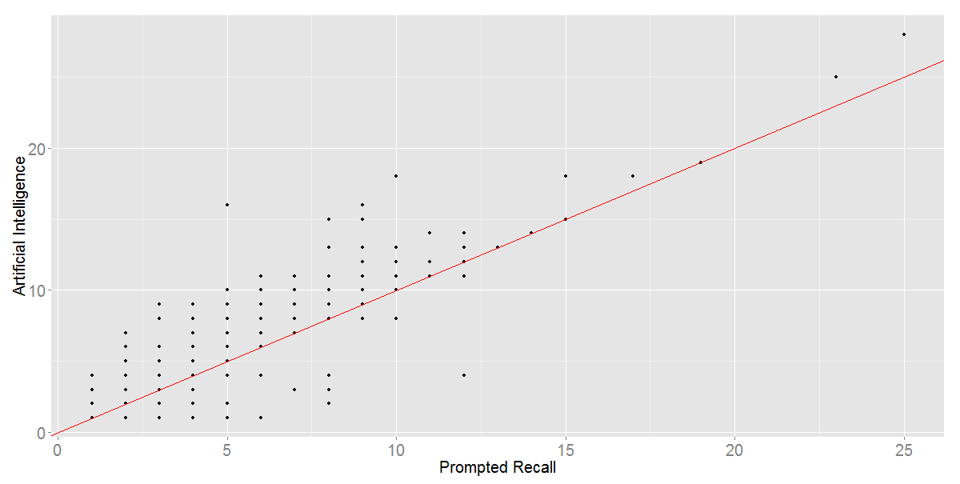
PR vs. AI

Slide 20
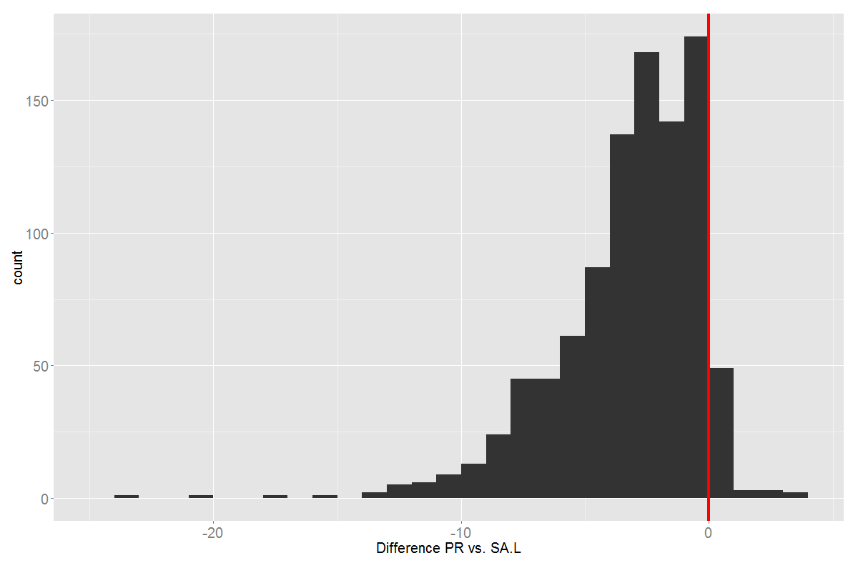
PR vs. SA Trips/Lawson Filtering
Notes:
This is Shuessler-Axhausen Trips with Lawson Filtering
Note: removed one that the algorithm predicted 756 trips (pretty sure they didn’t make 31.5 trips per hour, all day)

Slide 21
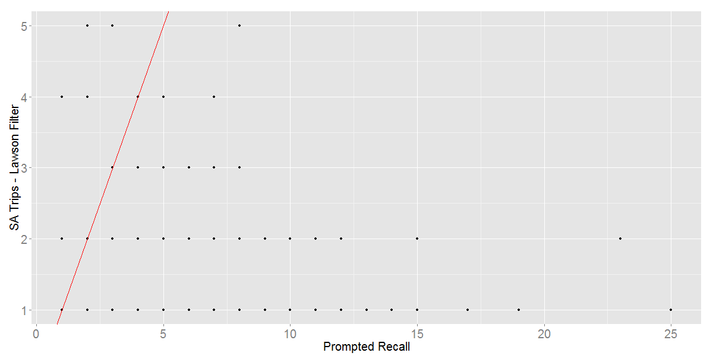
PR vs. SA Trips/Lawson Filtering

Slide 22
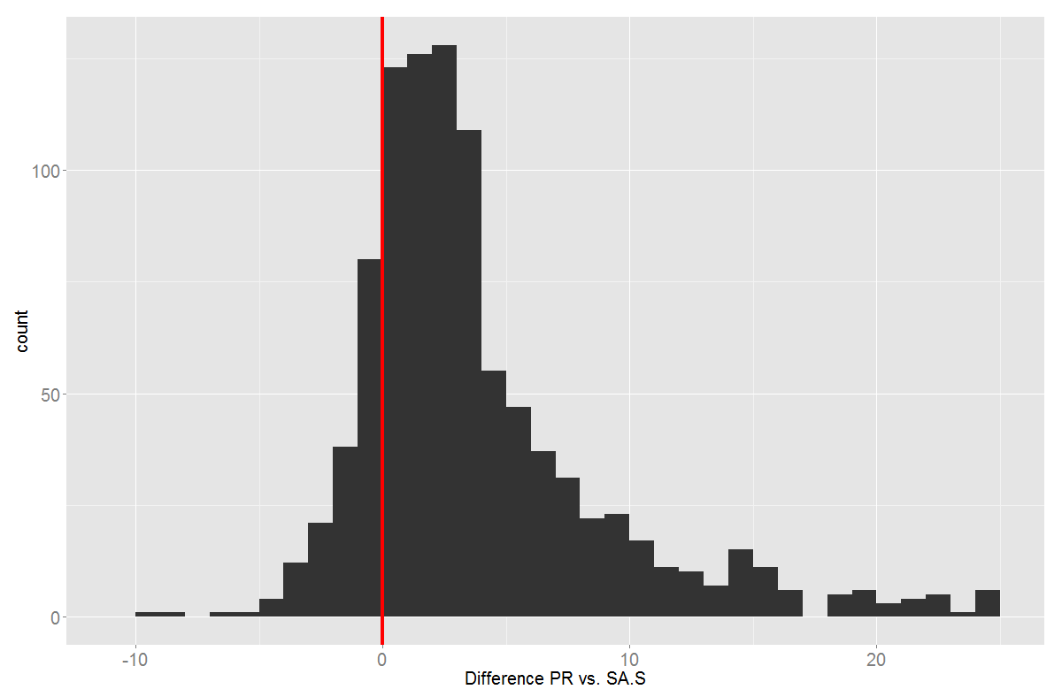
PR vs. SA Trips/Stopher Filtering
Notes:
This is Schuessler-Axhausen with Stopher Filtering

Slide 23
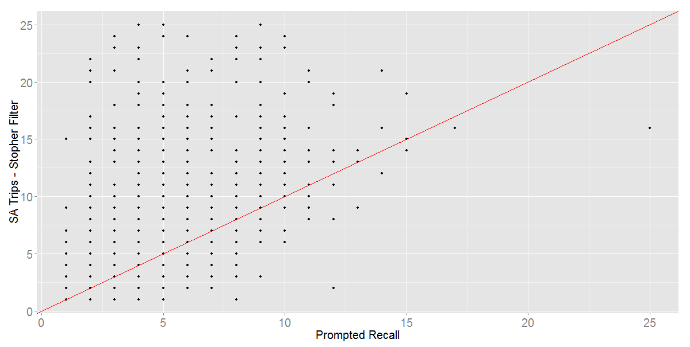
PR vs. SA Trips/Stopher Filtering

Slide 24
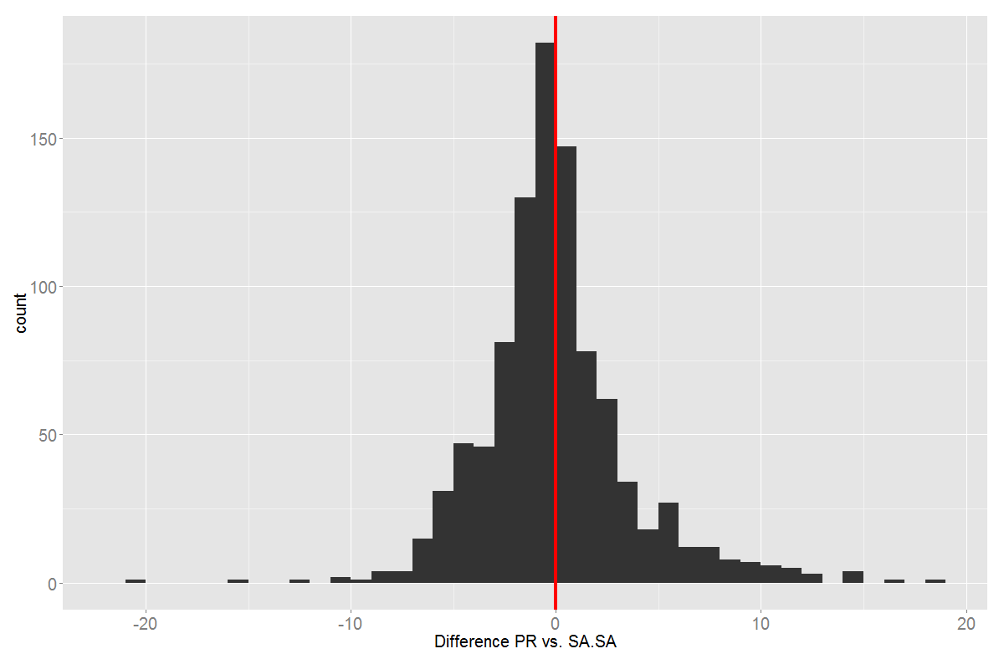
PR vs. SA Trips and Filtering

Slide 25
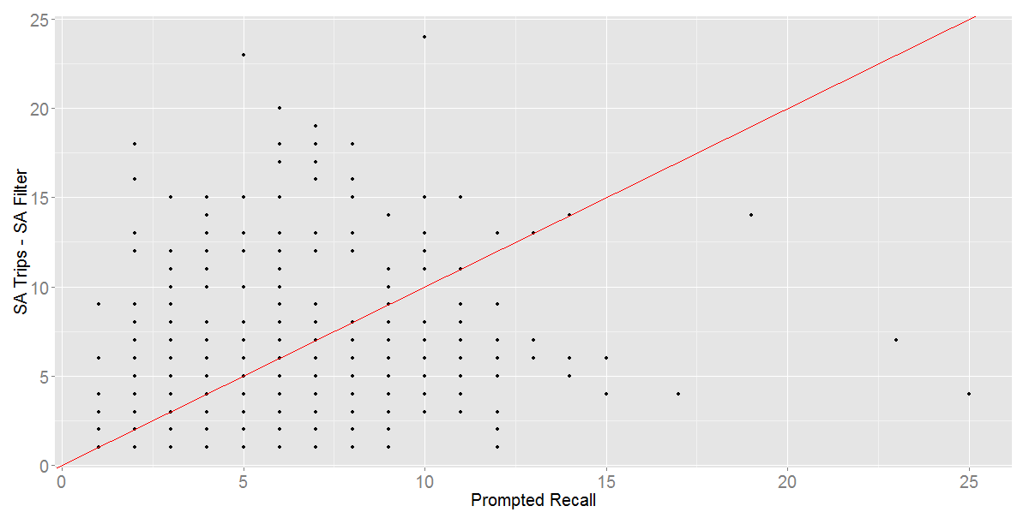
PR vs. SA Trips and Filtering

Slide 26
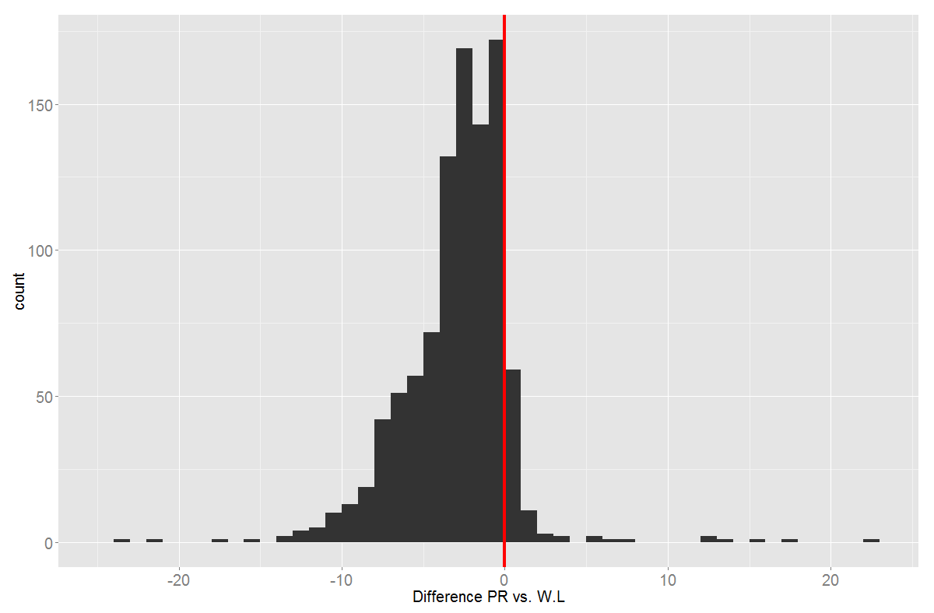
PR vs. Wolf Trips/Lawson Filtering

Slide 27
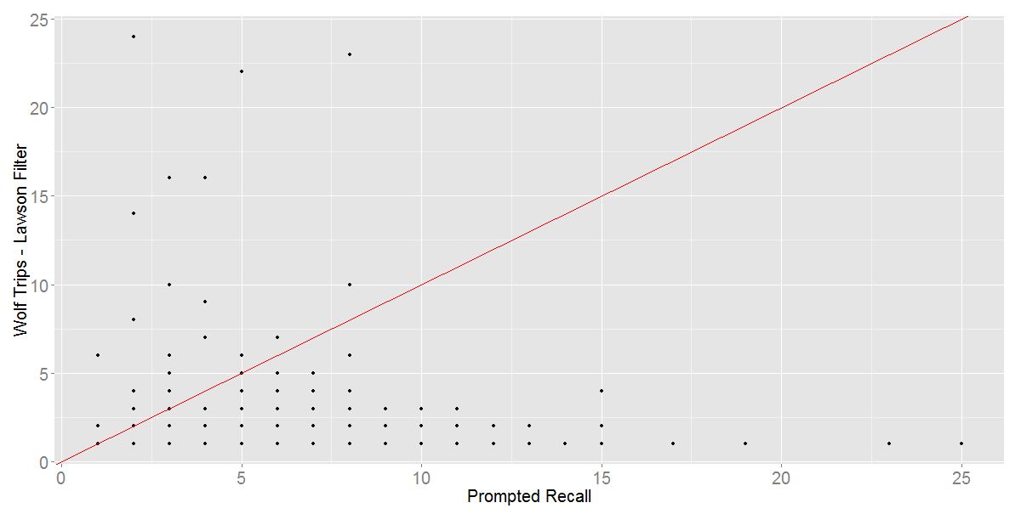
PR vs. Wolf Trips/Lawson Filtering

Slide 28
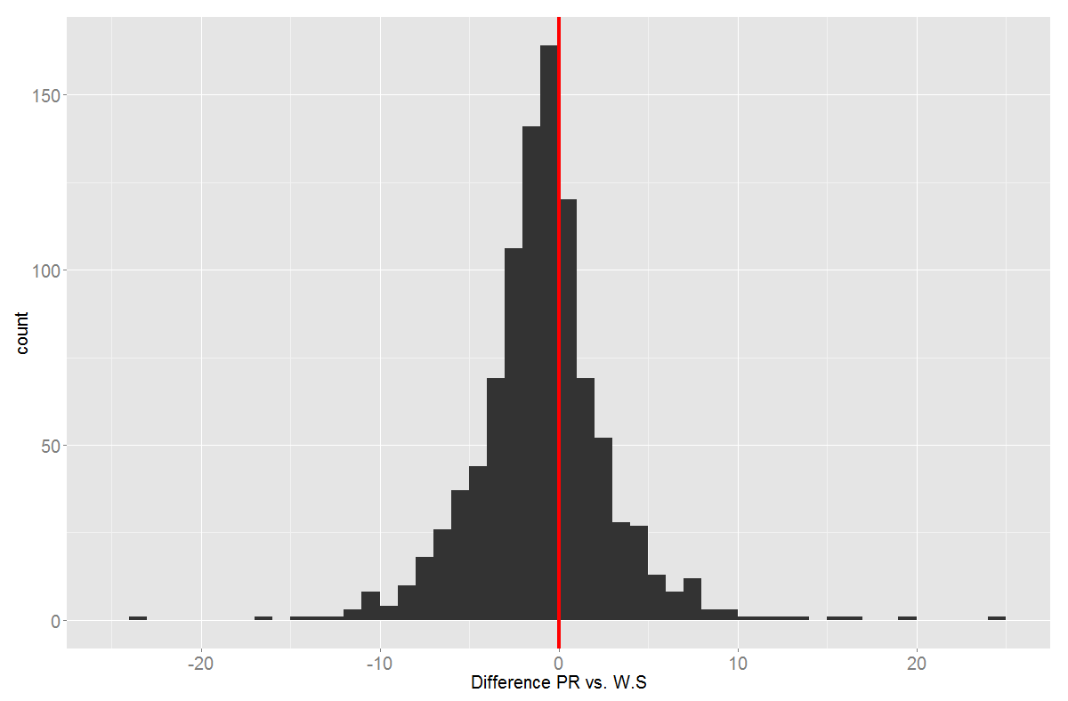
PR vs. Wolf Trips/Stopher Filtering

Slide 29
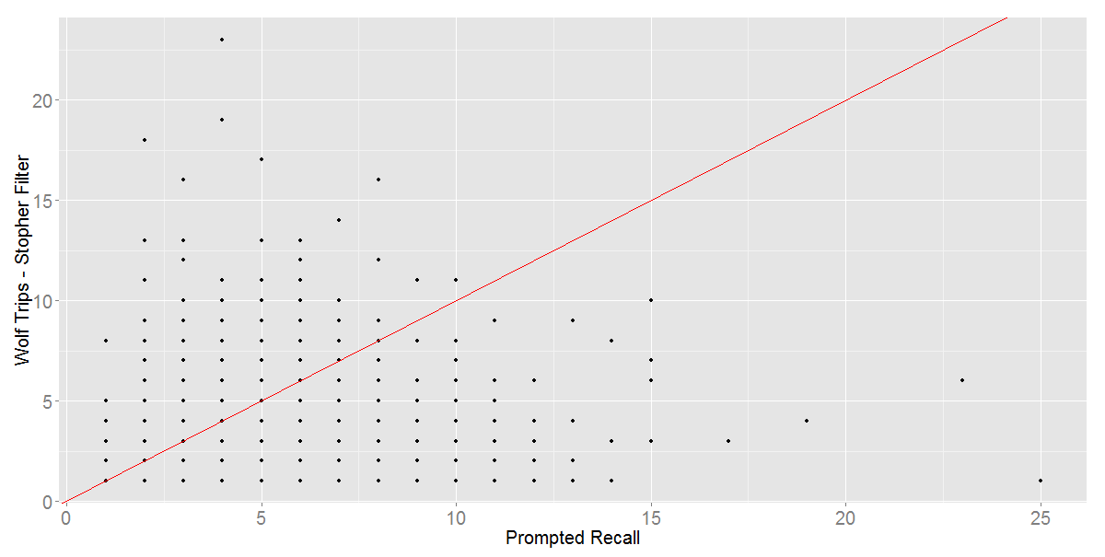
PR vs. Wolf Trips/Stopher Filtering

Slide 30
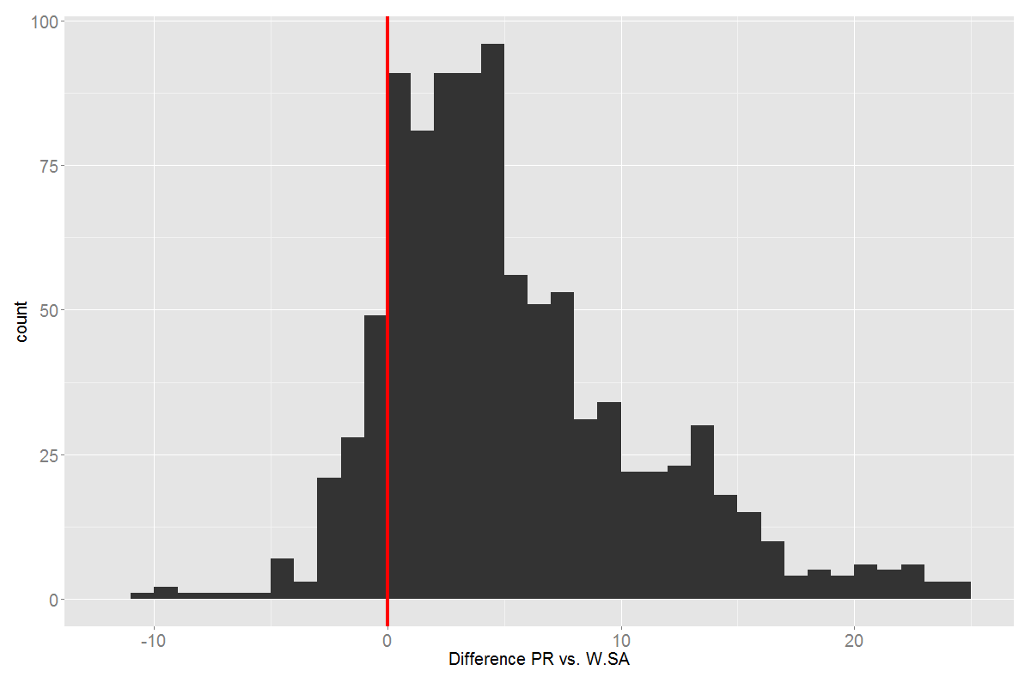
PR vs. Wolf Trips/SA Filtering

Slide 31
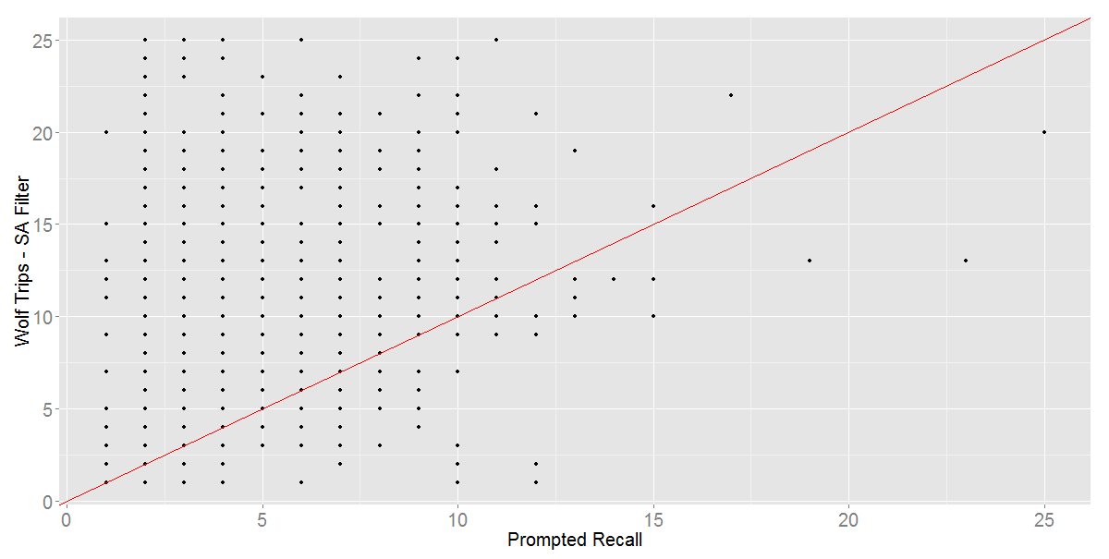
PR vs. Wolf Trips/SA Filtering

Slide 32
Overall Summary Statistics
Method | R2 | RMSE | AAE
AI | 0.917 | 1.345 | 0.643
SA.L | -0.021 | 24.515 | 4.534
SA.S | 0.468 | 7.665 | 4.514
SA.SA | 0.280 | 4.659 | 2.880
W.L | 0.005 | 4.794 | 3.731
W.S | 0.060 | 5.296 | 3.137
W.SA | 0.250 | 8.088 | 5.708

Slide 33
Conclusions
GPS is great, but strive for 100% PR
Any automatic methods should be enhanced with non-automatic QC… LOTS!
Note that survey usability is drastically decreased when using automatic (non-PR) methods:
“Efficiency coefficient of 0.5 for anything lower than GPS-assisted PR complete HH”
-Peter Vovsha ABJ40 Meeting 1/2015

Slide 34
Conclusions 2
One data point – use with caution!
This is a narrow view of a larger issue
Region specific AI model won over general models
Trained to region
Data delivered ONE YEAR after data collection end
These methods are part of the PR puzzle

Slide 35
Conclusions
Admiral Ackbar talking about automatic GPS Trip Imputation Methods

Slide 36
Questions?
Andrew Rohne
OKI Regional Council
arohne@oki.org
@okiAndrew

