Slide 1
On-board transit surveys in philadelphia - Where we’ve been, and - Where we’re going
May 21, 2015
Brad S. Lane, AICP

Slide 2
Outline
Brief History
2011 Regionwide On-Board Survey
Transitioning from paper to digital

Slide 3
Background / History
We would occasionally survey selected individual routes
But - Philadelphia region had not done a comprehensive, system-wide on-board transit survey since 1990
During this timespan - big changes in terms of out-migration from urban core to suburbs
No longer had a good understanding of who the passengers were, and how they were using the system

Slide 4
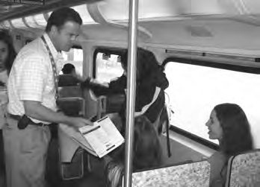
2011 Survey
Regionwide survey of most of the major routes
Paper hand-out, mail back survey
Done in 3 phases, over a 12 month period
Handed out close to 160,000 surveys

Slide 5
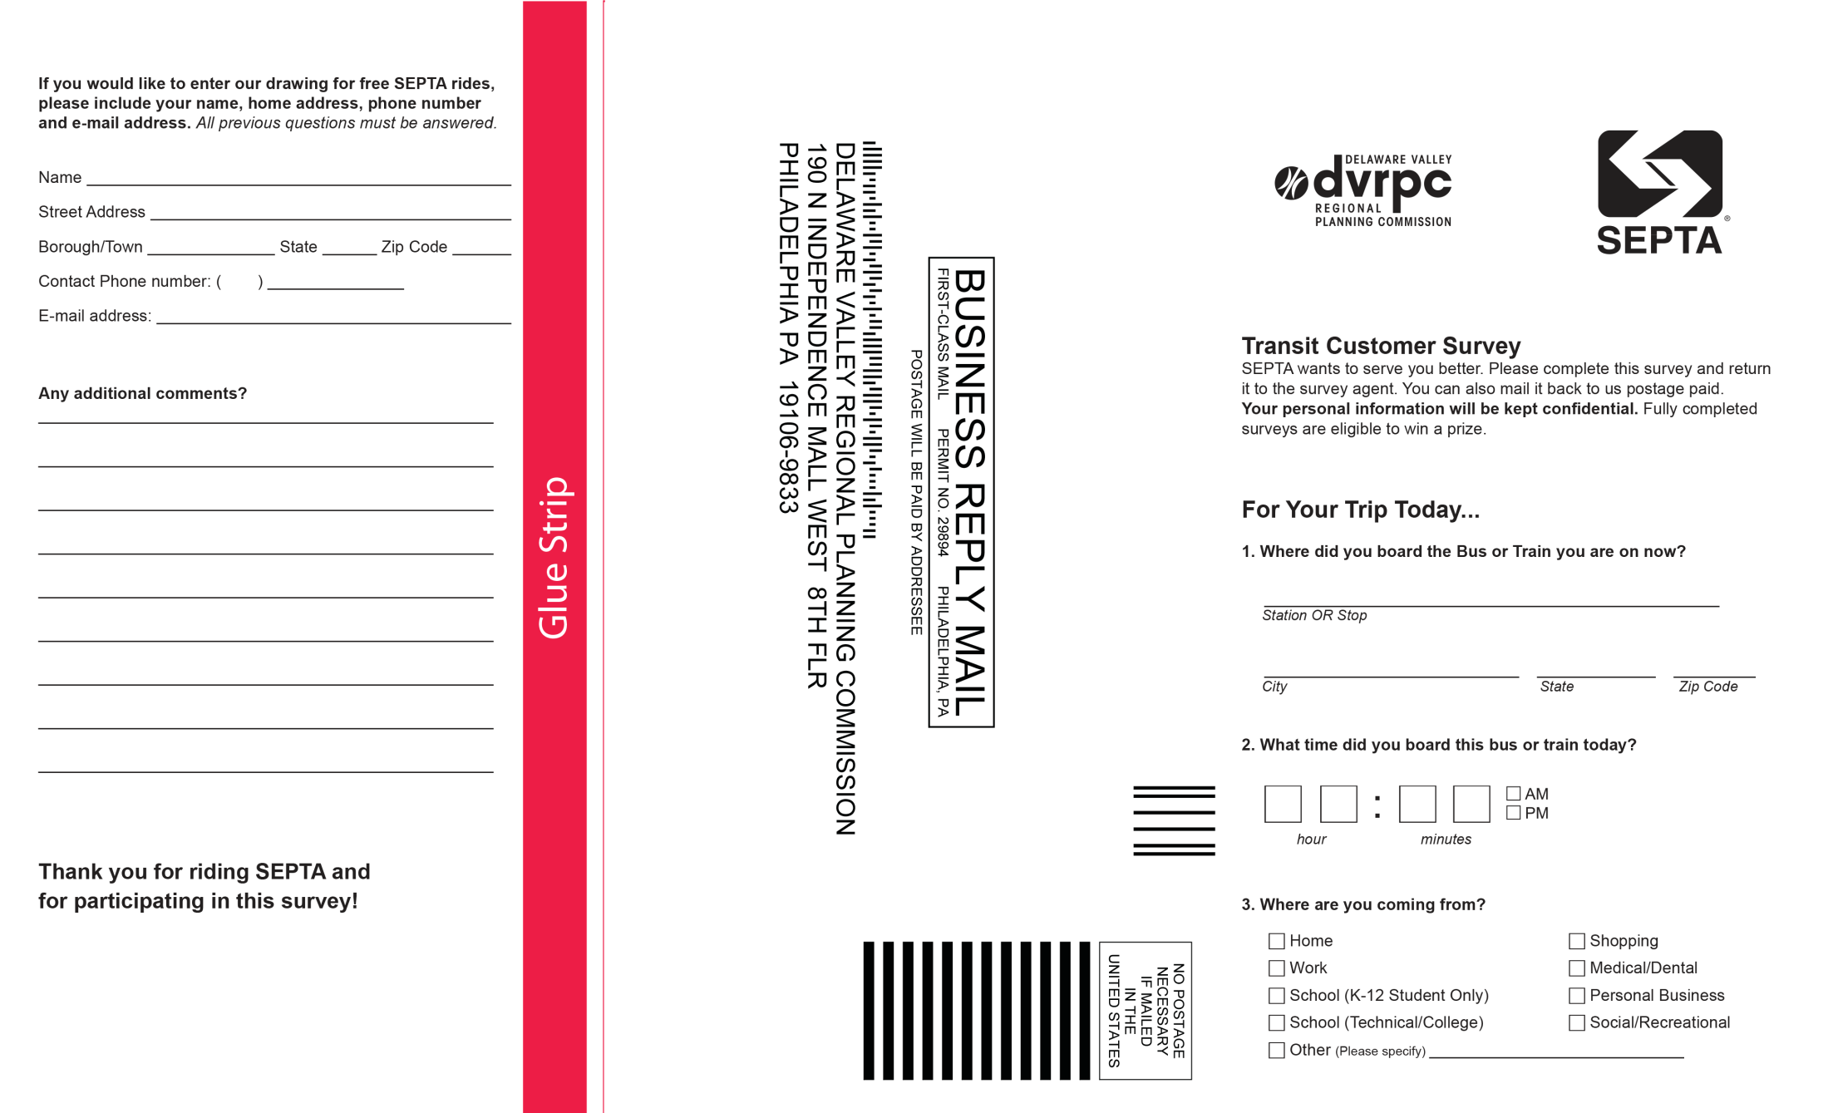
Survey Form - front

Slide 6
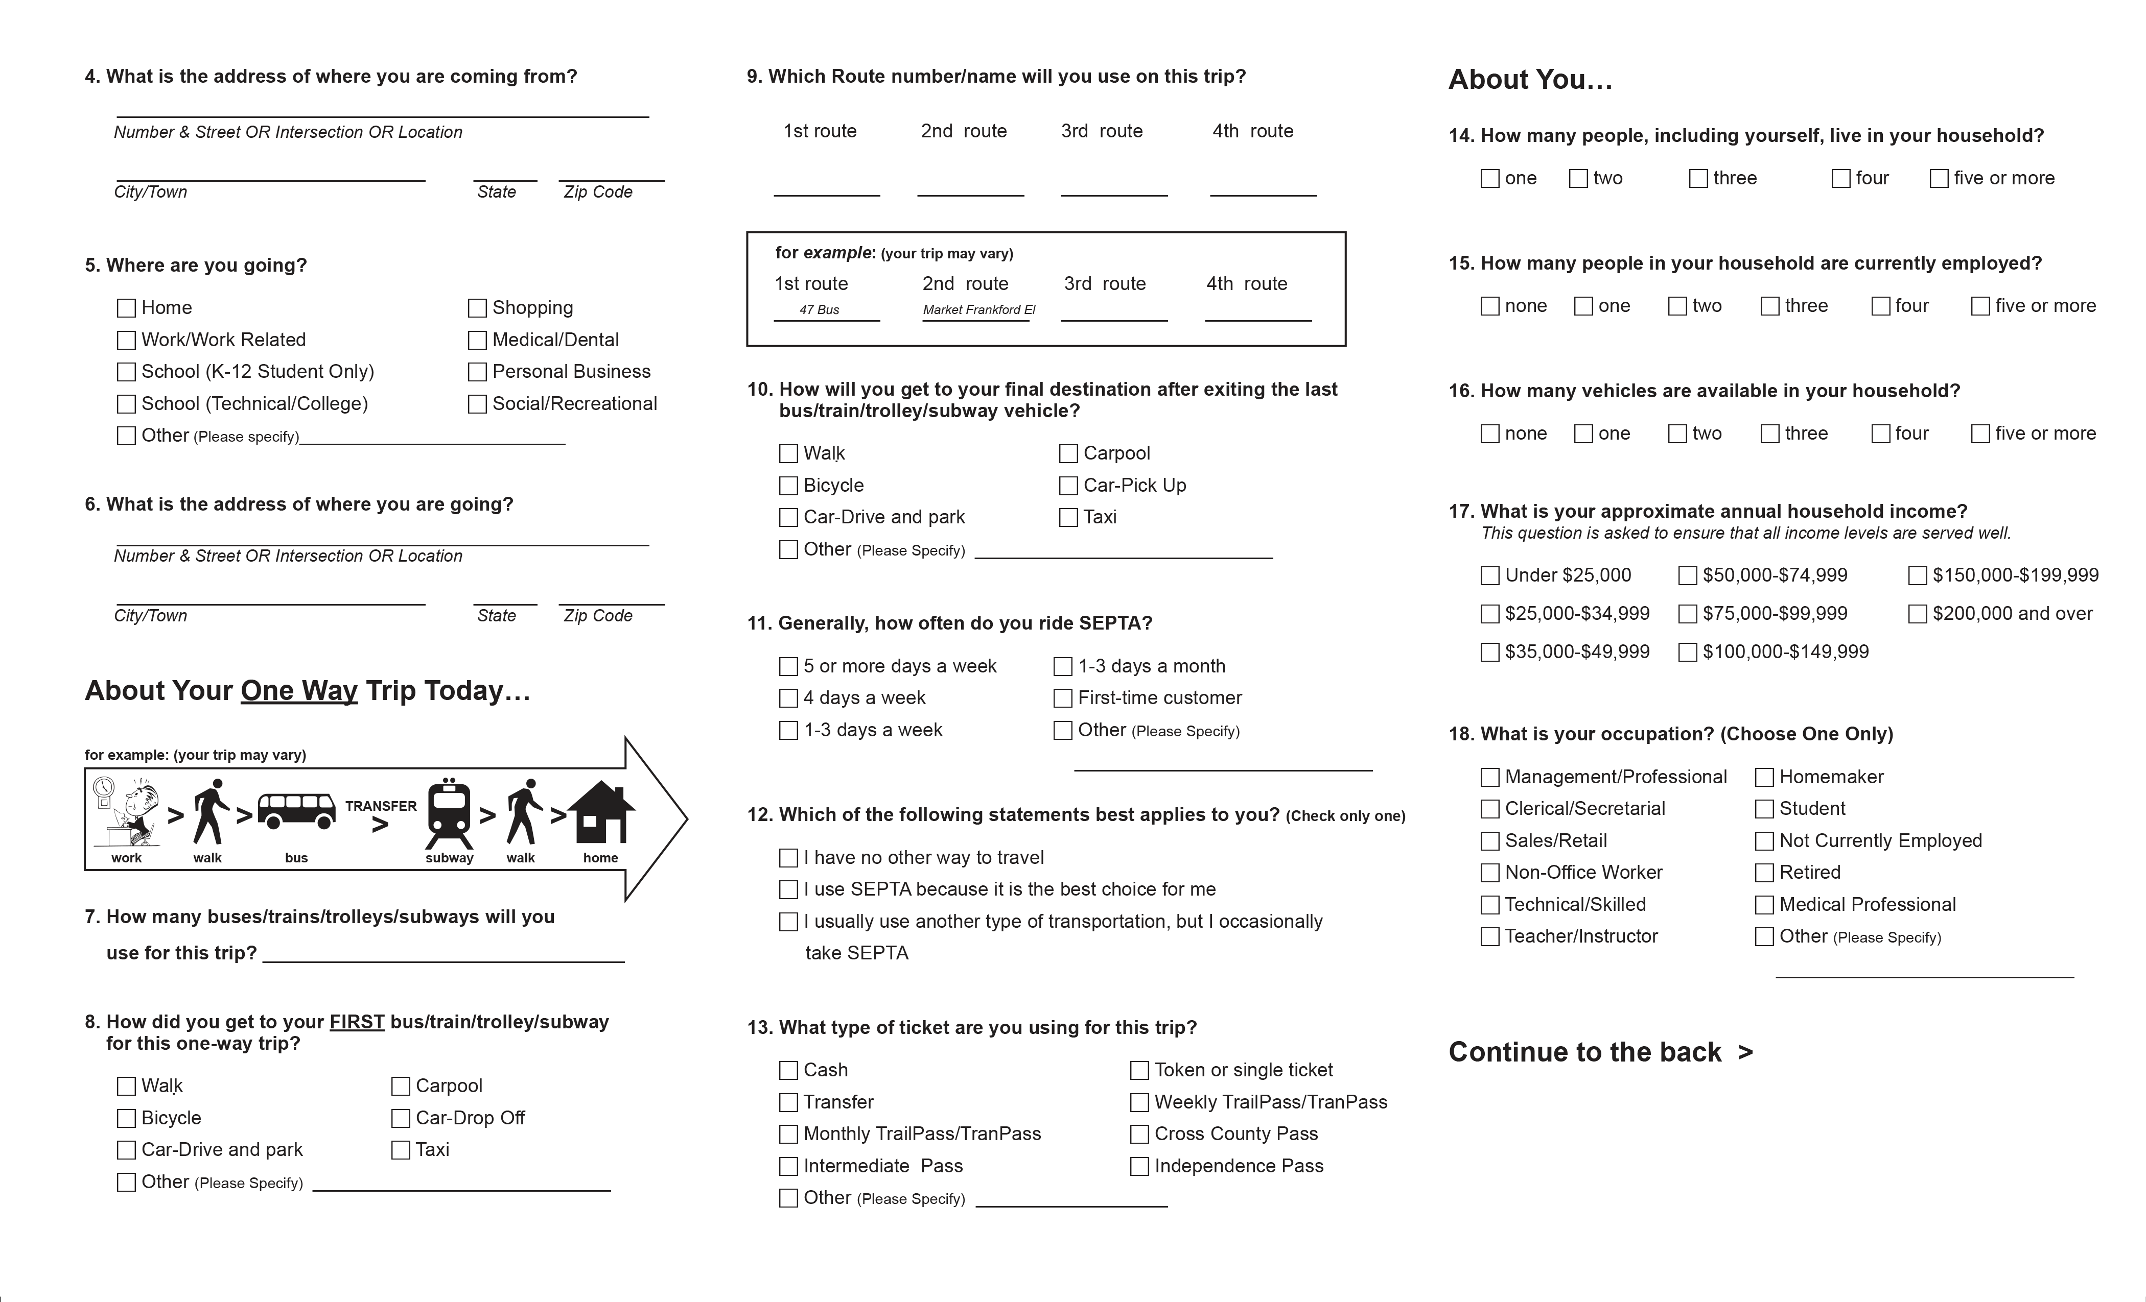
Survey Form - back

Slide 7
Income Comparison – City Bus Passenger vs. Regional Rail Passenger

Slide 8
Alternative Travel Mode

Slide 9
Survey document and data available on-line
http://www.dvrpc.org/Transportation/Modeling/Data.htm

Slide 11
Electronic Fare Payment
SEPTA Key Card – phased implementation beginning in 2015
Steady stream of data
Boardings, and
OD data

Slide 12
Tablet PCs
Have been used elsewhere
Metro Transit in Madison, WI
Valley Metro in Phoenix, AZ
Use to collect
Household, and
Demographic info

Slide 13
Plus / Minus of Tablets
Pluses
Makes it easier on the passenger – no form to fill out.
Allow riders with low English skills and disabilities to take the survey since surveyors can guide riders through questions and record their answers.
Collect more accurate location data since tablets use GPS to locate riders’ starting and ending locations and surveyors can error check responses.
Clean, organize, and present data in real time.
Minuses
They take longer than paper-based surveys and are more expensive because of the time surveyors spend asking questions.

Slide 14
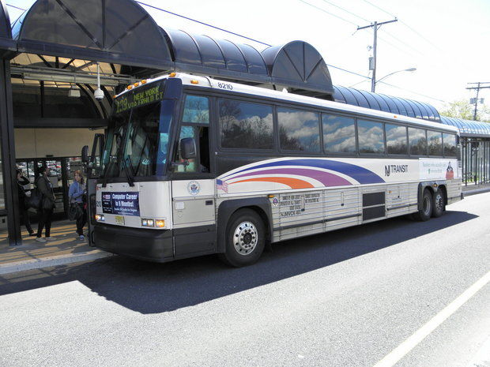
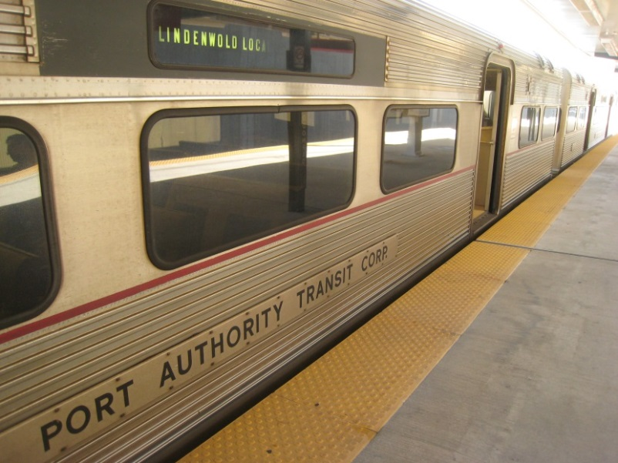
Upcoming surveys
New Jersey Transit bus routes
PATCO

Slide 15
The End
Brad Lane, AICP
(215) 238 – 2886
blane@DVRPC.org

