Slide 1
Realizing the Promise of Activity-based Travel Models in the San Francisco Bay Area
Presentation TRB Planning Applications Conference
David Ory | dory@mtc.ca.gov
May 2015

Slide 2
Promise
Approach
Macro Trends
Results
Recommendations

Slide 3
Promise
Approach
Macro Trends
Results
Recommendations

Slide 4
Transferable
Less Calibration

Slide 5
Promise
Approach
Macro Trends
Results
Recommendations

Slide 6
Calibrated model to 2000
Validated to 2000 & 2005
Realized 2010 Land Use
Realized & Coded 2010 Supply
Forecasted 2010 Demand

Slide 7
Promise
Approach
Macro Trends
Results
Recommendations

Slide 8
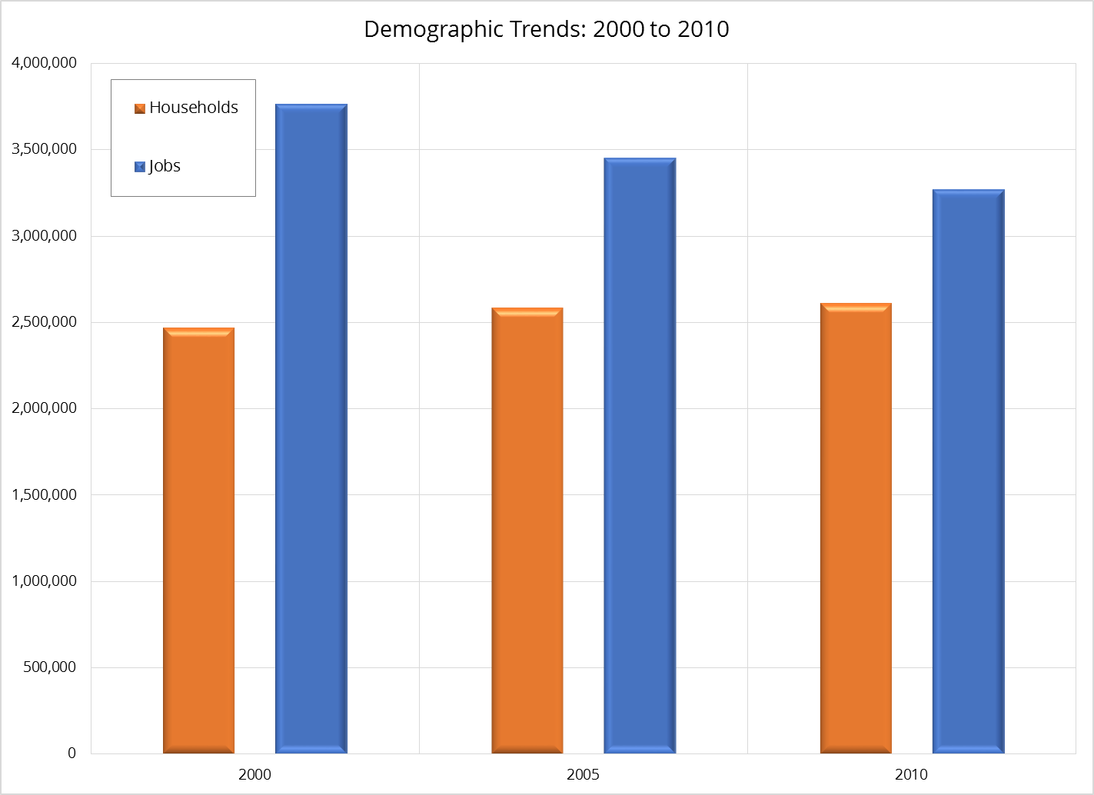

Slide 9
Promise
Approach
Macro Trends
Results
Recommendations

Slide 10
Easy
Validation Statistics

Slide 11
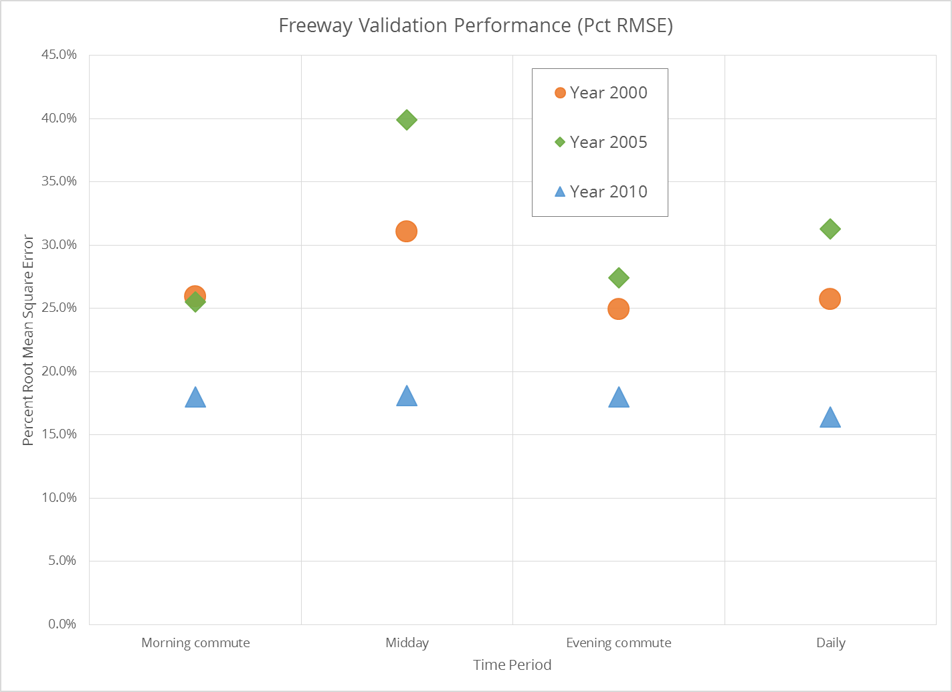

Slide 12
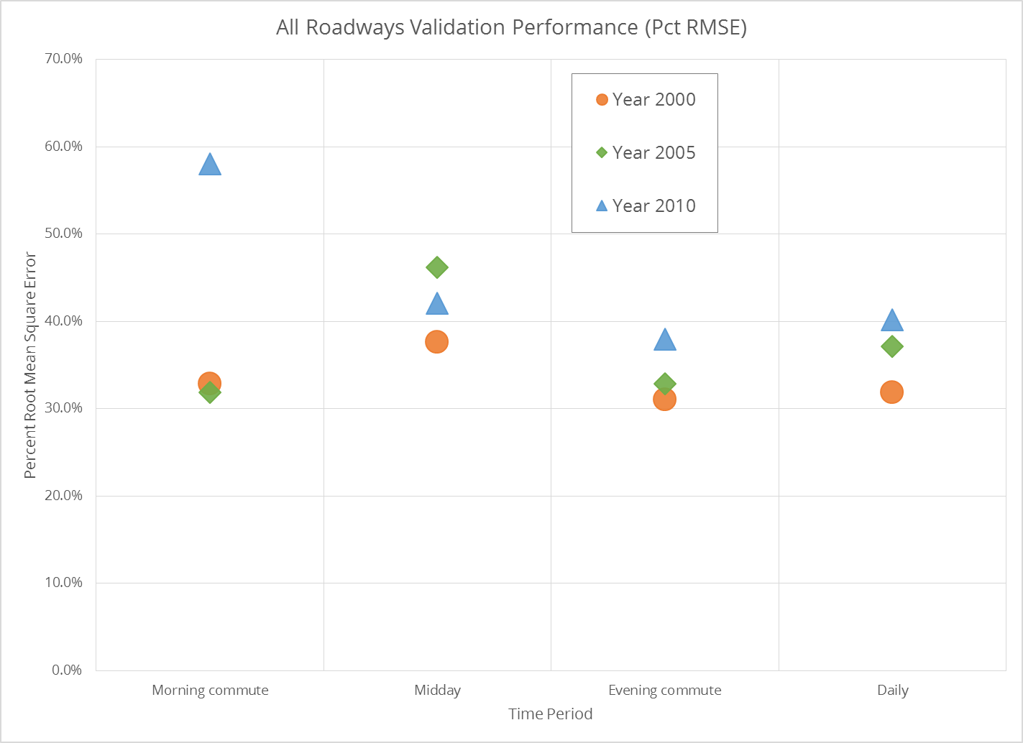

Slide 13
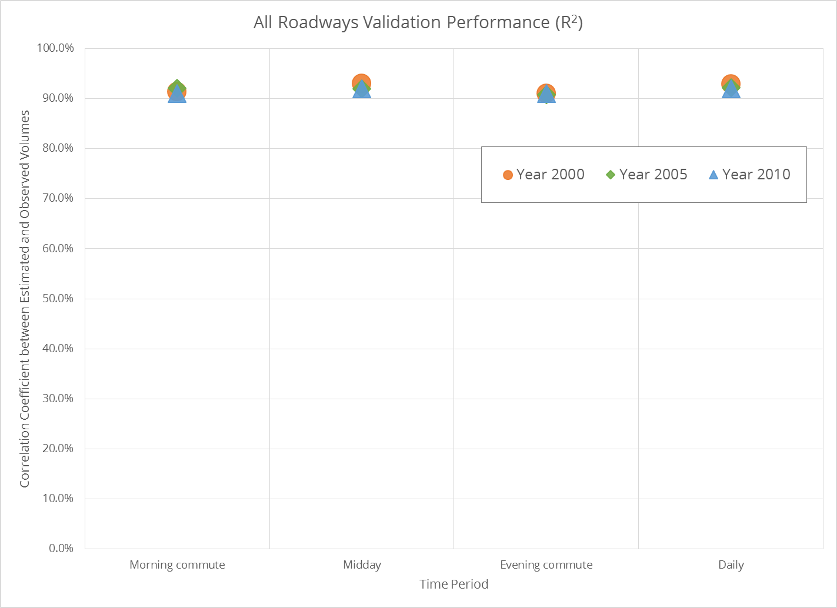

Slide 14
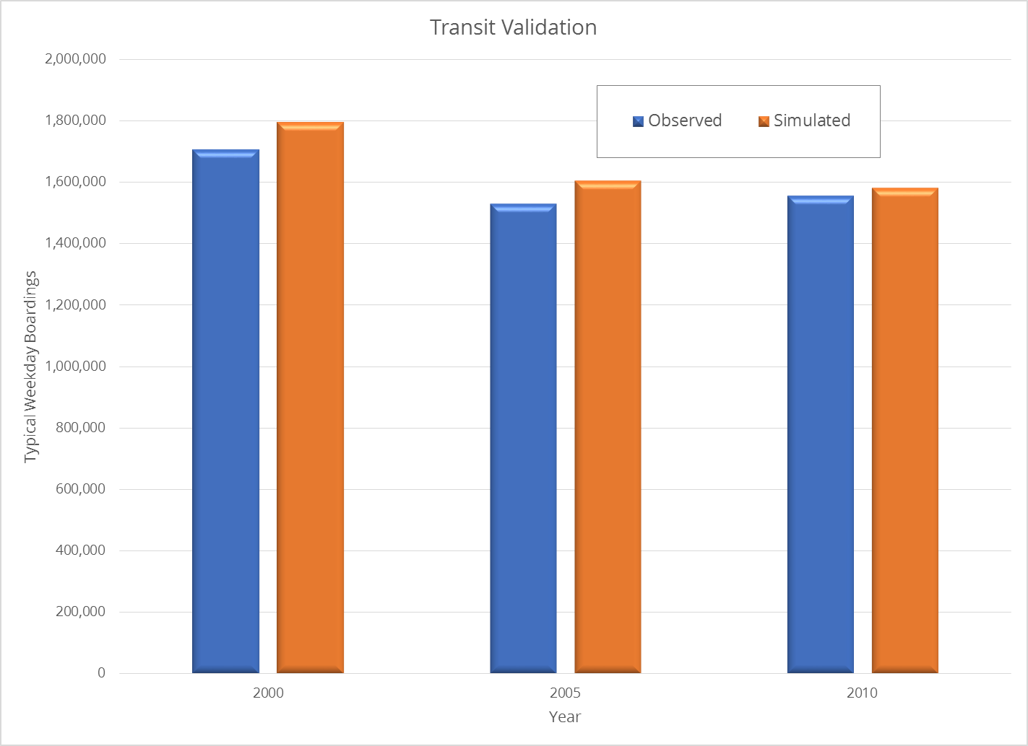

Slide 15
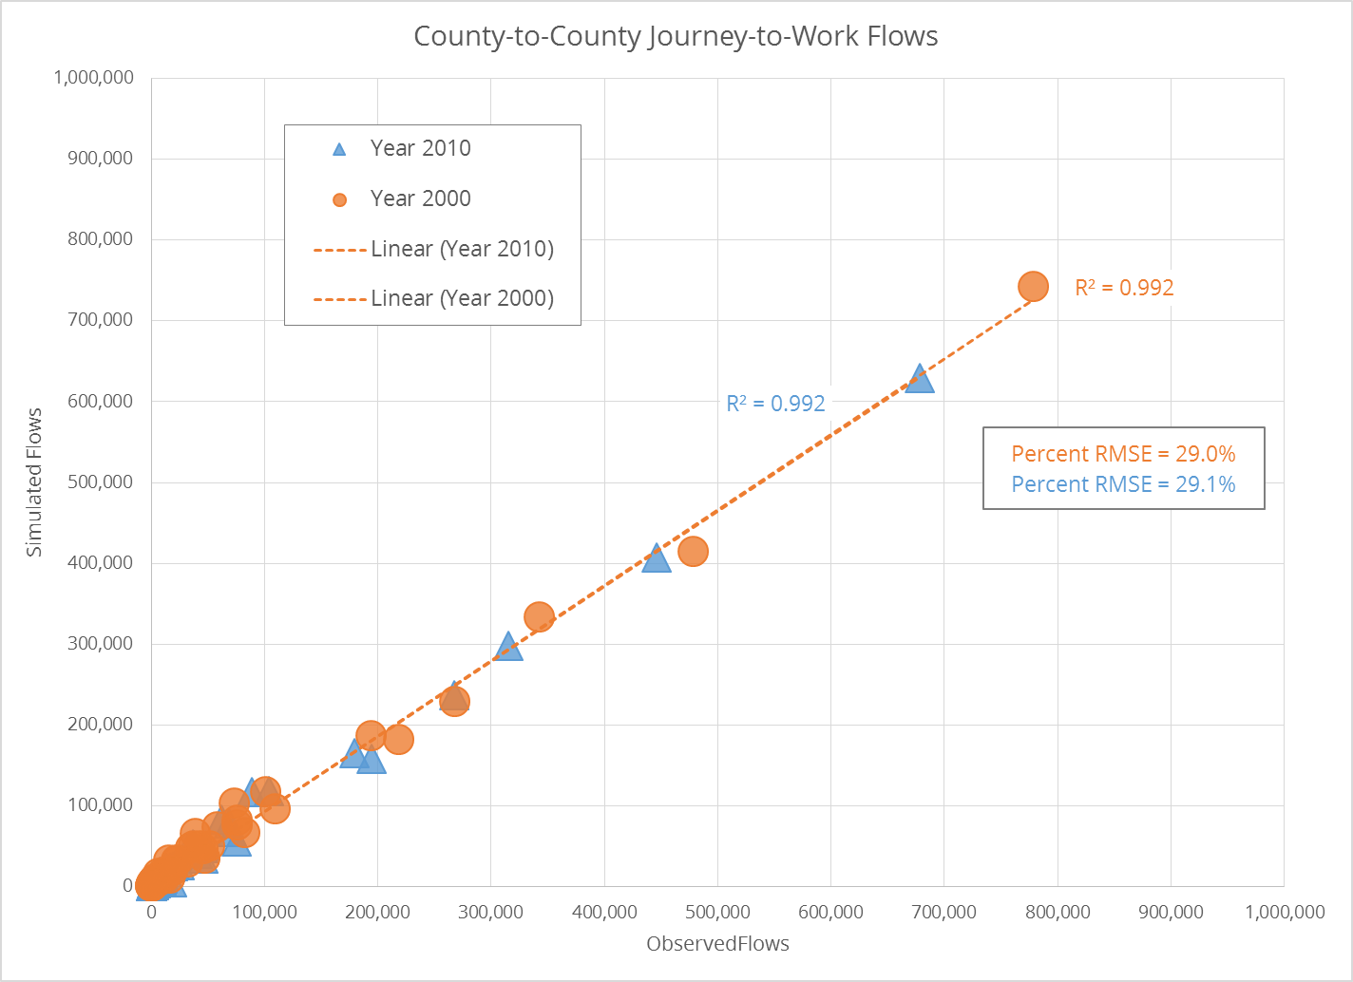

Slide 16
Hard
Predicting Trends

Slide 17
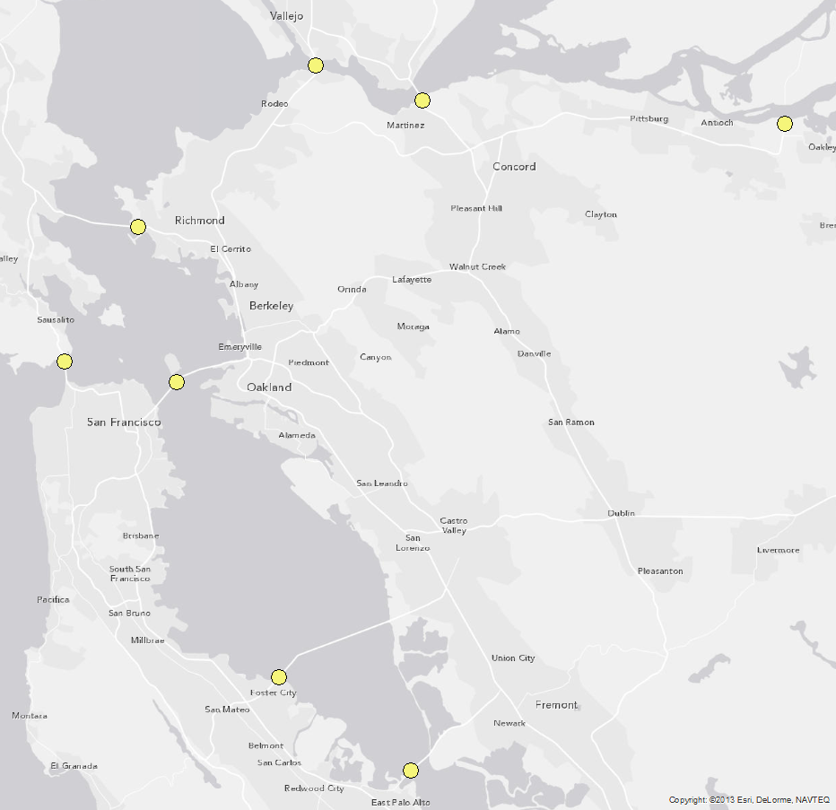

Slide 18
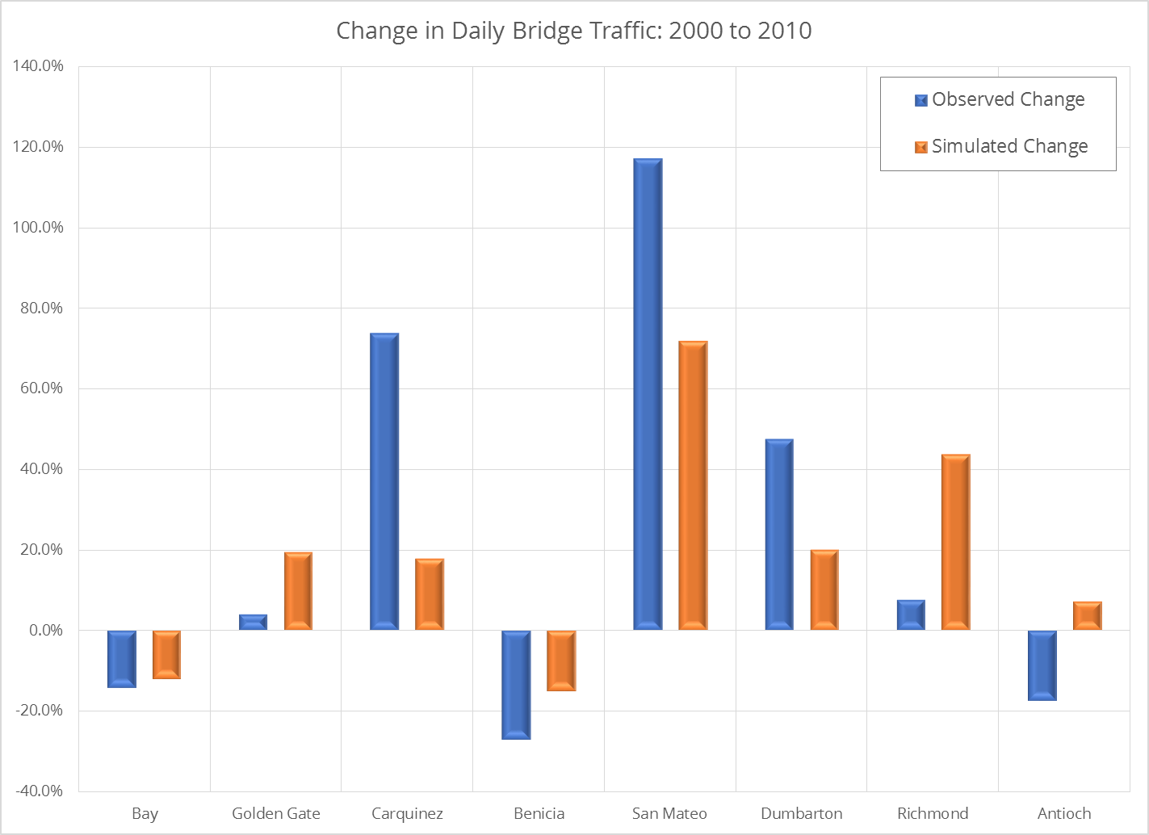

Slide 20
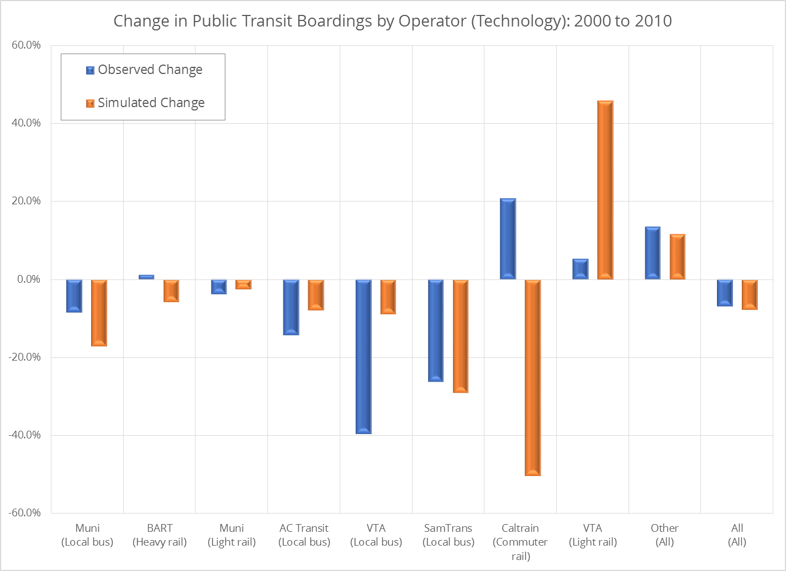

Slide 21
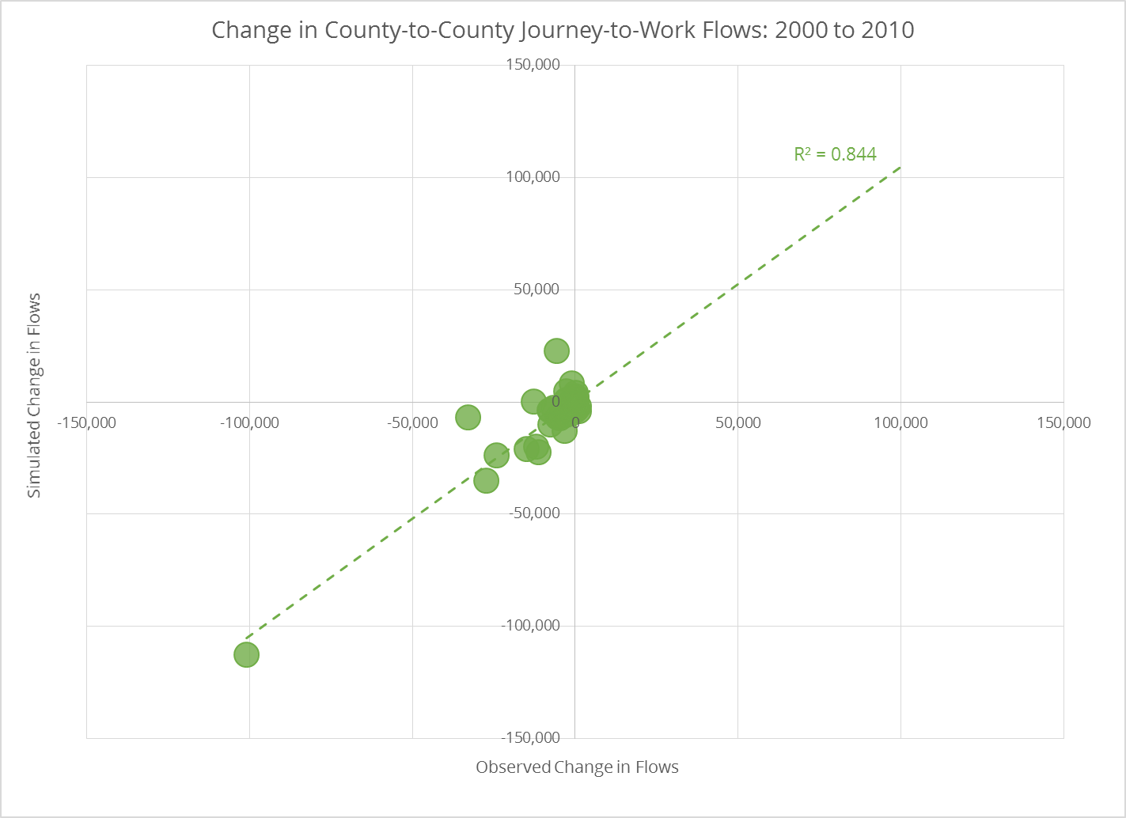

Slide 22
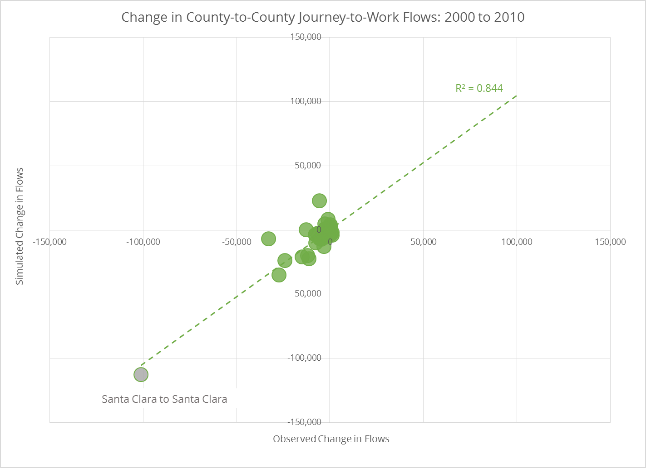

Slide 23
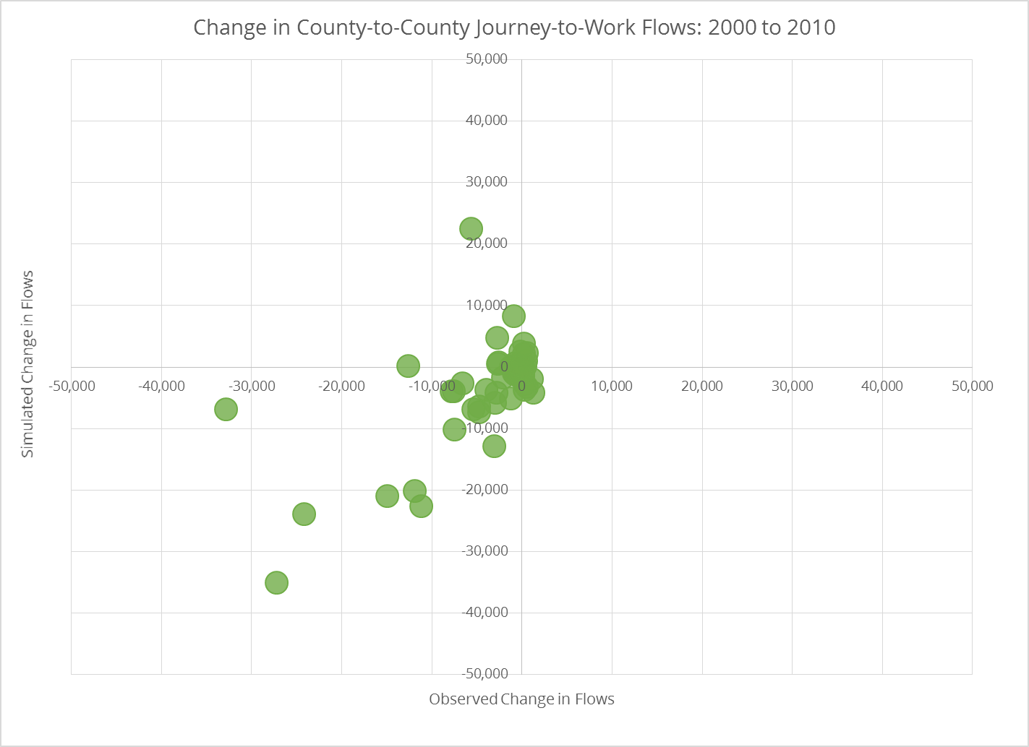

Slide 24
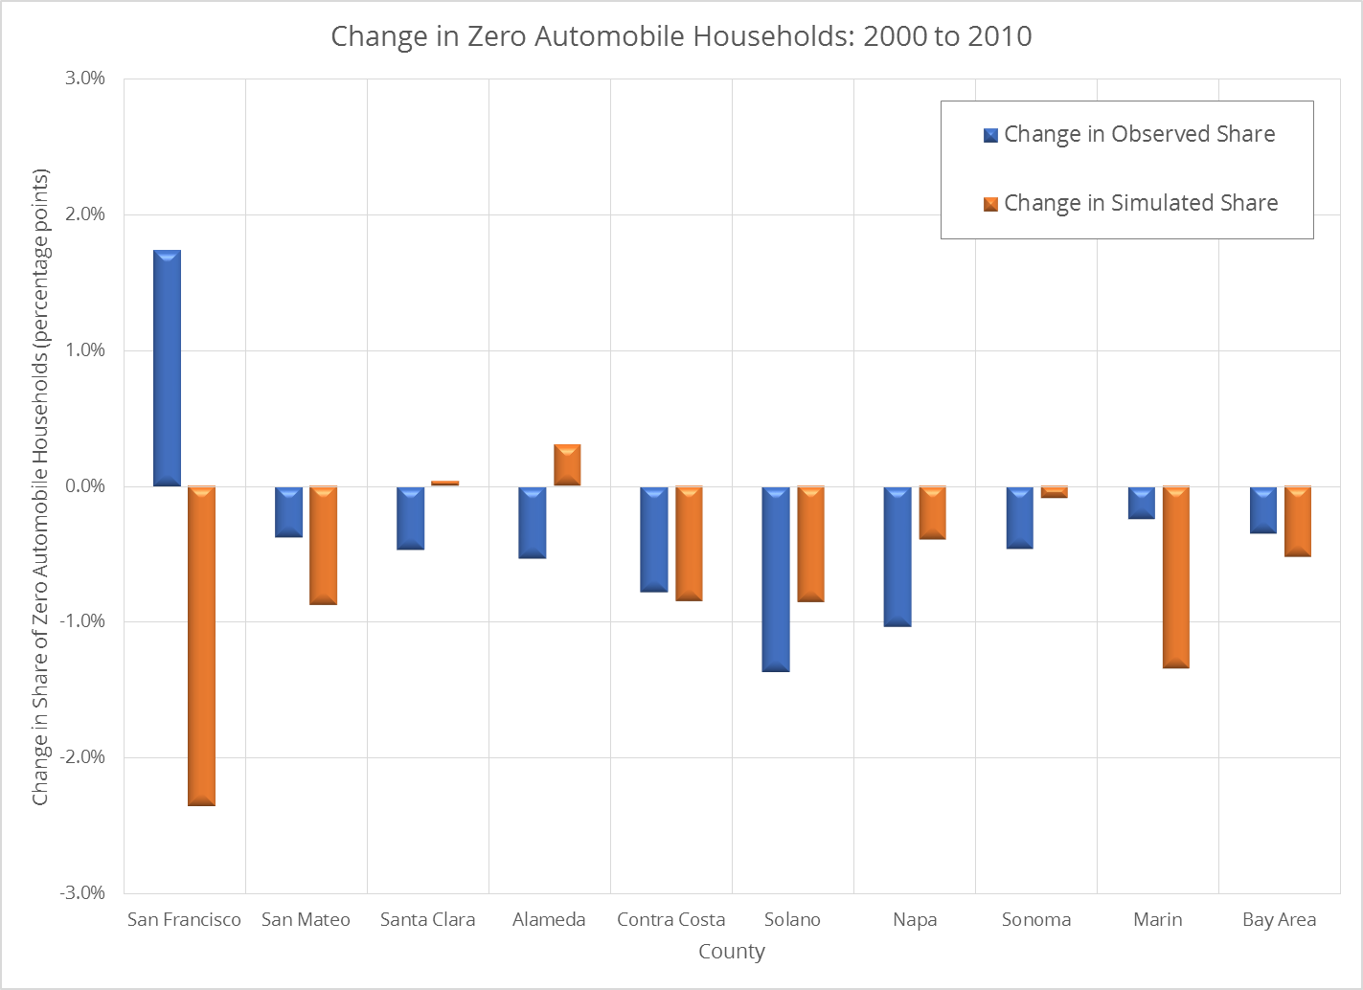

Slide 25
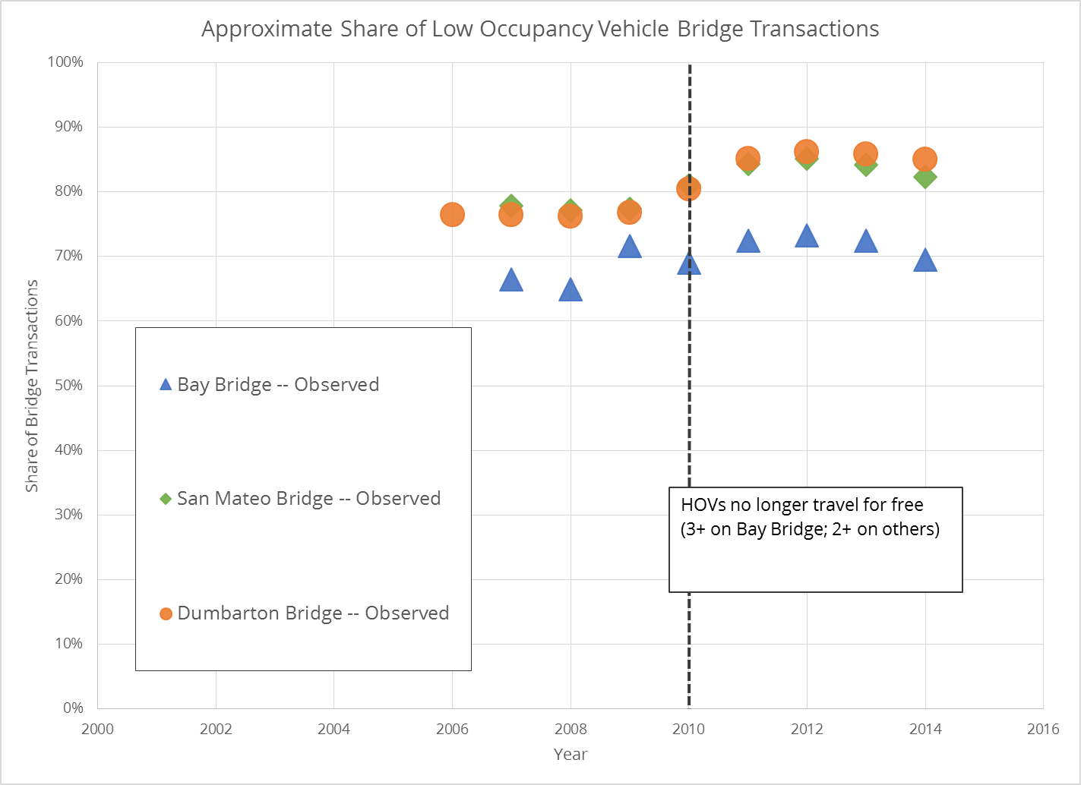

Slide 26
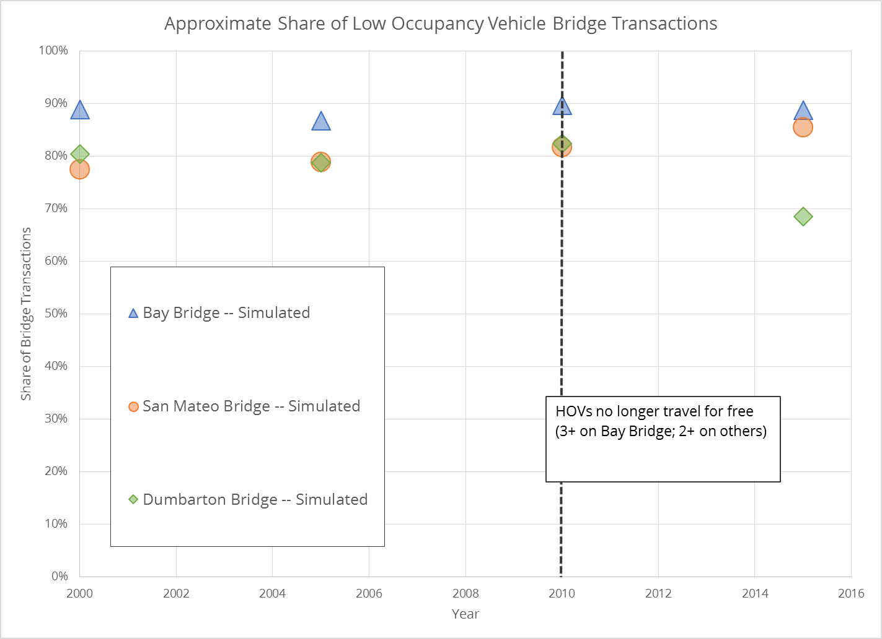

Slide 27
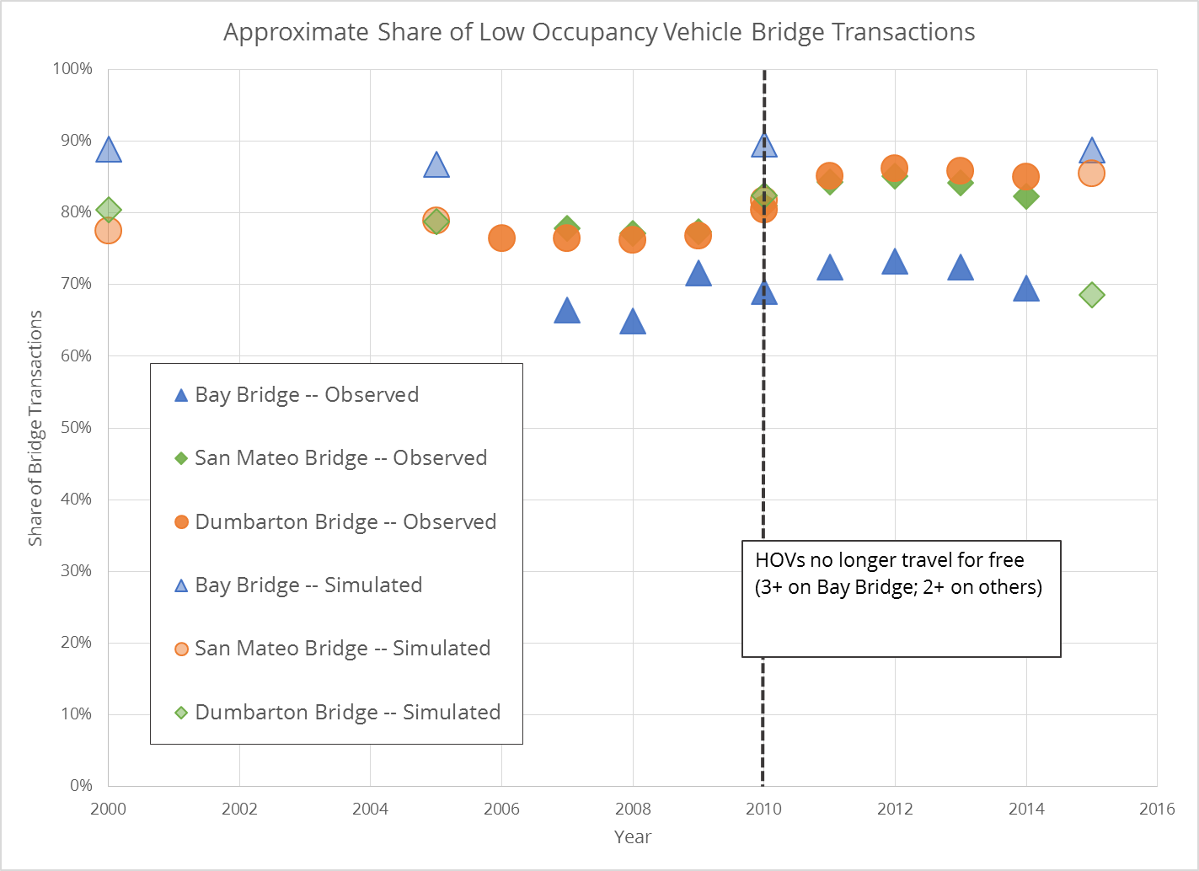

Slide 28
Promise
Approach
Macro Trends
Results
Recommendations

Slide 29
Make back-casting part of your practice (easy)
Calibrate to the Signal (hard)
Estimate to the Signal (harder)

Slide 30
<fin>

