Slide 1
Modeling University Student Trips Separately from the General Population
In a Regional Travel Demand Model
Presented to
15th TRB National Transportation Planning Application Conference
Presented by
Chao Wang, Cambridge Systematics, Inc. (Email: cwang@camsys.com)
Joseph Huegy, Institute for Transportation Research and Education
May 21, 2015
Atlantic City, New Jersey

Slide 2
Background
More and more university student surveys are conducted
4 universities in Virginia (2009, 2010)
Arizona State University (2012)
8 colleges/universities in Utah (2012)
2 universities in Texas (2013)
6 universities in North Carolina (2013, 2014)
Compared to the general population, university students have
Higher trip rate
Shorter trip distance
Different time of day distribution
Higher shares of non-motorized and transit trips

Slide 3
Methods
Current practices
No special treatments
Introduce special generators
Model Home Based University trips
Proposed method
Model university students separately from the general population
Different trip purposes
Different market segmentations
Different models

Slide 4
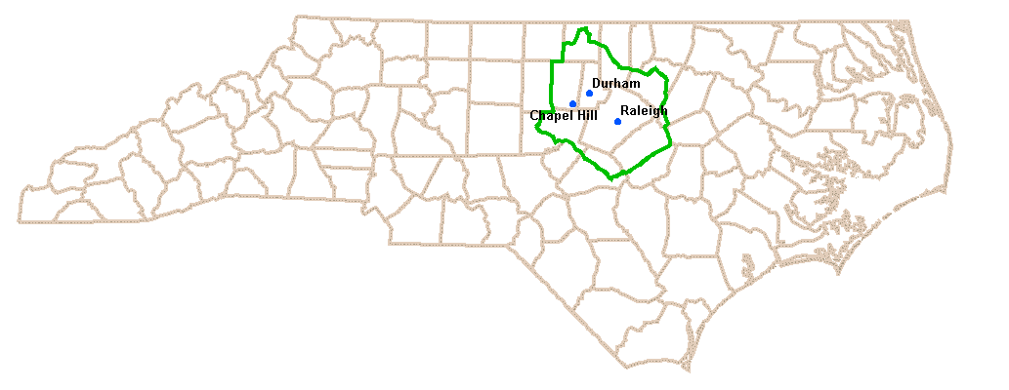
Triangle Regional Travel Demand Model (TRM)
TRM is a trip based four-step model
1.6 million population
Four major universities in the region (about 80K students)
North Carolina State University (NCSU)
University of North Carolina at Chapel Hill (UNC)
Duke University (DUKE)
North Carolina Central University (NCCU)

Slide 5
Is it worth the hassle to model university students separately?
Notes:
“All Strata” and “Strata 1 and 2” are from HHS. “Off-Campus Student” and “On-Campus Student” are from NCSU Student Survey. The numbers in parenthesis are from HHS.

Slide 6
Challenges
How to separate off-campus students from the general population
Collect student home addresses from universities
Population synthesizer
Off-campus student residence location model
Determine the total number of HBU trips made by off-campus students
Develop a discrete choice model to locate the home ends
Calculate the zonal number of off-campus students, based on the HBU trip rate as a function of the distance to campus

Slide 7
Validation - distribution of distance from home to campus

Slide 8
Summary
The impact of university student trips on a travel demand model might be big enough to require a separate model from the general population.
Off-campus students are usually treated as household population in the socio-economic data. They need to be separated from the general population carefully.

