Slide 1
University Travel: The 800 lb. Gorilla in the Room: Treatment of Texas A&M University
Kevin Hall (TTI)
Dr. Jim Benson (TTI)
James Burnett (TxDOT)
Greg Lancaster (TxDOT)
15th TRB National Transportation Planning Applications Conference
Atlantic City, New Jersey
May 2015

Slide 2
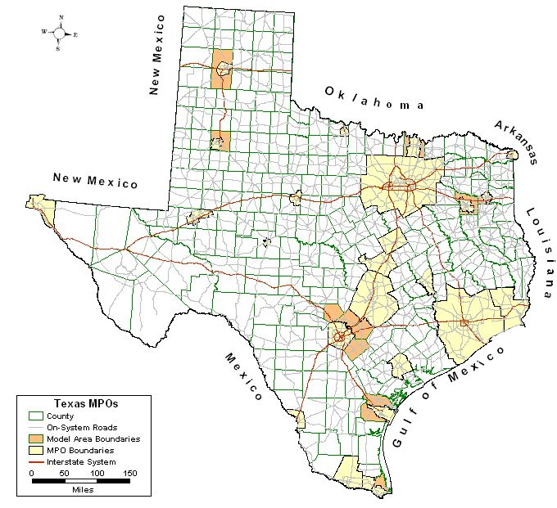
Brazos County, Texas

Slide 3
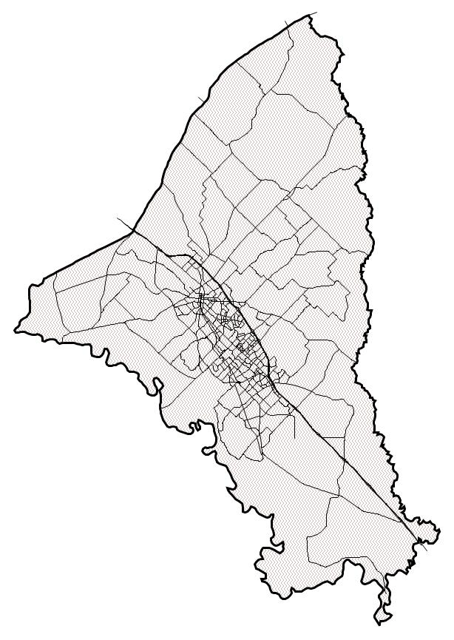
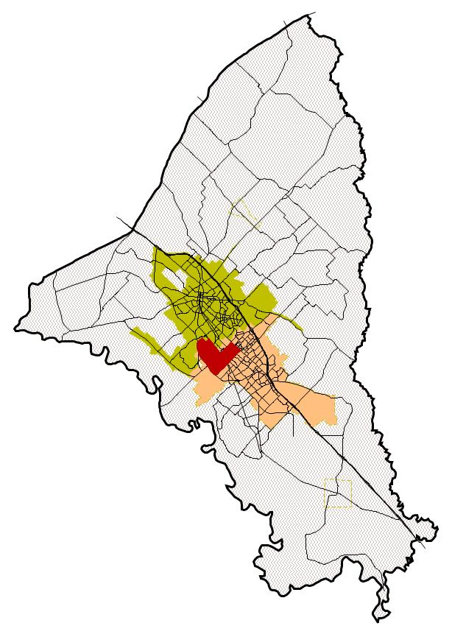
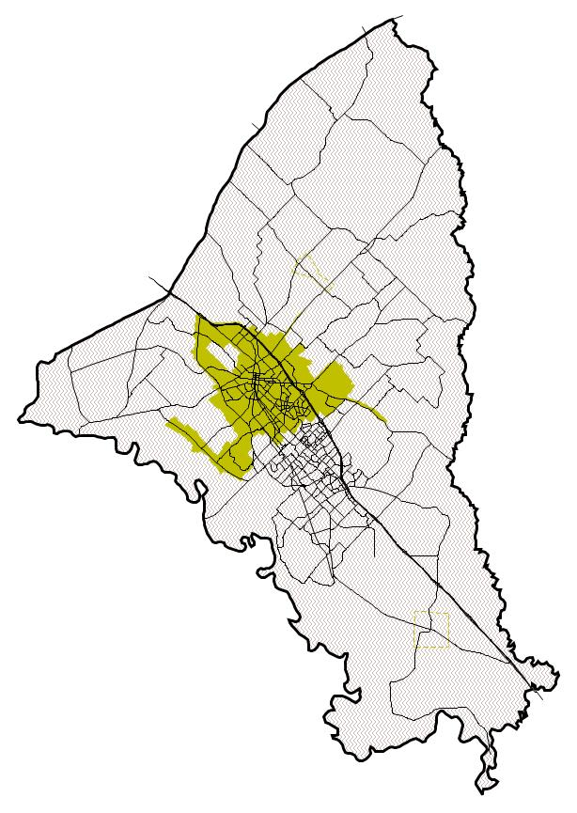
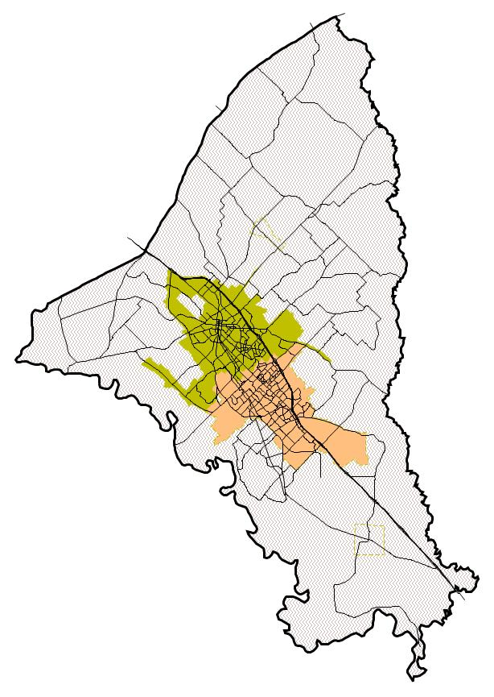
Brazos County, Texas Bryan-College Station
Blinn College
Texas A&M University

Slide 4
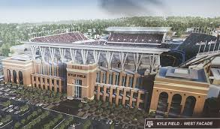
Influence of Universities
200,400
2012 Brazos County Census population
50,227
2012 TAMU enrollment
31.5%
Percentage of Brazos County population
13,000
2012 Blinn College enrollment
Region
Hospitals
Retail
Recreation
Attractions
900
“Hybrid”
Students

Slide 5
Defining the Challenge
Traditional households versus student households
For students – on and off-campus locations
Income
Incongruent
Employment
Non-university versus university
Full-time, part-time, student
Special generators of traffic

Slide 6
Characteristics of “Traditional” Households
Related individuals
One or more incomes
Shared rides (depending on children)
Transportation costs
Vehicle(s)
Vehicle maintenance/upkeep
Daily out-of-pocket costs (i.e. gas)

Slide 7
Characteristics of “Traditional” Household Travel
Fictitious Double-Income/Two-children family
Served
Passenger
Home
School
Work
Lunch
Served
Passenger
Work
School
Soccer Fields
Dinner/Errand

Slide 8
Characteristics of Student Households
One or more unrelated individuals
Small percentage married or living with parents
“Low” reported household income
May or may not work for income/expenses
Uncommon daily schedules
Propensity to travel is high
A number of daily activities
Insensitive to travel costs
Off-campus v. on-campus households and activities

Slide 9
Characteristics of Student Travel
Household
Member #1
After sleeping thru 8 o’clock class
Drive to College Station Softball Complex
Drive to back to Apt.
Repeat some facsimile for
Roommate
Number
Two
Repeat some facsimile for
Roommate
Number
Three
Drive to TAMU campus for
11 0’clock class
Walk over to local est. for Lunch
Drive back to campus to go to library to work on paper
Walk over to Arch. Bldg. to meet friends
Drive to Student Rec. Center
Drive back to Apt.
Drive to off-campus eatery
Drive to Olsen Field for baseball game
Drive back to Apt for dinner.
Drop friend off at Apt.

Slide 10
Identifying Off-Campus Student Households
Base year
Previously identified zones with students based on Texas A&M University Bus System routes
Proportion of households in a zone or sector
Forecast year
Determining control total
Determining TAMU and Blinn College enrollment
“Enrollment not expanding”
Blinn College building a new campus
Identifying zones
In-fill and new growth

Slide 11
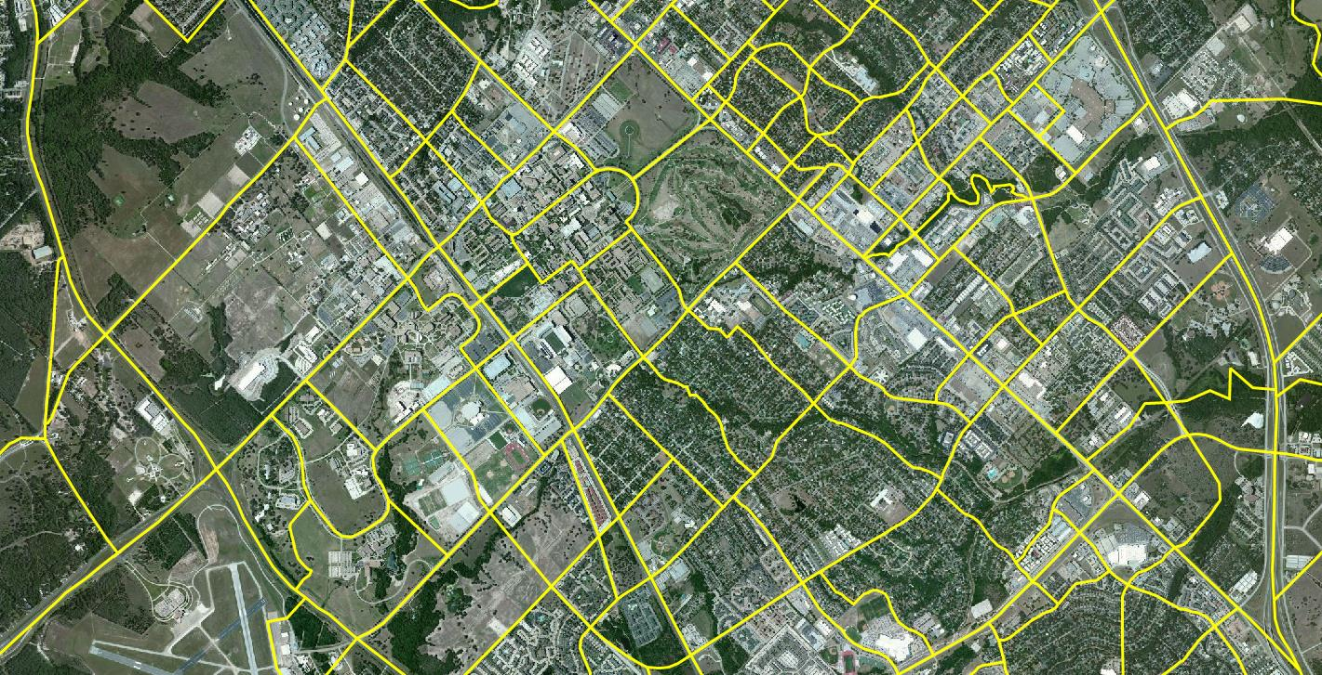
Student Households (Locations)

Slide 12
Identifying Student Households (Off-Campus & Campus Attractions)
West TAMU Campus
Main TAMU Campus
TAMU Bus Route System
Student Intense Area Type

Slide 13
Student Households Continuing to Evolve
Limited on-campus housing
Beginning to build on-campus private dorms (West Campus)
Creation of private dorms near campus
Costs exceed most monthly mortgages
Creation of higher end apartments and condos around town not in traditional locations
Marketing amenity-rich housing
Hardwood floors, granite countertops, leather furniture, meal plans
“Continuous” water river
Clubhouses
Proximity to campus

Slide 14
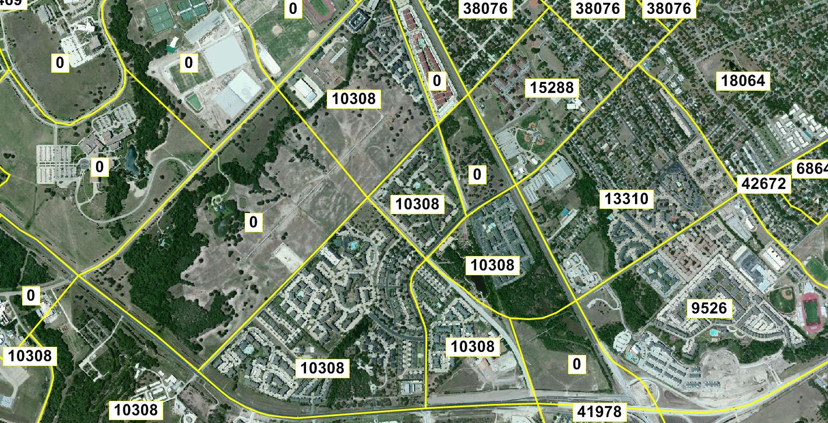
Income-Travel (Off-Campus Productions)

Slide 15
Traditional Household Production Rates
Home-Based Non-Work Trips
Household Size
 | 1 | 2 | 3 | 4 | 5+
1 | 2.095 | 2.961 | 3.578 | 4.459 | 4.907
2 | 2.281 | 3.229 | 3.907 | 4.826 | 5.534
3 | 2.363 | 3.348 | 3.982 | 5.004 | 5.805
4 | 2.436 | 3.448 | 4.084 | 5.075 | 6.084
5 | 2.644 | 3.792 | 4.539 | 5.668 | 6.835
Household Income

Slide 16
Accounting for Student Travel (Off-Campus Productions)
Traditional household production rates
Underestimate trips for areas with a disproportionate number of student housing
Students do not “behave” in a manner of other low-income households in the region
Non-home based
Home-based non-work trips

Slide 17
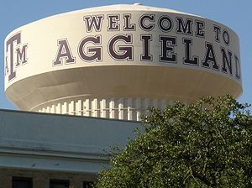
Accounting for Travel (On-Campus Activities)
On-campus housing
Live on-campus/stay on-campus
Live on-campus/run around town
Live on-campus/work on-campus
Live on-campus/work off-campus
On-campus employment
Full-time
Part-time
Student workers
Parking relative to final destination
Destinations with no employment attracting trips
Unique characteristics of final destinations (24-hour Vet. School v. Student Recreation Center v. Bush Library)

Slide 18
On-Campus Activities (Employment)
Full-Time Employees
Develop university attraction rates
Trips independently estimated for certain destinations
Part-time and Student Workers
Develop a set of additional part-time service employee attraction rates
Estimate daily participation rates for both part-time and student workers

Slide 19
On-Campus Activities (Parking Relative to Final Destinations)
Traffic
locations
Destinations:
Coincide with location of employment inventory

Slide 20
Travel Survey Activities
2012
Household
Workplace
Commercial vehicle
Special generator (i.e. St. Joe Hospital)
Targeted student travel survey

Slide 21
Additional Available Survey Data (2006 Travel Models)
2003 external station survey
External-local trips
External-through trips
Additional trips made by non-residents
External trip purposes are modeled by vehicle type (i.e. commercial and non-commercial)
Potential use of passive data to update external movements

Slide 22
Travel Survey Challenges
Develop expansion factors for traditional households and student households (unrelated individuals)
Married off-campus students household will be treated in the traditional HH.
Traditional HH with TAMU student will be treated as a traditional HH.

Slide 23
Travel Survey Challenges
Income
Develop a rate regardless of reported income
Asked what was their portion of the rent
Phones
Registered at parents address
Commute trips versus intra-campus trips

Slide 24
Travel Survey Challenges
Student targeted surveys
A number of them did not report a final stop or reported a final destination other than original household
University trip purpose trip lengths may be irrelevant
Similar to airport trips
Investigate rates by proximity to campus.

Slide 25
Special Thanks…
Texas Department of Transportation
James Burnett
Greg Lancaster
Texas A&M Transportation Institute
Dr. Jim Benson
Dr. David Pearson
Patti Ellis
Bryan-College Station MPO
Bart Benthul

Slide 26
Questions

