Slide 1
Forecasting Travel Time Index using a Travel Demand Model to Measure Plan Performance
Thomas Williams, AICP
Texas A&M Transportation Institute
2015 TRB Transportation Planning Applications
Atlantic City, NJ

Slide 2
What I’ll Talk About
Plan Performance
Stuck in Austin Traffic
Wedge Charts!
What Would it Take?

Slide 3
The Problem with Long Range Plan Performance Measurement
Extend Business As Usual Behavior
We have to do SOMETHING, at least
Vague Goals
We Can’t Fix the Problem! Let’s manage it.
Problem is Too Big
Hard to Measure
Compare Plan to No-Build, it looks better.
If we Don’t Complete the Plan, it will Worse

Slide 4
Difficulty Measuring Performance
Consensus on Stated Goals is Hard
Setting Benchmarks is Harder
Multiple, Complex Alternatives are Difficult to Compare using One Measure
Need Measures that can be Tracked over Time
Need Commonly Understood and Easily Communicated Measures

Slide 5
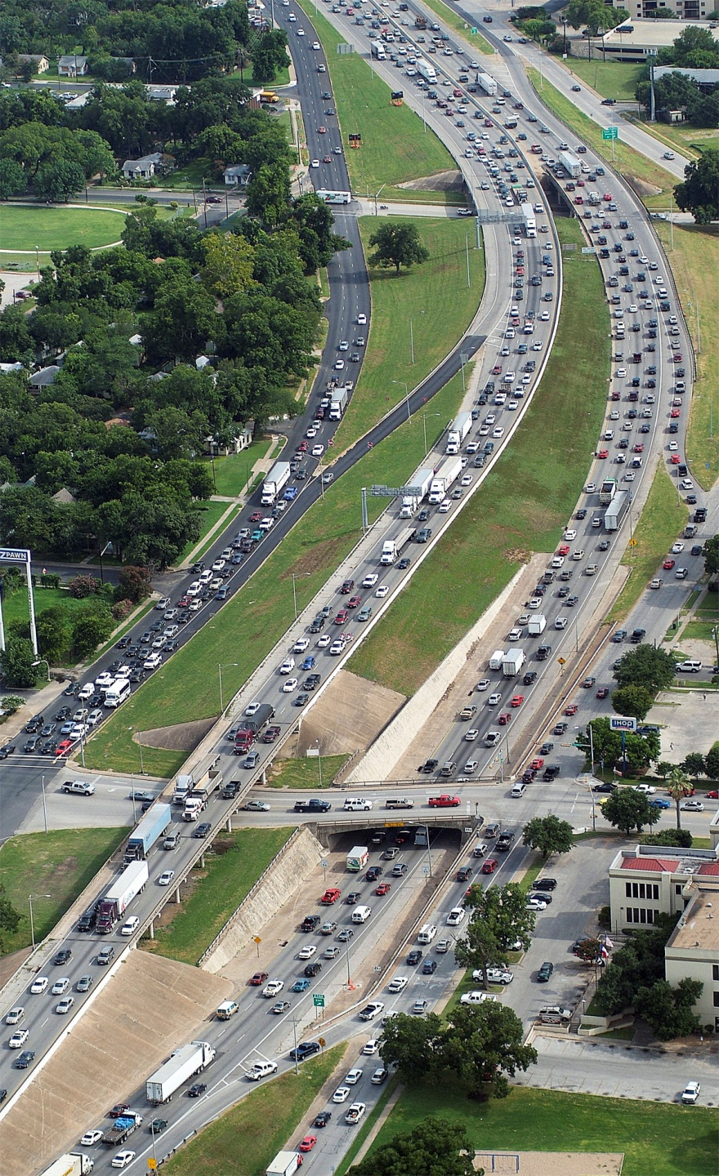
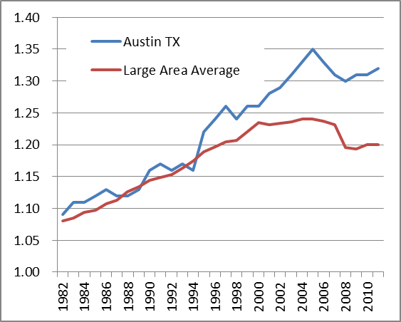
Austin’s Congestion
This Happens 8 to 10 Hours per Day!
Travel Time Index
Ranked 4th in Large City Category since 2008

Slide 6
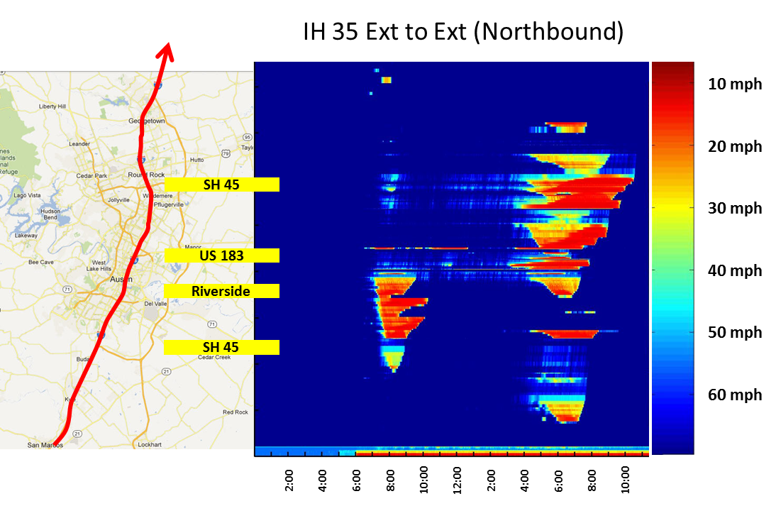
I-35 Investment Priorities Project
Studied 7 Alternatives - Included Managed Lanes, Toll Tolling, Major Re-construction
Dynamic Traffic Modeling
No Alternative
Significantly
Reduced
Congestion

Slide 7
But Compared to No Build, things Look Better…
A Little…

Slide 8
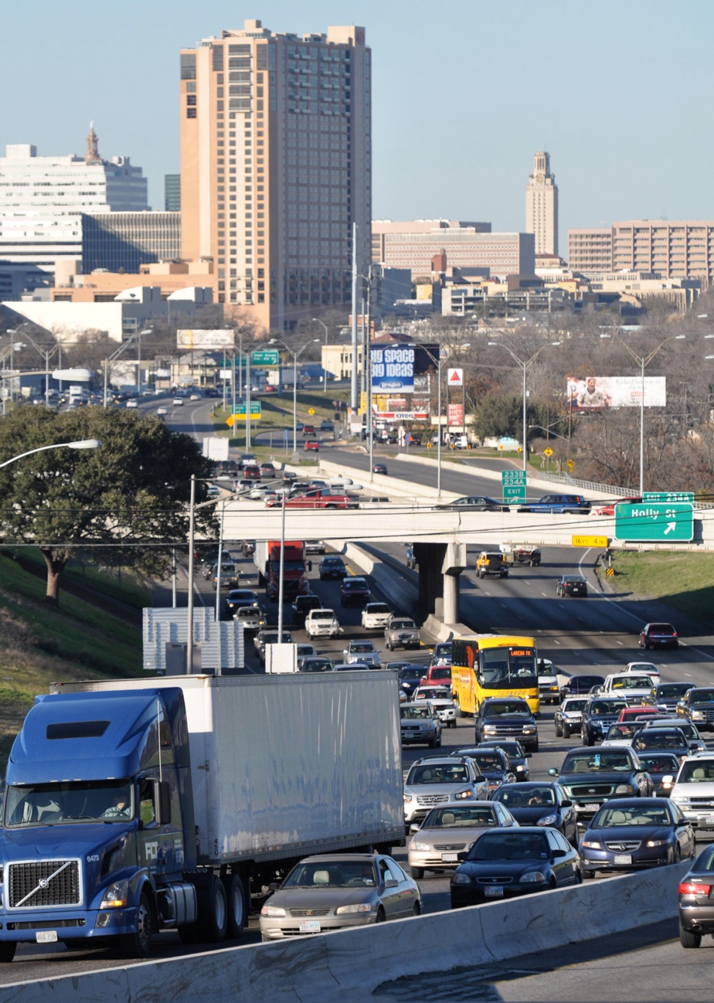
Questions Remain after I-35 Study
Is the Forecasted Congestion a Reasonable Conclusion?
Is there anything we can do to ease congestion?
What would it take to do it?
Answer: Trip Reduction!

Slide 9
Quantifying Strategies to Reduce Congestion
Austin Chamber of Commerce funded TTI
Demand Reduction Scenarios AND Quantify the Impact of Various Levels of Implementation
Chamber would Use Results to Discuss Strategies with Membership
Solutions to Congestion will take the Entire Community’s Participation

Slide 10
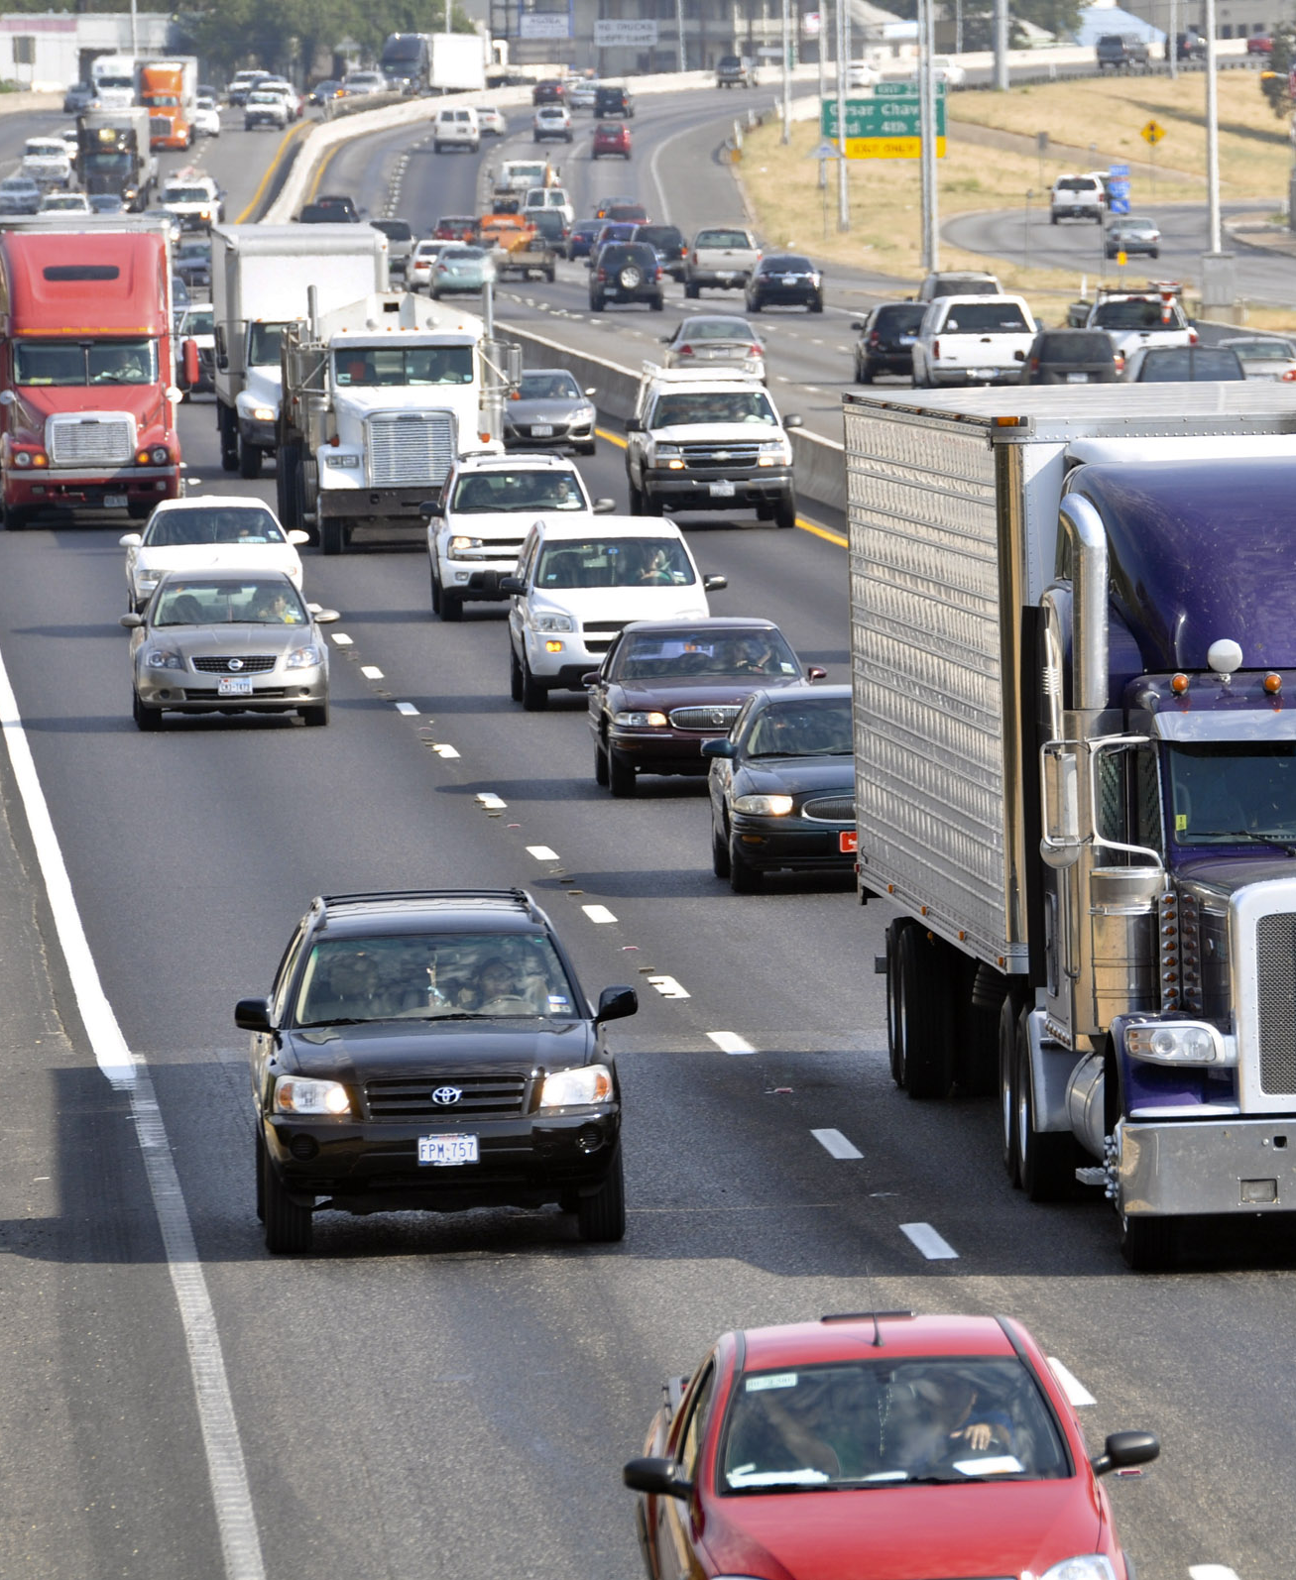
Travel Time Index
Commonly Understood, widely Publicized
Annual “Urban Mobility Report”
Ratio of Congested Travel Time to Free Flow Travel Time
“1.31” - trip will take 31% longer during Congested Periods
Applied to any Geographic area or Segment

Slide 11
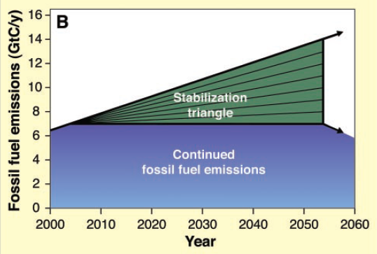
Wedge Charts in Climate Science
“Stabilization Wedges: Solving the Climate Problem for the Next 50 years with Current Technology” – S. Pacala & R. Socolow

Slide 12
Impact of Congestion Reduction Strategies
Capital Area 5-county Region
Travel Time Index
2.17 No Build
1.79 CAMPO Plan
1.63 Telecommute
Travel Time Index
1.54 Peak Shift
1.41 Mode Shift
1.31
1.18 Centers Plan
Notes:
Several strategies were developed to address the congestion problems related to the rapid growth in both population and vehicle miles of travel (VMT). The Travel Time Index was chosen as a measure of performance. The Travel Time Index is the ratio of congested travel time to uncongested travel time. A ratio of 1.31 was calculated in 2010 using observed speed data and is reported in the Urban Mobility Report annually. A ratio of 1.31 means that it will take 31% longer in congested conditions, usually the peak AM or PM period, than it would take for an average trip during uncongested times of the day. For this analysis, the AM peak period from 7 AM to 9 AM was chosen, since the CAMPO model contains this information.
The strategies tested include:
Building out the 2035 CAMPO Plan projects (with the addition of managed lanes on I-35, which were not originally in the Plan due to funding constraints)
Reducing home-to-work (and the reverse) trip making by 10%. This represents a telecommuting scenario of every other worker taking 1 day per week to telecommute.
Shifting 12% of all travel out of the peak AM period. 5% was shifted to earlier hours, while 7% was shifted to after 9AM.
Taking an additional 11% of Single-Occupant Vehicles (SOV) off the road by moving them to transit, biking, or walking during the AM peak period.
Implementing the CAMPO goals for Activity Centers and changing the travel behavior to represent more local capture of trips within Centers. The CAMPO goals in the 2035 Plan are to have 31%/38% population and employment, respectively, within Centers. According to TTI analysis of the Traffic Analysis Zones in the CAMPO model, there were about 11%/25% in or close to Centers in 2005. CAMPO reports in the Plan that there was 16%/36% population and employment in Centers in 2010.
It is important to note that these values are not predictive; these charts do not predict the levels of adoption of the strategies. The levels tested here are suppositions, not predictions. However, the impact to congestion, under these “what if” scenarios, is measured.

Slide 13
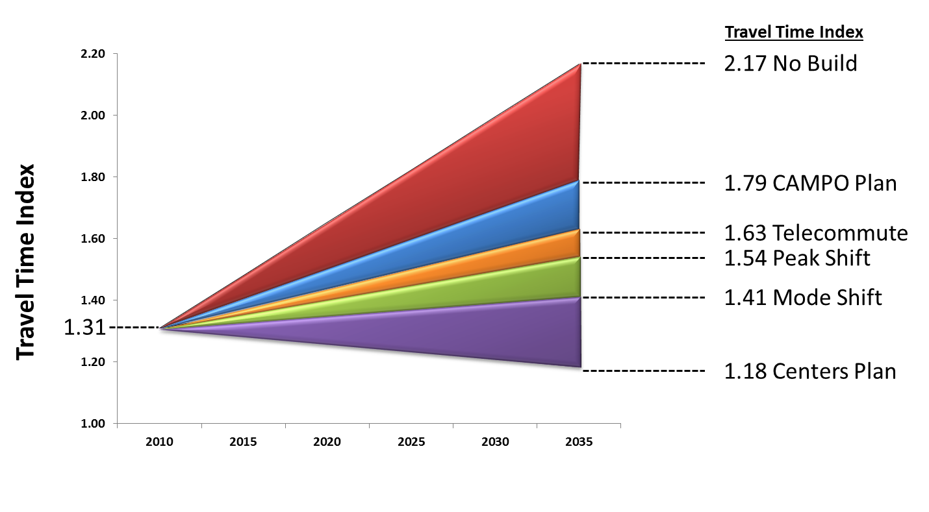
Why the Wedges?
Numerous, Interchangeable Scenarios
Shows Relative/Cumulative Impacts Visually
Picked up by Media, Referenced Many Times
Longer we Wait, the Worse it Gets

Slide 14
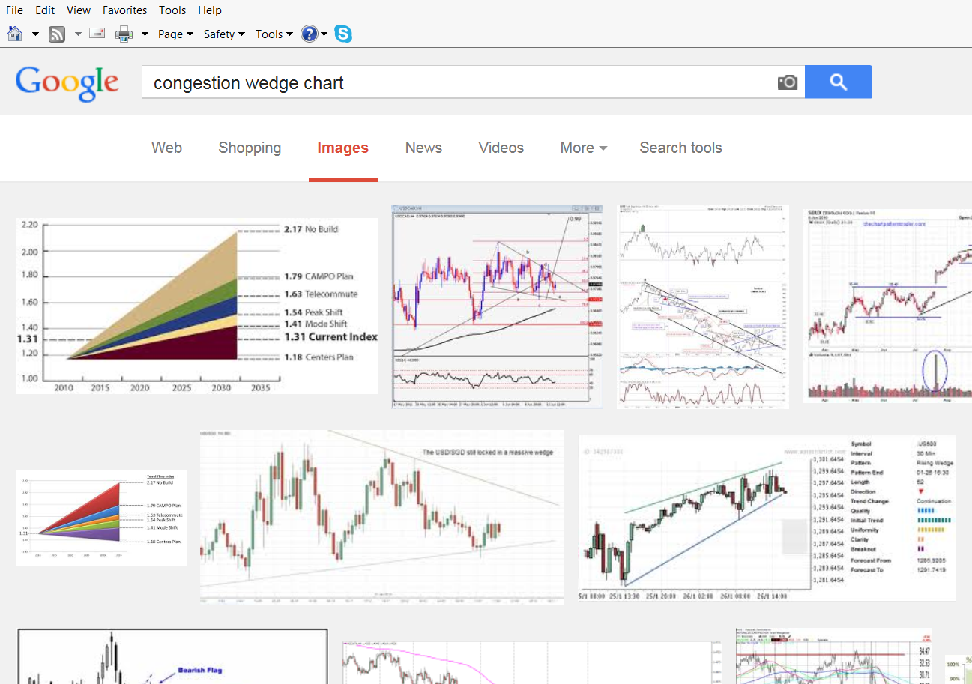
#1 on Google Image Search for “Congestion Wedge Chart”

Slide 15
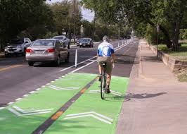
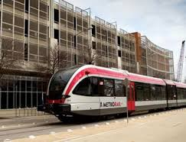
Impact on Regional Planning
“All of the Above” Strategy Came into Focus in Region
More Interest in Trip Reduction in Addition to Capacity Additions
Inclusion of Business Community in Regional Congestion Reduction
Media “Groks” Travel Time Index

Slide 16
Modeling the Index
Travel Time Index = Congested Time/Free Flow Time
Urban Mobility Report uses INRIX speed data
INRIX is Past Data – So, How to Forecast?

Slide 17
Modeling the Index
Forecast Relationship between Speed and Roadway Demand
Calibrate to Match Trend in Index
Select Geography to Match INRIX Region
Select Treatments to Reflect Trip Reduction Strategies
Communicate with Simple Graphics

Slide 18
Modeling the Index
Apply Speed-Volume Relationship to Peak Period Travel Demand Models

Slide 19
Selecting Scenarios, Reducing Trips in Peak Period TDM

Slide 21
Limitations to Method
Not Predictive – Scenarios are Assumed
Only measures Roadways, not Multimodal
Doesn’t account for other Criteria besides Congestion and Delay
Average may not Reflect Specific Corridors or parts of Region

Slide 22
Benefits of Wedges and Process
Well-known Travel Time Index as Measure of Performance
Can be used with Multiple Combinations of Treatments
Combines Capacity-Additions with TDM Treatments
Uses Demand Model
Compares Plan Performance to Existing Conditions, not No Build

Slide 23
What We Need
Models that Can Forecast
Demand Response to Severe Congestion
Technology Impacts
Adjustment to Long Range Planning to Explicitly Include TDM
And Measure It
Cost Comparison Studies of TDM/TSM Impacts

