Slide 1
A Road Pricing Feasibility Screening Tool
Thomas Adler, RSG
Nikhil Sikka, RSG
Vince Bernardin, RSG
Sarah Sun, FHWA
May 19, 2015

Slide 2
Background
Road pricing has become an important option for corridor planning
No easy way of knowing whether a potential corridor is a good candidate for tolling without engaging in involved modeling of the study corridor
Standard process involves the application of detailed network models which are generally both time consuming and costly
As an alternative, a quick response tool could generate an order of magnitude estimate of traffic and revenue suitable for determining whether a more detailed study is warranted

Slide 3
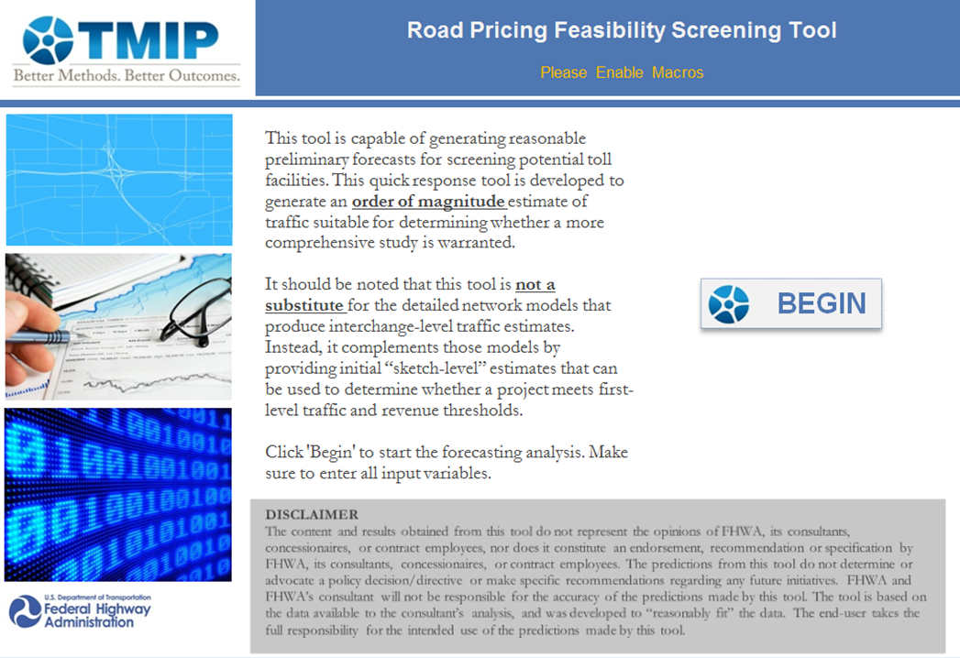
Summary - Road Pricing Screening Tool
Excel based tool created through the Travel Model Improvement Program (TMIP)
Based on an existing tool developed for Florida’s Turnpike Enterprise
Estimates toll road use based on statistical analysis of data from more than 40 operating toll roads
Can determine whether a potential corridor is a reasonable candidate for tolling, before conducting detailed modeling
Minimal data requirements
Provides future-year traffic and revenue estimates plus ranges of statistical uncertainty

Slide 4
Model Development

Slide 5
Data from Existing Toll Roads
Data were compiled from 28 operating toll roads
  Toll rate in cents/mile
  Average speed difference (miles/hour) between the proposed tolled facility and the fastest toll-free alternative
  Length of the proposed facility in miles
  Population within five-mile radius of the proposed facility’s interchanges
  Average annual household income of households within five-mile radius of the proposed facility’s interchanges
  Number of years since the opening of the facility

Slide 6
Summary of Existing Facilities

Slide 7
Summary of Existing Facilities (Example)

Slide 8

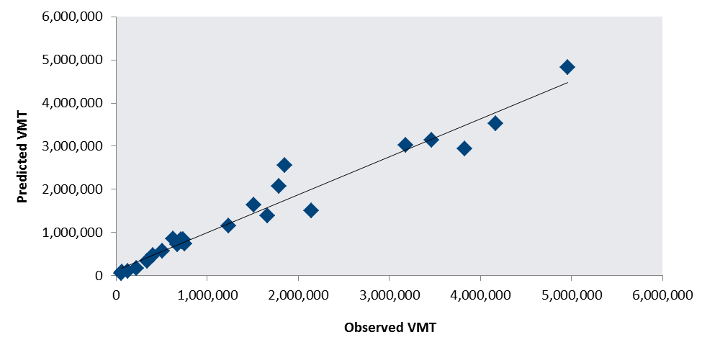
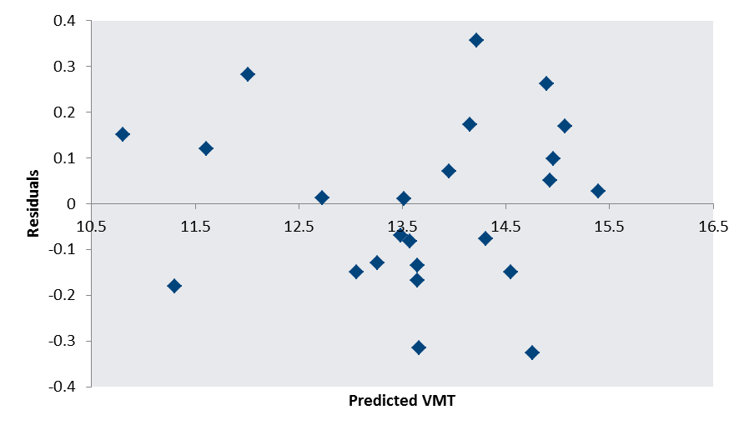
Statistical Model
Tested a variety of model forms and specifications - Cobb-Douglas form fits data best

Slide 9
Model Validation

Slide 10
Data from Existing Toll Roads
Data from an additional 13 facilities were used to test the model application

Slide 11
Model Application

Slide 12
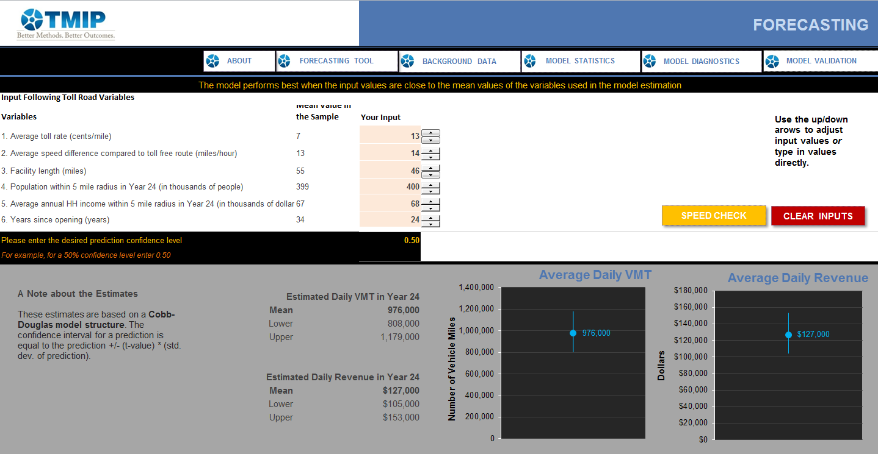
Model Application
Snapshot of the Spreadsheet Tool

Slide 13
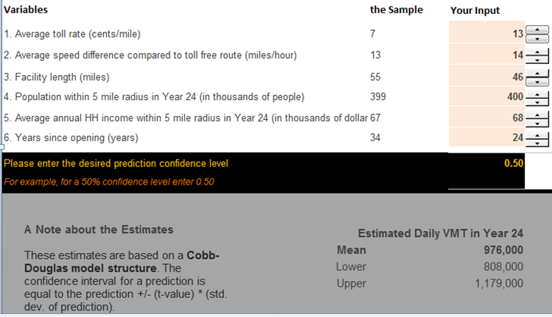
Inputs and Resulting VMT Estimates

Slide 14
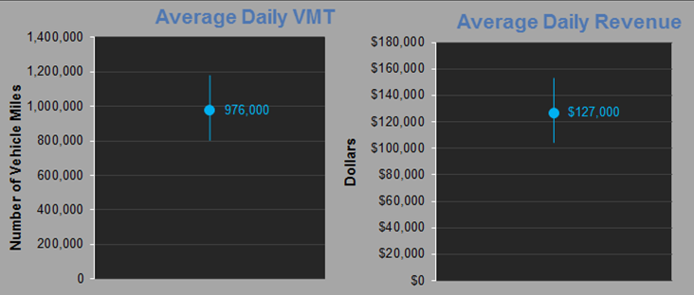
Estimates with Sampling Error Ranges

Slide 15
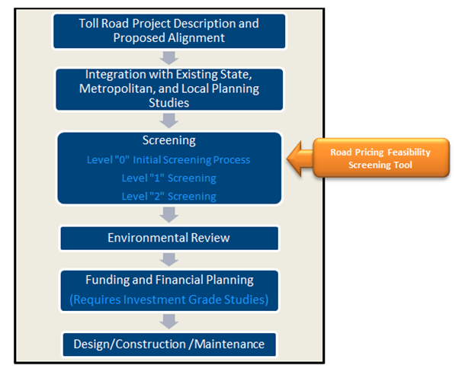
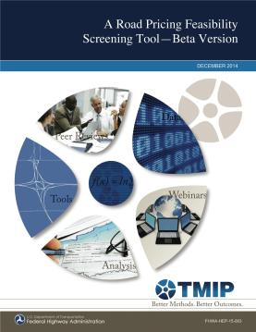
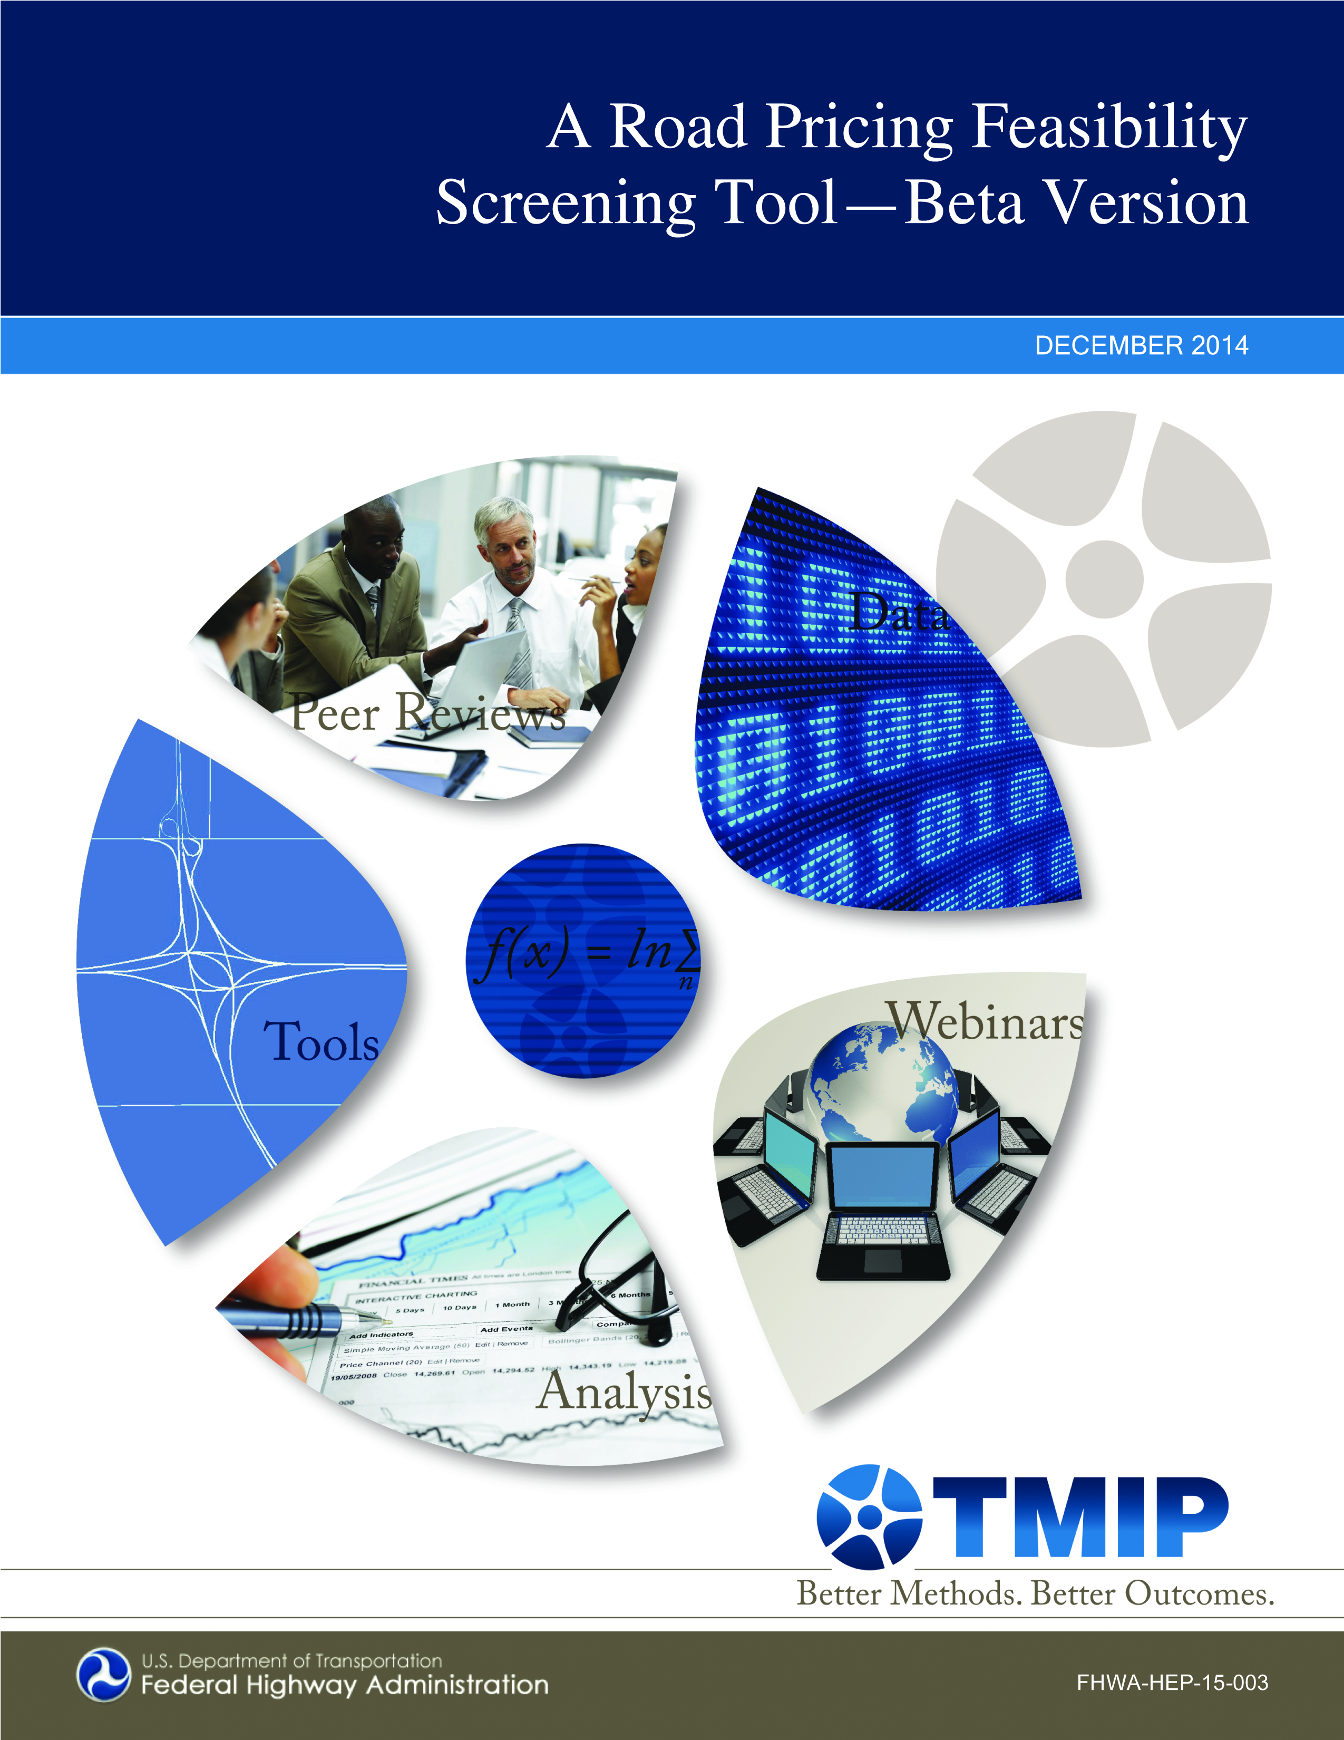
Model Application
Tool should be used during the Level “0” sketch level traffic and revenue study for the proposed toll road

Slide 16
Caveats and Future Work
Model is not designed to represent experience on managed lanes and toll bridges
Screening tool is not a substitute for a network-based model analysis and cannot predict diversions from or to parallel and intersecting facilities
Model was estimated using general vehicle miles of travel as a dependent variable; therefore, it does not distinguish among user classes
Finally, the analyses can, and should be, updated periodically to include the most recent traffic and population data and to include data from new/additional projects

Slide 17
Thank you…
Questions?

