Slide 1
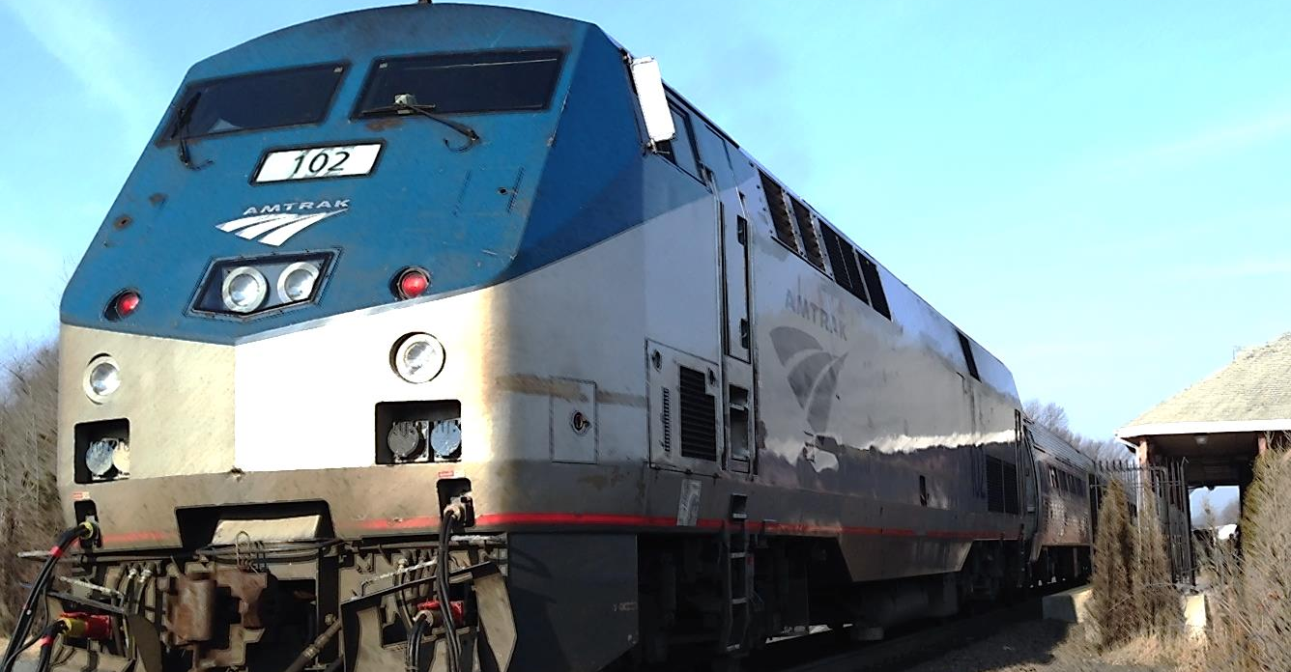
Ridership Forecasting for Central Corridor Passenger Rail Line Utilizing Cell Phone Data in Direct Demand Model
Miao(Mia) Gao, Travel Demand Modeler, HDR Engineering
Santanu Roy, Transportation Planning Manager, HDR Engineering

Slide 2
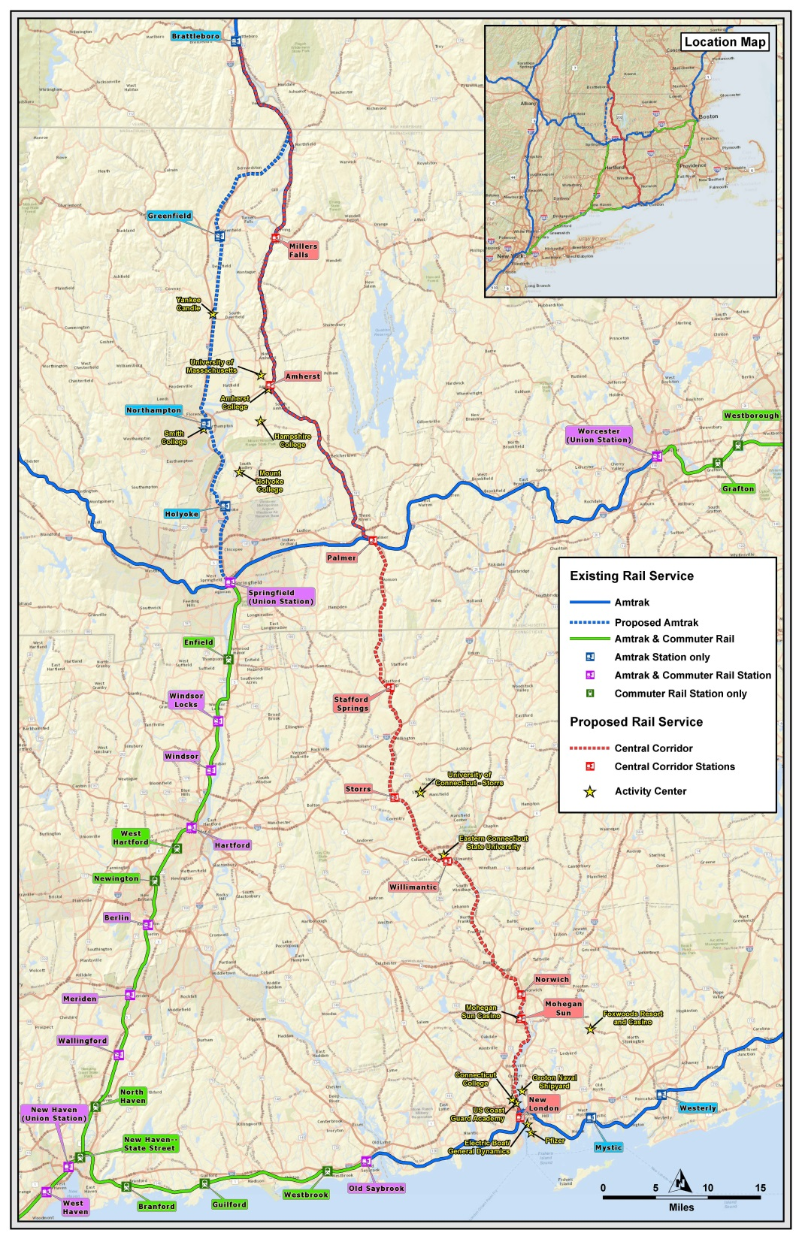

Background
Massachusetts DOT proposed the Central Corridor Line which is a 121-mile rail corridor that connects the cities of Brattleboro, Vermont and New London, Connecticut
Major Designations:
Two large state universities: U-Mass and U-Conn
Eleven smaller colleges such as Amherst College and Connecticut College
Mohegan Sun Resort and Casino

Slide 3
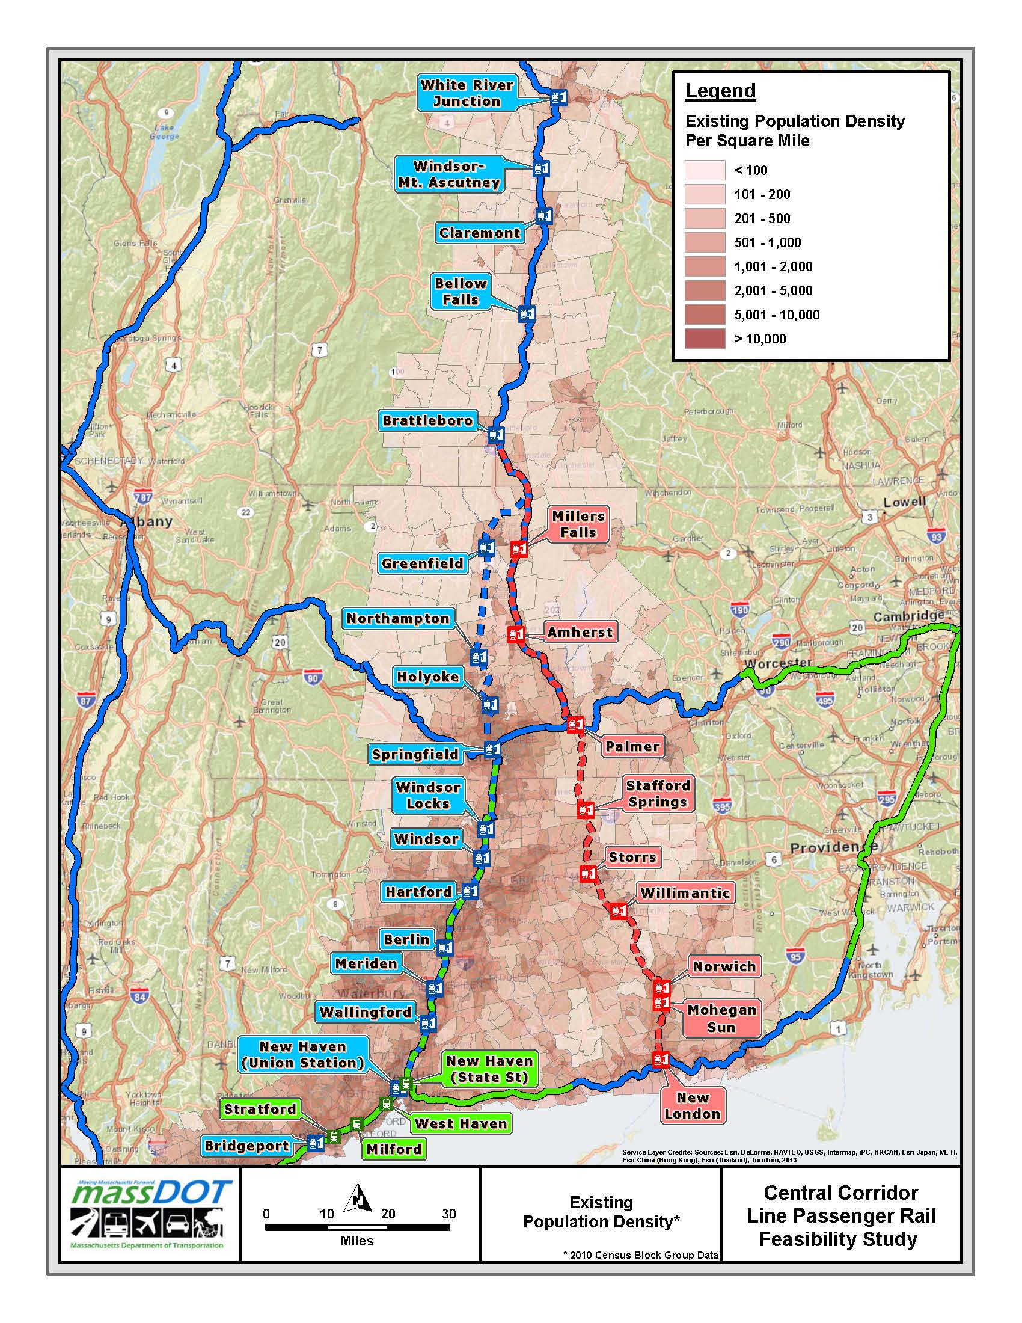

Methodology
Traditionally, four-step regional travel demand models have been utilized by the professionals for forecasting transit ridership
However, no readily available travel demand model existed for this multi-state corridor
The direct-demand travel models build a regression relationship between key independent variables and ridership
Based on previous study, this type of model produces reliable ridership projections appropriate for supporting a high level planning study such as this one.

Slide 4
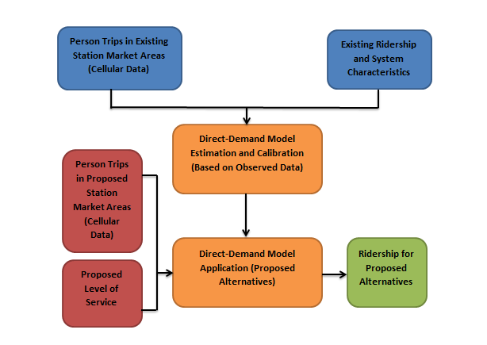
Methodology
The underlying assumption in the direct demand modeling approach is the observed railroad service usage in the existing area is an indicator of proposed and future railroad service usage
Three Key Steps
Data Assembly and Analysis of Existing Stations
Model Formulation
Data Assembly and Analysis of Proposed Stations

Slide 5
Methodology–
Data Assembly
Dependent Variable:
Ridership information for the existing
services was collected from Amtrak
Independent Variables:
Instead of collecting socio-economic data, person trips with in the primary market area (15 mile buffer) of each station are derived from cell phone
The total number of trains stopping at each station
Data on bus services and road network connections
Passenger railroad network structure

Slide 6
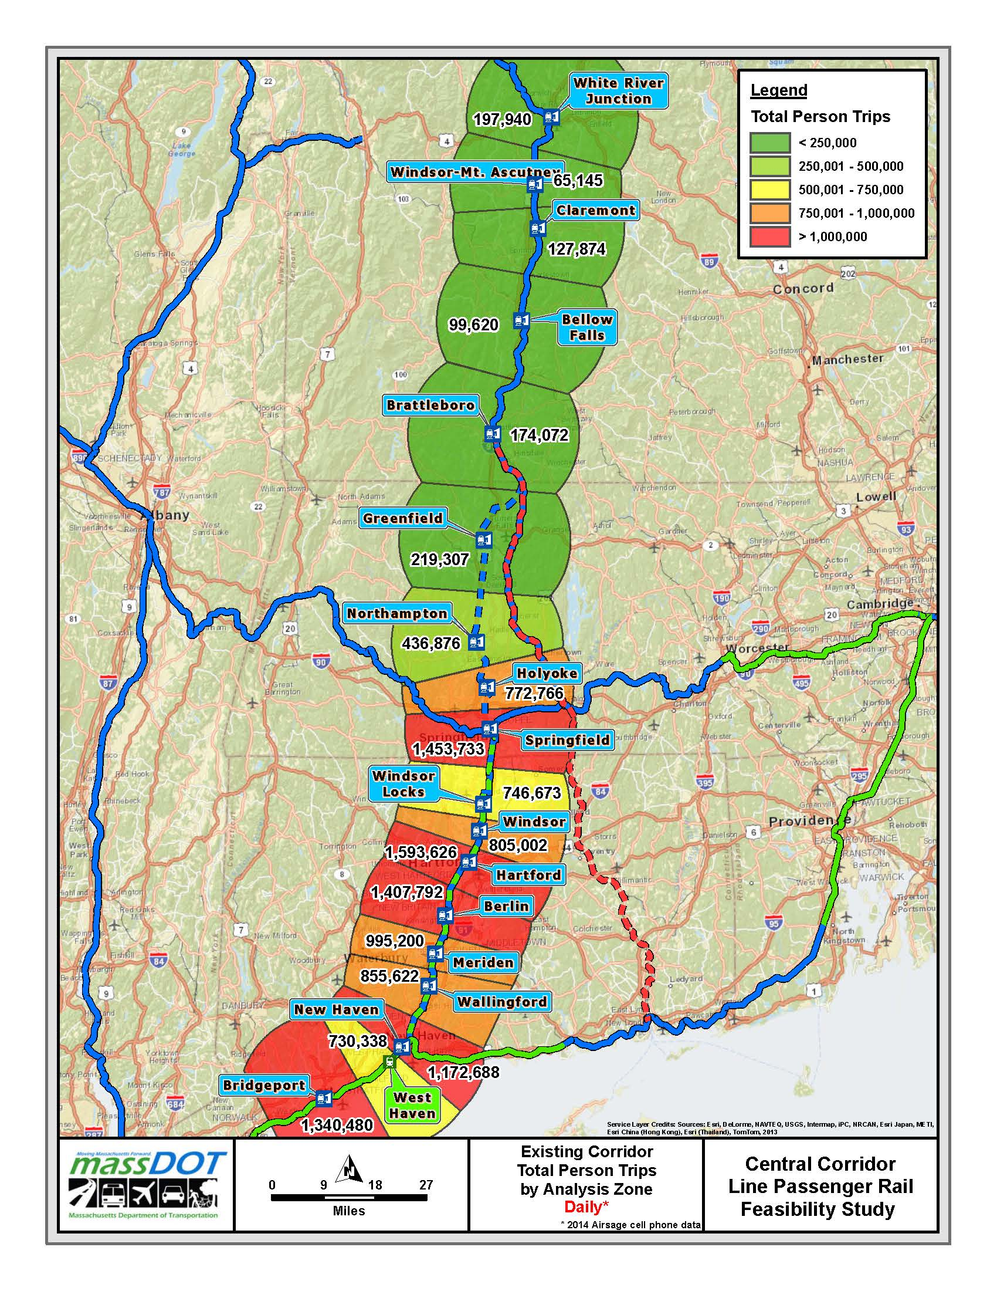
Methodology–
Data Analysis
Person Trips
As seen in the figure, there are five major cities in the knowledge corridor (Springfield, Hartford, Berlin, New Haven and Bridgeport) that have some of the highest person trips (between 1 million and 1 ½ million) within 15-mile of each station

Slide 7
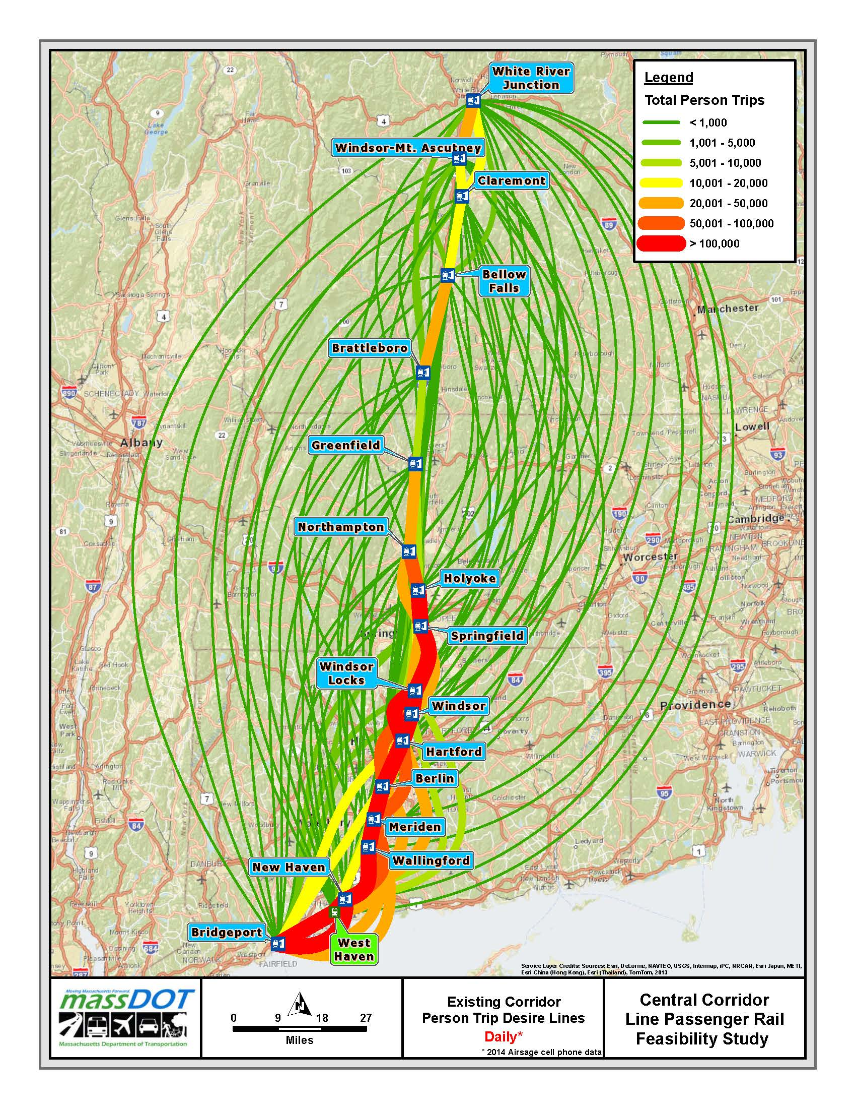
Methodology–
Data Analysis
Desire Line
As seen, most trips originate or are destined to areas having high population densities, confirming the validity and reasonableness of the cell phone data

Slide 8
Methodology–
Data Analysis
Hub Analysis
In order to reflect the physical important location associated with Springfield station (The union station of New Heaven-Harford-Springfield Corridor, Inland Route and Knowledge Corridor ), a hub variable was introduced as an independent varaible

Slide 9
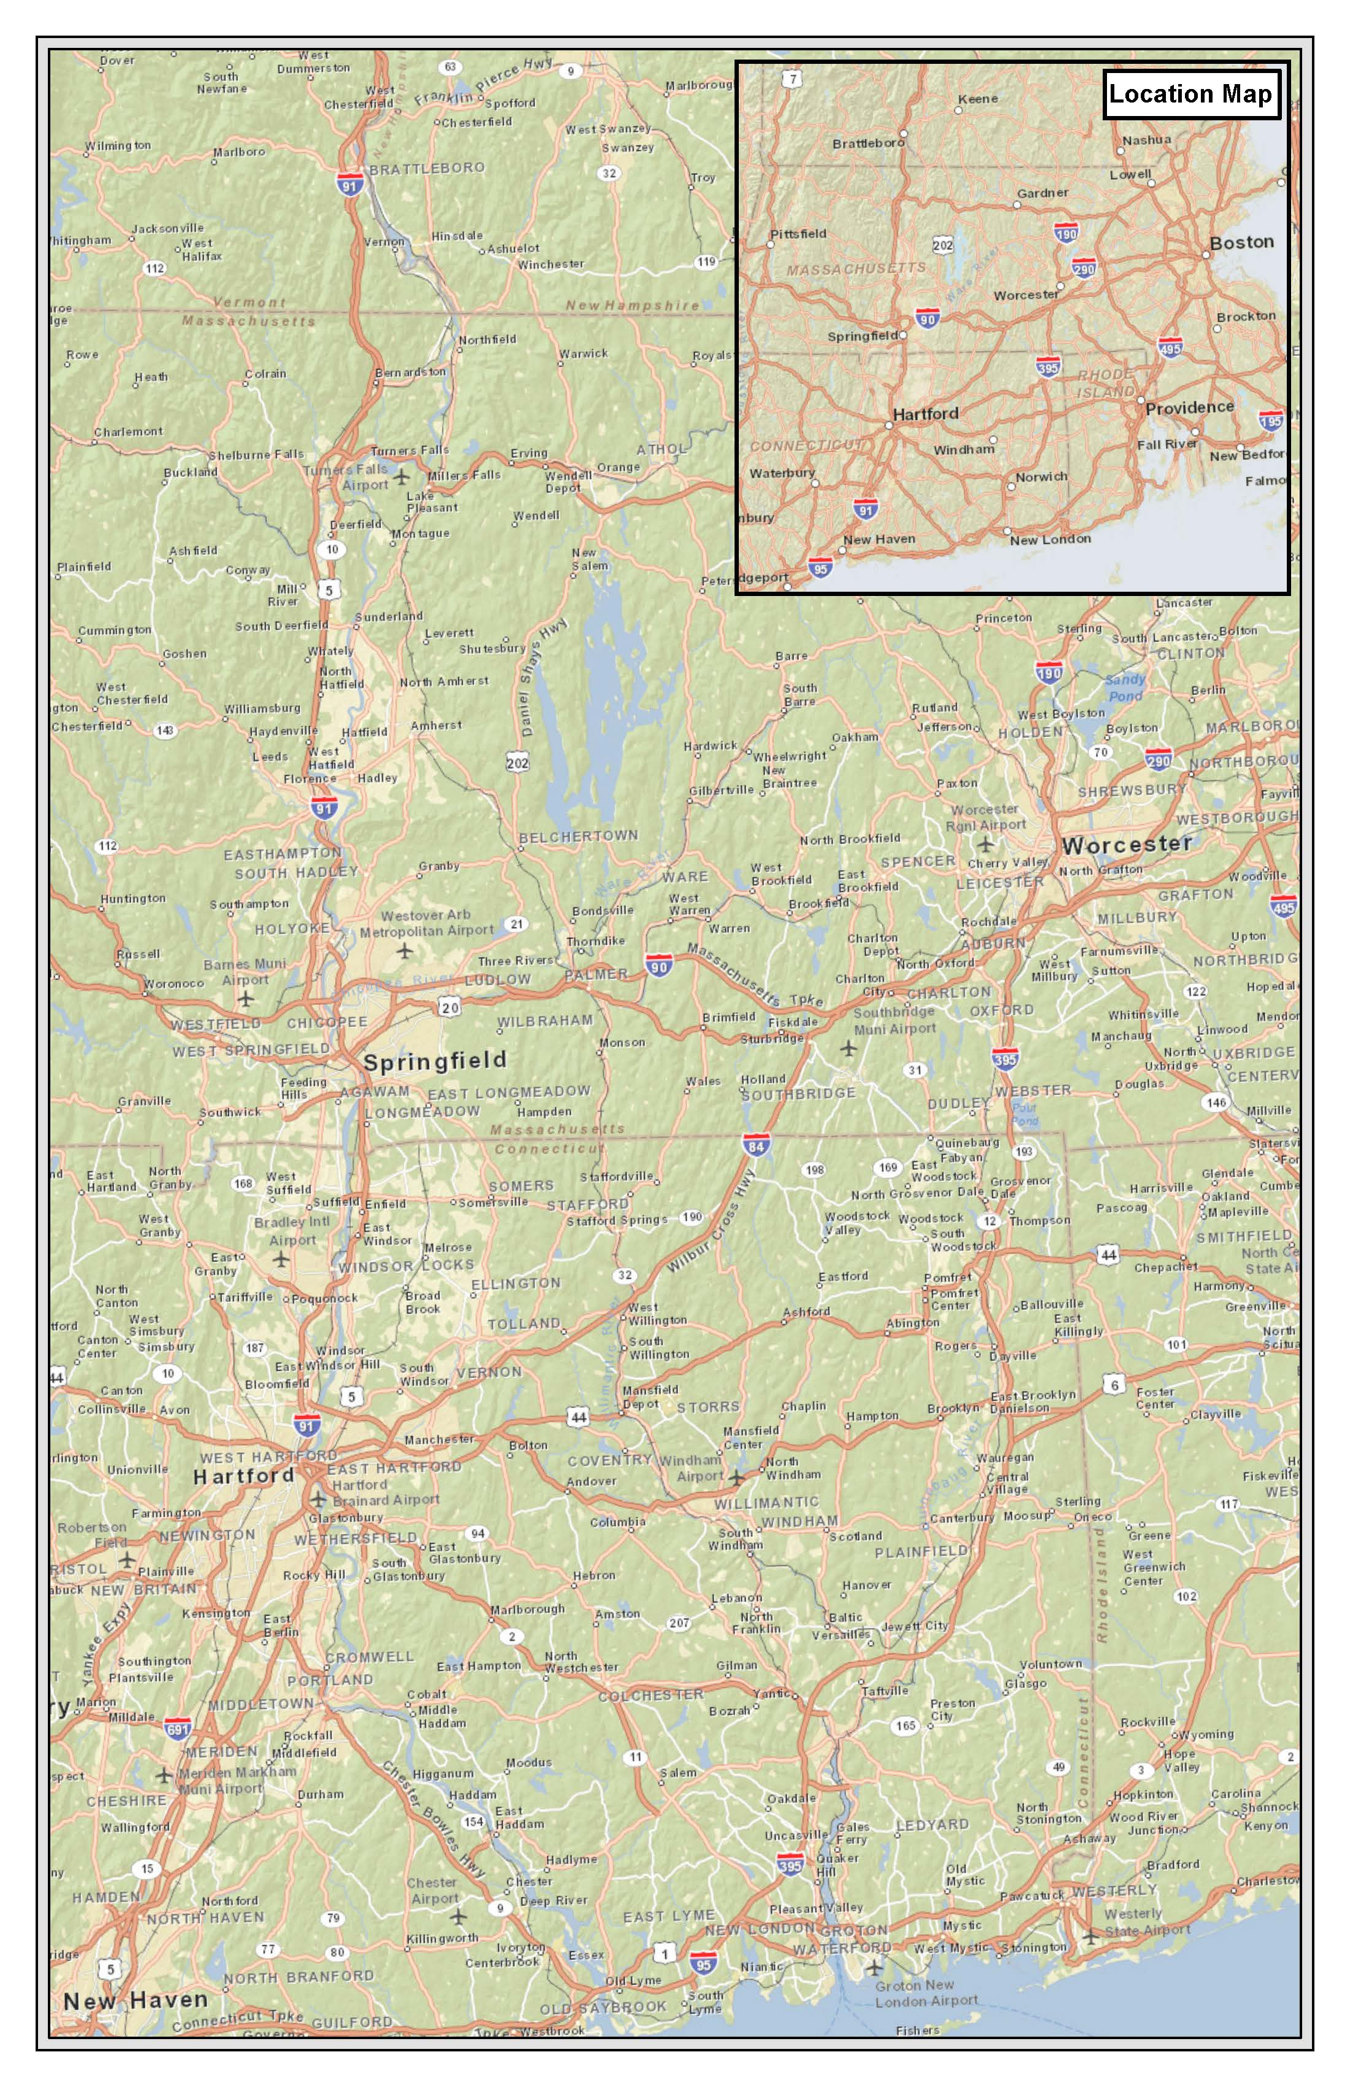
Methodology–
Data Analysis
Accessibility Analysis
In order to reflect the higher accessibility associated with Hartford station (two interstate highways, I-84 and I-91, pass through this capital city of Connecticut and 35 bus routes operate near the train station), an accessibility variable was introduced as a key independent variable

Slide 10
Methodology–
Model Formulation
The rail ridership at the station level (the dependent variable) is related to key independent variables. These variables can be person trips, number of trains operating daily, and other level-of-service parameters, fare, travel time, and etc.
During the process of model development, tests of different combinations of independent variables and data were conducted and evaluated

Slide 11
Methodology– Model Formulation
Final Dataset
Station | Number of Daily Boardings | Daily Person Trips | Daily Train Stops | Hub Dummy | Accessibility Dummy
White River Junction | 21 | 197,940 | 2 | 0 | 0
Windsor, VT | 2 | 65,145 | 2 | 0 | 0
Claremont | 3 | 127,874 | 2 | 0 | 0
Bellow Falls | 7 | 99,620 | 2 | 0 | 0
Brattleboro | 26 | 174,072 | 2 | 0 | 0
Springfield | 194 | 1,453,733 | 14 | 1 | 0
Windsor Locks | 26 | 746,673 | 12 | 0 | 0
Windsor, CT | 18 | 805,002 | 10 | 0 | 0
Hartford | 257 | 1,593,626 | 12 | 0 | 1
Berlin | 35 | 1,407,792 | 12 | 0 | 0
Meriden | 49 | 995,200 | 12 | 0 | 0
Wallingford | 23 | 855,622 | 12 | 0 | 0
Bridgeport | 110 | 1,340,480 | 15 | 0 | 0
Station: Existing stations where characteristics of existing rail services were analyzed
Number of Daily Boardings: Average number of people boarding the train at the existing Amtrak stations on a daily basis (derived from Amtrak data).
Daily Person Trips: Number of daily person trips within 15-mile buffer of the existing station (derived from cell phone data).
Daily Train Stops: Number of trains currently stopping at the station on a daily basis (derived from Amtrak schedule).
Hub: A variable that captures the impact of transfer activities and such on ridership, otherwise unexplained by the other variables. The variable value is either 1 or 0 depending on whether or not a station involves such activities.
Accessibility: A variable that captures impact of good accessibility to rail service on ridership, otherwise unexplained by the other variables. The variable value is either 1 or 0 depending on whether or not a station involves such activities.

Slide 12


Methodology–
Model Formulation
Direct Demand Model
$Daily Boardings=\left(3.86597{×10}^{−5}×Daily Person Trips\right)+\left(0.587245726×Daily Train Stops\right)+\left(129.9708413×Hub Dummy\right)+(187.9974064×Accessibility Dummy)$
$$R^{2}=0.96$$

Slide 13
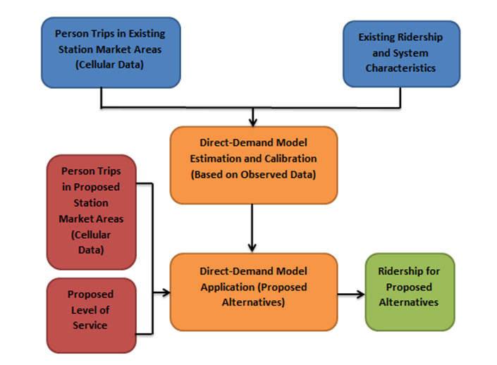
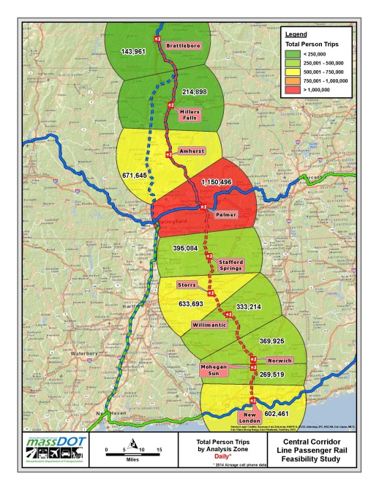
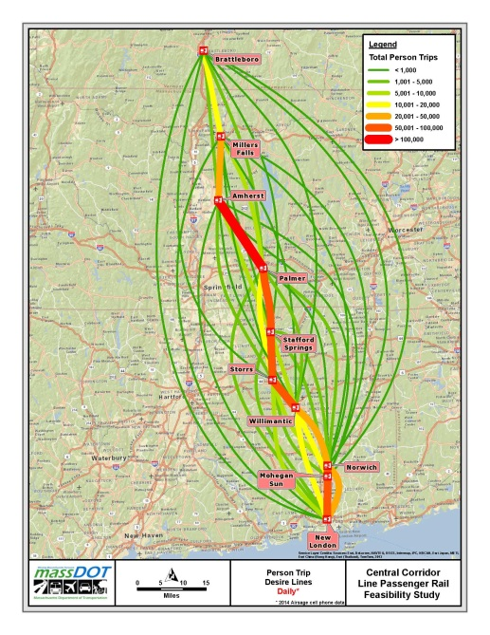
Ridership Forecasts
The ridership forecasts for the proposed future Central Corridor line were estimated by inputting the future corridor independent data to the validated direct demand model

Slide 14
Station | Daily Boardings
 | Scenario A | Scenario B | Scenario C
Brattleboro | 7 | 8 | 9
Millers Falls | 9 | 11 | 12
Amherst | 28 | 29 | 30
Palmer | 46 | 47 | 48
Stafford Springs | 17 | 18 | 19
Storrs | 26 | 27 | 29
Willimantic | 15 | 16 | 17
Norwich | 16 | 18 | 19
Mohegan Sun | 143 | 144 | 145
New London | 77 | 78 | 78
Total | 385 | 400 | 405
The total one-way travel time from Brattleboro to New London is estimated to be approximately 3 hours
Fares are assumed to be based on commuter rail-type distance based zone structure
Three different operating scenarios are being considered
Scenario A: Single train set
Scenario B: Two train sets
Scenario C: Three train sets

Slide 15
Summary
The total trip activity around each rail station is an important input to the model and in this study it was extracted from cell phone data covering the study area.
Given the nature of the proposed service, the travel market for intercity trips is limited. Once the market has been captured, simply increasing number of trains will not change the number of people needing to make the trip, which is not unusual for intercity passenger rail services in rural areas.
However, additional riders may potentially be captured in the corridor by changing the nature of the service being provided, such as increasing travel speed, reducing fare, and by making major land use changes over time.

Slide 16

Thank you!

