Slide 1
Modelling Intermediate Stops
Presented at
15th Applications Conference
Atlantic City May 2015
William G. Allen, Jr., PE
Consultant, Windsor, SC
Anna Hayes Gallup, PE
Charlotte DOT
Martin Kinnamon
Charlotte DOT
Notes:
I’d like to acknowledge my co-authors: Anna Gallup and Martin Kinnamon of Charlotte DOT. Martin is here to help answer the hard questions.

Slide 2
New Tour-Based Model in Charlotte
Simplified approach
Extension of Brunswick tour model
  presented in Reno, 2011
2012 standard home interview survey
Created in parallel with trip-based model
11 months, $70K
Notes:
I recently developed a new simplified tour-based model for Charlotte, North Carolina. I created this model structure in 2010 for small- and medium-sized areas that don’t have the resources to do a full activity-based model.
Charlotte did a travel survey in 2012 and I used that to update their trip-based model. They were interested in a more advanced model but didn’t have the resources for an activity-based model. So it looked like a simpler tour-based process would be right for them.

Slide 3
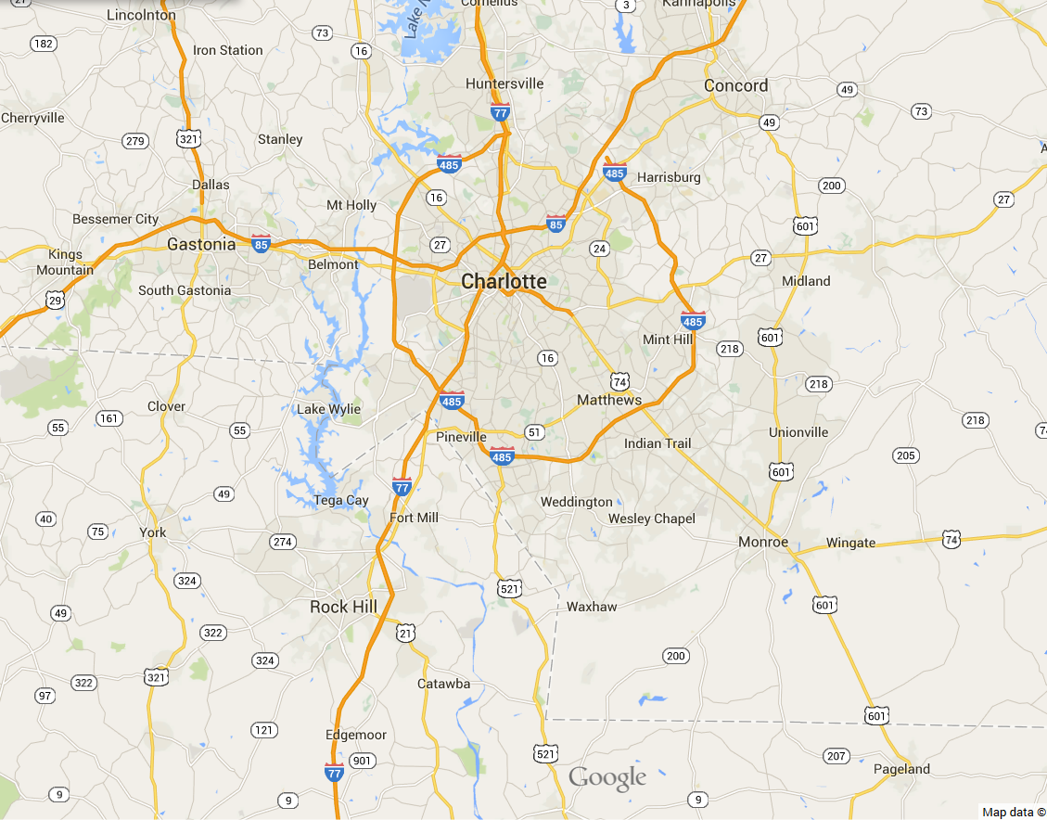
“Metrolina”
Notes:
The Charlotte area has about 2 million people and is located on the North Carolina – South Carolina state line. It includes 11 counties and 4 MPOs and is one of the fastest growing areas in the southeast. It’s the largest metropolitan area in North Carolina and is a major banking center. The dark blue line on this map is the state line.

Slide 4
What is an “Intermediate Stop”?
Travel is modelled as round-trip tours, between home and a major destination
  work, school, other
Intermediate stop is secondary activity
  shop or personal business
  for “other”, place of longest activity
Stops are related to tour main O & D
No more disjointed trip segments
Notes:
Intermediate stops are locations of secondary trip purposes that are made as part of a round-trip tour. When you analyze a travel survey to form tours, “home”, “work”, and “school” are the primary anchor points – the major origins and destinations of many tours. Of course, some tours are made entirely for shopping or personal business purposes.
But an increasing share of shopping and personal activities are made as stops within a tour that has some other main purpose. Once you know the main origin and destination of the tour, it’s easier to estimate the locations of these stops.
And as we all know by now, this is one of the key reasons to switch to tour-based modelling.

Slide 5
Simplified Tour Model Steps
HH synthesis
Tour frequency by purpose
Tour main destination choice by purpose
Number of stops by purpose, direction
Stop location by purpose, direction
Time of day (4 periods)
Truck tours
No mode choice yet
Notes:
This slide lists the major steps that make up the simplified tour-based model, as implemented in Charlotte. My presentation today focuses on the model to estimate the locations of the intermediate stops. This consists of several sub-models, stratified by tour purpose and direction.

Slide 6
Challenges in Modelling Stops
Few patterns are evident
Survey geocoding always suspect
Must limit search geography
Keep outliers from influencing calibration
  weird patterns do occur
Notes:
One advantage in modelling stops in a tour-based model is that you know the origin and major destination of the tour. For most tours, you’d think that any intermediate stops would be located somewhere BETWEEN the tour origin and destination. But not always. People don’t always behave logically. And many of the factors that influence stop location are things like store opening and closing hours, and the logistics of getting your ice cream home from the grocery store before it melts.
These are things that will never be in any database.

Slide 7
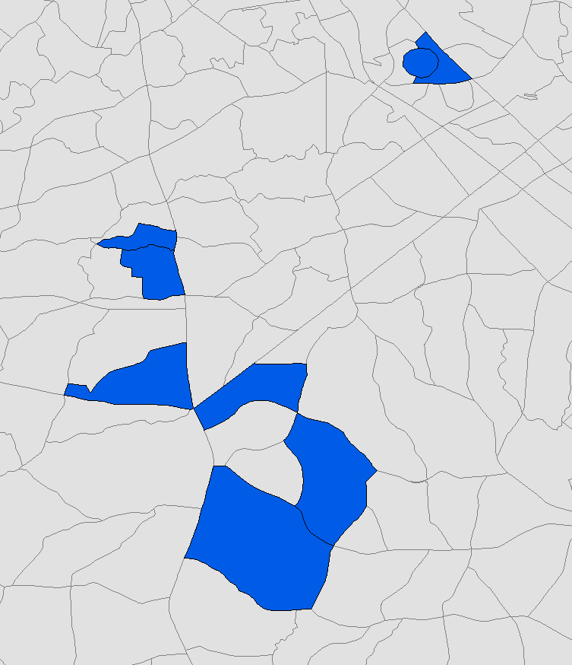
Actual Work Tour
3
7
6
4
2
5
8
1
destination
origin
Notes:
Here’s a diagram of an actual work tour in Charlotte. The tour origin and destination zones happen to be next to each other. But the person made 6 intermediate stops between the origin and main destination, and they are all over the place.

Slide 8
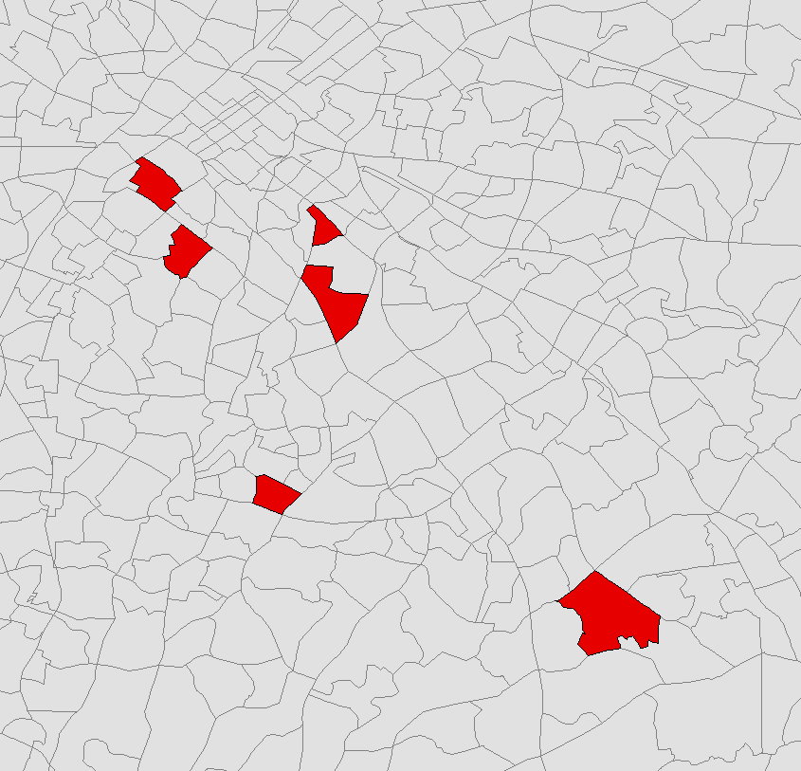
Actual Non-Work Tour
5
destination
1
origin
4
2
3
Notes:
This diagram of an actual non-work tour also shows some of the weird patterns that can occur. This also serves as a reminder of the need for extremely good geocoding.

Slide 9
Model Estimation
Logit model, similar to Destination Choice
“Size” variables, detour time, zonal attributes
Estimate with ALOGIT
Consider selected stop zone + 9 others
Other candidates selected at random
  tried importance-based sampling
  random selection worked better
Notes:
The model of stop location is a logit model, very similar to the tour destination choice model. It includes zonal size variables, detour time, and zonal attributes. There are over 3,000 zones in the Metrolina model and as most of you know, you can’t consider all possible zones in the estimation of the coefficients. In this effort, I used 10 zones: the actual stop zone plus 9 alternatives.
Now a key question is: how do you select the alternative zones? Recent work by John Bowman and others has suggested that it is best to do a weighted selection, in which zones have been pre-stratified by their importance. I tried that approach, but it didn’t work very well. I then tried picking the 9 alternatives completely at random and that produced better model coefficients.

Slide 10
Stop Frequency
Notes:
This graph shows that the number of stops varies by purpose. About 60% of tours have no stops in either direction. Shopping tours are the most likely to make stops and School tours are the least likely, which seems logical.

Slide 11
Original Version (Brunswick)
Different models by purpose, direction
(P-A, A-P)
Stop location influenced by tour O/D, jobs, area type, detour time
Stops are independent of each other
Less accurate but simpler
Notes:
The first model of this type that I developed was in Brunswick, GA. In that version, I used different stop location models by purpose and direction. I treated each stop as being independent of the other stops. This is less accurate but produces a simpler model.

Slide 12
Enhancement for Charlotte
Looked more closely at stop locations
Some dependencies between stops
Tour purpose not so important
Stop sequence is important
Income mattered, too
  higher income = more sensitive to detour time
Notes:
In Charlotte, I looked more closely at tours with multiple stops. It will come as no surprise to learn that the stop locations are in fact not independent of each other and that the sequence of stops is important. I also found that higher income travellers were more sensitive to detour time, which makes sense.
The trick is to find a way to include the stop sequence in the model without making it overly complicated.

Slide 13
Detour Time
stop
10
5
origin
12
destination
detour time = 10 + 5 – 12 = 3
Notes:
I mentioned “detour time” a minute ago. This is simply the time you have to go out of your way to get to any particular intermediate stop. In general, travellers try to minimize their detours, subject to a bunch of other factors.

Slide 14
Change the Groups
Based on tour purpose, HH income, stop sequence number
Income groups:
  lower 50%
  higher 50%
Influenced by sample size
  not a lot of multi-stop tours
Explicitly models stop sequencing
Notes:
So, how can you include the stop sequence without making things too convoluted? I changed the way the stop location models were stratified.
Instead of doing separate stop location models by purpose, I grouped some of the purposes, split the sample by high versus low income, and looked specifically at the stop sequence number.

Slide 15
New Hierarchy
HBW, stop 1, low inc
HBW, stop 1, high inc
HBW, stop 2
SCH / HBU, stop 1
HBS / HBO / ATW / EXT, stop 1, low inc
HBS / HBO / ATW / EXT, stop 1, high inc
All non-work, stop 2
All purposes, stop 3
All purposes, stops 4-7
Notes:
This list shows the final stop location models. There are 3 work models, depending on income and which stop we’re modelling. School and university are a separate model. The other non-work purposes are split by income. For more than 2 stops, there were too few observations to reliably stratify the models by purpose.

Slide 16
Zone More Likely to Be a Stop If...
Lower detour time (esp. < 10 min.)
More development (esp. retail emp.)
Accessibility to jobs
Urban area type
Closer to CBD
For multi-stops
  lower time from last stop
  closer to tour destination
Notes:
The final stop location models were all fairly logical. A zone was more likely to be a stop, given the attributes that you see here. These results seem reasonable.
The big difference compared to the Brunswick model was the explicit treatment of multi-stop tours. It makes a lot of sense that the location of the 2nd stop was related to the location of the 1st stop. And similarly for the 3rd, 4th, 5th, and 6th stops.

Slide 17
Sequencing is VERY Difficult
Establishment opening & closing times
Sequencing for certain purposes
  do grocery shopping last
  serve passenger: pick-up / drop-off sequence
Requires data that is unavailable
Notes:
Modelling the sequence of intermediate stops accurately is very difficult. This is because most of what influences the particular sequence of stops is unknown to the model. So we’ll never have the information needed to REALLY know why a person made his stops in a particular order. Fortunately, overall model accuracy is not extremely sensitive to the sequencing of stops. What’s more important is to get the stops in the right zones. I think that including the stop sequence number helps to do that.

Slide 18
So What?
Simple stratification by purpose is insufficient
Work / school / non-work distinction matters
  but non-work purpose distinction not very important
Stop sequence IS important
  difficult to model, but worth trying
  greater accuracy in stop locations
Notes:
So what are the major findings?
Stratifying the stop location model by purpose is easy but not very accurate. You need to look at the order of stops.
It’s OK to group the non-work purposes together, but you need to consider the stop sequence number. This does complicate the model somewhat, but I believe the results are worth it. It appears that including the stop sequence number makes the estimated stop locations more accurate.

Slide 19
Questions?
(803) 270-7114
wgallen@isp.com
www.williamgallen.com

