Slide 1

Understanding dimensions of telecommuting:
Options, choice and frequency of telecommuting
in Southern California
Bayarmaa Aleksandr (SCAG)
Hsi-Hwa Hu (SCAG
Guoxiong Huang (SCAG)
Mana Sangkapichai (SCAG)
November , 2014

Slide 2
Outline
Overview of SCAG ABM
Background of Telecommute
Data source and preliminary analyses
Work At Home
Telecommuting
Summary

Slide 3
SCAG ABM
Motivation: RTP Guideline by California Transportation Commission - the largest four MPOs in California are encouraged to transition to activity-based travel demand models
Model Concept: SCAG-ABM is an activity-based, simulates the entire weekday travel pattern of each person in the SCAG region (18+ million):
derives travel from activity participation decisions
explicitly accounts for within household interactions
incorporates spatial and temporal constraints and influences when predicting activity participation and travel
Model Application:
- Built in new TransCAD 7.0
operates on a detailed representation of the region’s population, land use and transportation networks
.

Slide 4
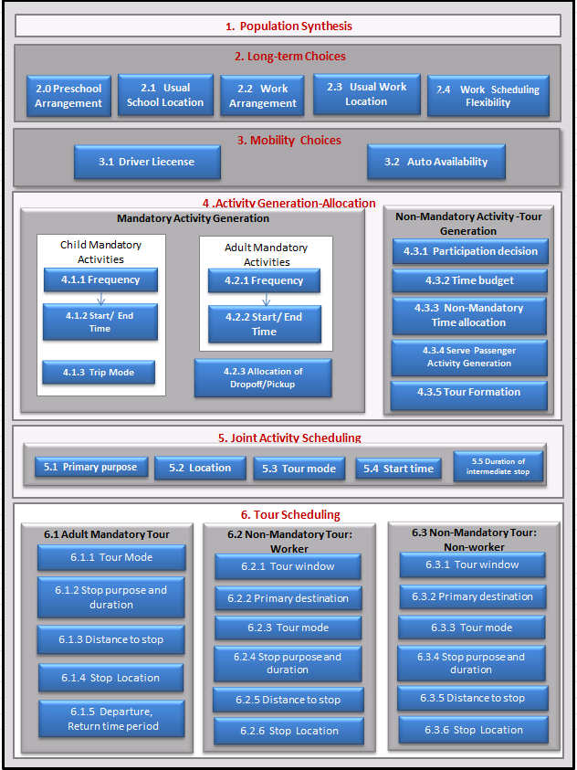
SCAG ABM

Slide 5





Segmentation
Person types:
  Worker
  College student
  High school Student
  Adult non-worker
  Children 6-15 years old
  Children 0-5 years old
Activity types:
  Work
  School/College
  Escort
  Shopping
  Maintenance
  Social
  Entertainment
  Visiting family and friend
  Active recreation
  Eating out
  Work related
  Other

Slide 6
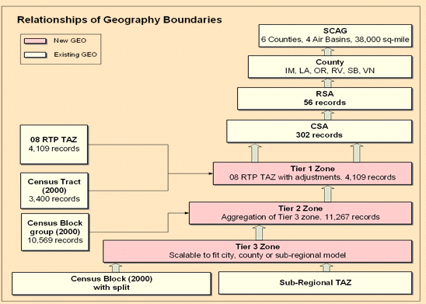
Spatial resolution

Slide 7
Temporal resolution
Five time periods used for skimming and assignment
  AM Peak (6:00 AM to 9:00 AM)
  Midday (9:00 AM to 3:00 PM)
  PM Peak (3:00 PM to 7:00 PM)
  Evening (7:00 PM to 10:00 PM)
  Night (10:00 PM to 6:00 AM)
15-minute and 30-minute resolution for scheduling primary activity of a tour, extended to continuous
Continuous for scheduling all other activities

Slide 8
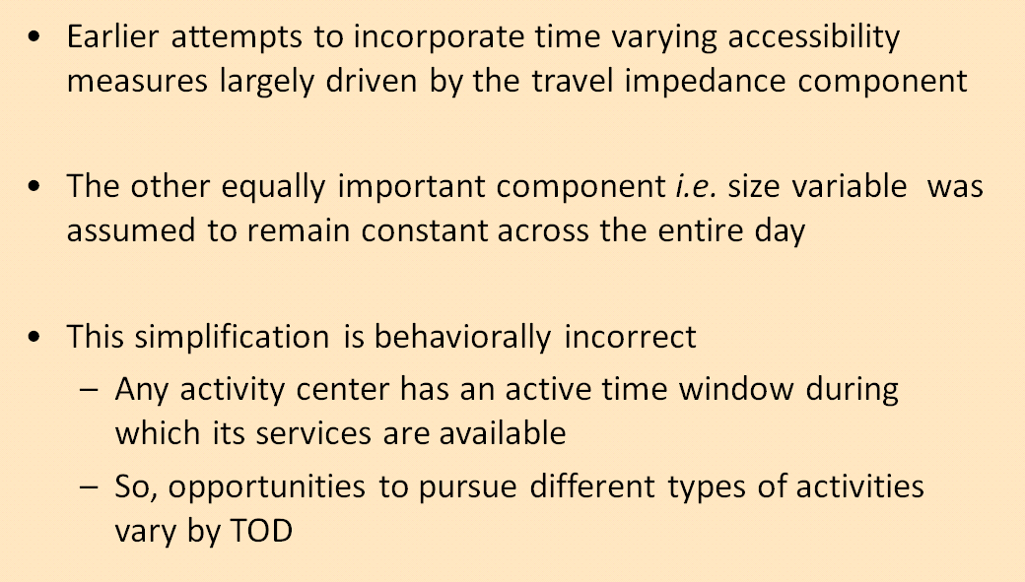
Time-varying Accessibility Measures

Slide 9
Background of Telecommuting
Telecommuting is continuing to very rapidly develop as a normal way of working in the United States (U.S) and elsewhere (e.g. Salomon, 1986; Mokhtarian, 1991; Pendyala et al. 1991; Koenig et al. 1996; Hjorthol and Nossum, 2008)
An important Travel Demand Management (TDM) action that could reduce roadway congestion and Greenhouse Gases (GHG) emissions, and thus saving energy and improving air quality in the region (Nilles, et al., 1976)
The actual amount and impact of telecommuting in any particular region, however, will depend on particular travel demand measures in place and other aspects such as local condition and local transportation and land use environment
Interactions between transportation systems and telecommunications applications
  Substitution- assumes that some demand for travel will be replaced by telecommunications
  Modification - telecommunications technology to increase the use of transportation systems (a shift in timing, location, linking and trip chaining)
  Complementarity-refers to the situation where both transportation and telecommunications systems will enhance the efficiency of each other
  Neutrality- telecommunication has no foreseeable effect on trip making

Slide 10
Defining telecommuting
There is no common definition of telecommuting
"the partial or total substitution of telecommunications, with or without the assistance of computers for the daily work trip" (Nilles et al., 1976).
Most of researchers have tried to establish their own definitions of the concepts. Some of the common definitions, on a more general level, are as follows:
“ working at home or at an alternate location and communicating with the usual place of work using electronic or other means, instead of physically travelling to a more distant work site” (AQMD, in Moktharian, 1991)
... the combination of flexiplace, flextime and electronic communication (Kugelmass, 1995, p. 20)
Teleworking is defined ... as working at home or a location closer to home than the regular workplace, using information and communication technology (ICT) to support productivity and communication. (Choo et al., 2005, Hjorthol and Nossum 2008)

Slide 11



SCAG-ABM
Type 1
Work at home= Home office
Type 2
Telecommute=Teleworker
a person who works exclusively from home
a person who works regularly, but not exclusively, at home.

Slide 12

SCAG ABM:WAH sub-model
Person and Household Characteristics; Industry
  Home
  Out of home
If home is not
the work place
2.3 Usual Work
Location
Primary work place type

Slide 13
Work at Home Model
 | Variable | Beta - Specific to Choice Alternatives
 |  | 0 | 1 (WAH)
Constant | Constant |  | -3.440
Gender | Female |  | -0.070
Age | Less than 35 |  | -0.514
 | 35-44 (reference)
 | 45-54 |  | 0.239
 | 55-64 |  | 0.348
 | 65 and older |  | 0.847
Household Income | 50K-100K |  | 0.235
 | >100K |  | -0.283
Industry | Agriculture, Mining |  | -1.175
 | Constuction, Utility |  | -0.766
 | Manufacturing, Wholesale |  | -0.929
 | Retail, Other Service |  | -0.390
 | Information, Business Service |  | 0.201
 | FIRE (Finance, Investment, Real Estate) |  | 0.570
 | Arts, Entertainment, and Hospitality, Food Service |  | -0.421
 | Public administration |  | -1.699

Slide 14
Type 2: Telecommute
Data sources:
California Household Travel Survey February 2012 through January 2013
2012 SCAG Travel survey (CHTS add-on)- 2,486 households
Survey question:
Does your employer offer an option of working at home instead of going into your work place?
How many times in the last month did you work at home?

Slide 15
Telecommuting dimensions by AGE
worker who have option to telecommute
 | Yes | No
AGE
16-24 | 3% | 97%
25-44 | 20% | 80%
45-60 | 19% | 81%
60+ | 28% | 72%
Total | 19.5% | 80.5%
Given the option, “Choice” to telecommute
 | Yes | No
AGE
16-24 | 2% | 98%
25-44 | 14% | 86%
45-60 | 12% | 88%
60+ | 16% | 84%
Total | 13% | 87%

Slide 16
Daily travel characteristics telecommuters versus commuters

Slide 17
“ Option” to telecommute
Variable | Beta - Specific to Choice Alternatives
 | 0 | 1
Constant |  | -4.412
Age
Less than 35 |  | -.411
35-44 (reference)
45-54 |  | -.506
55-64 |  | -.201
65 and older |  | -.103
Education : Bachelor and higher |  | .653
Has flexible working schedule |  | 2.168
Has compressed working schedule |  | .529
Industry
Agriculture, Mining |  | 1.214
Constuction, Utility |  | .726
Manufacturing, Wholesale |  | .148
Retail, Other Service |  | -.327
Information, Business Service |  | .991
Education & Health/Social Service
FIRE (Finance, Investment, Real Estate) |  | 1.328
Arts, Entertainment, and Hospitality, Food Service |  | .226
Public administration |  | -.038

Slide 18
Frequency of Telecommuting
Never
once a week
twice a week
More
than 2
Multinomial model structure

Slide 19
Estimation result
 | never | once a week | twice a week | More than 2
 | 1 | 2 | 3 | 4
Constant | 1.085 |  | -0.352 | 0.788
Female | -0.669 |  | 0.082 | 0.322
Household income | -0.826 |  | -0.146 | -0.558
Information, Business Service | -0.385 |  | -0.756 | -0.962
FIRE (Finance, Investment, Real Estate) | -0.590 |  | -0.745 | -0.789
Presence of small children | -0.615 |  | -0.660 | -0.177
Smart phone | -0.608 |  | -0.122 | -0.235
Age 50 years old + | 0.422 |  | -0.172 | -0.070
Number of vehicles in a household | -0.576 |  | -0.227 | -0.112
Jobmix (9 sectors) | 1.561 |  | 0.000 | -0.739

Slide 20
Summary
Work at home and telecommuting are important TDM action that could reduce roadway congestion and GHG.
Understanding key factors in WAH and telecommuting behavior
Incorporation in travel models: WAH
Considers the supply dimension “ Option” of telecommute to analyze telecommuting behavior
Future Enhancement:
  More data and sample
  Consider other factors: land use and technology
  Incorporation in travel models: Telecommuting

Slide 21

Thank you
Question?
Bayarmaa Aleksandr, aleksandr@scag.ca.gov

