Slide 1
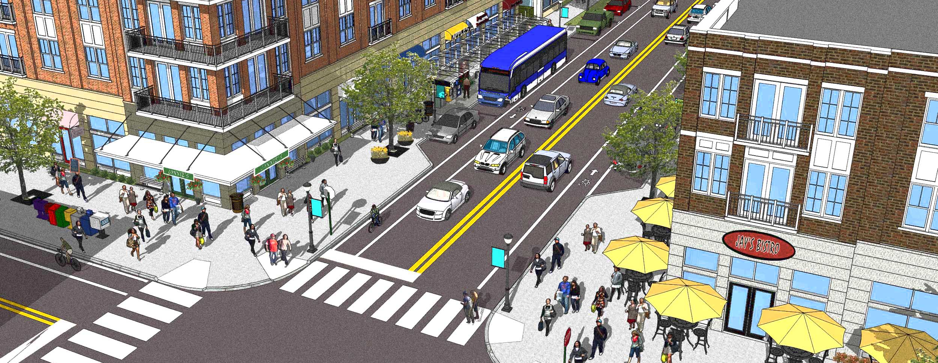
A GIS-BASED ACCESSIBILITY APPROACH FOR ESTIMATING NON-MOTORIZED TRAVEL DEMAND
Alex Bell, AICP
May 18, 2015

Slide 2
NCHRP REPORT 770
Performed as NCHRP Project 08-78: New tools for estimating walking and biking demand
Published as Report 770 (August 2014): A Practitioner Guidebook
Research Team:
  Renaissance Planning
  Fehr & Peers
  University of Texas Austin
  NuStats
  Specialist Consultants:
Mark Bradley -- John Bowman -- Keith Lawton -- Richard Pratt
INTRODUCTION

Slide 3

PROJECT PURPOSE
Important planning questions unanswered:
  What is the potential for walking and biking?
  What is the relationship with land use/built environment?
  How important are facilities?
  How critical are land use and walkability to transit and TOD?
  What impact on auto use & VMT?
Major gap in existing planning tools
  Regional TAZ-based forecasting models too coarse
  Practitioner facility demand models not “choice based” (can’t get at traveler, trip purpose, destination, etc.)
INTRODUCTION

Slide 4
RESEARCH FINDINGS
Bicycle and Walk must be treated separately:
  different distances, facility needs, purposes, users
Lots of “research” – not so many useable tools:
  Data limited (counts and behavior)
  Bike focused on route choice, walk on intersections
  Not much on walk or bike as “travel choices”
INTRODUCTION

Slide 5
NEW TOOLS FROM NCHRP 08-78
Tour Generation & Mode Choice
(Mark Bradley)
Seattle/ PSRC
Enhanced 4-Step Process
(Kara Kockelman)
GIS-Based Accessibility Approach
(Renaissance)
GIS-Based Accessibility Approach
(Renaissance)
Arlington/ MWCOG
Arlington/ MWCOG
INTRODUCTION

Slide 6
ARLINGTON GIS ACCESSIBILITY APPROACH

Slide 7
CORE CONCEPTS OF ACCESSIBILITY
DISCUSSION OUTLINE
1
2
TOOLS AND DATA RESOURCES
3
INTERPRETING OUTPUTS
NCHRP 770 SPREADSHEET TOOL (WALC TRIPS XL)
EXAMPLE APPLICATION

Slide 8
CORE CONCEPTS OF ACCESSIBILITY
1
1

Slide 9
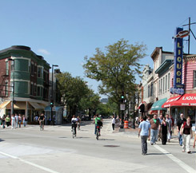
A SIMPLE AND POWERFUL PREMISE
Accessibility is a direct measure of a fundamental question:
“WHAT OPPORTUNITES ARE AVAILABLE TO ME?”
As accessibility increases, so too do opportunities
Accessibility increases through improvements to activity patterns and transportation networks
In short, the more activities I can reach by walking, the more likely I am to walk. The network’s job is to connect me to those activities directly and safely.
CORE CONCEPTS

Slide 10
ACCESSIBILITY AS A FRAMEWORK
Land
Use
Opportunities
Number
Variety
Proximity
ACCESSIBILITY =
Transportation Network
Travel Time
Connectivity
Directness
Safety
CORE CONCEPTS

Slide 11
TOOLS AND DATA RESOURCES
2
1

Slide 12
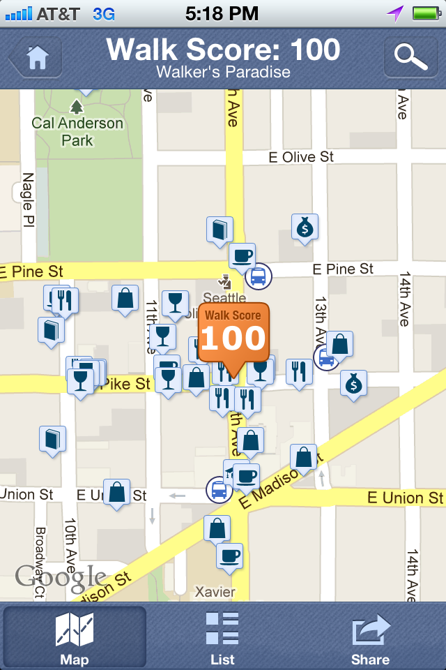
GIS ACCESSIBILITY MODEL
Wanted a menu of tools for different situations
Liked idea of “Walk Score” – try to operationalize
Had access to great resources:
  Recent travel survey (MWCOG)
  Great GIS data on employment (Dun and Bradstreet, InfoUSA)
  Support of MWCOG and Arlington County
MODEL DEVELOPMENT
Notes:
Approach needed to be transferable to various geographic contexts and flexible to suit a variety of analytical needs
Walk Score good – how do we get control over the inputs – altering networks and land uses
Used data provided by our partners in the region, who were extremely supportive of this effort

Slide 13
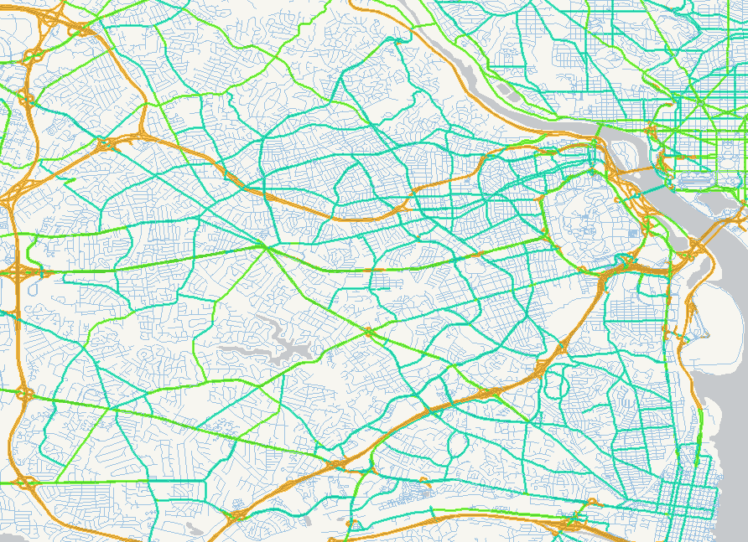
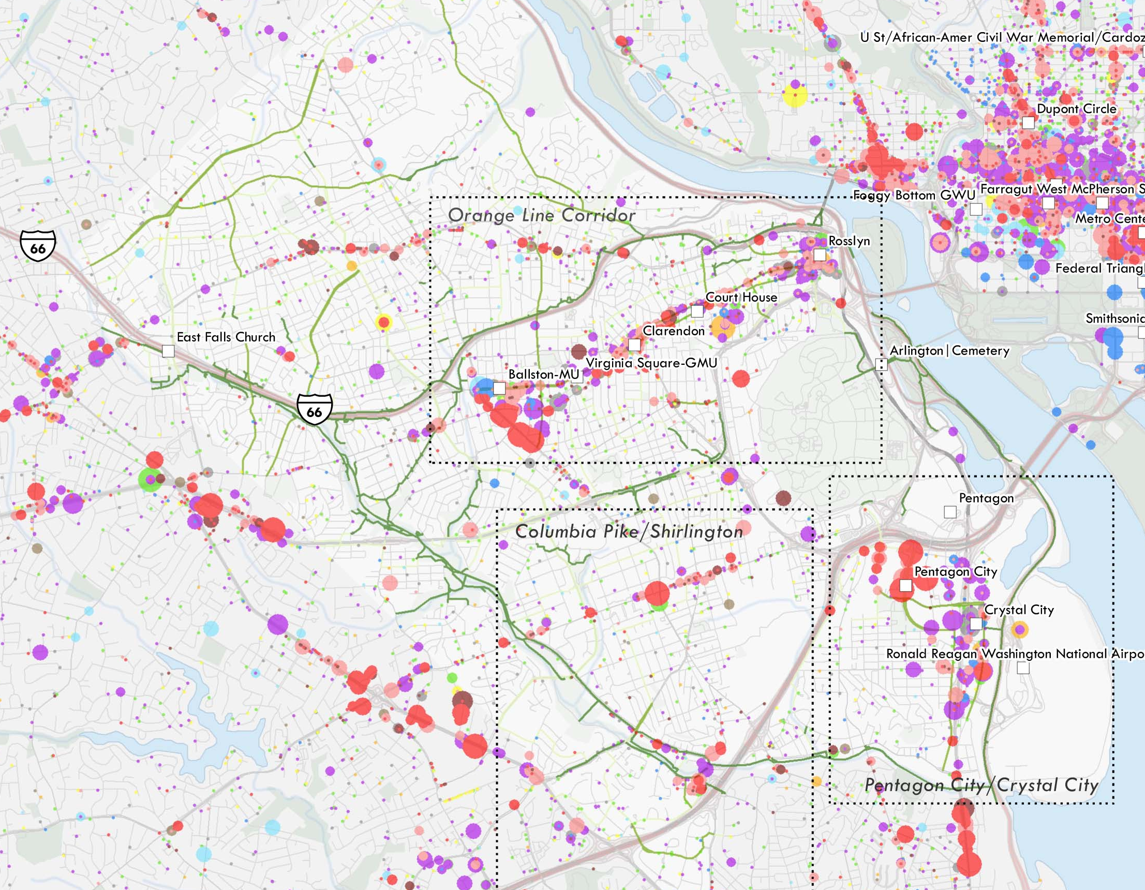
DATA NEEDS
GIS RESOURCES
Transportation connections
Land use
Detailed network data
example: NAVTEQ, augmented with bike facilities data
Detailed employment data
example: Dun and Bradstreet points
MODEL DEVELOPMENT

Slide 14
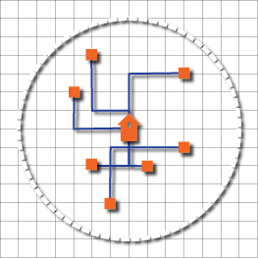
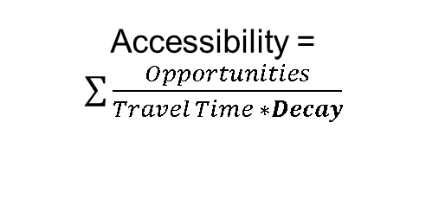
ACCESSIBILITY SCORE CALCULATION
Where:
OPPORTUNITIES = Number of Jobs (HBW) or Number of Retail/Service Establishments (HBNW)
TRAVEL TIME = Time to reach opportunity over actual network (Network Analyst)
DECAY* = Factor reflecting decrease in value of opportunity that are farther away
MODEL DEVELOPMENT
Notes:
It s the sum, we do it the same thing for all origins in our study area

Slide 15
DISTANCE-DECAY RELATIONSHIPS
MODEL DEVELOPMENT
Notes:
Decay rates derived from survey data
Vary by purpose, maybe by socioeconomic/demographic groups

Slide 16
INTERPRETING OUTPUTS
3
1

Slide 17
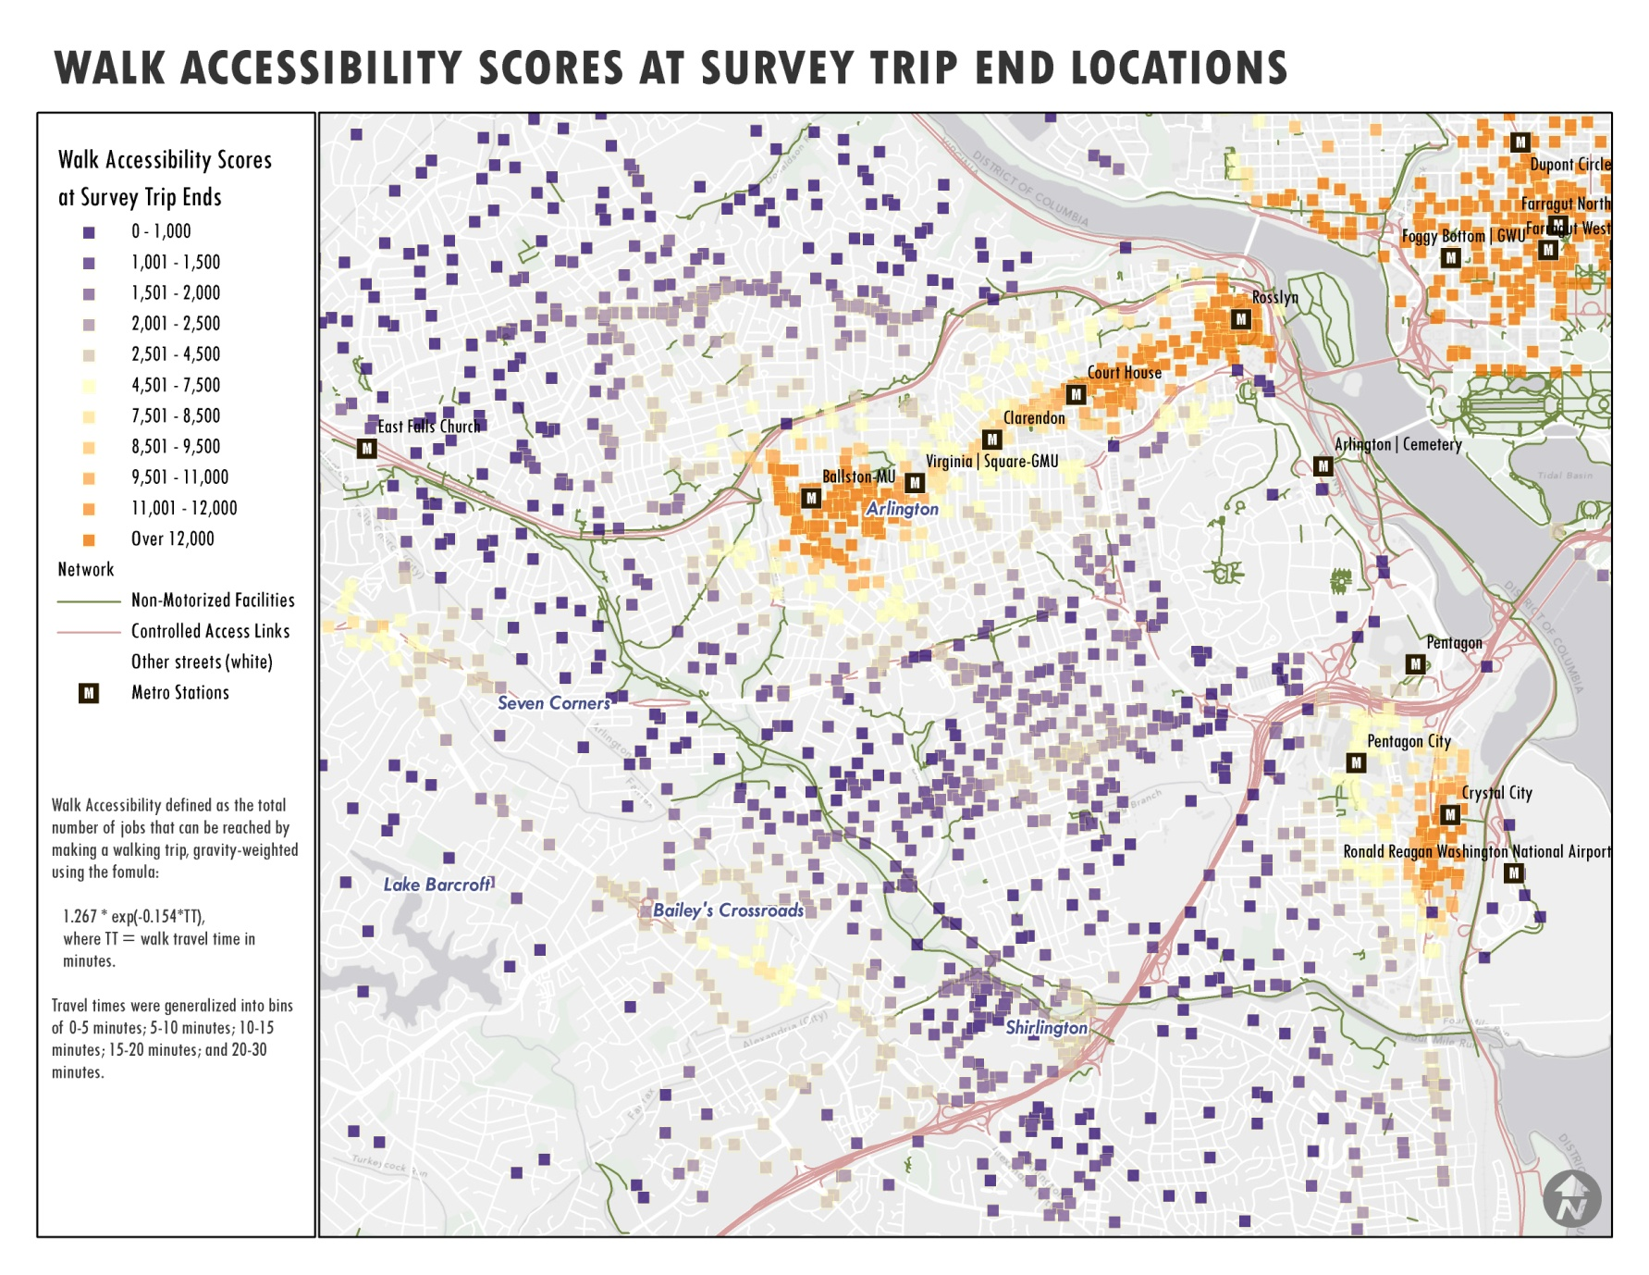
WHAT DOES AN ACCESSIBILITY SCORE MEAN?
Literally: the number of ‘gravity-weighted’ opportunities reachable from an origin
Difficult to define thresholds or targets
  Destination opportunities
  Decay curves
  Regional variation
Walk accessibility
(multimodal accessibility)
Walk demand
(multimodal demand)
INTERPRETING OUTPUTS
Notes:
“opportunities” can be defined in any number of ways to suit analytical needs

Slide 18
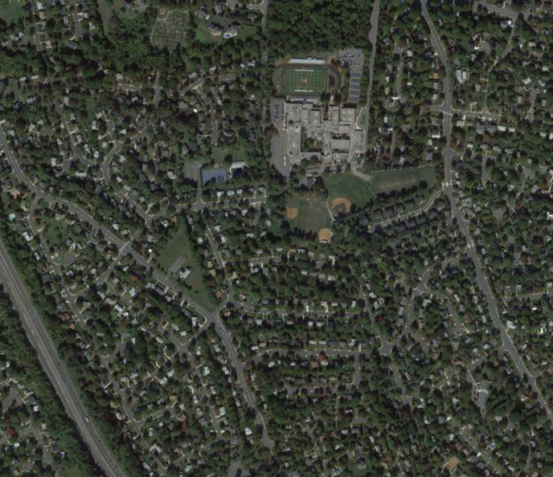
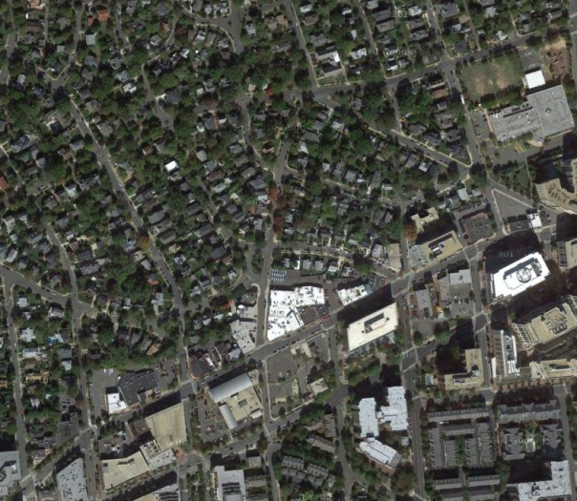
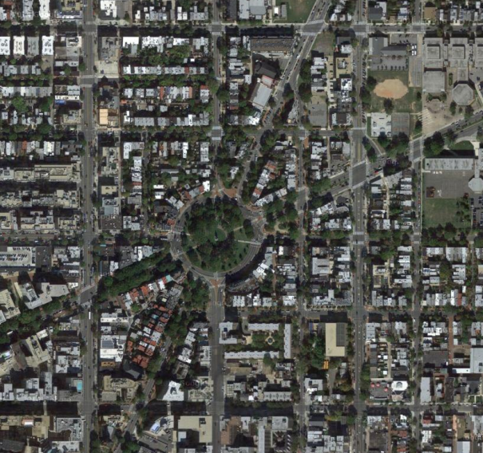
EXAMPLES OF COMPARITIVE ACCESSIBILITY SCORES
 | McLean | Clarendon | Logan Circle
ACCESSIBILITY SCORES
Auto | 10,464 | 23,536 | 44,570
Transit | 426 | 2,055 | 5,822
Walk | 63 | 433 | 2,452
McLean
Clarendon
Logan Circle
INTERPRETING OUTPUTS

Slide 19
EXAMPLES OF COMPARITIVE ACCESSIBILITY SCORES
McLean has the lowest scores, so let’s treat it as a baseline condition
McLean
Clarendon
Logan Circle
INTERPRETING OUTPUTS

Slide 20
EXAMPLES OF COMPARITIVE ACCESSIBILITY SCORES
Logan Circle’s auto access value is greater than McLean’s by a factor of 4
Logan Circle’s walk access value is nearly 40 times greater than McLean’s
McLean
NMT MODE SPLIT
McLean | 8%
Clarendon | 21%
Logan Circle | 41%
Clarendon
Logan Circle
INTERPRETING OUTPUTS
Notes:
But where the relationships begin to show themselves is when you look at the modal comparisons.
Yes, Logan Circle has the highest auto accessibility – because it’s in the center of the region.
However if you compare it’s score with that of McLean, it is only greater by a factor of 4 to 1
When you compare them on transit accessibility, the comparative advantage jumps to 13 to 1
For bike 15 to 1, and for walk almost 40 to 1!
And sure enough, if you compare those relationships observed travel behavior, use of non-motorized modes is about 41% in Logan Circle, 21% in Clarendon, and only 8% in McLean

Slide 21
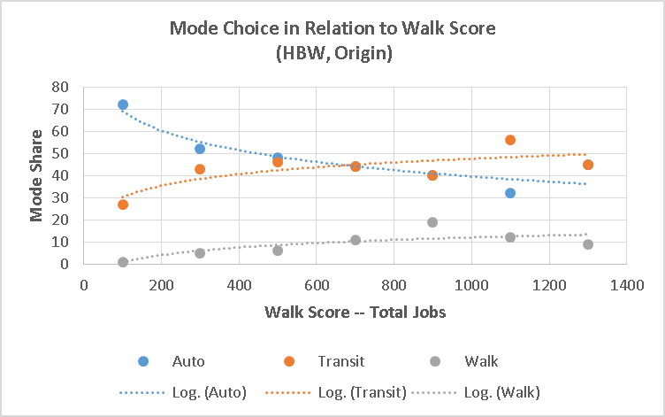
RELATING ACCESSIBILITY TO MODE SHARE
Found simple relationships that allow estimation of mode shares based on walk accessibility
Transferability of relationships unknown but results are encouraging
INTERPRETING OUTPUTS

Slide 22
WALC TRIPS XL
4
1
Notes:
We wanted to put the power of these relationships into planners’ hands in a platform that would feel familiar

Slide 23
A SPREADSHEET TOOL TO FACILITATE PLANNING
Best suited to neighborhood-scale analyses
Allows users to import data developed in a GIS or similar modeling environment
Facilitates execution of model development and model application steps
WALC TRIPS XL

Slide 24
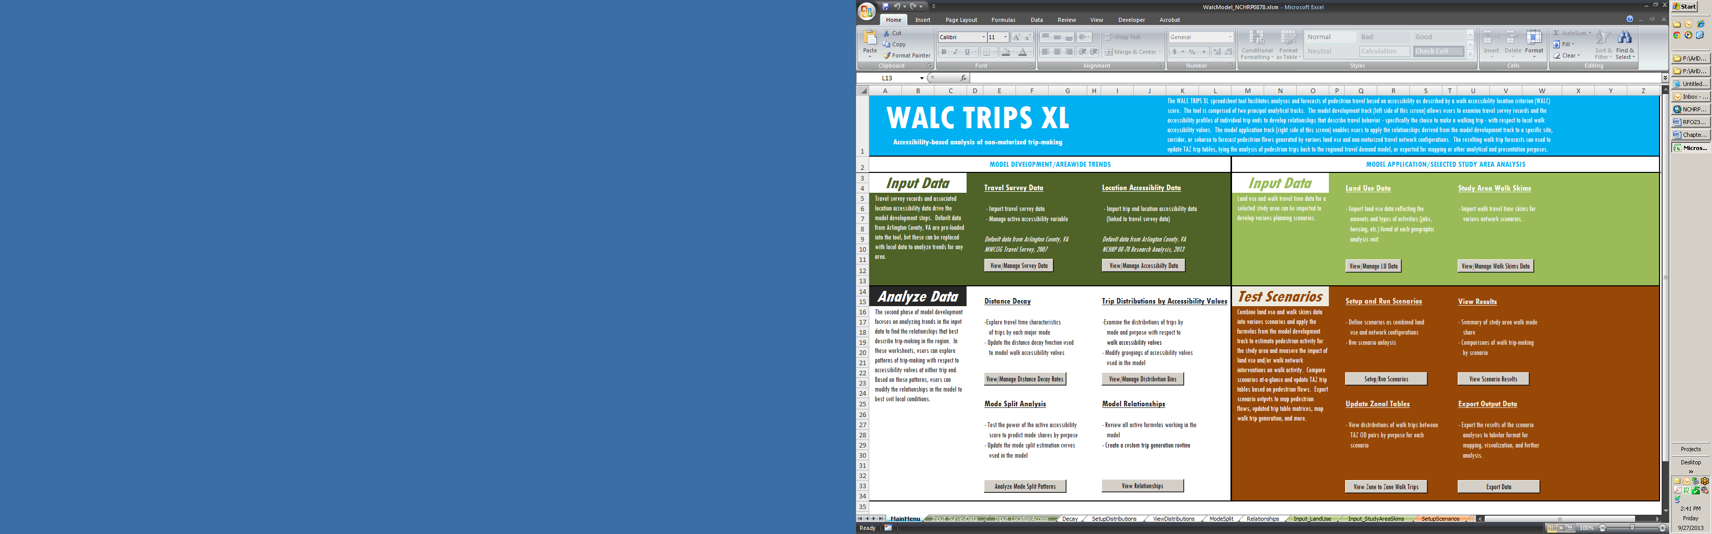
Notes:
Main interface – guides navigation of analytical steps and provides instructions for how to format and import your data, much of which will have been developed in GIS or through some other software that supports network analysis

Slide 25
Model development tools:
Survey data
  Trip records with mode, travel time, purpose information
  Trip end accessibilities
  These support the development of mode split relationships
Evaluate/apply distance decay based on survey data
View frequency distributions of trips by accessibility scores (at O or D end)
  Relies on binning scores – an exercise in nuance
Analyze walk mode split (and others) by accessibility group
Review model relationships
  Decay, mode split (internal)
  Trip gen (external)
Notes:
Survey data – should be bigger than your application study area and be broadly representative of your region
Modes should be at least walk and non-walk; purposes are open ended
Frequency distributions can also be viewed with mode and purpose breakdowns
Setting up the bins of accessibility scores is key, and in this tool, it involves a lot of trial and error. It’s probably the one area of the tool that’s least complete, but it was the best way we found to give users a lot of flexibility to explore and establish relationships for their area while working within this basic construct.

Slide 26
Model application tools:
Study area data
  Land units (blocks, parcels, e.g.)
  Activities data (jobs, pop, e.g.)
  Walk skims (usually from GIS)
Set up and run scenarios
  Mix and match land use and walk network scenarios
View scenario results
  Walk trips by mode and purpose
Use findings to update TAZ trip tables
Export data for use in other applications
Notes:
Modes should be at least walk and non-walk; purposes are open ended
Frequency distributions can also be viewed with mode and purpose breakdowns
Setting up the bins of accessibility scores is key, and in this tool, it involves a lot of trial and error. It’s probably the one area of the tool that’s least complete, but it was the best way we found to give users a lot of flexibility to explore and establish relationships for their area while working within this basic construct.

Slide 27
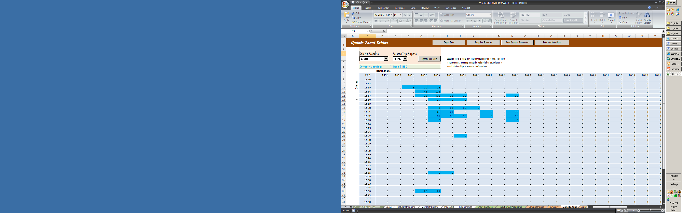
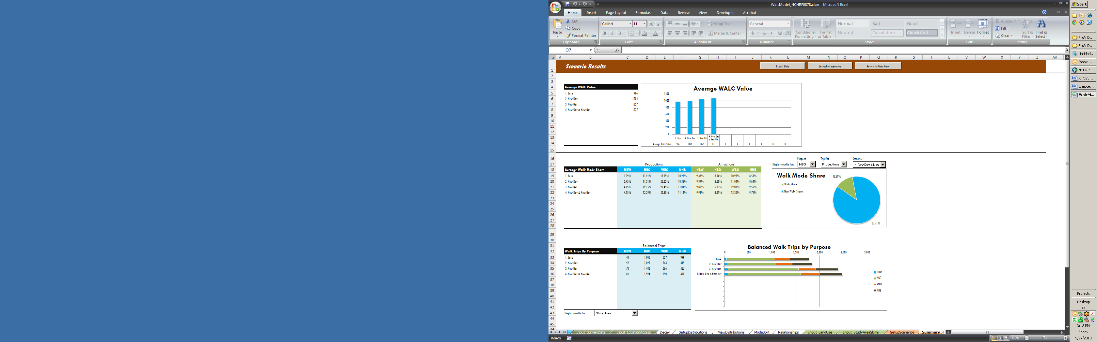
Outputs
WALC TRIPS XL
View summary of changes in walk trip-making
Update TAZ trip table based on distribution of walk trips
Export outputs for mapping, visualization, or additional analysis
Notes:
Review results in various charts and tables
Explore results by scenario and purpose

Slide 28
EXAMPLE APPLICATION
5
1

Slide 29
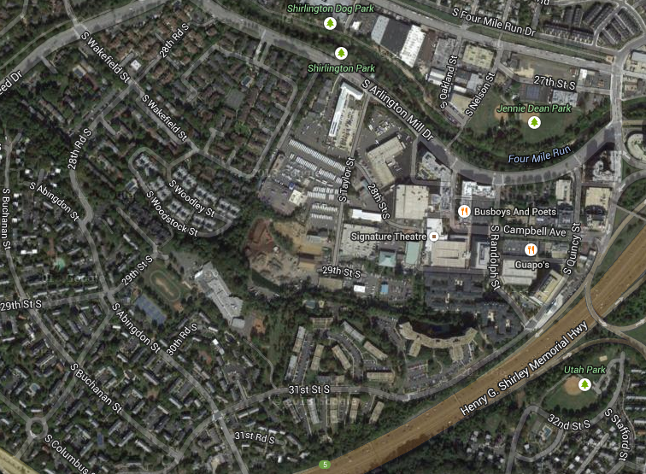
SHIRLINGTON EXAMPLE (HYPOTHETICAL)
Mixed use center
Not a TOD but well-served by multiple bus routes
Less than optimal walking connections between center and surrounding neighborhoods
Shirlington
EXAMPLE APPLICATION

Slide 30
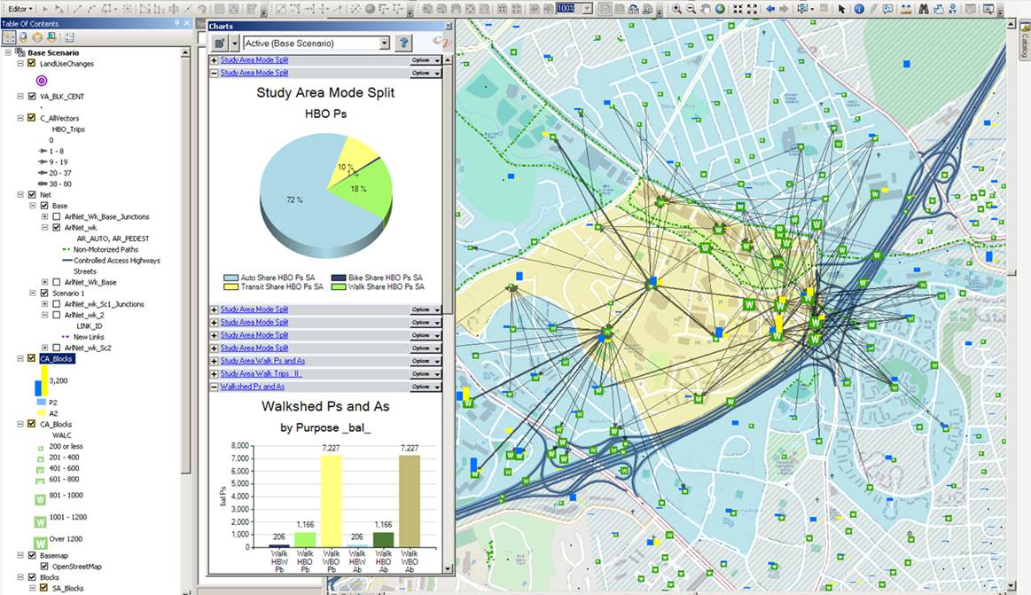
SHIRLINGTON EXAMPLE (HYPOTHETICAL)
Estimated pedestrian demand in existing condition
Areas of major trip production and attraction
Limited connectivity
EXAMPLE APPLICATION
Notes:
Walking trips focused on the mixed use center, which makes sense

Slide 31
SHIRLINGTON EXAMPLE (HYPOTHETICAL)
Modeled new connections
EXAMPLE APPLICATION

Slide 32
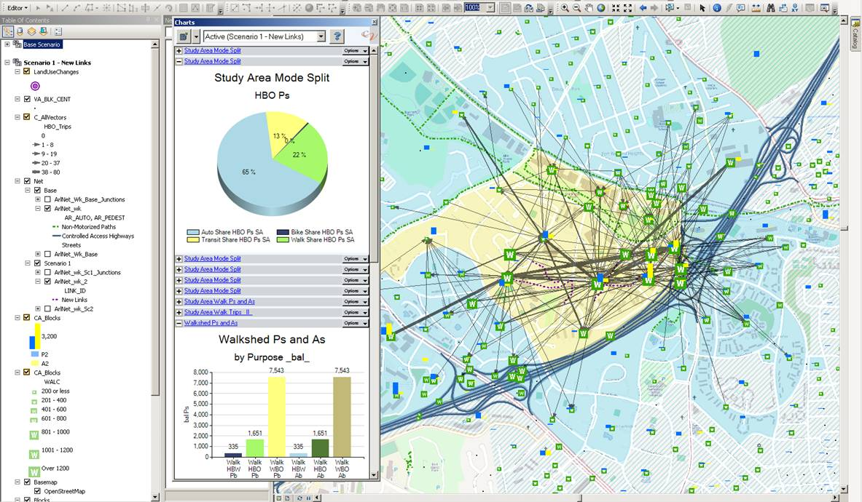
SHIRLINGTON EXAMPLE (HYPOTHETICAL)
New connections engender increased pedestrian activity
EXAMPLE APPLICATION

Slide 33

MARYLAND DEPARTMENT OF TRANSPORTATION: ANALYTIC SUPPORT TOOL
Providing planning and policy support to a state DOT
  Existing tools lack sensitivity for multimodal planning and programming needs
  Important to know about land use, transit, walk/bike
  See potential in NCHRP 8-78 Accessibility Model
  Recommend pilot application in major corridor
ENHANCEMENTS
Notes:
So now let’s move on to the activity with Maryland DOT

Slide 34
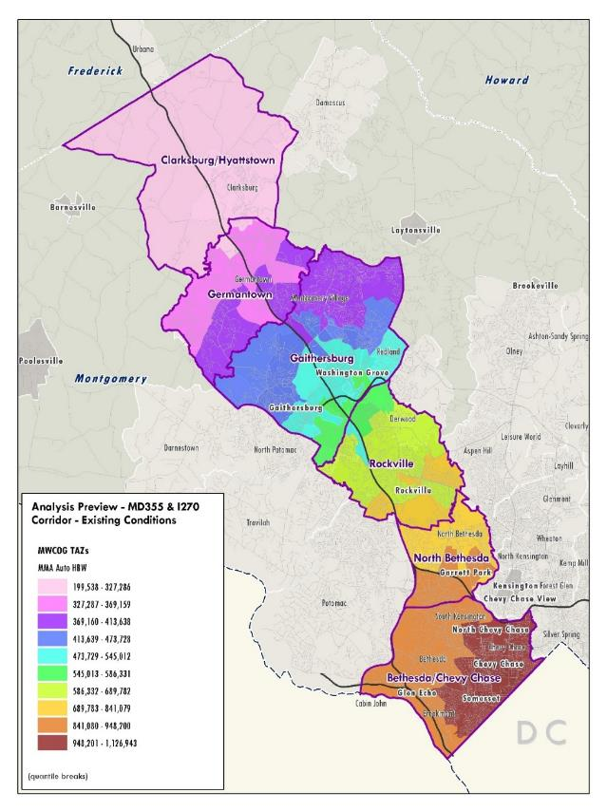
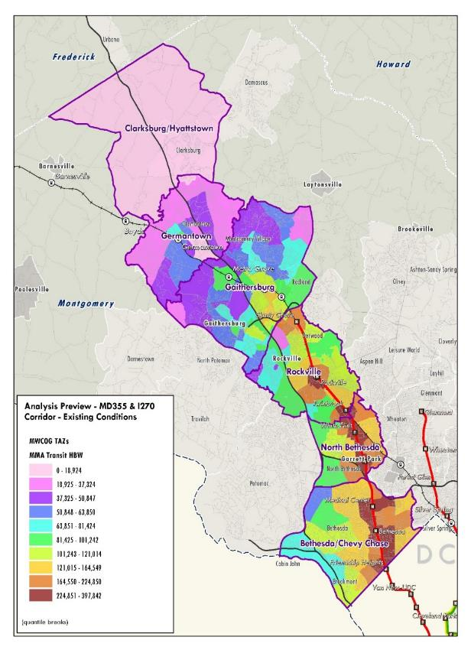
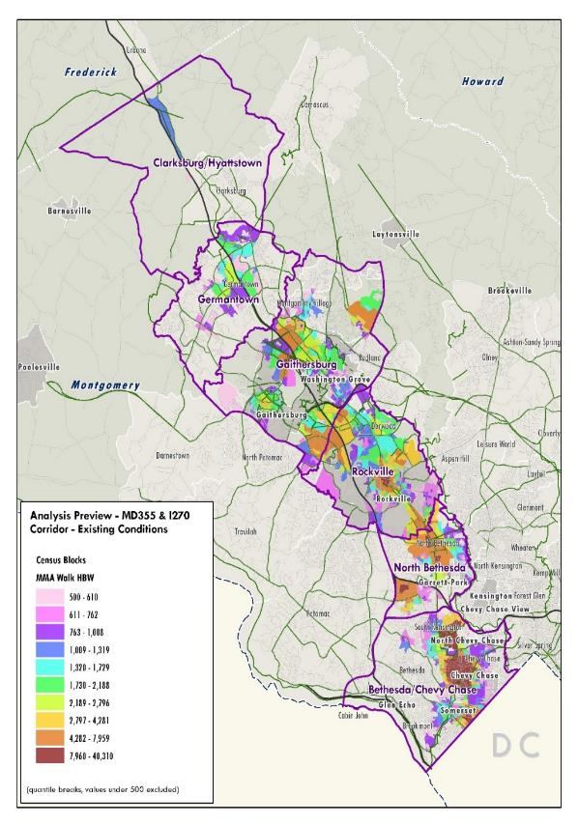
CALCULATED & MAPPED ACCESSIBILITIES
Auto
Transit
Walk
EXAMPLES

Slide 35
REGRESSION MODEL CONVERTS SCORES TO MODE SHARES
Mode Share for Work Trips:
Auto
Transit (drive access)
Transit (walk access)
Walk
Auto Score
Mode Choice Model
Transit Score
Mode Share for Non-Work Trips:
Auto Driver
Auto Passenger
Transit
Walk
Walk Score
EXAMPLES

Slide 36
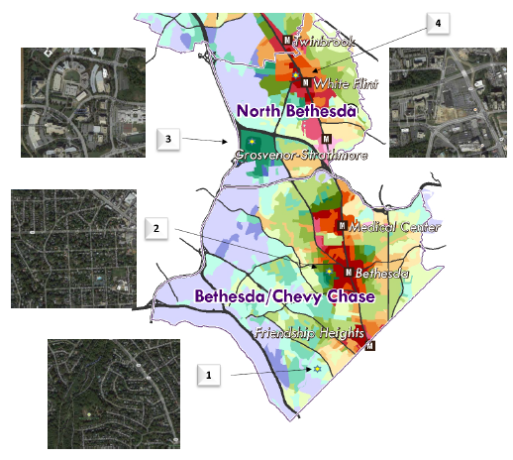
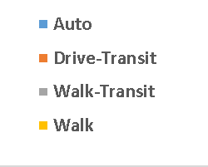
Ability to Use Scores in Any Place to Quantify Relationship Between Land Use, Transportation System and Travel Behavior
EXAMPLES

Slide 37
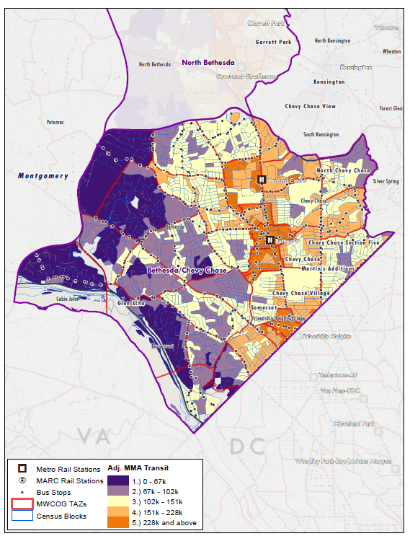
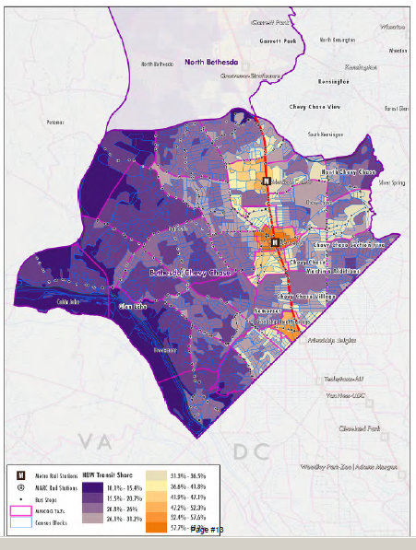
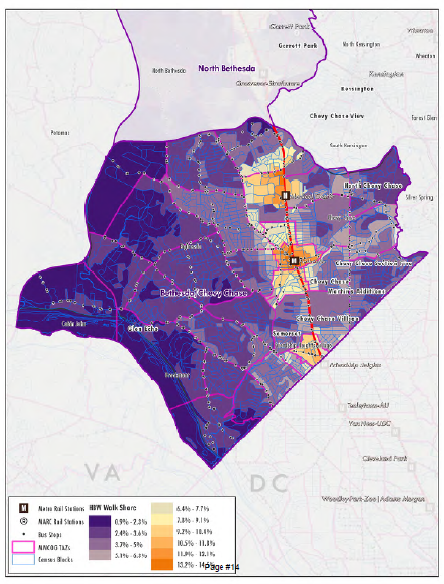
PREDICTING MODE SHARES AT BLOCK LEVEL
Transit Accessibility: HBW
Transit Mode Share: HBW
Walk Mode Share: HBW
EXAMPLES
Notes:
Using the models, we were able to go back in and estimate mode shares at a block level throughout the corridor.

Slide 38

SUMMARY
Elegant and promising approach to estimating and forecasting pedestrian demand
Bike models less reliable (small sample size)
Evolving toolkit
  Conceptual advancement outpacing beta tests
  Applicability to many other planning applications
  Multimodal dynamics
CORE CONCEPTS

