Slide 1
New Experience Expanding Truck GPS-Based Origin-Destination Data in Tennessee
15th TRB National Transportation Planning Applications Conference
May 20, 2015
Erich Rentz, RSG
Vince Bernardin, PhD, RSG
Steven Trevino, RSG
Jeff Short, ATRI
Robert Rock, TDOT

Slide 2
ATRI Board of Directors

Slide 3
ATRI Truck GPS Dataset
Ongoing Truck GPS data research beginning in 2001
Comprehensive North American Truck GPS dataset
“Big Data”
Real time data feeds/ significant hardware and software
Currently near 100 million data points per day
Will approach 1 billion points per week later this year
Fully deployed applications
Performance measurement/management
Freight flow and truck trip modeling
Key research areas
Economic competitiveness and supply chains
Truck volume/intensity/national travel patterns
Weather, parking, emergency events

Slide 4
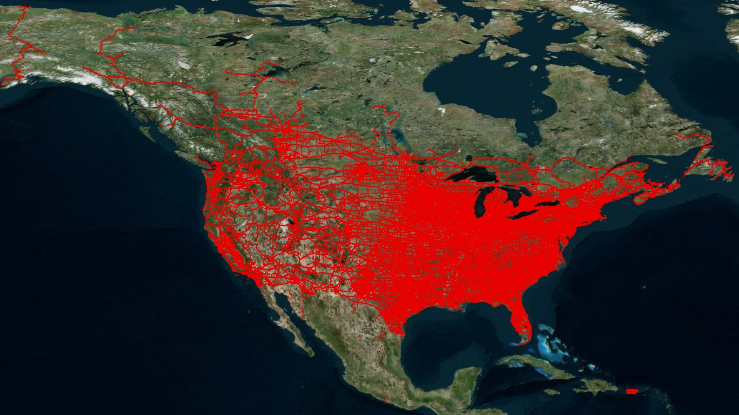
ATRI Truck GPS Dataset – One Day

Slide 5
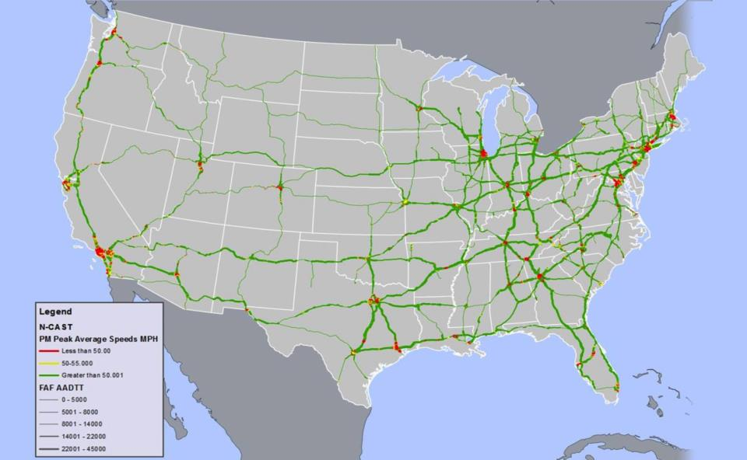
ATRI Truck GPS Dataset

Slide 6
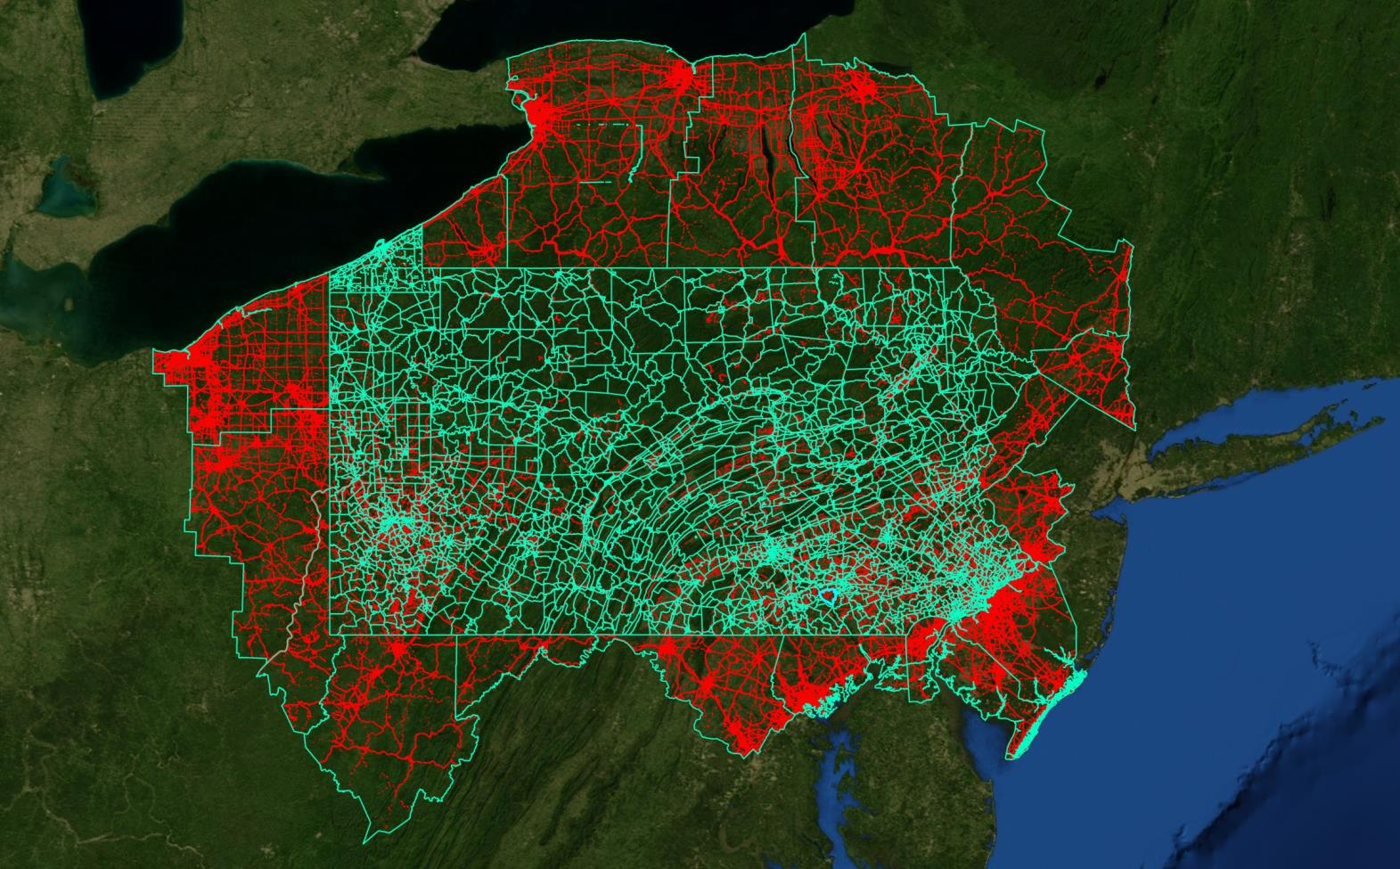
ATRI Truck GPS Dataset

Slide 7
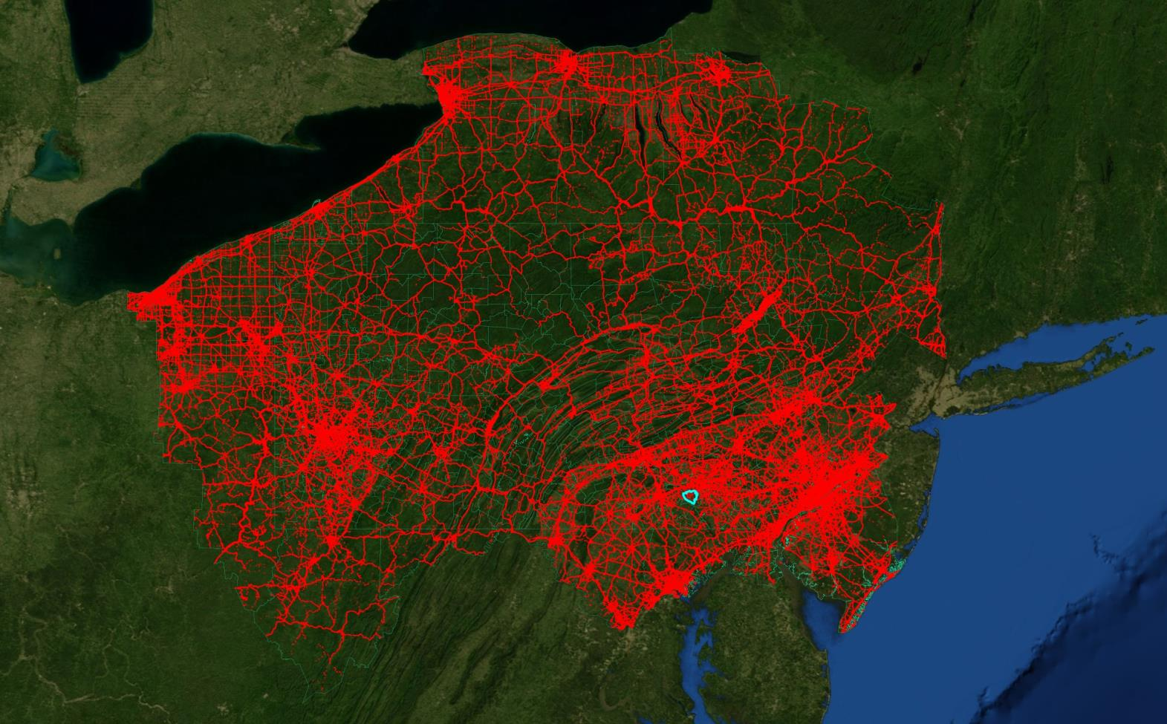
ATRI Truck GPS Dataset

Slide 8
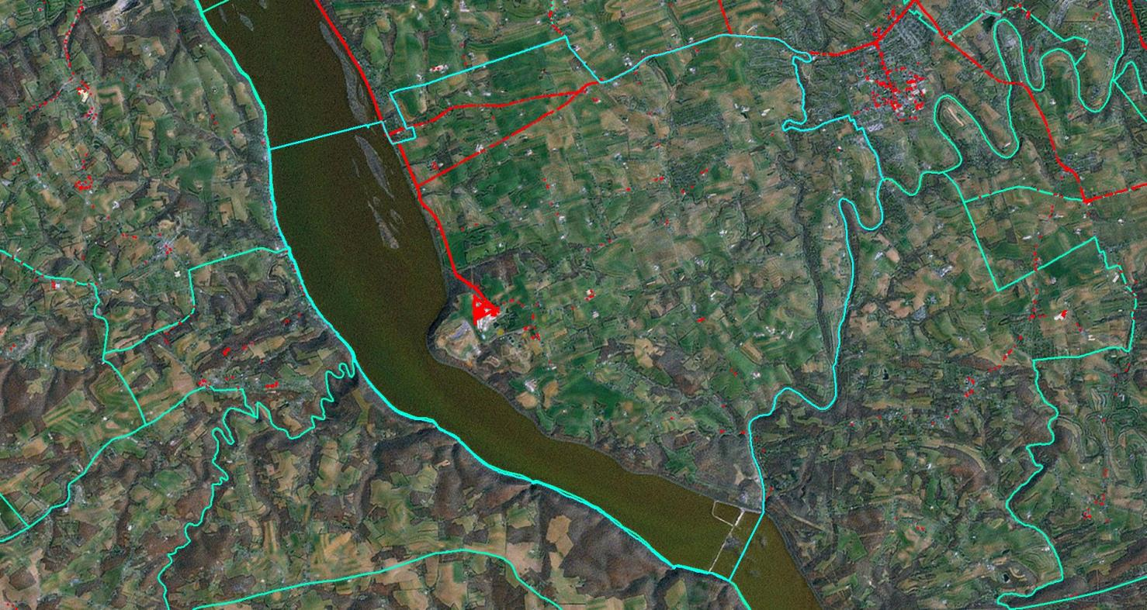
ATRI Truck GPS Dataset

Slide 9
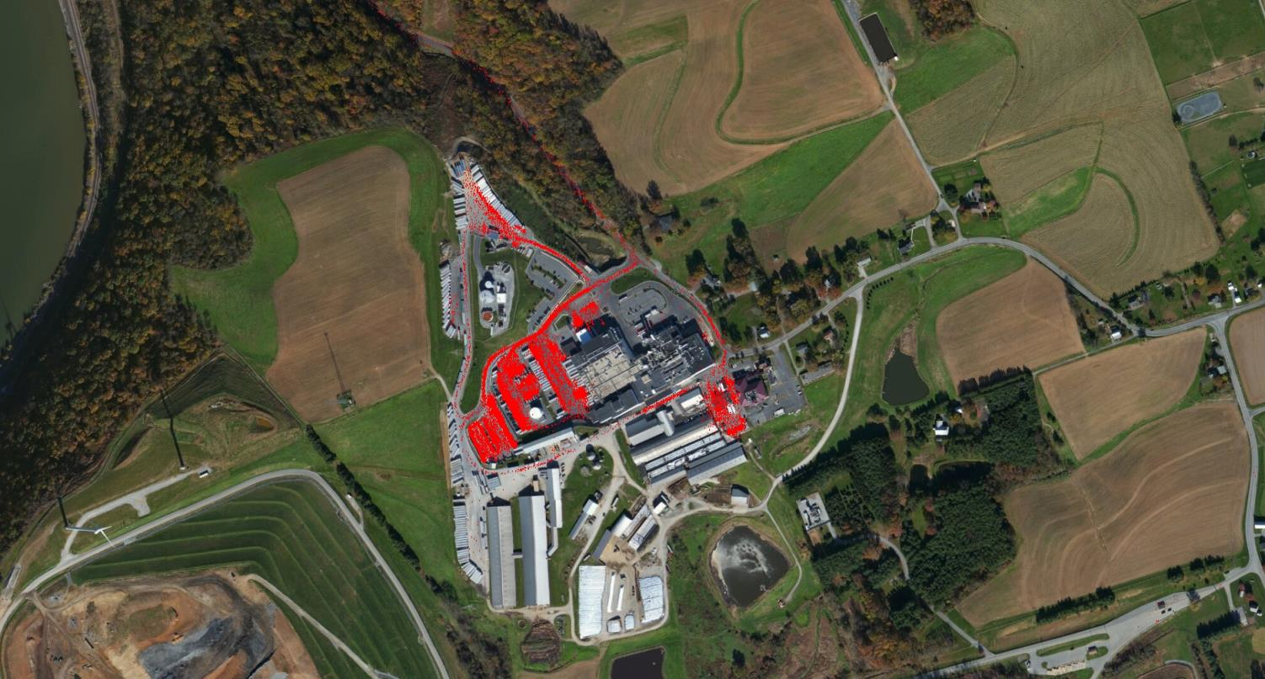
ATRI Truck GPS Dataset

Slide 10
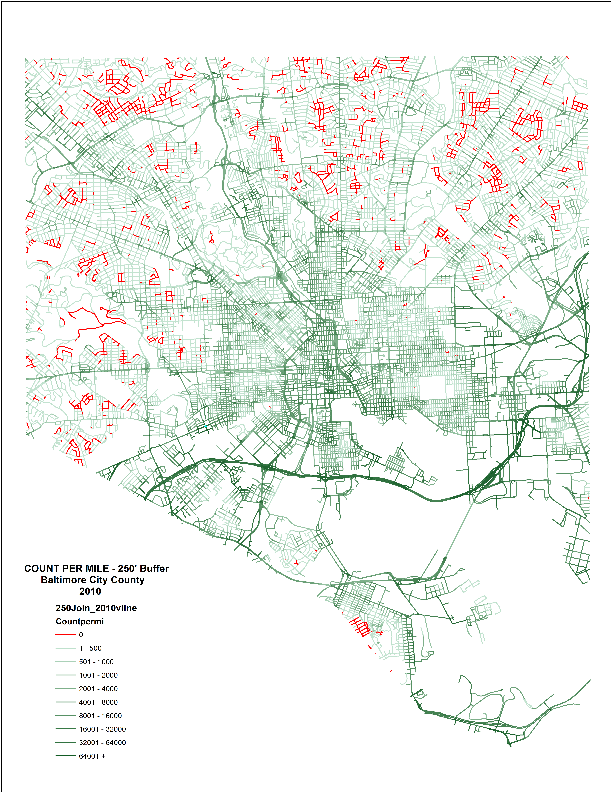

Slide 11
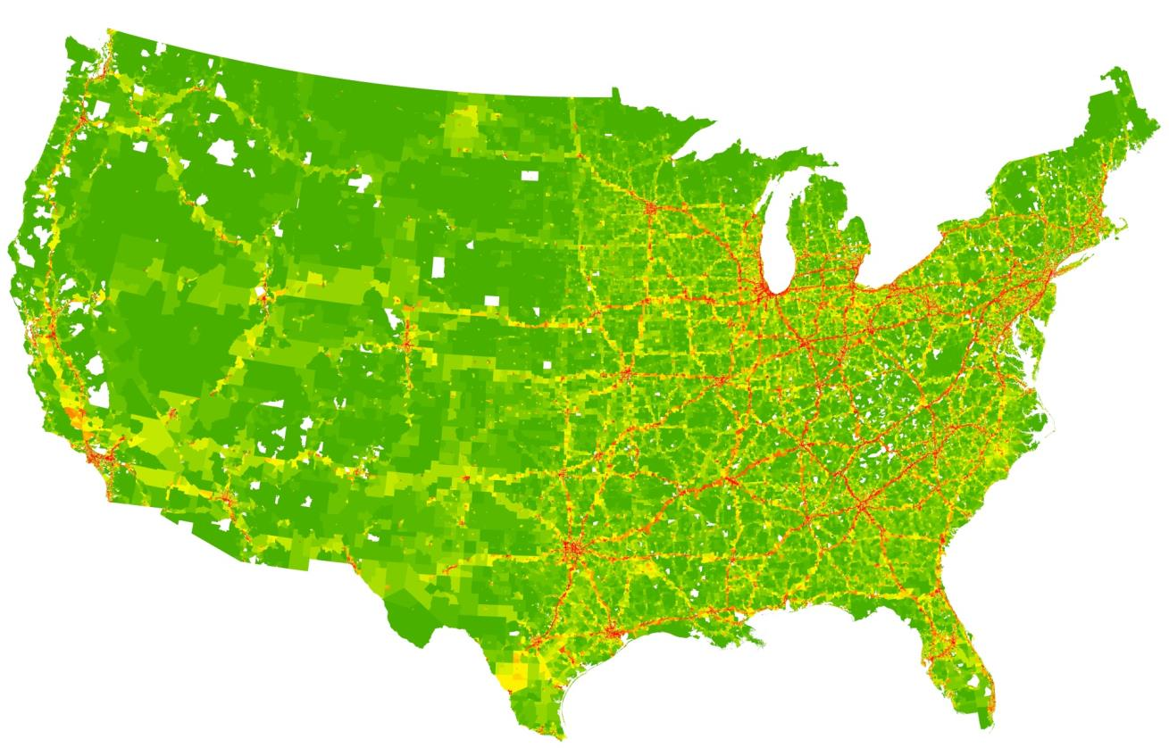
ATRI Truck GPS Dataset

Slide 12
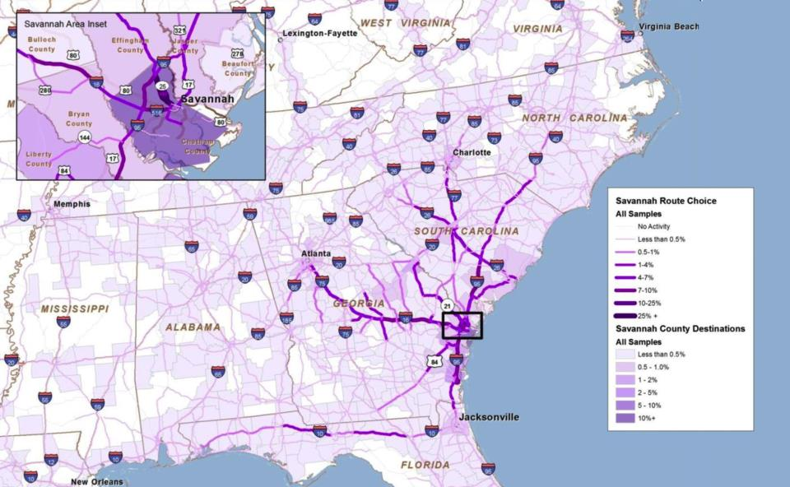
ATRI Truck GPS Dataset

Slide 13
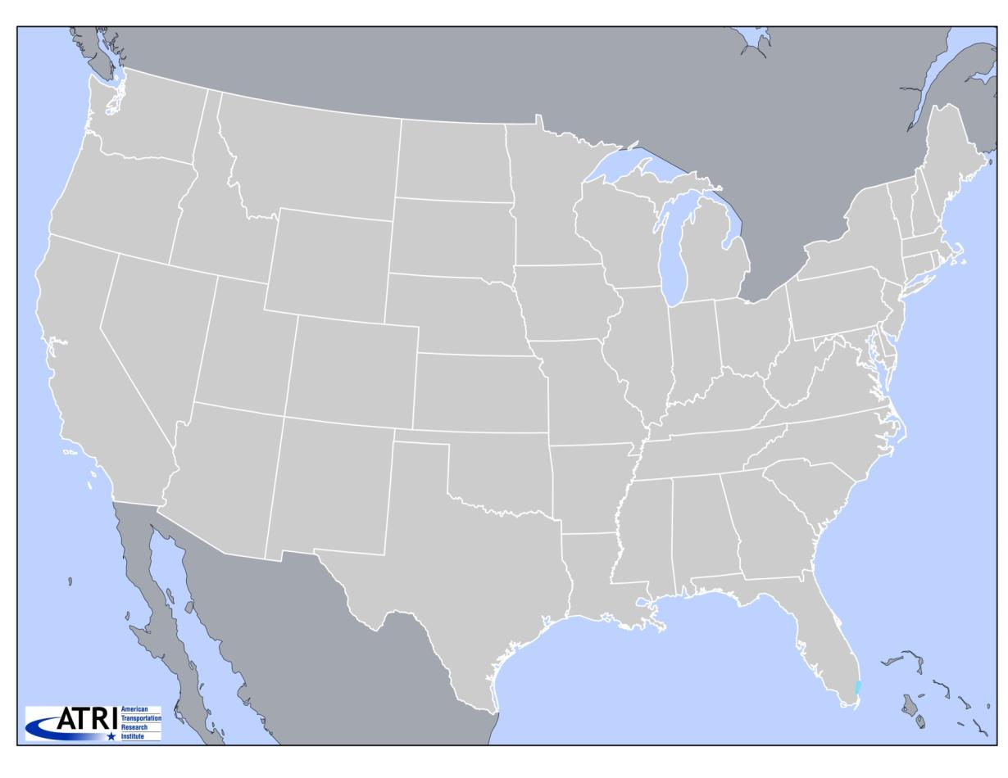
ATRI Truck GPS Dataset

Slide 14
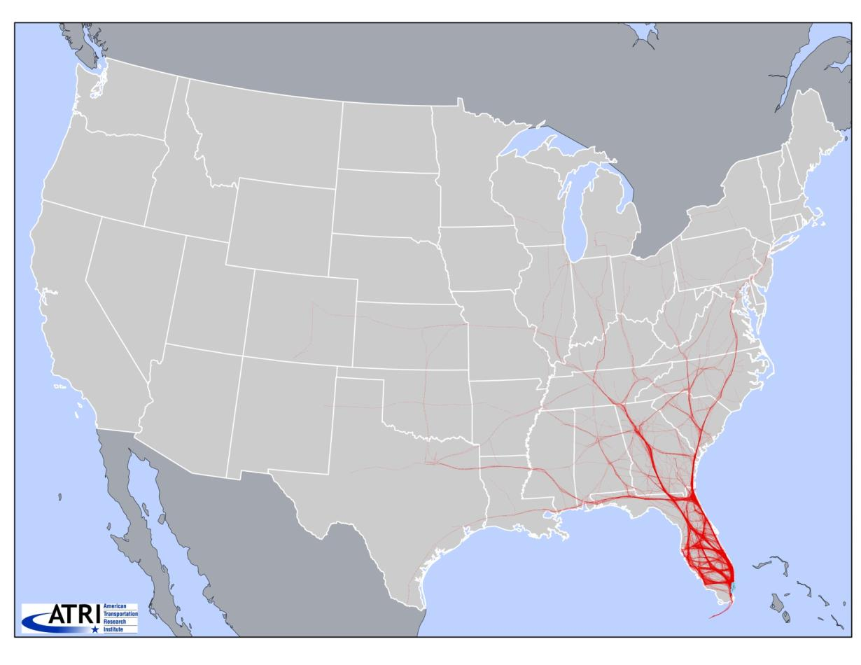
ATRI Truck GPS Dataset

Slide 15
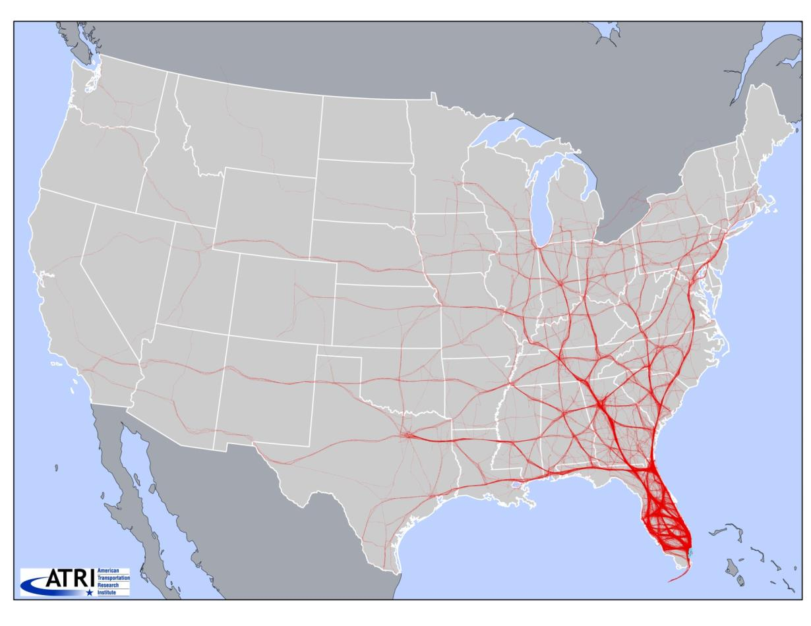
ATRI Truck GPS Dataset

Slide 16
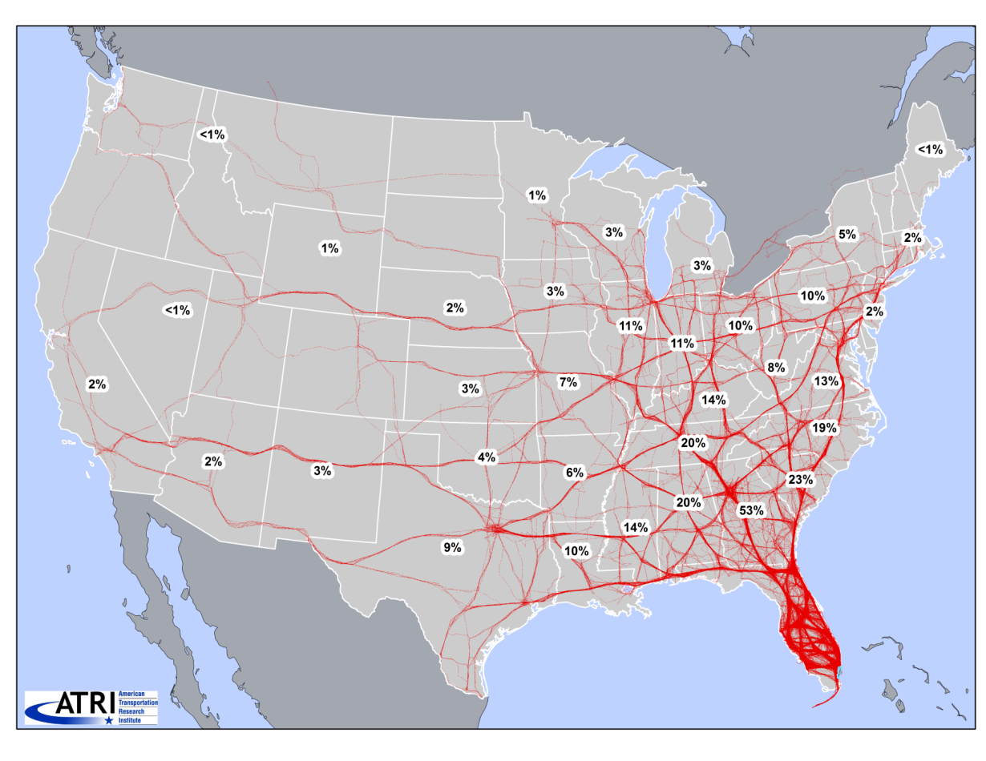
ATRI Truck GPS Dataset

Slide 17
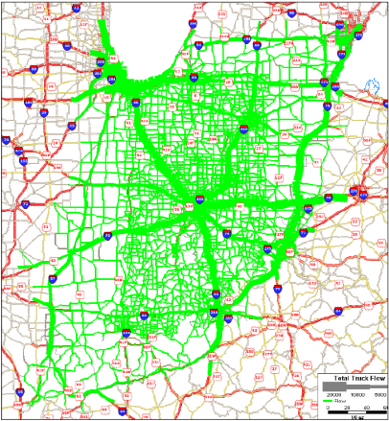
Modeling Applications
PRIOR USAGE OF ATRI TRUCK GPS DATA
2012 Indiana Statewide Travel Demand Model Update
RMSE: 69.3% to 60.6%
MAPE: 74% to 42%

Slide 18
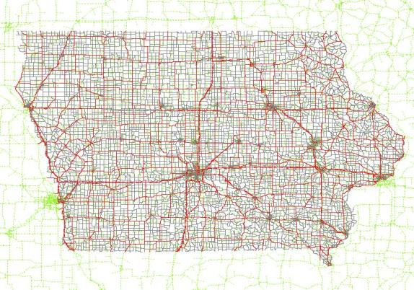
Iowa Dataset
DETAILS OF ATRI TRUCK GPS DATA WITHIN IOWA
Four 2-week samples from each quarter of 2012
Over 135,000 individual trucks
Notes:
This also includes two weeks of 2013
Truck positions paired into “pings”
Data Privacy – Anonymous IDs, GPS coordinates to TAZs
Ping Dataset : IDs, timestamp, distance, start/end TAZs

Slide 19
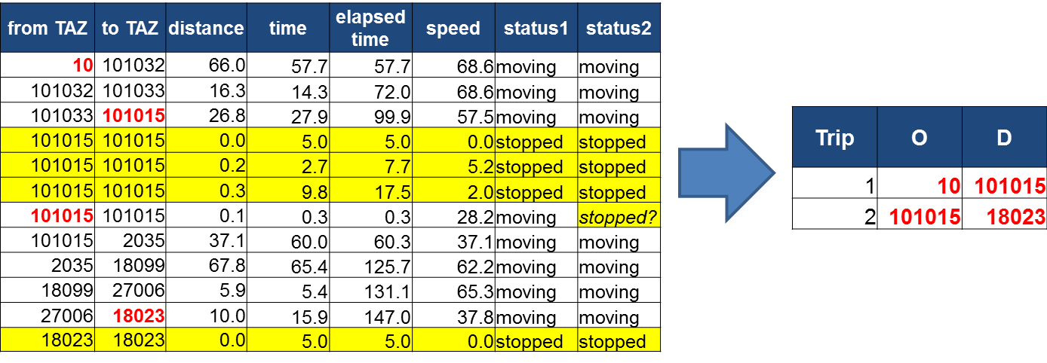
Data Processing
ATRI PING DATASET MUST BE PROCESSED TO TRIP O-D PAIRS
Identifying movement for all records
Determine trip O-Ds, travel time, VMT

Slide 20
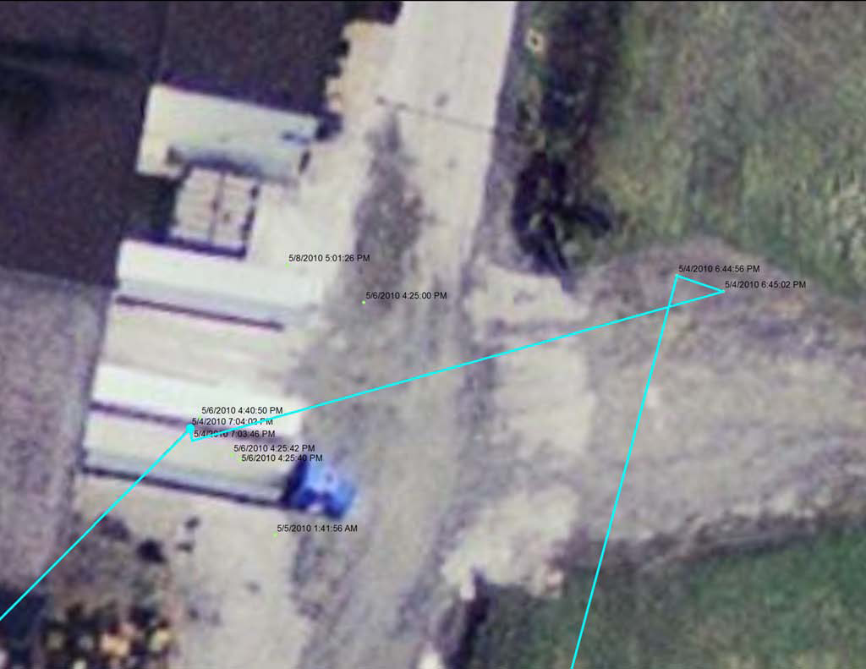
Data Processing

Slide 21
Data Cleaning
METHODS INTRODUCED TO IMPROVE PROCESSING
Over 50 million movement records from 135,000 trucks
Data Filtering:
GPS jumps – urban canyons, mountains, spatial joins, etc.
Missing data – spatial joins
Study period edges – trips in progress
Duration & OD mismatch – missed stops, GPS jumps
Applied conservative filtering methods in Iowa
Working on more intelligent filters

Slide 22
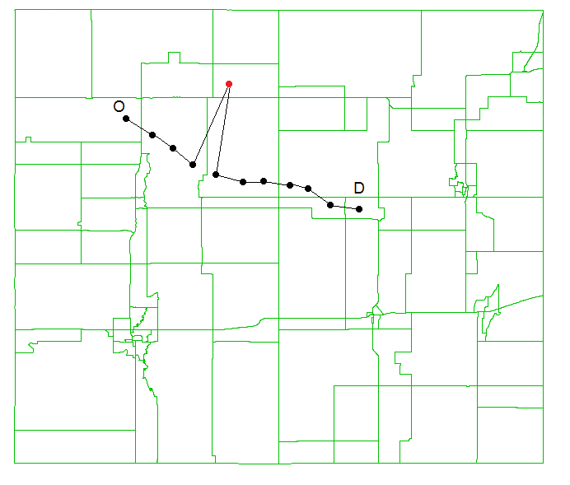
GPS Blips

Slide 23
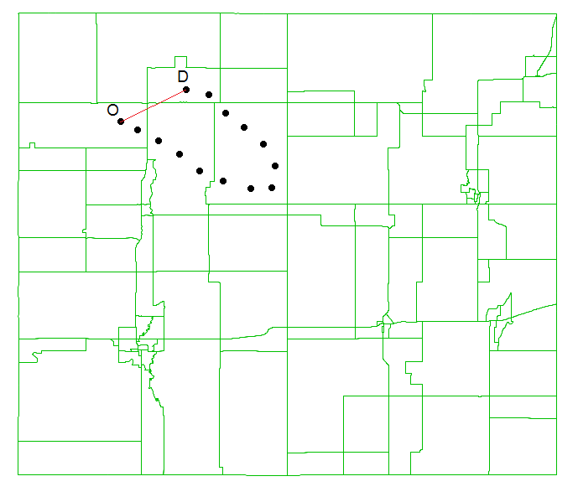
Circuity

Slide 24
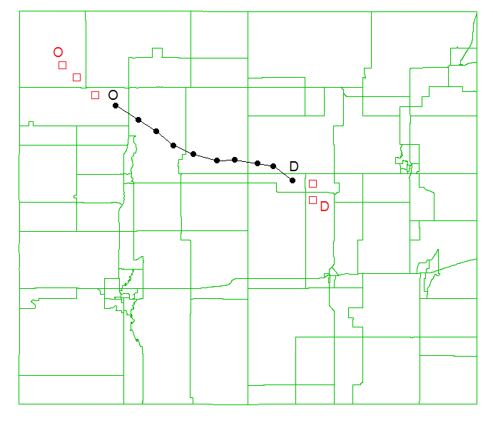
Start & End Time

Slide 25
Processing Results & Scaling
DATA CAPTURES ROUGHLY 10% OF TRUCKS OVER 56 DAYS
Processed data contains:
2.8 million truck trips over 56 days
60,656,488 VMT within Iowa
1,083,152 Daily Average VMT
10,731,507 Iowa DOT estimated 2012 daily truck VMT
Sample rate of 10.1%
Factored raw data by 0.1769 to represent daily preliminary seed OD table

Slide 26
Weighting & Expansion
GOAL FOR IOWA TO MOVE BEYOND SIMPLE SCALING
Initial statewide truck modeling application of ATRI data in Indiana stopped with scaling
ATRI data is not a random sample – suspected some biases
Anecdotal evidence for geographic/regional & trip-length (short-haul) biases
Developed a weighting scheme to address these sample biases using ODME

Slide 27
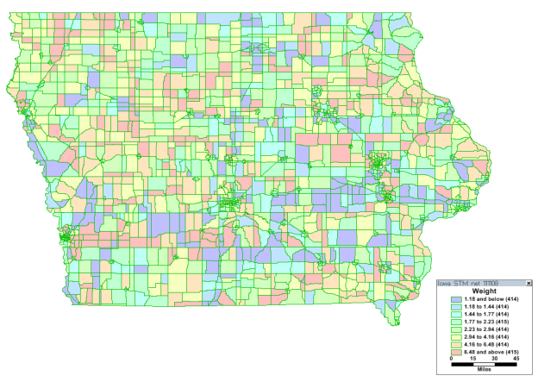
Geography
NO EVIDENCE OF SYSTEMATIC GEOGRAPHIC BIAS
Geographic differences of sample coverage in Iowa / Halo area

Slide 28
Trip Length – Short Haul / Long Haul
BIAS TOWARDS LONG HAUL
Confirmed suspected bias of long-haul over short-haul truck trips
Bias was not as strong as some may have supposed

Slide 29
Weighting Scheme
WEIGHTING SCHEME BASED ON TRIP LENGTH

Slide 30
Truck Assignment Tests
TRUCK ASSIGNMENTS MADE FOR TESTING PURPOSES ONLY
ATRI data used as one component of truck model
Assignment used to assess count consistency, weighting effectiveness, goodness-of-fit bounds
Previous model used ODME to achieved 81% RMSE for trucks
Assignment Type | RMSE
Scaled Data | 116%
Weighted Data | 92%
ODME on Data | 58%
Notes:
63,044 counts

Slide 31
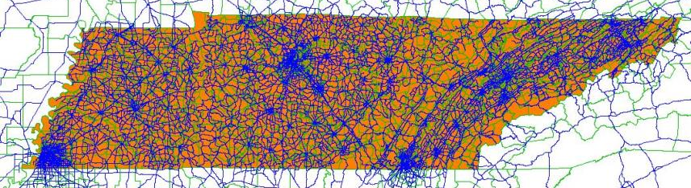
Tennessee
ATRI DATA SAMPLE FOR TENNESSEE
Similar four 2-week samples over 2013 quarters.
235,000 unique trucks.
138 million records processed to 5.8 million trips.
84,147,030 truck VMT within TN.
Sample rate of 6.5% vs. total trucks
Sample rate of 10.7% vs. multi-unit trucks

Slide 32
Conclusions
ATRI’s truck GPS data provides a rich and growing source of information on truck travel patterns
It is a large sample – but still a sample
Failure to properly expand it could lead to under-representation of short-haul movements and faulty analysis or false conclusions
Weighting offers both:
an understanding of ODME
Confirmation and measurement of long-haul bias
Mixed findings on geographic sample rates
and an alternative to ODME
No ODME uncertainty or individual OD adjustments
Better Data + Better Analysis =
Better Models + Better Planning

