Slide 1
Scenario Planning for Albuquerque Metropolitan Planning Area –
Integrating Land Use and Travel Demand Model and the Application of Policy Levers
15th TRB National Transportation Planning Applications Conference, Tuesday, May 19th 2015

Slide 2
Key Contributors
Chowdhury Siddiqui – Land Use/Travel Demand Modeler, MRCOG
Eddie Janowicz – Synthicity

Slide 3
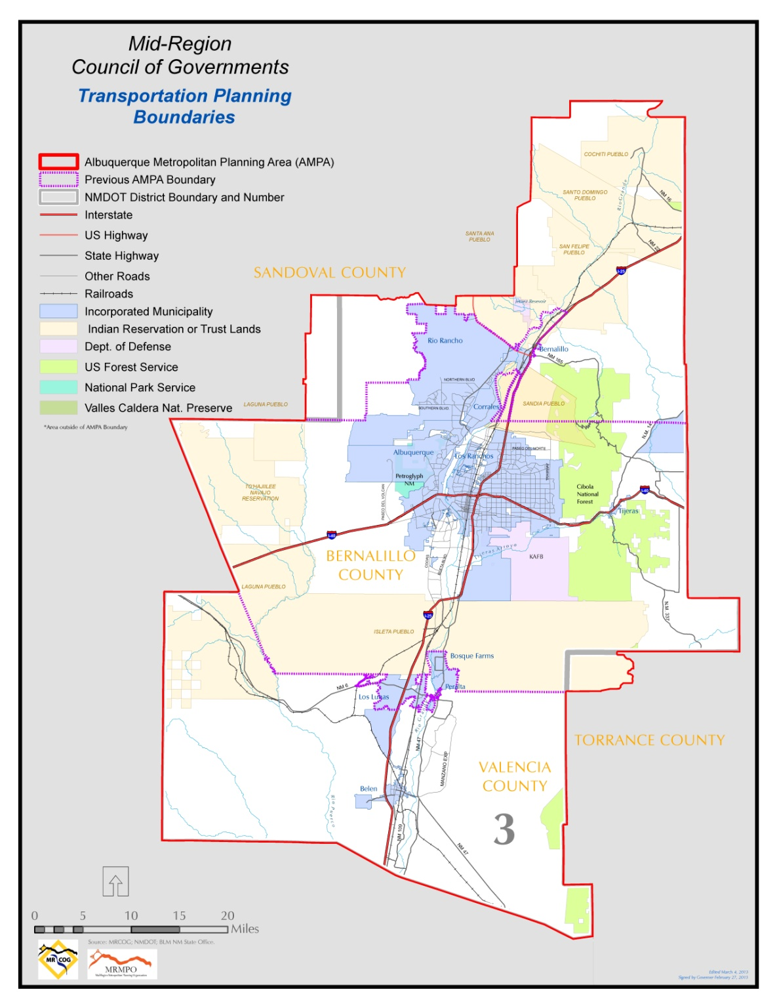
Albuquerque Metropolitan
Planning Area
3 Counties
2 Urbanized Areas
19 Incorporated Places
13 Pueblos/Tribal Lands
900,000 People
400,000 Jobs
Notes:
Greatest amenity is also our largest transportation challenge… the Rio Grande, which bisects the region
80 percent of jobs east of the river, residential growth pressure west of the river
Forecasts show 50 percent growth over the next 25 years
Future river crossing congestion major issue

Slide 4
Scenario Planning Process
Preliminary Scenarios
Scenario Evaluation
Refined Scenarios
Scenario Concepts
Identify
Challenges
June 2013
Spring 2014
Summer 2014
Committees / Workshops / Focus Groups
Spring 2015
Futures 2040
Notes:
First time we adopted a preferred scenario
First forecast with the UrbanSim Model
Hot pursuit of scenario planning as a tool to help bring regional stakeholders together
Technical Assistance Grant from FHWA
Unique situation with several federal land agencies, drought, wildfire, and flooding risks
Technical and consulting assistance through Scenario Planning for Climate Change grant from FHWA & Volpe
Very large, time intensive 2 year effort

Slide 5
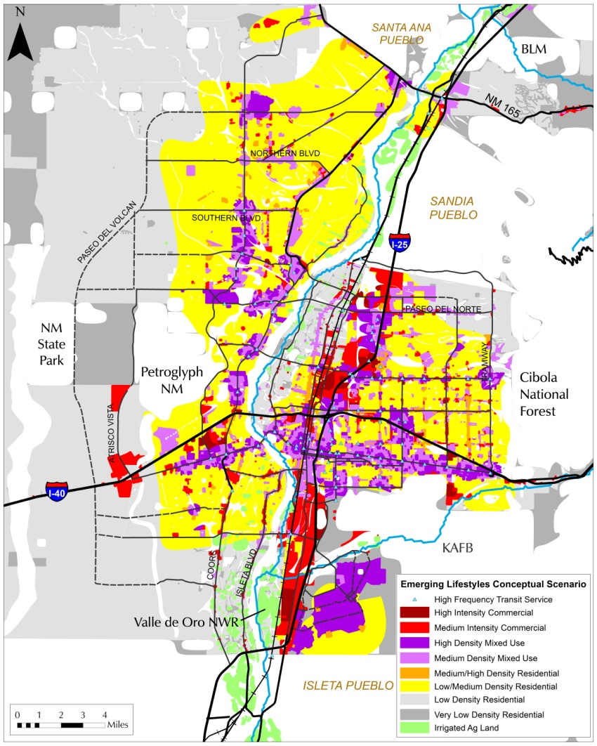
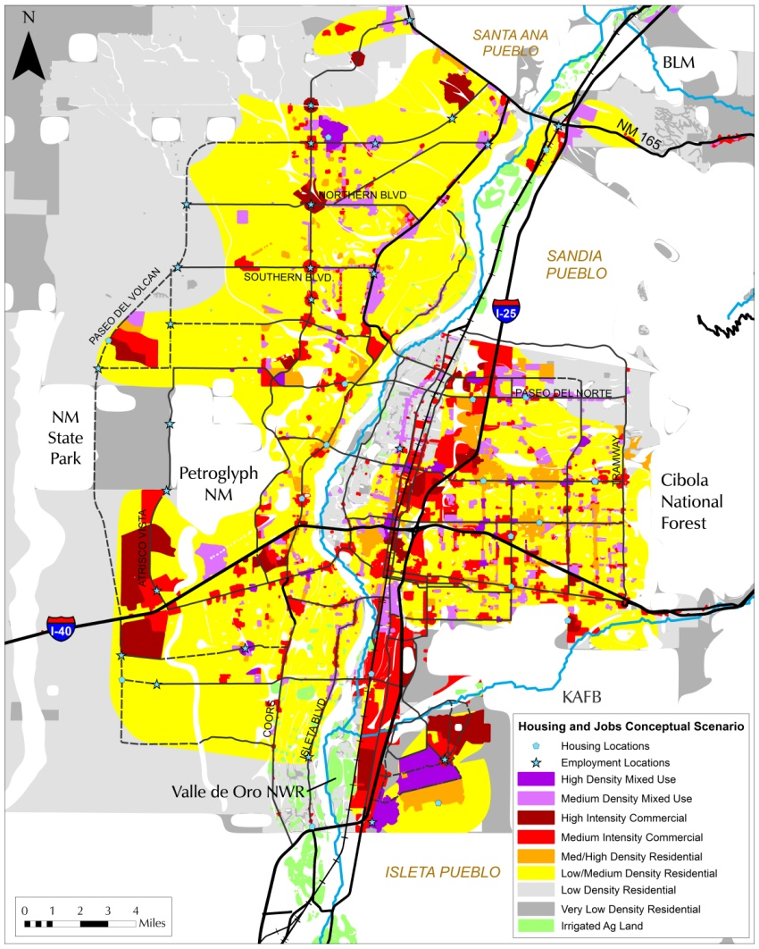
Conceptual Scenarios
Emerging
Lifestyles
Balanced Jobs/Housing
Notes:
Approach is looking at alternative futures based on land use, to quantify land use as a strategy to alleviate congestion and mitigate future conditions.

Slide 6
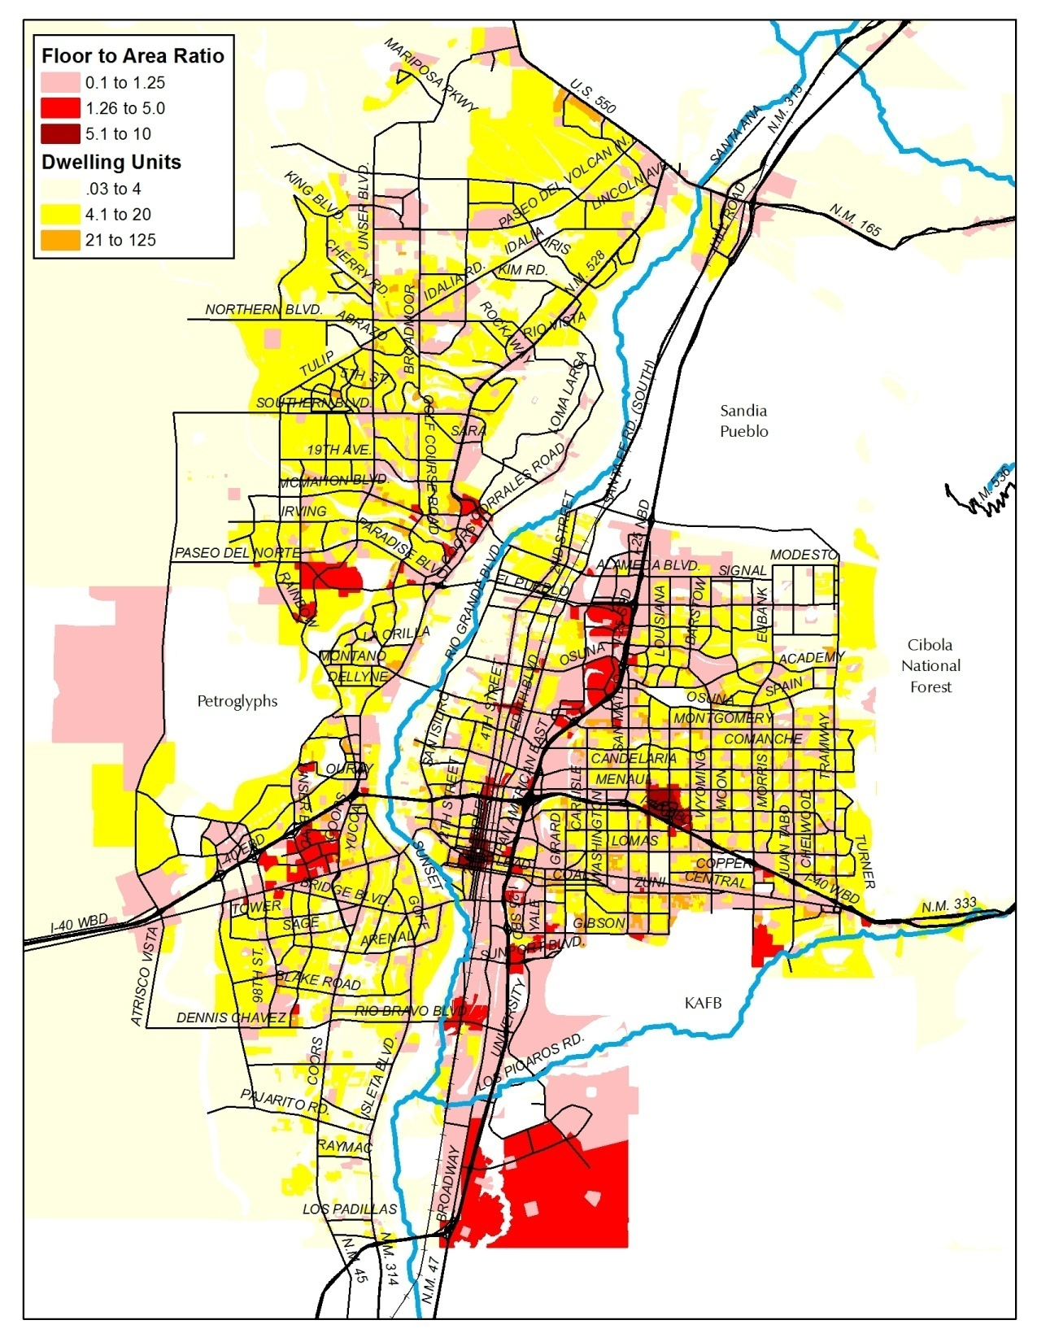
Trend
Existing plans and policies
Existing zoning
Fiscally constrained roadway and transit networks

Slide 7

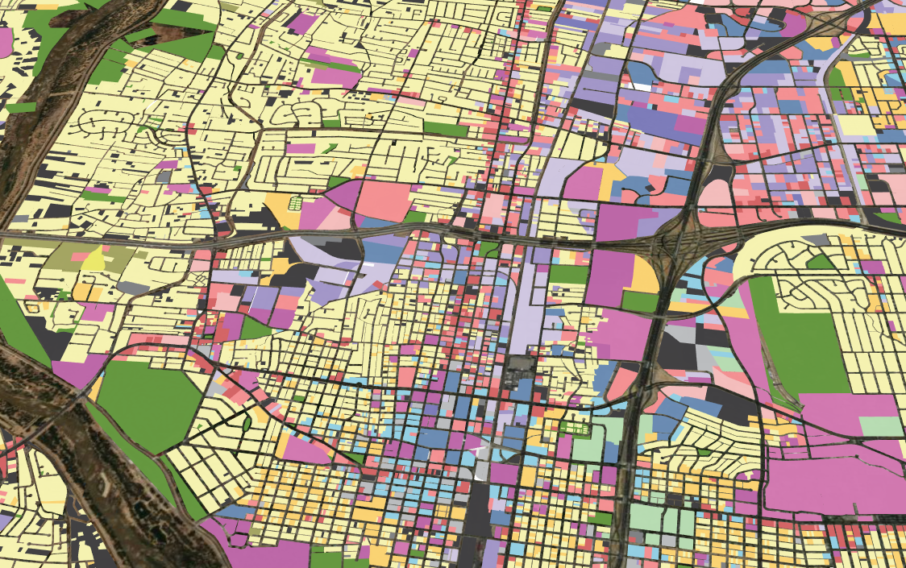

Modeling Environments

Slide 8
Integrated Model Flow
UrbanSim
2012 - 2025
Cube
2025
UrbanSim
2025 - 2040
Cube
2040
Performance
Measures

Slide 9

Policy Levers
ZONING
Notes:
How to turn conceptual to modelable? Policy lever toolbox. Zoning was single change for round 1. Valid and informative to isolate potential impact of zoning. Tested lever.

Slide 10
Scenario Evaluation
Notes:
Buckets of performance measures:
Access
Land Use
Roadway
Transit
Economic
Safety
Sustainability

Slide 11
Network Performance
Notes:
When compared to the base year all scenarios show declining conditions. However EL clearly showed benefits over the trend and the JH.

Slide 12
Sustainability Measures

Slide 13
Commuting Measures

Slide 14

Scenario Refinement
Preliminary Scenarios
Scenario Evaluation
Refined Scenarios
Scenario Concepts
Identify
Challenges
Pursue a Hybrid Approach
Make a Bigger Impact

Slide 15
Policy Levers
ZONING
PREFERRED
SCENARIO
INCENTIVES
Notes:
Zoning was single change for round 1. Valid and informative to isolate potential impact of zoning. Incentives. These do not simulate a specific type of incentive explicitly, rather they function to increase attraction in user defined areas. Essentially, they function as a proxy for any action that might spur activity including special financing tools, process incentives including fee waivers and expedited approvals, or infrastructure cost-sharing. The lever increases the likelihood of development but does not ensure it.

Slide 16
Preferred – Zoning

Slide 17
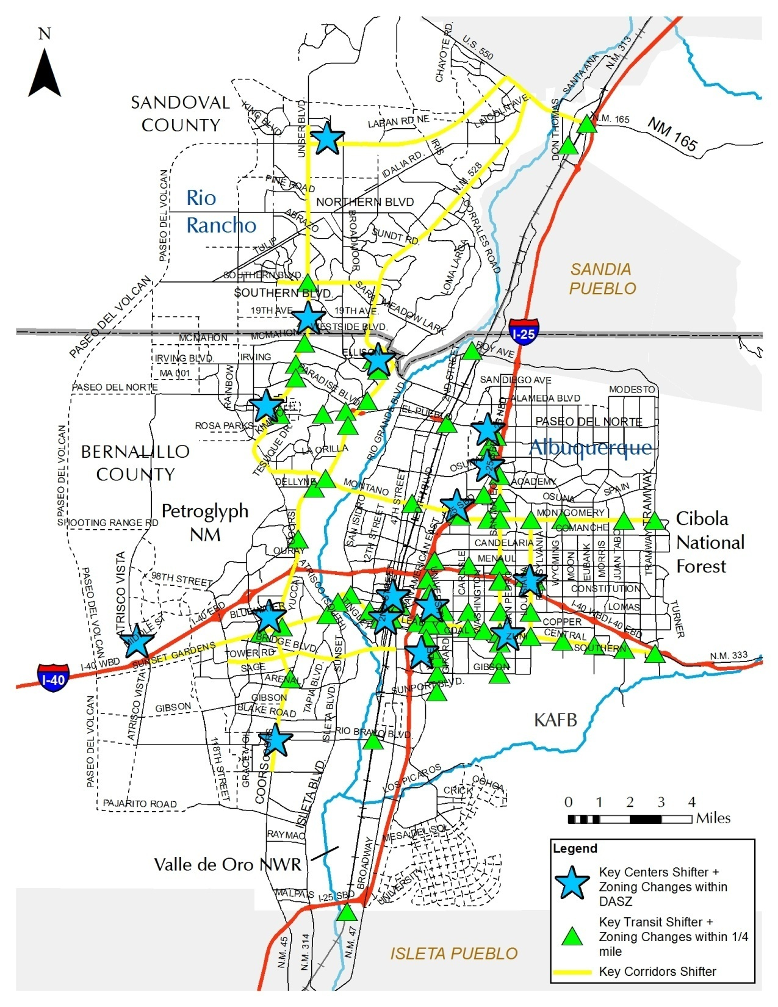
Preferred –
Incentives
Key Transit Nodes
  Attraction of 87 points
Key Activity Centers
  Attraction in 21 zones
Centers enhanced with Tiered Approach
Notes:
Point based lever used to tag parcels and influence the simulation based on network distance queries. Zone based levers allowed us a flexible tool to place weights on specific zones in order to increase the probability for development. Given that all centers are treated the same and the stakeholders wanted to prioritize some over others, we went back and implemented a tiered centers approach. Downtown example. Good point that results can not only be used to form an acceptable alternative scenario, but also to inform the relative magnitude of investment that may be required in order to achieve desired outcomes.

Slide 18
Reasonableness and Sensitivity Testing
Test | Employment | Residential
Test 1 (base case) | 0.0 | 0.0
Test 2 | 1.0 | 1.0
Test 3 | 1.5 | 1.5
Test 4 | 2.0 | 2.0
Test 5 | 3.0 | 3.0
Notes:
Levers function as knobs, which can be turned up or down to influence location attractiveness. Appropriate settings for these knobs were determined by performing scenario tests and evaluating the sensitivities and limitations of the modeling system.

Slide 19
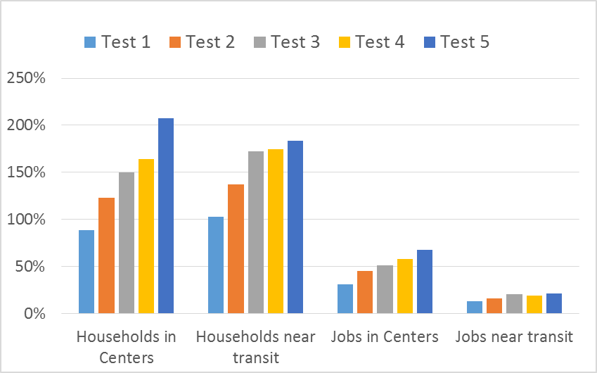
Model Results
Notes:
The impact was in general greater with a greater shifter value. Households demonstrated a larger relative impact. This is not the case every time, however, given that this was developed as an attraction lever and not a blunt force tool. The development is still subject to other functions and internal logic within the model.

Slide 20
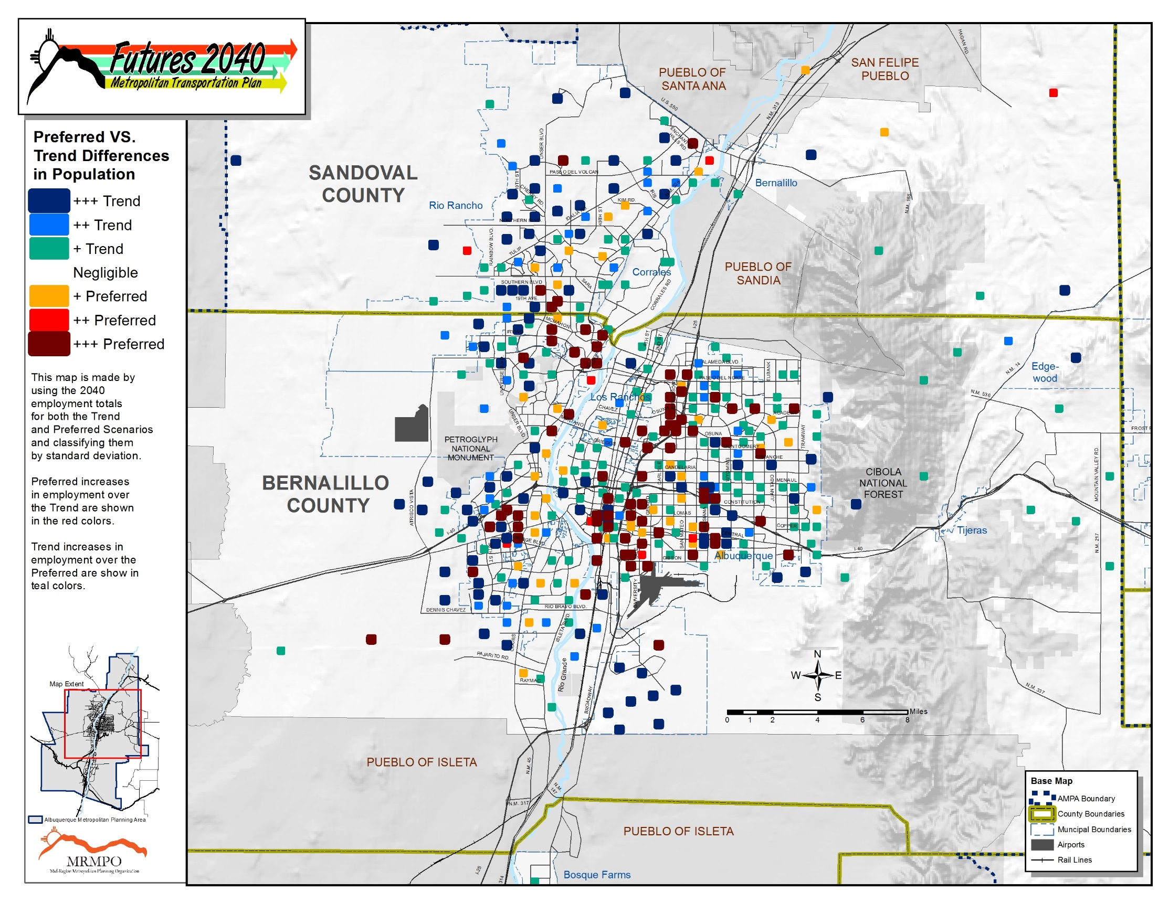
Notes:
Another important evaluation approach was through forecast visualization. The policy levers were fine-tuned and adjusted the until the results were 1) adequately different from the trend 2) reasonable and 3) reflect the stated desires of the stakeholders.

Slide 21
Roadway Performance
Systemwide Speed
Hours Traveled
Miles Traveled
Notes:
Once again, all scenarios experience degradation from base year, however the conditions under the preferred scenario are superior to the trend.

Slide 22
Commuting Measures
River Crossing Trips
Average Commute Time

Slide 23
Sustainability Measures

Slide 24
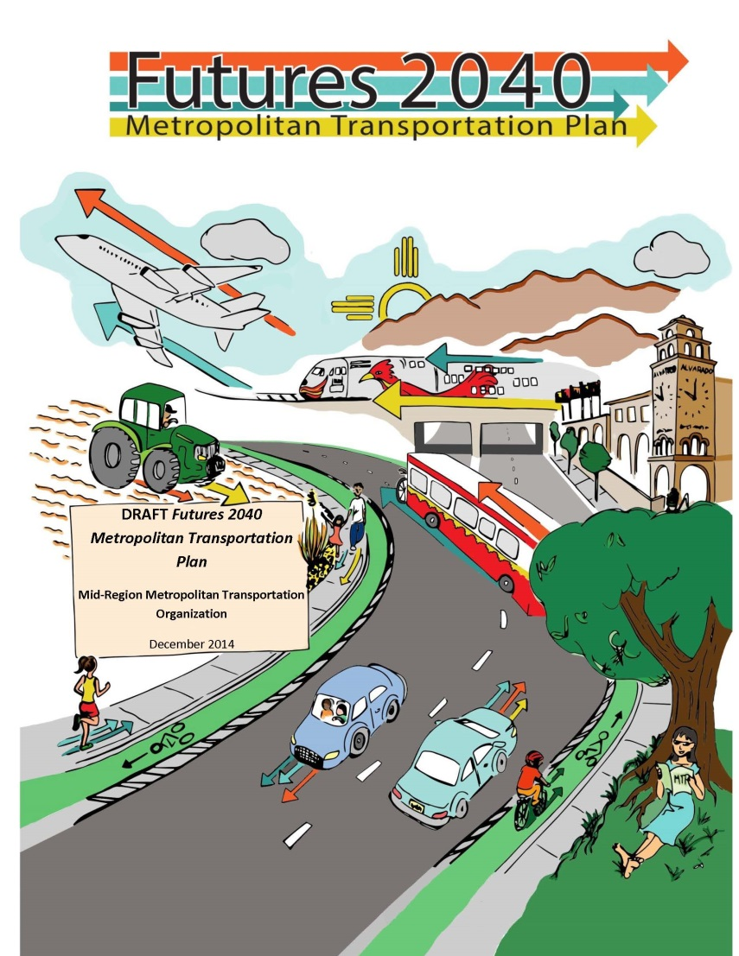
Board Approved Trend & Preferred
Continued desire to make a larger impact

Slide 25
Questions
How much is enough?
***
A predictive land use model may temper stakeholder aspirations, but it provides important information for decision-makers regarding the relative magnitude of investment that may be required in targeted locations…
Notes:
Stakeholders still desired a larger difference from the trend. This brings up an interesting modeling question, when you’re simulating alternatives, how much is enough and how is that determined? When you are using a predictive model rather than a sketch model we lose are ability to “make” things happen and measure the impacts, but we gain the ability to make statements about the feasibility of various policy and investment decisions.

