Slide 1
Corridor-Focused Transit Survey Data Collection and Application in South Florida
15th TRB National Transportation Planning Applications Conference, Atlantic City NJ
Presented by
Ashutosh Kumar, AECOM
May 20, 2015

Slide 2
The Problem
Multi-modal corridor studies typically suffer from lack of corridor-level transit data that is
Up-to-date,
Sufficiently detailed, or
Of sufficient quality for corridor analysis
Pre-planning for these types of studies is generally limited to the collection of readily-available, system-/region-wide travel data/model

Slide 3
The Consequence
Multi-modal corridor studies that use their resources inefficiently and suffer from high schedule-delay risk
Data collection: limited windows of opportunity (Jan-Apr/Sep-Nov), data processing time
Technical tools: regional models and other route planning tools (such as TBEST in Florida) are not sufficiently prepared for corridor analysis or may not be most appropriate for some corridors
Tight schedule because downstream funds are programmed in next FY (1-2 month delay → 1 fiscal year delay)

Slide 4
Objectives
Identify issues in advance to inform project scope development
Move data collection and model development outside of the project
Better control of costs/delivery of the data and models
Reduce study distractions from the data/model work
Keep focus on the study analysis and consensus efforts
Faster delivery of projects to NEPA/design phases

Slide 5
FDOT District 4 Program
District 4 covers Ft. Lauderdale and West Palm Beach metro areas in South Florida; includes 5 counties (Broward, Palm Beach, Martin, St. Lucie and Indian River)
Program initiated in FY 2012
Six corridors covered so far in Broward County covering 45% of the system-wide boardings
The program is in second iteration right now
Survey methodology, processing and application updated with lessons learned and industry research after each survey

Slide 6
Methodology
Collect and analyze readily available corridor data
Conduct state-of-the-art corridor-focused field travel surveys
Utilize the data to
Develop preliminary case for the project based on the readily available and collected data
Develop efficient corridor data-driven simplified ridership model
Develop other data driven route planning applications to support transit agencies plans

Slide 7
Readily Available Data Collection and Analysis
Demographic data: latest SERPM model, Census/ACS
D2D trip flow data: ACS, CTPP 2000, SERPM
Roadway and Traffic Characteristics: Florida Traffic Information data, HERE/INRIX data
Transit data: Public time table, system-wide on-board, existing APC and farebox data
Etc..

Slide 8
Corridor-Specific Transit Data Collection
Two surveys conducted
Boarding-to-alighting (B2A) survey
Card distributed to rider, and returned to surveyor when rider alights
Captures boarding and alighting stops for each rider
40-55% sample rate (4-5x standard transit O/D survey)
Simplified main survey, asking questions oriented to route:
Origin and destination, Up- and down-stream transfers, Trip purpose, Others as necessary
~20% sample rates (2x standard transit O/D survey) – rates determined by period, segment-to-segment flows
Platform/intersection surveys as necessary
Retirement community residents versus workers
Transfer patterns at intersections
Mall terminal patterns

Slide 9
Field Travel Surveys – “What’s Uncommon Here”
On-board survey with portable smart devices (first transit application in South Florida area):
Real-time update and accumulation of survey data
Real-time geo-coding of the riders’ origin/destination addresses plus boarding/alighting stops
Real-time in-field quality control measures with built-in algorithm
State-of-the art sampling plan based on segment-to-segment flows rather than at route level
Local survey crew staff – most of them sufficiently trained and experienced over multiple surveys

Slide 10
A Comparison of Approaches: An Actual Example (Route 18)
 | Traditional (Regional transit survey) | With Pre-Planning & Data Collection (Corridor-specific transit survey) | Notes
Riders making at least one transfer | 49% | 67% | More riders transferring than previously thought; different routes and magnitudes
Top 4 transfer routes | 22, 72, 34, 36 | 72, 36, 7, 34
Percentage of work trips | 43% | 49% | Relatively similar
Average trip length (overall) | 8.33 miles | 7.18 miles | Previous estimates over-stated trip lengths (long-trip response bias)
Average trip length (on bus) | 6.54 miles | 4.93 miles
Sub-route travel movements | Insufficient information | Detail information; created trip table | Now have better data to inform route planning

Slide 11
Application of the Data 1. standard tables and Maps from the survey 2. data-driven route planning application 3. data-driven simplified model 4. preliminary case for the project document

Slide 12
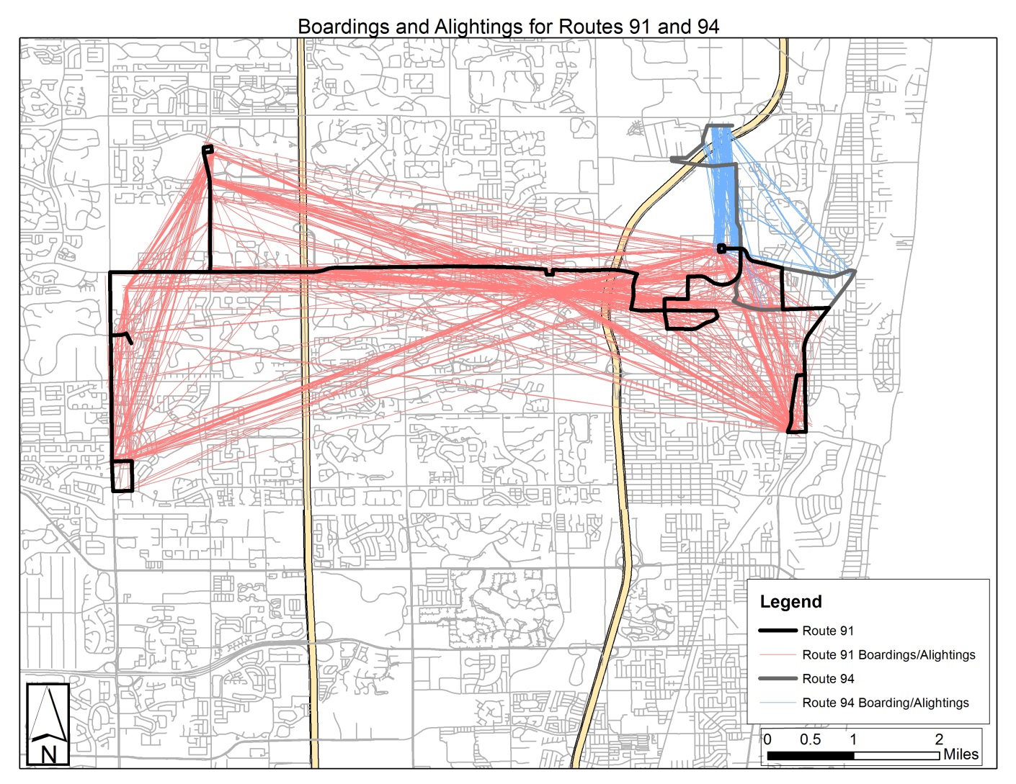
Data Application – Transit Rider Desire Line Map
“Standard” set of analyses to understand the market…
Source: Connetics Transportation Group

Slide 13
Data Application – Route Planning Application Interface
Simple Application for understanding route travel patterns.

Slide 14
Route Planning Application – Trips by Purpose Example

Slide 15
Route Planning Application – Segment to Segment Flows Example
Dynamically displays segment-to-segment flow information using D3 (Data Drive Documents) technology

Slide 16
Data Application – Data-Driven Ridership Model
Ingredients
Route-specific survey data, supplemented with system-wide survey
Auto skims, person trip tables, and transit networks from regional travel model
Incremental logit mode choice model (pivot-point)
TCRP Report 118: BRT Practitioner’s Guide
Cube Voyager platform
Development time/cost: 2 months and ~$30,000 (for high ridership routes)
15% of regional model running time (6x faster)

Slide 17
Preliminary Case for the Project Documentation
Initial draft completed by pre-planning team using the readily-available and the collected data (3-4 pages)
Project identification and setting
Current (base year) conditions
Near-term and horizon-year changes
Enumeration of corridor transportation problems
Remaining sections to be completed by project team during corridor study (3-4 pages)
Purpose of the Project
Merits of the Low-Cost and Locally-Preferred Alternatives
Uncertainties: Ridership
Summary

Slide 18
Reactions / Summary
Highly favorable reactions from the local transit agency and FDOT staff
Pre-planning & data collection efforts provide many benefits to transit planners
Improved understanding of corridor
Focused use of resources
Reduced schedule delay in corridor studies
Adopted to better assess unique corridor travel market

Slide 19
Acknowledgments
Scott Seeburger and Shi-Chiang Li, FDOT
David Schmitt and Hongbo Chi, AECOM
FTA

