Slide 1
The Travel Implications of Aging Population in Metro Atlanta using Activity-Based Model
May 18, 2015
Kyeil Kim, Ph.D., PTP, Atlanta Regional Commission
Guy Rousseau, Atlanta Regional Commission
Joel Freedman, Resource Systems Group
Jonathan Nicholson, Atkins

Slide 2
Older Population in the U.S.
Population aged 65 and over in U.S.
  2010: 40.3 million (13.0% of total population)
  2040: 79.7 million (21.0% of total population)
  Mainly driven by baby boomers
State of Georgia
  2010: 0.9 million (10.2% of total state population)
  2030: 1.9 million (15.9% of total state population)

Slide 3
Baby Boomers
2012 2035
Source: U.S. Population Projections: 2012 to 2060, Jennifer M. Ortman, U.S. Census Bureau, 2013

Slide 4
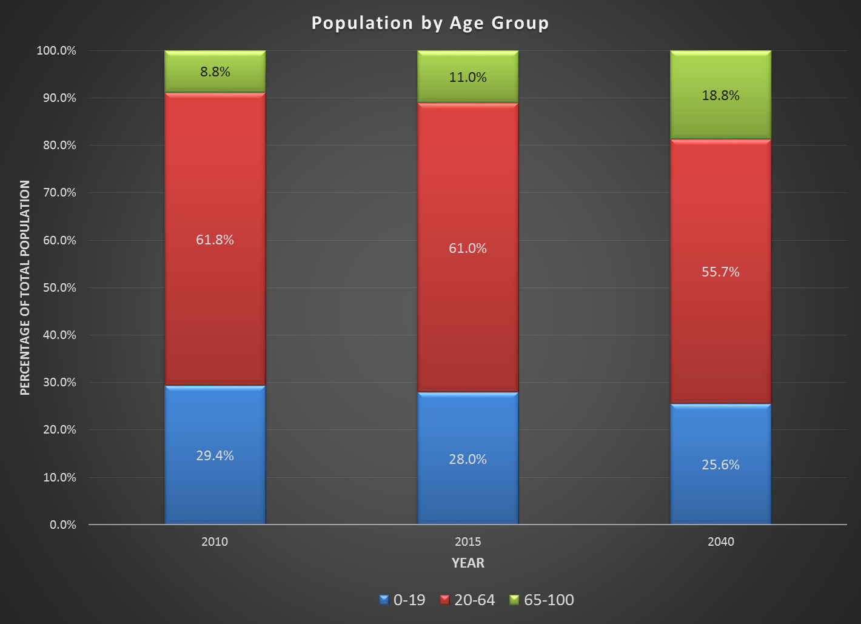
Age Projections - Metro Atlanta

Slide 5
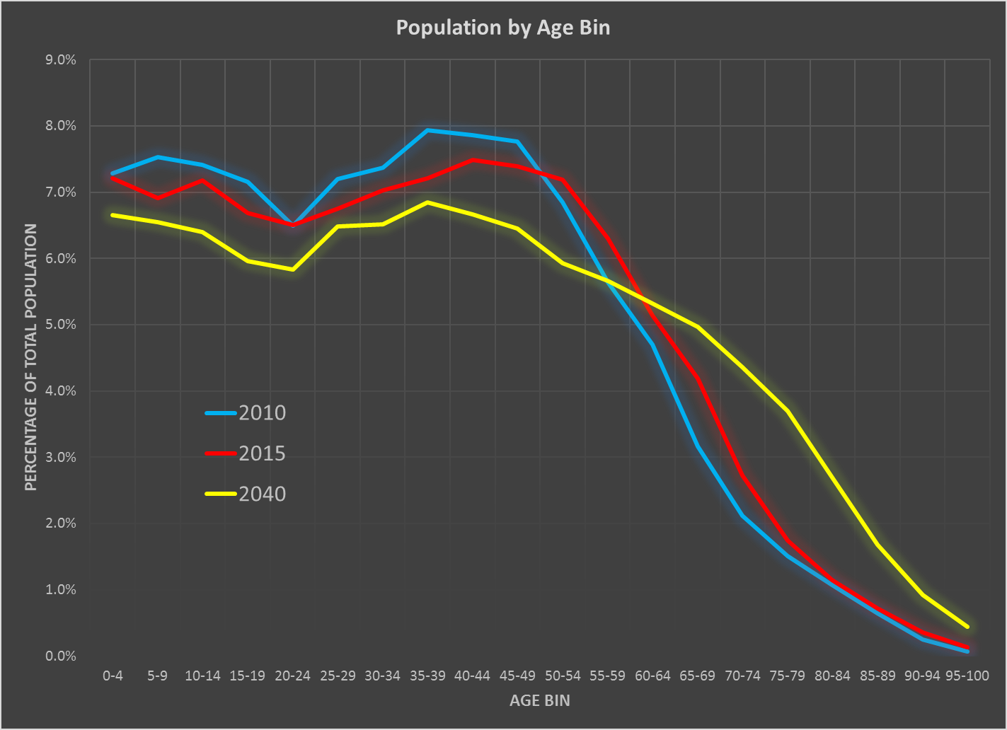
Age Structure - Metro Atlanta

Slide 6
Methodology
Two datasets tested
  ARC’s projection of persons by age for 2040 reflecting aging population
  → “Future Age Structure”
  Projection of persons by age for 2040 preserving the age structure of year 2010
  → “Base Age Structure”
Synthesize population/household from two datasets
Run ABM for the synthesized population for each dataset

Slide 7
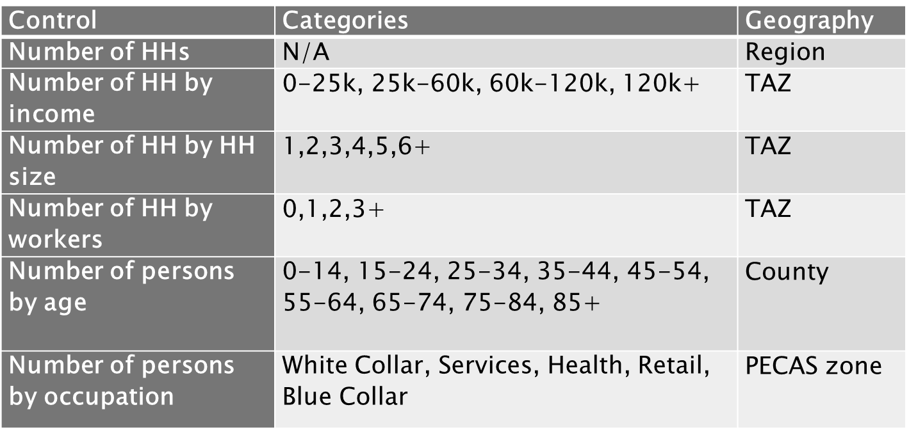
Population Synthesis
Household and person constraints

Slide 8
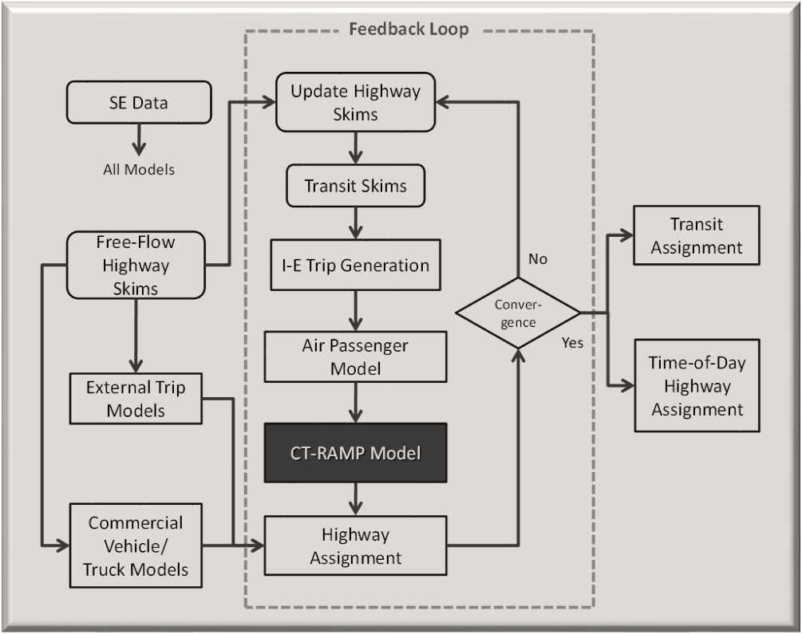
ARC Activity-Based Model
Model structure

Slide 9
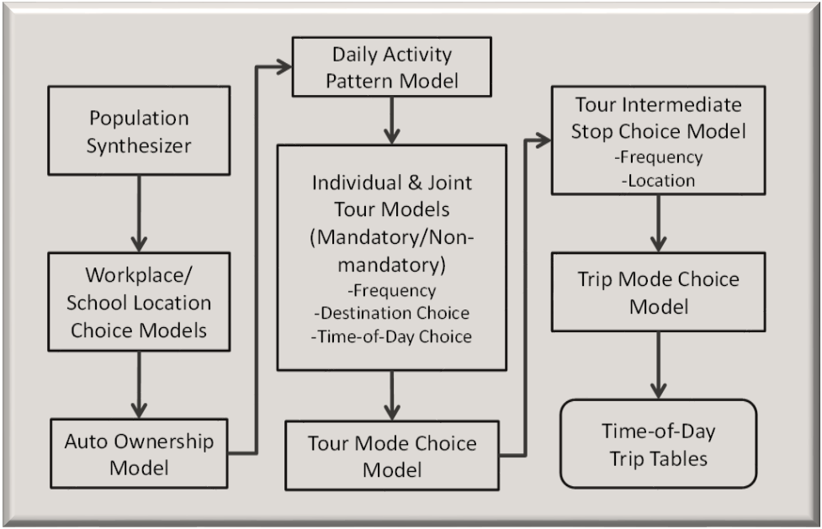
ARC Activity-Based Model
Internal Demand Generation

Slide 10
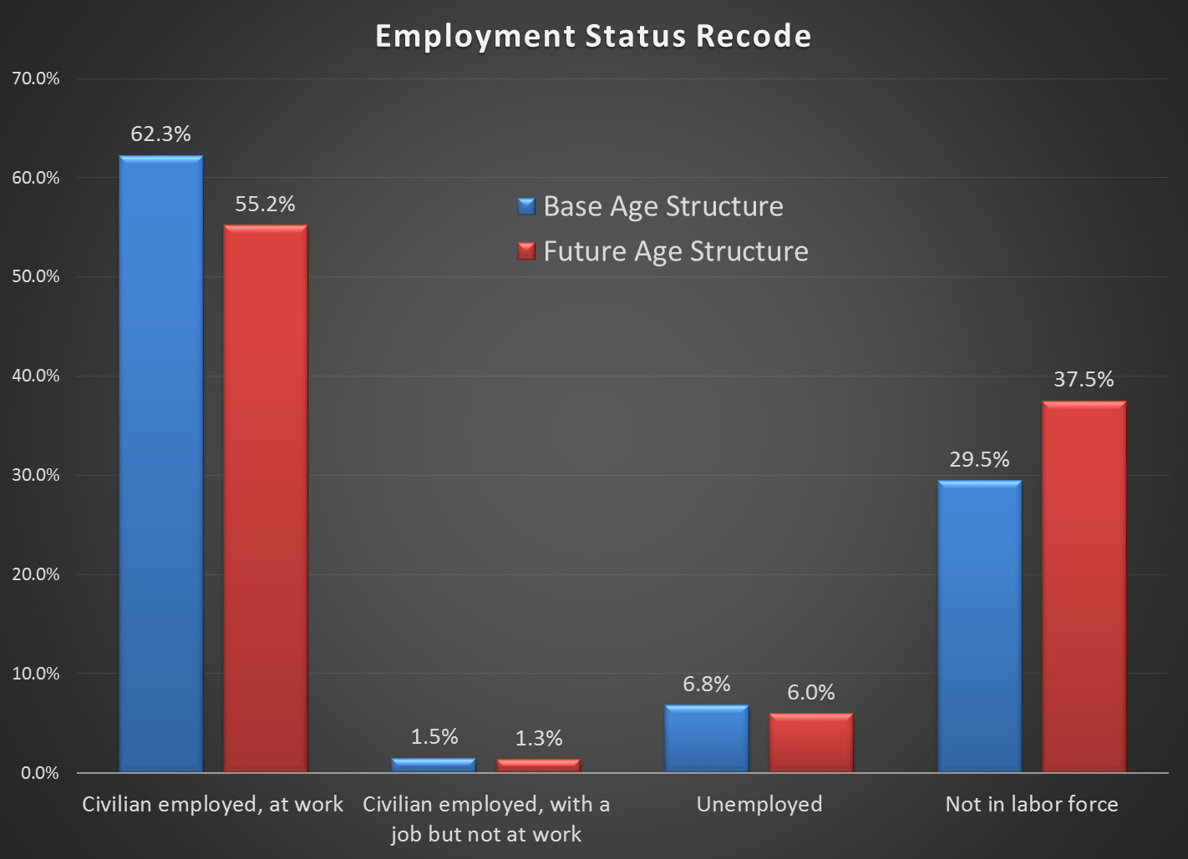
PopSyn Results

Slide 11
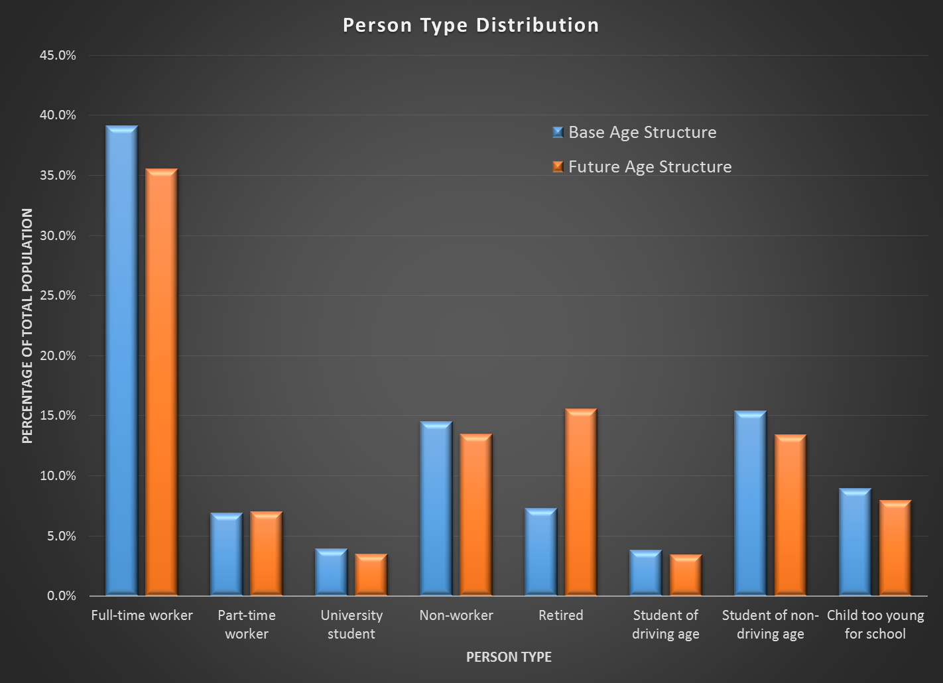
Person Type Distribution

Slide 12
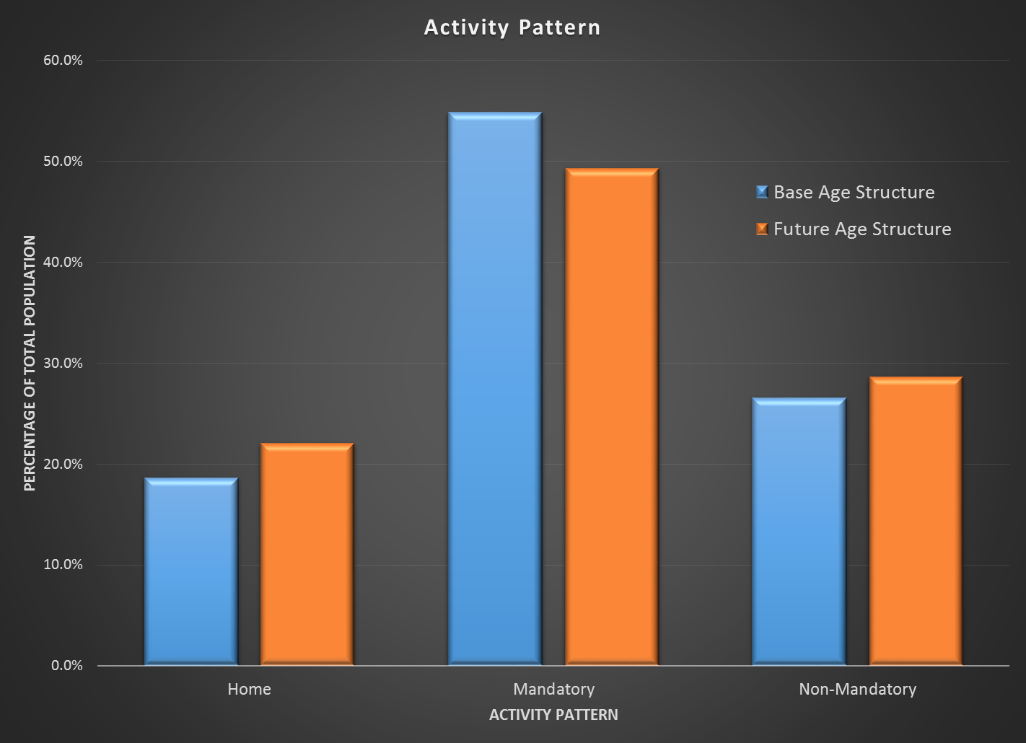
Daily Activity Patterns

Slide 13
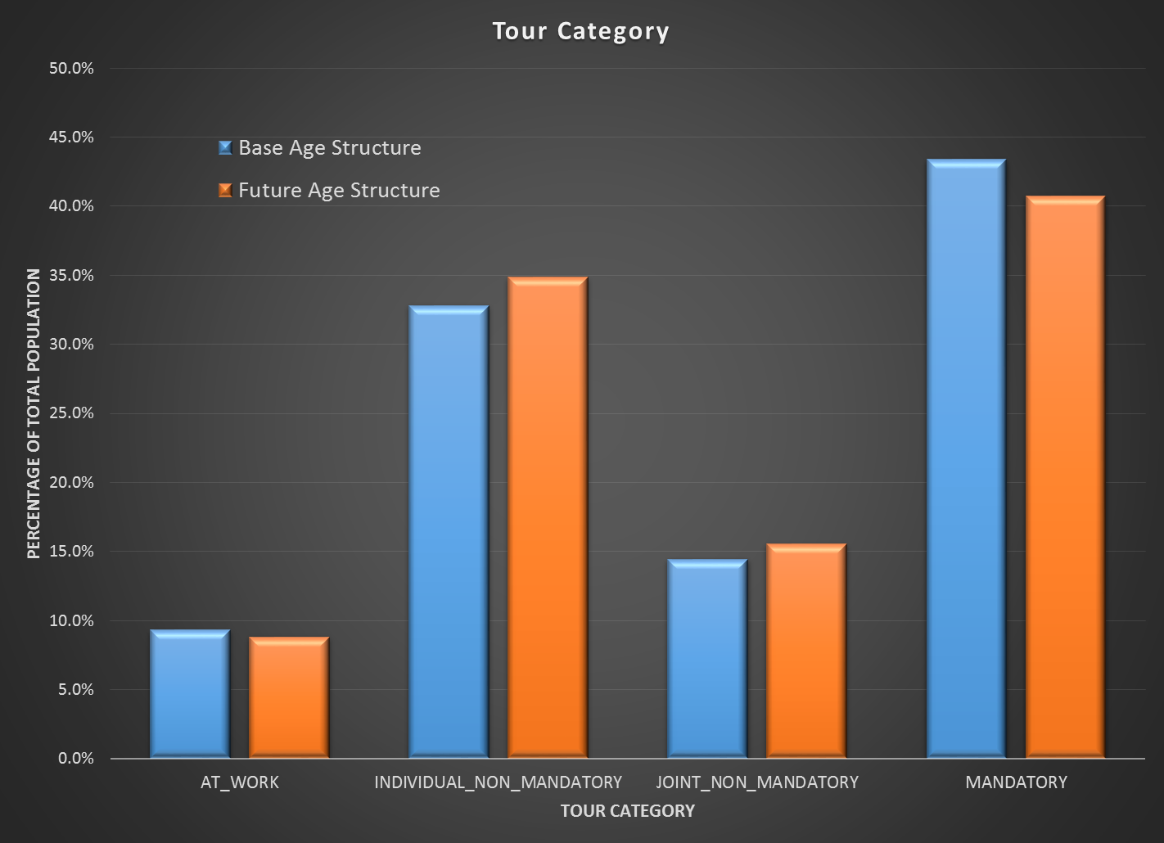
Tour Generation

Slide 14
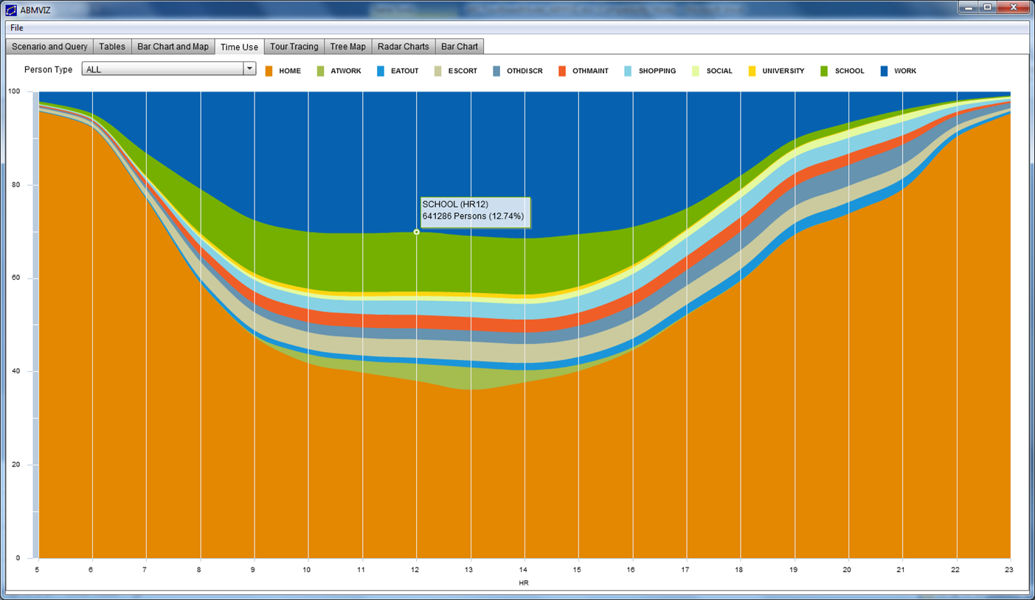
Timeuse

Slide 15
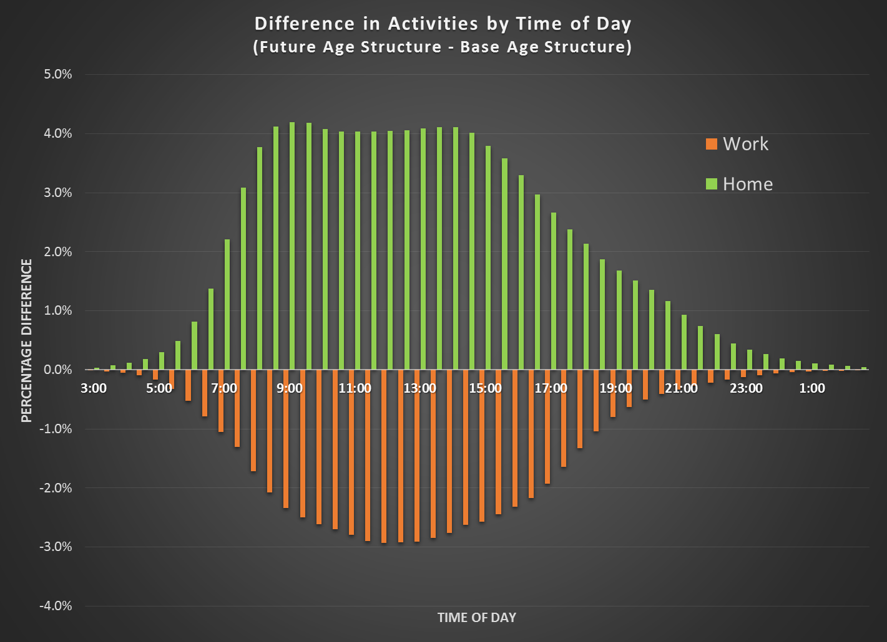
Timeuse

Slide 16
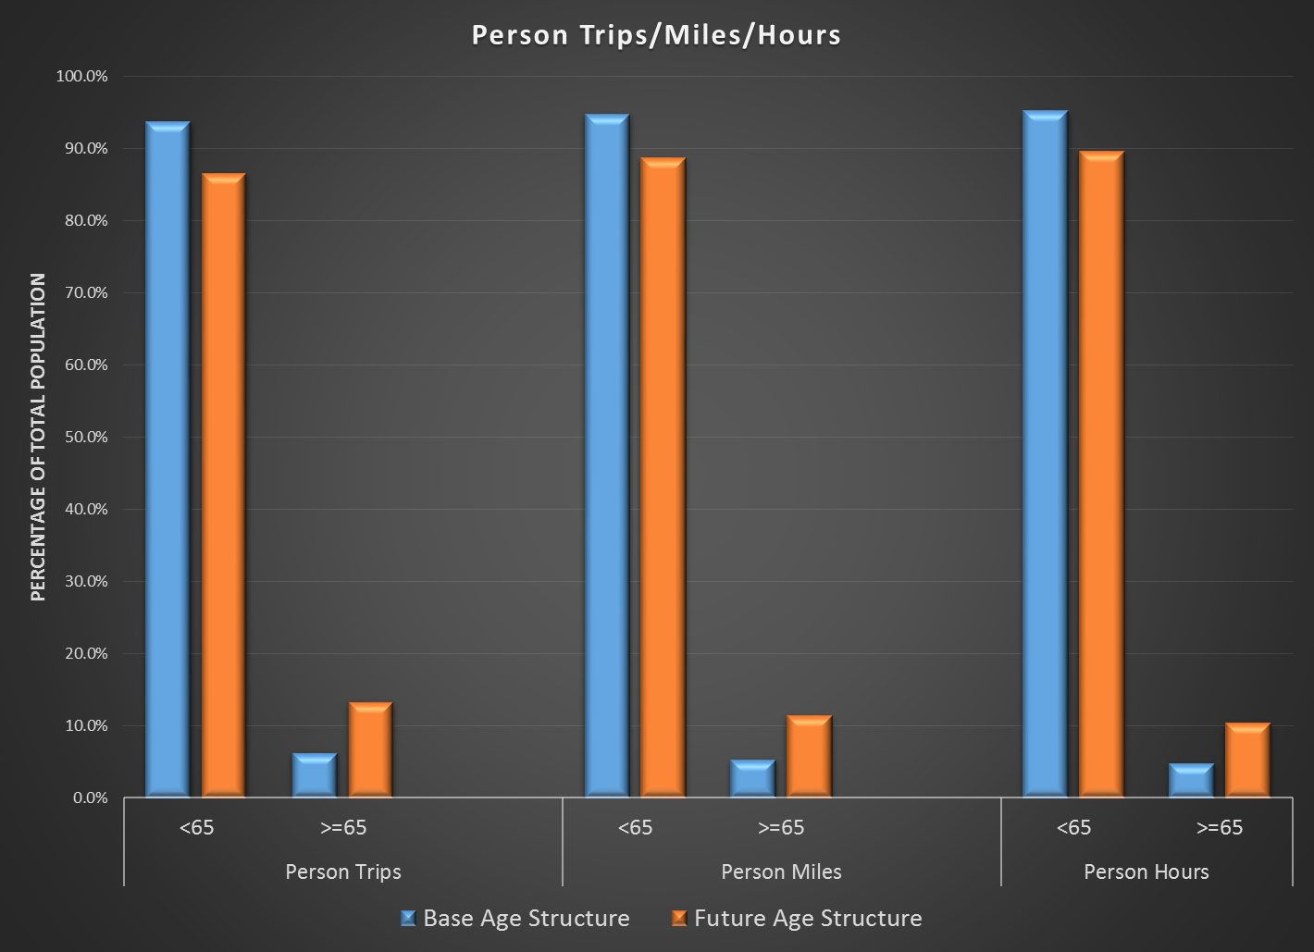
Travel Demand Results

Slide 17
Systemwide Results
With 10% increase in population aged 65 and over in metro Atlanta
  Total vehicle trips decreased by 2.8%
  Total VMTs decreased by 2.8%
  Total VHTs decreased by 4.9%
  3.36 average trips/person, down from 3.51 base
Annual congestion cost per person decreased by 12.7%
Total cost per person decreased by 12.2%

Slide 18
Systemwide Results
More travel demand by population aged 65 and over in metro Atlanta
  13.4% of total trips, up from 6.3% base
  11.4% of total vehicle miles, up from 5.3% base
  10.4% of total vehicle hours, up from 4.8% base
Transit trips by population aged 65 and over in metro Atlanta
  79,700 trips in the base age structure; 150,000 trips in the future age structure
  88% increase in transit trips by older population

Slide 19
Summary/Policy Implications
Contribution of the older population on travel demand
  Decrease in systemwide congestion
  More travel demand generated by the older population
  More non-mandatory tours, less mandatory tours
  Shorter systemwide trip lengths
  Significant increase in transit trips
Transportation policy implications
  Safety concerns
  Prudent investment between capacity expansion and transit service improvement
  Involvement of the older population in transportation planning process

Slide 20
Contact
Kyeil Kim, Ph.D., PTP
Atlanta Regional Commission
kykim@atlantaregional.com
(404) 463-3276

