Slide 1
An Application of Mitigating Flow Bias from Origin/Destination Surveys in a Transit System
Jamie Snow (AECOM)
David Schmitt (AECOM)
May 20, 2015

Slide 2
Addressing Flow Bias in Transit Surveys
Accurate information on flows is critical in transportation planning
Observation: Expansion methods using only the origin/ destination survey typically under-represent short trips and misrepresent flows
  Difficult to know where the biases occur
Can flows be made more accurate using auxiliary data and iterative proportional fitting (IPF) techniques?

Slide 3
Advanced Expansion Process (AEP) Methodology
Develop segment-to-segment on-to-off flows using survey and ancillary data
Develop origin/destination segment-to-segment flows using survey
Divide on-to-off flows by origin/destination flows
Create synthetic origin/destination records where necessary
Apply expansion factors to main survey records
Define route segmentation

Slide 4
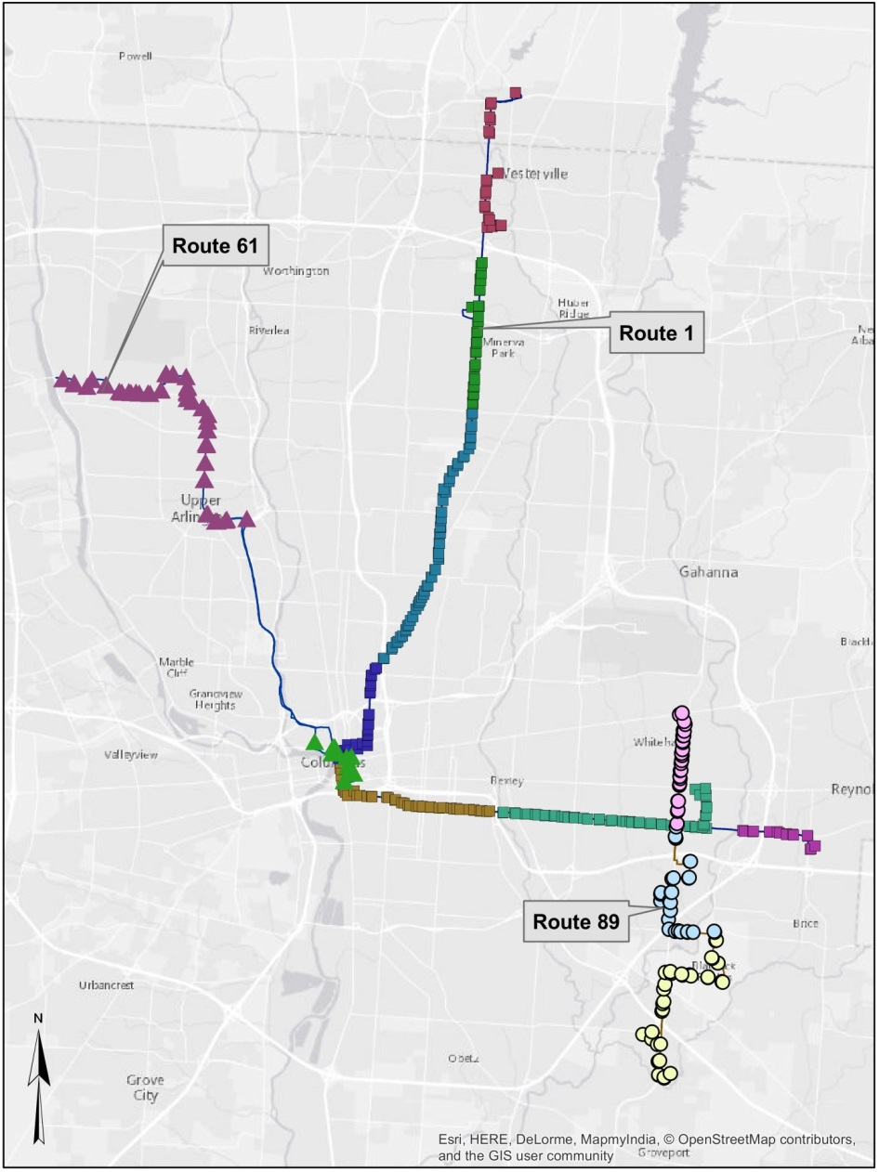
Define Route Segmentation
Segment the transit routes using
  Natural boundaries
  Major cross streets
  Large differences in travel patterns
Local routes represented by 4-6 segments
Express and crosstown routes represented by 2-3 segments

Slide 5
Develop On-to-off Flows
Automatic Passenger Counter (APC) data
  Averaged over 5 months
  Used to generate the column and row marginals for IPF
On-to-off counts
  Collected at 20% or 100% sampling rate, depending on route
  Used to generate the “seed” matrices for the IPF process
  Developed synthetic records where APC and/or OD > 0 but On-to-off = 0
Use IPF to expand on-to-off counts
  On-to-off counts as “seed” matrices
  APC counts for row/column marginals
  Result: segment-to-segment flows

Slide 6
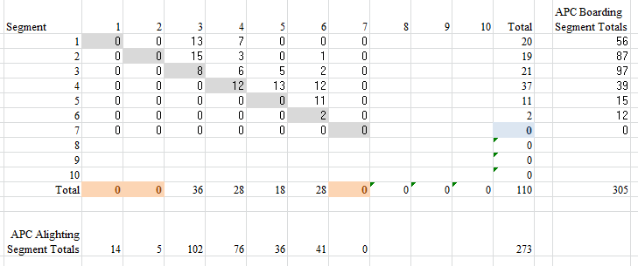
Using IPF to Develop Segment to Segment Flows
Generated from the on-to-off data by route, time period, direction, and segment
Generated from the APC data by route, time period, direction, and segment
Indicates the need for a Synthetic Record

Slide 7
Develop Origin/Destination (OD) Flows
Initial expansion factors developed by dividing segment-to-segment flows expanded to APC values by segment-to-segment count of OD survey records
Synthetic records developed in cells where On-to-off flows and/or APC > 0 but OD = 0

Slide 8
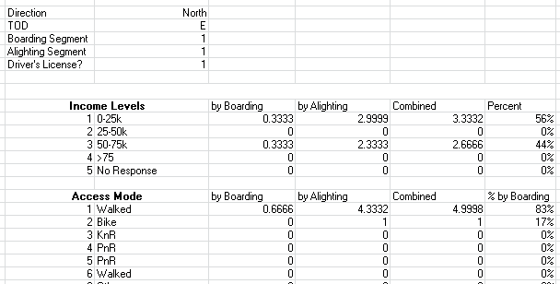
Origin/Destination Expansion Example
Performed by direction and time period for each route
Segment-to-segment flows expanded to APC values
Segment-to-segment count of OD survey records *
Segment-to-segment expansion factors
* Synthetic OD survey records developed where the observed flow > 0 but count of main survey records = 0
*Synthetic origin/destination survey record

Slide 9
Is AEP Better Than Traditional RTD Expansion?
Traditional expansion: route, time period, and direction using OD survey only (RTD)
Objective: compare AEP results to traditional expansion results using APC data as the “ground truth”
Metrics
  Mean Absolute Percent Error (MAPE)
  Root Mean Square Error (RMSE)
Three COTA routes
  Local Route 1 (large – 8,800 daily boardings)
  Crosstown Route 89 (medium – 1,000 daily boardings)
  Express Route 61 (small – 150 daily boardings)

Slide 10
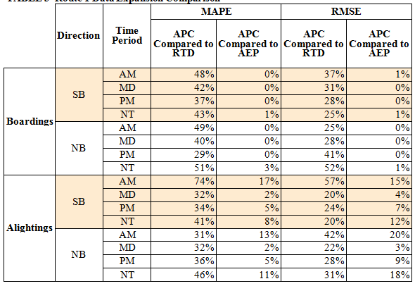
Comparison Results – Local Route 1
Average Daily Ridership = 8,824
Expanding the data using RTD produces mean absolute percentage errors that are 3-5 times higher than expanding the data with the AEP
Similarly root mean square errors are 2-4 times higher expanding the data using RTD
7 segments

Slide 11
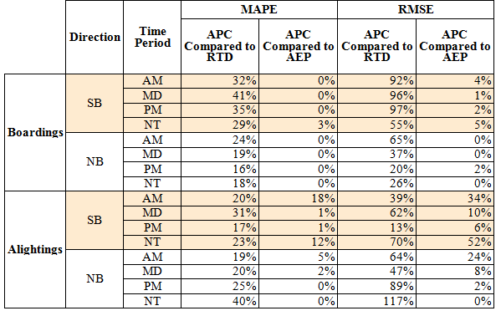
Comparison Results – Route 89
Average Daily Ridership = 999
Similar to Route 1, AEP expansion has less MAPE than RTD. Less segmentation of the route begins to close the gap between expansion methods
RMSEs are closer but AEP methodology still drastically outperforms RTD expansion
3 segments

Slide 12
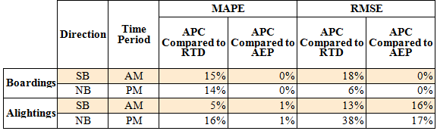
Comparison Results – Route 61
Average Daily Ridership = 139
2 segments
Again, AEP outperforms RTD expansion when comparing MAPE
When the minimal number of segments are utilized, RMSE for both methodologies are very similar

Slide 13
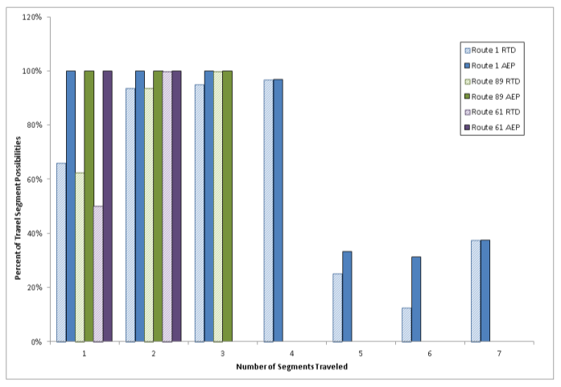
Results Continued
AEP methodology addresses flow movements better using number of segments traveled; minimizes short trip bias

Slide 14
Results Continued
Large number of OD survey records with an expansion factor less than 1.0 (+2,400 or 18%)
The causes were explicable based on the data

Slide 15
Conclusions
Using IPF with on-to-off flow data and APCs produces more accurate boarding and alighting results than RTD in these routes
Also improved representation of short trips
Missing flow movements incorporated into the expanded dataset which removed biases from over- and underweighting of various flow movements

Slide 16
Acknowledgements
Rebekah Anderson, Ohio Department of Transportation
Dr. Mark McCord, The Ohio State University
Dr. Rabi Mishalani, The Ohio State University
Mike, McCann, The Central Ohio Transportation Authority

Slide 17
Thank you
Jamie.Snow@aecom.com
David.Schmitt@aecom.com
May 20, 2015

