Slide 1
SEPTA Fare Sensitivity Analysis Using DVRPC’s Regional Travel Forecasting Model
May 17, 2015
Fang Yuan, Brad Lane, and Vanvi Trieu

Slide 2
Outline
Introduction
Fare Elasticities from the Literature
Data
How we model Fares at DVRPC
Scenarios Analyzed
Conclusions and Recommendations

Slide 3
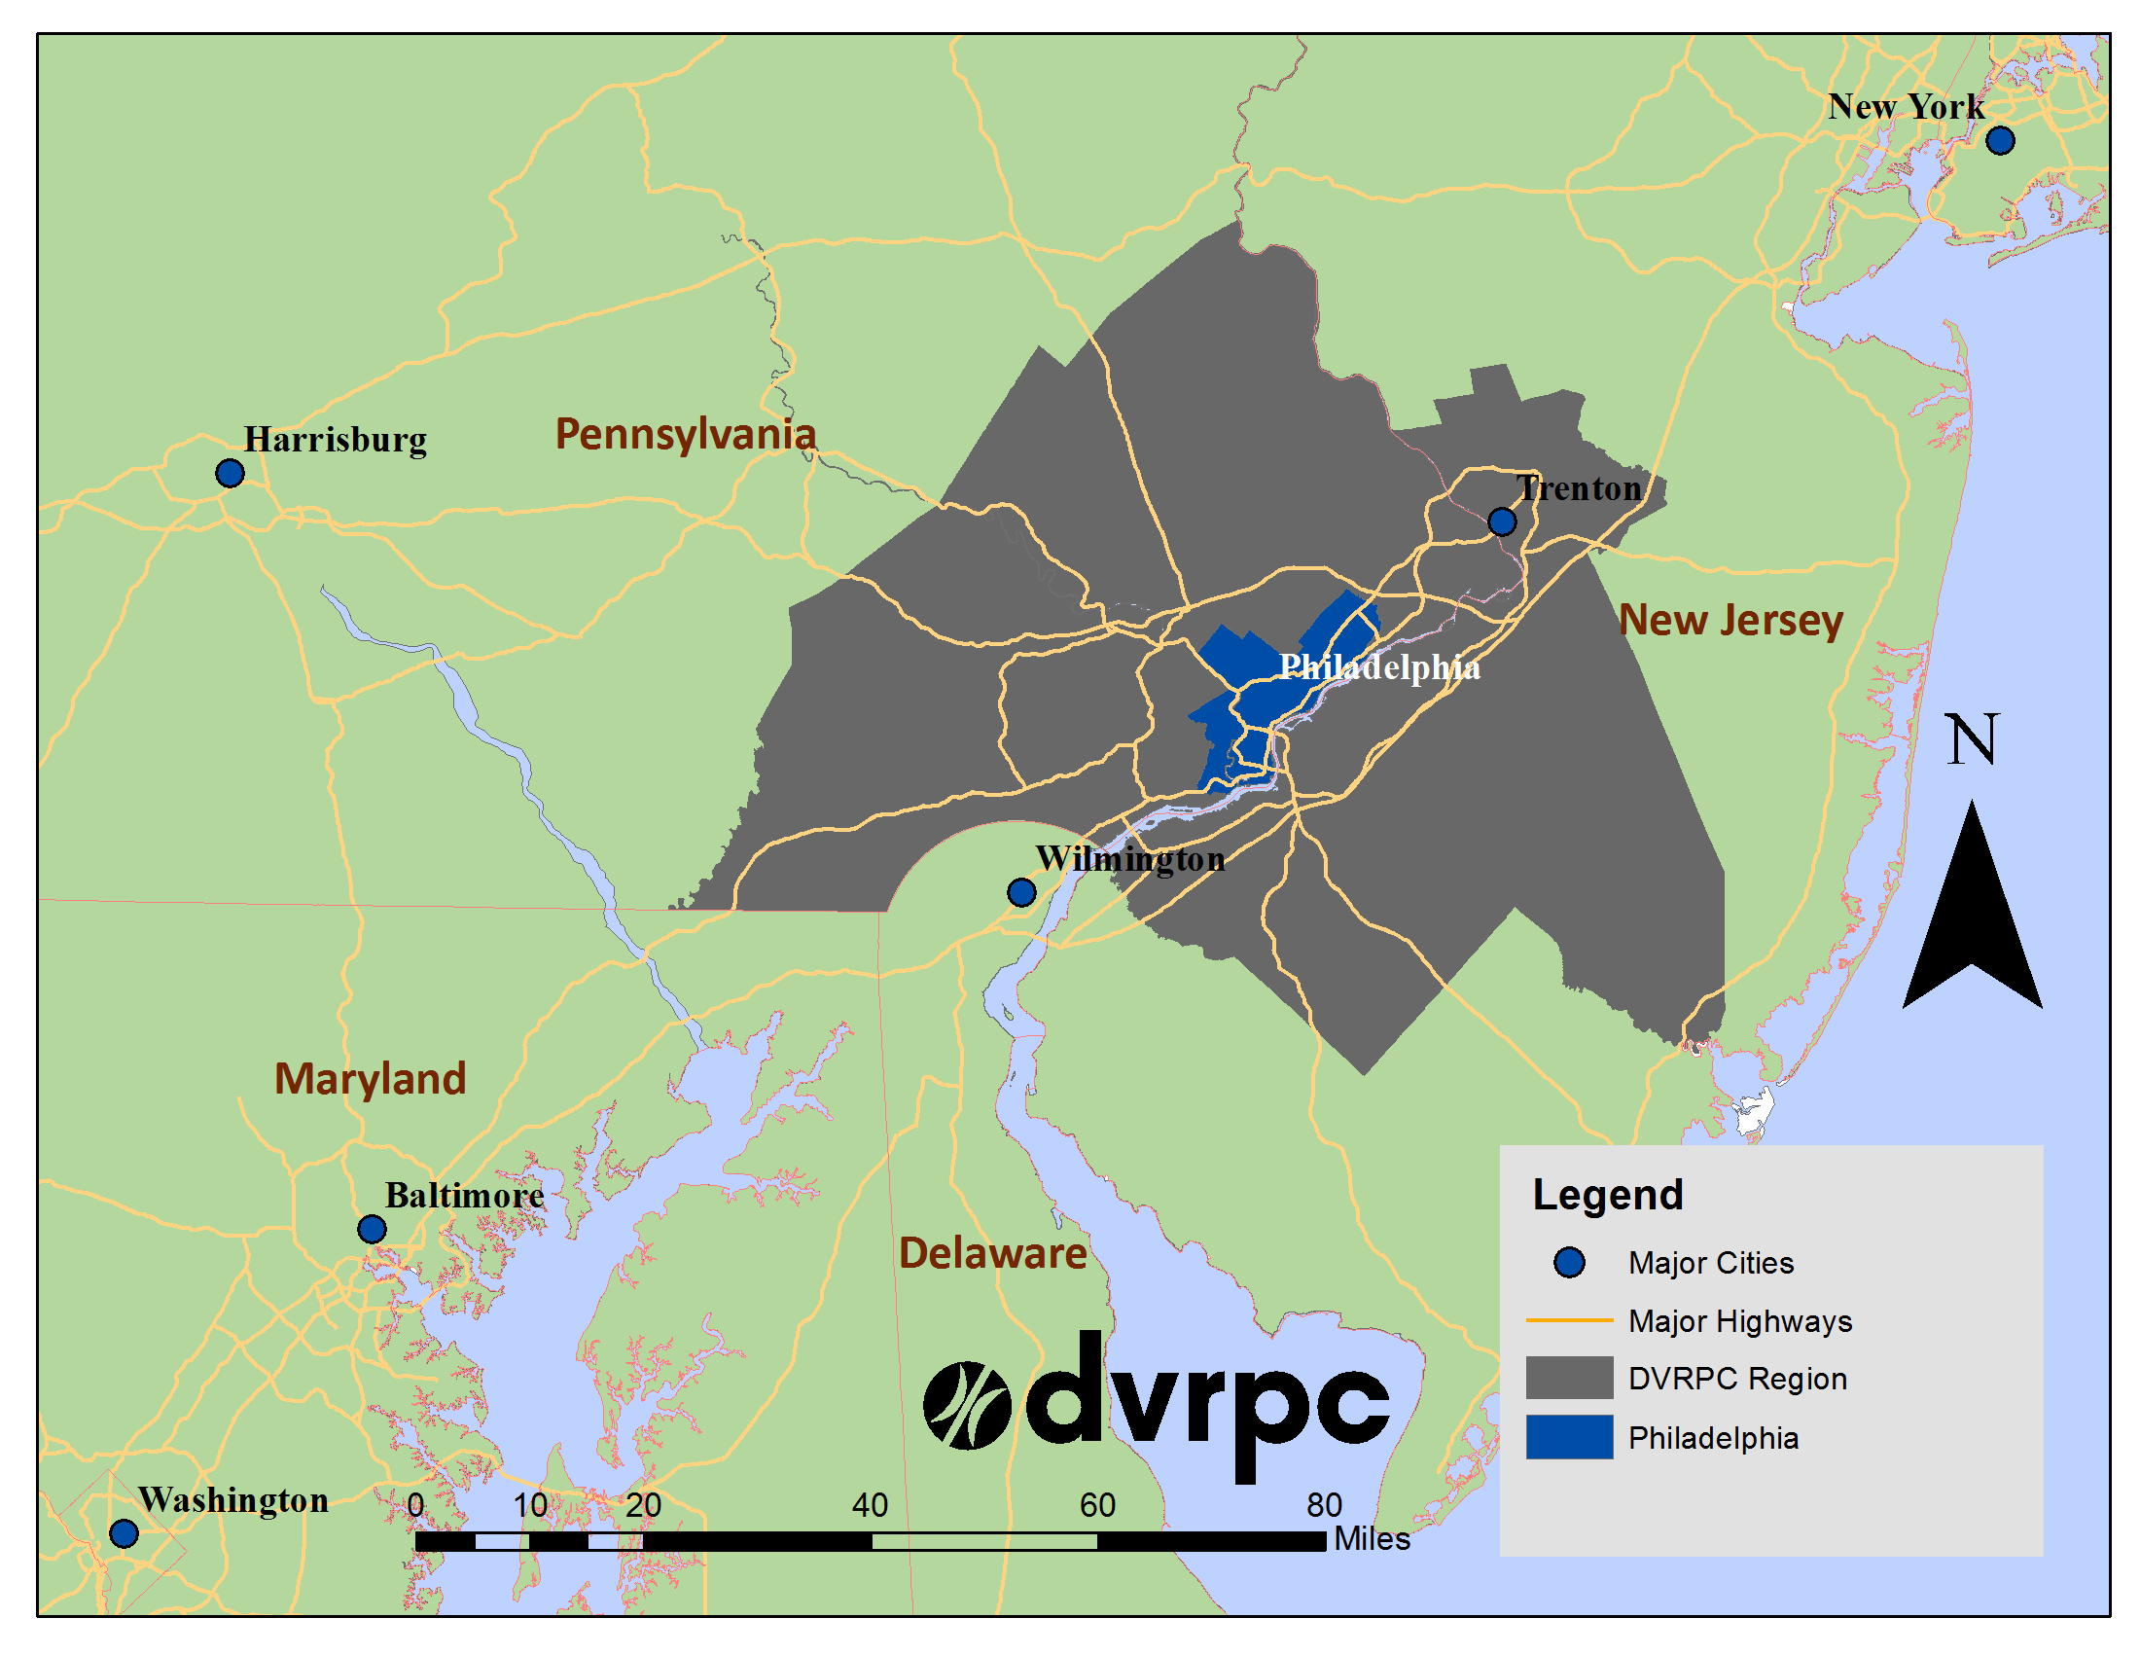
Delaware Valley Regional Planning Commission
Metropolitan Planning Organization (MPO)
2 States
9 Counties
351 Municipalities
5.6 Million Population
3,800 sq. miles
~115 employees
Activities –
Long Range Plan (LRP)
Transportation Improvement Program (TIP)
Wide range of planning and technical support for regional partners
Notes:
Created in 1965, the Delaware Valley Regional Planning Commission (DVRPC) is the federally designated Metropolitan Planning Organization (MPO) for the Delaware Valley region (Greater Philadelphia region). Somewhat unique among MPOs in that we are a bi-state agency covering sections of nj and pa. The region includes Bucks, Chester, Delaware, and Montgomery counties as well as the City of Philadelphia, in Pennsylvania; and Burlington, Camden, Gloucester, and Mercer counties in New Jersey. These nine counties together comprise over 3,800 square miles and are made up of over 350 municipalities. The region is home to 5.5 million residents and 2.8 million jobs. Land use varies from the dense urban core of Center City Philadelphia to the open rural areas of the New Jersey Pinelands.

Slide 4
Introduction
Analysis was done as part of model improvement process
We have several major transit studies coming up
Really wanted to see how well our model does at capturing the impact of fare changes
Notes:
Set the stage
This is a really applied problem, right?
How many of you have wondered - well how sensitive is your model to a fare change?
We certainly did
Part of our motivation for doing this - we have a lot of transit projects, that we are currently working on.
As well as several major projects that are coming
At the same time - one of the major transit operators in the Philadelphia area (SEPTA) has pretty regular fare changes
About every 3 years
With a major change coming up next - switch to NPT electronic payment

Slide 5
Elasticity of Ridership in Literature
Fare
Typically -0.33 (-0.1 to -0.6, higher in long term)
Rail/subway is less elastic (more resilient) than bus
Peak-hour is less elastic than off-peak
Population (+0.61) and employment (+0.25)
Service (+0.71)
Gas price (+0.12 ~ +0.16)
Trip type and user type
Parking availability/cost and auto ownership
Notes:
We looked at observed elasticities from other studies
Mainly from the U.S. and Europe
Sooo, if you increase subway fare by 1% ridership will decrease by 0.09%

Slide 6
Data
Time period: 2000 – 2014
A lot of changes in Philadelphia
Gathered data on:
Fares
Employment
Population
Gas Prices
Ridership
Notes:
There was a lot going on during this time-frame
Data spans the Recession
The reason we want to show this - many of the theoretical assumptions underpinning the use of Elasticities are based on “Ceteris Paribus”
The idea that you are changing 1 thing - and holding everything else constant
Well - clearly, that was NOT what was going on in Philadelphia during this time period
Which definitely complicated things

Slide 7
Data - Fares
SEPTA Fare Price History (2000 – 2014)
Notes:
This figure shows the most recent fare hikes in 2001, 2007, 2010, and 2013
For example, during this time the Cash Fare went from $1.60 to $2.25

Slide 8
Data – Employment
Percent Annual Change in Employment
Notes:
This graph shows the sharp drop in employment during the Recession
Philadelphia was a little less impacted than the country as a whole - but still between 2008 and 2009, employment decreased by about 3%

Slide 9
Data – Unemployment
Unemployment Rate - Philadelphia-Camden-Wilmington MSA
Notes:
This graph shows Unemployment in Philadelphia urban area
Again - sharp increase in 2009 more than doubled
From 4.1% to 9.4%
Since then, it has steadily declined though still not totally back to where we were before the Recession

Slide 10
Data - Population
Census Population (2000 – 2013)
Notes:
The Region as a whole (yellow) grew by 5.5%
The City of Philadelphia (blue) –
For the first time in a long time, population in the City actually started to increase round about 2009

Slide 11
Data – Gas Prices
Retail Price of Gasoline - Central Atlantic Region
Notes:
Sharp decline in 2009
Then from 2010 to 2012 gas prices have climbed back to where they were before the Recession

Slide 12
Data - Ridership
Total SEPTA Ridership (2000 – 2013)
Notes:
Despite all of the above - beginning in 2007 pretty steady increase in ridership

Slide 13
Data – Summary 2000 to 2014
Fares – Increasing
Employment –
Sharp Drop during Recession,
then slowly, steadily coming back
Population –
Steady increase for Region as a whole
City - Beginning in 2009, first uptick in decades
Gas Prices –
Sharp Drop during Recession
Then climbed back
Ridership – Despite (or because of) above - Increasing

Slide 14
How we model Fares
SEPTA has a very complex fare structure
And their ridership and revenue data–by their own admission–it’s not great
Our trip based model (TIM 2.0) and VISUM
need “aggregate” fare inputs
A major challenge is just to model the
existing fare system
Notes:
Now we’d like to shift gears - start to get into nitty gritty modeling discussion
As is the case in many trip-based models, the majority of the demand model components are dedicated to modeling person trips. Households are further stratified by certain household characteristics (including household size, number of workers, and household income) for trip generation, but only the income stratification is carried forward through distribution and mode-split components of the model.

Slide 15
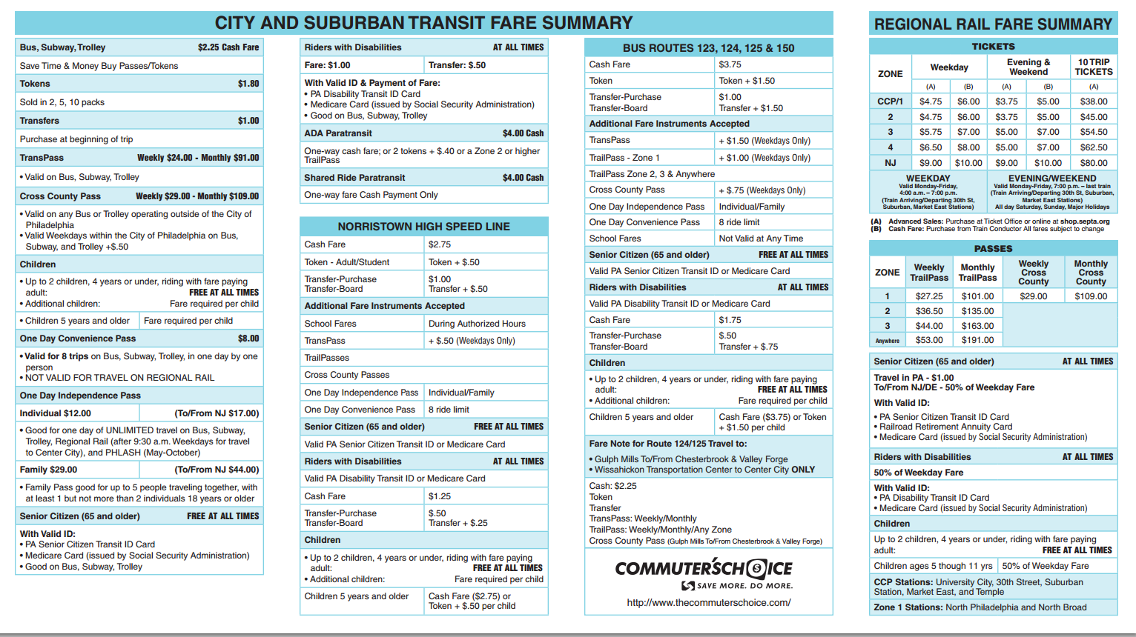
How we model Fares
SEPTA has a very complex fare structure
Notes:
Now we’d like to shift gears - start to get into nitty gritty modeling discussion

Slide 16
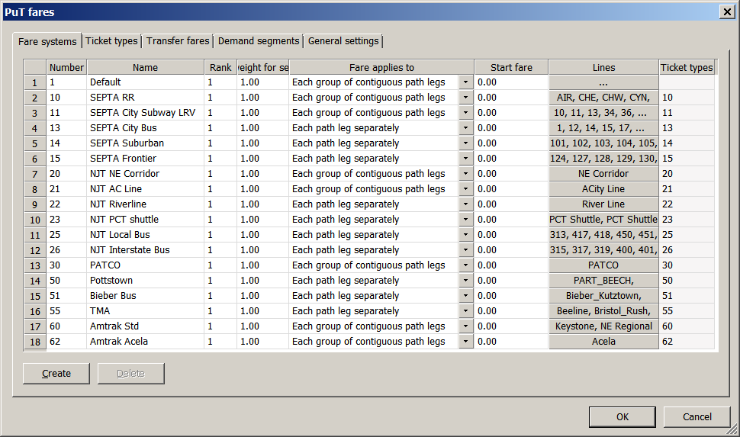
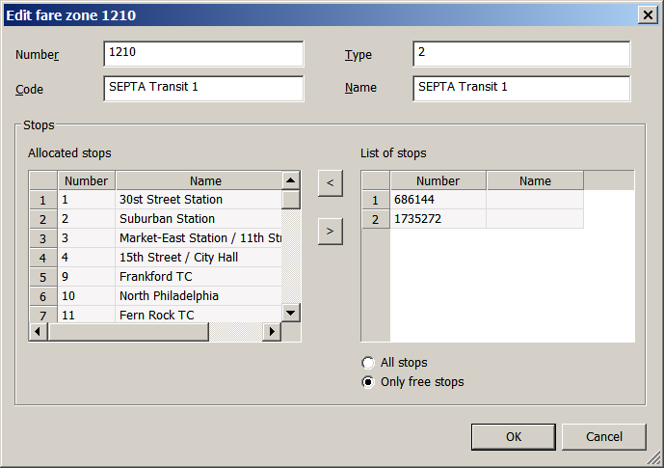
Transit Fare Modeling TIM 2.1
Line –> Fare System
Stop –> Fare Zone
Notes:
New software also allows a much more precise representation of transit fare. The fare model is presented by fare systems. A “fare system” is a group of transit lines that exhibit the same characteristics with regard to pricing. A total of 17 fare systems are defined in TIM 2.1 based on prices charged by the transit operators for different services. Fare zones can be defined at the stop level as what SETPA uses in reality.

Slide 17
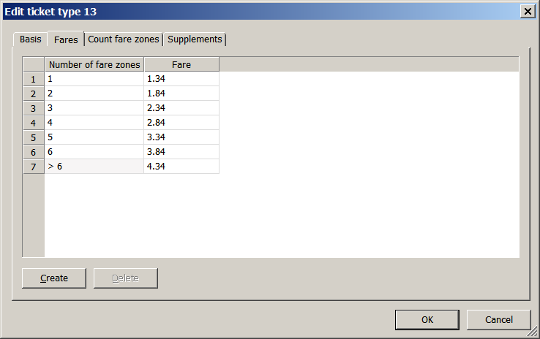
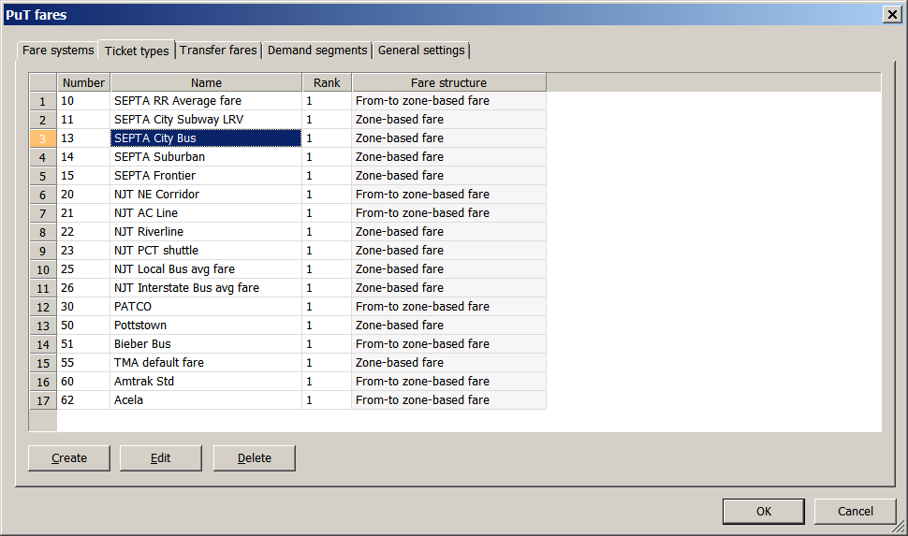
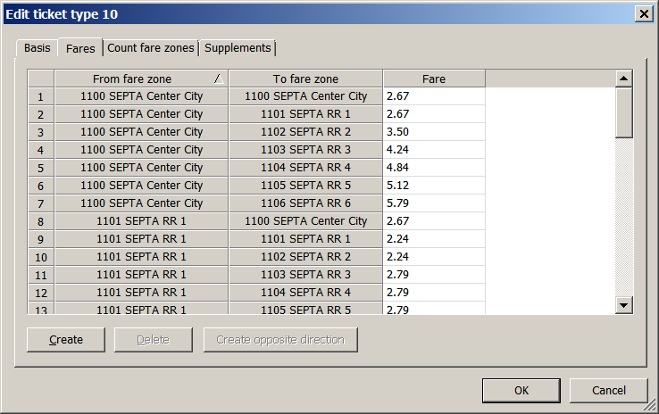
Transit Fare Modeling TIM 2.1
Bus – zone based
Regional Rail –
zone-to-zone based
Fare System
–> Base fare
Notes:
Visum allows a much more precise representation of transit fare.
You can group transit lines into fare systems if they exhibit characteristics in terms of pricing.
We have a total of 17 fare systems in the model with 5 for SEPTA.
For each fare system, you can define either a zone-based fare as used for SEPTA transit or a zone-to-zone based fare as used for Regional Rail.
You can also set the transfer discount between different fare systems.

Slide 18
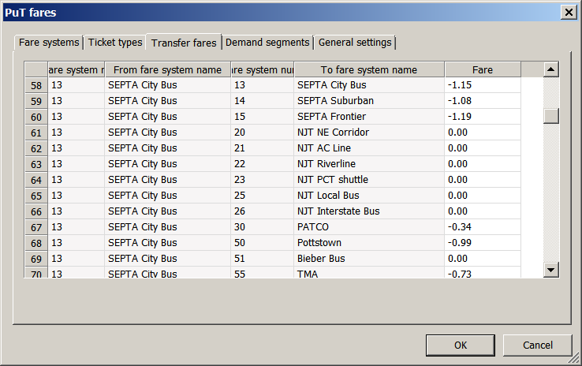
Transit Fare Modeling TIM 2.1
Fare System
–> Transfer discount
Notes:
Visum allows a much more precise representation of transit fare.
You can group transit lines into fare systems if they exhibit characteristics in terms of pricing.
We have a total of 17 fare systems in the model with 5 for SEPTA.
For each fare system, you can define either a zone-based fare as used for SEPTA transit or a zone-to-zone based fare as used for Regional Rail.
You can also set the transfer discount between different fare systems.

Slide 19
2010 Average Fare – SEPTA City Bus
Fare Media | Fare Cost | Rides per Fare Media | Per-Ride Fare | Weight by Riders | Weighted Fare
Adult Token | $1.55 | 1 | $1.55 | 18.3% | $0.28
Cash Fare | $2.00 | 1 | $2.00 | 15.4% | $0.31
Monthly TransPass | $83.00 | 64 | $1.30 | 14.2% | $0.18
Weekly TransPass | $22.00 | 17 | $1.30 | 26.6% | $0.34
Senior Citizen | $1.00 | 1 | $0.00 | 11.6% | $0.00
School Ride | $15.36 | 9 | $1.77 | 11.7% | $0.21
Day Pass | $7.00 | 7 | $1.00 | 0.7% | $0.01
Handicap Fare | $1.00 | 1 | $1.00 | 1.0% | $0.01
Free Ride | $0.00 | 1 | $0.00 | 0.6% | $0.00
Average Fare | — | — | — | — | $1.34
Notes:
SEPTA offers a wide array of fare options, but in the model, we have to simplify the representation of fare options and use average fares,
which were calculated based on the most commonly used fare media types and their weights in terms of ridership split.
In the same way, we calculated the average transfer fares.

Slide 20
Model Calibration – FY 2011 Daily Ridership
Transit System | FY 2011 Count | Model Output | Difference | %Difference
City Rail | 418,420 | 367,471 | −50,949 | −12.2%
City Bus | 468,355 | 508,701 | 40,346 | 8.6%
Victory | 56,744 | 65,022 | 8,278 | 14.6%
Frontier | 13,489 | 20,732 | 7,243 | 53.7%
Regional Rail | 118,305 | 113,947 | −4,358 | −3.7%
SEPTA Total | 1,075,313 | 1,075,873 | 560 | 0.1%
PATCO Total | 35,686 | 37,000 | 1,314 | 3.7%
NJT Total | 83,402 | 73,739 | −9,663 | −11.6%
Region-Wide Total | 1,194,401 | 1,186,612 | −7,789 | −0.7%
Notes:
In this study, we had more data to refine the fare model and calculate average fares. This slides compared the model outputs in terms of simulated ridership versus SEPTA counts, after these adjustments. Overall, the improved base year model is within 1 percent of total for SEPTA and the region across all three transit providers.

Slide 21
Scenarios Analyzed
Direct Elasticity Test - Hypothetical Fare Changes
Cross Elasticity Test - Hypothetical Fare Changes
Backcast and Validation - July 2010 Fare Change
Forecast and Validation - July 2013 Fare Change
Forecast - Impact of New Payment Technology
Notes:
This project was intended as a continuation of the model calibration and validation. It is specifically to verify whether the model is reasonably sensitive to pricing alternatives. For example, what happens to ridership if the Southeastern Pennsylvania Transportation Authority’s (SEPTA) fares increase by 5 percent? To verify the model’s ability in answering this type of question, we conducted a series of scenario modeling exercise.
These scenarios include both hypothetical and “real-world” situations. For the hypothetical scenarios, fares in the model were changed in an arbitrary way (across-the-board increase for instance), and then the resulting change in ridership as estimated by the model was compared to the expected change, based on the empirical studies. The real-world scenarios involved actual recent fare changes as implemented by SEPTA. In these cases, the same exact fare change was entered into the model, and then the resulting ridership change as estimated by the model was compared to the actual observed change in ridership as reported by SEPTA. In addition to these empirical tests and backcasting exercise, a set of forecasting scenarios were simulated to analyze the impact of the New Payment Technology (NPT) and associated fare changes as planned by SEPTA in the future horizon.

Slide 22
Scenario 1: Direct Elasticity Test
Notes:
First, we tested how model behaved according to the literature. For example, how would the model respond to the fare change, say the SEPTA average fares increased by 5, 10, 15, and 20 percent across the board, while other factors are held constant. As we know, besides fare, there are many other factors would have more or less an impact on transit ridership, such as population, employment, gas price, level of transit service, parking cost and highway congestion.
In literature, a commonly used rule of thumb for ridership in response to fare change is that an overall fare increase of 10 percent will result in ridership loss of 3 percent (i.e., fare elasticity = –0.3). Throughout the United States and Europe, the most commonly observed range of aggregate fare elasticity values is from –0.1 to −0.6
Overall, the model responds to the fare increase in a linear fashion and the point elasticities are within the range reported in the literature except for Regional Rail, which is appears overly sensitive and more elastic than other modes.

Slide 23
Scenario 2: 2010 Fare Change
July 2010 Fare Change
Adult token +7%
Transfer ticket +33%
TransPass +6%
TrailPass +5~10%
Gas Price +28% (2010-11)
Modeled as distance-based toll
Modeling Scenario
Fare and gas price change
No population/employment/service change
Transit System | Average Fare Increase Per Leg
City Rail | $ 0.04 | 4%
City Bus | $ 0.03 | 3%
Victory | $ 0.07 | 7%
Frontier | $ 0.06 | 5%
Regional Rail (All Zone Pairs) | $ 0.09 | 3%
Notes:
Next, we modeled the SEPTA’s fare change in July 2010. These were the changes with some fare types at that time. The average fare increase was less significant, when you considered inflation and calculated the average fares. However, a significant change was the gas price, which was increased by 28% from 2010 to 2011. We had considered this in the model by treating the gas price difference as a distance-based toll (about 3 cents per mile).

Slide 24
Model vs. Count – before and after 2010 Fare Change
Transit System | SEPTA Count |  | Model Results
 | Difference | %Difference | Difference | %Difference
City Rail | 11,335 | 2.8% | 2,746 | 0.8%
City Bus | 15,054 | 3.3% | 9,465 | 1.9%
Victory | 3,104 | 5.8% | 389 | 0.6%
Frontier | 690 | 5.4% | 570 | 2.8%
Regional Rail | 3,280 | 2.9% | −1,959 | −1.7%
Total | 33,463 | 3.2% | 11,210 | 1.1%
Notes:
Comparing the model results to the observed change in ridership, the model’s predication is largely in the right direction. However, the magnitude is lower than the observed change. In addition, the model predicts a 1.7 percent decrease for Regional Rail while the actual ridership went up after the fare change.

Slide 25
Scenario 3 – 2013 Fare Change
July 2013 Fare Change
Adult token +16%
Cash fare +13%
Transfer ticket +0%,
TransPass +9%
Fare Zone changes
Gas Price Stabilized (2011-14)
Population/Household/Employment +1% (2010-14)
Modeling Scenario
Fare and population/employment change
No other changes
Transit System | Average Fare Increase Per Leg
City Rail | $ 0.06 | 6%
City Bus | $ 0.05 | 6%
Victory | $ 0.04 | 4%
Frontier | $ 0.06 | 5%
Regional Rail (All Zone Pairs) | $ 0.17 | 6%

Slide 26
Model vs. Count – before and after 2013 Fare Change
Transit System | SEPTA Counts |  | Model Results
 | Difference | %Difference | Difference | %Difference
City Rail | 3,536 | 0.8% | 6,075 | 1.7%
City Bus | 27,622 | 5.9% | 17,617 | 3.5%
Victory | 2,854 | 5.0% | 1,181 | 1.8%
Frontier | 69 | 0.5% | 261 | 1.3%
Regional Rail | 10,510 | 8.9% | −1,031 | −0.9%
Total | 44,592 | 4.1% | 24,102 | 2.2%
Notes:
Same remarks as scenario 1
Predictions are in right direction but ridership values are underestimated

Slide 27
Conclusions and Recommendations
TIM 2.1 performed well in estimating the impact of fare changes (and simultaneous changes of multiple factors) on ridership change
Revisit the model configuration given the relatively high Regional Rail fare sensitivity
Include sensitivity test and backcasting exercise as a part of the TIM 3.0 (ABM) validation
Notes:
NPT Impact - the total ridership was estimated to remain the same if the 95% of token and 75% of cash riders will switch to NPT

Slide 28
Income Comparison – City Bus Passenger vs. Regional Rail Passenger
Notes:
Comparison of HH Income of City Bus Passengers versus people riding Regional Rail – which serves the suburbs

