Slide 1
Integrating Travel Time Reliability, Dynamic Assignments, and a
Trip-Based Travel Demand Model
TRB Transportation Planning Applications Conference
May 20th 2015
Peter Bosa
Senior Researcher and Modeler
Modeling Services
Metro
Portland, OR

Slide 2
TRB SHRP2 L35(A)
Local Methods for Modeling, Economic Evaluation, Justification and Use of the Value of Time Reliability in Transportation Decision Making
Research Team
University of Arizona
Dr. Yi-Chang Chiu
Hyunsoo Noh
Alireza Khani
Ye Tian
Andisheh Ranjbari
Portland Metro
Richard Walker
Peter Bosa
RST International Inc.
Dr. Robert Tung

Slide 3
TRB SHRP2 L35(A)
  Project Goals
  Demonstrate value of travel time reliability measures (TTRM)
  Demonstrate process to engage decision makers on reliability
  Project Accomplishments
  Incorporate reliability within existing model framework
  Survey to established local travel time reliability ratio
  Linkage of dynamic assignments & travel demand model with feedback mechanism
  Application of model using test scenarios

Slide 4
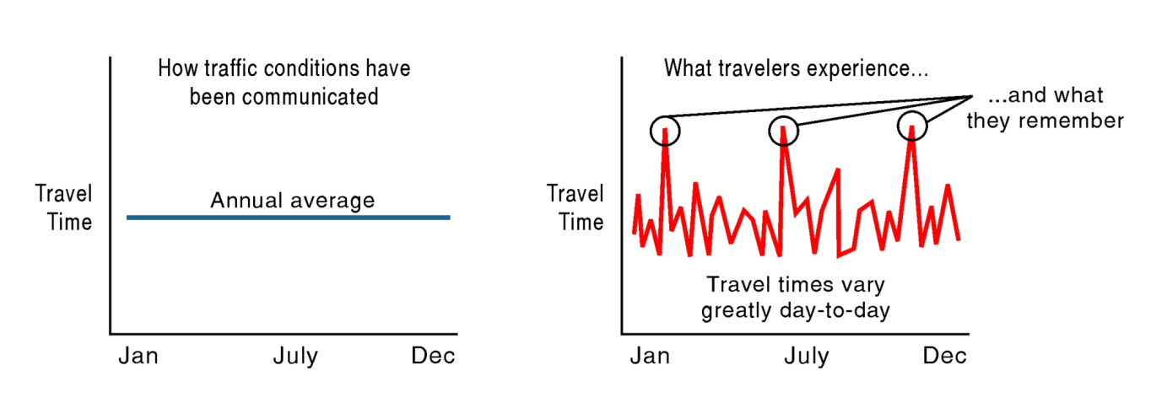
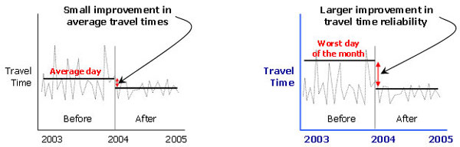
Travel Time Reliability
Source: Federal Highway Administration

Slide 5
Incorporating Reliability
Modified SHRP2 L03 methodology:
Reliability Ratio =
Value of Travel Time Reliability / Value of Travel Time
Travel Time Equivalent (TTE) =
Average Travel Time (TT) + Reliability Ratio x Std(TT)
Travel Time used in trip-based model
Dynamic assignment models updated to reflect TTE

Slide 6
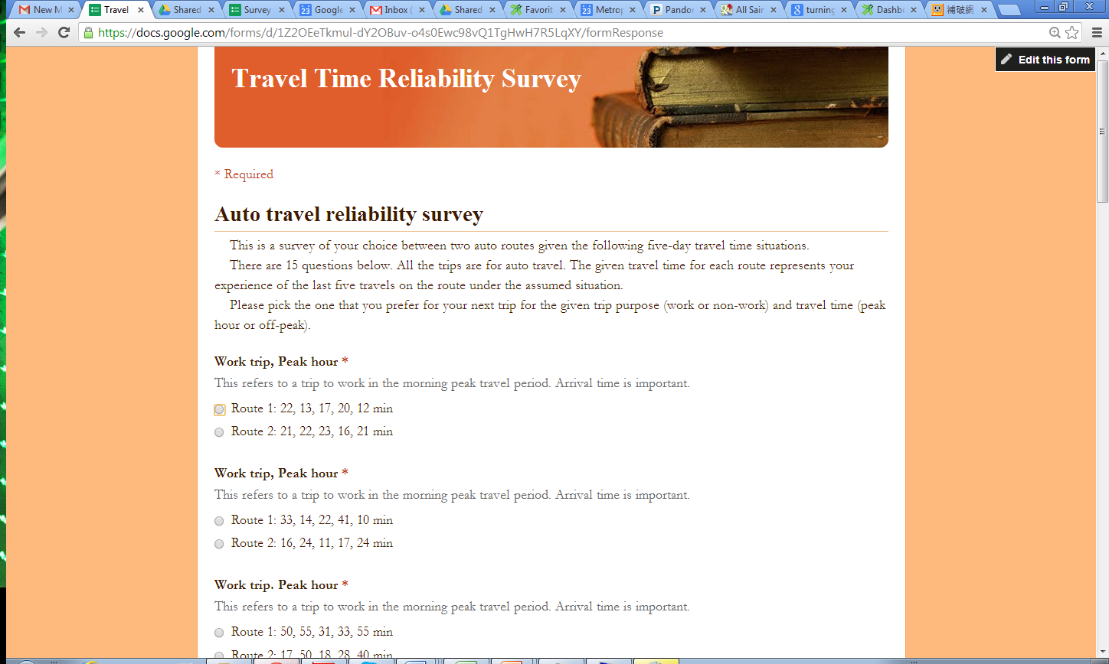
Survey: Phase 2 Web-based

Slide 7
Incorporating Reliability
 | Reliability Ratio
 | Auto | Transit
Work, Peak hour | 0.83 | 1.55
Travel Time Equivalent =
Average Travel Time (TT) + Reliability Ratio x Std(TT)
Example:
Average Travel Time (auto and transit) = 10 min
Standard deviation (reliability) = 6 min
Auto reliability time = 6 min * 0.83 = 5 min
Total travel time equivalent for autos = 10 min + 5 min = 15 minutes
Transit reliability time = 6 min * 1.55 = 9.3 min
Total travel time equivalent for transit = 10 min + 9.3 min = 19.3 minutes

Slide 8
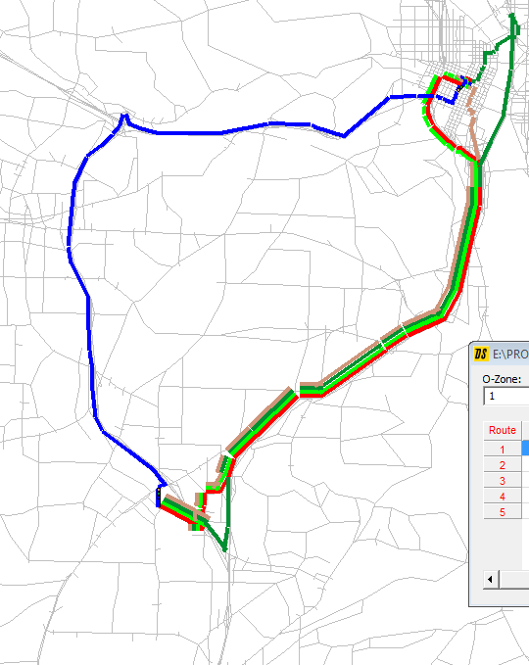
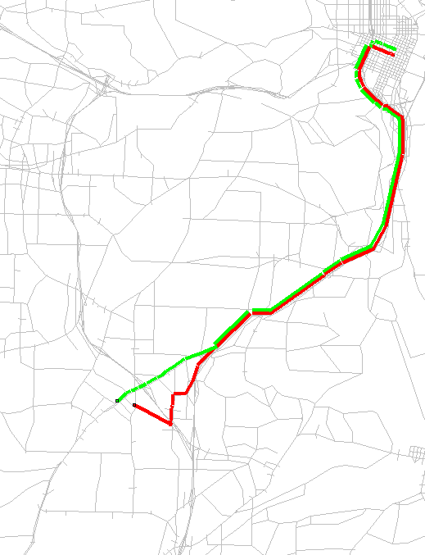
Impact of Reliability on Auto Route Choice
Route options between Portland CBD and Tigard
Without Reliability
With Reliability
Very congested
corridors
(unreliable)

Slide 9
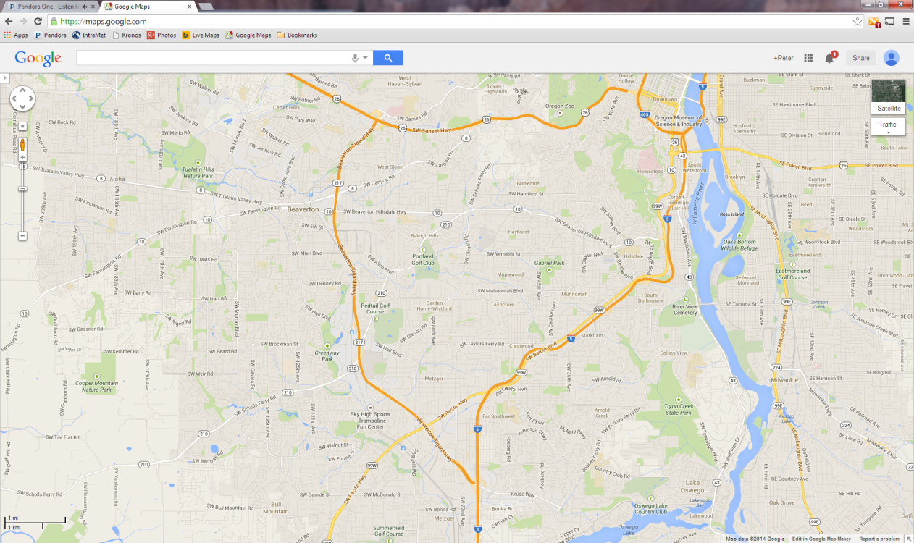
Impact of Reliability on Perceived Travel Times
Peak travel time equivalent between Tigard and Portland CBD
 | Total travel time equivalent (min) | Travel time (min) | Travel time equivalent of reliability (min)
Baseline (no reliability) | 38 | 38 | --
Baseline (reliability) | 48 | 41 | 7
BRT in exclusive ROW via add lane (reliability) | 46 | 40 | 6
Single Occupancy Vehicle

Slide 10
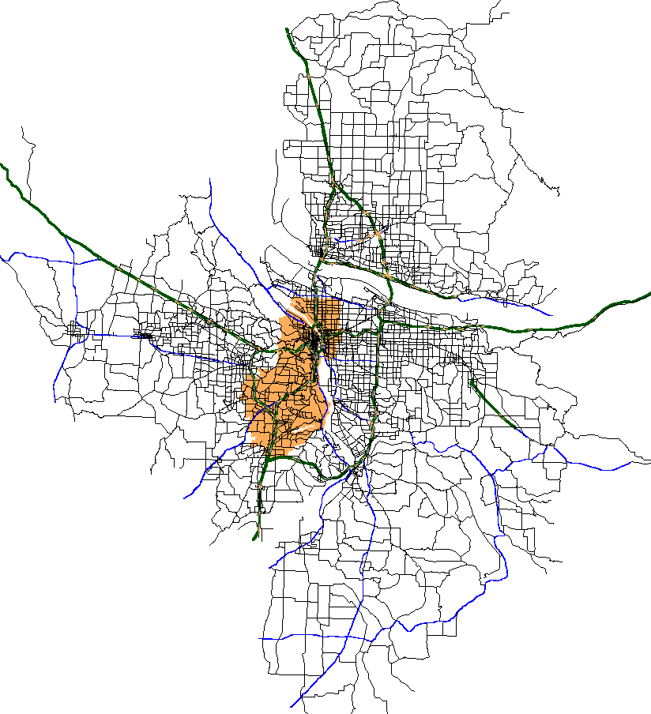
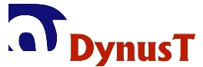
Metro Travel Demand Model
Initial Assignment (Skim Building)
Regional zone-to-zone travel times
Regional static assignment model
auto + transit
Trip Generation
How many trips by category?
Destination Choice
Where do those trips go?
Skim Building / Final Route Choice
Zone-to-zone travel times
Including Travel Time Equivalent of Reliability
Mode Choice
How do those trips get there?
Integrated dynamic assignment model
FAST-TrIPs
auto
transit

Slide 11
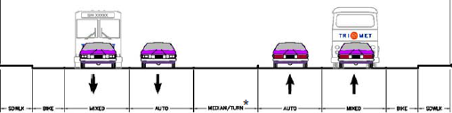
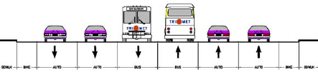
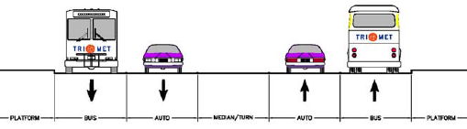
Scenario Testing: Transit
Existing Transit (Baseline) and BRT in Mixed Traffic
BRT in exclusive ROW by adding transit lane
BRT in exclusive ROW by converting auto lane

Slide 12
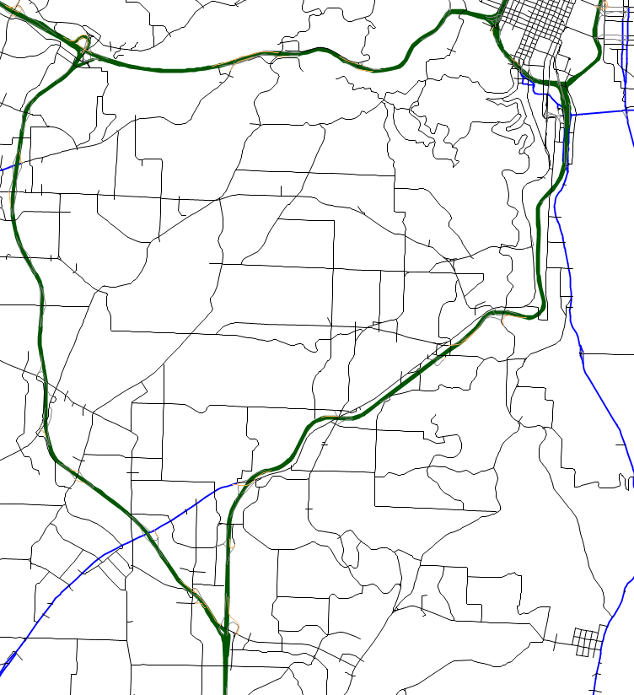
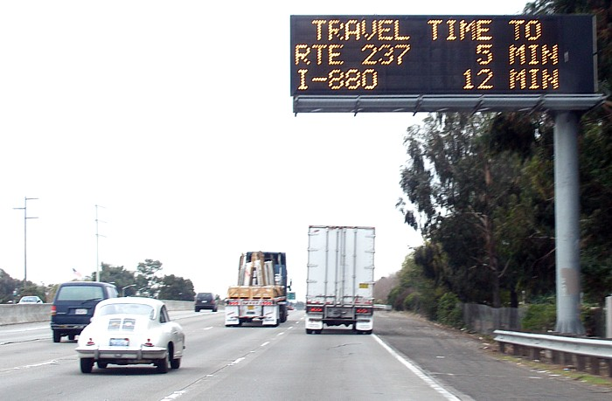
Scenario Testing: VMS
i
i
i
Source: Wikimedia Commons
i
i
i
i
i
i
i
VMS on Barbur Blvd
i
VMS on I-5 / I-405
i

Slide 13
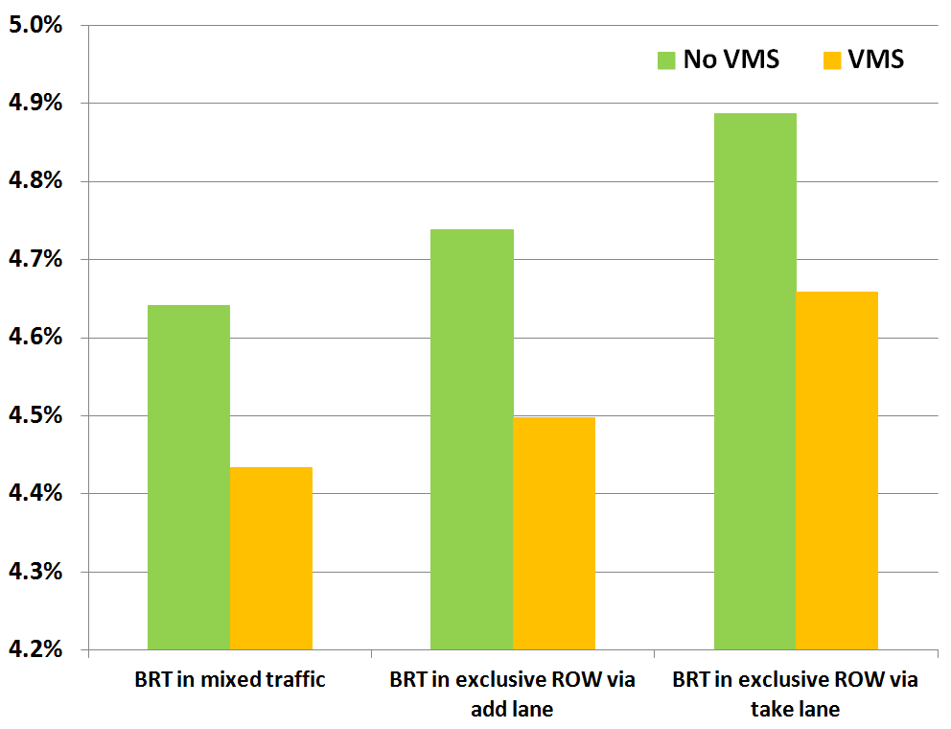
Impact of VMS on Transit Mode Shares
Intra Southwest Corridor Transit % (all scenarios w/ reliability)

Slide 14
Impact of Reliability on Scenario Analysis
Average % reduction from Baseline scenario for all person trips on Barbur (auto & transit)
Variable Message Signs
BRT in exclusive ROW by adding transit lane
BRT in exclusive ROW by adding transit lane
Vehicle Miles
Traveled
Average
Travel Time
Total
Delay
Vehicle Miles
Traveled
Average
Travel Time
Total
Delay
No Reliability
Reliability

Slide 15
Stakeholder Feedback
Effectively captured reliability in route and mode choice analysis
Demonstrated ability to capture corridor improvements related to operational strategies (VMS)
Recognized limits of VTTR survey
Expand VTTR survey to larger group
Explore role of VTTR perception within DC, MC, RC
Re-estimate models ?!?
Promote integrated model methodology
Next Steps

Slide 16
Information
SHRP2 L35(A) final report:
Value of Travel Time Reliability in Transportation Decision Making:
Proof of Concept—Portland, Oregon, Metro
http://onlinepubs.trb.org/onlinepubs/shrp2/SHRP2_S2-L35A-RW-1.pdf
Contacts
Peter Bosa
Metro - Portland, OR
Peter.Bosa@oregonmetro.gov
Dr. Yi-Chang Chiu
University of Arizona
chiu@email.arizona.edu

