Slide 1

A Tour-Based Freight Model for the Tampa, Florida Metropolitan Region
Monique Stinson, Zahra Pourabdollahi, Richard Tillery, Kai Zuehlke
May 2015

Slide 2

Acknowledgment
Florida Department of Transportation – District 7

Slide 3
Overview
Introduction
Data
Framework Design
Model Application
Conclusions & Next Steps

Slide 4
Introduction
Urban Freight Movements
Freight activities are key elements of economic prosperity & livability of cities
About 3%* of regional VMT is from Urban Freight Distribution and Warehouse Deliveries
  Heavy & medium urban freight trucks
  Disproportionate impacts on:
    Congestion
    Safety
    Emissions (particulates & GHG)
    Energy consumption
    Noise
    Vibration
    Visual intrusion
*Source: Accounting for Commercial Vehicles in Urban Transportation Models, prepared for FHWA by Cambridge Systematics, 2003.

Slide 5
Introduction
Tampa Bay Area
Tampa - St. Petersburg - Clearwater Metropolitan Area
Prominent role in regional distribution
Proximity to consumer markets (Central Florida, Coasts)
Large international seaports
  Port Tampa Bay
  Port Manatee
Greater Atlanta Area
Future anticipated growth
  PANAMAX
  Expansion of Latin American
  and Caribbean markets
Source: Tampa Bay Regional Strategic Freight Plan: An Investment Strategy for Freight Mobility and Economic
Prosperity in Tampa Bay. Florida DOT: District Seven and District One. July 2012.

Slide 6
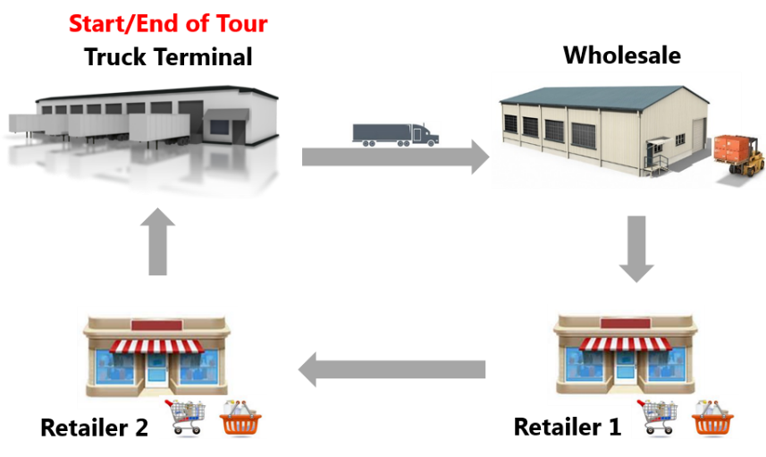
Introduction
Objectives
Improve representation of trucks in Tampa Bay regional model
  Existing model: 3-step truck model
  New model: tour-based truck model
    Other model types were considered
  Integrate with existing passenger model
Meet Policy Objectives – address important regional freight considerations including:
  Improved estimates of truck trips, VMT, route choices, stop locations
  Better understanding of goods movement, including distribution
  Improved ability to test managed lanes, congestion pricing, and truck-only lanes

Slide 7
Data
Truck Touring Survey
Type of Information | Details
Company information | Name
 | Address of Distribution Center
 | Industry Class (6-digit NAICS)
 | Employment
 | Fleet size
Tour information | ID
 | Vehicle class
 | Departure & arrival time, date, day of week
 | Trip type (inbound/outbound)
 | Miles traveled (trip)
 | Origin & destination addresses
Other data sources:
Zip/County business patterns
Infogroup
Parcel land use
Network / distance information

Slide 8
Data
Truck Touring Survey
Number of Companies | Total Tours | Total Stops | # of Survey Days
5 | 858 | 2,435 | 20
3
Avg. Daily Tours Per Company | Avg. Daily Stops Per Company | Avg. # Stops Per Tour
42.9 | 121.8 | 2.8
1
2

Slide 9
Data
Truck Touring Survey
Percentage of Tours Visited Each County

Slide 10
Framework Design
Model Components
Tour Generation
Stop Frequency Estimation
Destination Choice
Firm Synthesis
Joint Network Assignment

Slide 11
Framework Design
Firm Synthesis - Freight Generator Agents
2012 NAICS Code | 2012 NAICS Industry Description | Major Commodity Truck Producer? | Include in Full Model
11 | Agriculture, Forestry, Fishing & Hunting | Yes
21 | Mining, Quarrying, and Oil & Gas Extraction | Yes
22 | Utilities | No
23 | Construction | Moderate
31-33 | Manufacturing | Yes | X
42 | Wholesale Trade | Yes | X*
44-45 | Retail Trade | Moderate | X
48-49 | Transportation and Warehousing | Yes | X*
51 | Information
52-53 | Finance, insurance, real estate, rental, and leasing | No
54-56 | Prof., Scientific, & Technical Services, Mgmt. of Companies & Enterprises, Admin. & Support; Waste Mgmt. & Remediation Services | No
61-62 | Educational Services; Health Care & Social Assistance | No
71-72 | Arts, Entertainment, & Recreation; Accommodation & Food Services | No
81 | Other Services (except Public Administration) | No
92 | Public Administration
Adapted for FDOT District Seven from M. Stinson for Florida Department of Transportation, SWOT Analysis of Commodity Flow Datasets,
presented to Florida Model Task Force meeting on May 5 & 6, 2015.
*Included in Version 1

Slide 12
Framework Design
Tour Generation
Estimates number of daily tours generated by individual firms
Based on firms’ characteristics:
  Industry type
  Employment
NAICS Code | Industry Classification | Daily Tour Generation Rate per Employee
4236 | Household Appliances and Electrical and Electronic Goods Merchant Wholesalers | 0.13
4244 | Grocery and Related Product Merchant Wholesalers | 0.45
4246 | Chemical and Allied Products Merchant Wholesalers | 0.13
4841 | General Freight Trucking | 0.38
4842 | Specialized Freight Trucking | 0.08
4931 | Warehousing and Storage | 0.23

Slide 13
Framework Design
Stop Frequency Model
Predict number of intermediate stops in each tour
Determine tour pattern
Ordered Response Discrete Choice Model
  Characteristics of decision making firm:
    Industry Class
    Employment
    Geographical Coverage
Direct Tour Peddling

Slide 14
Framework Design
Stop Frequency Model Results (y=#Stops per Tour)
Variable | Parameter Estimate | t | Comment
Constants | 0 and 3.14 |  | (adjusted in calibration)
Company Size
Employment <= 50 | 5.74 | 11.2 | Smaller companies make more stops per tour
Employment > 50 | (Base)
Geographic Coverage of Company’s Tours
Local area | (Base) |  | Greater coverage fewer stops; Need more data
Local area + Central Florida + Coastal areas | -1.42 | -5.46
Local area + Central Florida | -3.26 | -10.04
Breakpoints
tau1 | 0.1 | fixed
tau2 | 3.33 | 17.6
tau3 | 4.94 | 22.76
Model Statistics: 646 observations
Adjusted rho-square: 0.23
Notes:
You might remind the audience that the estimation is based on 5-6 companies and we would expect different results with an expanded data sample.

Slide 15
Framework Design
Destination Choice Model
The same concept as of destination choice in passenger travel models
Formed a choice set of 11 zone options (including chosen zone) for each firm
Predict the location of next stop in tour
Multinomial Logit (MNL) Model Structure
Descriptive Variables:
  Characteristics of the decision maker
  Attributes of potential destination
  Attributes of tour

Slide 16
Framework Design
Destination Choice Model Results
Variable | Parameter Estimate | t | Comment
Distance Terms (Great Circle Distance; Miles)
Direct Tours
Distance to Stop | -0.047 | -15.9 | Distance to Next Stop has similar impact for Direct & Peddling Tours
Peddling Tours
Distance to Next Stop | -0.048 | -45.3
Distance between Next Stop & Home (Final Stop Only) | -0.011 | -4.8 | The Last Stop tends to be closer to home base
Number of Establishments in Zone
#Firms, NAICS 31-33 | 0.014 | 5.3 | Manufacturers attract a lot of stops
#Firms, NAICS 42-49 | 0.003 | 10.4 | Wholesale, Retail & Transportation/Warehousing also attracts some stop activity
Model Statistics: 3,026 observations
Adjusted rho-square: 0.59
Notes:
You might mention again that the estimation is based on 5-6 companies and we would expect different results with an expanded data sample.

Slide 17
Model Application
For The Base Year 2006
Firm Synthesis
  1,745 TAZ
  Hillsborough, Pasco, Pinellas County
Notes:
You might mention that Hillsborough, Pasco, Pinellas County were selected for the prototype implementation because they were the counties that we had Infogroup data for. However, for the full implementation, we might get a larger Infogroup sample – it is available for the entire state.

Slide 18
Model Application
Logistics Choice Replication
Daily Tours Generated | 15,071
Average number of Daily Tour Per Firm | 3.1
Average Number of Stops Per Tour | 2.4
Total Estimated Truck Trips | 51,500
Tour-based model estimates 53.3 % of truck trips predicted by 3-step truck model
Number of Stops Per Tour | Frequency | %
1 | 2,452 | 16 %
2 | 6,379 | 42 %
3 | 3,741 | 25 %
4+ | 2,499 | 17 %
Total | 15,071 | 100 %

Slide 19
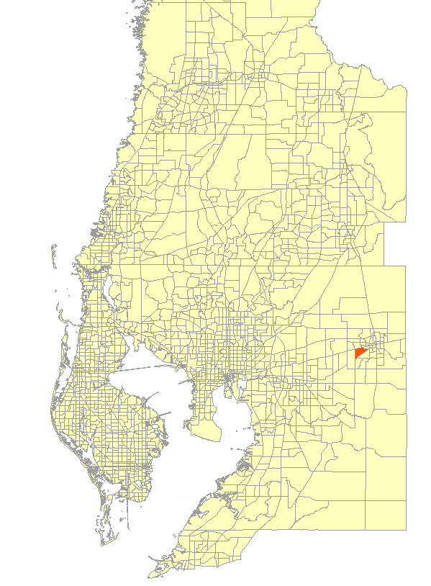
Model Application
An Instance of Synthesized Agents And Simulated Tours
Firm ID: 93000
Company: A family-owned packing
house for farmed goods
Industry Class: Grocery and Related
Product Merchant Wholesalers
[NAICS 4244]
Employees: 60
Location:
  Parcel_ID: 22283158Z000000000010P
  TAZ: 577, Hillsborough County
Estimated:
  Number of Daily Tours: 27
  Average Number of Stops Per Tour: 1.8

Slide 20
Model Application
A Simulated Tour
Tour #2
Number of Intermediate stops : 3
Destination Choices: TAZ 2157, 2117, 1230
Stop | TAZ | # of Establishment | Employment | Manufacturing Firms | Wholesale Firms | Retail Firms | Transportation & Warehousing Firms
1 | 2157 | 16 | 506 | 1 | 2 | 13 | 0
2 | 2117 | 9 | 51 | 2 | 1 | 6 | 0
3 | 1230 | 12 | 24 | 2 | 0 | 8 | 2

Slide 21
Summary
An operational tour-based prototype model
Two industries represented:
  Wholesale Trade
  Transportation & Warehousing
Incorporated critical logistics & choice models : Tour generation, Stop Frequency, Destination Choice
Simulates freight movements at firm level
Better integration with disaggregate passenger travel demand models such as ABM

Slide 22
Future Directions
Data collection
Greater industry coverage
Improve each model component with expanded data
Consider estimating recipient firm location (instead of zone) in next stop model
Consider estimating the commodities being carried to improve destination choice
  Allows estimation of disaggregate commodity flows distributed daily in the area

Slide 23
Thank You!
Zahra Pourabdollahi
Zahra.Pourabdollahi@rsandh.com
(813) 636-2654
Monique A. Stinson
Monique.Stinson@rsandh.com
(312) 526-5043

