Slide 1
Estimating Commuter Rail Station-Level Ridership
Using American Community Survey Journey to Work data
TRB Applications Conference
Martin Milkovits
Daniel Tempesta
May 19, 2015

Slide 2
Outline
Project background
Previous commuter rail sketch models
Data driven model with Journey to Work data
Model estimation

Slide 3
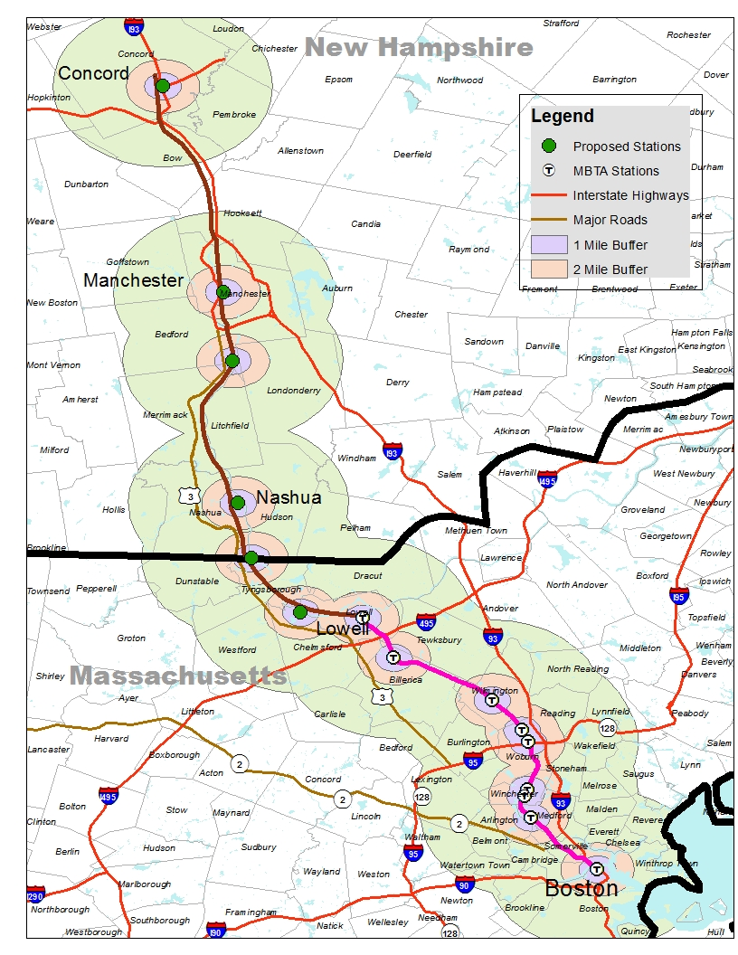
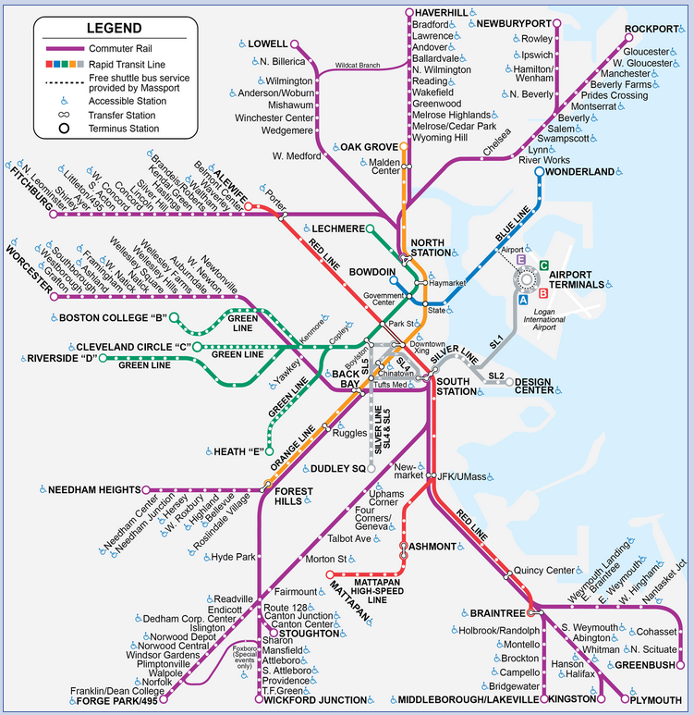
NH Capitol Corridor
Notes:
Most ridership will be to Boston CBD
MBTA survey: 90% of inbound AM trips to CBD
Manchester may attract reverse commute trips
Highest boardings at South Nashua
Some of these riders will be existing riders in Lowell
Majority of ridership will be for Work purposes
MBTA survey: 87% work trips

Slide 4
Aggregate Rail Ridership Forecast (ARRF)
Project predated FTA STOPS model
ARRF prediction for Lowell line ~ 50% of observed
No station-level forecasts

Slide 5
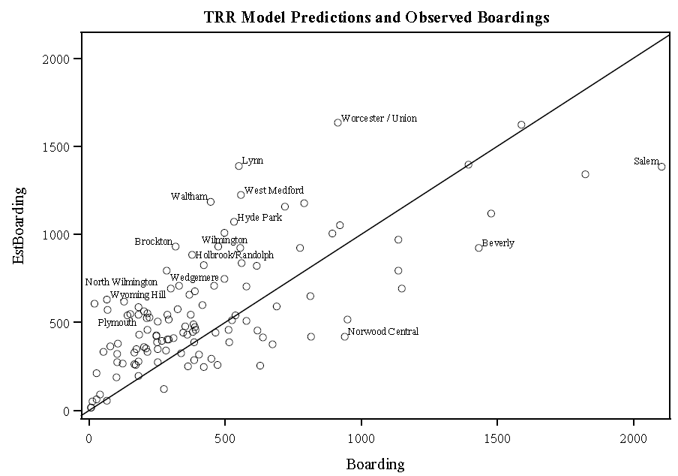
TRR 1986 (Update to TCRP Report 16) commuter rail ridership sketch model
Poor fit with observed station data
Manchester NH station forecast (1,700) unreasonably high

Slide 6
Data-driven station model
Station attributes (parking, transit, highway)
Distance and travel time to CBD
Level of service
Demand
  Population
  Employment
  Journey to Work data

Slide 7
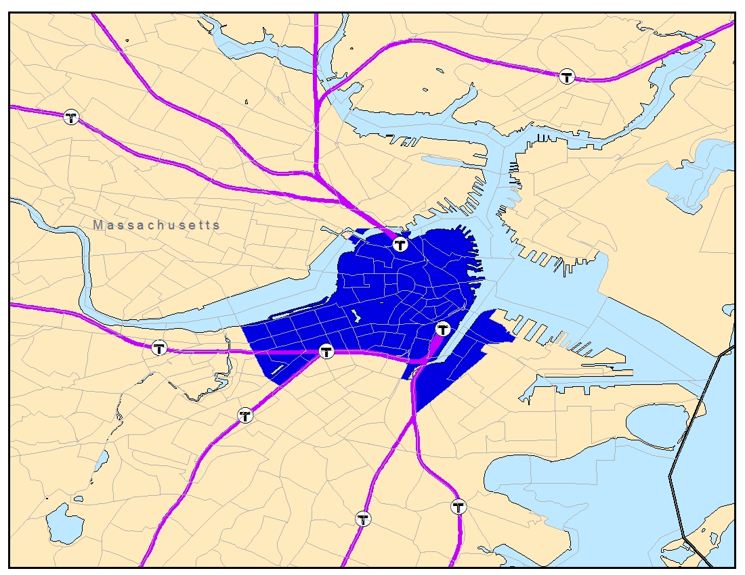
JTW destination zones
Notes:
CBD zones were selected using the employment density distribution method from TRR paper, and validated by examining the JTW trips by RR. 3 stations fall within the CBD. The Lowell line terminates at North Station.

Slide 8
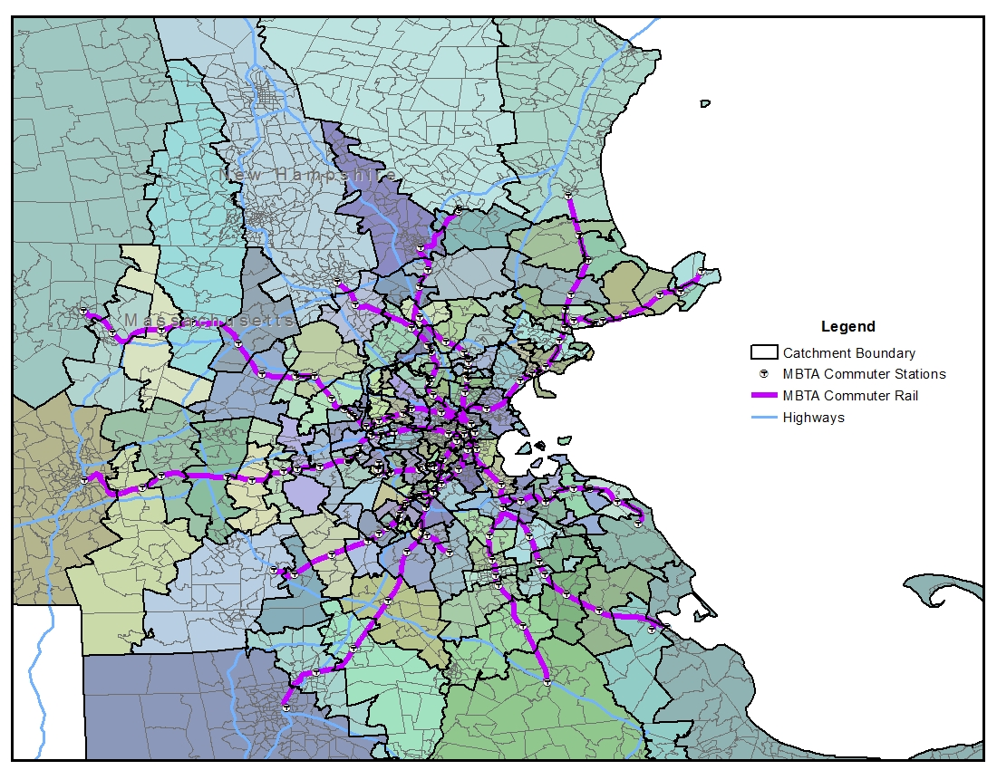
Station catchment areas
Notes:
Station catchment areas defined by shortest distance between zone centroid and station, we felt this was a straightforward and simple approach that is justified for a model with this level of detail.

Slide 9
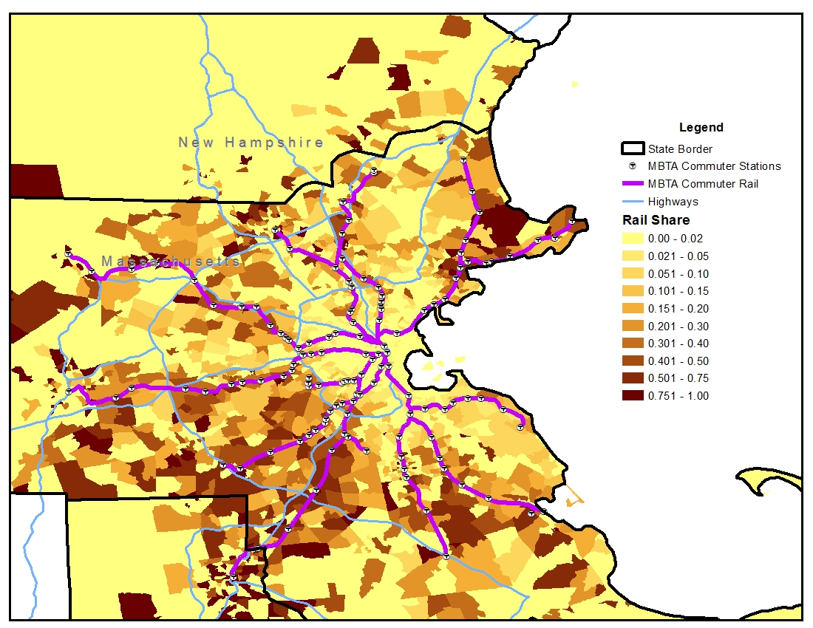
JTW rail share
Notes:
Highlight areas near S. Nashua

Slide 10
Recommended model
Estimates ln(boardings)
Weighted service levels
JTW rail share by distance
Employment buffer
PnR station flag
 | est
(Intercept) | 0.309
Peak trains | 0.141
Offpeak trains | 0.032
ln(JTW) within 10 miles from CBD | 0.255
ln(JTW) 10-20 miles from CBD | 0.308*
ln(JTW) > 20 miles from CBD | 0.348
ln(Employment within 1/2 Mile) | 0.157
PnR Station | 0.557
N | 88
Adjusted R^2 | 0.758
*significant at the 95% confidence level, all other significant at > 99%

Slide 11
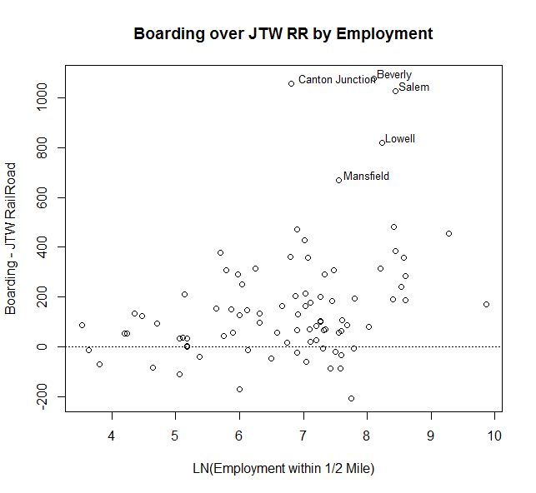
Employment
Exclusive buffers
Ln( Employment within 1/2 Mile ) | 0.157

Slide 12
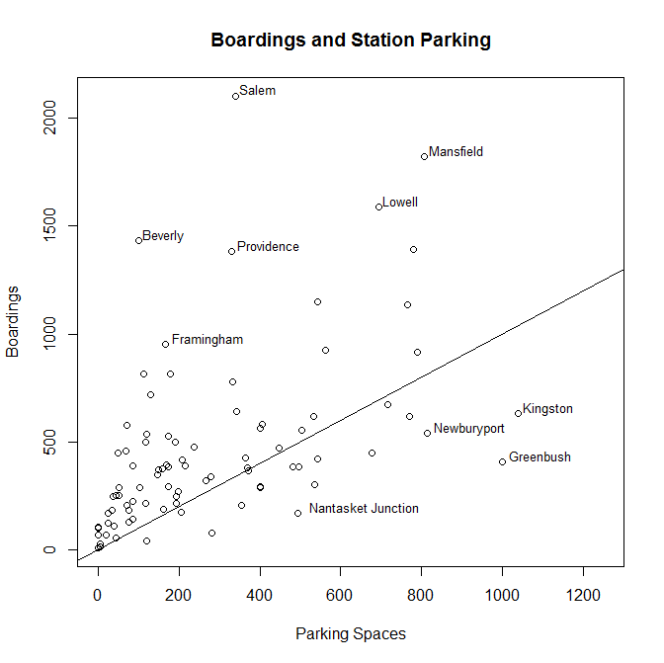
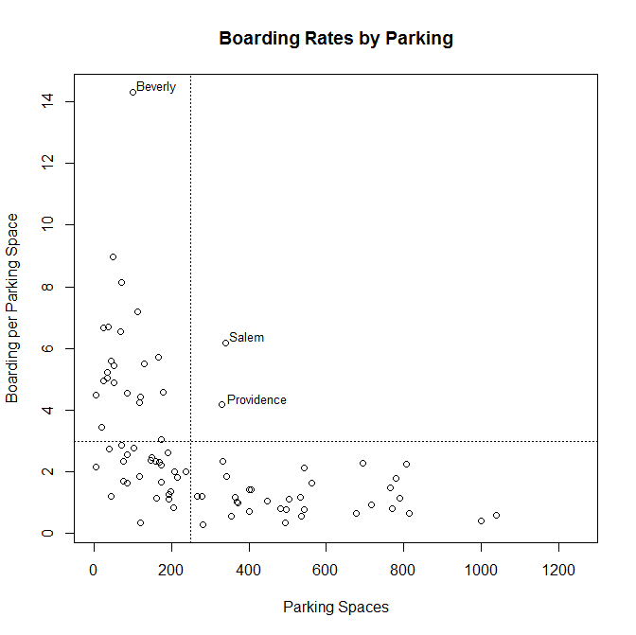
Parking
PnR Stations: > 250 Spaces with fewer than 2.5 boardings / space
Notes:
Greenbush is an example of a new station that has not yet lived up to it’s parking goals
Downtown Manchester and Nashua stations designated to not be PnR

Slide 13
Model Results – Manchester Regional
Service | Peak | Off-Peak
Nashua | 11 | 22
Manchester | 7 | 9

Slide 14
Conclusion
Data-driven ridership estimate
JTW data provided market controls to support extension forecasts
  Distance & Density
  Forecasts beyond current system extents
  “Opening Day” ridership
Model risks
  The existing MBTA fare structure is maintained
  Current reliability levels are maintained
  Current travel times on both rail and highway are maintained.

Slide 15
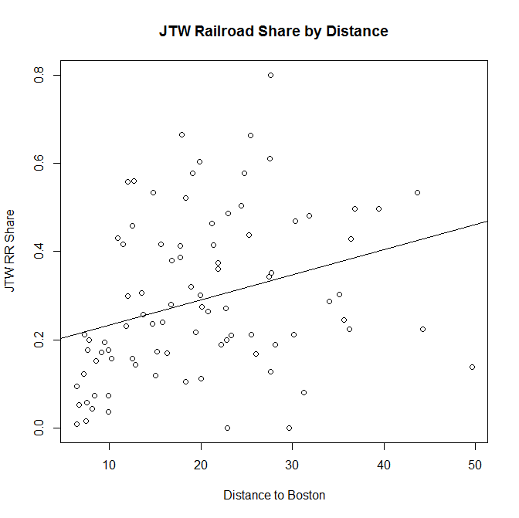
JTW
ln(JTW) within 10 miles from CBD | 0.255
ln(JTW) 10-20 miles from CBD | 0.308
ln(JTW) > 20 miles from CBD | 0.348

Slide 16
Likely ridership characteristics
Most ridership will be to Boston CBD
  MBTA survey: 90% of inbound AM trips to CBD
  Manchester may attract reverse commute trips
Highest boardings at South Nashua
  Some of these riders will be existing riders in Lowell
Majority of ridership will be for Work purposes
  MBTA survey: 87% work trips

