Slide 1
Utilizing Advanced Practice Methods to Improve Travel Model Resolution and Address Sustainability
Bhupendra Patel, Ph.D., Senior Transportation Modeler
Association of Monterey Bay Area Government (AMBAG)
Paul Ricotta, Principal Engineer
Caliper Corporation

Slide 2
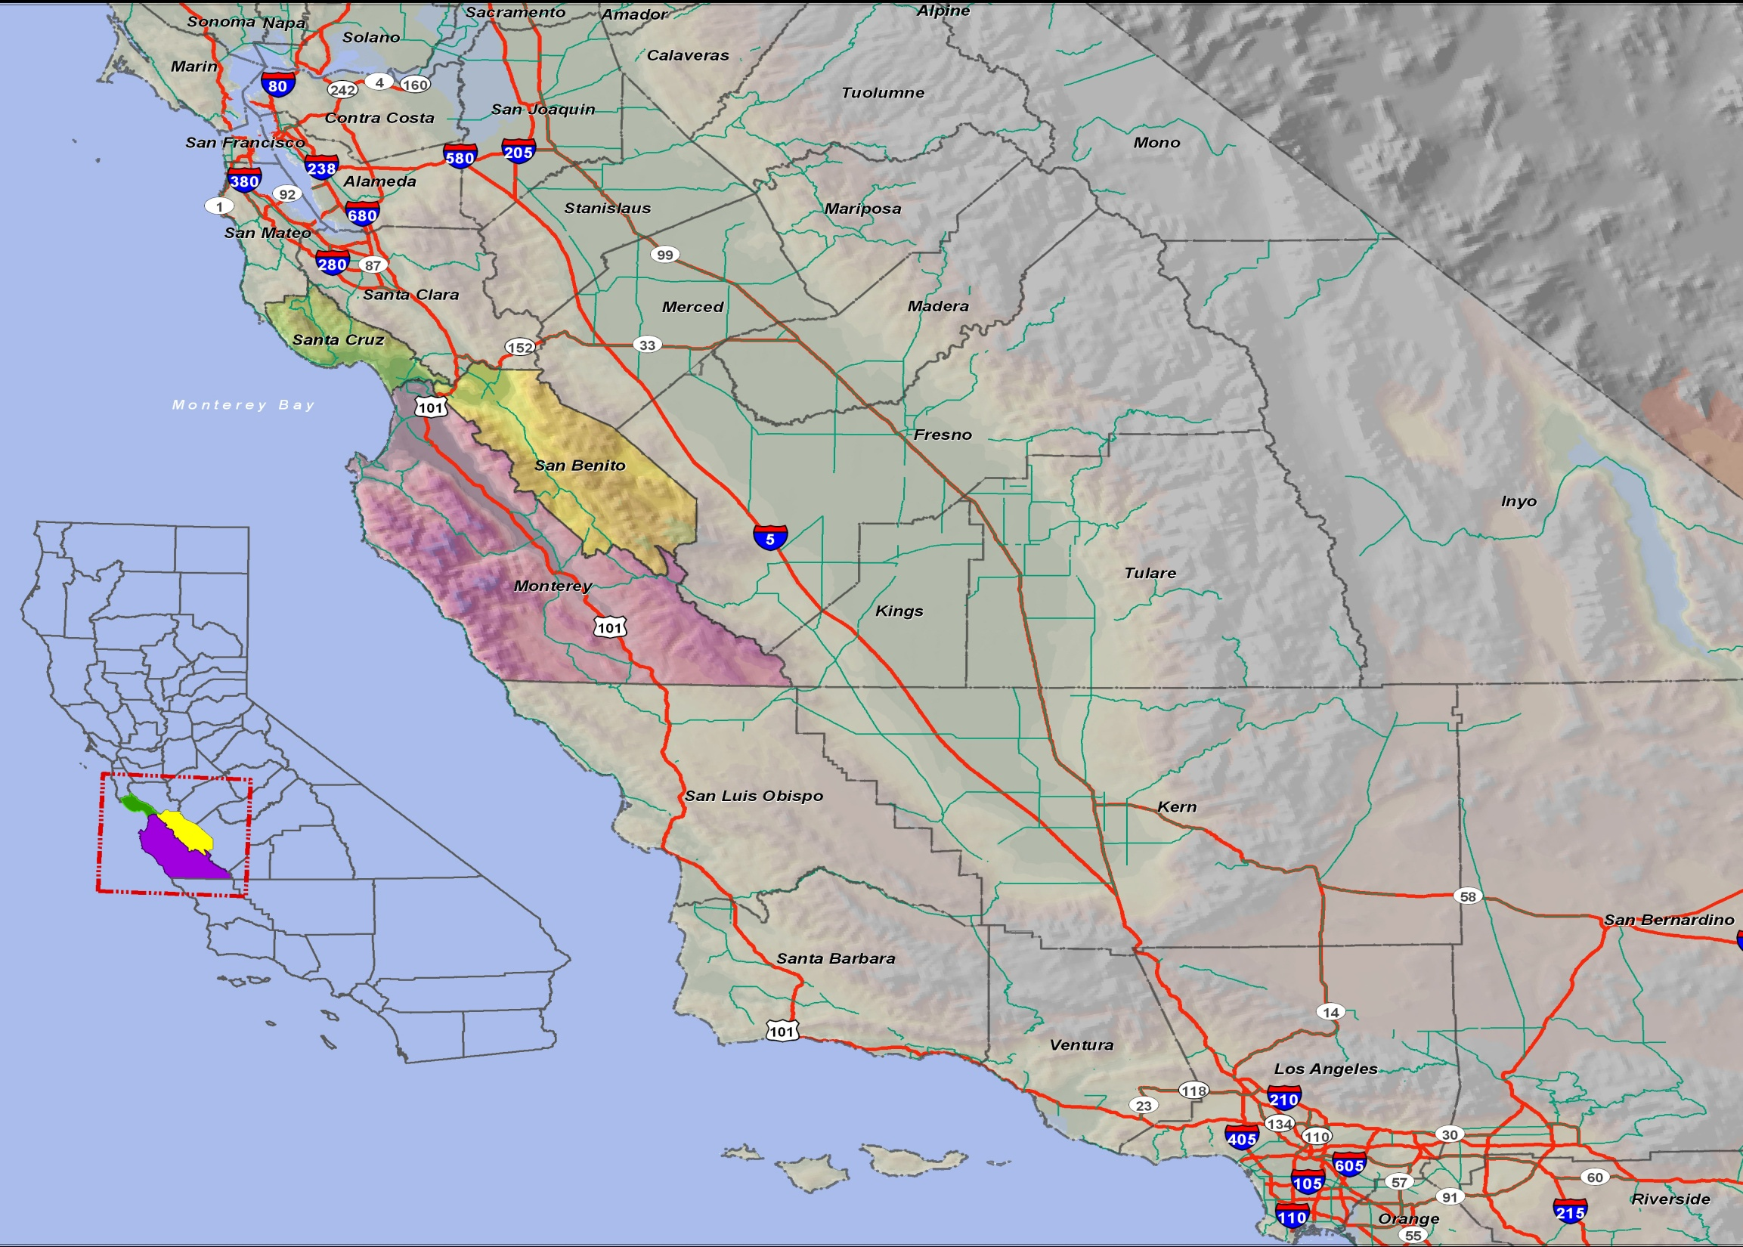
Monterey Bay Area
Central Coast of California
Metropolitan Planning Organization (MPO)
Covering 3 Counties, 18 Cities
735,708 Population in 2010
66% Population live in cities
885,000 Population by 2035
Major Employment: Agriculture, Service, and Government

Slide 3
Modeling Challenges
Influence of SF Bay Area
Heavy commuter trips, telecommuting, flex schedule
Job-Housing Imbalance
Coastal area vs. inland rural county area
Agriculture activities
Farm workers are transient/ seasonal
Aging population (65 +)
Attracts service trips, retirement homes
Longer trip length
Tourists attractions
Weekend, seasonal variation and special events

Slide 4
AMBAG RTDM Updates
AMBAG Regional Travel Demand Model (RTDM) recently underwent a significant overhaul
Completely re-estimated using local survey data
Implements Short and Medium Term Improvements recommended by 2011 TMIP Peer Review panel
Considers Long-term improvement strategy
A step closer to an Activity Based Model (ABM)
Upgrade travel model in response to;
Better measure transportation and land use relations
Integrate GHG modeling to address SB375 requirements

Slide 5
Hybrid Approach
Implements advanced practice techniques such as population synthesis to drive a disaggregate trip generation
Destination choice modeling to aid in better alignment of housing to job location
Provide increased model sensitivity to land use changes and 4D measures (Density, Diversity, Design, and Destinations)
Capture individual-based travel behavior
Streamline reporting to increase productivity and efficiency

Slide 6
Trip Generation
Disaggregated trip generation approach
Population Synthesis
Sophisticated nested population synthesis routine
Anchoring the socio-economic component
Productions calculated on a person basis
Population derived from a synthetic population
Match totals of HH’s by:
Size at Block level
Income Category, Workers, Auto Ownership at Block Group
Persons over 65 years of age and under 18 years of age residing in household at Block Group
Estimating future years synthetic population is a challenge

Slide 7
Trip Distribution
Fully estimated destination choice framework
Assists in better aligning workers with their job locations
Deployed destination choice model
Other home-based trip purposes to better align non-work travel choices
Includes shadow pricing to match attraction totals
Utilizes a tract-based approach for choosing destination
“D” measures incorporated for several purposes wherever found to be significant in model formulation.
Continued use of Gravity for purposes thought to be more proximity-based (e.g., NHBW/NHBO)

Slide 8
Mode Choice Structure

Slide 9
Mode Split
Significant upgrade to nested logit structure
Utilizing a completely estimated formulation
Utilizes “D” measures wherever they were found to be significant
Allowing sensitivity to changes in land use policy resulting in increased accessibility to destinations via transit or non-motorized modes.
Exceptional match on observed mode shares (HH Survey)

Slide 10
Highway Assignment : Daily Flows

