Slide 1
Logistics Costs in an Advanced Freight Model for Florida
15th TRB National Transportation Planning Applications Conference
May 17-21, 2015

Slide 2
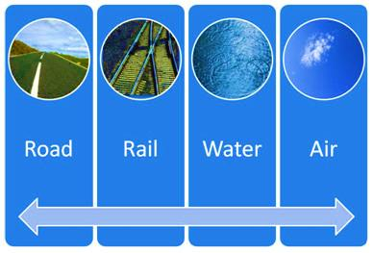
Introduction
  Tour-based and logistics supply-chain modeling framework (FHWA)
  Applied to Florida
  Logistics Decisions (mode choice )
  Inventory Costs
  Variable Costs
  Commodity Characteristics

Slide 3
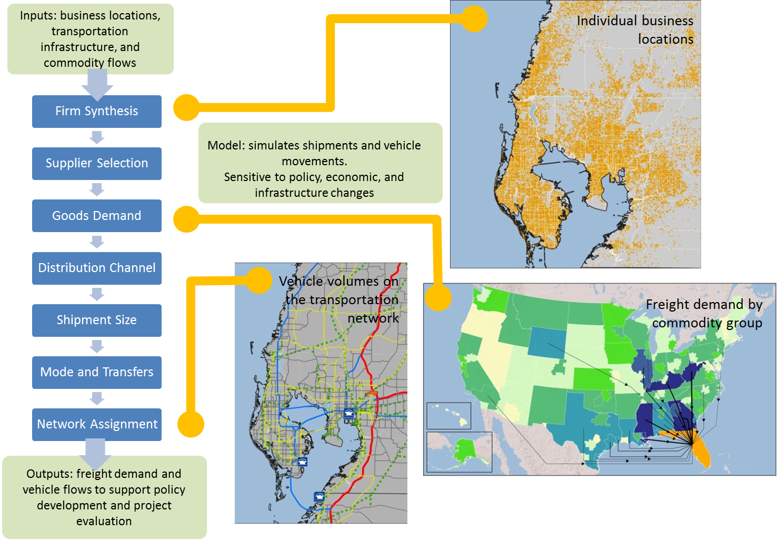
Florida Statewide Freight Model

Slide 4
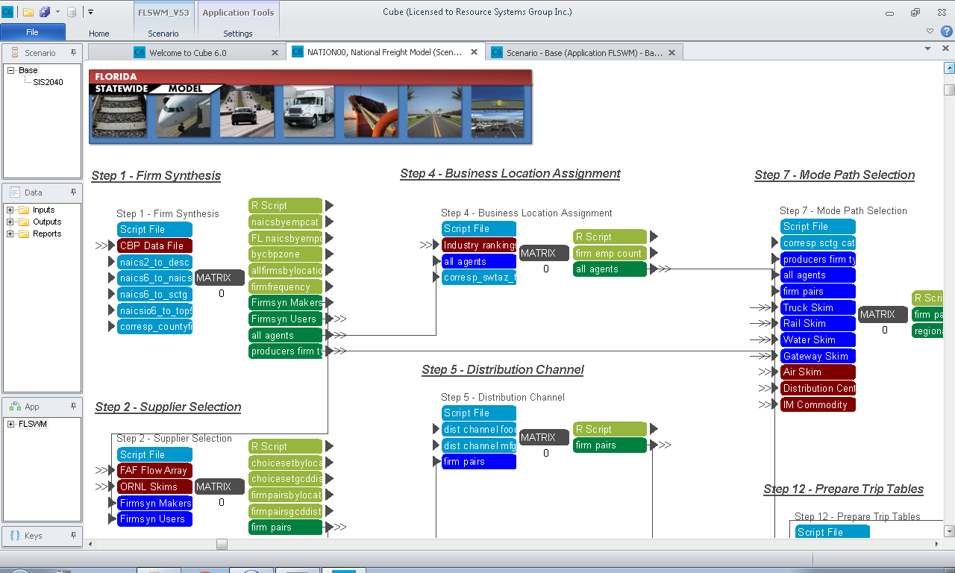
Florida Model Integration

Slide 5
Florida Statewide Freight Model
Firm Synthesis
Supplier Selection
Goods Demand
Distribution Channel
Shipment Size
Mode and Transfers
Synthesizes a list of businesses in Florida, the rest of the US, plus an international sample
Connects suppliers to buyers based on the commodities produced by the supplier and consumed by the buyer
Distributes commodity flows amongst the paired suppliers and buyers
For each buyer/supplier pair, selects whether shipments are direct or involve intermediate handling (intermodal, distribution center)
For each buyer/supplier pair, converts an annual commodity flow to shipments by size and frequency
Identifies the mode for each leg of the trip from supplier to buyer and the transfer locations

Slide 6
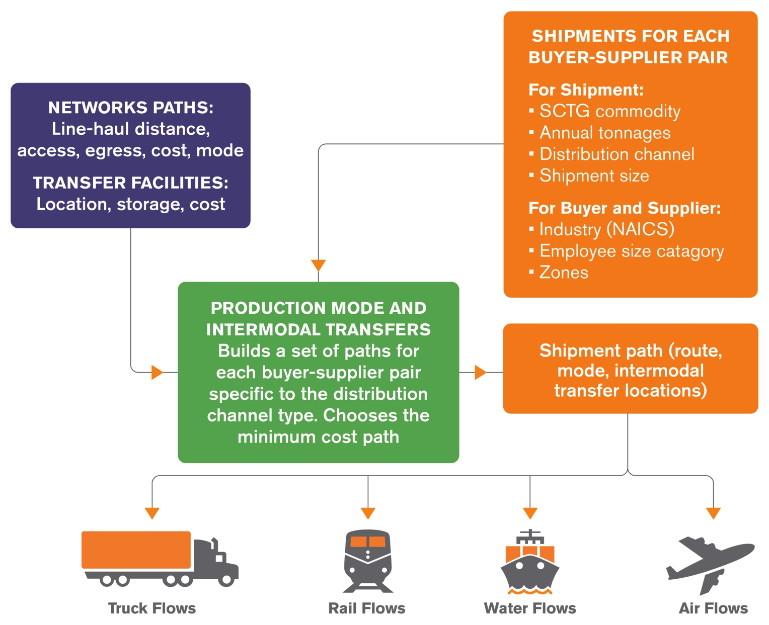
Mode Choice Model
Shipments are Assigned to the Following Modes:
  Truck (Full truck load, less than truck load)
  Rail (Carload, intermodal)
  Water (international, non-international)
  Air
Paths for shipments with complex distribution channel (that are not direct from shipper to buyer) can be multimodal, e.g.
  Truck – Rail – Truck
  Truck – Air – Truck
  Truck – Water

Slide 7
Mode Choice Model
Model structure based on the Aggregate-Disaggregate-Aggregate (ADA) framework**
  Disaggregation of commodity flows at their production and consumption ends to firm-to-firm flows, shipping and receiving firms paired then treated as a single behavioral unit
  Modeling of logistics decisions that are made by the shipper-receiver pair based on evaluation of the total transport and logistics costs on available paths; and
  Aggregation of individual shipments to origin and destination zones for network assignment purposes
** implemented in Norway and Sweden by de Jong and Ben-Akiva

Slide 8
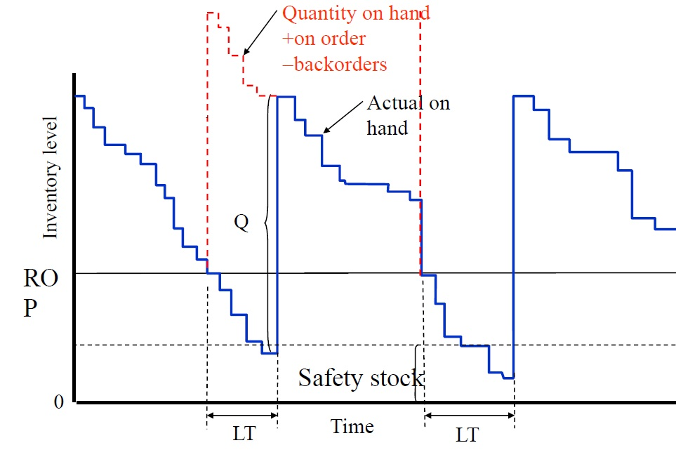
Total Cost
Total Costs = Transport costs + Non-Transport costs
Non-Transport Costs
=
ordering
+
carrying
+
damage
+
Inventory in-Transit
+
Safety Inventory
Order preparation, order transmission, production setup if appropriate
Cost of money, obsolescence, insurance, property taxes, and storage costs
Order lost or damaged
Inventory between shipment origin and delivery location
Lost sales cost, backorder cost (Demand and Lead-time uncertainty)
Very important for high-tech commodities (electronics)

Slide 9
Total Cost Equation
$$G_{mnql}=β_{0ql}+β_{1}×\left(\frac{Q}{q}\right)+T_{mnql}+β_{2 }×j ×v×Q+ β_{3 }×t_{mnl }× j× v× \frac{Q}{365}+\left(β_{4}+β_{5}×v\right)×\frac{q}{2}+v×a×\sqrt{(LT×{σ_{Q}}^{2})+(Q^{2}×{σ_{LT}}^{2})}$$
Ordering Cost
Transport and Handling Cost
Inventory in-transit cost
Damage Cost
Carrying Cost
Safety Stock Cost
Variable or Parameter | Description or Interpretation (of Parameters) | Source
G_{mnql} | Logistics cost (shipper m and receiver n with shipment size q and logistics chain l) | Calculated in the model
Q | Annual flow in tons | FAF
q | Shipment size in tons | Variable
β_{0ql} | Alternative-specific constant | Parameter to be estimated
β₁ | Constant unit per order | Parameter to be estimated
T | Transport and intermediate handling costs | network skims, survey data
β₂ | Discount rate | Parameter to be estimated
j | Fraction of shipment that is lost or damaged | Survey data or assumed value
v | Value of goods (per ton) | FAF data
β₃ | Discount rate of goods in transit | Parameter to be estimated
t | Average transport time (days) | Lookup table (or skims), survey data
β₄ | Storage costs per unit per year | Parameter to be estimated
β₅ | Discount rate of goods in storage | Parameter to be estimated
a | Constant, set safety stock a fixed prob. of not running out of stock | Survey data or assumed value
LT | Expected lead time (time between ordering and replenishment) | Lookup table (or skims) , survey data
σ_{Q} | Standard deviation in annual flow (variability in demand) | Survey data, assumed value
σ_{LT} | Standard deviation of lead time | Lookup table (or skims), survey data

Slide 10
Equation modification
$$G_{mnql}=β_{0ql}+β_{1}×\left(\frac{Q}{q}\right)+T_{mnql}+β_{2 }×j ×v×Q+ β_{3 }×t_{mnl }× j× v× \frac{Q}{365}+\left(β_{4}+β_{5}×v\right)×\frac{q}{2}+a×\sqrt{(LT×{σ_{Q}}^{2})+(Q^{2}×{σ_{LT}}^{2})}$$
Ordering Cost
Transport and Handling Cost
Damage Cost
Inventory in-transit cost
Carrying Cost
Safety Stock Cost
Term “j” is redundant (the fraction of shipment that is lost or damaged)
Unit = tons (safety inventory level), should be multiplied by the cost of holding safety inventory.
Only “Transport”, “Inventory in-transit” and “Safety stock” costs are reliant on “cost” and “time” from skims (the model performs the shipment size choice before mode choice).
$$G_{mnql}=β_{0ql}+T_{mnql}+ β_{3 }×t_{mnl }× v× \frac{Q}{365}+β_{5 }× v× a×\sqrt{(LT×{σ_{Q}}^{2})+(Q^{2}×{σ_{LT}}^{2})}$$
Transport and Handling Cost
Inventory in-transit cost
Safety Stock Cost

Slide 11
Product and Supply Chain Types
Safety Stock Cost
Depends on product type
Depends on supply chain type and service level
Depends on product demand patterns
Functional Products | Innovative Products
Mature product | Early life cycle stage
Low product variety | High product variety
Predictable demand | Unpredictable demand
minimize inventory | Deploy significant buffer stocks
Greater reliance on low cost modes | Greater reliance on fast and reliable modes
MATCH
MISMATCH
MISMATCH
MATCH
Categorizing commodities
Functional Product
Innovative Product
Efficient Supply Chain
Different parameters
Responsive Supply Chain

Slide 12
Model Run Comparisons
Commodity | Wood Products
Segment | Internal - Internal
Origin FAF | 129 (Florida, remainder)
Destination FAF | 123 (Florida, Orlando)
Cost type ($) | Formula | Truck | Rail | Air | Water
B₀ | Constant | 2,788.9 | 2,739.9 | 99,999,999 | 99,999,999
Transport | Q*C | 247.7 | 266.3 | 4,406.4 | N/A
Inventory in-transit | B₃*(t/(24*60))*v*Q/365 | 0.4 | 0.7 | 0.5 | N/A
Safety Stock | B₅*v*a*((LT)*(Q_{sd})^²)+(Q^²+(LT_{sd})^²))^^{0.5}) | 1,314.5 | 1,452.7 | 1,378.4 | N/A
Ordering | B₁*(Q*2000/q) | 50.0 | 50.0 | 50.0 | 50.0
Damage | B₂*j*v*Q | 1.2 | 1.2 | 1.2 | 1.2
Carrying | (B₄+(B₅*v))*((q/2000)/2)) | 15,581.6 | 15,581.6 | 15,581.6 | 15,581.6
TOTAL COST ($) |  | 19,984 | 20,092 | N/A | N/A
Shipment Characteristics | c ($) | 39.9 | 42.9 | 709.7 | N/A
 | t (min) | 1,602.6 | 3,284.8 | 2,380.2 | N/A
 | Q (tons) | 6.2 | 6.2 | 6.2 | 6.2
 | GCD (mile) | 89.5 | 89.5 | 89.5 | 89.5
 | Value ($) | 2,365.3 | 2,365.3 | 2,365.3 | 2,365.3
 | v ($/ton) | 380.9 | 380.9 | 380.9 | 380.9
 | LT (days) | 11.1 | 12.3 | 11.7 | N/A

Slide 13
Model Run Comparisons
Commodity | Electronics
Segment | Internal - External
Origin FAF | 123 (Florida, Orlando)
Destination FAF | 379 (North Carolina, remainder)
Cost type ($) | Formula | Truck | Rail | Air | Water
B₀ | Constant | 2,309.6 | 5,122.6 | 846.2 | 99,999,999
Transport | Q*C | 17.8 | 22.2 | 777.9 | N/A
Inventory in-transit | B₃*(t/(24*60))*v*Q/365 | 3.3 | 26.1 | 13.6 | N/A
Safety Stock | B₅*v*a*((LT)*(Q_{sd})^²)+(Q^²+(LT_{sd})^²))^^{0.5}) | 31,485.8 | 39,791.6 | 35,245.5 | N/A
Ordering | B₁*(Q*2000/q) | 776.0 | 776.0 | 776.0 | 776.0
Damage | B₂*j*v*Q | 30.3 | 30.3 | 30.3 | 30.3
Carrying | (B₄+(B₅*v))*((q/2000)/2)) | 160.0 | 160.0 | 160.0 | 160.0
TOTAL COST ($) |  | 34,783 | 45,929 | 37,850 | N/A
Shipment Characteristics | c ($) | 45.9 | 57.2 | 2,005.0 | N/A
 | t (min) | 578.3 | 4530.2 | 2,367.2 | N/A
 | Q (tons) | 0.39 | 0.39 | 0.39 | 0.39
 | GCD (mile) | 518.5 | 518.5 | 518.5 | 518.5
 | Value ($) | 12,105.9 | 12,105.9 | 12,105.9 | 12,105.9
 | v ($/ton) | 31,201.5 | 31,201.5 | 31,201.5 | 31,201.5
 | LT (days) | 10.4 | 10.4 | 10.4 | 10.4

Slide 14
Model Run Comparisons
Commodity | Pharmaceuticals
Segment | External - Internal
Origin FAF | 139 (Georgia, remainder)
Destination FAF | 129 (Florida, remainder)
Cost type ($) | Formula | Truck | Rail | Air | Water
B₀ | Constant | 2,194.2 | 903.5 | 1,268.0 | 99,999,999
Transport | Q*C | 1.5 | 2.2 | 74.7 | N/A
Inventory in-transit | B₃*(t/(24*60))*v*Q/365 | 0.3 | 3.0 | 1.7 | N/A
Safety Stock | B₅*v*a*((LT)*(Q_{sd})^²)+(Q^²+(LT_{sd})^²))^^{0.5}) | 3,814.5 | 4,781.8 | 4,318.8 | N/A
Ordering | B₁*(Q*2000/q) | 50.0 | 50.0 | 50.0 | 50.0
Damage | B₂*j*v*Q | 3.7 | 3.7 | 3.7 | 3.7
Carrying | (B₄+(B₅*v))*((q/2000)/2)) | 287.3 | 287.3 | 287.3 | 287.3
TOTAL COST ($) |  | 6,352 | 6,031 | 5,877 | N/A
Shipment Characteristics | c ($) | 36.7 | 53.2 | 1,801.9 | N/A
 | t (min) | 470.8 | 4,242.3 | 2,285.6 | N/A
 | Q (tons) | 0.04 | 0.04 | 0.04 | 0.04
 | GCD (mile) | 342.0 | 342.0 | 342.0 | 342.0
 | Value ($) | 1,477.2 | 1,477.2 | 1,477.2 | 1,477.2
 | v ($/ton) | 36,061.1 | 36,061.1 | 36,061.1 | 36,061.1
 | LT (days) | 10.3 | 10.3 | 11.6 | 10.3

Slide 15
Mode Choice Validation Results
Calibration of the mode choice model resulted in a relatively good match to the mode choice shares observed in the Transearch data

Slide 16
Contacts
Kaveh Shabani
kaveh.shabani@rsginc.com
www.rsginc.com
Colin Smith
colin.smith@rsginc.com
Maren Outwater
maren.outwater@rsginc.com

