Slide 1

Importance of Modeling Bicycle Ownership at Individual Level to Predict Travel Mode Share
May 18, 2015
Nazneen Ferdous and John Gliebe, RSG
Richard Walker, Bud Reiff, and Cindy Pederson, Metro

Slide 2

Overview
  Background
  Motivation and Approach
  Model Estimation
  Model Implementation

Slide 3
Background
Typically, travel models that include bicycling as an alternative assume that the mode is available for all trips within a certain travel distance threshold
  Person attributes are not considered
  Can produced biased estimates of value of time
  May forecast bicycle trips in the wrong locations
2011 Oregon Household Activity Survey
  Just 29.5% of respondents reported owning and using a bicycle on a regular basis
  Sample of 9,059 individuals, age 16-plus from 4,778 households in three counties in the Portland region

Slide 4
Proportion of Bicyclists by Age Group
Age > 65

Slide 5
Background
Many studies examine the effects of person attributes and urban form on the frequency of bicycling for various trip purposes, but do not address the fundamental question of whether bicycling is considered a viable mode option for persons who are not observed bicycling
For many people, bicycling may not be a realistic alternative for reasons such as:
  Do not own a working, adult-size bicycle
  Age and fitness do not permit bicycling
  Biking environment is poor or dangerous around home and/or to reach places of interest (work, school, social/recreational)
  Personal tastes and influence of others

Slide 6
Behavioral Economics
Effects of others on personal choices
Persons who use bicycles regularly tend to live with other people who bike regularly
Persons who do not use bicycles regularly tend to live together
Persons who use bicycles regularly tend to choose neighborhoods and jobs that support an active lifestyle (self selection)

Slide 7
Motivation for Model Improvement
Evaluation of investments in bike-supportive infrastructure and policies
  More accurately characterize where bicyclists live
  Understanding conditions that might lead to higher bicycle usage—identify latent markets
Improve model accuracy
  Remove bias that all persons consider bicycling in their choice set within a given maximum distance
  Capture neighborhood amenity and biking environment effects
  Capture effects of changing demographics
    Aging population
    Smaller household sizes
    Millenials – fewer cars, prefer urban living

Slide 8
Approach
Estimate and apply a binary logit choice model of persons who regularly own and use a bicycle based on response to survey
Simulation-based application environment developed as part of DASH activity-based model system
Conditioned by upstream long-term choice models
  Work and school locations, auto ownership, and worker mobility options
Use to condition choice sets in downstream mode choice models
Use Metro’s bicycle route choice model skims to create accessibility variables

Slide 9
Metro Bicycle Route Choice Model
Zonal skims
  Utility and Distance
  Commute and Non-commute purposes
Model development
  2007 GPS survey of 162 bicyclist over 1 to 2 weeks (~1500 trips)
  Path-size logit accounting for overlapping alternatives
GIS street networks with elevation changes, AADT, intersections, and bike facilities coded
Source: Joe Broach, Portland State University

Slide 10
Model Estimation Results
 | Variable | Estimate | t-statistics
 | Alternative-specific constant for bicycle | -3.930 | -12.67
Person-level attributes
 | Female | -0.695 | -12.80
 | Age | 0.088 | 8.51
 | Age²/100 | -0.109 | -9.91
 | Age missing | 1.430 | 4.71
 | Some flexibility in work schedule | 0.198 | 3.15
 | Full flexibility in work schedule | 0.249 | 2.61
 | Transit pass provided by employer | 0.366 | 3.69
 | Long-term parking cost at workplace | 0.047 | 3.04
Household-level attributes
 | Presence of children age 0-4 in the household | -0.165 | -1.70
 | Presence of children age 5-15 in the household | 0.153 | 2.42
 | Income < $15K × household has no car | 0.479 | 2.18
 | One other household member owns and uses a bicycle regularly | 1.860 | 31.74
 | Two other household members own and use bicycle regularly | 1.880 | 15.50
 | Three or more household members own and use bicycle regularly | 2.340 | 9.69
Land-use and bicycling environment-related attributes
 | Intersection density within half-mile radius of home TAZ | 0.004 | 6.08
 | Ln(home bike accessibility to indoor recreation (arts & entertainment employment)) | 0.111 | 2.35
 | Residuals from regressing bike utility on distance between home and workplace | 0.025 | 4.07
 | Residuals from regressing bike utility on distance between home and school | 0.048 | 3.13
Model Fit Statistics
 | Number of observations | 9,059
 | Log-likelihood with coefficients = 0 | -6,279.22
 | Final log-likelihood | -4,336.91
 | Adjusted rho-square | 0.306

Slide 11
Effect of Age on Utility

Slide 12
Summary of Findings from Estimation
Most significant predictor of being a regular bicycle user is whether other household members are regular bicycle users!
Age, gender, presence of children are relevant
Interaction of low income and zero cars is significant
Workplace flexibility, transit incentives, parking disincentives are relevant (reduce need for cars)
Bicycling accessibility to recreation opportunities and quality of the bicycling environment are important
Not significant: college/university student status

Slide 13
Model Implementation
Self-referential model—choices of each person in the household affects choices of other persons in the household
Monte Carlo simulation, iterate over household members
Maximum iterations is number of eligible household members
Iteration 1 to Max Iter
Simulate choice for each person in household with knowledge of other persons’ choices from previous iteration
Iteration 0
Simulate choice for each person in household with no knowledge of other persons’ choices
Number of other household members who are regular bicyclists
Number of other household members who are regular bicyclists
Are zero persons regular bicyclists?
Is utility same as previous iteration?
No - next iteration
No - next iteration
Yes - Stop
Yes - Stop

Slide 14
Model Application: Effects of Other Household Members on Personal Choice
Household ID | Iteration | Number Persons Age 16+ | Predicted Regular Bicyclists | Household Composite Utility
520000 | 0 | 3 | 0 | 0.5314
430000 | 0 | 2 | 1 | 0.3145
430000 | 1 | 2 | 1 | 1.0299
810000 | 0 | 3 | 1 | 0.5709
810000 | 1 | 3 | 2 | 1.7984
810000 | 2 | 3 | 2 | 2.5507
190000 | 0 | 4 | 2 | 0.6608
190000 | 1 | 4 | 3 | 3.0230
190000 | 2 | 4 | 3 | 3.3572
190000 | 3 | 4 | 3 | 3.3572
250000 | 0 | 7 | 1 | 1.6724
250000 | 1 | 7 | 4 | 5.0748
250000 | 2 | 7 | 5 | 8.3777
250000 | 3 | 7 | 5 | 8.3777

Slide 15
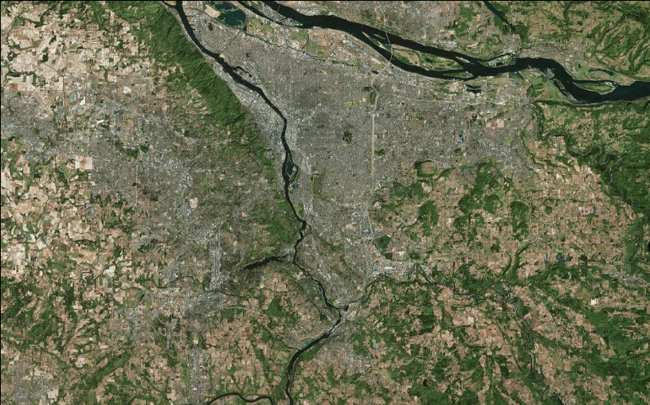
Lay of the Land: Portland Metro Region
World_Imagery - Source: Esri, DigitalGlobe, GeoEye, Earthstar Geographics, CNES/Airbus DS, USDA, USGS, AEX, Getmapping, Aerogrid, IGN, IGP, swisstopo, and the GIS User Community

Slide 16
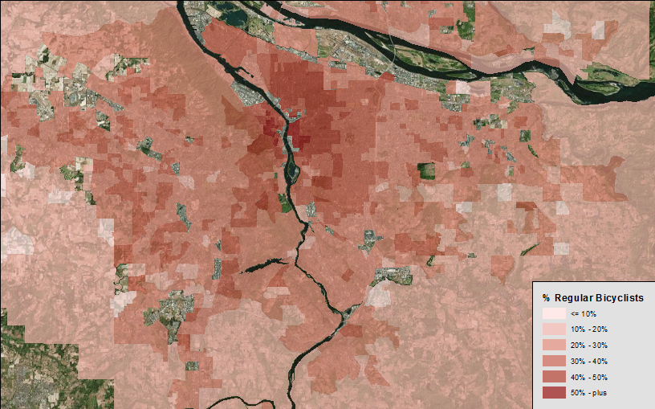
Predicted Percentage of Regular Bicycle Users (age 16+) by TAZ
Vancouver
St. Johns & University of Portland
Alberta Arts District
Hillsboro
NW & Pearl District
Buckman Area
Downtown & PSU
Hawthorne Area
I-205
Beaverton
Lewis & Clark College
Reed College
Tigard
Oregon City

Slide 17
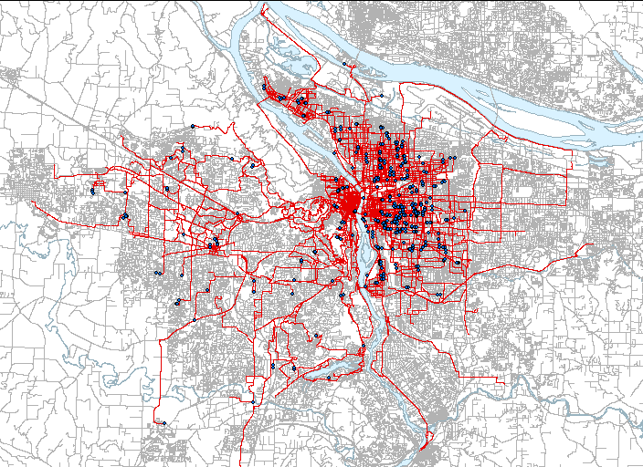
Observed Bike Paths from 2007 GPS Survey
Source:
Joe Broach, Portland State University

Slide 18
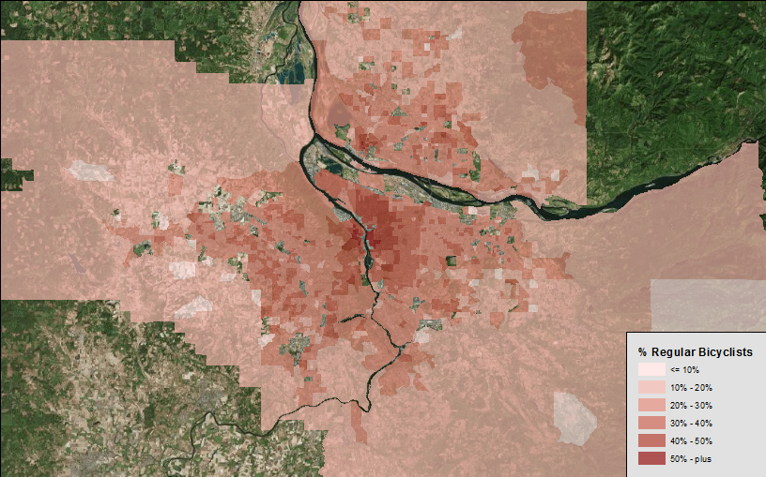
Predicted Percentage of Regular Bicycle Users (age 16+) by TAZ (Larger Model Region)

Slide 19
Summary and Next Steps
Model predicts concentrations of regular bicycle users in areas where they would be expected
  Strong urban lifestyle and bicycling environment effects
Now being used in estimating tour mode choice models to condition choice sets
  Bike and Transit-bike access mode alternatives
  Results in slightly lower estimated values of time since there are fewer cases in which bicycle is being traded off against faster, chosen motorized modes
Full-model implementation
  Calibration and sensitivity testing

Slide 20
John Gliebe
John.Gliebe@rsginc.com
240.283.0633
Nazneen Ferdous
Nazneen.Ferdous@rsginc.com
240.283.0634

