Slide 1
The Bay Area Now and Then:
A Longitudinal Evaluation of Household Travel Surveys in the Bay Area
May 19, 2015

Slide 2
Bay Area Overview
OVERVIEW > BACKGROUND CHANGES > FINDINGS > SURVEY OBSERVATIONS > CONCLUSIONS
Bay Area Overview
Changes from 2000 to 2010
Overall growth
Demographic changes
Transportation changes
Survey Findings
Discussion of Survey Consistency
Conclusions / Next Steps

Slide 3
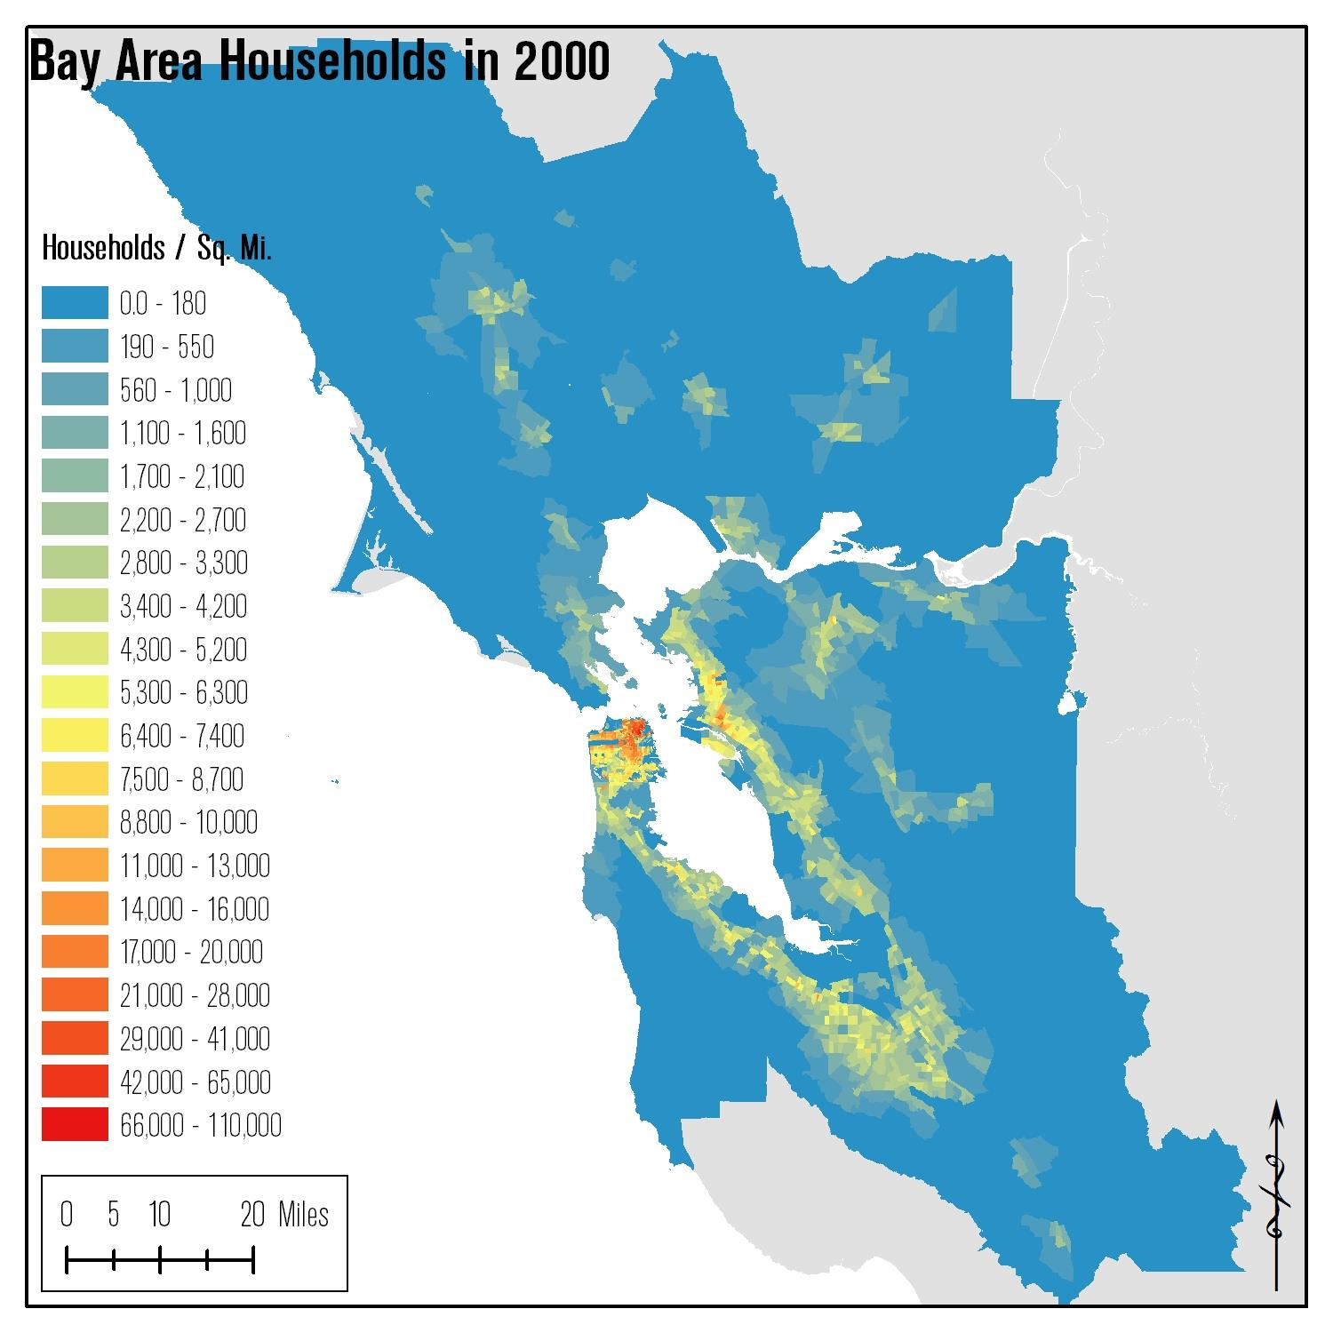
Bay Area Overview
OVERVIEW > BACKGROUND CHANGES > FINDINGS > SURVEY OBSERVATIONS > CONCLUSIONS
Bay Area Population
 | Households | Population
1990 | 2.25 M | 6.02 M
2000 | 2.46 M | 6.78 M
2010 | 2.61 M | 7.15 M

Slide 4
How has the population changed?
OVERVIEW > BACKGROUND CHANGES > FINDINGS > SURVEY OBSERVATIONS > CONCLUSIONS
Household Type by Household Size
 |  | 2000 |  | 2010
Family | 2 Person | 593,764 | (24%) | 613,232 | (24%)
 | 3 Person | 362,953 | (15%) | 396,044 | (15%)
 | 4 Person | 335,693 | (14%) | 363,496 | (14%)
 | 5+ Person | 302,060 | (12%) | 313,200 | (12%)
 | Total | 1,594,470 |  | 1,685,972
Nonfamily | 1 Person | 637,575 | (26%) | 680,925 | (26%)
 | 2 Person | 179,385 | (7%) | 184,607 | (7%)
 | 3 Person | 34,379 | (1%) | 33,087 | (1%)
 | 4 Person | 12,364 | (1%) | 13,993 | (1%)
 | 5+ Person | 7,846 | (0%) | 9,439 | (0%)
 | Total | 871,549 |  | 922,051
Total | 1 Person | 637,575 | (26%) | 680,925 | (26%)
 | 2 Person | 773,149 | (31%) | 797,839 | (31%)
 | 3 Person | 397,332 | (16%) | 429,131 | (16%)
 | 4 Person | 348,057 | (14%) | 377,489 | (14%)
 | 5+ Person | 309,906 | (13%) | 322,639 | (12%)
 | Total | 2,466,019 |  | 2,608,023
*Census 2000 and Census 2010

Slide 5
How has the population changed?
OVERVIEW > BACKGROUND CHANGES > FINDINGS > SURVEY OBSERVATIONS > CONCLUSIONS
Age Shifts
Lower share of householders under 44
Higher share of householders over 55
Age of Head of Household
 | 2000 |  | 2010
15-24 | 89,753 | (4%) | 84,953 | (3%)
25-34 | 458,327 | (19%) | 407,062 | (16%)
35-44 | 601,166 | (24%) | 528,091 | (20%)
45-54 | 535,869 | (22%) | 575,739 | (22%)
55-64 | 326,830 | (13%) | 479,097 | (18%)
65-74 | 226,969 | (9%) | 272,843 | (10%)
75+ | 227,105 | (9%) | 260,238 | (10%)
Total | 2,466,019 |  | 2,608,023
*Census 2000 and Census 2010

Slide 6
How has the population changed?
OVERVIEW > BACKGROUND CHANGES > FINDINGS > SURVEY OBSERVATIONS > CONCLUSIONS
Population increased marginally
140,000 households (6%)
370,000 people (5%)
Household size, owner / renter, family / nonfamily rates relatively unchanged
Modest increase in age of householders

Slide 7
How has transportation changed?
OVERVIEW > BACKGROUND CHANGES > FINDINGS > SURVEY OBSERVATIONS > CONCLUSIONS

Slide 8
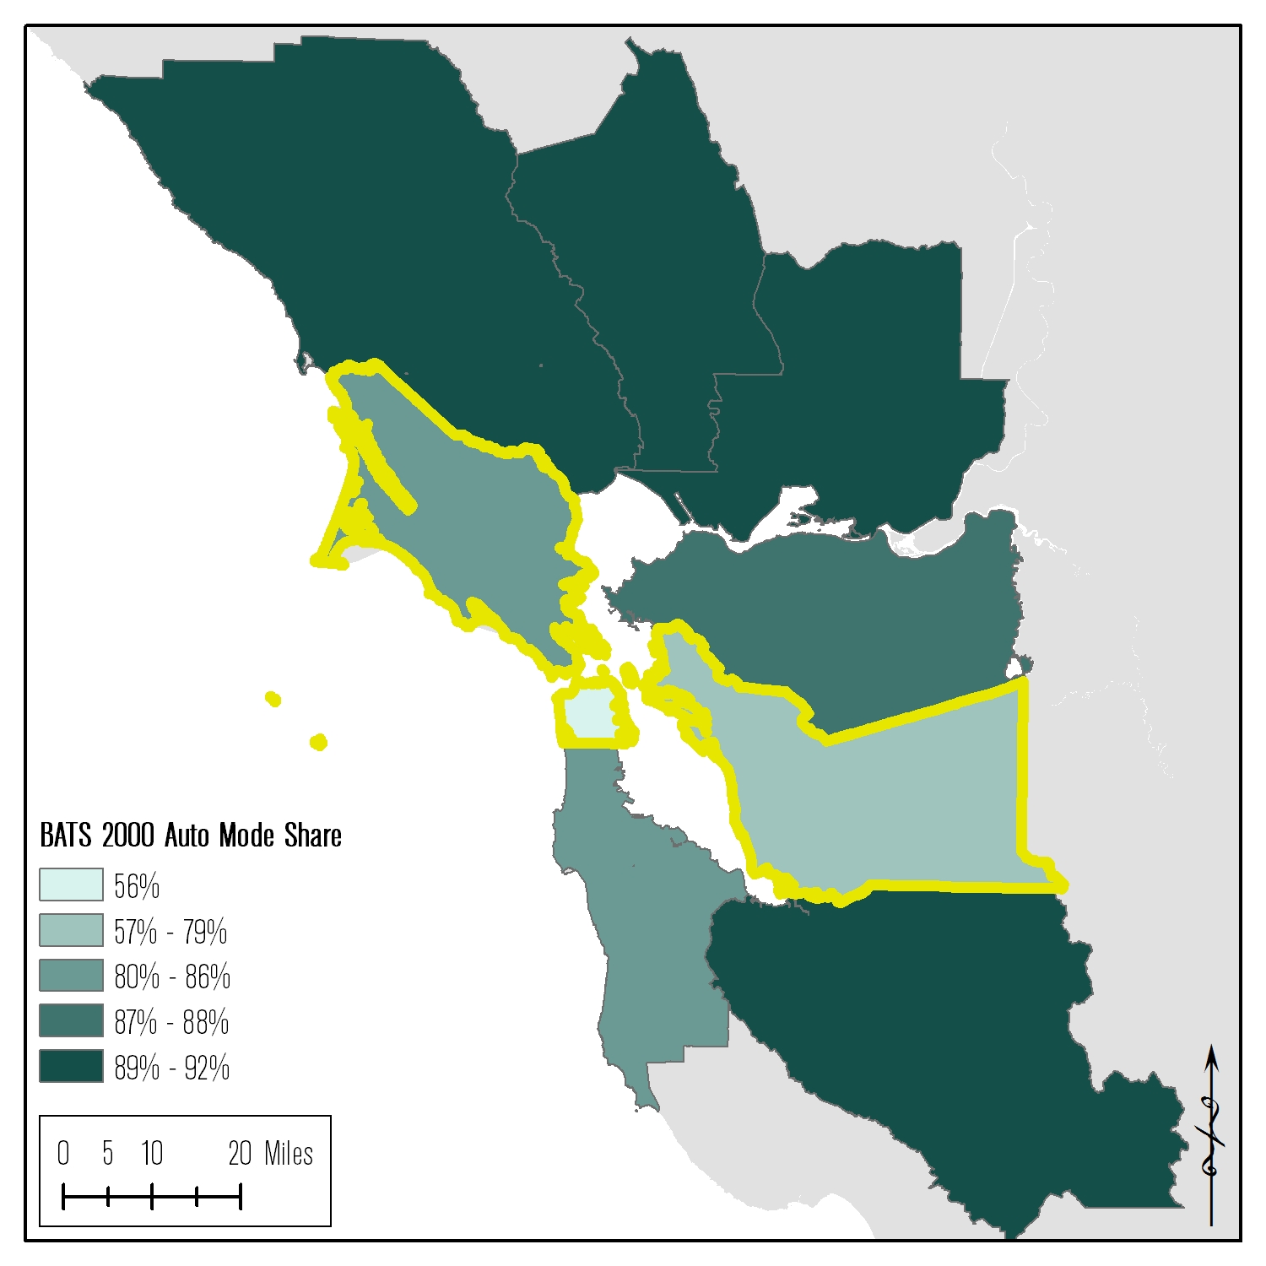
What do the surveys say? Mode Share — Lowest Auto Mode Share
OVERVIEW > BACKGROUND CHANGES > FINDINGS > SURVEY OBSERVATIONS > CONCLUSIONS

Slide 9
What do the surveys say? Mode Share — Lowest Auto Mode Share
OVERVIEW > BACKGROUND CHANGES > FINDINGS > SURVEY OBSERVATIONS > CONCLUSIONS
San Francisco
Alameda
Marin

Slide 10
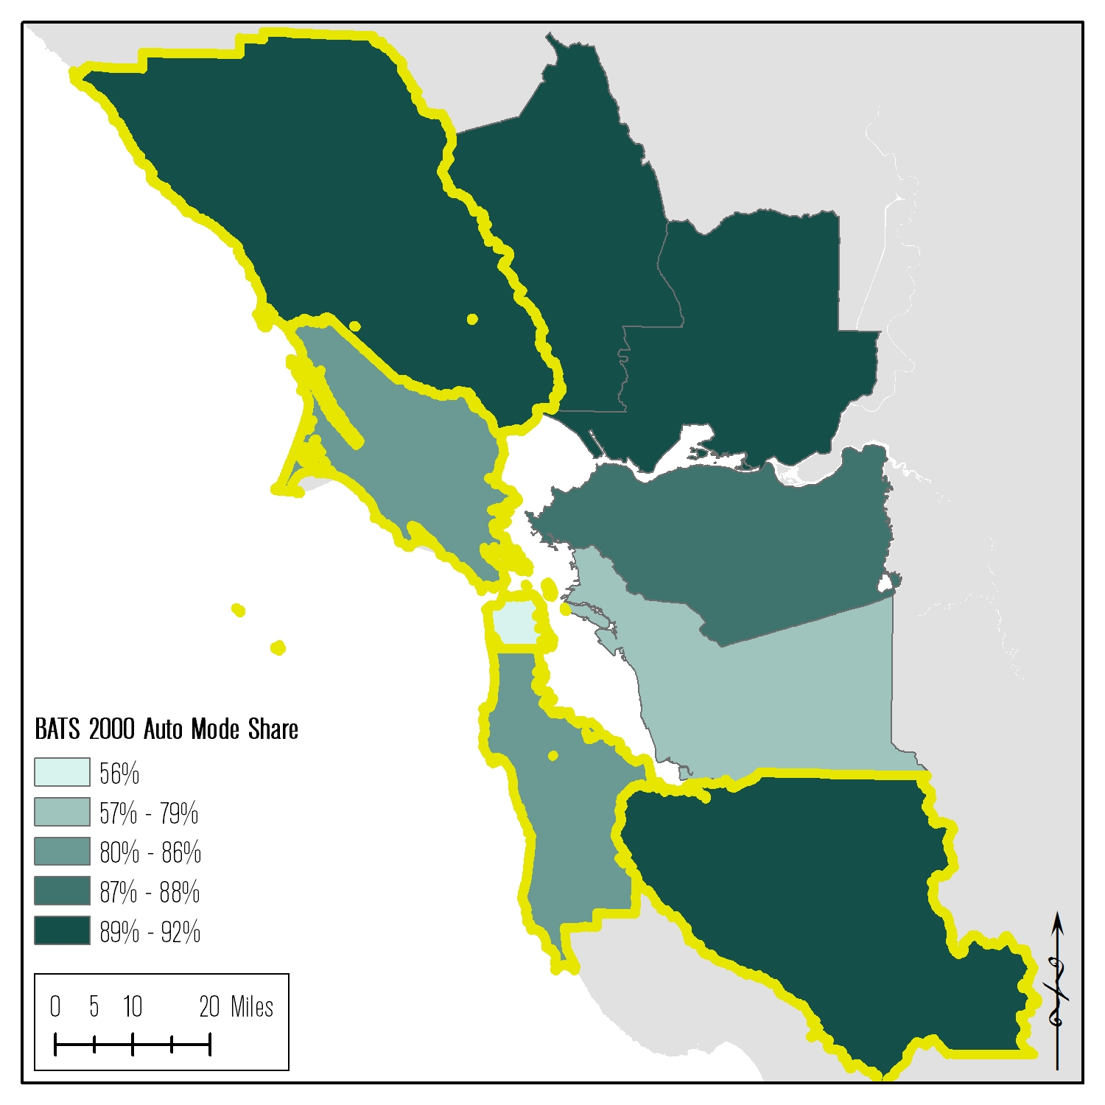
What do the surveys say? Mode Share — Biggest Change
OVERVIEW > BACKGROUND CHANGES > FINDINGS > SURVEY OBSERVATIONS > CONCLUSIONS

Slide 11
What do the surveys say? Mode Share — Biggest Change
BACKGROUND CHANGES > LAND USE > TRANSPORTATION NETWORKS > TRAVEL BEHAVIOR
San Francisco
Santa Mateo
Santa Clara
Sonoma
Marin

Slide 12
What do the surveys say? Mode Share — By Area Type
OVERVIEW > BACKGROUND CHANGES > FINDINGS > SURVEY OBSERVATIONS > CONCLUSIONS
Regional Core
Central Business District
Urban Business
Urban
Suburban
Rural

Slide 13
What do the surveys say? Mode Share — By Area Type
OVERVIEW > BACKGROUND CHANGES > FINDINGS > SURVEY OBSERVATIONS > CONCLUSIONS
Regional Core
Central Business District
Urban Business
Urban
Suburban
Rural

Slide 14
What do the surveys say? Mode Share
OVERVIEW > BACKGROUND CHANGES > FINDINGS > SURVEY OBSERVATIONS > CONCLUSIONS
Age of Householder
Age 18 – 24
Age 25 – 44
Age 45 - 64
Age 65+
Children in Household ?
No
Yes

Slide 15
What do the surveys say? Mode Share
OVERVIEW > BACKGROUND CHANGES > FINDINGS > SURVEY OBSERVATIONS > CONCLUSIONS
Land use density
Increasing density -> decreasing driving
Age
Transit use decreases with age, until 65+
Presence of children increases likelihood of driving
No
Yes

Slide 16
A closer look at the surveys… Survey Consistency
OVERVIEW > BACKGROUND CHANGES > FINDINGS > SURVEY OBSERVATIONS > CONCLUSIONS
BATS 2000
Bay Area travel survey sponsored by MTC
Two-day travel survey
Activity diary (encouraged) with follow-up phone interview
CHTS 2010
Statewide travel survey with Bay Area over-sampling
One-day travel survey
Activity diary
Summer month travel diaries*
Significantly higher trip rates with CHTS survey
No
Yes

Slide 17
A closer look at the surveys… Survey Consistency — Trip Rates
OVERVIEW > BACKGROUND CHANGES > FINDINGS > SURVEY OBSERVATIONS > CONCLUSIONS
Weighted Trip Rates, BATS vs CHTS
 | Trips per Household |  |  | Trips per Person
 | BATS | CHTS | % diff | BATS | CHTS | % diff
auto trip rate | 6.5 | 8.0 | 23% | 2.4 | 2.9 | 21%
transit trip rate | 0.2 | 0.2 | 41% | 0.1 | 0.1 | 38%
walk trip rate | 0.7 | 1.2 | 76% | 0.3 | 0.4 | 72%
bike trip rate | 0.1 | 0.2 | 78% | 0.0 | 0.1 | 74%
other trip rate | 0.2 | 0.4 | 76% | 0.1 | 0.1 | 72%
all trip rate | 7.6 | 10.0 | 31% | 2.9 | 3.7 | 28%

Slide 18
What do the surveys say? Survey Consistency — Trip Rates
OVERVIEW > BACKGROUND CHANGES > FINDINGS > SURVEY OBSERVATIONS > CONCLUSIONS
Unweighted Survey Sample Trip and Tour Rates
 | BATS | CHTS
Households | 15,193 | 7,187
People | 33,282 | 15,866
Avg HHLD Size | 2.19 | 2.21
trips (multiday) | 212,566 | 70,000
trips (avg weekday) | 123,747 | 70,000
trips / hhld | 8.1 | 9.7
trips / person | 3.7 | 4.4
hhldr trip rate | 4.2 | 4.8
non hhldr trip rate | 3.8 | 4.1
tours / hhld | 3.07 | 3.53
tours / person | 1.48 | 1.60
*Source: BATS 2000 and CHTS 2010

Slide 19
Conclusions
OVERVIEW > BACKGROUND CHANGES > FINDINGS > SURVEY OBSERVATIONS > CONCLUSIONS
Decennial surveys give a brief snapshot
May lose context of local (in time) trends
Many sources of potential bias
Survey instrument
Sampling method
Survey weighting and expansion methods
Direct comparisons may be quite difficult

Slide 20
Next steps / stuff to think about
OVERVIEW > BACKGROUND CHANGES > FINDINGS > SURVEY OBSERVATIONS > CONCLUSIONS
Potential investigation / estimation / correction of trip under-reporting
Investigation into data cleaning methods
Ongoing (ACS-style) household travel surveying

Slide 21
Sources
OVERVIEW > BACKGROUND CHANGES > FINDINGS > SURVEY OBSERVATIONS > CONCLUSIONS
Census 2000
Census 2010
ACS 2007-2011
Bay Area Travel Survey 2000
California Household Travel Survey 2010-2012
Statistical Summary of Bay Area Transit Operators: Fiscal Years 2008-09 Through 2012-13
Statistical Summary of Bay Area Transit Operators: Fiscal Years 2007-08 Through 2011-12
Statistical Summary of Bay Area Transit Operators: Fiscal Years 2006-07 Through 2010-11
Statistical Summary of Bay Area Transit Operators: Fiscal Years 2005-06 Through 2009-10
Statistical Summary of Bay Area Transit Operators: Fiscal Years 2000-01 Through 2004-05

Slide 22
Thank you! drew.cooper@sfcta.org

