Slide 1
Development of a Truck Model for Memphis
2015 Transportation Planning Applications Conference
Anurag Komanduri, Daniel Beagan, Thomas Rossi
Andrew Ray, Kwasi Agyakwa, Memphis MPO
May 20, 2015

Slide 2
Why Model Trucks?
Trucks move goods and provide services in urban areas
  Contribute to congestion
  Impact air quality and emissions
  Affect roadway wear-and-tear and safety
Federal requirements to study freight - CFR Title 23 Part 450
  320.c.1 Identify & evaluate alternative strategies
  306.a.4 Increase accessibility & mobility of people and freight
  306.a.6 Enhance the integration and connectivity of the transportation system,..., for people and freight

Slide 3
Memphis Region
Major freight and logistics hub
  Five Class I railroads serve Memphis
  Busiest cargo airport in the US – second only to Hong Kong
  Major river port on the Mississippi River
Federal Express is headquartered in Memphis
  Major distribution center
  Truck traffic “in” and “out” of the distribution center
Freight expected to keep growing…

Slide 4
Memphis Truck Model
Develop model based on “reality”
  Use as much data as possible to build models
Use FAF3 to assess VMT from freight trucks
  Total trucks reported on links from HPMS
  FAF trucks are assigned – 35% of total VMT
  Therefore, 65% of VMT by service trucks
  64% of truck tonnage is EI/IE/EE
Modeling data needs
  Internal trucks – combination of freight and service trucks
  External trucks – freight (commodity) trucks

Slide 5
Memphis Truck Model
External truck model database - TRANSEARCH
  Commodity flow database
  Provided by Tennessee DOT
  County-level information
Internal truck model database – ATRI
  Includes both freight and service trucks
  Processed ATRI GPS data provided by Tennessee DOT
  Trip ends available at statewide model TAZ level
  Use QRFM as a basis for model development

Slide 6
Memphis Truck Model
Step 1. Clean and prepare estimation datasets
Step 2. Develop detailed employment datasets for estimation
Step 3. Identify top commodity groups/QRFM employment categories for freight model
Step 4. Estimate trip production/attraction rates
Step 5. Estimate parameters for trip distribution model
Step 6. Combine truck trips and assign to network

Slide 7
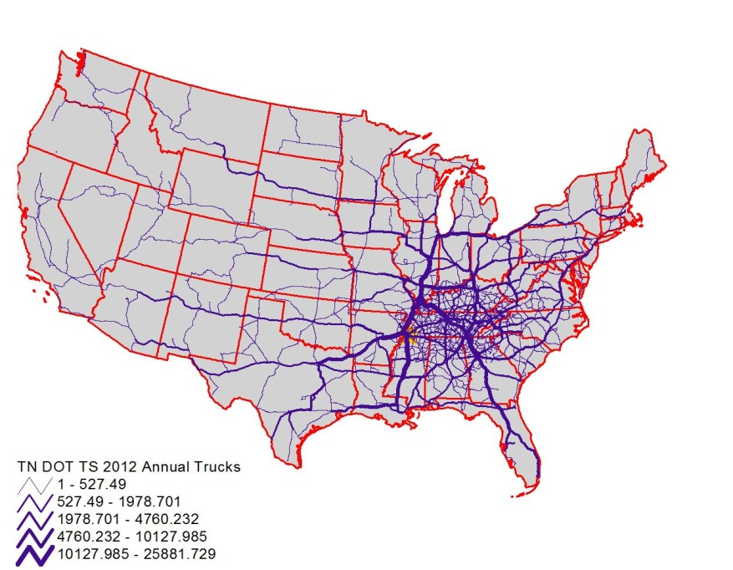
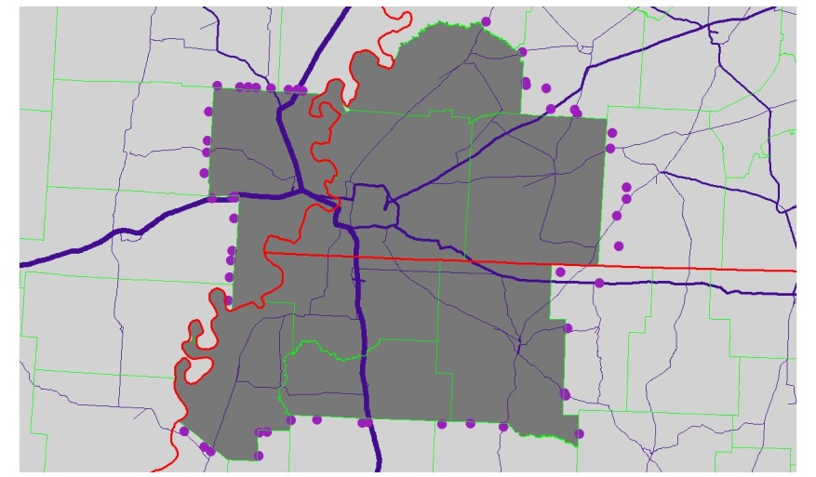
Step 1. External Estimation Database
Obtain and process TDOT TRANSEARCH data
Assign to FAF3 highway network
Window to Memphis MPO model boundary
Identify I-E/E-I/E-E trips
County-level estimation
TAZ-level application
Notes:
TnDOT TRANSEARCH (2012 base year) was assigned to the national FAF highway network and then windowed to the Memphis region. This is the estimation dataset for IE/EI TG equations and TD parameters.

Slide 8
Step 1. Internal Estimation Database
Weighted ATRI truck trip ends assigned to TAZ
  ATRI only contains heavy trucks
  QRFM has equations for heavy, medium, and light
Differences found in average travel times
  QRFM heavy trucks = 33.3 minutes
  ATRI heavy trucks = 10 minutes
Differences in Memphis region potentially driven by industry and local land use
Notes:
TnDOT TRANSEARCH (2012 base year) was assigned to the national FAF highway network and then windowed to the Memphis region. This is the estimation dataset for IE/EI TG equations and TD parameters.

Slide 9
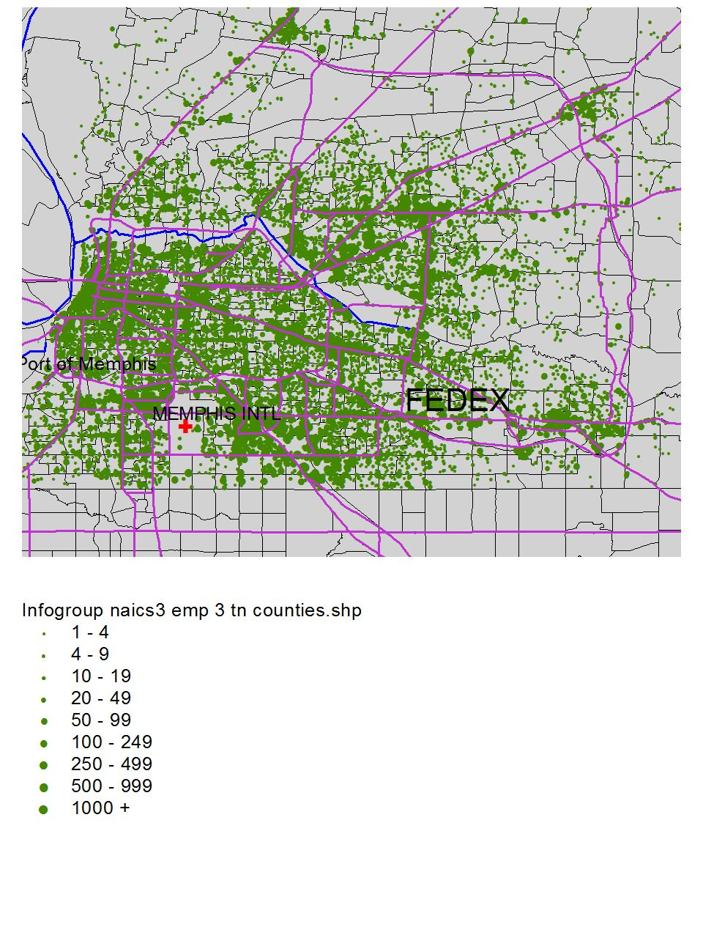
Step 2. Develop NAICS Employment Databases
Obtain TDOT Infogroup data
  Purchase 2013 data for Memphis region
Obtain and process Infogroup data for AR & MS Counties
Perform manual corrections to develop baseline employment data
Assigned to both Memphis MPO model TAZ and statewide Model TAZ

Slide 10
Step 3. Commodity Groups – External Model
Commodity Group | SCTG | Daily IE Trucks Produced from Region |  | Daily EI Trucks Attracted to Region
Farm Products | 01-05 | 222 | 6% | 1,122 | 28%
Food Products | 06-09 | 262 | 7% | 242 | 6%
Sand and Gravel | 11-15 | 277 | 7% | 990 | 24%
Gasoline & Fuel | 16-19 | 277 | 7% | 324 | 8%
Chemicals | 20-23 | 167 | 4% | 47 | 1%
Non-Durable Manufacture | 24-30 | 91 | 2% | 134 | 3%
Clay, Concrete, Glass | 31 | 343 | 9% | 168 | 4%
Durable Manufacture | 32-40 | 120 | 3% | 141 | 3%
Waste | 41 | 232 | 6% | 74 | 2%
Secondary and Mixed Freight | SCTG 43 SCTG 50 | 1,859 | 48% | 827 | 20%
Total |  | 3,850 | 100% | 4,068 | 100%
Notes:
TRANSEARCH suggests that freight truck can be separated into 10 Commodity Groups ( like purposes in passenger travel) that are likely to have different explanatory variables and behavior. The largest internal Ps are Secondary and Mixed Freight; and Clay, Concrete, Glass. The largest internal attractions are of Farm Products, Sand and Gravel and Secondary and Mixed Freigth trucks, all show as bold text.
FYI TAN SEARCH reports annual trucks. This was converted to average weekday trucks by dividing annual trucks by 295 as suggested by NCFRP Report 8.

Slide 11
Step 3. QRFM Model Trip Rates – Internal Model
Employment Categories | Light Trucks | Medium Trucks | Heavy Trucks
Agriculture, Mining and Construction | 1.110 | 0.289 | 0.174
Manufacturing, TCU and Wholesale Trade | 0.938 | 0.242 | 0.104
Retail Trade | 0.888 | 0.253 | 0.065
Office and Services | 0.437 | 0.068 | 0.009
Households | 0.251 | 0.099 | 0.038
Notes:
Columns 2,3,4 are from QRFM. Column 5 is from new regression. Explanatory variables are from Memphis NAICS3 employment by TAZ aggregated to the categories used in QRFM . Note wells, that for those variables that were found to be significant ( i.e. all except office employment and household's) regression rates are 5 to 10 times higher than default QRFM rates.

Slide 12
Step 4. External Trip Generation Models
Internal (TAZ) Truck Trips ends
  Develop NAICS employment by TAZ as explanatory variables
  Use most suitable NAICS for each commodity group
External (Station) Truck Trip Ends
  Estimate from windowed TRANSEARCH
  Match observed truck counts – get splits between EI/IE/EE
Apply modeled internal trip end results to all TN counties
  Assess whether model estimates are reasonable
  All work fine – except “secondary and mixed freight”
  Impact of FedEx probably causes Shelby County to be outlier
Notes:
TnDOT TRANSEARCH (2012 base year) was assigned to the national FAF highway network and then windowed to the Memphis region. This is the estimation dataset for IE/EI TG equations and TD parameters.

Slide 13
Step 4. External Trip Generation Models
Notes:
Shelby County is major producer of CG10 trucks for both Memphis MPO and all of TN. It only appears as less of a outlier when looking at all of TN BECAUSE Memphis to Nashville is I-E with respect to the Memphis MPO (green diamond), but it is I-I with respect to all of TN. Recommend using the TN rate, but calculating the outlier from the Memphis I-E observation for Shelby.

Slide 14
Step 4. Internal Model Trip Generation Models
Variable | QRFM Heavy Truck Rate | ATRI Heavy Truck Rate
Agriculture, Mining and Construction | 0.174 | 0.504
Manufacturing, TCU and Wholesale Trade | 0.104 | 0.942
Retail Trade | 0.065 | 0.784
Office and Services | 0.009 | 0.0001
Households | 0.038 | 0.0001
Employment Categories – Scaled Rates | Light Trucks | Medium Trucks | Heavy Trucks
Agriculture, Mining and Construction | 3.215 | 0.837 | 0.504
Manufacturing, TCU and Wholesale Trade | 8.496 | 2.192 | 0.942
Retail Trade | 10.711 | 3.052 | 0.784
Office and Services | 0.005 | 0.001 | 0.0001
Households | 0.001 | 0.0003 | 0.0001
Notes:
Columns 2,3,4 are from QRFM. Column 5 is from new regression. Explanatory variables are from Memphis NAICS3 employment by TAZ aggregated to the categories used in QRFM . Note wells, that for those variables that were found to be significant ( i.e. all except office employment and household's) regression rates are 5 to 10 times higher than default QRFM rates.

Slide 15
Step 4. Internal Model Trip Generation Models
Outlier analysis
  Observed trips more than +/- 34% ( ½ SD) of estimated trips
Difference between observed trips and ½ SD tested as special generator adjustment
TAZ | ATRI | From Model | Special Generator Addition | Revised Estimates | Facility
2456 | 15,905 | 5,751 | 11,939 | 17,690 | BNSF Memphis IM Yard
2457 | 13,355 | 6,662 | 8,801 | 15,463 | BNSF Memphis IM Yard
2484 | 7,119 | 3,518 | 4,720 | 8,238 | BNSF Memphis IM Yard
2518 | 9,997 | 1,682 | 8,839 | 10,522 | Port of Memphis
Notes:
Applying these rates compared to the ATRI TAZ totals can also identify the outliers, which may be special generators not explained by just the explanatory employment and household variables. Unsurprisingly, the outliers are in the TAZs with the BNSF rail yards and the Port of Memphis.

Slide 16
Step 5. Trip Distribution Models
Gravity model used for trip distribution
  Distance used as the friction factor for the external model
  Travel time used as the friction factor for the internal model
Productions and attractions from trip generation results
Friction factor coefficient is the inverse of the average trip length
  For external model, internal and external distance skims developed for each CG
  For internal model, congested travel time skims used
Models estimated and then applied…
Notes:
TnDOT TRANSEARCH (2012 base year) was assigned to the national FAF highway network and then windowed to the Memphis region. This is the estimation dataset for IE/EI TG equations and TD parameters.

Slide 17
Step 5. Trip Distribution Models
External model behaves reasonably well
Allows for forecasts using…
  Future year TRANSEARCH/FAF projections at external stations
  Socio-demographic data in internal zones
Internal model has interesting elements
  Trip generation in model – much higher than QRFM
  Average travel time in model much lower than QRFM
  Many intra-TAZ trips found in processed ATRI database
  Possibly low threshold set for “truck stop durations”
  Overall “assignable” truck trips comparable to QRFM estimates

Slide 18
Step 6. Truck Model Assignment
Tables from internal and external truck models combined prior to assignment
Key points…
  Internal truck trip ends are function of SED in each TAZ
  External truck trip ends controlled by traffic counts
  Distribution of trips within Memphis model is based on network skims
Model results calibrated to truck counts in region
Notes:
So combine 1) the E-I and I-E estimated table., 2) the E-E table from the FRATAR process, and 3) the I-I truck tables. You now have a table where the I ends of I-E/E-I and I-I trucks are based on TAZ SED. And the distribution is based on network skims. QED!

Slide 19
Conclusions
High-performance truck models can be developed from aggregate and passive sources of data collection
Collaborative data purchases can support multiple projects and reduce costs
Processing of passive data must be customized to local behavior
Understand special generators and account for them during modeling
Notes:
So combine 1) the E-I and I-E estimated table., 2) the E-E table from the FRATAR process, and 3) the I-I truck tables. You now have a table where the I ends of I-E/E-I and I-I trucks are based on TAZ SED. And the distribution is based on network skims. QED!

Slide 20
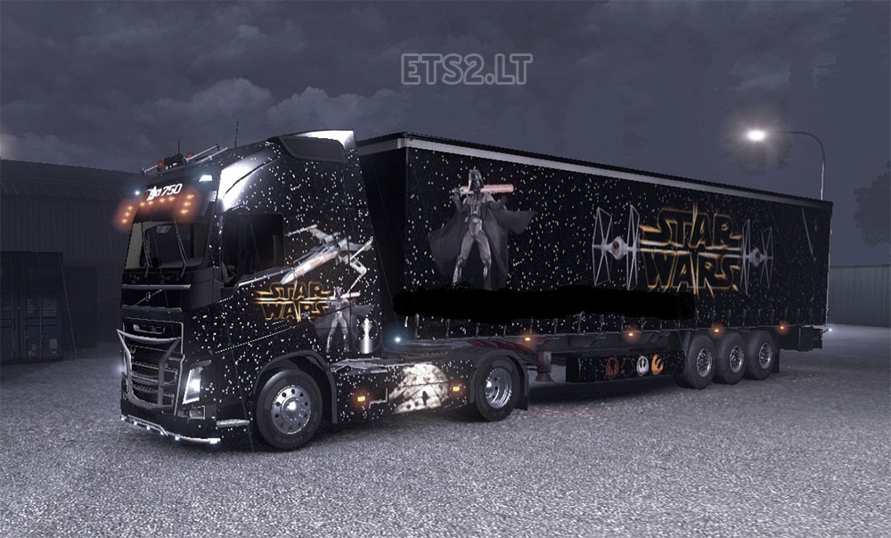
Questions?
Email:akomanduri@camsys.com

