Slide 1
Forecasting the Operational Impacts of Bus Rapid Transit Projects
A Survey of Current Practices
in North America
May 19, 2015

Slide 2
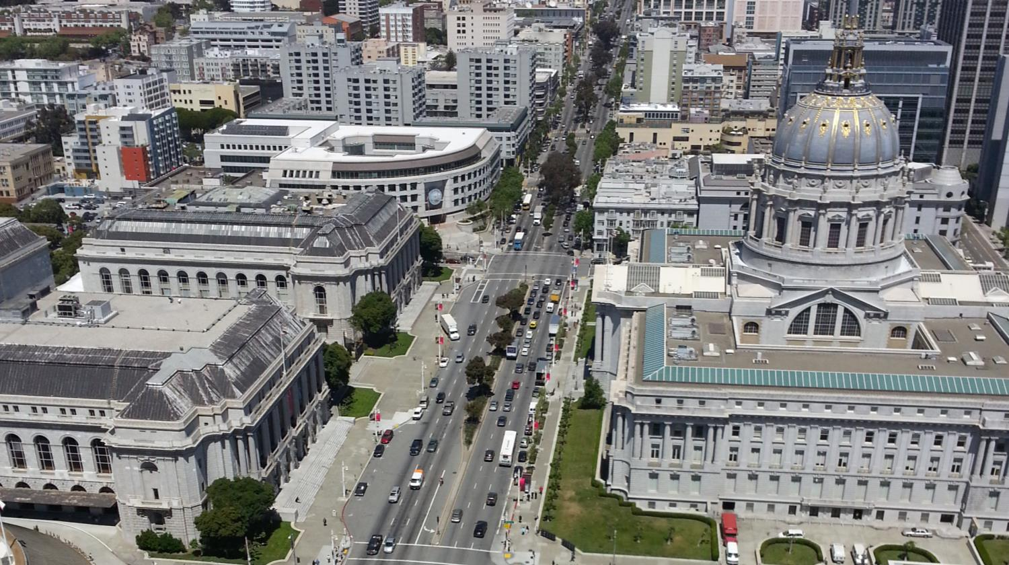
Bus service enhancement in San Francisco
Notes:
Here’s Van Ness Ave as it passes SF City Hall. Van Ness Ave is a key arterial and transit corridor in San Francisco. This will also be the location of San Francisco’s first bus rapid transit corridor.

Slide 3
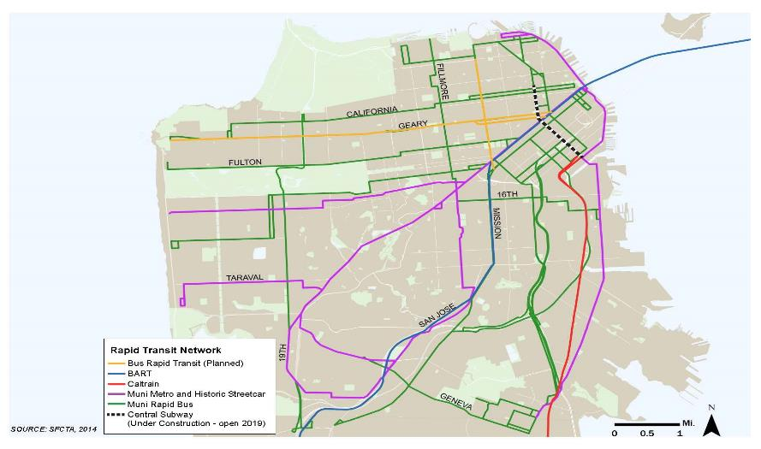
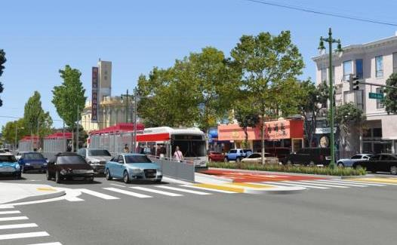
Bus service enhancement in San Francisco
Future bus rapid transit corridors
Van Ness Ave
Geary Blvd
Geneva Ave
16th St
Muni Forward
Notes:
But Van Ness is not the only BRT corridor under development. Three others are in some stage of planning.
The first two projects are far enough along to say that they will include dedicated lanes, low floor buses, all-door boarding, quality stations, frequent service, signal priority, real time bus arrival info. In both cases bus lanes were assumed, but alternatives analysis considered alignments with side lane (in current right-most lane adjacent to on-street parking) bus lanes and center-running bus lanes. In general, side-running lanes would be cheaper to implement, but center-running lanes are perceived to have better travel time benefits. Given these trade-offs a key concern in project analysis has been to understand relative travel time savings of different possible design elements.

Slide 4
BRT project planning Considerations
Considerations
Cost
Ridership
Stakeholders
Traffic and parking impacts
Environmental
Fleet management
Economic development
Travel time
Reliability
Notes:
In the real world planning process, a broad variety issues are considered in project alternative definition. But travel time and reliability stand out in importance. 1. they directly influence other measures of success such as ridership, and 2. they form the basis of the benefits on which other trade-offs are made. They are also difficult to understand. Whereas we know a fleet with mixed vehicle types is harder to manage than single vehicle fleet and that a business that is concerned about parking will prefer more parking.

Slide 5
BRT project planning Purpose and needs
“Existing transit service” … “is unreliable, slow, and crowded, and is in need of improvement in order to promote high ridership and competitiveness with other travel modes.”
Speed and reliability are key objectives
Notes:
This is an excerpt from one of our official purpose and need statements for a BRT corridor in San Francisco. The speed and reliability is of transit service is a key concern in addition to others.

Slide 6
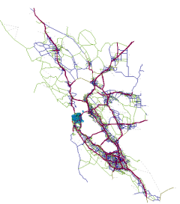
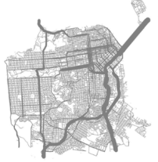
San Francisco CTA BRT modeling framework
Land
Use
Transportation
System
Ridership forecasts
ABM w/ Static
Assignment (CHAMP)
Bus travel time
Auto Demand in Subarea
Dynamic Assignment
Model (Dynameq)
Intersection
Volumes
Roadway Performance
Auto
Demand
Bus travel time
Analytical Traffic
Assessment (Synchro)
Transit &
Non Motorized
Demand
Microsimulation
(VISSIM)
Roadway Performance
Transit Performance
Bus travel time
Notes:
This is the approach we have used in planning and environmental review for our more advanced BRT projects. Used for traffic impacts, ridership projections, and to develop estimates of bus run times and reliability changes. It is a fairly intensive process. Requires a lot of input data, a lot of model validation and calibration. And in practice required a lot of intermediate adjustments, post-processing, and alternate tool development in order to work effectively.
Note, discuss where transit operations estimates come from.

Slide 7
Perceived modeling tradeoffs
 | Simulation | Alternate Approaches
Pros | Analysis detail Corridor specifics Interactive results | Simplicity Empirically derived
Cons | Higher cost More data needs Longer timeline Black box parameter creep Not everything that matters included | Hard to estimate interactive effects Applicability and range uncertainty
Notes:
Perceived trade-offs between complicated modeling structure and sketch planning methods, e.g. spreadsheet to calculate TT savings based on BRT features, etc.
Cons of simulation
- Parameterization decisions lead to different policy recommendations
Models don’t necessarily capture TT reliability, NMT behavior, signal priority in practice, vehicle violations, etc.
Cons of Sketch methods
How applic for local context? (compare w/ ITE trip gen, urban planners long frustrated by ITE trip gen rates derived from suburban examples being used to set urban policy)
5 to 30s TT savings per block! When is it 5, when is it 30?

Slide 8
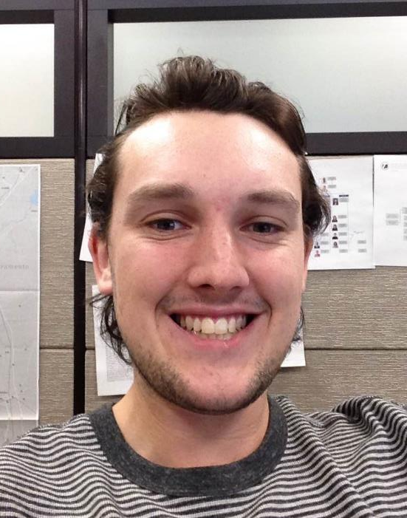
BRT modeling investigation Reconsidering SFCTA methodology
I’m going to:
Inventory US BRT systems
Review published guidance on BRT system planning
Research planning and forecasting of operations benefits
Interview planners at relevant agencies about transit operations forecasting
Assess effectiveness of “simpler” approaches
Alex Grant
Notes:
Here is the problem statement. Is it worth it for us to go through our extensive process. Could we achieve similarly effective forecasts of TT savings with quicker methods?
Here is our approach for this study

Slide 9
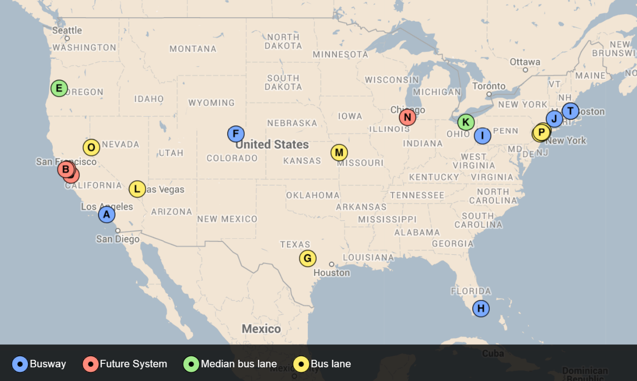
Bus rapid transit and bus priority Systems in the United States
Source: batchgeo.com
Notes:
Close to 20 implemented projects that could be considered BRT or BRT-light. Many more in planning, especially in regions that have already implemented systems.

Slide 10
Bus rapid transit and bus priority System features

Slide 11
Guidance Organizations
Transit Cooperative Research Program (TCRP)
Federal Transit Administration (FTA)
United States Department of Transportation (USDOT)
Center for Urban Transportation Research (CUTR)
National Bus Rapid Transit Institute (NBRTI)
EMBARQ
The Institute for Transportation and Development Policy (ITDP)

Slide 12
Guidance Documents
TCRP 90 V.2 (2003)
This report covers the main components of BRT and outlines the desirable conditions for implementation of a BRT system.
TCRP 118 (2007)
A practitioner’s guide that serves as a holistic approach to planning, designing and implementing a Bus Rapid Transit system.
FTA/USDOT: Characteristics of BRT for Decision Making (2009)
Contains basic information and data that supports the development and evaluation of BRT systems.
ITDP: Bus Rapid Transit Planning Guide (2007)
Comprehensive guide for planning, designing and implementing a BRT system.
EMBARQ: Social, Environmental and Economic Impacts of BRT Systems (2013)
Synthesizes information regarding costs and impacts and aims to contribute new evidence from case studies.
Notes:
Here is our approach for this study

Slide 13
Guidance Example – TCRP 118 on running ways
Notes:
Here is our approach for this study

Slide 14
BRT modeling elsewhere What have others done?
Traffic operational
Regional travel demand model
Synchro, VISSIM
Ridership
Regional travel demand model, STOPS
Spreadsheet-based calculations, elasticities
Transit operational
Detailed analysis of existing travel time
Spreadsheet-based calculations (simulation highly uncommon)
Avoided publicly announced expectation
Used experience from previous corridors

Slide 15
U.S. BRT systems Forecasted run time performance
Bus Run Time (min)

Slide 16
U.S. BRT systems Actual run time performance
Bus Run Time (min)

Slide 17
U.S. BRT systems Travel time reduction

Slide 18
U.S. BRT systems Simplified run time estimation

Slide 19
San Francisco BRT scenarios Simulated travel times

Slide 20
San Francisco BRT scenarios Run time comparison

Slide 21
What next? Do we change anything?
For current projects
Build some bus rapid transit
Several SF Bay Area projects opening 2015-2020
Document performance and assess forecasting success
For future projects
Seriously consider alternatives to simulation
Try multiple methods and cross validate estimates

Slide 22
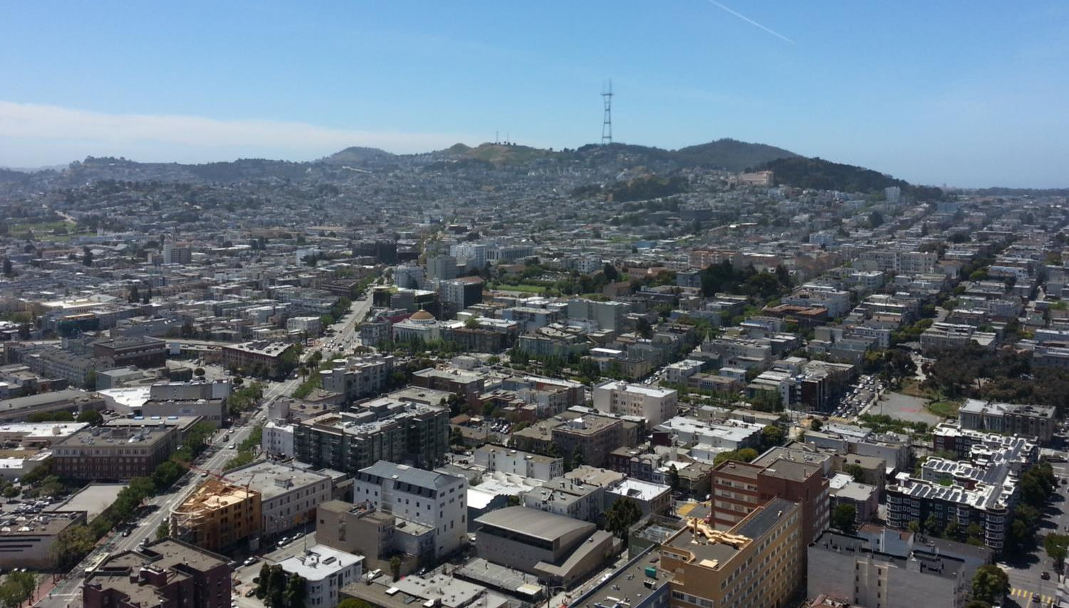
The End Almost

Slide 23
Words of wisdom Lessons from BRT implementers
Understand your delay
Every corridor is different
Features, designs, treatments only effective if they address existing causes of delay
(While not adding new sources of delay)
Avoid overpromising in the face of uncertainty
Lots of unknowns
Regardless of forecasting, won’t know until buses on ground
Specific TT savings not important if customer is happy
In some cases, travel time savings failed to meet expectations,
But ridership exceeded forecasts
If the ride feels fast and customers are happy → success

Slide 24
Words of wisdom Lessons from BRT implementers
Need proof of concept
Some cities started with less controversial corridor
Many cities with BRT are working on new corridors
Coalition building
BRT meant to be cheaper and faster, but still challenging to implement
Need coalition of support including community, politicians, businesses, etc.

Slide 25
Thank you. Dan Tischler dan.tischler@sfcta.org

