Slide 1
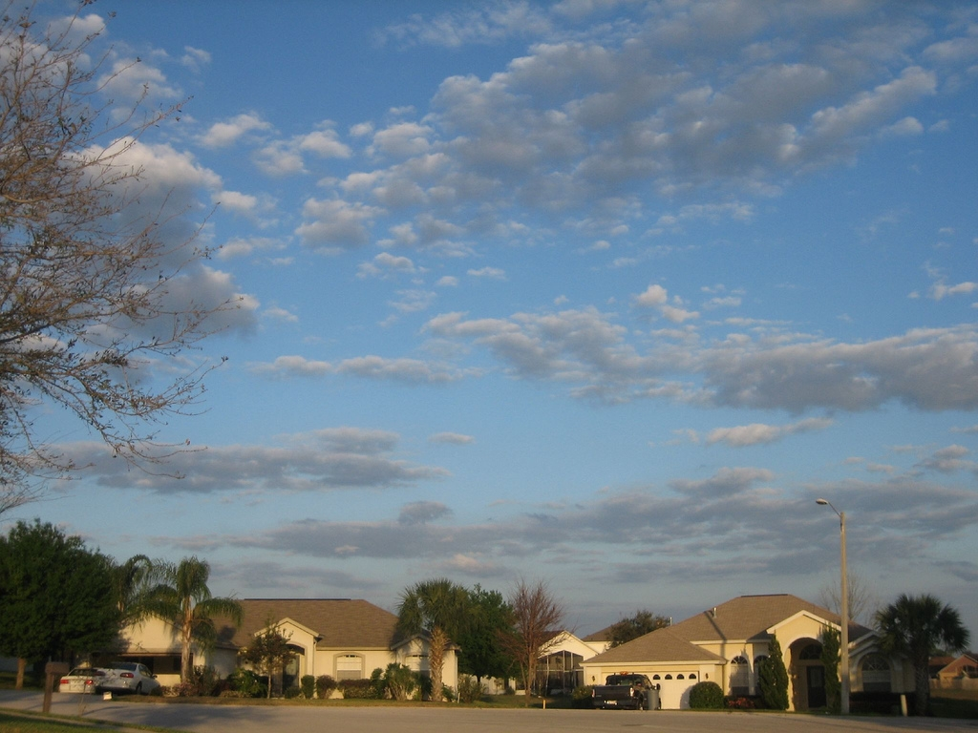
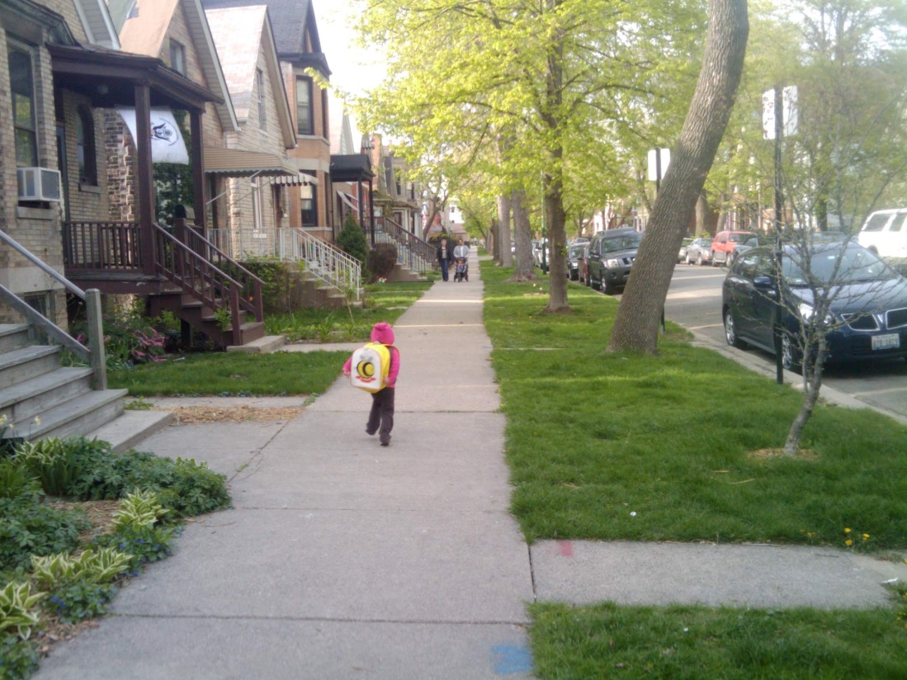
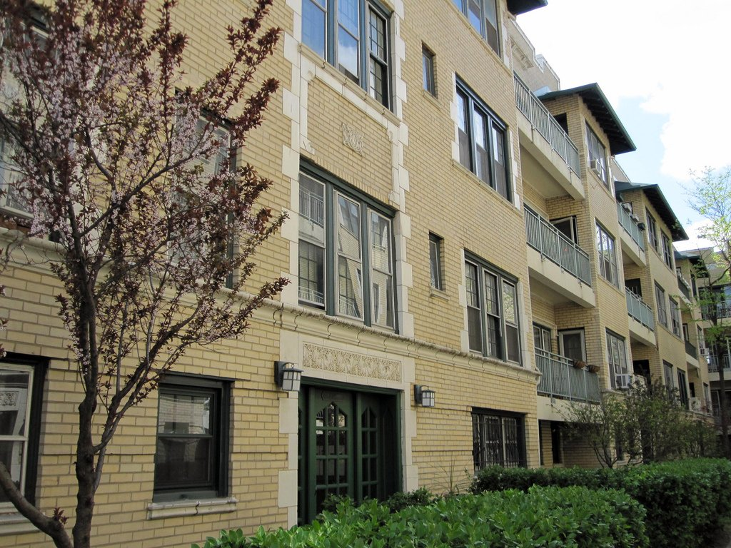
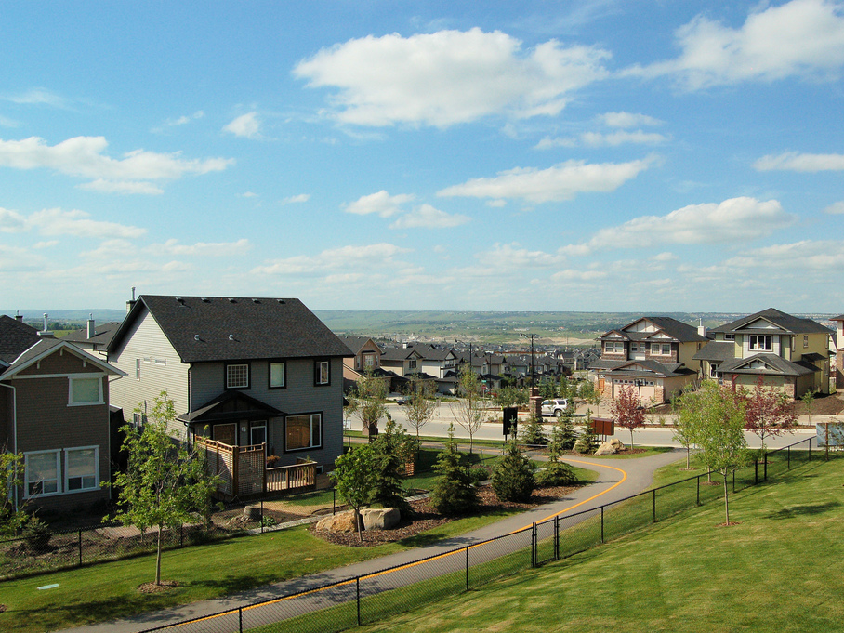

Neighborhood Location Efficiency and Household Transportation Costs
The 15th TRB National Transportation Planning Applications Conference
Innovative Tools in Transportation and Land Use Planning
May 18, 2015 – Atlantic City, NJ
Peter Haas, Ph.D. – Chief Research Scientist, Center for Neighborhood Technology

Slide 2


ABOUT CNT
    CNT is a national hub for research, strategies and solutions to help cities use resources more efficiently and equitably.
    We believe solving problems like poverty, climate change and urban sprawl starts with making neighborhoods, cities and regions work better.
Notes:
Transparent charcoal box = RGB 38/38/38 @ 12% transparency
Title and Bullets = RGB 242/242/242
Title = Tw Cen MT size 44; all caps
Bullets = Tw Cen MT size 24
Text box (title) = .84” x 8.5”
Horizontal distance from top left corner = .75”
Vertical distance from top left corner = 2.3”
Text box (bullets) = 2.7” x 8.5”
Horizontal distance from top left corner = .75”
Vertical distance from top left corner = 3.14”

Slide 3
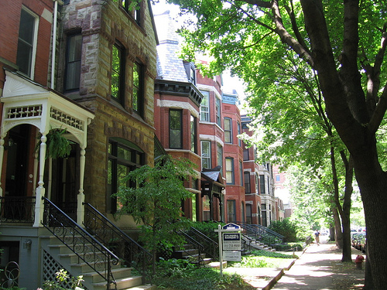
TRANSPORTATION IS A HOUSEHOLD’S SECOND-LARGEST EXPENSE AFTER HOUSING
Photo Credit: straightedge217/Flickr, Creative Commons License
Notes:
Transparent charcoal box = RGB 38/38/38 @ 12% transparency
Title = RGB 242/242/242; Tw Cen MT size 44; all caps
Text box (title) = 1.68” x 8”
Horizontal distance from top left corner = .92”
Vertical distance from top left corner = 2.49”

Slide 4

TRANSPORTATION COSTS DEPEND ON PLACE
Photo Credit: Ann Fisher/Flickr, Creative Commons License
Notes:
Transparent charcoal box = RGB 38/38/38 @ 12% transparency
Title = RGB 242/242/242; Tw Cen MT size 44; all caps
Text box (title) = 1.68” x 8”
Horizontal distance from top left corner = .92”
Vertical distance from top left corner = 2.49”

Slide 5
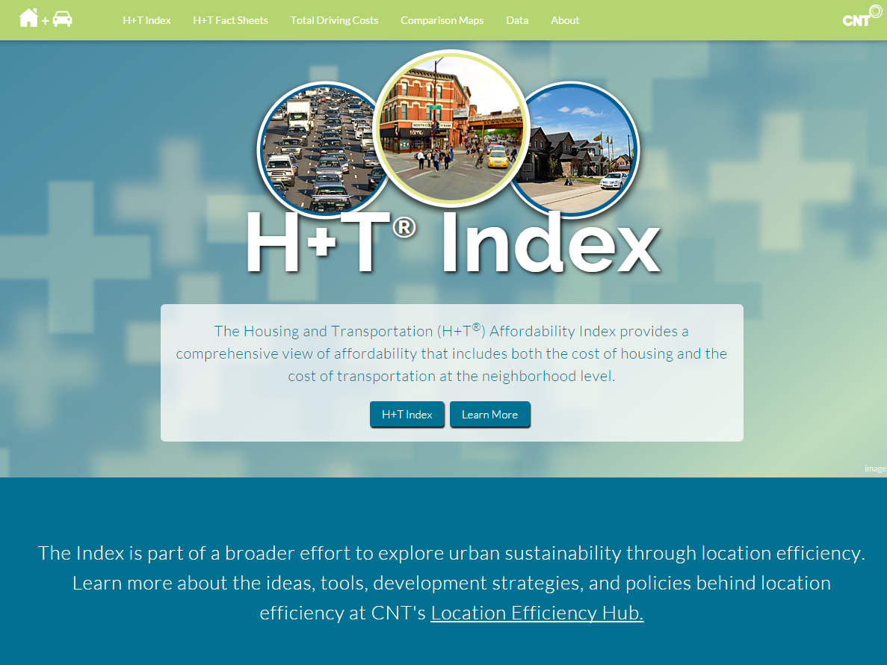

Notes:
Steven Vance

Slide 6
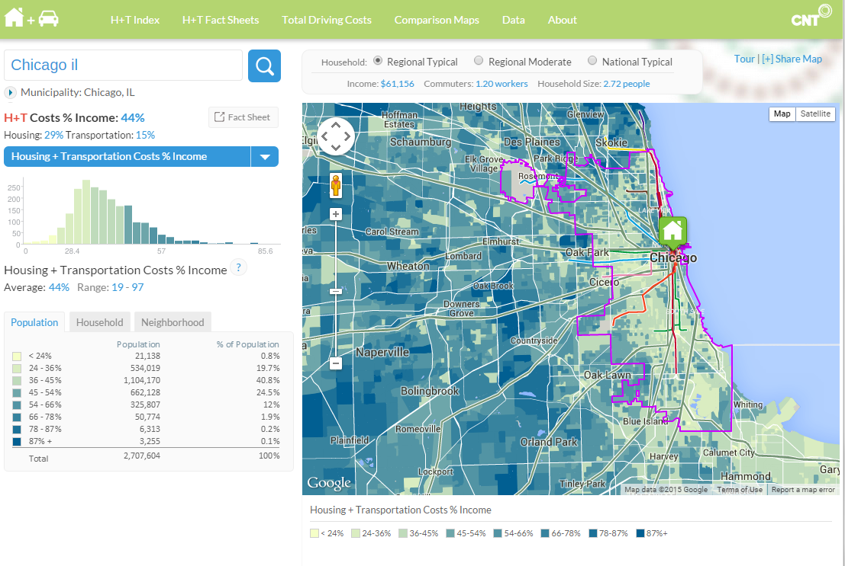
Notes:
Steven Vance

Slide 7
Household Transportation Cost Model
Households know their housing costs;
An accurate estimation of household transportation costs related to a household location is elusive;
Therefore CNT created a household transportation cost model.
It is:
An aggregate place based model.
Based on US Census Block Groups as its unit of analysis.
Estimating the cost of all driving, and transit.
Predictive model to be used for the H+T Index.
National in scope for all metropolitan and micropolitan areas.
It is not:
A travel demand model.
Derived from travel survey data.
A journey to work model.
Necessarily a parsimonious model.
A rural cost model.
Notes:
Steven Vance

Slide 8
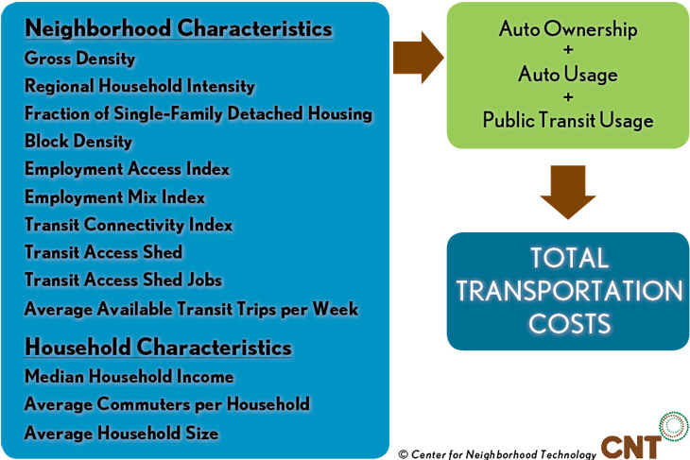
Household Transportation Cost Model
Notes:
Steven Vance

Slide 9
Dependent Variables
Auto Ownership
2013 ACS
Average vehicles per occupied housing unit (HH)
Transit Use
No ubiquitous measure of transit use is available at the block group level,
As proxy, the percent of commuters utilizing public transit as means of transportation to work.
Notes:
Steven Vance

Slide 10
Dependent Variables (Continued)
Auto Use
Odometer readings from 2010 through 2012 odometer readings were acquired in Illinois for the Chicago and St. Louis metro areas.
Data were matched for over 660,000 records (two records for each individual vehicle identification number (VIN)) and the change provided VMT estimates.
The dataset represents a diverse set of place types from rural areas to large cities, and provides a very good data set to calibrate the model.
Data obtained were geographically identified with ZIP+4TM and then assigned to Census block groups.
The final value of VMT includes an additional factor of eight percent to compensate for the fact that the vehicles in this sample were all five years old or older.
Notes:
Steven Vance

Slide 11
Independent Variables – Household
Variable | Description | Data Source | Type
Median HH Income | Median household Income in the block group | 2013 ACS | Household
Commuters/HH | Workers per household who do not work at home | 2013 ACS | Household
Avg. HH Size | Average number of people per household | 2013 ACS | Household
Notes:
Steven Vance

Slide 12
Independent Variables – Neighborhood
Variable | Description | Data Source | Type
Gross Household Density | Number of households divided by the land area in the Census block group | 2013 ACS, TIGER/Line files | Neighborhood Characteristic (housing density)
Regional Household Intensity | Households summed divided by the distance squared in miles between block group by (the households in the block group are not included) | 2013 ACS, TIGER/Line files | Neighborhood Characteristic (housing density)
Fraction of Single Family Detached Housing | Fraction of single family detached households in the block group | 2013 ACS, TIGER/Line files | Neighborhood Characteristic (housing density)
Employment Access Index | Jobs summed by blocks divided by the distance squared in miles (if less than one mile not scaled) | Census LEHD-LODES | Neighborhood Characteristic (employment)
Employment Mix Index | Number of block per acre Weighted sum of 13 different employment types each scaled by a coefficient that are optimized using transit use | Census LEHD-LODES | Neighborhood Characteristic (employment)
Block Density | Number of block per acre | TIGER/Line files | Neighborhood Characteristic (walkability)
Transit Connectivity Index | Sum of buses/trains per week scaled by overlap of 1/8 mile rings about every stop that intersects the block group | CNT AllTransit | Neighborhood Characteristic (transit)
Average Available Transit Trips per Week | Number of possible transit rides within the block group and a ¼ mile of its border. | CNT AllTransit | Neighborhood Characteristic (transit)
Transit Access Shed | Total area that transit riders from the block group can access in 30 minutes with 1 or no transfers for all the transit stations within a ¼ mile of the block group | CNT AllTransit | Neighborhood Characteristic (transit)
TAS Jobs | The total number of jobs in the TAS area | CNT AllTransit | Neighborhood Characteristic (transit)
Notes:
Steven Vance

Slide 13
Costs
Auto ownership and use costs:
Derived from research conducted by HUD and DOT using the Consumer Expenditure Survey (CES) from the US Bureau of Labor Statistics.
The research is based on the 2005-2010 waves of the CES, and costs are estimated for autos up to ten years old.
Because expenditures are represented in inflation-adjusted 2010 dollars using the Consumer Price Index for all Urban
The factor used is derived from the CES; the average expenditure in 2010 is $2,588 and in 2013 it is $3,271, thus the factor applied is 1.26.
Expenses are then segmented by five ranges of household income ($0-$20,000; $20,000-$40,000; $40,000-$60,000; $60,000-$100,000; and, $100,000 and above)
Notes:
Steven Vance

Slide 14
Costs
Transit use costs:
From The 2013 National Transit Database (NTD) – directly operated and purchased transportation revenue were used.
The transit revenue, as reported by each of the transit agencies, to related geographies where GTFS data were collected; revenue was allocated to the counties served based on the percentage of each transit agency’s bus and rail stations weighted by the number of trips provided within each county served.
Each county’s estimated transit revenue was assigned to block groups on the basis of molded percent transit journey to work and the total households.
Notes:
Steven Vance

Slide 15
Household Transportation Cost Model
Notes:
Steven Vance

Slide 16
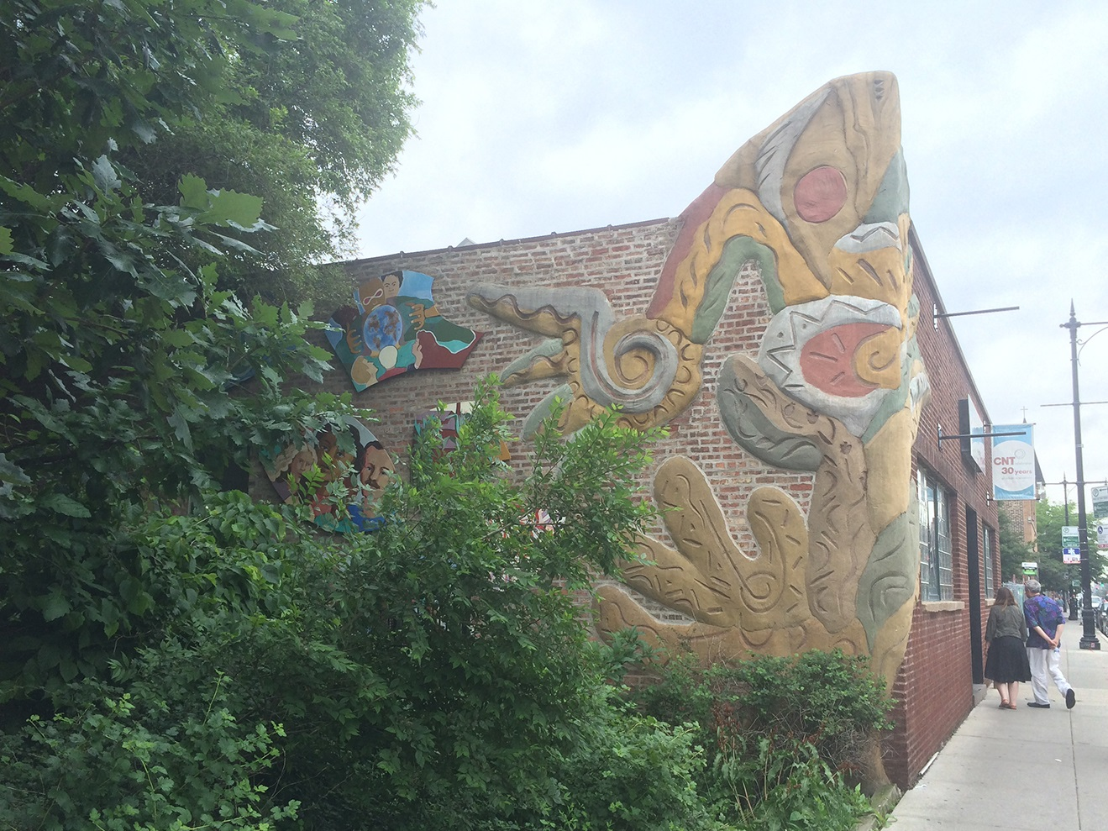
THANK YOU
Peter Haas
pmh@cnt.org | Twitter:@pmh_cnt
www.cnt.org
Twitter:@CNT_tweets | Facebook:CenterforNeighborhoodTechnology

