Slide 1
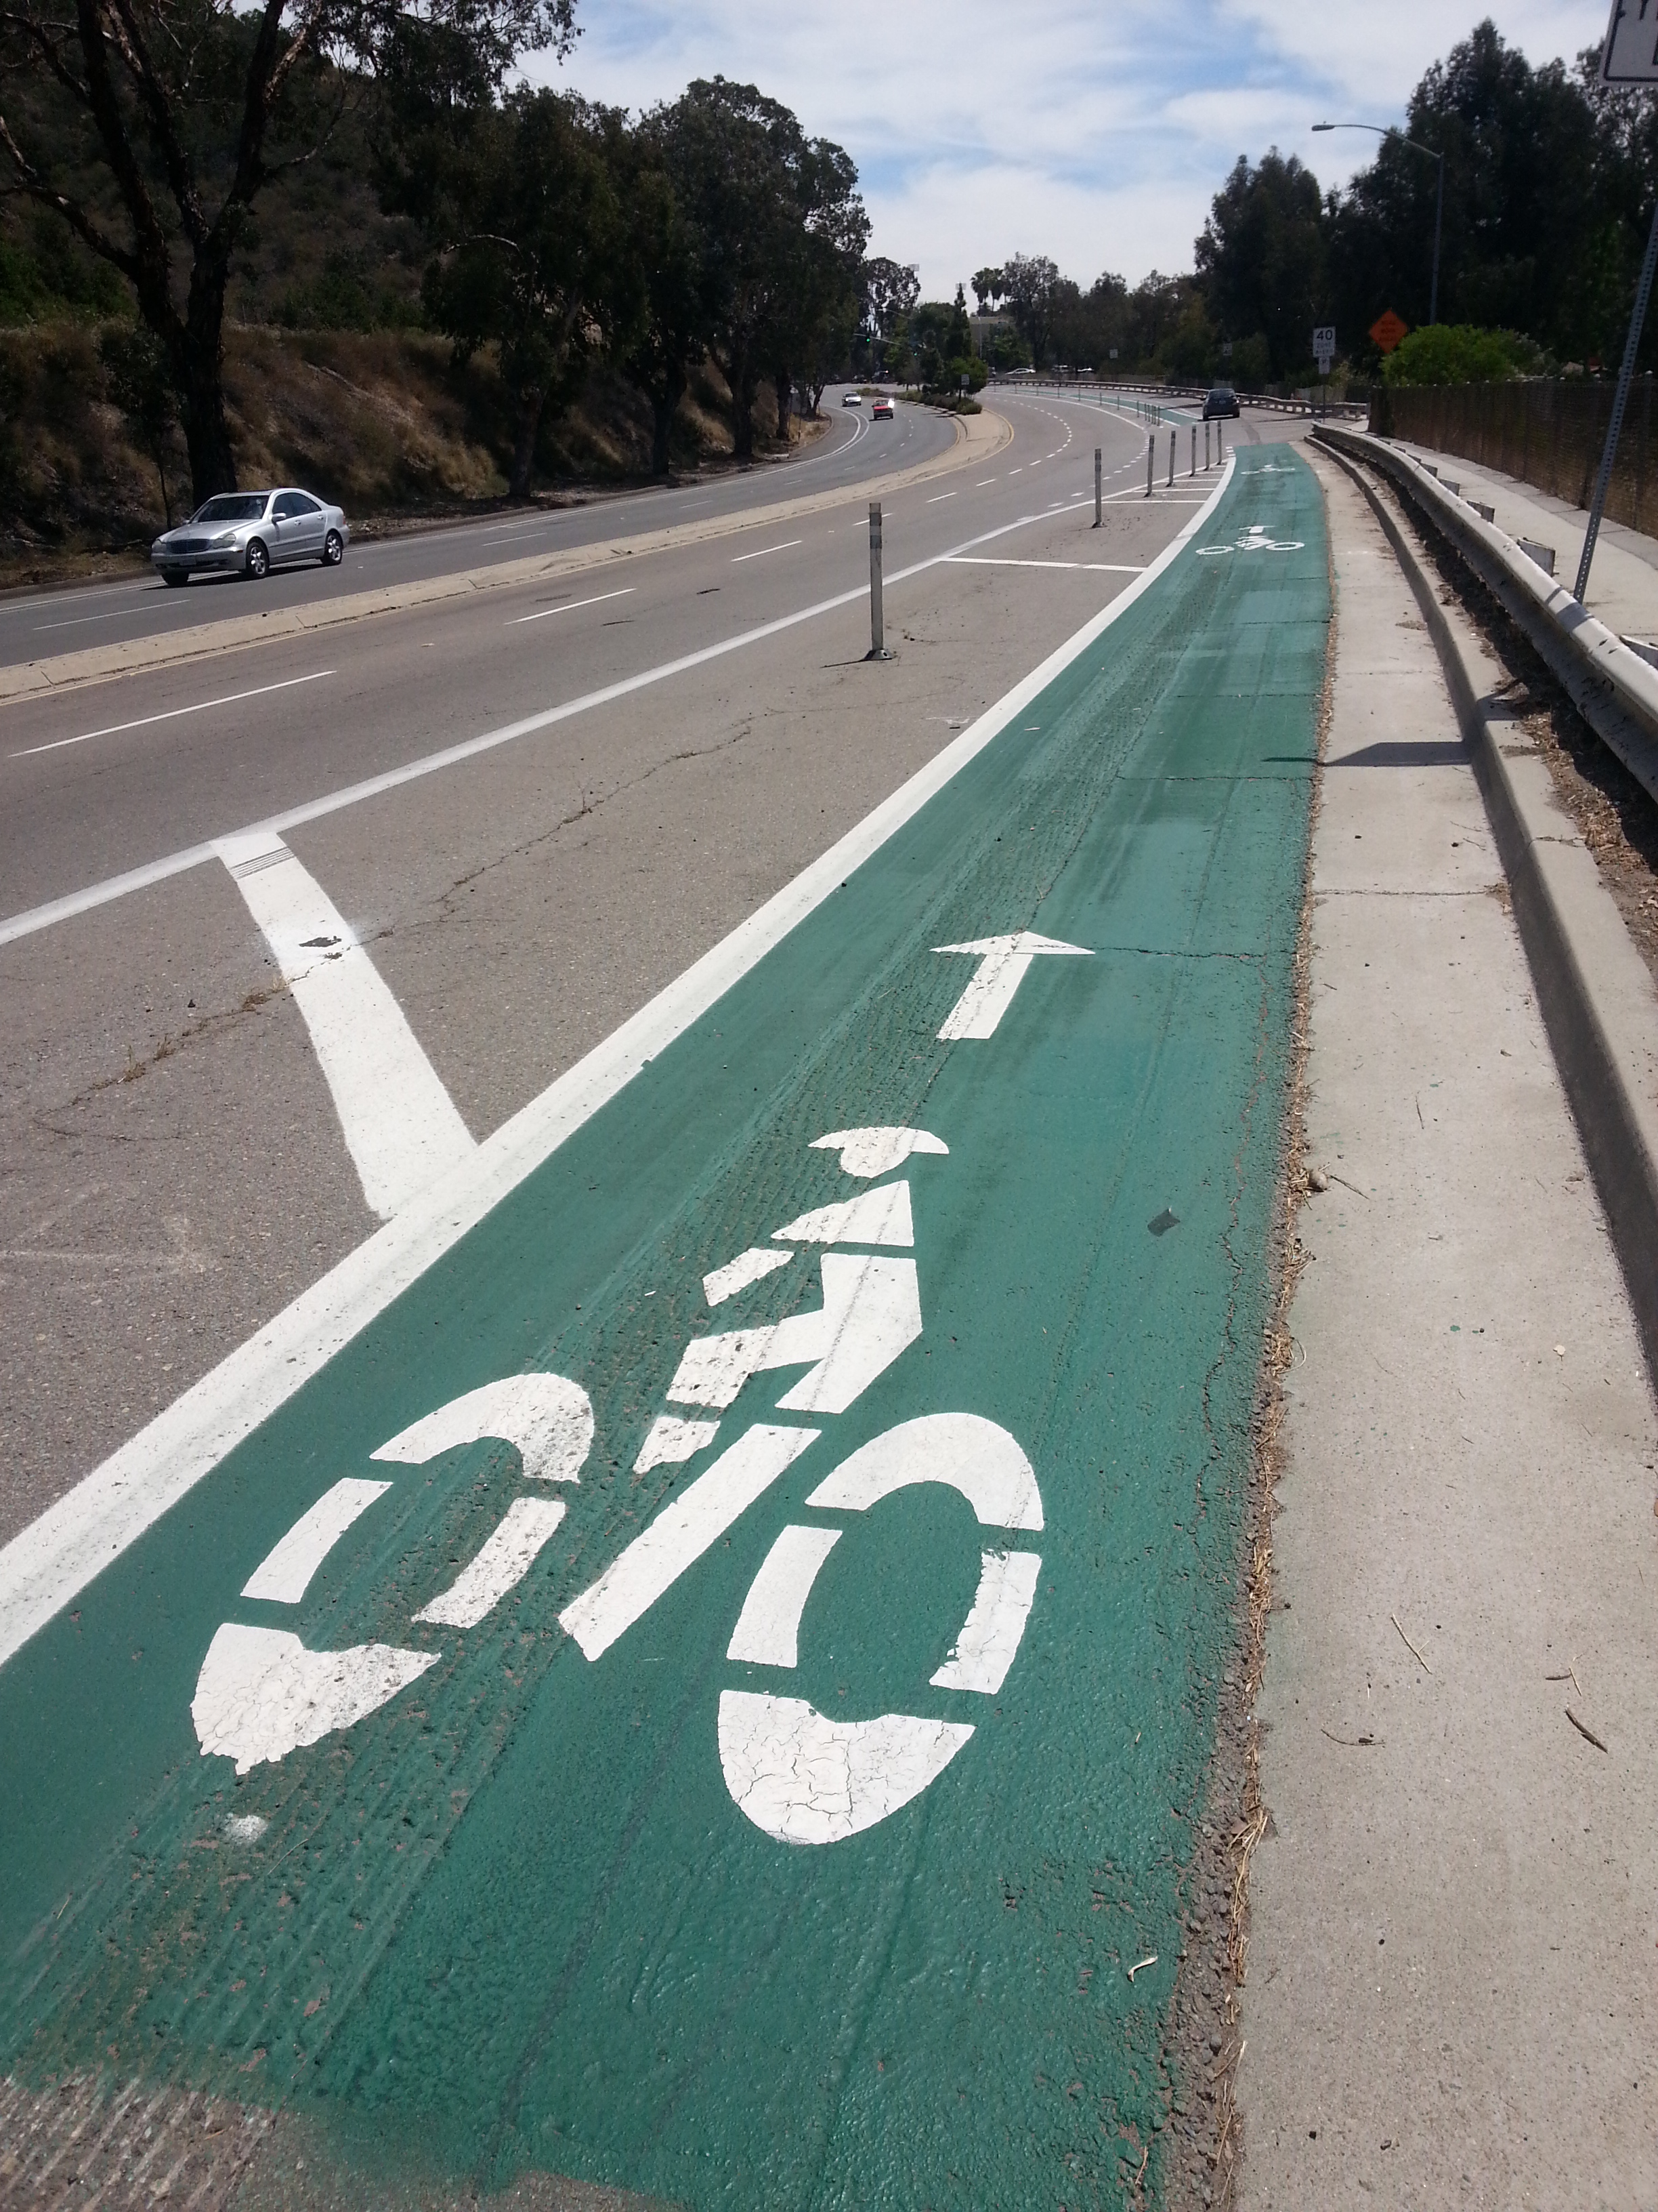
Identifying Bicycle Trips in Routine Travel GPS Data:
Are Accelerometers Necessary?
Dara Seidl
Statistical GIS Analyst
May 18, 2015
TRB Applications Conference

Slide 2

Introduction
Experienced survey, opinion, policy research firm
Transportation, health, public policy, environment
In-house GIS department
Data collection & analysis in household travel research
GPS Travel Survey Considerations
Lower respondent burden and higher trip capture
GPS data processing challenges
Imputation of mode, trip purpose
Horizon of smartphone GPS, accelerometer

Slide 3
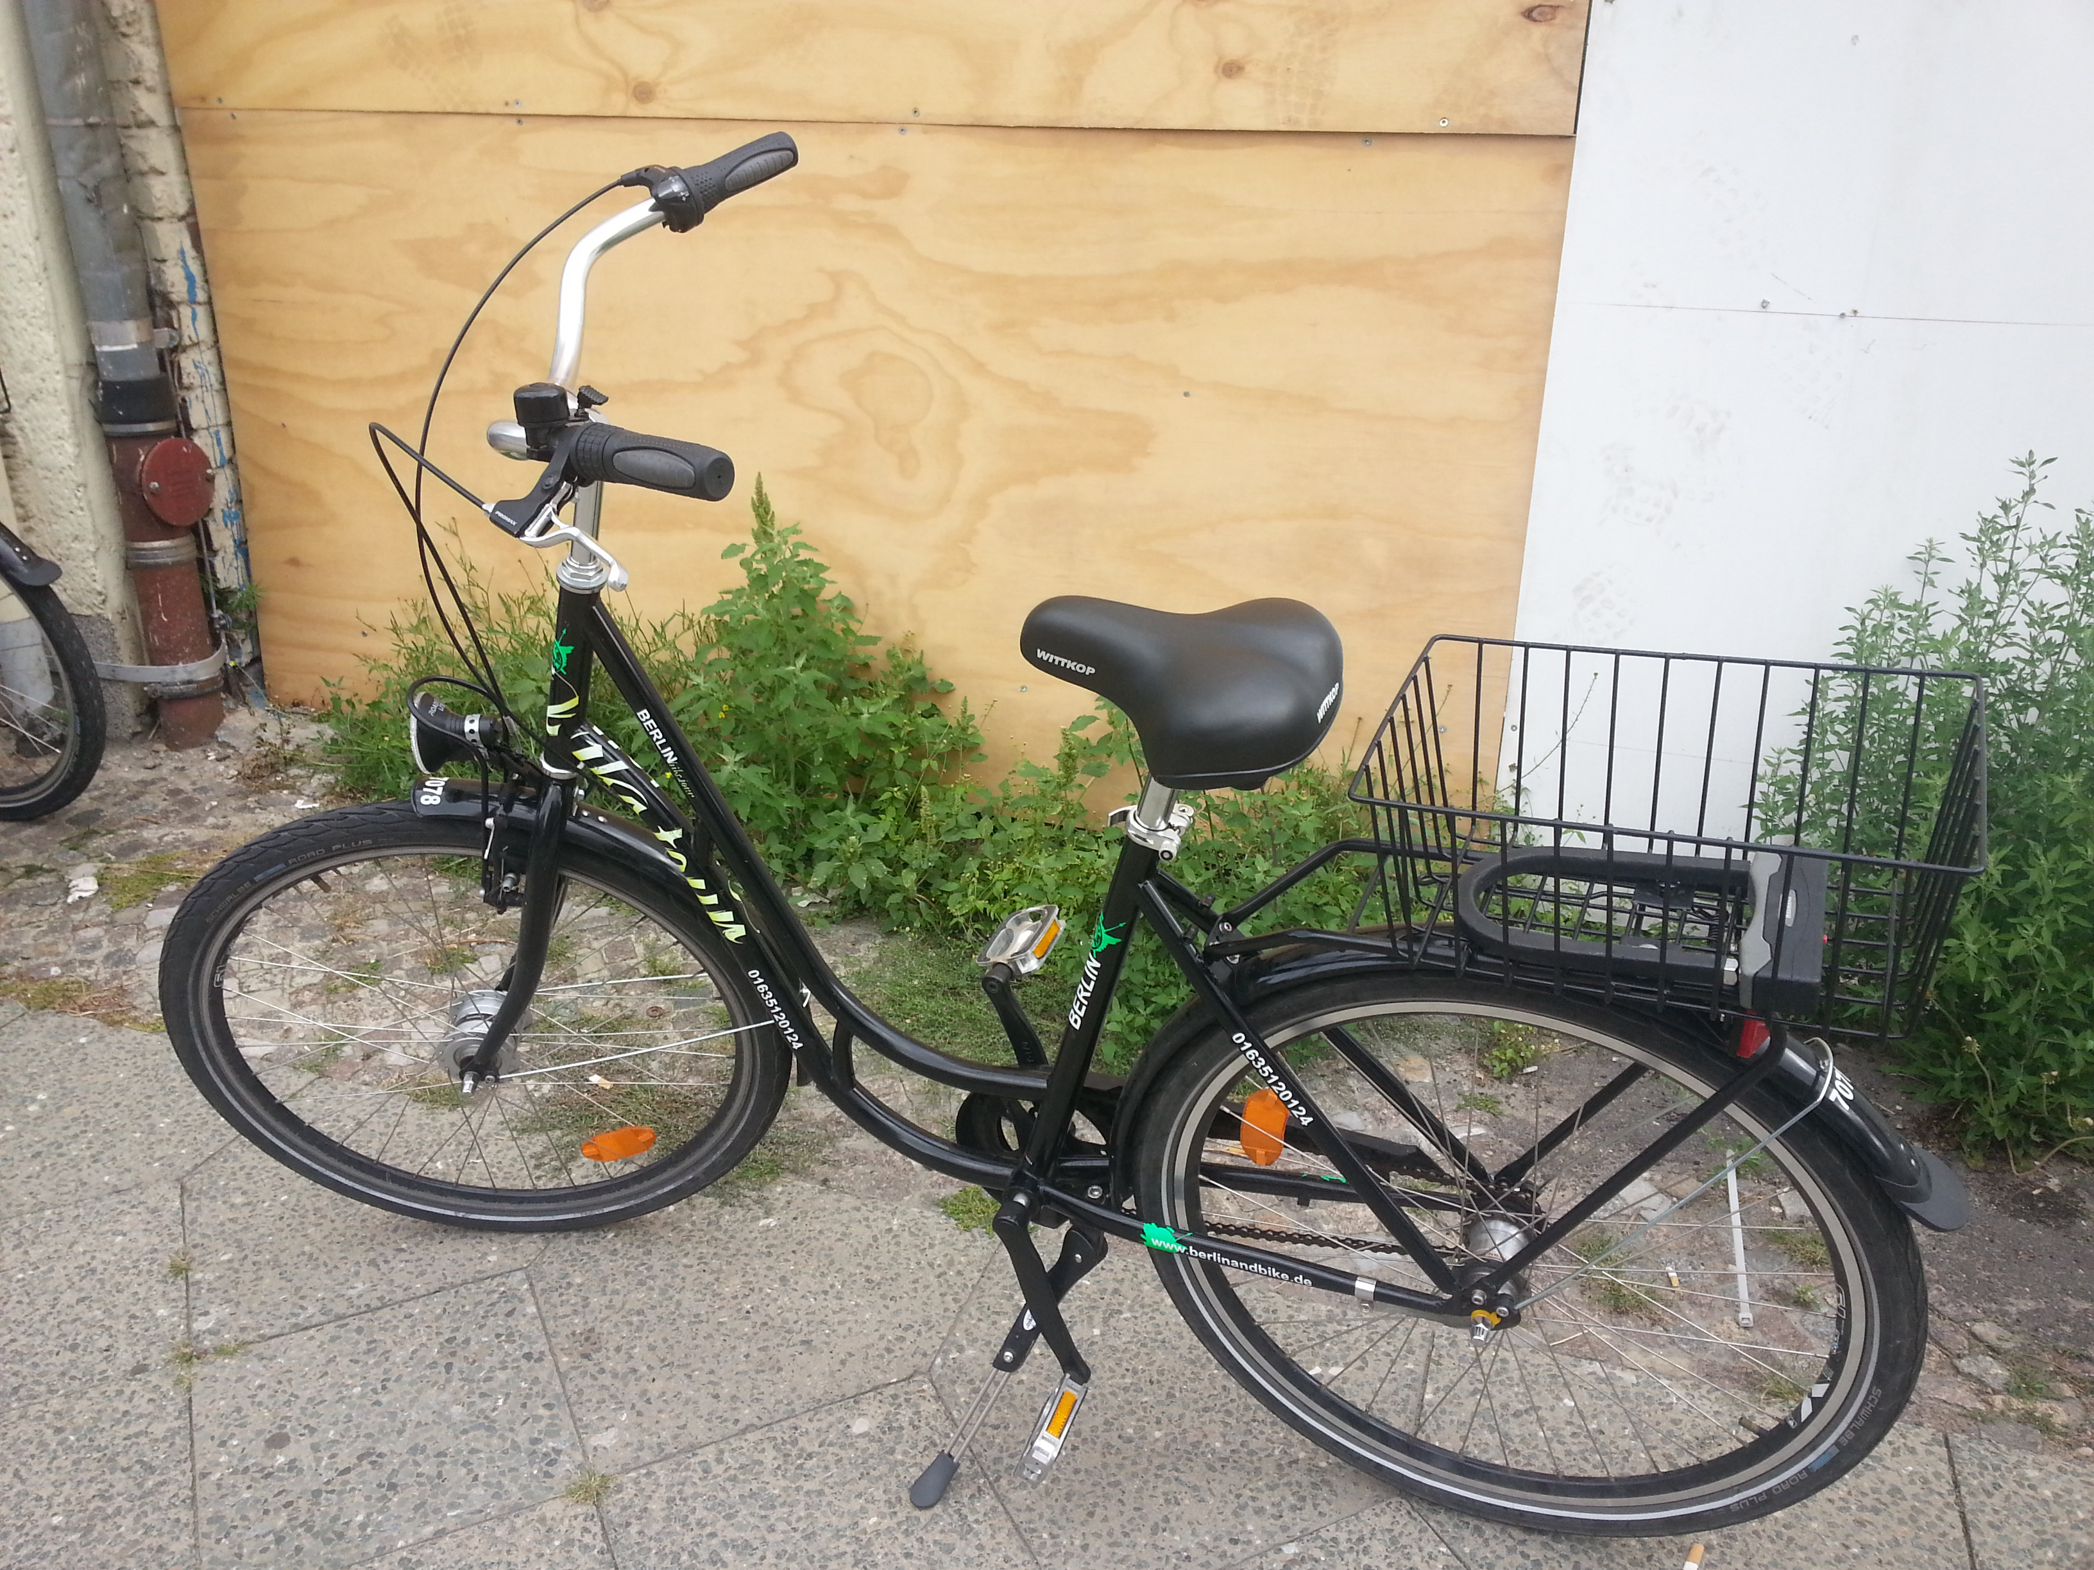
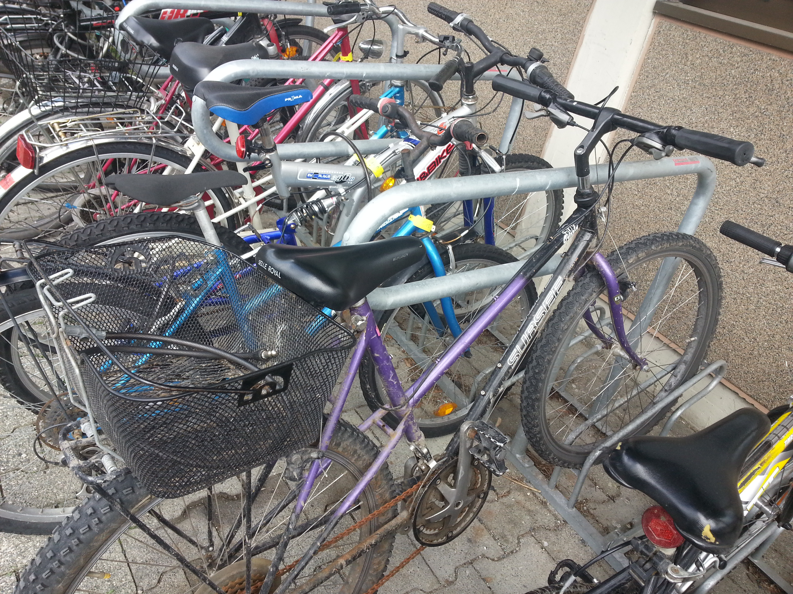
Central Questions
How can GPS trip characteristics be used to classify travel mode? (Part I)
What utility does accelerometer data provide in determining travel mode? (Part II)

Slide 4
Background
Interest in Accelerometers
Implementation Issues
Measure physical activity
Uses in health travel research
Combine transportation and health data collection (NCHRP 2013)
Lower respondent burden
Mode identification in non-motorized travel (Oliviera et al. 2006)
Cost of additional device
Integration of data sets
If using smartphone:
  Background data logging
  Disruption of picking up phone
  Variations between phones and apps
User fatigue

Slide 5
Accelerometer Data by Mode
5-second samples captured by Android smartphone
X
Y
Z

Slide 6
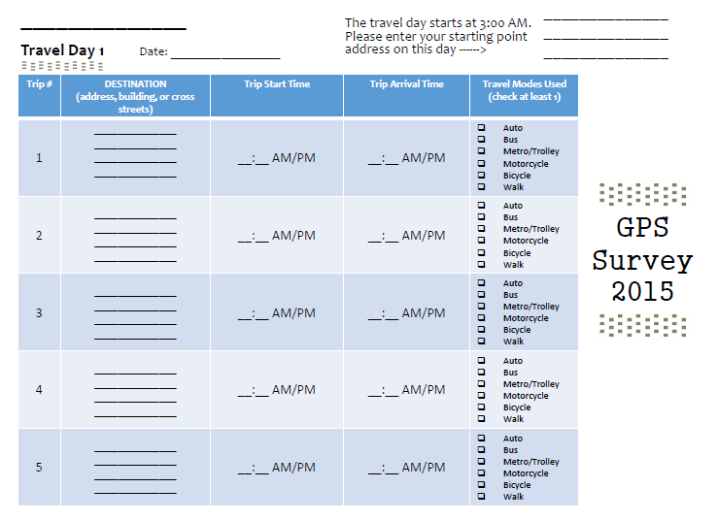
Survey Instruments
GPS Data Logger

Slide 7
Methods Overview
Collect GPS and Diary Travel Data
Process Into Trips
Divide to 120-Second Segments
Identify Mode for Reference Segments
Random Forest Classification
Evaluate Mode Classification

Slide 8
Data Characteristics
Participants
Trips
Number
6 Total
Geography
5 San Diego
1 Chicago
Age
Range: 24-30
Mean: 26
Number
92 trips
Duration
65 sec – 58 min
Length
0.1—12 miles
15.3/participant
Mean: 13 min
Mean: 2.6 miles

Slide 9
Segment Characteristics
Following trip processing, confirmed trips divided into 120-second segments
543 segments
90 segments per participant

Slide 10
Segment Variables
Maximum Speed
Mean Speed
Mean Heading Change
0-Speed Frequency
Seconds of Rest at Bus Stop

Slide 11
Segment Variables
Maximum Speed
Mean Speed
Mean Heading Change
0-Speed Frequency
Seconds of Rest at Bus Stop

Slide 12
Segment Variables
Maximum Speed
Mean Speed
Mean Heading Change
0-Speed Frequency
Seconds of Rest at Bus Stop

Slide 13
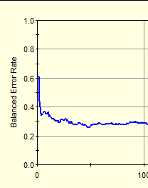
Random Forest Classification
Machine learning algorithm
Grows many decision trees
Uses bagging to prevent overfitting
Reports most useful predictors
Success in travel mode classification (Stenneth et al. 2011; Ellis et al. 2014)

Slide 14

Classification Results

Slide 15
Segment Prediction Success
Actual Class | Total Class | Percent Correct | Auto N = 113 | Bicycle N = 189 | Bus N = 98 | Walk N = 140
Auto | 148.00 | 58.11% | 86.00 | 7.00 | 52.00 | 3.00
Bicycle | 219.00 | 80.82% | 14.00 | 177.00 | 23.00 | 5.00
Bus | 38.00 | 55.26% | 12.00 | 4.00 | 21.00 | 1.00
Walk | 135.00 | 97.04% | 1.00 | 1.00 | 2.00 | 131.00
Total: | 540.00
Average: |  | 72.81%
Overall % Correct: |  | 76.85%

Slide 16
Variable Importance

Slide 17
Top Variables by Travel Mode

Slide 18
Bigger Picture
Classification considers small 120s segments, rather than full trip characteristics
Considering micro- and macro-view of trips in tandem may produce better results
Even if segment is misclassified, multiple segments per trip can produce better estimates of overall trip modes
Bicycle
Bicycle
Bicycle
Auto
Bicycle
Bicycle
Trip 7
Bicycle

Slide 19
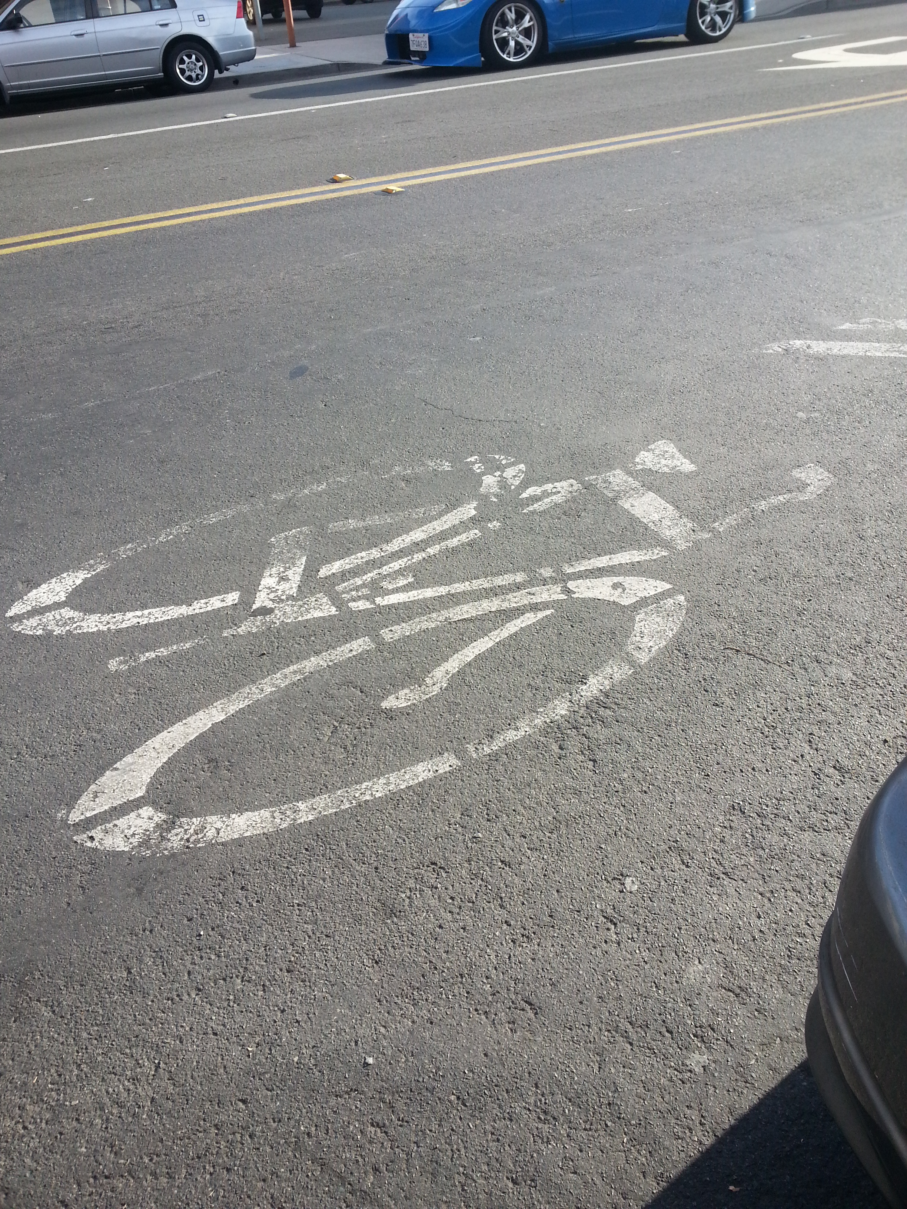
Conclusions
Mode classification by 120 s captures typically under-represented multimodal trips (Clifton and Muhs 2011)
Overall 77% accuracy in segment mode prediction, 81% for bicycle
Random forest classification performs relatively better for non-motorized travel modes
Including accelerometer data as a classifying variable is Part II of this study…coming soon

Slide 20

Questions?
Dara Seidl
Statistical GIS Analyst
d.seidl@srbi.com
Timothy Michalowski
Senior Statistical GIS Analyst
t.michalowski@srbi.com

Slide 21
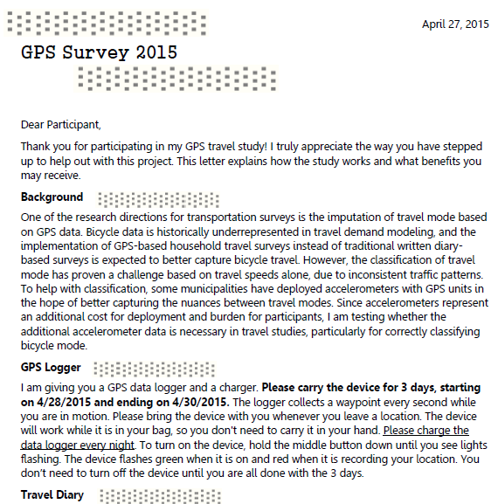

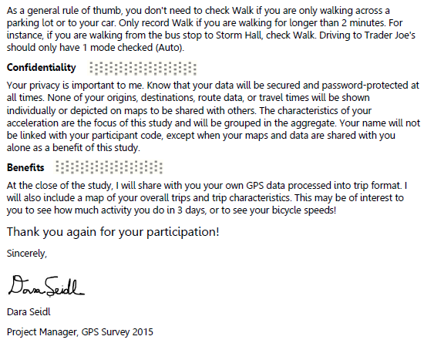
Letter to Participants

