Slide 1
Sample Expansion for Transit Rider Surveys
Experiments with Two Rail Systems

Slide 2
Motivations
FTA requirements for rider surveys
Model validation for major-project forecasting
“Before” and “After” rider surveys for projects
Frequently asked questions:
What is best practice for sample expansion?
Are special on-to-off “surveys” worth the effort?

Slide 3
Motivations (continued)
Sample expansion
Computed weight for each survey record:
actual trips in the cell
Weight = ------------------------------------------------
useable survey records in the cell
Where the cell is an element of the sampling frame
By route
By route, direction, and time of day (TOD)
By route, TOD, direction, and boarding stop
By route, TOD, and on-to-off (or entry-to-exit) locations

Slide 4
Experimental design
Find rider surveys for which station-to-station trip flows are known from fare-gate data
Compare accuracy of survey records expanded:
To entry-station counts
To entry-station to exit-station flows estimated through matrix filling with:
Seed matrix = 1.0 for all cells
Seed matrix = tabulated survey records
Seed matrix = N% sample of fare-gate records

Slide 5
Survey datasets
Washington DC Metrorail system (2008)
58,100 records from 750,400 daily entries (7.7%)
Paper survey forms with self enumeration
After-the-fact tabulation of the data
Atlanta GA rail system (2009/2010)
22,900 records from 195,500 daily entries (11.7%)
Personal interviews with tablets
Active sample monitoring and deficit repairs

Slide 6
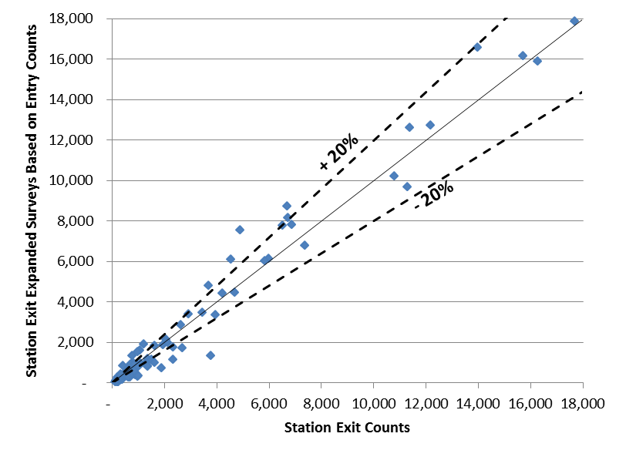
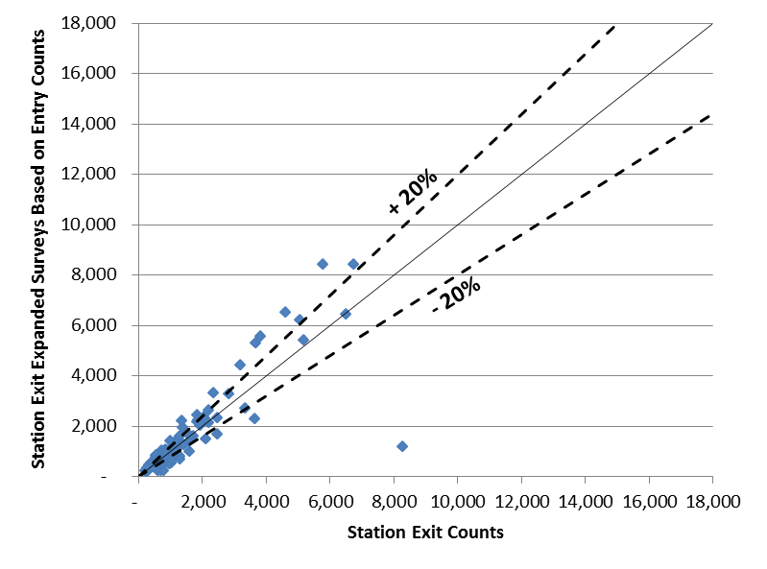
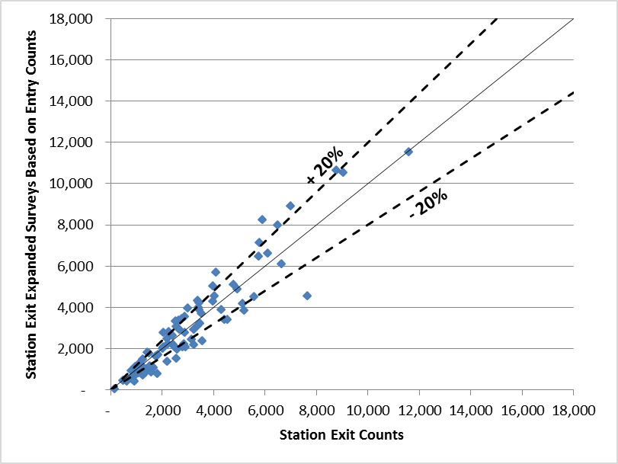
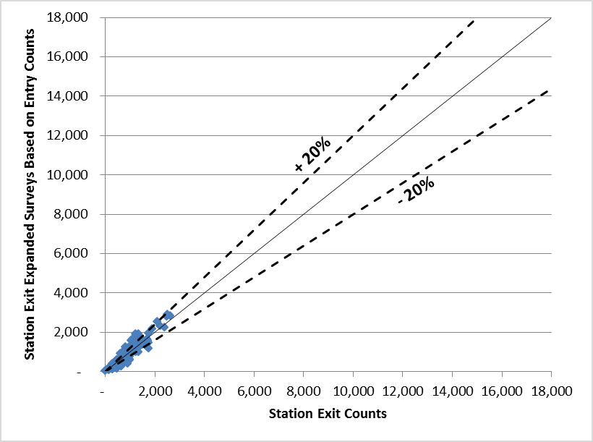
1. Expansion to entry-station counts Estimated v. actual exits: Washington
AM
MD
PM
EV

Slide 7
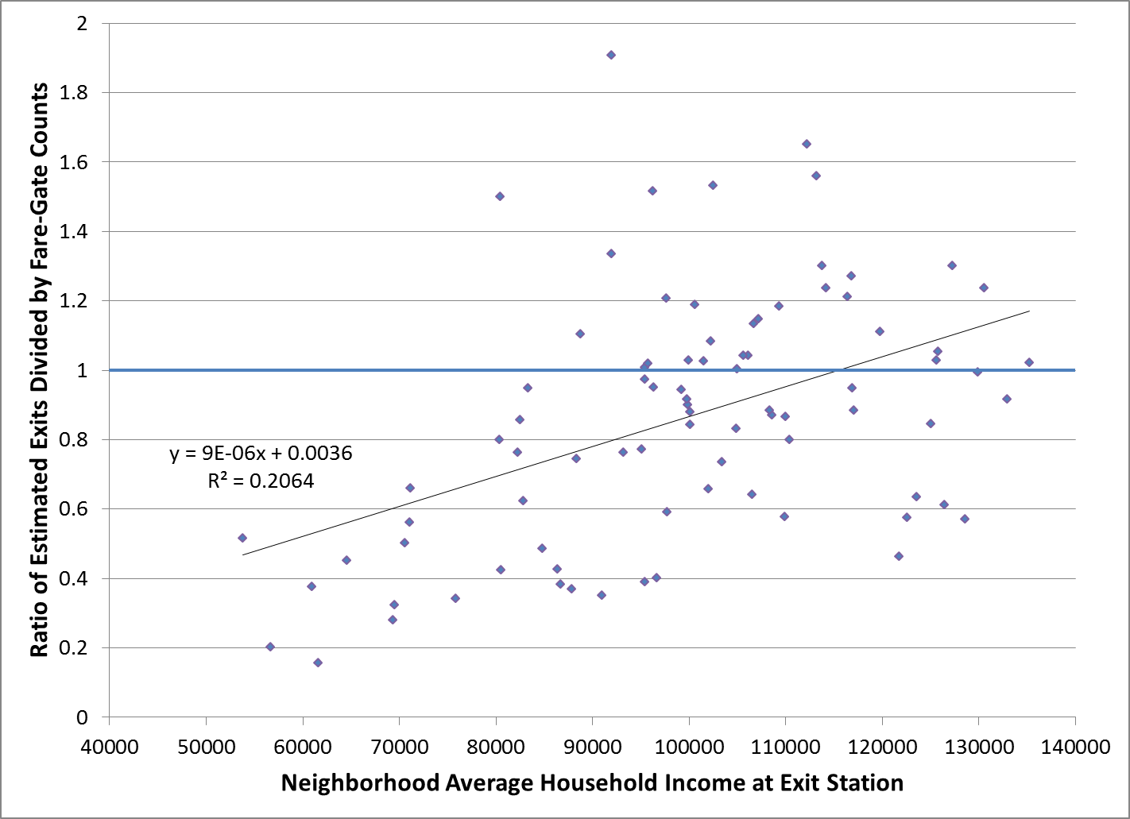
Expansion to entry-station counts (cont’d) Bias in estimated exits: Washington
Plotted points are the 86 rail stations
R Squared = 0.2064

Slide 8
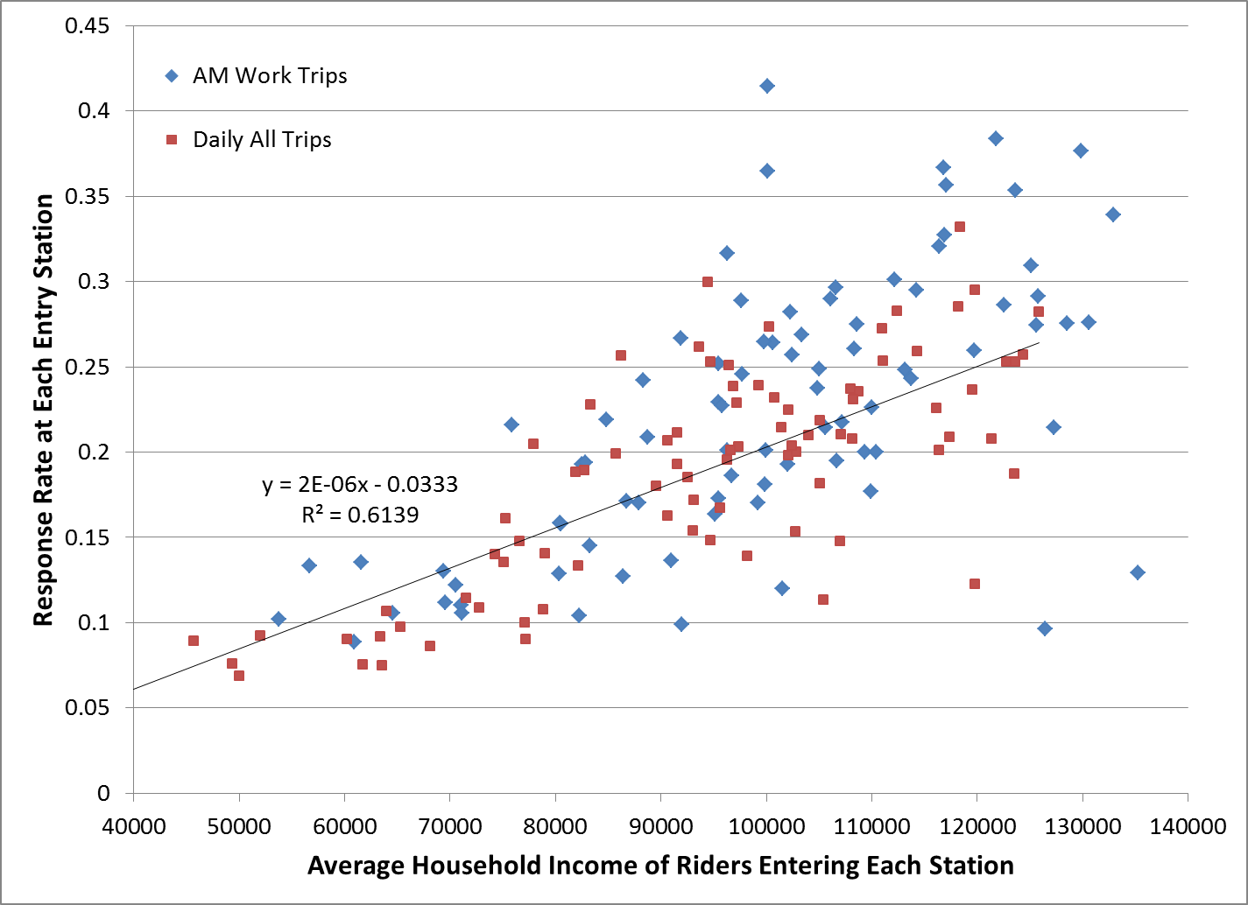
Bias in response rates: Washington
R Squared = 0.6139

Slide 9
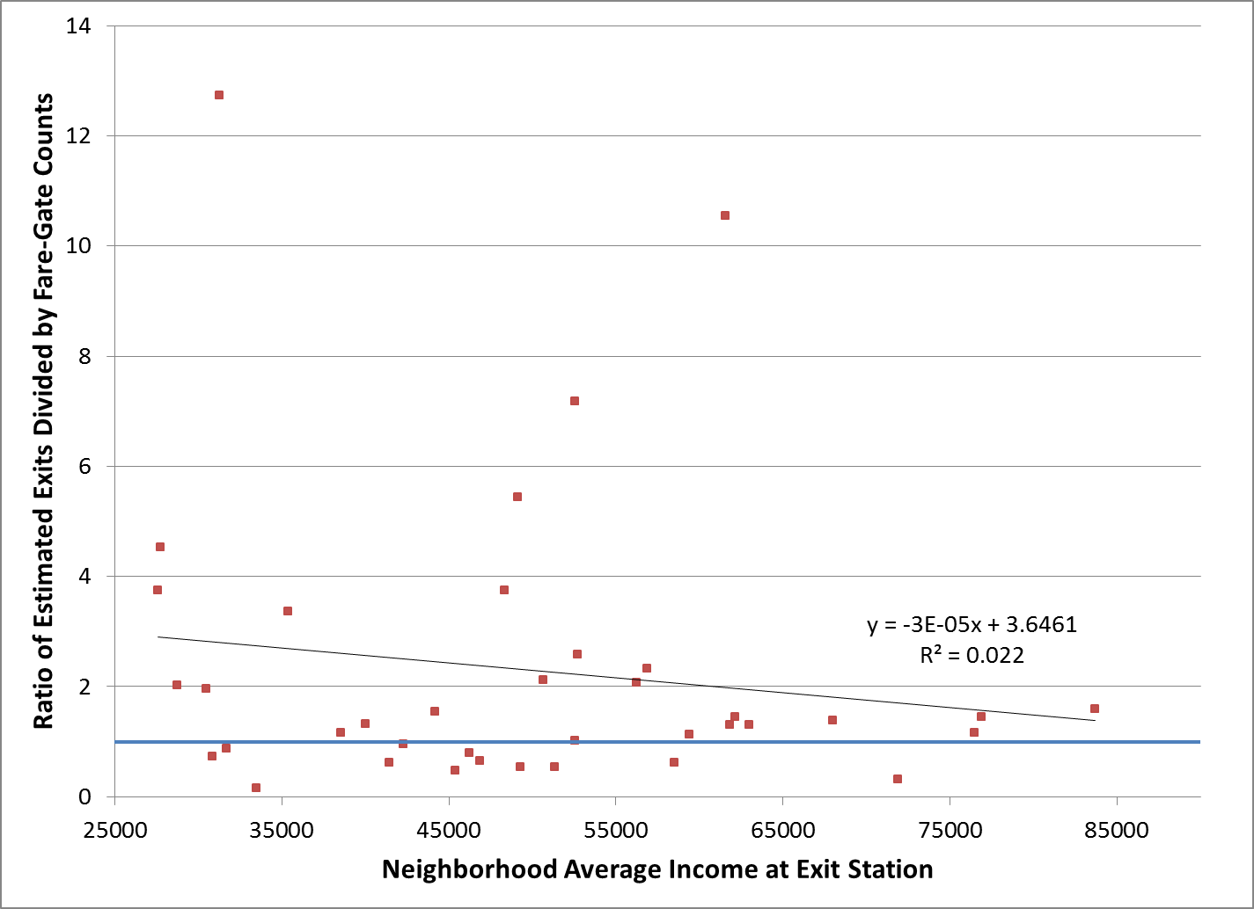
Expansion to entry-station counts (cont’d) Bias in estimated exits: Atlanta
R Squared = 0.022

Slide 10
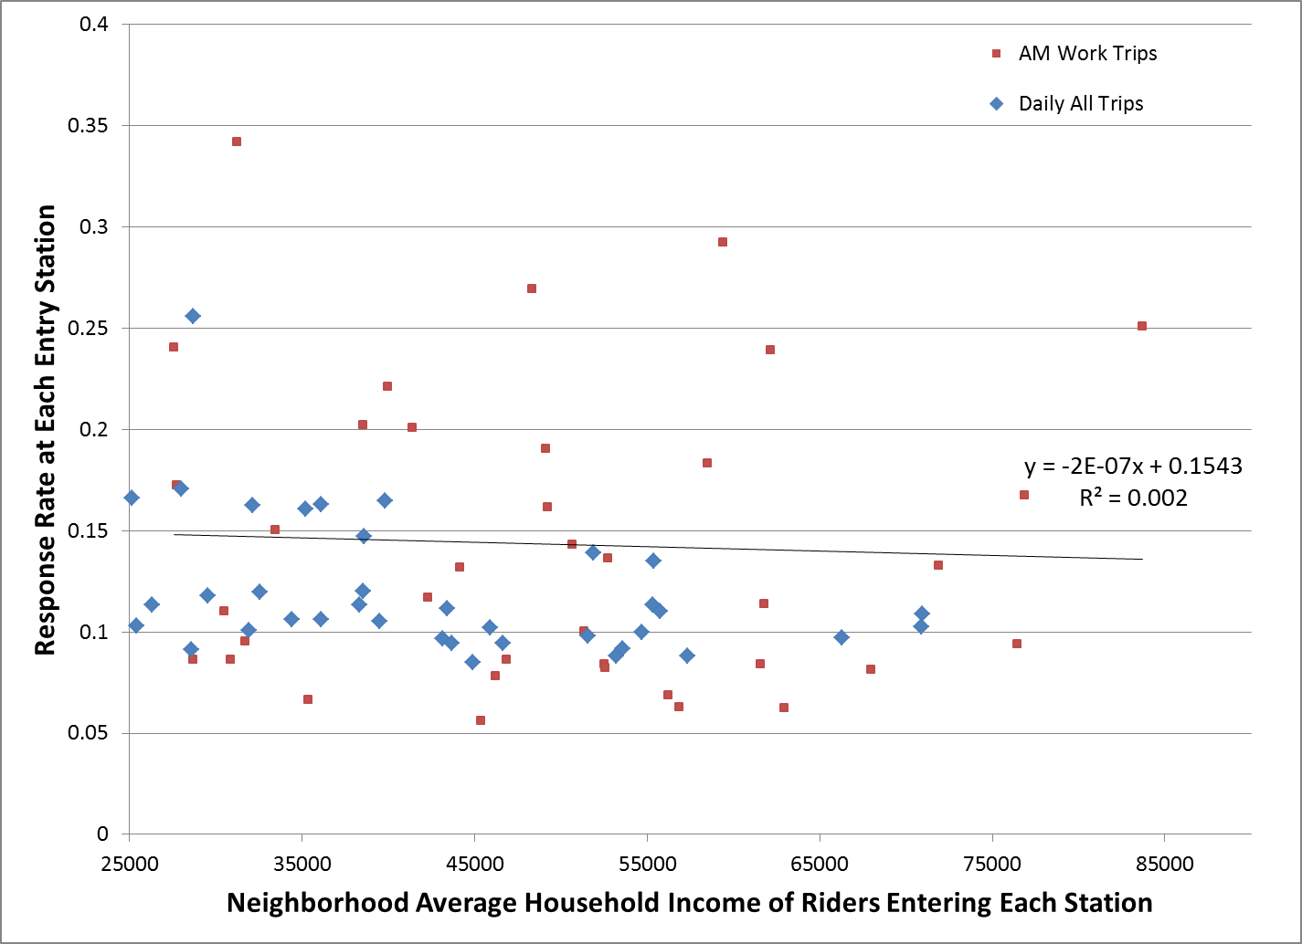
Bias in response rates: Atlanta
R Squared = 0.002

Slide 11
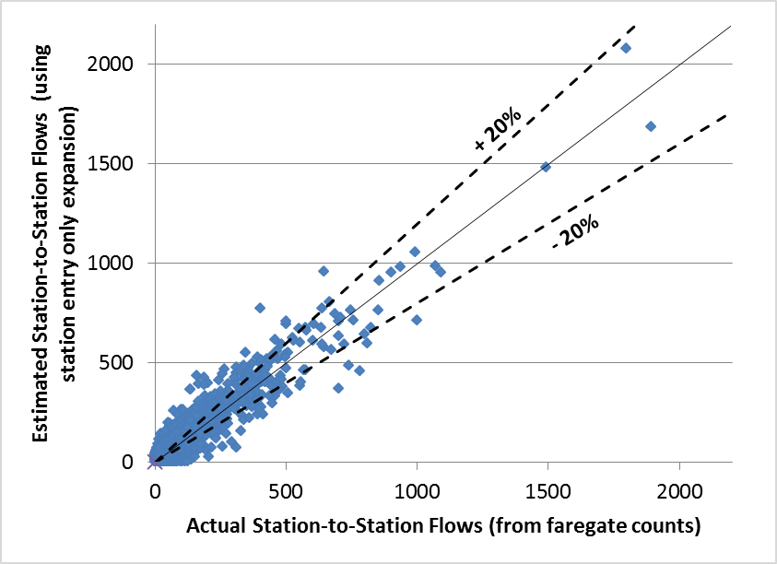
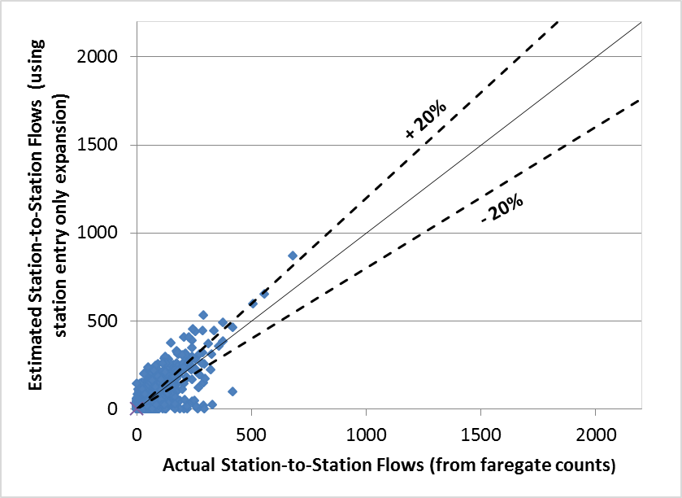
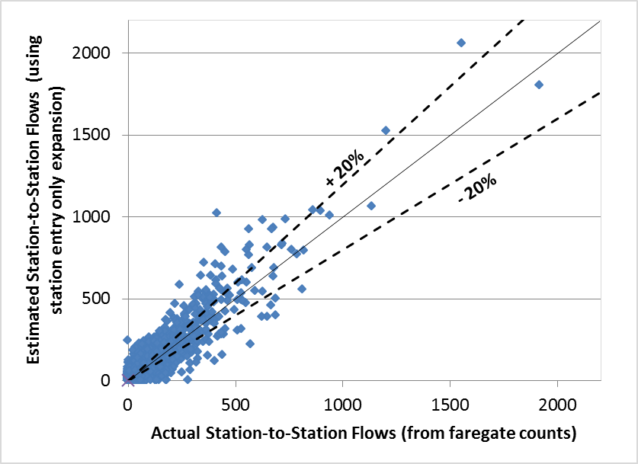
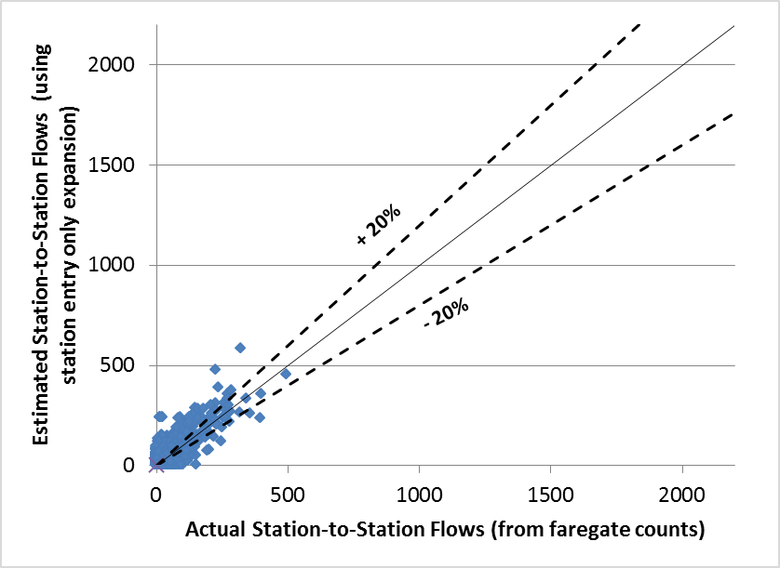
Expansion to entry-station counts (cont’d) Estimated v. actual flows: Washington
AM
MD
PM
EV

Slide 12
2. Expansion to station-to-station flows
Cells in sample designed defined jointly by:
Entry station and exit station by time period
Expansion weight computed for records in each cell
Number of actual trips divided by number of records
Method to estimate actual trips in each cell
Matrix filling via iterative proportional fitting (IPF)
Counts of station entries and exits → targets for rows and columns
Seed matrix: Survey records? Sample of flows?

Slide 13
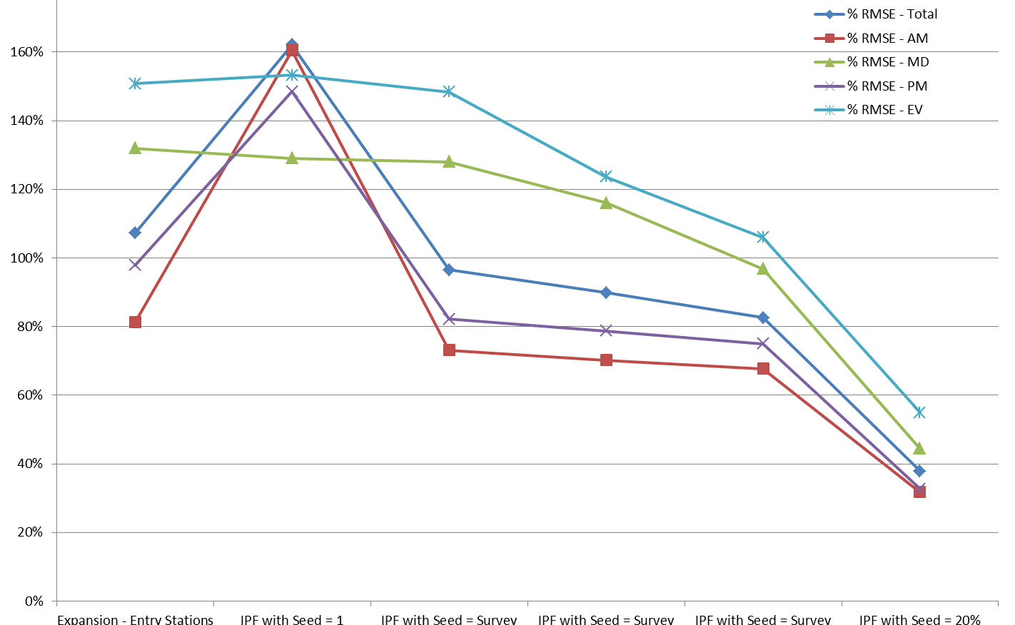
2. Expansion to station-to-station flows (cont’d) Percent RMSE by time period: Washington
109%
39%
Entry counts only
IPF: seed = 1’s
IPF: seed = survey records
IPF: seed = survey; 0.1 infills
IPF: seed = survey; 1.0 infills
IPF: seed = 20% flow sample
Method for Estimating Station-to-Station Flows
Notes:
Seed = 1 performs poorly for AM/PM peaks due to high directionality and clustering in the flows. The non-peak periods are much more evenly distributed, and therefore an evenly distributed seed does cause as many problems.

Slide 14
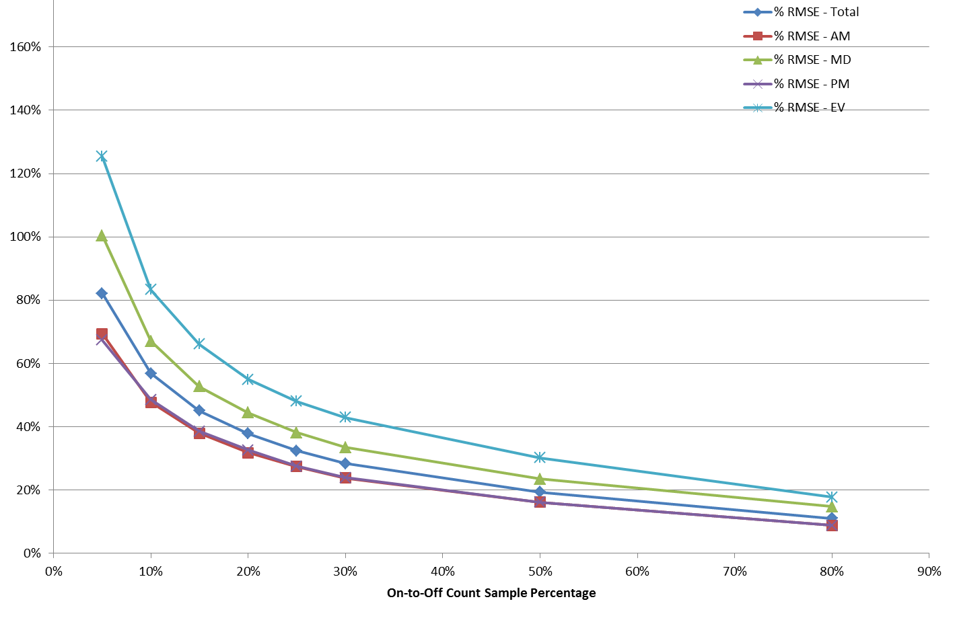
2. Expansion to station-to-station flows (cont’d) Percent RMSE by time period: Washington
39%
20%
Sampling Rate for the Sample of Entry-to-Exit Flows
Notes:
100% sample would have all %RMSEs = 0

Slide 15
2. Expansion to station-to-station flows (cont’d) Sparseness of the flow table: Washington
Actual flows have relatively few empty cells
Low sampling rates lead to sparse seed matrices
Main effect is to empty out cells with 1-5 trips
Actual: 28,466 trips
5%: 0 trips
20%: 20,101 trips
50%: 24,127 trips
Percent of station-to-station cells with specified number of trips
Sample rate | 0 trips | 1-5 trips | 6-10 trips | >10 trips
100% | 8% | 38% | 15% | 39%
5% | 64% | 0% | 0% | 36%
10% | 51% | 0% | 10% | 39%
15% | 44% | 1% | 18% | 38%
20% | 38% | 13% | 11% | 38%
25% | 35% | 17% | 10% | 38%
30% | 32% | 17% | 13% | 38%
50% | 24% | 25% | 13% | 38%
80% | 18% | 33% | 12% | 38%

Slide 16
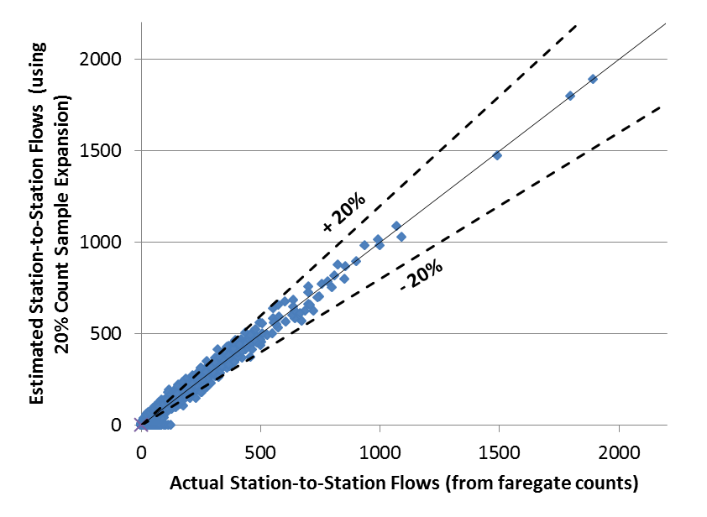
2. Expansion to station-to-station flows (cont’d) Comparison for AM flows: Washington
Records expanded with counts of station entries
Records expanded with flows developed from a 20% sample

Slide 17
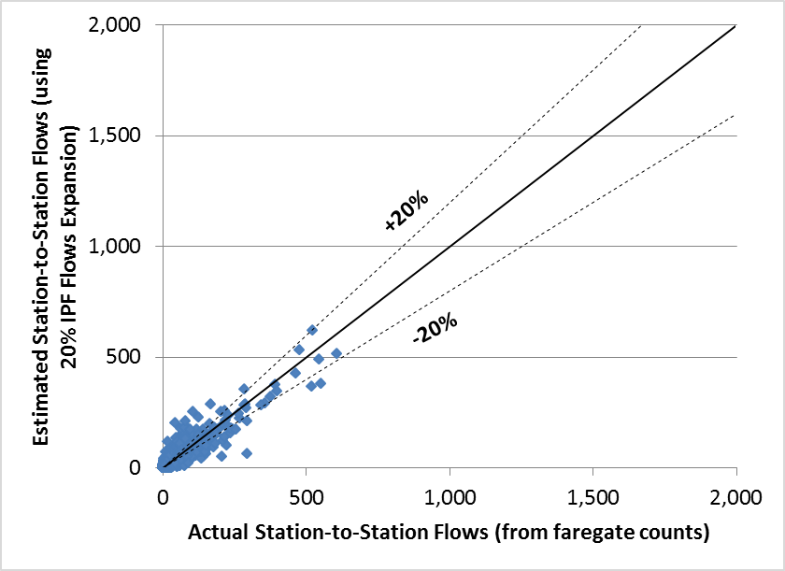
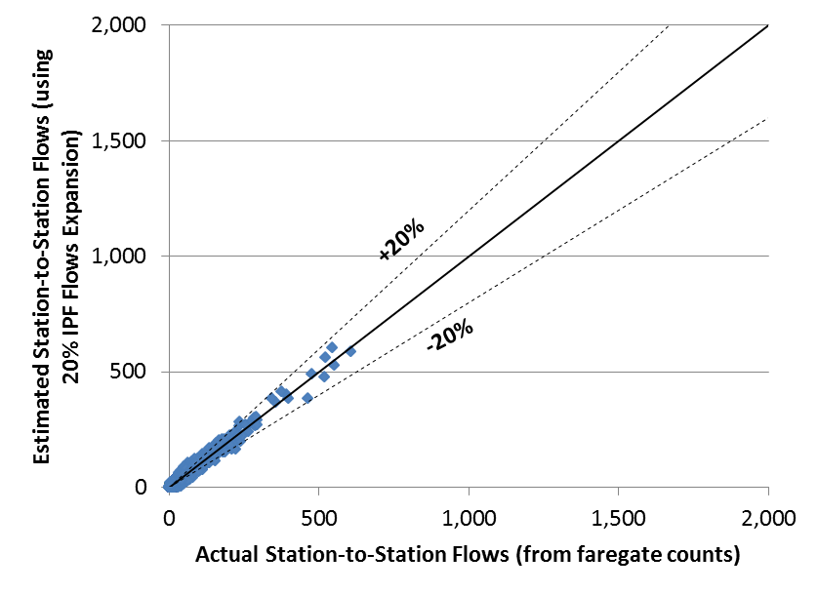
2. Expansion to station-to-station flows (cont’d) Comparison for AM flows: Atlanta
Records expanded with counts of station entries
Records expanded with flows developed from a 20% sample

Slide 18
Observations
Expansion to station-entry counts
Errors in estimates of flows and station exits
Income-related biases in response rates
Evident with paper-based, post-processed survey
Much less evident with combination of:
Tablet-assisted personal interviews,
Sample design based on fare-gate flows, and
Real-time monitoring to ensure realization of the sample design

Slide 19
Observations
Expansion to station-to-station flows
Adds important information: station exits
IPF application improves estimate flows significantly
Seed matrix from survey records retains survey biases
Seed matrix from independent sample of flows
20-30% sample effective for these two systems
Larger samples marginally better

Slide 20
Implications for rider surveys
Method in the field matters
Second dimension helpful in all cases
Sample of flows helps
With sample design and management
With sample expansion
Extension to smaller-ridership cases
Similar sample design, management, expansion
Sparseness → grouping of stations/stops

Slide 21
Thank you. Questions?

