Slide 1
Planning Applications: A City-wide Microsimulation Model for Virginia Beach
TRB Planning Applications Conference
Atlantic City, NJ May 2015
Craig Jordan, Old Dominion University
Mecit Cetin, Old Dominion University
David Gerstle, Caliper Corporation
Daniel Morgan, Caliper Corporation

Slide 2
Presentation Outline
Project purpose
Unique challenges
Project scope
Model inputs
Model development
Calibration methodology and results
Future uses of the model. Next steps.

Slide 3
Project Purpose
Extend and complement the analytical capabilities of the regional Hampton Roads travel demand model (TDM)
Provide a consistent and calibrated base model for conducting detailed evaluations of projects throughout Virginia Beach
Changes in land use and demographics
Travel Demand Model
Forecast traffic volumes
Simulation Model
Simulate changes at an operational level
Project travel demand throughout county

Slide 4
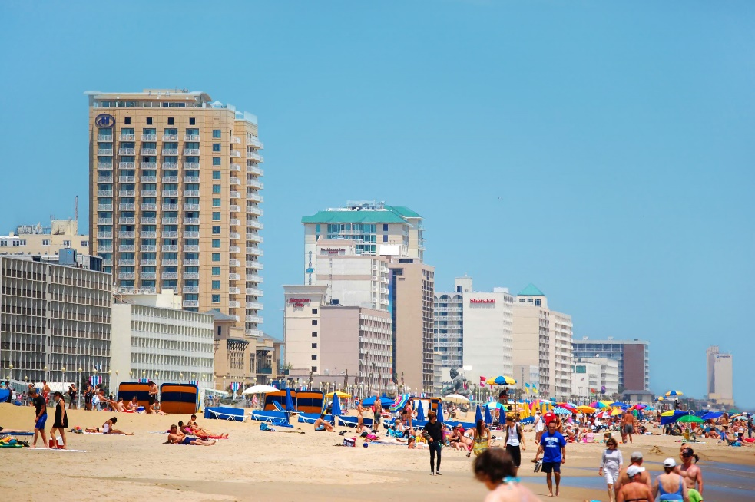
Unique Challenges
Lane-Level Detail + Traffic Signal Timing Representation
Wide-Area Dynamic Traffic Assignment (DTA)
  DTA is still rare as a means for simulating route choice in a wide-area simulation model
  Microsimulation-based origin-destination matrix estimation (ODME)
Non-centralized traffic pattern
Popular tourism destination

Slide 5
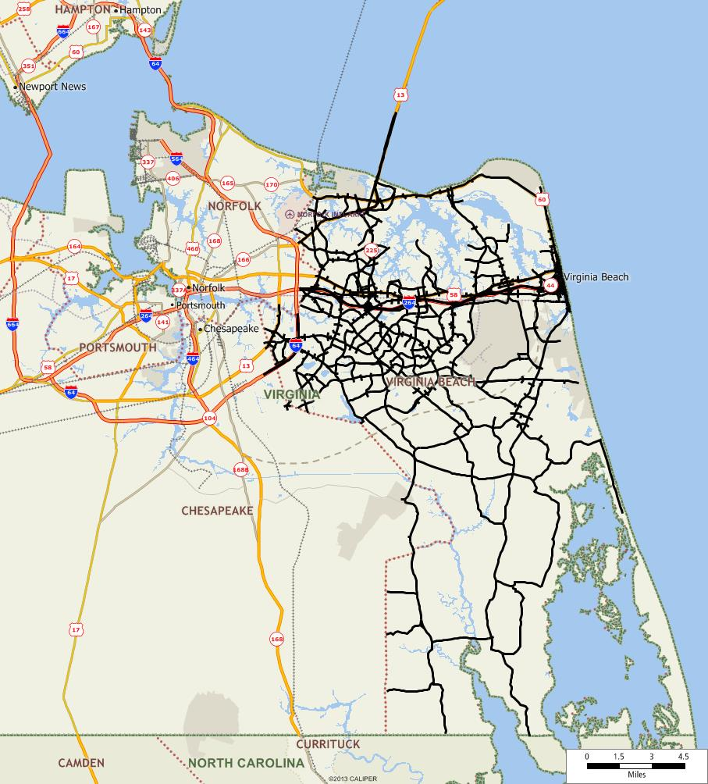
Project Scope
300 square miles
470 road-miles
2,400 links; 1,850 nodes
380 signalized intersections
261 origins and destinations
8am, 10am, 4pm 2-hour models

Slide 6
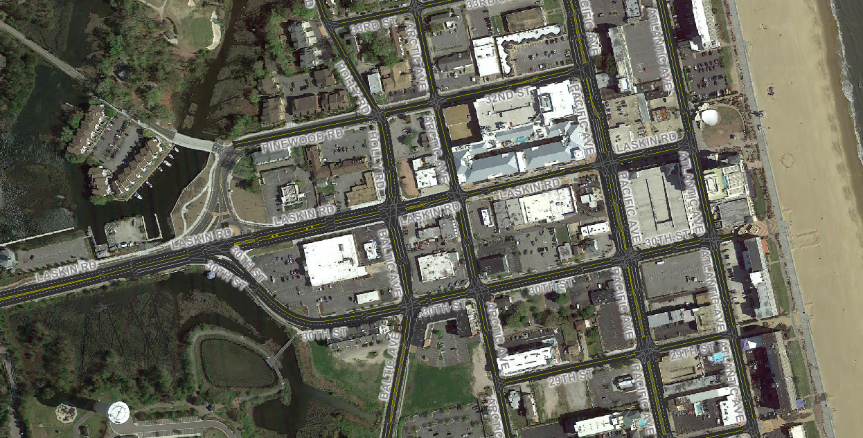
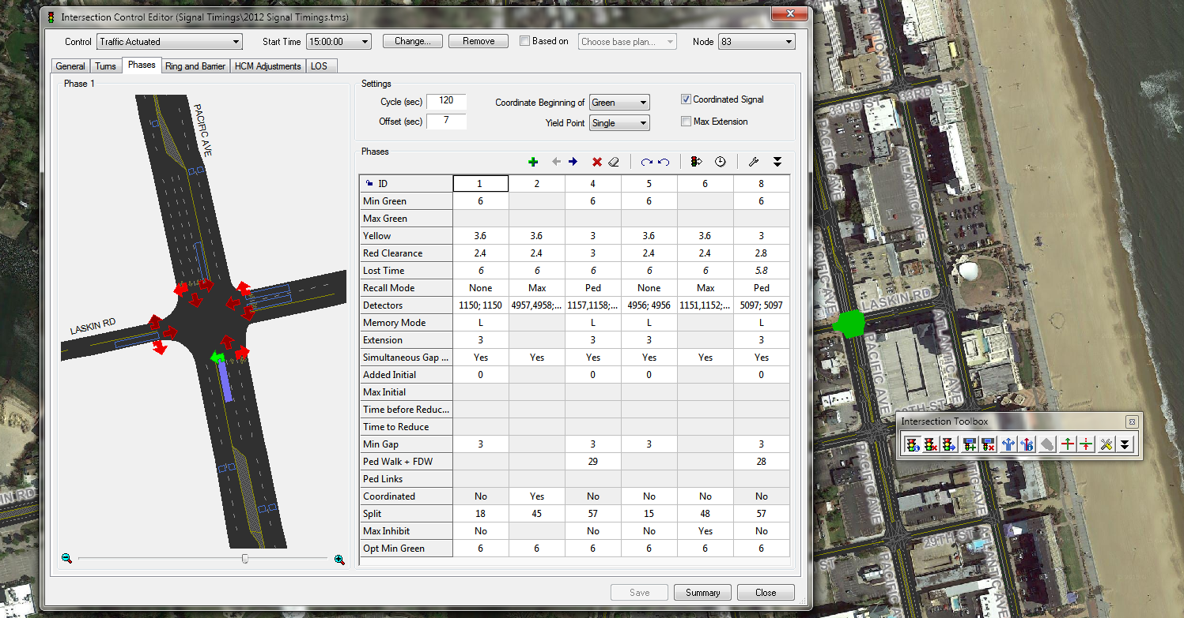
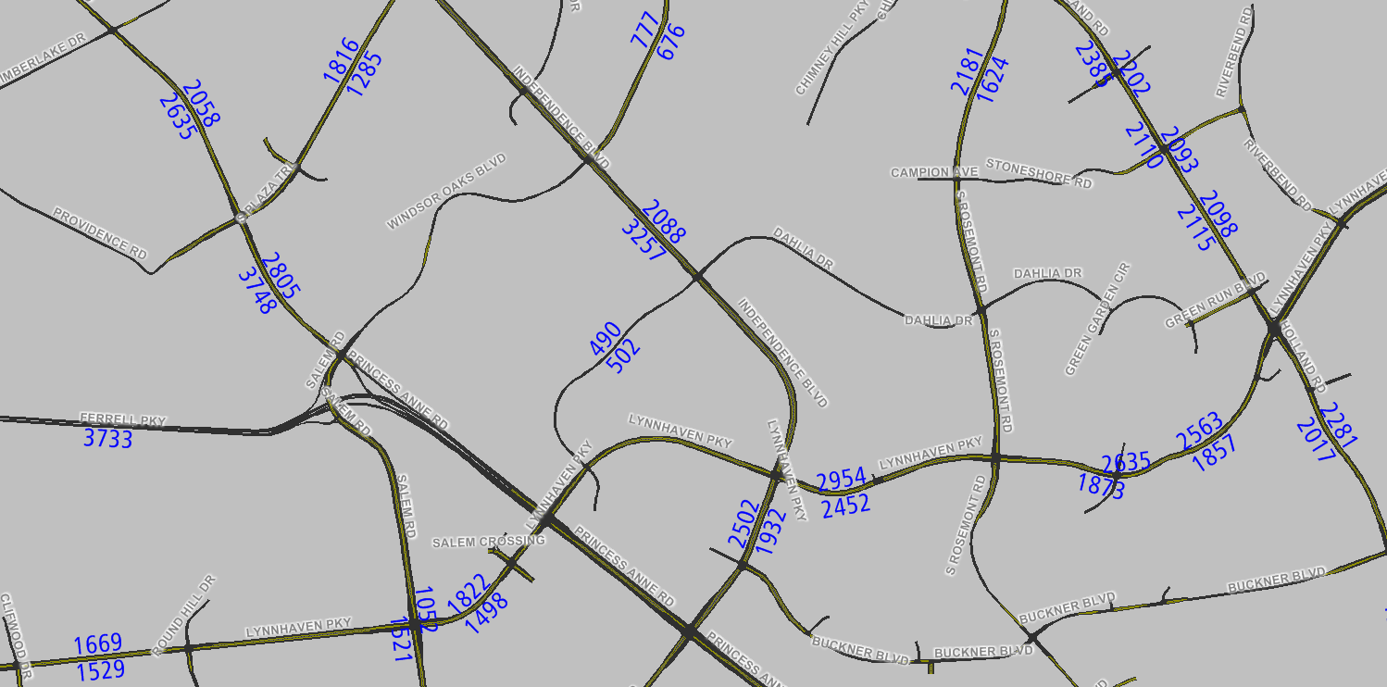
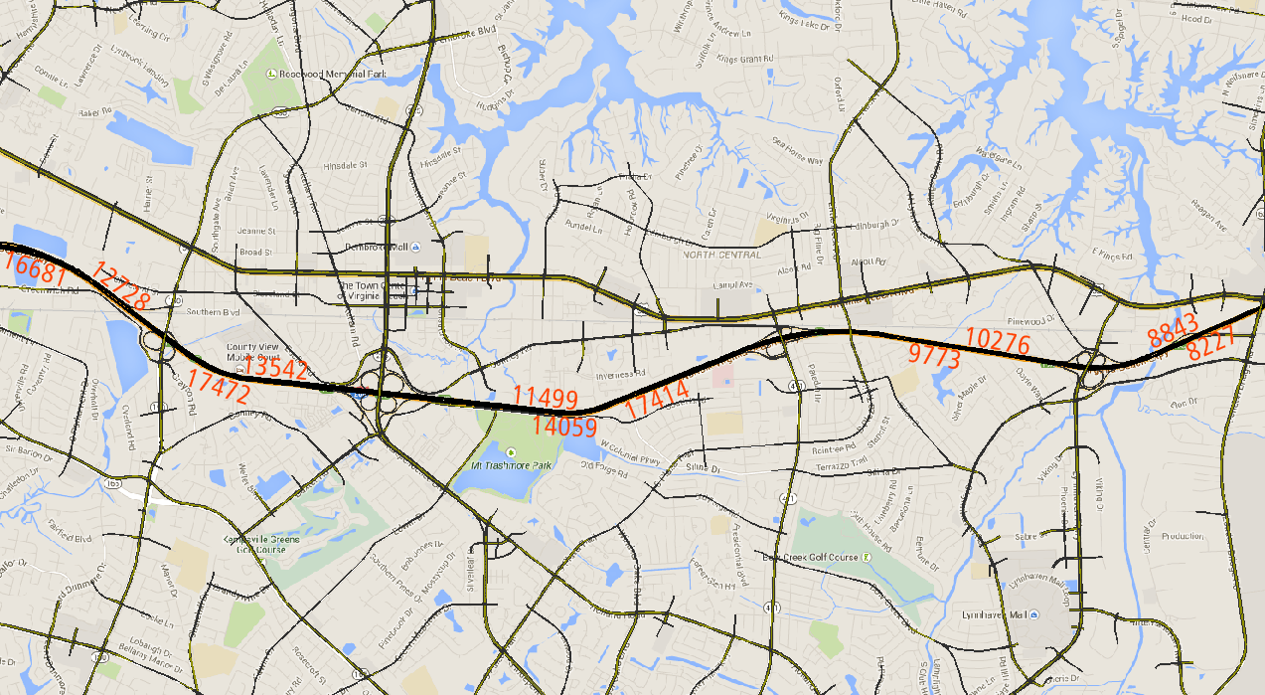
Model Inputs
Aerial Imagery
Signal Timings
Arterial Traffic Count Data
Freeway Traffic Count Data

Slide 7
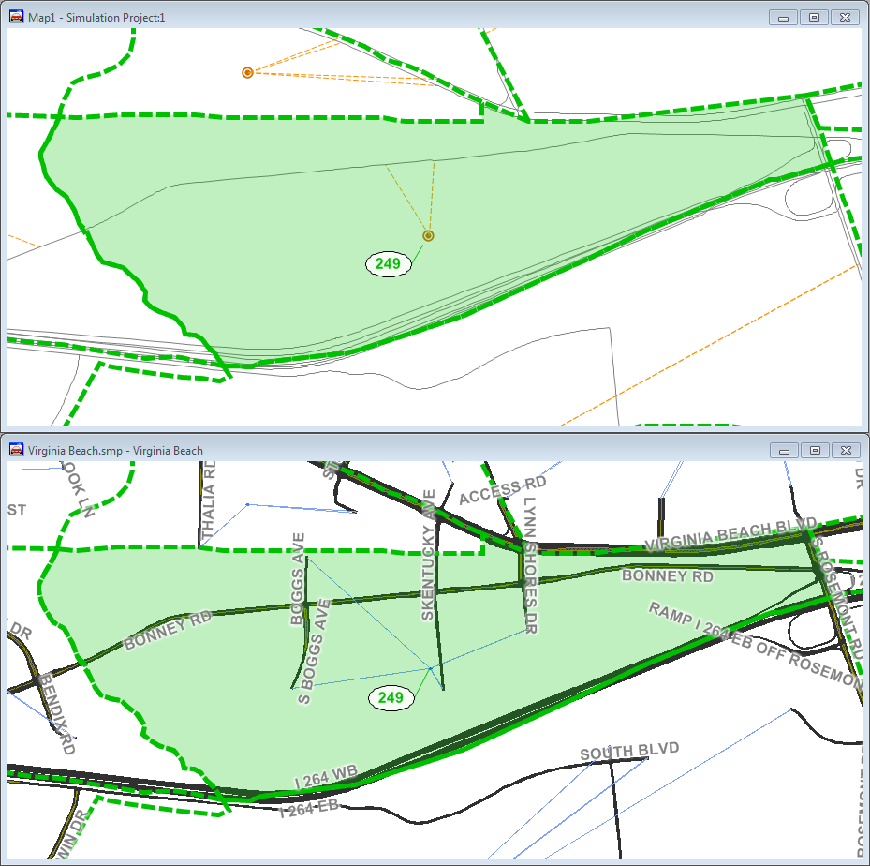
Model Development: Interface with TDM
Interfaces directly with Hampton Roads regional travel demand model
Accurate representation of access points via centroids loading onto side streets not arbitrarily from mid-block (image)

Slide 8
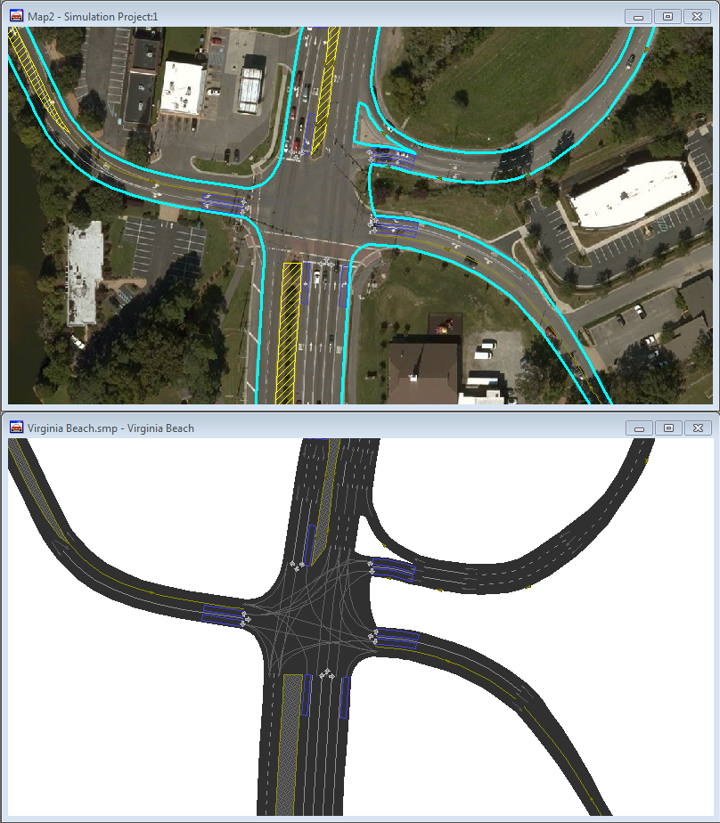
Model Development: Geometric Accuracy
Emphasis on geometric detail

Slide 9
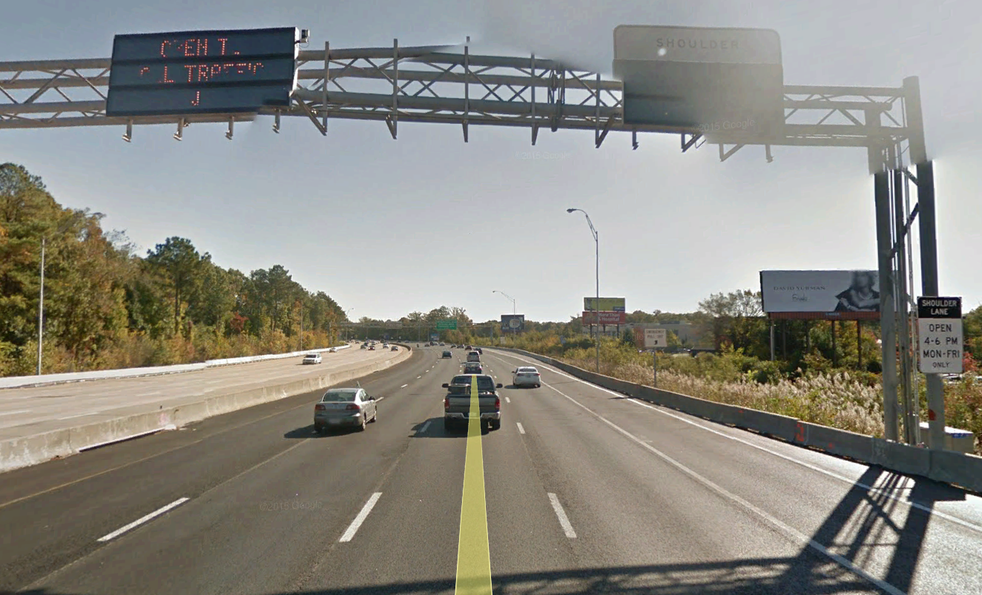
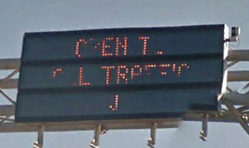
Model Development: Lane Access Control
TOD HOV restrictions and addition of the shoulder as a travel lane on I-264

Slide 10
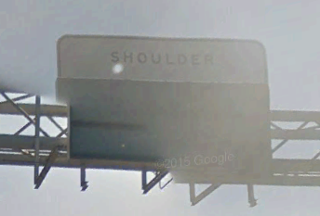
Model Development: Lane Access Control
TOD HOV restrictions and addition of the shoulder as a travel lane on I-264

Slide 11
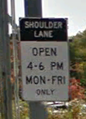
Model Development: Lane Access Control
TOD HOV restrictions and addition of the shoulder as a travel lane on I-264

Slide 12
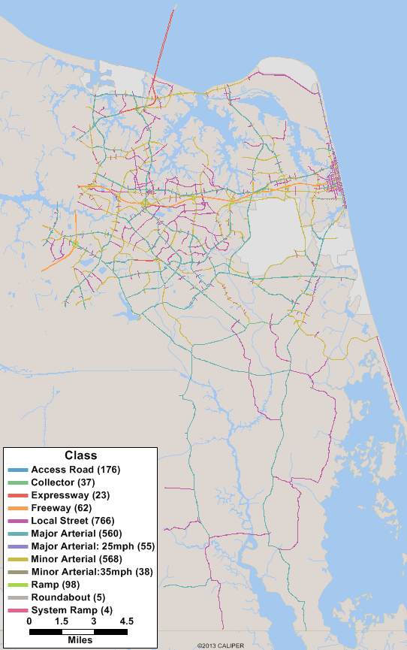
Model Development: Functional Class
Accurate designation of functional class important
Speed limit of functional class strong influence on simulation
Conservative drivers adhere closely to speed limit; aggressive drivers travel faster

Slide 13
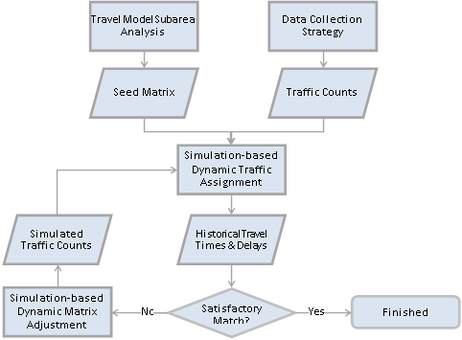
Calibration Methodology

Slide 14
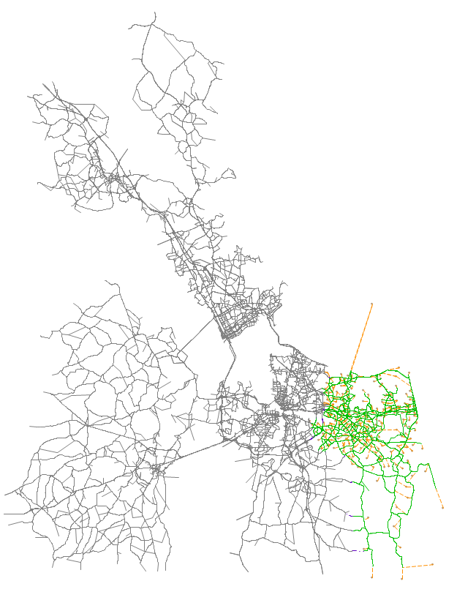
Subarea Analysis
Hampton Roads Regional Model
  1,093 zones
  23,338 links
Virginia Beach Subarea
  223 zones (20%)
  4,182 links (18%)
  42 interface nodes
  Subarea matrix 265 x 265
  Most populated city in the Hampton Rods MSA

Slide 15
Calibration

Slide 16
Calibration

Slide 17
Calibration

Slide 18
Calibration

Slide 19
Calibration

Slide 20
Calibration

Slide 21
Calibration

Slide 22
Calibration

Slide 23
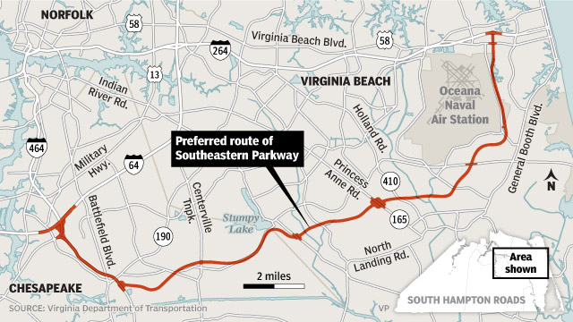
Ongoing and Future Applications
Southeastern Parkway and Greenbelt (SEPG) Study
Evacuation Planning
Model Expansion
  Chesapeake Bay
  Portsmouth

Slide 24
Questions?
Thank you!

