Slide 1


Colorado Springs Metropolitan Planning Area Congestion Management Process
15th TRB National Transportation Planning Applications Conference
May 17 – 21, 2015 Atlantic City, New Jersey
Data Collection & Management Session: May 18, 2015 8:30 AM – 10:00AM
An MPO “Big Data” Application

Slide 2
Pikes Peak/Colorado Springs Region
01

Slide 3
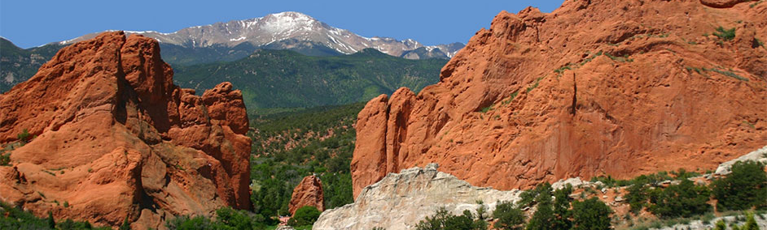
Pikes Peak Area Council of Governments (PPACG)
Population over 600,000
Nine Member Agencies
Over 800 roadway miles

Slide 4
Regional Transportation Plan—Congestion Management Process (CMP)
02

Slide 5

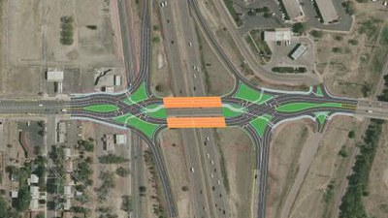
Congestion Management Process (CMP)
Develop strategies to improve transportation system
Systematic assessment
Alternative assessment
Implementation strategies
Funding

Slide 6
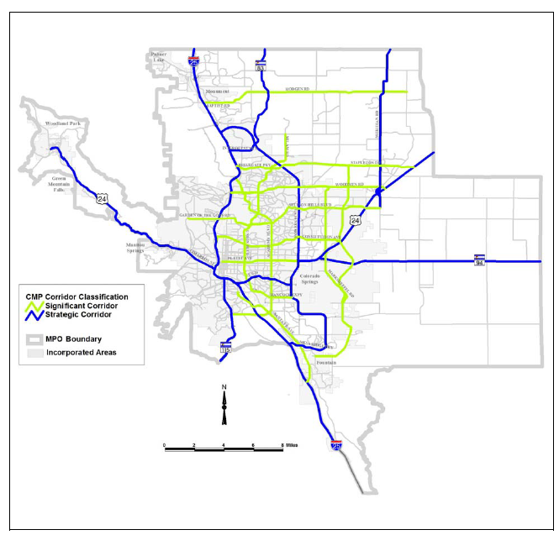
Congestion Management Plan (CMP) Corridors
2035 Update RTP Corridors
  Significant Corridors
  Strategic Corridors

Slide 7
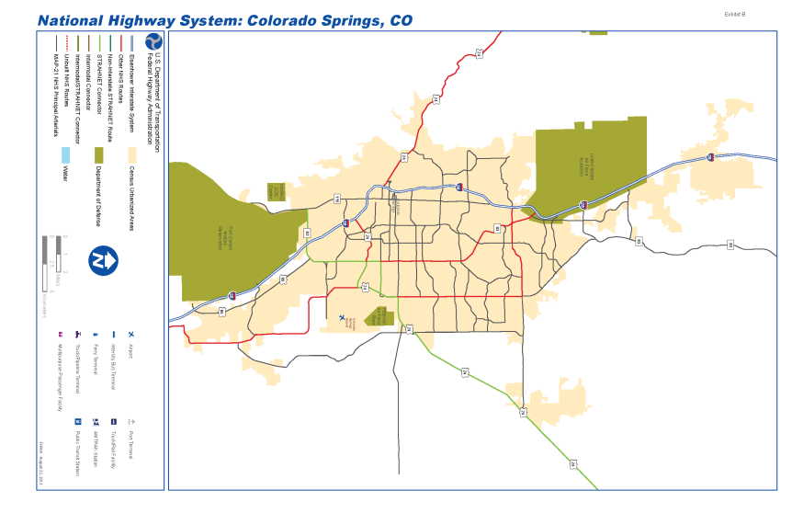

National Highway System Additions
MAP-21 included the full NHS network facilities in CMP network

Slide 8
What are the evaluation options?
03

Slide 9
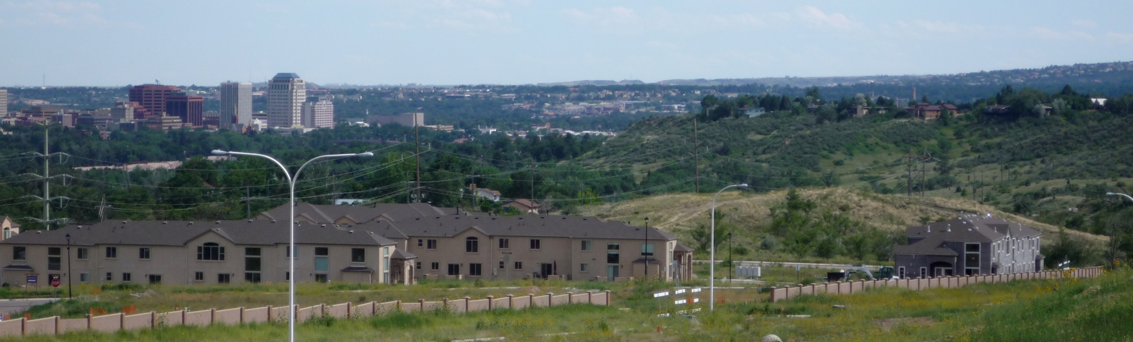
Traditional Data Collection
Static
Resource Intensive
Peak Hour Data Collection
Limited Data on Roadway System

Slide 10
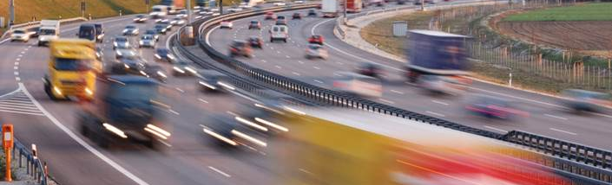
Big Data Collection
  Dynamic
  Regional System View of Roadway Operations
  Comprehensive Data on Major Roads
  24/7 Data Records
  Seasonal Variations Recorded
  Bottleneck Identification
  Data Collected in 1 minute intervals

Slide 11
Development of the Colorado Springs Congestion Management Process
04

Slide 12
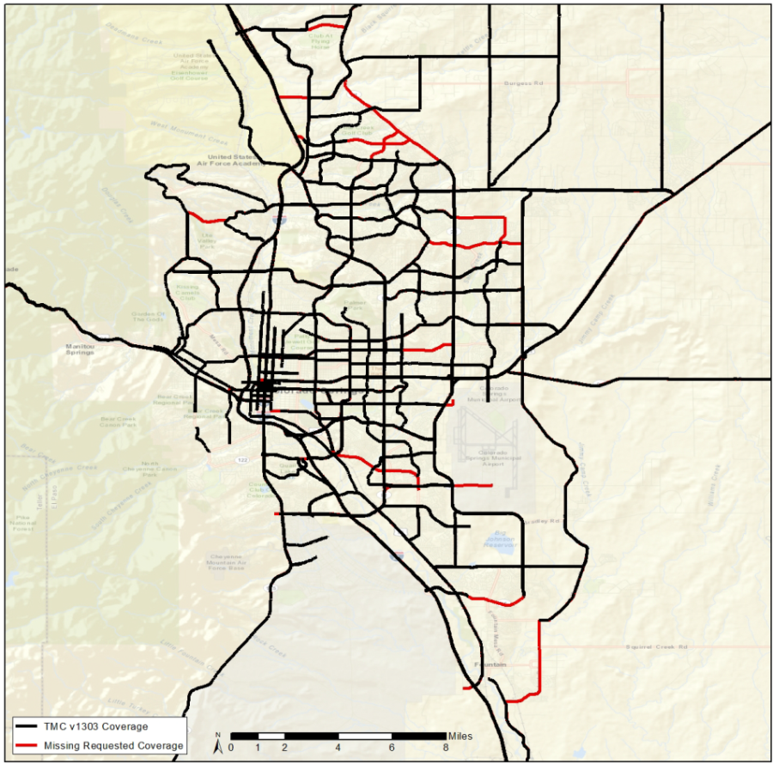
Travel Time Data Collection – INRIX Data
INRIX Vehicle Probe data provided travel times/speed coverage for most corridors
Additional Travel Time Surveys conducted manually to “spot check” recorded data
Travel Time Surveys conducted on corridors not included within the INRIX data set

Slide 13
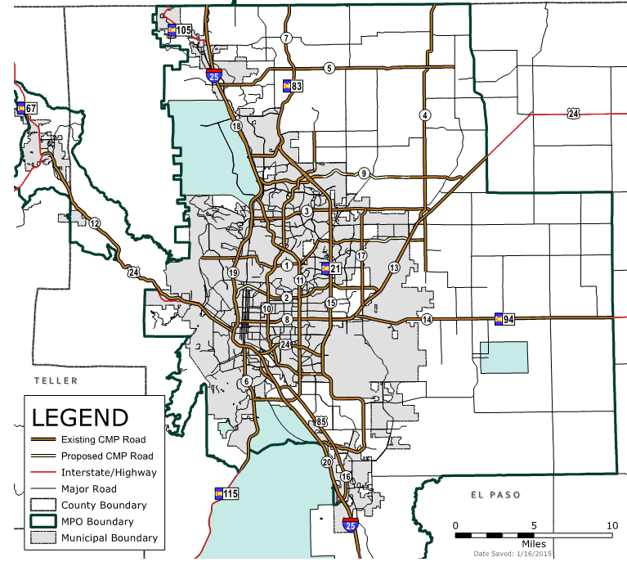
Congestion Management Process (CMP) Corridors
20 corridors to analyze
200 Corridor Miles
30 Interchanges
150+ Signalized Intersections

Slide 14
Performance Measures
05

Slide 15
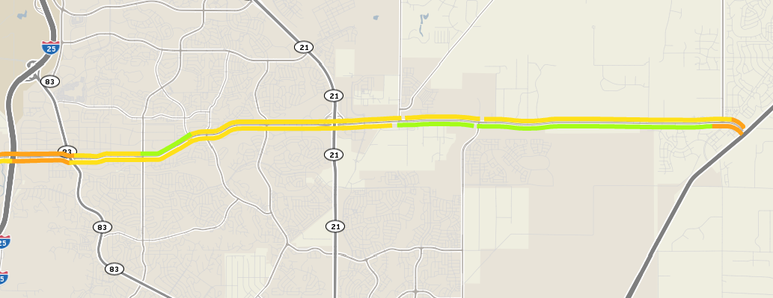
Woodmen Road Corridor
Congestion Greatest at Roadway Termini Source: INRIX Analytics

Slide 16
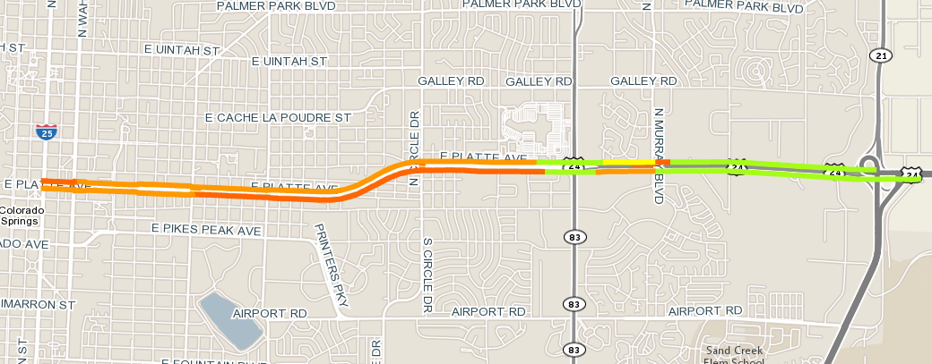
Platte Avenue Corridor
Congestion Greatest Through Urban Core Source: INRIX Analytics

Slide 17
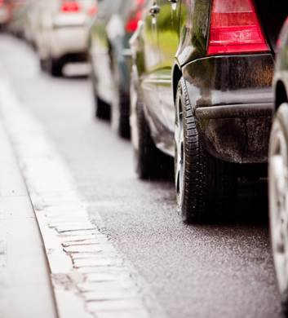
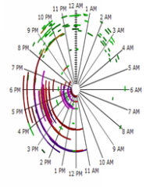
When Are the Queues the Greatest?
Source: INRIX Analytics

Slide 18
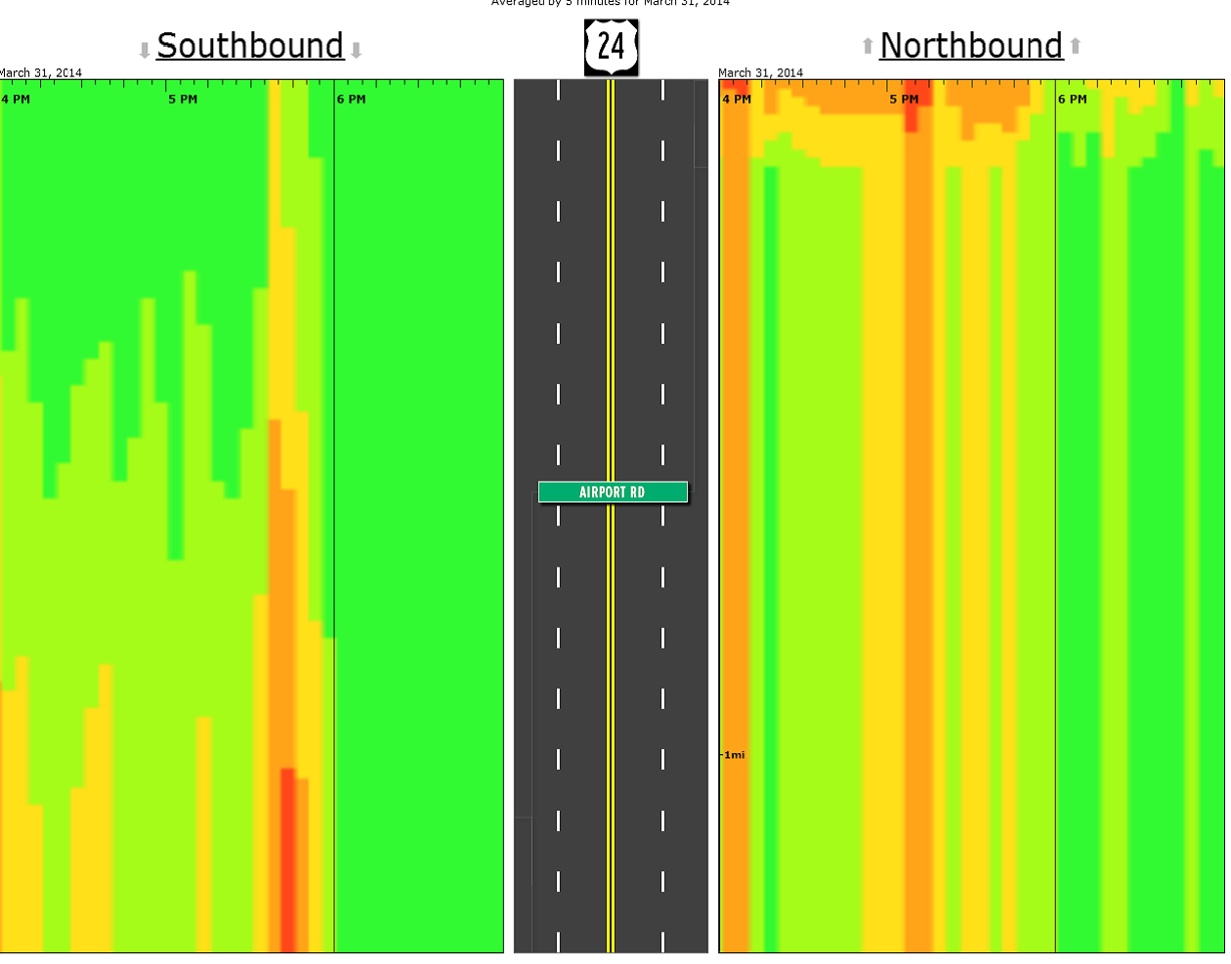
Congestion Scans
Illustrate Queue Build-Up
Length of Queue
Time of Day
Source: INRIX Analytics

Slide 19
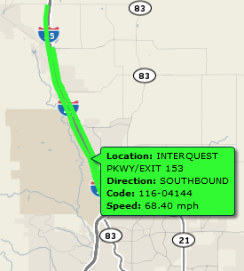
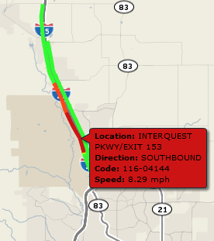
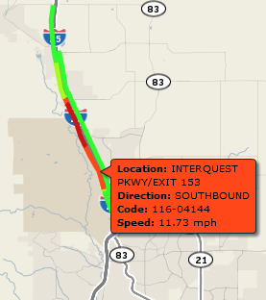
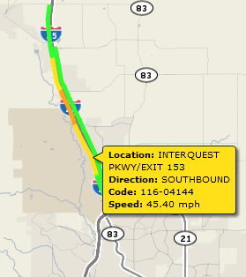


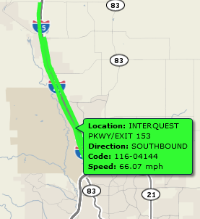

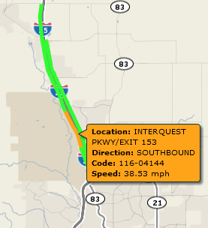
I-25 Congestion Management/Incident Planning
Source: INRIX Analytics
Big Data reveals progression of an incident
  10:45 a.m. February 26, 2014
  11:00 a.m. February 26, 2014
  11:15 a.m. February 26, 2014
  12:00 noon February 26, 2014
  12:15 p.m. February 26, 2014
  12:30 p.m. February 26, 2014
  12:45 p.m. February 26, 2014
  1:00 p.m. February 26, 2014
  1:45 p.m. February 26, 2014

Slide 20
Now What?
06

Slide 21
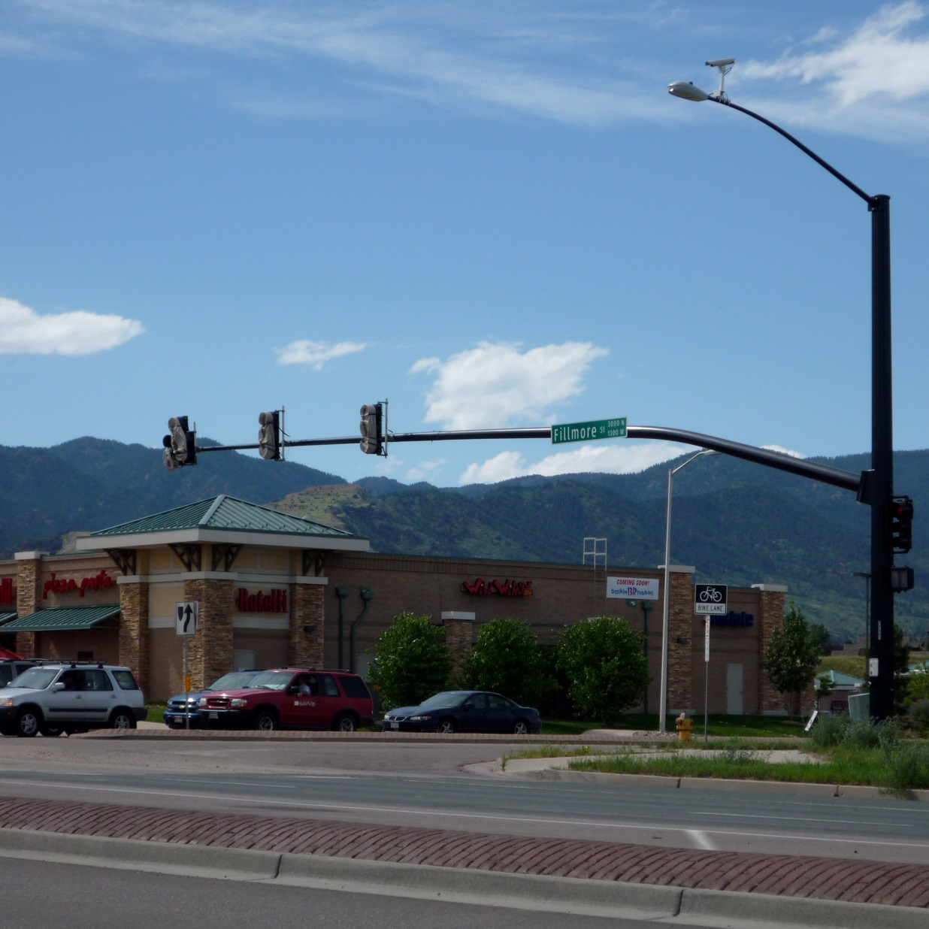
So Much Information
150+ Congested Intersections
Corridor Data
  Travel Speeds
  Travel Time
Intersection Data Rich
  Average Duration
  Average Maximum Queue Length
  Number of Occurrences
  Impact Factor

Slide 22
Top Five (5) Congested Intersections by Season
Winter Season
Powers Blvd | Airport Road
I-25 (Exit 135) | S. Academy Blvd
Platte Ave | Academy Blvd
I-25 (Exit 146) | Garden of the Gods Rd
N. Circle Dr | Platte Ave
Summer Season
I-25 (Exit 156) | North Gate Road
I-25 (Exit 149) | Woodmen Road
I-25 (Exit 161) | SH 105
I-25 (Exit 150) | N. Academy Blvd
I-25 (Exit 153) | Interquest Pkwy

Slide 23
Top Five (5) Congested Intersections Occurrence and Impact
Impact Factor
I-25 (Exit 125) | Ray Nixon Road
I-25 (Exit 167) | Greenland Road
I-25 (Exit 163) | County Line Road
Powers Blvd | Airport Road
I-25 (Exit 132) | SH 16
Number of Occurrences
I-25 (Exit 135) | S. Academy Blvd
Platte Ave | Circle Drive
Powers Blvd | Airport Road
I-25 (Exit 141) | Cimarron St
Academy Blvd | Galley Road

Slide 24
Types of Congestion
Congestion Classification | Congestion Experienced (Number of Occurrences)
Recurring Congestion
Continuous Congestion | > 100
Anticipated Congestion | 31<x<100
Non-Recurring Congestion | <30
Recurring:
Continuous: Frequent/Regular Occurrence
Anticipated: Occurs Frequently
Non-Recurring: Infrequent Occurrences with Great Impacts

Slide 25
Summary of Findings
07

Slide 26
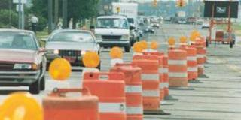
Powers Blvd | Airport Rd
I-25 (Exit 135) | S. Academy Blvd
Platte Ave | Academy Blvd
Platte Ave | Circle Dr
I-25 (Exit 141) | Cimarron St

Slide 27
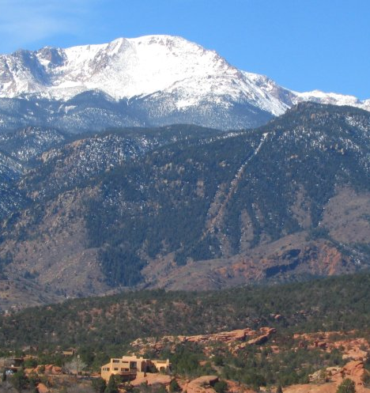
Congestion Management Process (CMP) Results
Developed strategies to reduce congestion
Utilized objective-driven and performance-based processes
Incorporated safety, security, mobility, recurring and nonrecurring congestion
Multiple strategies including a mix of infrastructure and operational strategies

