Slide 1
Network Robustness Index (NRI) Application to Security Critical Link Identification and 2040 RTP Project Prioritization
15th Transportation Research Board
National Transportation Planning Applications Conference
May 17 – 21, 2015 Atlantic City, New Jersey
Performance Evaluation Session: May 20, 2015
Wednesday: 1:30 PM – 3:00 PM
Authors:
Maureen Paz de Araujo, HDR
Mary Lupa, Parsons Brinckerhoff
Ken Prather, PPACG
Craig T. Casper, PPACG
A Colorado Springs MPO Pilot Implementation Study

Slide 2
01
Network Robustness Index Concept
05
PPACG NRI-Based NHS Security Criticality Tests
02
Review of NRI Planning Applications
06
PPACG NRI-Based Project Prioritization Tests
03
PPACG NRI Application Study Design
07
Summary of Findings
04
PPACG NRI Sensitivity Tests

Slide 3
Network Robustness Index Concept
$$NRIa=Ca −C$$
01

Slide 4
Network Robustness Index (NRI) Calculation
The Network Robustness Index (NRI)
The NRI is calculated as the increase in network-wide travel “cost,” represented as vehicle-hours of travel (VHT), that result from disruption (removal or decrease in capacity) of a given link. The Network Robustness Index for disruption of link a (NRIa) is calculated as:
where: the total network “cost” with all links present (C) and the total network cost with link a disrupted (Ca) are calculated by equation (1) and equation (2), respectively as:
(1) (2)
and where:
t_{i} = the travel time across link i in minutes per trip
x_{i} = the flow of link I at user equilibrium
I = the set of all links in the network
The increase in network-wide travel “cost,” expressed as vehicle-hours of travel (VHT), resulting from disruption (removal or decrease in capacity) of a given link:
NRI with link “a” disrupted
$$NRIa=Ca −C$$
network-wide VHT for base network
network-wide VHT with link “a” disrupted

Slide 5
Calculation of Network Cost
Total network “cost” with all links present (C ) and the total network cost with link a disrupted (C_{a} ) are calculated as:
The Network Robustness Index (NRI)
The NRI is calculated as the increase in network-wide travel “cost,” represented as vehicle-hours of travel (VHT), that result from disruption (removal or decrease in capacity) of a given link. The Network Robustness Index for disruption of link a (NRIa) is calculated as:
where: the total network “cost” with all links present (C) and the total network cost with link a disrupted (Ca) are calculated by equation (1) and equation (2), respectively as:
(1) (2)
and where:
t_{i} = the travel time across link i in minutes per trip
x_{i} = the flow of link I at user equilibrium
I = the set of all links in the network
$$C=\sum_{i=1}^{I}{tixi}$$
$$Ca=\sum_{i=1}^{I}{tixi}$$
where:
t_{i} = the travel time across link i (in minutes)
x_{i} = the flow of link i at user equilibrium
I = the set of all links in the network

Slide 6
Review of NRI Planning Applications
02

Slide 7
NRI Applications by Research Organizations
Relevant Studies
2006 - McMaster University Center for Spatial Analysis
Network Robustness Index: A New Method for Identifying Critical Lengths and Evaluating Performance of Transportation Networks
2010 - University of Vermont Transportation Research Center
Application of the Network Robustness Index to Identifying Critical Road-Network Links in Chittenden, Vermont
NRI APPLICATIONS BY RESEARCH ORGANIZATIONS
ORGANIZATION | YEAR | KEY ELEMENTS
Center for Spatial Analysis at McMaster University D. M. Scott, D. Novak, L. Aultman-Hall, F. Guo | 2006 | Shifts focus from localized impacts system-wide impacts Goal to yield system-wide benefits Applies travel time metrics vs. V/C ratio metrics Focuses on methodology Uses small networks to test theory and results
University of Vermont Transportation Research Center J. Sullivan, D. Novak L. Aultman-Hall, | 2010 | A complete application of peak and daily NRI processing to full network Used data from Chittenden County MPO Used automated “tool” within TDM software to expedite processing

Slide 8
PPACG NRI Application Study Design
PPACG Region Size – Population: 600,0000
PPACG Model Run Time – 2 to 3 hours
PPACG Model Staff – 1-person plus consultants
Network Size – 12,300+ Links
03

Slide 9
NRI Applicability to PPACG Planning Process
PPACG identified two potential application for the NRI:
To identify “critical links” with respect to security
To serve as a criterion for prioritizing transportation system investments

Slide 10
PPACG NRI Application Approach
STEP 1
Conduct Sensitivity Testing
STEP 3
Model NHS and Test Projects
STEP 2
Establish Modeling Approach
PPACG used a three-step process to direct the MPO’s NRI application:
Sensitivity tests of NRI modeling results were conducted at a screening level to support targeted applications
Establish approach/process to support efficient application at a system-wide level
Conduct model runs to screen for security criticality and to support project-level investment prioritization

Slide 11
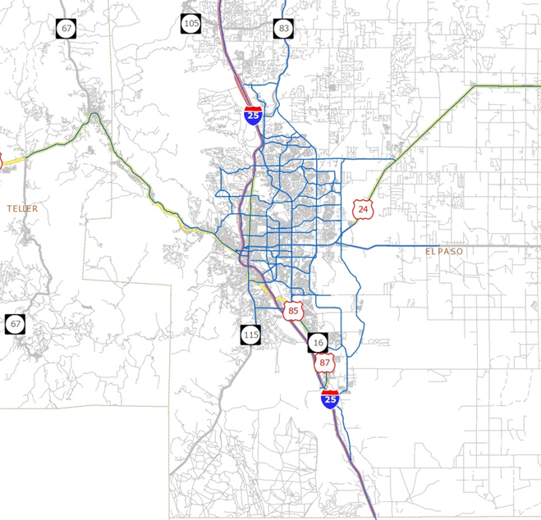
NHS Identified for Screening Analysis
As for the MPO Congestion Management Process, PPACG evaluated system security criticality for the National Highway System. The NHS provided a smaller, established high-level network for security criticality screening consistent with the approach used by the MPO for Congestion Management.
PPACG National Highway System Facilities
Interstate System Routes
Other NHS Routes
STRAHNET Routes
MAP-21 NHS Principal Arterials
Non-NHS Street Network

Slide 12
PPACG NRI Sensitivity Tests
04

Slide 13
NRI Sensitivity Tests
Why?
To test the PM peak period as a single scenario to be modeled
To test the feasibility of “disrupting” a single link of a test roadway segment in lieu of using the entire segment
To test the importance of location and connectivity of the single segment to be disrupted
Two sensitivity tests were conducted prior to full National Highway System NRI Modeling:
Peak hour closure of a high-volume freeway segment
Iterative test closures of alternative major arterial segments

Slide 14
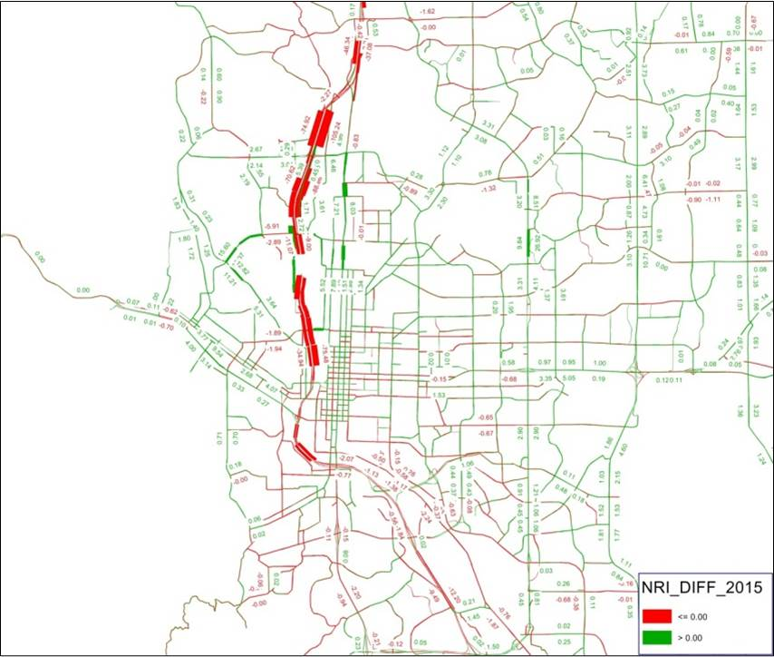
Sensitivity Test #1: Freeway Segment Closure
Test closure of a high volume freeway segment confirmed the value of using peak hour analysis to represent “worst case” conditions.
INTERSTATE 25 SEGMENT CLOSURE
SCENARIO | PM_VHT | DIFFERENCE | % DIFFERENCE
Base 2015 Network | 36,491
Network with Segment Removed | 37,300 | 809 | 2.2%

Slide 15
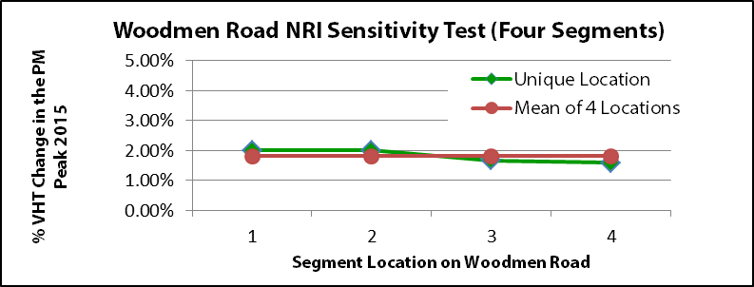
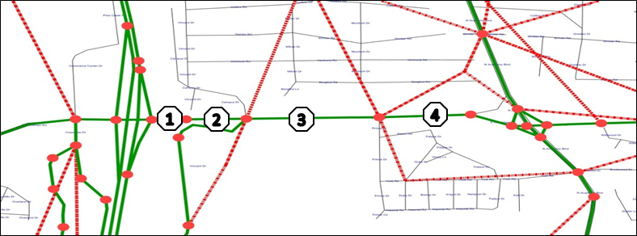
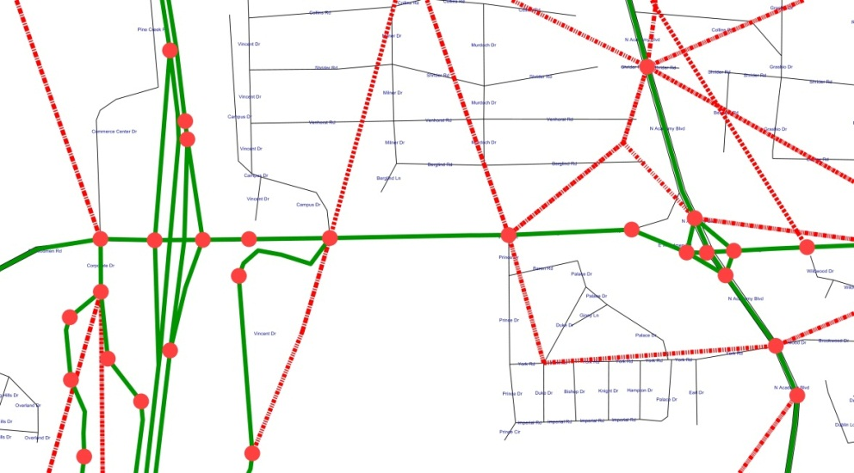
Sensitivity Test #2: Segment Location Test
Iterative tests using alternative major arterial segments provided a framework for consistent selection of closure segments.
SENSITIVITY TESTS OF SEGMENT LOCATION
SCENARIO | PM_VHT | DIFFERENCE | % DIFFERENCE
Base | 36,491
NRI_002_1 | 37,219 | 728 | 1.99%
NRI_002_2 | 37,217 | 727 | 1.99%
NRI_002_3 | 37,098 | 607 | 1.66%
NRI_002_4 | 37,069 | 578 | 1.58%
Average | 37,151 | 660 | 1.81%
1
2
3
4

Slide 16
PPACG NRI-Based NHS Security Criticality Tests
05

Slide 17
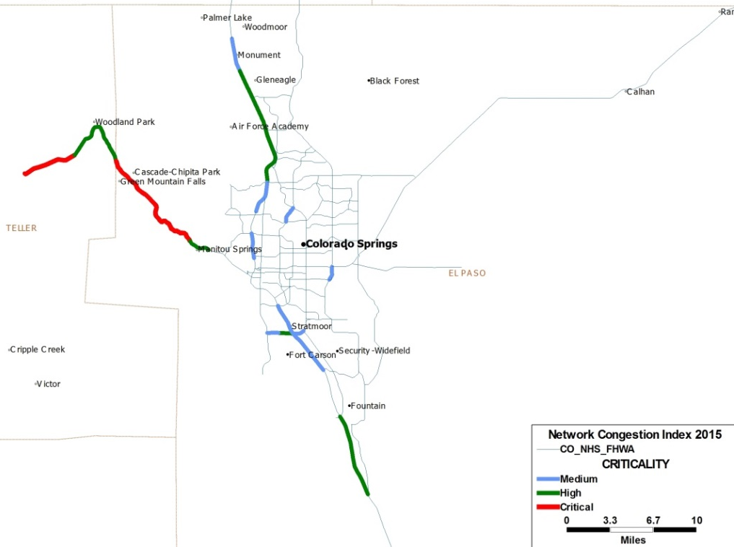
Medium, High and Critical Segment Findings
The NRI provides a clear basis for ranking NHS roadway criticality.
Rugged terrain, barrier features, bridge crossings and network redundancy are often factor in facility criticality.
NRI CRITICALITY FINDINGS SUMMARY
LEVEL | COUNT | % | MINIMUM | MAXIMUM
Low | 180 | 87% | 0.0% | 1.9%
Medium | 16 | 8% | 2.2% | 4.4%
High | 7 | 3% | 6.2% | 23.4%
Critical | 4 | 2% | 139180% | na

Slide 18
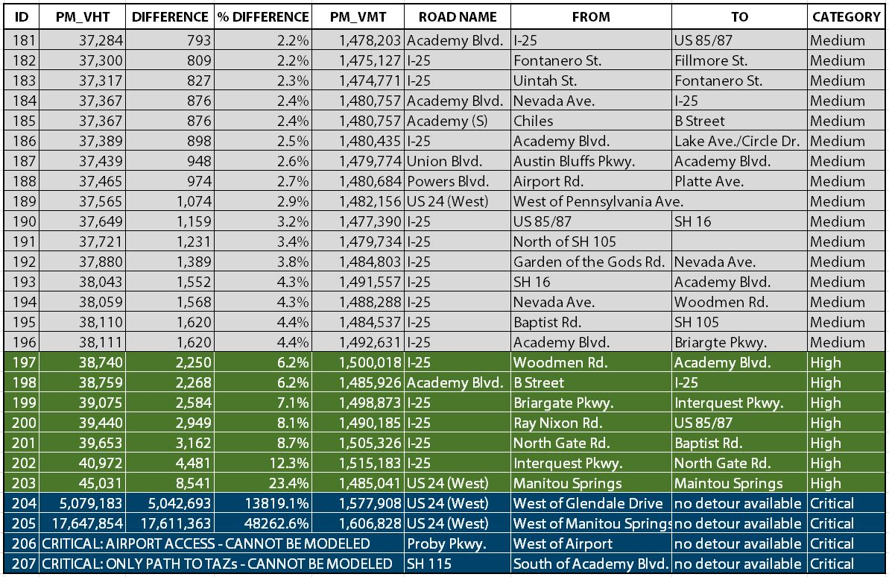
NHS Results Summary

Slide 19
PPACG NRI-Based Project Prioritization Tests
06

Slide 20
NRI Project Screening Findings
The following 2040 RTP projects were screened using the NRI:
Project #1 - Centennial Extension Addition of a two-mile completion segment to an existing arterial roadway
Project #2 - Woodmen Road Widening
Widening 1.5-mile long segment of a 4-lane arterial to 6 lanes
Project #3 - I-25 Widening Addition of one lane in each direction to the most congested segment of I-25
FIRST PASS 2040 RTP PROJECT COMPARISON USING NRI
SCENARIO | PM_VHT | DIFF | % DIFF | PM_VMT | DIFF | % DIFF
2015 Base | 36,491 |  |  | 1,472,063
Test 1 | 36,394 | (97) | -0.27% |  | (466) | -0.03%
Test 2 | 35,066 | (1,425) | -3.90% |  | (22,404) | -1.52%
Test 3 | 35,365 | (1,126) | -3.-8% |  | (24,468) | -1.66%

Slide 21
Summary of Findings
07

Slide 22
Key Findings
NRI provides assessment of highway improvement value in terms of time savings
NRI provides a clear basis for identification of security critical highway segments
There is potential to link NRI scores at the project level to scoring and portfolio optimization

Slide 23
Questions?

