Slide 1
Benefit Cost Analysis Using an Activity-Based Model
Joe Castiglione (RSG / SFCTA)
Jeff Frkonja (RSG)
Jim Miller (SANDAG)
TRB Planning Applications Conference
Atlantic City, NJ
May 20, 2015

Slide 2
Acknowledgements
SANDAG
  Clint Daniels
  Gregor Schroeder
  Ziying Ouyang
RSG
  Vince Bernardin
  Bryce Lovell
  Mariela Tinarejo
AECOM
  Toni Horst

Slide 3
Agenda
SANDAG Projects and Plan Alternatives Evaluation Process
BCA Metrics and Supporting Assumptions
BCA Analysis Using SANDAG’s Activity-Based Model (ABM)
Noteworthy Features of BCA based on ABM

Slide 4
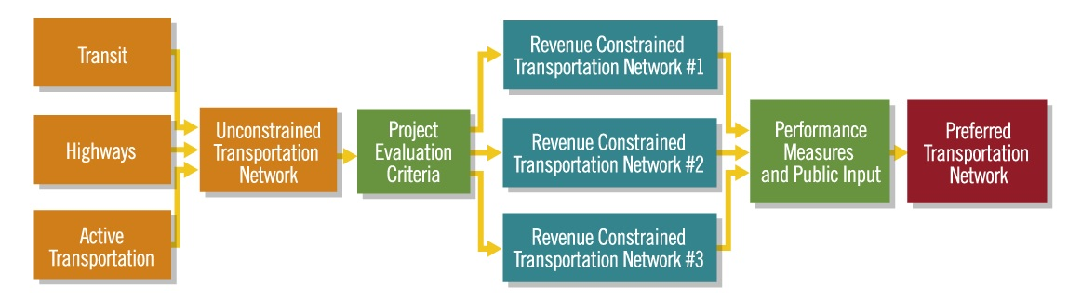
Transport Choices→Project Evaluation→Plan Alternative
Process Flow
  Develop Choices
  Categorize Proposed or Potential Projects
  Evaluate each Project
  Combine Projects into Coherent “Networks” (Plan Alternatives)
  Evaluate “Networks”
  Apply Evaluation Results to Choosing/Designing Final Alternative
Source: SANDAG (see http://www.sdforward.com/mobility-planning/creating-transportation-choices)

Slide 5
Benefit-Cost Analysis Overview
Uses monetary value as the metric to support decision-making by making different characteristics comparable
Q: Does an investment (relative to no or different investment) produce more benefits than costs?
  To invest or not to invest
  To prioritize investments
  To better “design” a given investment
Q: Who benefits?
  Harder to answer this question with past tools
Notes:
Repeat for minority populations.
Can be broken out by benefit type if desired.

Slide 6

Benefit-Cost Analysis Principles
Analysis should…
  Be comprehensive across the population at hand
  Address both costs and benefits independently
  Explicitly treat difficult-to-monetize benefits and costs
  Be transparent

Slide 7
Benefit-Cost Analysis Metrics
Direct benefits
  Mobility cost savings
    Actual travel time savings (residents, trucks)
    Reliability benefits (residents, trucks)
  Vehicle operating cost savings
  Auto ownership cost savings
Indirect benefits
  Safety (accident reduction) benefits
  Emissions (and other environmental) cost savings
  Physical activity health benefits

Slide 8
BCA Assumptions
Value of Travel Time Savings (VTTS or VOT)
Value of Reliability Benefits (VOR)
Value of Accidents Prevented (by type)
Value of Quantities of Emissions Reduced
Vehicle Operating Costs
Vehicle Ownership Costs
Value of Physical Activity
Economic
  Discount Rate
  Inflation Rate
“Rule of half”

Slide 9
SANDAG BCA Assumption Choices
Item | Valuation
In-Vehicle Travel Time (Auto & transit) per Person Hour of Travel | $12.02
Out-of-Vehicle Travel Time (Auto & transit) per Person Hour of Travel | $26.44
In-Vehicle Travel Time (Freight/Truck) per Person Hour of Travel | Heavy = $43.20 Medium, Light, Comm = $30.00
Travel Time Reliability (Auto) per Person Hour of Non-Recurring “Total Equivalent Delay” | $12.02
Travel Time Reliability (Freight/Truck) per Person Hour of Non-Recurring “Total Equivalent Delay” | Heavy = $43.20 Medium, Light, Comm = $30.00
Auto Operating Costs per Auto Mile Travelled (increases by year) | $0.216 - $0.263
Truck operating Costs per Truck Mile Travelled | $0.35
Physical Activity (per person exceeding minimum threshold) per year | $180
2010 $
Source: SANDAG, RSG. Technical Memorandum “” San Diego Forward Cost Effectiveness Evaluation Criteria Assumptions. 3/6/2014.

Slide 10
SANDAG BCA Assumption Choices
Item | Valuation
Fatality Collisions ($ per fatality) | $8,640,000
Injury Collisions ($ per injury) | $406,200
Property Damage Only Collisions ($ per incident) | $9,550
CO2 (per ton, increases per year) | $51.81
PM2.5 (per ton) | $459,000
PM10 (per ton) | $139,000
NOx (per ton) | $7,300
ROG (per ton) | $6,365
SO2 (per ton) | $37,900
Auto Ownership Costs (per vehicle) | $5,900
2010 $
Source: SANDAG, RSG. Technical Memorandum “” San Diego Forward Cost Effectiveness Evaluation Criteria Assumptions. 3/6/2014.

Slide 11
Segmentation
Communities of Concern
  Income
  Race / ethnicity
  Age
Purpose
  Commute
  non-commute
  Work
  Truck / comm
VOT
  Resident
  Trucks by type
Geography

Slide 12
Mulityear Processing
Benefits and costs considered over multi-year period
  Stream of benefits produced by tool
  Stream of costs input to tool
Two-step process
  1) Compare base and scenario alternative for all forecast years to calculate benefits
  2) Interpolate / extrapolate to produce stream of benefits to compare to costs
Flexibility
  Start year
  Interim years
  End year

Slide 13
Multiyear Assumptions
Inflation rate
  Currency value decline over time
Discount rate
  Time value of money
Annualization factor

Slide 14
Example ABM BCA Results
First or One of the First BCA Applications in ABM framework
Source: RSG, SANDAG

Slide 15
Example of ABM BCA Findings
Who benefits?
  Benefits by individuals belong to a “Community of Concern” (similar to Environmental Justice)
Source: RSG, SANDAG
Notes:
“White alone, not Hispanic or Latino, percent, 2013” share was 47.2% - i.e.. San Diego is a majority minority county.
Most “core” investments serve minority areas

Slide 16
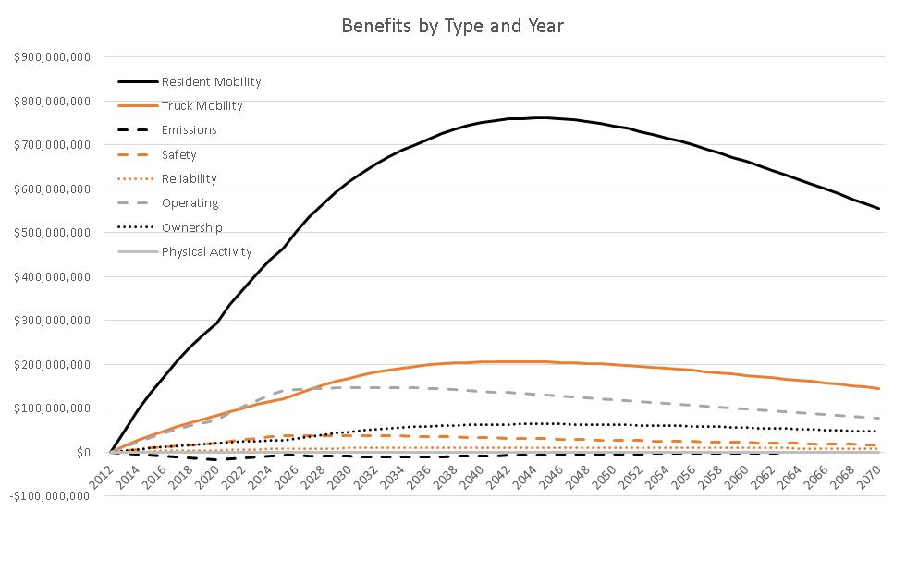
Multiyear Benefit Stream

Slide 17
Aggregate vs. Activity-Based Analysis
Aggregate potential level of detail:
  Zone
  Market Segment (e.g. Home-Based-Work-Low-Income)
Activity-based potential level of detail:
  Person, along any characteristic (e.g. HH income, age, etc.)
  Person-trips
Notes:
Repeat for minority populations.
Can be broken out by benefit type if desired.

Slide 18
Activity-Based Analysis
Environmental Justice (“Communities of Concern”): In aggregate modeling the zone becomes a proxy for the people
Typical: Green is an “EJ” zone because threshold percent of residents meet EJ criteria; assume global proportion of trips
Notes:
Repeat for minority populations.
Can be broken out by benefit type if desired.

Slide 19
Activity-Based Analysis
Environmental Justice (“Communities of Concern”): In ABM modeling we know exactly who the EJ individuals are (dark green arrows) because model simulates individual characteristics
ABM enables more-precise accounting by person and characteristic
Notes:
Repeat for minority populations.
Can be broken out by benefit type if desired.

Slide 20
Activity-Based Analysis
Physical Activity Threshold=22 min/day
  Aggregate model sees three trips below threshold
8 min
10 min
14 min
Notes:
Repeat for minority populations.
Can be broken out by benefit type if desired.

Slide 21
Activity-Based Analysis
Physical Activity Threshold=22 min/day
  ABM sees set of daily activity that in total crosses threshold
8 min
10 min
14 min
Notes:
Repeat for minority populations.
Can be broken out by benefit type if desired.

Slide 22
Geographic Subarea Analysis
Possible with Aggregate approach
  ABM enables cross-tabulating user characteristics with geography (e.g. Blue-Green Trips by EJ folks)
Investment
Blue-Green Trips
Purple-Green Trips
Notes:
Repeat for minority populations.
Can be broken out by benefit type if desired.

Slide 23
Challenges
Imputation of transit impedances when not present in base or scenario alternative
  Segmented by access type
  Based on drive alone auto distances
Different resolutions
  Disaggregate trips
  Persons
  Links
  OD pairs
Limitations of COC benefit segmentation

Slide 24
Different Resolutions
Benefit Type | Resolution | COC
Mobility – Residents | Person trip | Yes
Mobility – Trucks / Comm | TAZ OD trip | No
Emissions | Link | No
Accidents | Link | No
Reliability | Link | No
Vehicle Operating | TAZ OD trip | No
Vehicle Ownership | HH | Yes
Physical Activity | Person | Yes

Slide 25
Future Developments
Extension of COC reporting
  Emissions
  Accidents
  Reliability
  Vehicle Operating
Improved user interface
Flexible COC specification
Performance Tuning

Slide 26
Sources for Valuation and How-To
Travel Demand Forecasting Value-of-Time Definition
  Implied VOT: ratio of time and cost coefficients in the (primary) mode choice statistical model
USDOT Value-of-Time Definition
  USDOT. The Value of Travel Time Savings: Departmental Guidance for Conducting Economic Evaluations Revision 2. 2011.
AASHTO “Red Book” (project-level BCA)
  American Association of State Highway and Transportation Officials. User and Non-User Benefit Analysis for Highways. 2010

Slide 27

Thank You!
Joe Castiglione
617.251.5111
joe.castiglione@sfcta.org
Jeff Frkonja
312.605.9213
jeff.frkonja@rsginc.com
Jim Miller
jim.miller@sandag.org
619.699.7325

Slide 28
Reserve Slides

Slide 29
Project Evaluation
Example Highway Corridor Criteria
  Congestion Relief *
  Safety
  Evacuation Route Access
  Non-SOV Mobility *
  Emissions Reduction *
  Serves Designated Growth Areas
  Promotes Physical Activity *
  Support Goods Movement/Freight System Bottleneck Relief *
  Cost-Effectiveness *
* BCA can inform these criteria
Source: SANDAG “Project Evaluation Criteria”(see http://www.sdforward.com/mobility-planning/evaluating-projects)

Slide 30
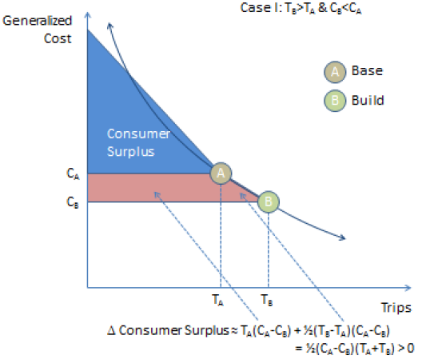
BCA Founded in Economic Theory
Consumer Surplus
“Good” = travel from O to D
$ Willing to Pay
$ Actually Paid
Willing minus Actual = Surplus
Build Alternative Changes the Surplus
Additional Surplus can be invested in some other good and thus has economic and personal value
Source: Ohio DOT : “Enhancement of Economic Analysis Capabilities: Initial Review and Recommendations”. 2011

Slide 31
In-Vehicle Travel Time (freight / trucks)
 | Heavy Trucks | Light Trucks
ATRI, 2010 | 89.23
Smalkowski & Levinson, 2005 | 58.10
Outwater & Kitchen, 2008 | 53.32 | 42.66
Miao et al., 2011 | 33.94 - 57.65
Almy et al., 2010 | 45.15
Mei et al., 2013 | 33.29 - 52.22 | 26.06 - 46.14
BLA, EDRG & RSG, 2013 | 36.05 | 22.26 - 27.24
Kawamura, 1999 | 32.25
Kawamura, 2003 | 21.96 - 34.94
Cal-BC | 28.70
USDOT* | 26.43
*Driver's time only, USDOT acknowledges there is value to commodities' time
Notes:
Repeat for minority populations.
Can be broken out by benefit type if desired.

Slide 32
In-Vehicle Travel Time (auto and transit)
Trips on work tours
  c(i) = -0.15/$ / [((income(i) / 30,000 ^0.6) * (occupancy(i) ^ 0.8))]
  b(i) = -0.030/min
Trips on non-work tours
  c(i) = -0.15/$ / [((income(i) / 30,000 ^0.5) * (occupancy(i) ^ 0.7))]
  b(i) = -0.015/min
Notes:
Repeat for minority populations.
Can be broken out by benefit type if desired.

Slide 33
Travel Time Reliability (auto & freight / truck)
Calculate “Total Equivalent Delay”
Link-level calculation
  Segmentation limited to assignment classes
  Trucks / auto
Set VOR equal to IVTT VOT
Source: SHRP2 L05
Notes:
Repeat for minority populations.
Can be broken out by benefit type if desired.

Slide 34
Collisions
Segmented by collision type
Link-level calculation
  Facility type segmentation only
  SANDAG staff updating VMT-based rates using SWITRS
Auto only
Source: USDOT Memo (2/28/2013) on the value of statistical life, Cal-B/C
Collision Type | Value
Fatality | $9,100,000
Injury | $427,700
Property damage only | $10,200
Notes:
Repeat for minority populations.
Can be broken out by benefit type if desired.

Slide 35
Emissions
Segmented by pollutant
Link-level calculation
Source: BAAQMD
Pollutant | Monetization
CO2 | $55.35 / ton
PM2.5 | to be imputed from MTC monetization factors and SANDAG weighted distribution of PM2.5 by type
NOx | $7,800 / ton
ROG | to be imputed from MTC monetization factors and SANDAG weighted distribution of ROG by type
SO2 | $40,500 / ton
Notes:
Repeat for minority populations.
Can be broken out by benefit type if desired.

Slide 36
Auto Ownership Costs
MTC = $6,290 / year
AAA = $6,000 / year
Household-level calculation
Source: MTC
Notes:
Repeat for minority populations.
Can be broken out by benefit type if desired.

