Slide 1
Developing Travelshed TAZ Using ArcGIS
15th TRB National Transportation Planning Applications Conference
May 20, 2015
Erich Rentz, RSG
Vince Bernardin, PhD, RSG
Brian Grady
Robert Rock, TDOT

Slide 2
Outline
Introducing Travelshed Transportation Analysis Zones (TAZ)
  Traditional 4-Step Travel Demand Model TAZ
  Traditional vs. Travelshed TAZ
  Advantages of Travelshed TAZ
  Case Study Introduction: Tennessee Statewide Model
Developing Travelshed TAZ
  Delineation Process Outline
  Common Boundary Identification
  Automated Delineation
  Manual Review and Revision
Concluding Thoughts
Questions?

Slide 3
Introducing Travelshed TAZ

Slide 4
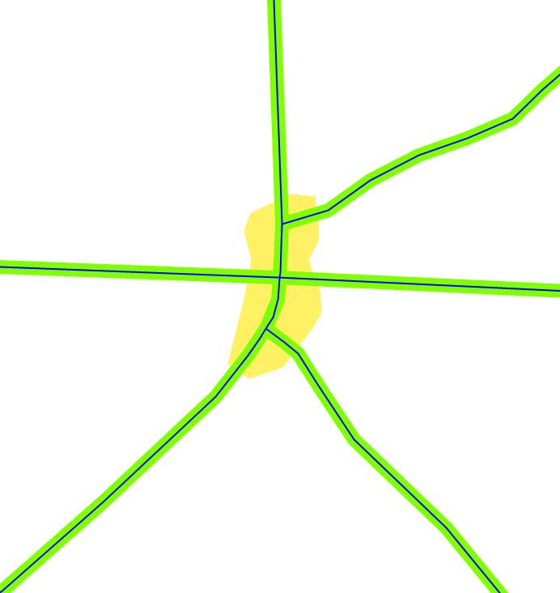
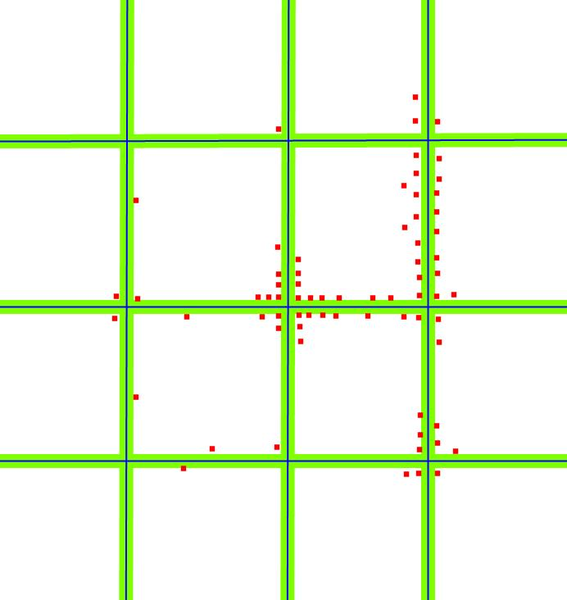
Traditional 4-Step Travel Demand Model TAZ
Traditional Transportation Analysis Zone (TAZ) Definition Limitations:
  Zones defined and delineated by the transportation network
  Opposite sides of the same street are often split into different Zones
  In urban areas, assessment of walkability difficult
  In rural areas / statewide models, assessment of area type difficult

Slide 5
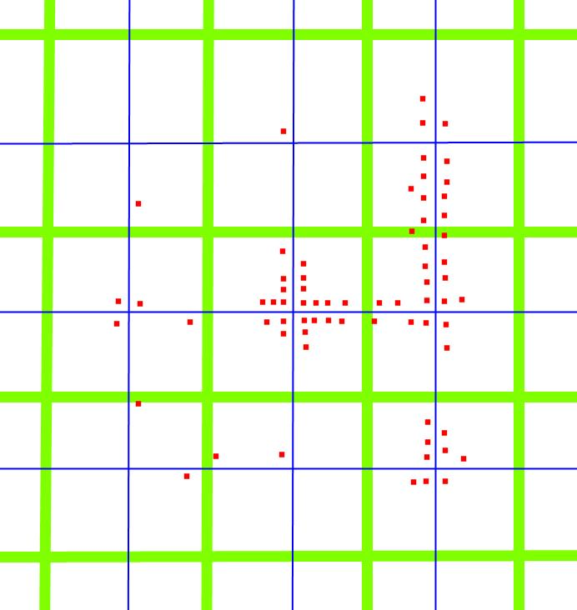
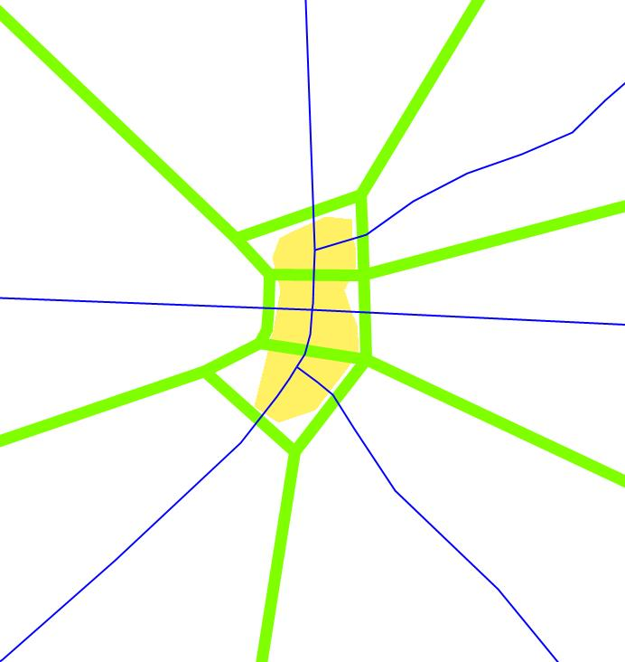
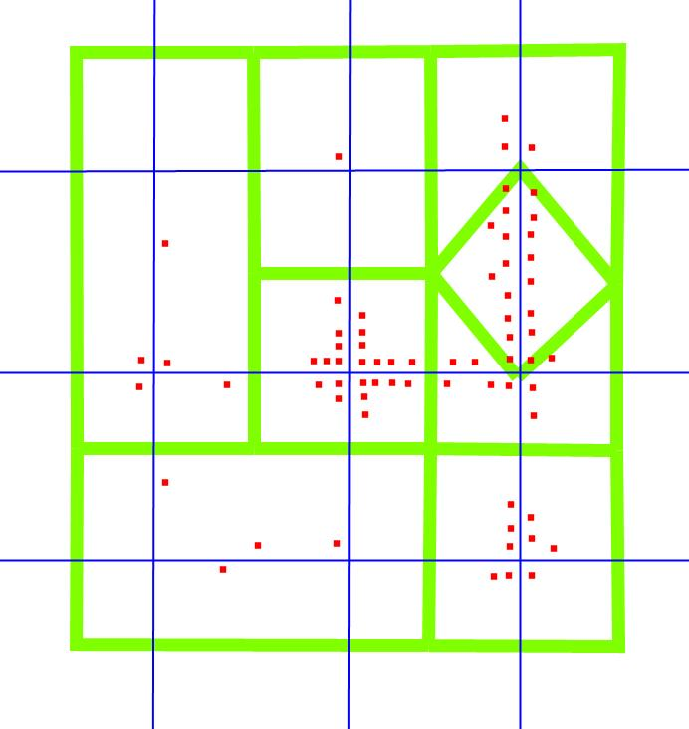
Traditional vs. Travelshed TAZ
What is a travelshed?
  View road facilities and their catchment areas as akin to rivers and their basins in a hydrological system

Slide 6
Advantages of Travelshed TAZ
Clearer relationship between zones and underlying roadways
  Less ambiguity around placement of loading points (centroid connectors)
Walkability clearer in urban areas
Area type much clearer in rural areas
Naturally takes into account other boundaries and barriers to travel

Slide 7
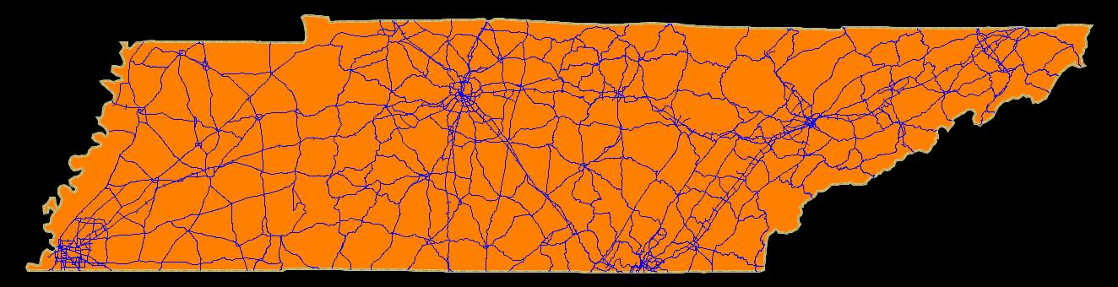
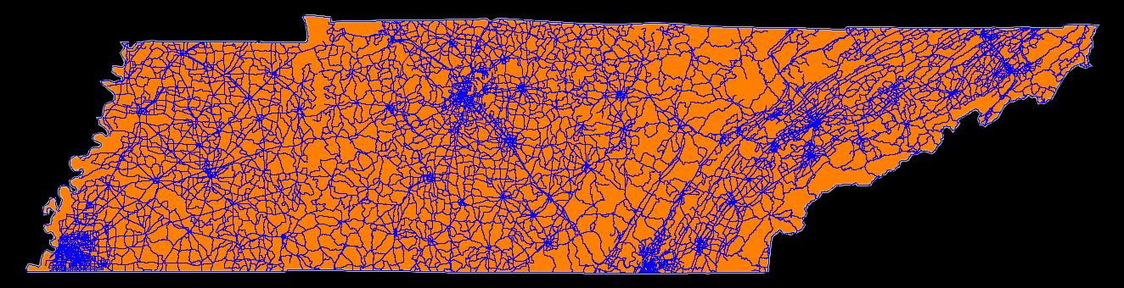
Case Study Introduction:
Tennessee Statewide Model
New Network and Zone System has ~3x as much detail
  Roadmiles in TN: 9,421 to 32,546
  TAZ in TN: 1,222 to 3,293
Original 2005
Model
New Version 2
Model

Slide 8
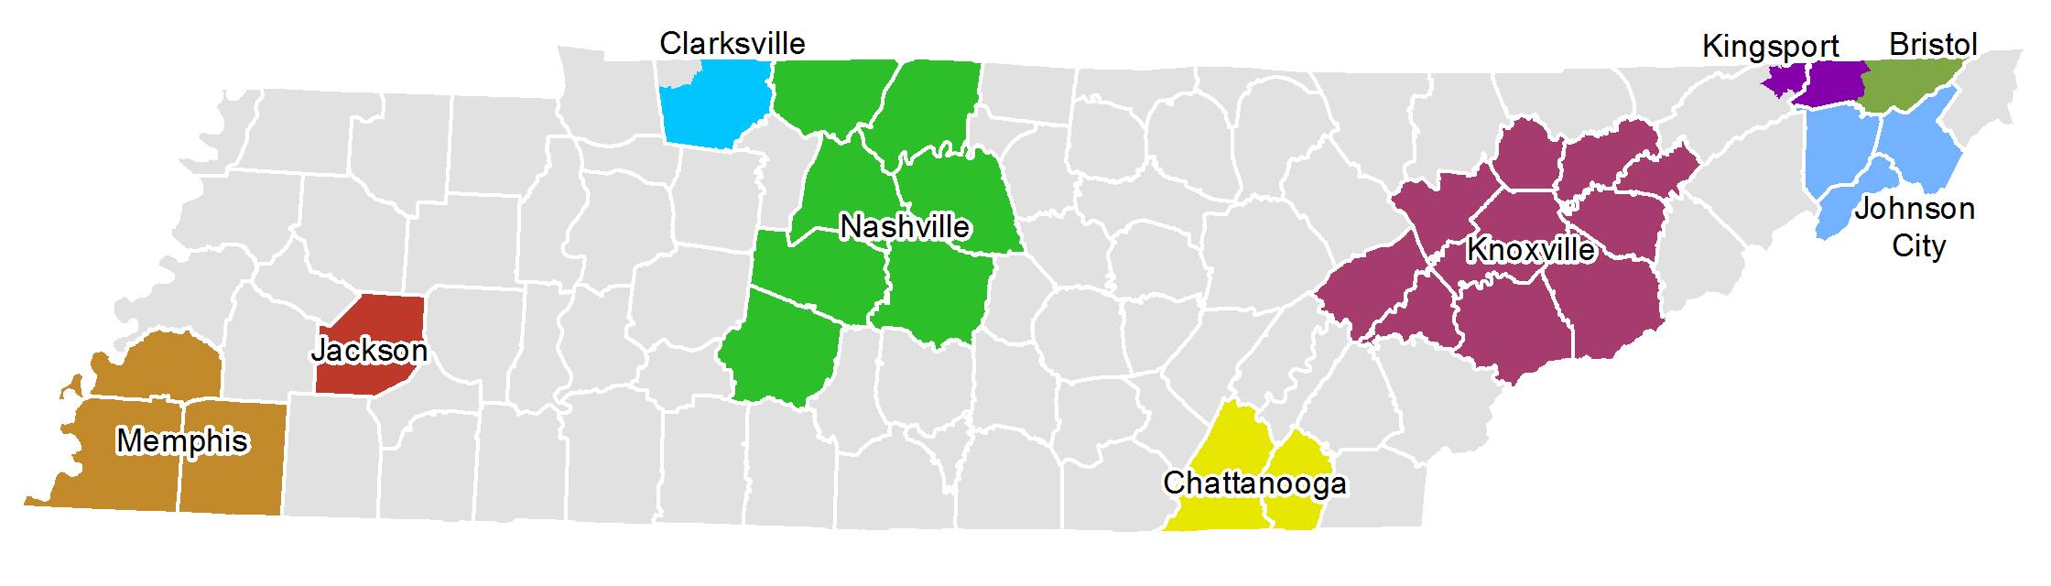
Case Study Introduction:
Delineation Approach
Urban (MPO) areas
  Emphasis on consistency with MPO TAZ
    Statewide TAZ developed from aggregated MPO TAZ
  Part travelshed, part traditional delineations
Rural areas
  Emphasis on delineating area types /small towns
    Statewide TAZ developed from aggregated census blocks
  Predominantly travelshed delineations

Slide 9
Developing Travelshed TAZ

Slide 10
Delineation Process Outline
  Common Boundary Identification
  Automated Delineation
Manual Review and Revision

Slide 11
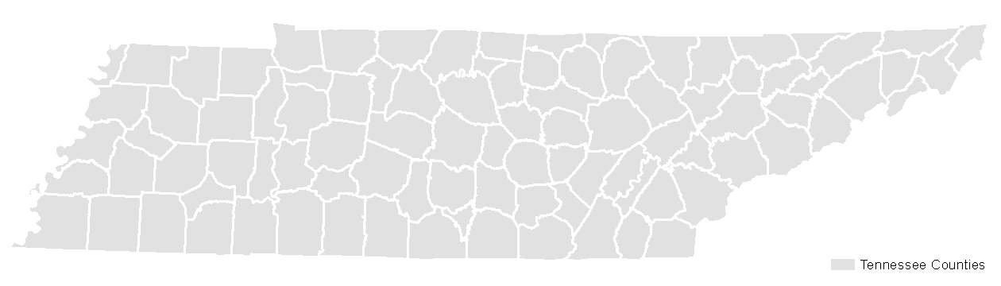
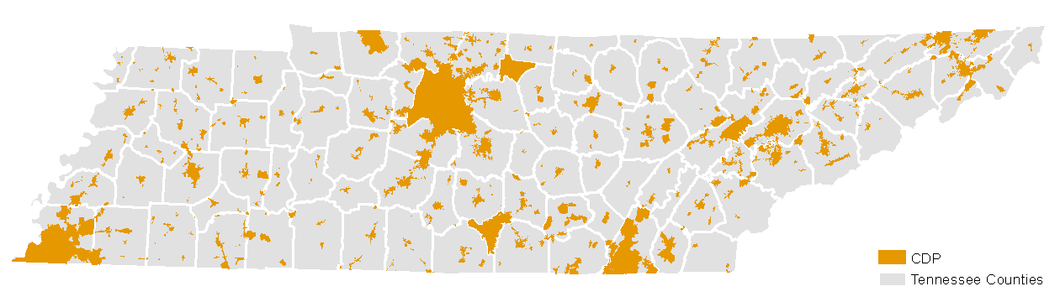
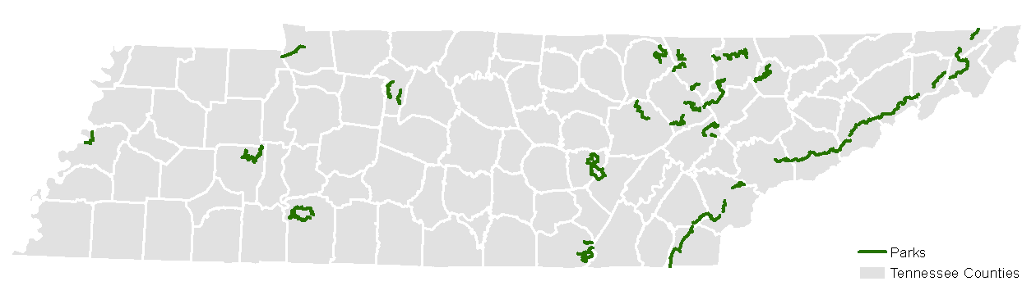
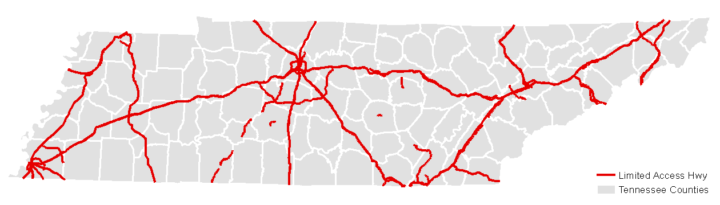
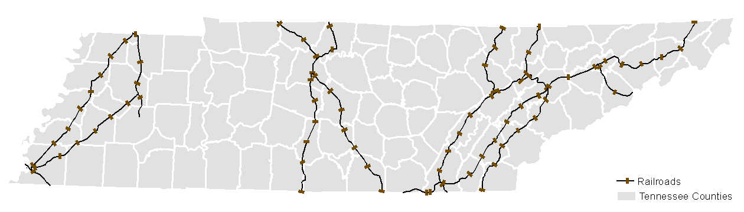
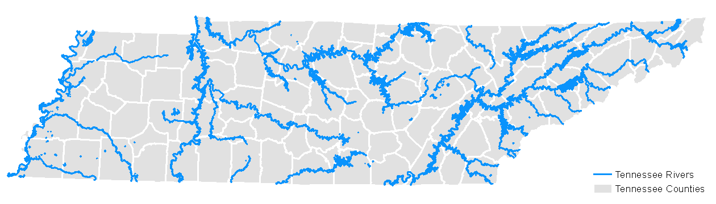
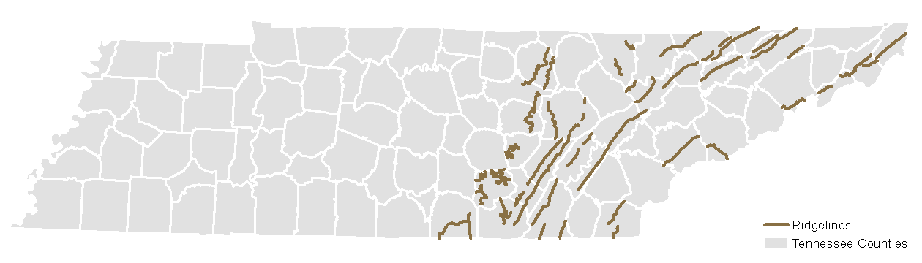
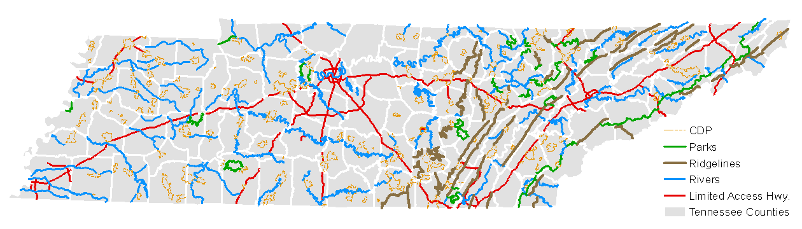
Common Boundary Identification
Boundaries & Travel Barriers
Boundaries
  Counties
  Census Designated Places (CDP)
  National & State Parks
Barriers
  Roadways
  Railroads
  Rivers
  Ridgelines

Slide 12
Automated Delineation
  Prepare Source Data
  Identify Travelsheds
Generate Output Polygon TAZ Layer

Slide 13
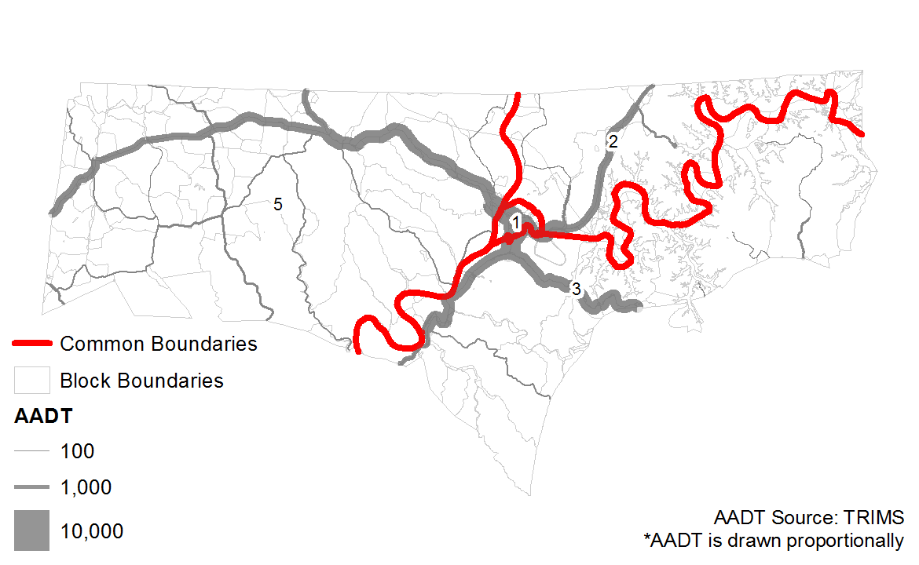
Automated Delineation:
Identify Target TAZ Count by CBL Polygon

Slide 14
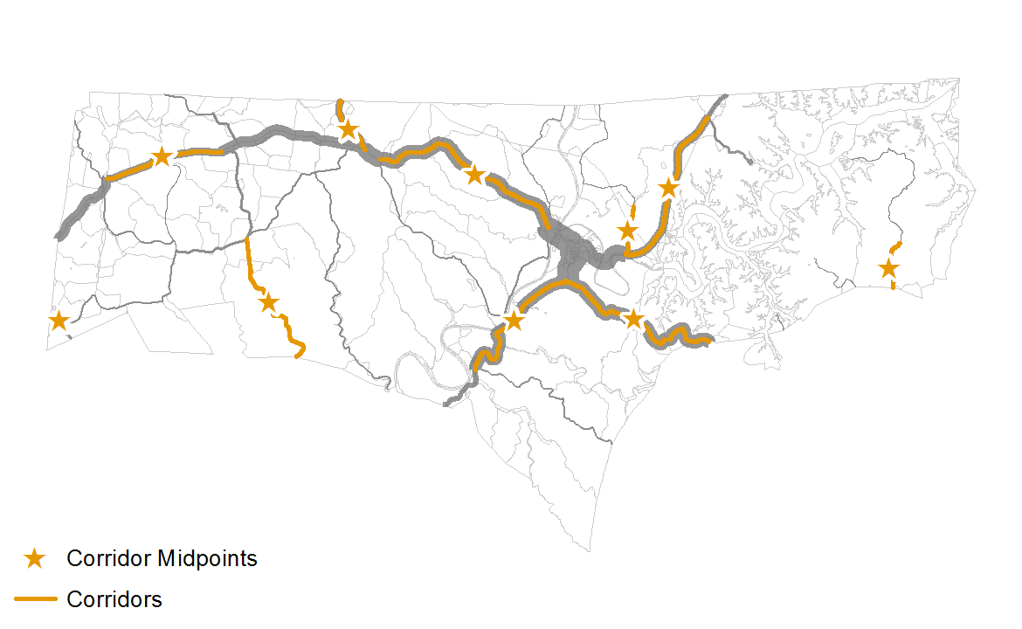
Automated Delineation:
Identify Corridors

Slide 15
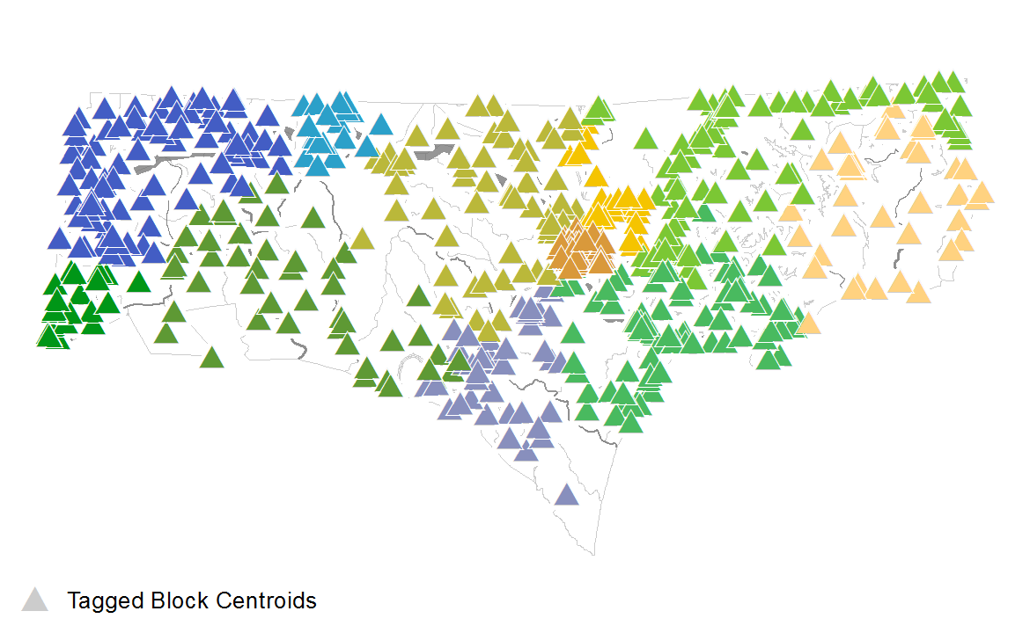
Automated Delineation:
Assign Blocks to Corridors

Slide 16
Automated Delineation:
Block Assignment
For i = Buffer distance (500 foot increment to max)
For j = Corridor (high AADT to low AADT)
Assign Blocks or MPO zones to Corridor
Next j
Next i
Where,
i = range of buffers from 500 feet to maximum distance required to tag all blocks or MPO zones
j = unique travelshed corridors (zones) desired for each common boundary polygon

Slide 17
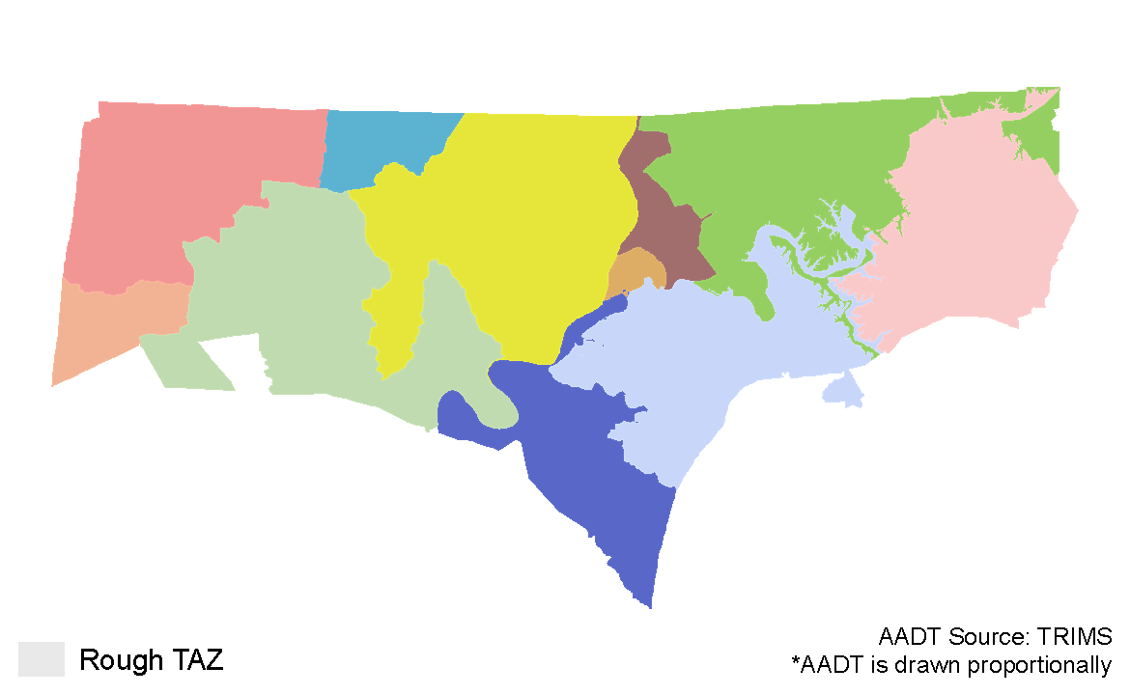
Automated Delineation:
Generate Output Polygon TAZ Layer

Slide 18
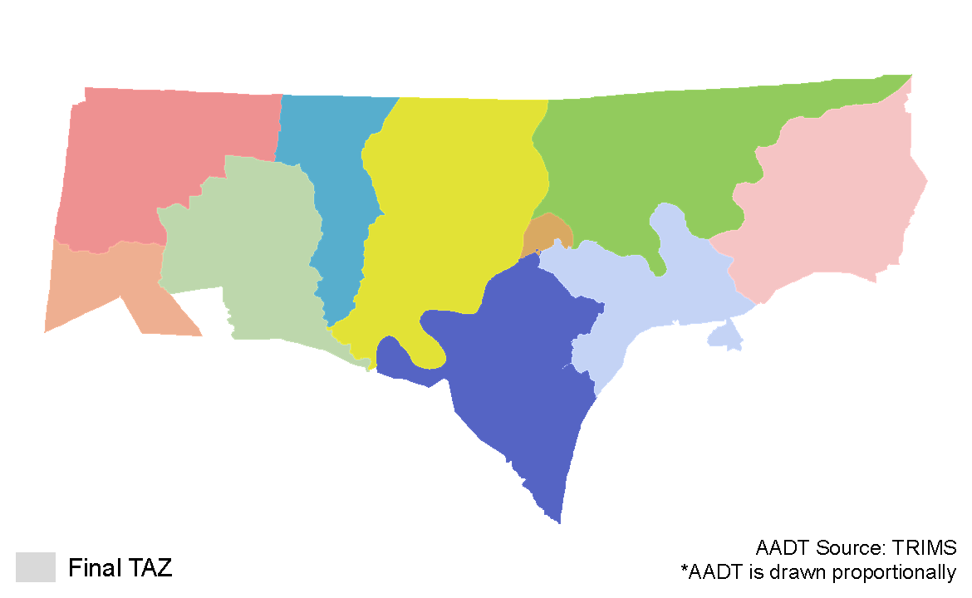
Manual Review and Revision

Slide 19
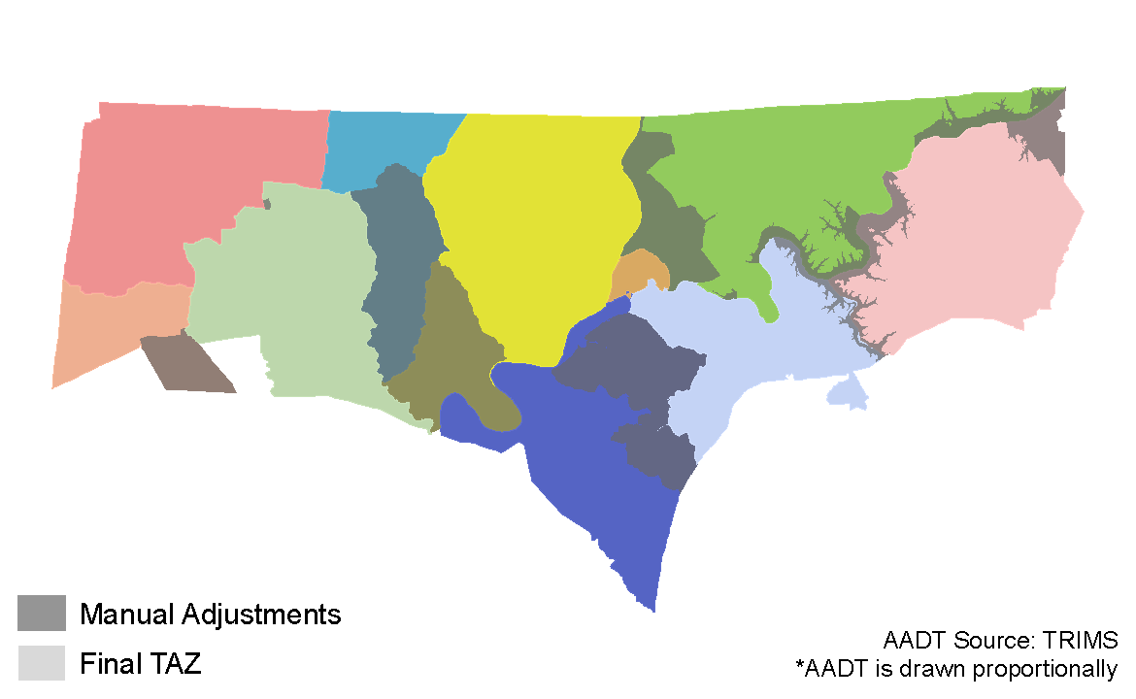
Manual Review and Revision:
What was changed?

Slide 20
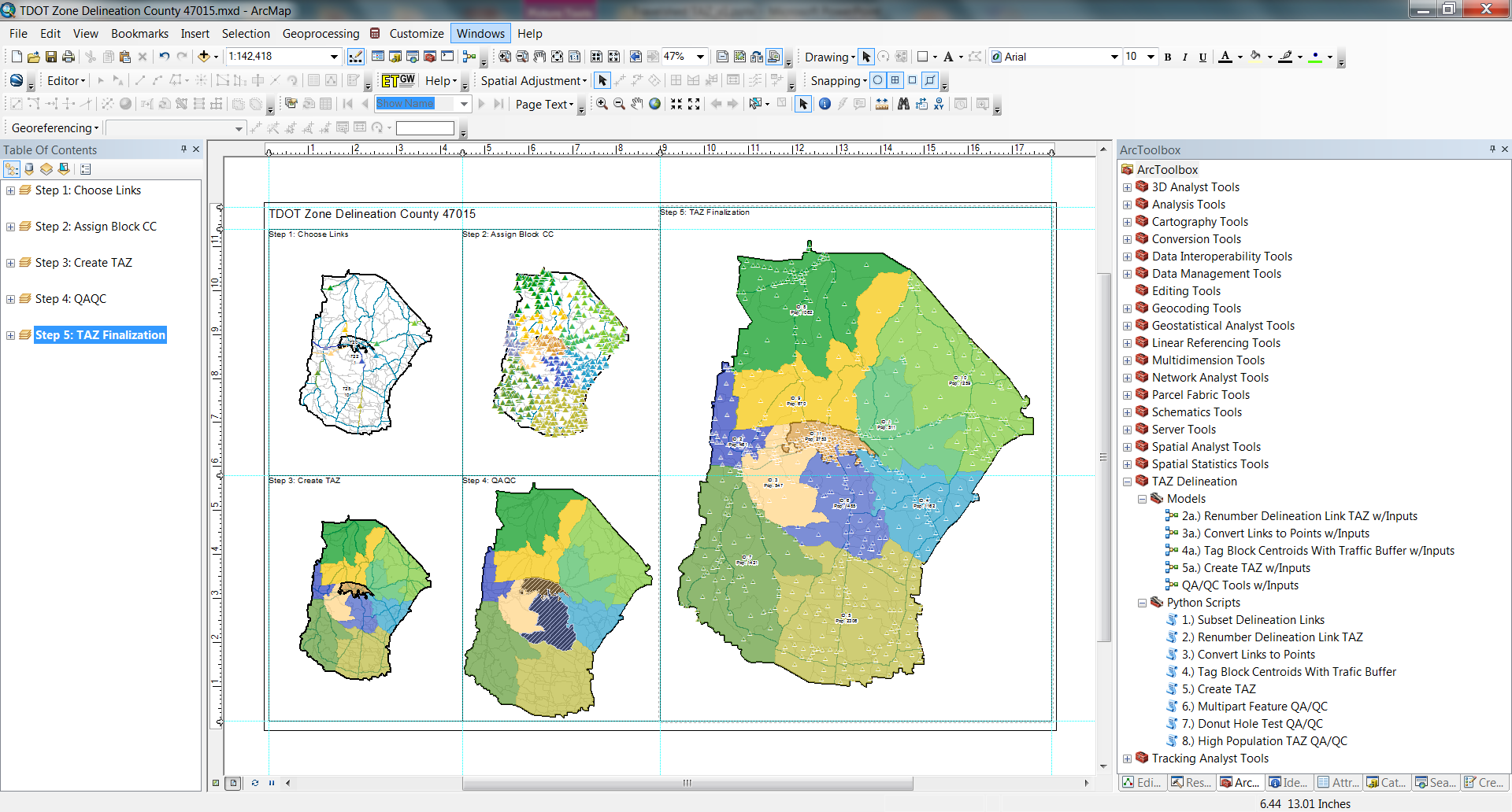
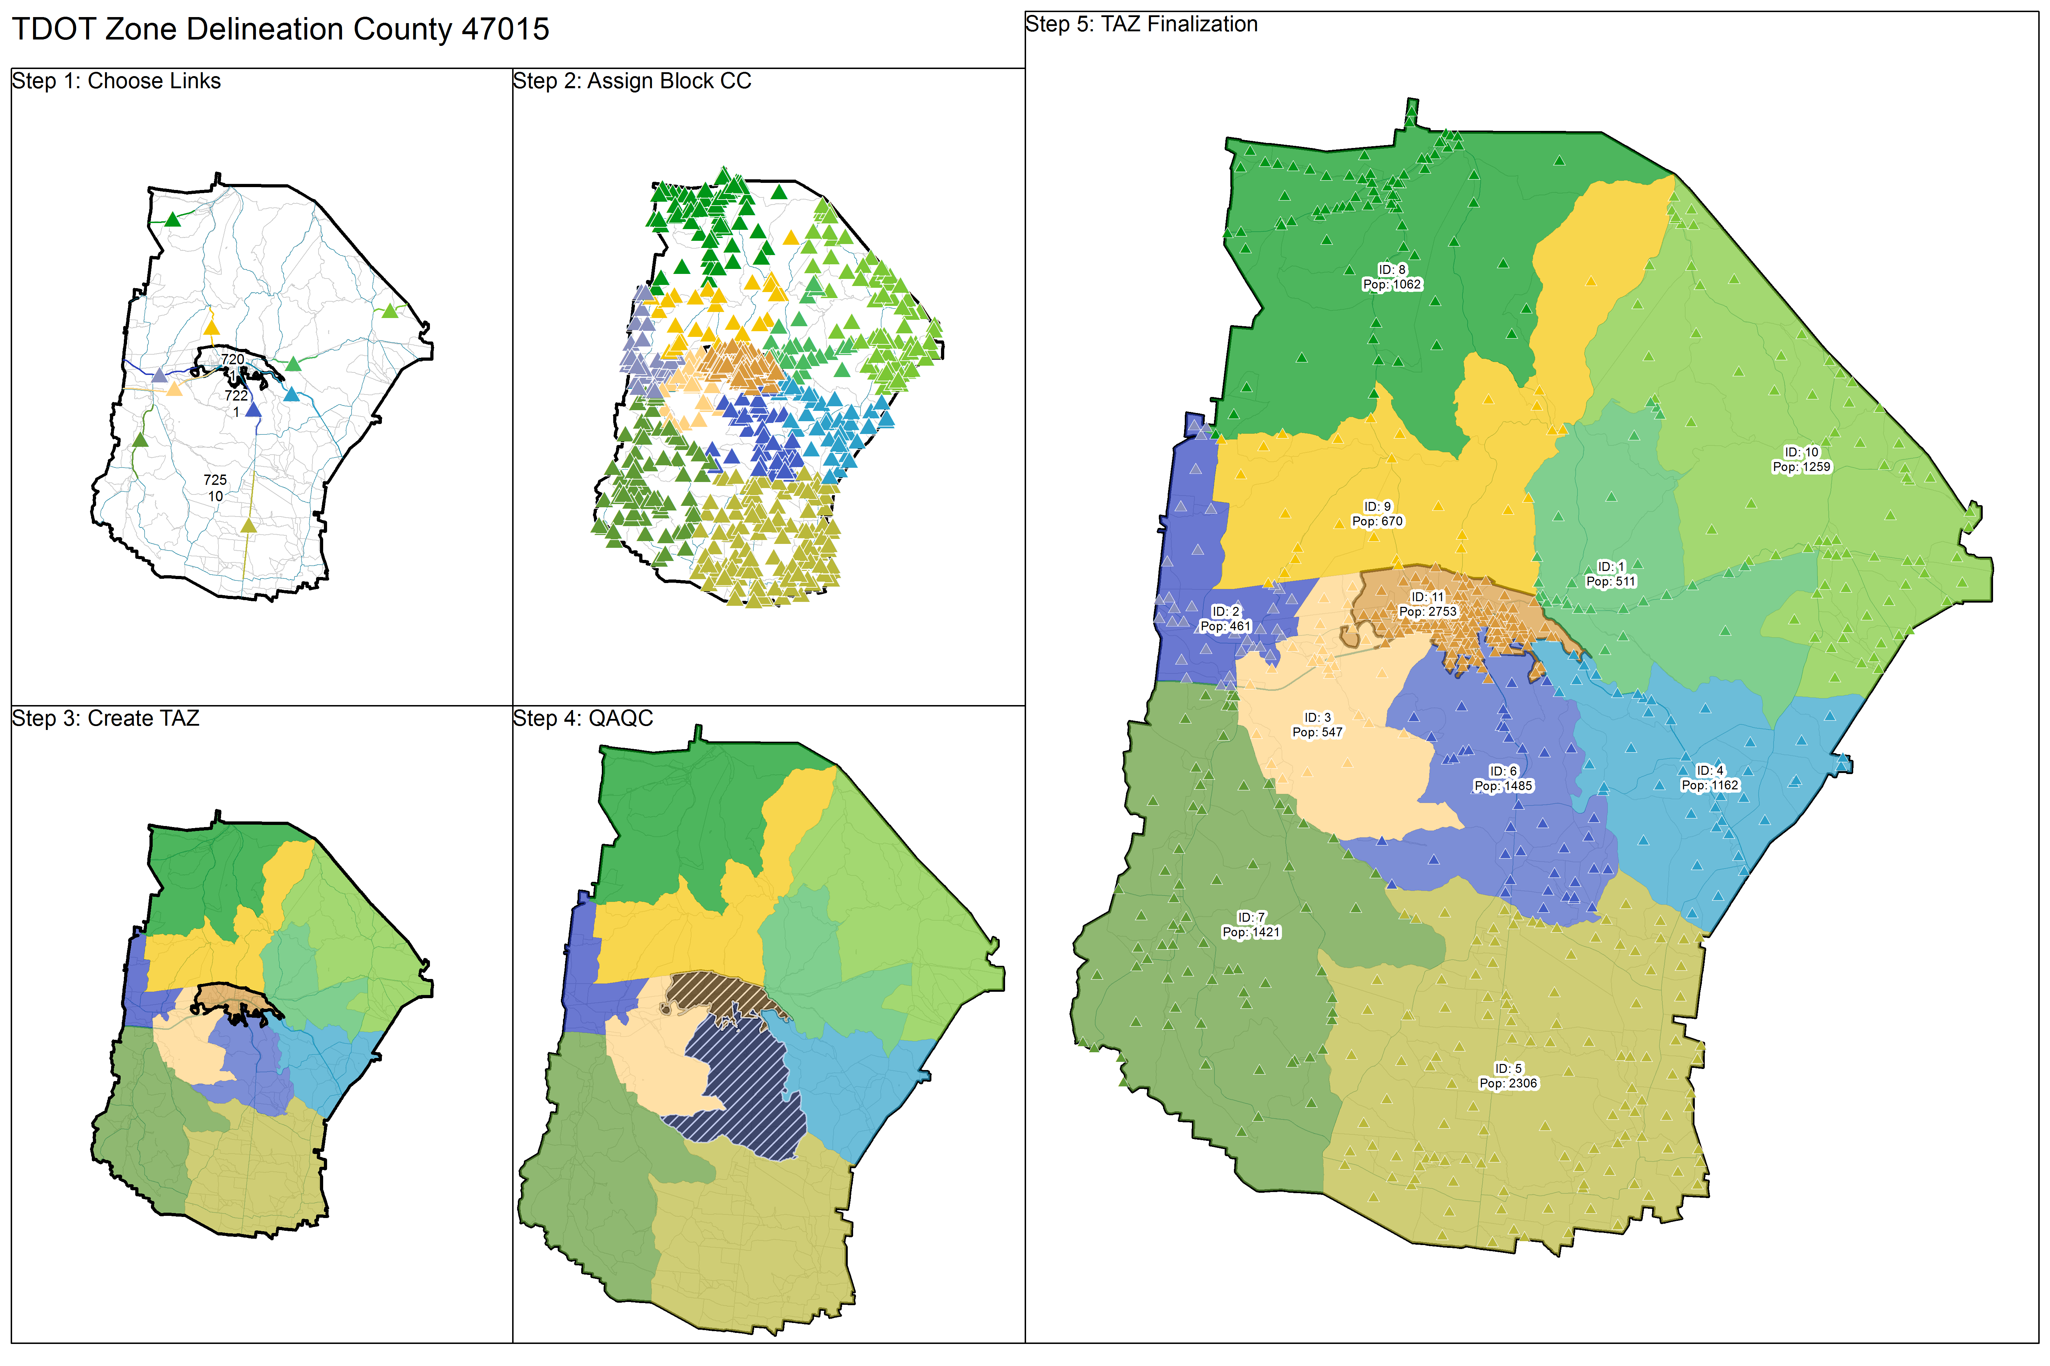
Manual Review and Revision:
Environment

Slide 21
Concluding Thoughts

Slide 22
Concluding Thoughts
The version 2 Tennessee statewide model is now in use
Using Travelshed TAZ, the model achieved great base year validation statistics for a statewide model
Volume Range |  | Number of Count Stations | Percent Error | Correlation Coefficient | MAPE | %RMSE
 |  |  |  |  |  | Model | Standard
1 | 5,000 | 7,288 | 10.2 | 0.69 | 66.8 | 91.1 | 101.4
5,000 | 10,000 | 1,943 | 5.5 | 0.61 | 31.1 | 39.6 | 56.3
10,000 | 20,000 | 1,700 | 0.8 | 0.79 | 21.0 | 27.8 | 51.4
20,000 | 30,000 | 747 | -2.1 | 0.85 | 15.9 | 21.5 | 35.7
30,000 | 40,000 | 318 | 0.6 | 0.85 | 12.0 | 18.1 | 32.0
40,000 | + | 661 | -0.1 | 0.94 | 11.5 | 15.6 | 21.6
Total |  | 12,645 | 2.1 | 0.97 | 47.9 | 37.0 | 60.0

Slide 23
Acknowledgments
I’d like to thank Bob Rock and the GIS staff at TDOT who supplied key data, direction, and patience…
…Vince Bernardin and Brian Grady of RSG for their vision, insights, and leadership…
…and Sumit Bindra, Christine Sherman, and Kaveh Shabani for supplying the manual review and revision…

Slide 24
Questions?

Slide 25
Contact
ERICH RENTZ
SENIOR ANALYST
erich.rentz@rsginc.com
801.456.4902
www.erichgeospatial.com
www.rsginc.com

