Slide 1
Interfacing Regional Model with Statewide Model to Improve Regional Commercial Vehicle Travel Forecasting
Bing Mei, P.E.
Joe Huegy, AICP
Institute for Transportation Research and Education
North Carolina State University
15th TRB Planning Applications Conference, Atlantic City, NJ
Notes:
Hello, everybody. What I am going to present is some work we did for the Triangle Regional model in North Carolina. First, let me acknowledge my co-author, Mr. Joe Huegy. The work is about interfacing the Triangle regional model with the north carolina statewide model so that the regional model can make use of forecasts from the statewide model for its external trip forecasting. We believe this is a better way than the old one we have used for years. This presentation will focus on the truck part.

Slide 2
Outline
Background
Models (and survey) involved
Procedures
Summary
Notes:
First, outline of this presentation. First, I will talk a little about the background, then the models and a survey involved in this interfacing work will be introduced. The procedures section will provide detailed information about how the interfacing work is conducted, followed by a summary. So it is pretty straight-forward.

Slide 3
Background
This work deals with commercial vehicle trips having one end outside the region or both ends outside but passing through the region
  I-E, E-I, and E-E trips
Old approach:
  forecasting total traffic volumes at external stations;
  distributing trips between external stations and internal zones;
  growing E-E trip matrix
Limitations of old approach:
  commercial vehicle travels substantially influenced by economy, not only of the region studied but possibly of a much larger area
  difficult to forecast traffic volumes at external stations for future years without additional data
  trips do not start or end at the external stations & could travel much farther beyond external stations
Notes:
Read first point.
The old approach that we have used for many years in our region forecasts total traffic volumes at external stations using some growth factors based on historical data or professional judgment of the planner. Then a gravity model is used to distribute the trips between external stations and internal zones. This is for IE and EI trips. For E-E thru trips, the base year trip matrix is usually grown using again growth factors and then fratared.
There are a number of limitations of this approach. Read the sub-points of the third point.

Slide 4
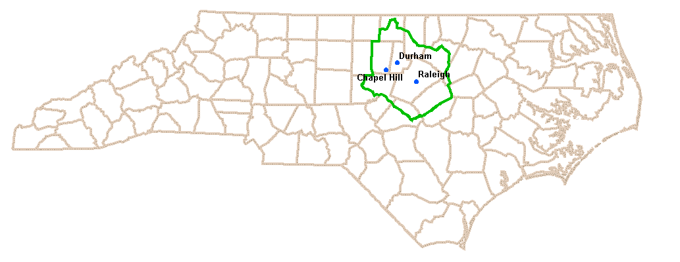
Models Being Interfaced
Triangle Regional Travel Demand Model (TRM), version 6
  Commercial Vehicle Model
NC Statewide Travel Model (NCSTM), version 1
  Truck Model
Notes:
The models that are interfaced are Triangle Regional Model, specifically the commercial vehicle part, and the truck component of the North Carolina Statewide model. As a note, the version of the statewide model we have been using is version 1, which was the latest version when this work started about a year back. As I understand, version 2 is almost ready and it has many improvements over version 1.
This figure shows the location and boundaries of the Triangle Region in North Carolina.

Slide 5
Triangle Regional Commercial Vehicle Model
Models by trip type:
  Internal trips
  External trips
Internal trip model developed based on 2010 Triangle Region commercial vehicle travel survey
  Vehicle types: light-duty commercial vehicle (LCV), single-unit truck (SUT), and multi-unit truck (MUT)
  Trip purposes: delivering goods, delivering services, and other
  Trip generation, destination choice, time of day, etc.
External trip model
  Interfacing with NCSTM
  Same vehicle types as internal trip model
  No stratification on trip purposes
Notes:
So the Triangle Regional model has the commercial vehicle model as a component. There are two sets of models for commercial vehicles, one for internal trips and the other for external trips, which is the focus of this presentation.
The model is stratified by vehicle type and trip purpose.

Slide 6
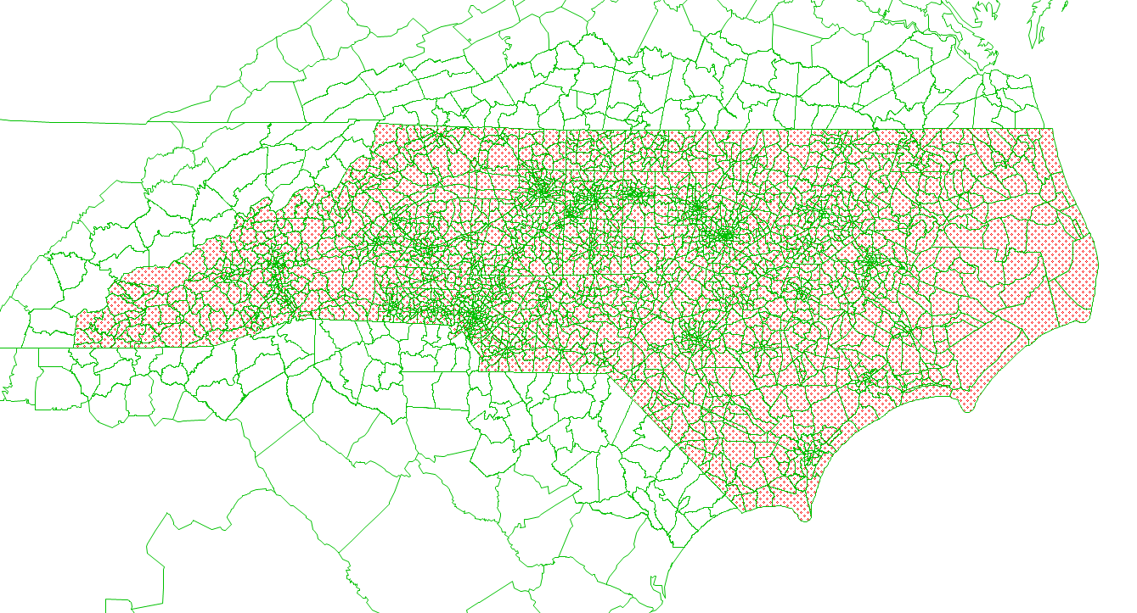
NC Statewide Model (version 1) - Truck Models
Nationwide long-haul truck trips
  FAF3 based
  Disaggregated from FAF zones to NCSTM zones
  Conversion from commodity tonnage to truck trips
  Single-unit trucks (SUT) and multi-unit trucks (MUT)
Local short-haul truck trips
  SUT and MUT
  QRFM trip rates used
  Gravity model for trip distribution
  Calibrated to NC statewide truck counts
TAZs
  2,577 inside North Carolina
  317 outside
Notes:
The truck model of north carolina statewide model includes two components too. The first one deals with nationwide long-haul truck trips. It is based on the FHWA FAF3 data. The FAF3 commodity flow matrices are disaggregated from large FAF zones to smaller county zones and finally to the statewide model TAZs. And payload factors are then used to convert commodity tonnage to truck trips by truck type, which includes single-unit trucks and multi-unit trucks.
The local short-haul trip model is the second component. It estimates trips for both SUTs and MUTs too. Quick response freight manual rates are used to trip estimation. The rates from the 2010 Triangle Regional commercial vehicle survey were tried but for some reason it was not successful for this model. Gravity models are used for trip distribution.
This figure shows part of the NC statewide model TAZs. The area highlighted in red is the TAZs within north carolina.

Slide 7
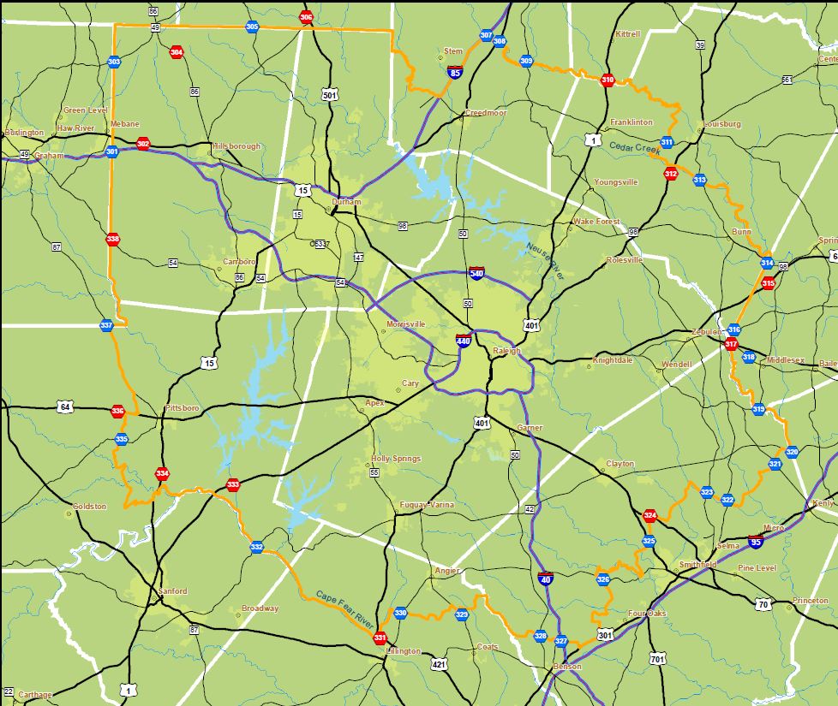
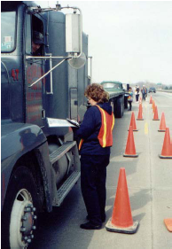
2006 Triangle Region Cordon Survey
13 stations on arterials
No survey on interstate
highways
In-bound only
7:00 am – 6:00 pm
Samples:
  6,835 complete samples
  6,100 autos (89.2%)
  179 medium trucks (2.6%)
  556 heavy trucks (8.1%)
8% of total in-bound daily traffic at the 13 locations
Notes:
The Triangle Region had a cordon survey in 2006 to collect data on external trips. While the survey has some limitations, some statistics from the survey are used for comparison and reasonableness check. 13 locations on arterials were selected for the survey, but no data collection on interstate highways. The survey only collected data from in-bound vehicles from 7:00 am to 6:00 pm. Here are some statistics from the survey. Of the 68 hundred samples surveyed, there are only 179 medium trucks and 556 heavy trucks. The total samples accounted for about 8% of total in-bound daily traffic at those 13 stations.

Slide 8
Procedures
Notes:
Now let me introduce what we did to link the statewide model outputs to the regional model.

Slide 9
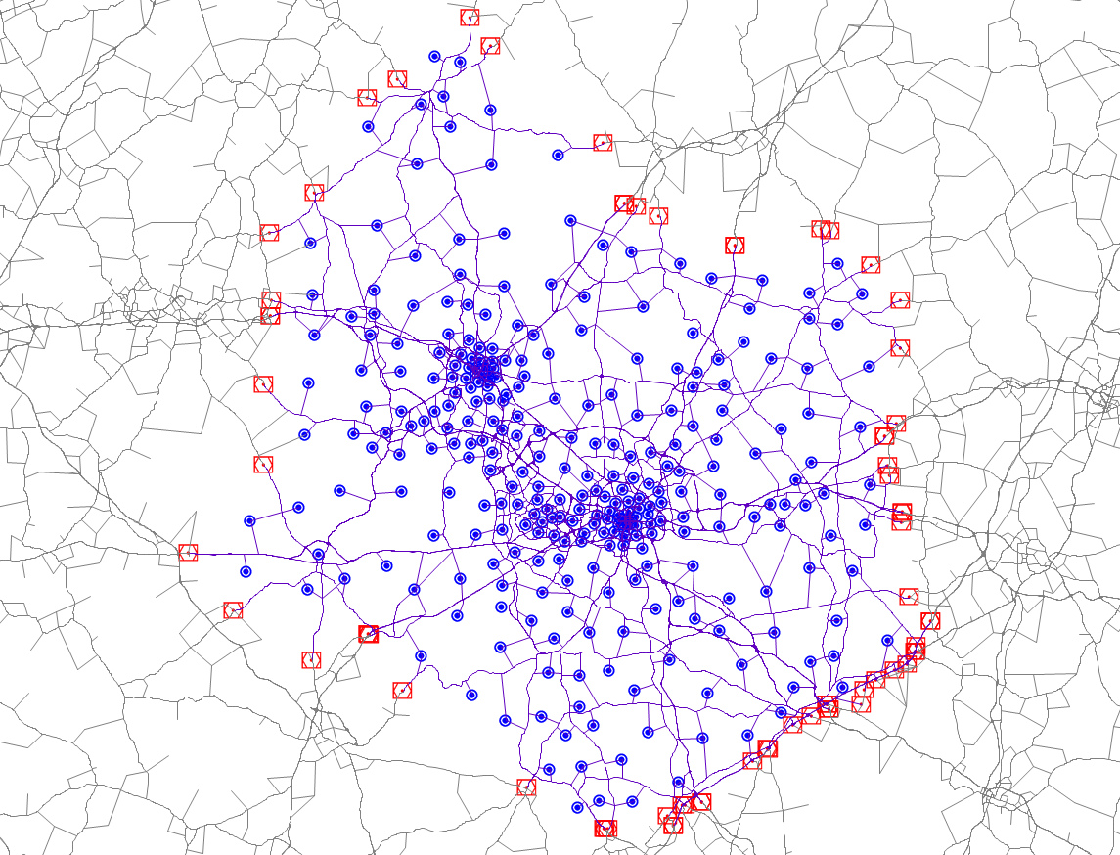
  Step 1 - Creating Triangle Region subarea and obtaining subarea trip matrices from NCSTM
299 zones inside the region
69 zones outside the region
Total 368 zones
Notes:
To achieve the goal, essentially we disaggregate statewide model output trip matrices to the regional model zones. As a result, the critical component of this interfacing work is to create correspondence tables between the two model TAZ systems, with one table for internal TAZs and the other table for external stations. So the very first step is creating Triangle region subarea in the statewide model and obtaining trip matrices from the statewide model using subarea analysis.
This figure shows the Triangle Region subarea in the statewide model. Blue dots are internal zones and red dots are external zones.

Slide 10
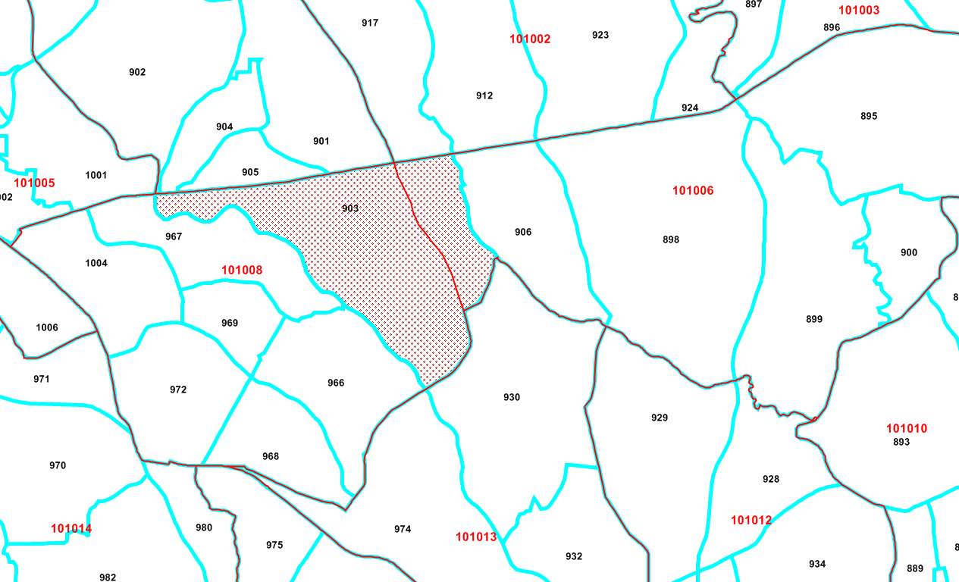
  Step 2 - Developing geographical correspondences between TRM internal zones and NCSTM zones
NCSTM_TAZ | TRM_TAZ | TRM_TAZ Split_Share
101010 | 886 | 1
101010 | 892 | 1
101010 | 891 | 1
101010 | 888 | 1
101010 | 887 | 1
101010 | 893 | 1
101010 | 889 | 1
101010 | 890 | 1
101008 | 903 | 0.793
101006 | 903 | 0.207
101008 | 966 | 1
101008 | 967 | 1
101008 | 968 | 1
101008 | 972 | 1
101008 | 969 | 1
101008 | 1004 | 1
101006 | 895 | 1
101006 | 898 | 1
101006 | 906 | 1
101006 | 899 | 1
101006 | 900 | 1
… | … | …
Notes:
The second step is developing geographical correspondences between TRM internal zones and NCSTM zones based on area. This correspondence table is mainly used to split TRM TAZs which overlap with more than one NCSTM zones.

Slide 11
Step 3 - Developing linear regression models for estimating internal truck trip ends
Different employment types have different trip generation rates
TRM and NCSTM use different employment types
Instead of creating a correspondence table for employment types between the two model systems (can be pretty tough), develop regression models
NCSTM Employment Types
Education
Gov
Military
High Industrial
High Retail
Industrial
Office
Retail
Service
Hospital
Households
TRM Employment Types
Industrial
Office
Retail
Service
Notes:
The reason we develop regression models between employment and the number of trips generated is because we think correspondence tables should be developed based on the number of trips rather than the number of employees. This is because a TAZ may have quite different employment type than the other and different employment types can have very different trip generation rates.

Slide 12
Step 3 - Regression models (cont’d)
Regression Models for National FAF3 Based Truck Trips
1) Single-unit truck trips
2) Multi-unit truck trips
Predictive Variable | Coefficient | t Stat | Adjusted R Square
Industrial employees | 0.0305 | 11.84 | 0.67
Office employees | 0.0062 | 6.30
Service employees | 0.0017 | 1.93
Retail employees | 0.0077 | 2.50
Predictive Variable | Coefficient | t Stat | Adjusted R Square
Industrial employees | 0.0220 | 11.37 | 0.69
Office employees | 0.0052 | 7.01
Service employees | 0.0014 | 2.09
Retail employees | 0.0073 | 3.17
Notes:
The dependent variable is the number of FAF3 converted truck trips from the statewide model, and the independent variables are employment by type in the Triangle Regional model. There are 299 internal zones, and therefore there 299 data records for model estimation.

Slide 13
Step 3 – Regression models (cont’d)
Regression Models for Local Short-Haul Trips
1) Single-unit trucks
2) Multi-unit trucks
Predictive Variable | Coefficient | t Stat | Adjusted R Square
Industrial employees | 0.0895 | 16.90 | 0.95
Office employees | 0.0409 | 20.04
Service employees | 0.0363 | 20.52
Retail employees | 0.0967 | 15.34
Predictive Variable | Coefficient | t Stat | Adjusted R Square
Industrial employees | 0.0599 | 13.48 | 0.84
Office employees | 0.0174 | 10.17
Service employees | 0.0094 | 6.36
Retail employees | 0.0411 | 7.77

Slide 14
  Step 4 - Developing trip-based correspondences between TRM internal zones and NCSTM zones
Models developed in step 3 are applied to employment data of TRM zones and sub-zones (created in step 2, if a zone is split) to compute the number of trips generated from those zones.
Calculated trips are summarized by NCSTM zone boundaries based on the geographical correspondence.
Shares are derived for each TRM zone or subzone by dividing the number of trips in that TRM zone by the total number of trips in the corresponding NCSTM zone.
These shares are those eventually used for disaggregating NCSTM trip ends to TRM internal zones

Slide 15
  Step 5 - Developing correspondences between TRM external stations and NCSTM external zones
99 external stations in TRM network, but 69 external zones in Triangle Region subarea from NCSTM
The 69 external zones fall in five categories:
  One zone - one TRM external station (replace)
  One zone - multiple TRM external stations (disaggregate)
  Two zones - one TRM external station (aggregate)
  Combination of 1) and 2) above (aggregate and then disaggregate)
  Two or more zones - one TRM external station (aggregate)
Notes:
The steps described above handles internal zones. This step works on the correspondence table for external zones.

Slide 16
  Step 6 - NCSTM trip matrix disaggregation
With the correspondence tables developed in previous steps, 368-NCSTM-zone based subarea trip matrices are disaggregated to 2,956-TRM-zone based trip matrices, one for each of the four trip types
A computer program developed to automate the process

Slide 17
  Step 7 - Adjustment of disaggregated trip matrices using Iterative Proportional Fitting (IPF)
Differences exist between disaggregated NCSTM trip matrices and local traffic count data at external stations
A 3-dimension Iterative Proportional Fitting (IPF) procedure is utilized to align modeled trips with truck counts
  Origin ends – in-bound traffic
  Destination ends – out-bound traffic
  Travel time distribution
What travel time distribution to use?
Average Travel Time (in minutes)
Vehicle Type | Cordon Survey | Disaggregated NCSTM Trips
Single-unit Truck (medium) | 29.2 | 30.2
Multi-unit Truck (heavy) | 32.4 | 33.6

Slide 18
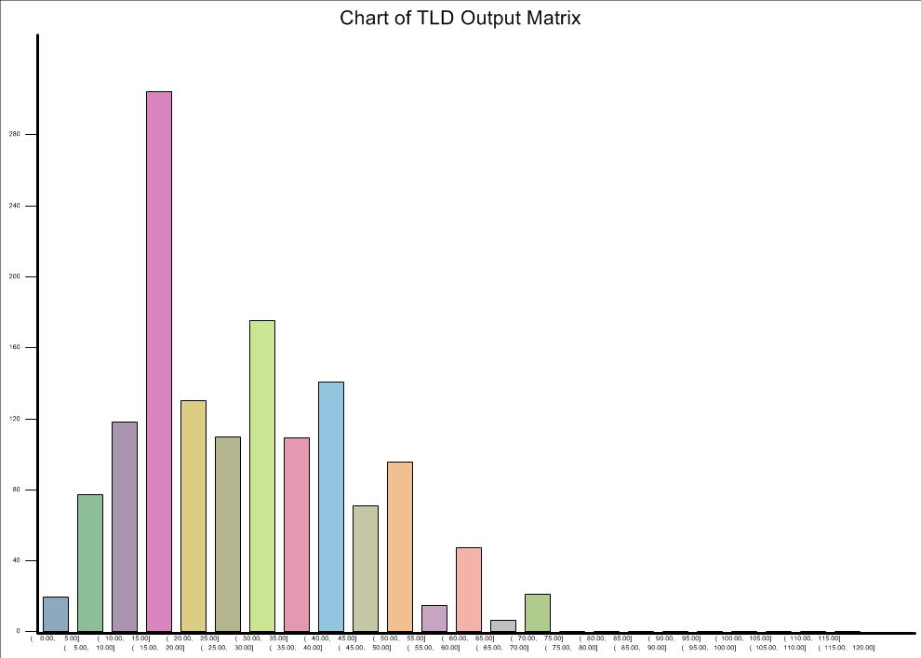
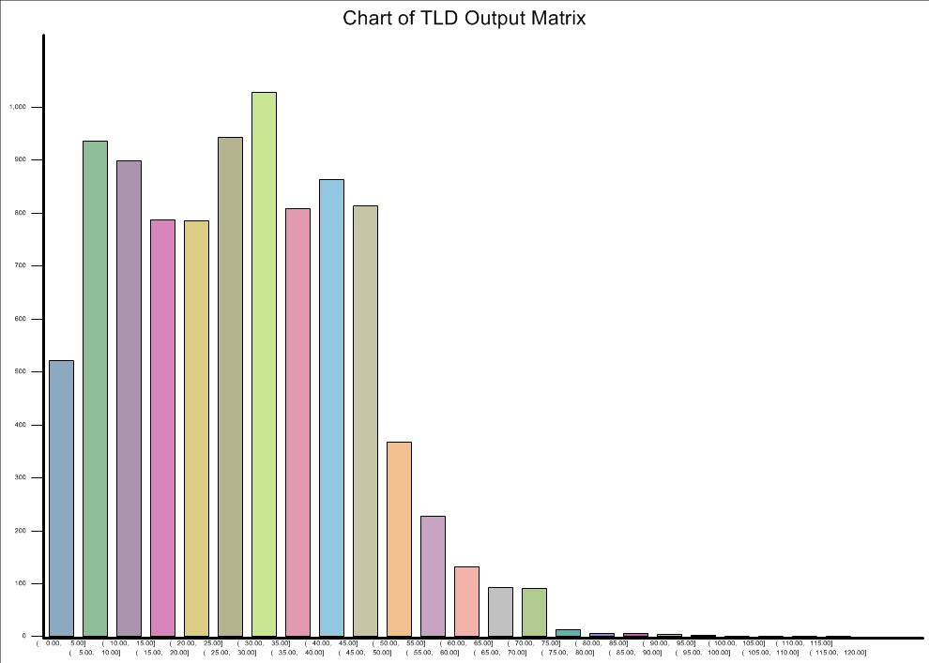
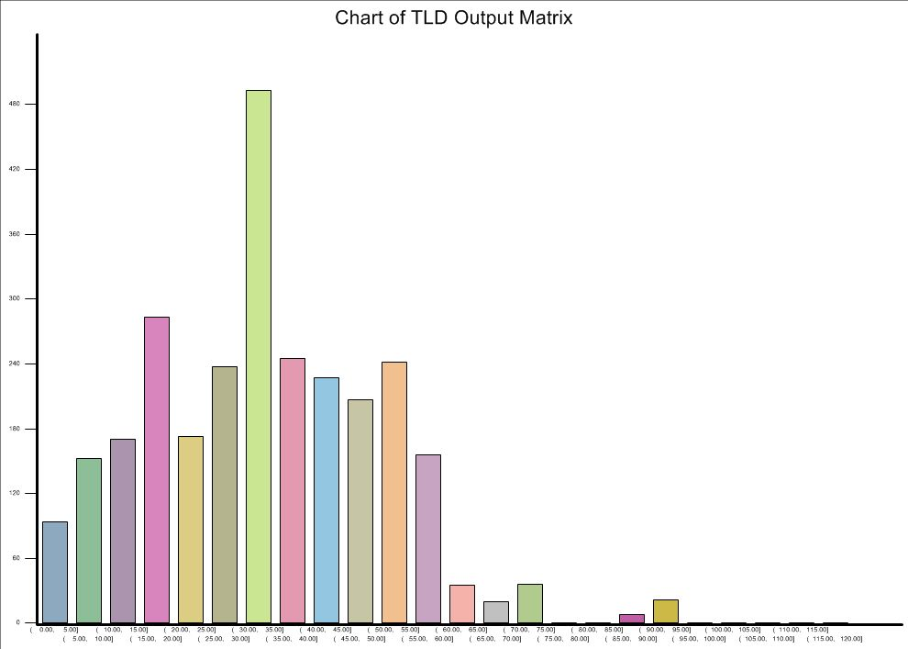
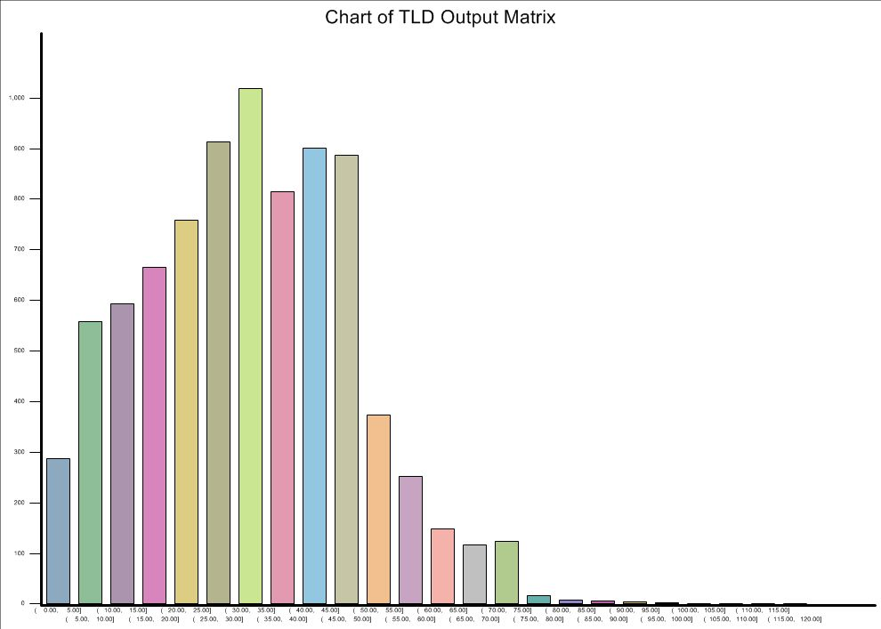
Step 7 – IPF (cont’d)
Travel time frequency distribution (IE/EI Trips)
Cordon Survey – Medium Truck
Disaggregated NCSTM Trips – SUT
Cordon Survey – Heavy Truck
Disaggregated NCSTM Trips – MUT

Slide 19
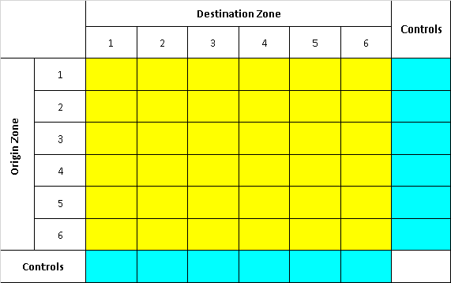
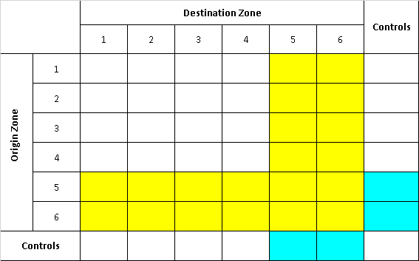
Step 7 – IPF (cont’d)
Traditional Modified

Slide 20
Step 8 - Deriving factor matrices and trip difference matrices
Two sets of matrices derived:
  Factor matrices: dividing IPF’ed matrix by original matrix
  Trip difference matrices: subtracting original matrix from IPF’ed matrix
For future year forecasting
  Applying factors only can be dangerous
  Applying differences only can be a bit conservative
  Other approaches are being considered

Slide 21
Summary and Future Work
A linkage between the regional model and NCSTM has been established. The regional model will benefit from the linkage whenever NCSTM gets improved
New approach does not rely on the forecasting of external station counts using growth factors but employs statewide model forecasting results. This is deemed to be a better way to forecast external trips for regional models
Base year TRM model calibration is currently under way and the base year disaggregated trip matrices may need some adjustments
When applying the calibrated model for future year forecasting, some creative ideas will be needed to make a good use of the factor and/or difference matrices

