Slide 1
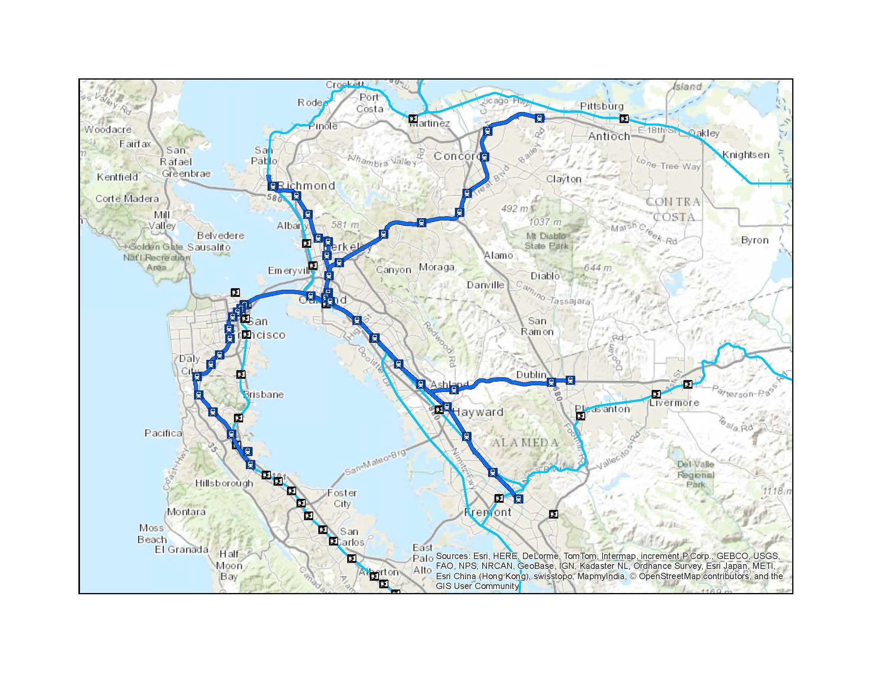
“An Iterative Capacity Constrained Parking Methodology for Ridership Forecasts for BART Extension Stations”
15th TRB National Transportation Planning Applications Conference
Mike Aronson
May 19, 2015

Slide 2
Presentation Overview
BART Livermore extension
Available modeling tools
Problems encountered
Parking constraint approach
Next time!

Slide 3
Disclaimer
Incremental retrofit to address key issues
  Fit schedule and budget constraints
This is not a recommended start-to-finish approach
However, components could be applied to other studies

Slide 4
1. BART to Livermore Extension

Slide 5
Bay Area Rail Transit
Capitol Corridor
Amtrak
BART
Livermore Extension
ACE Commuter Rail
BART
SF Airport
Capitol Corridor
Caltrain

Slide 6
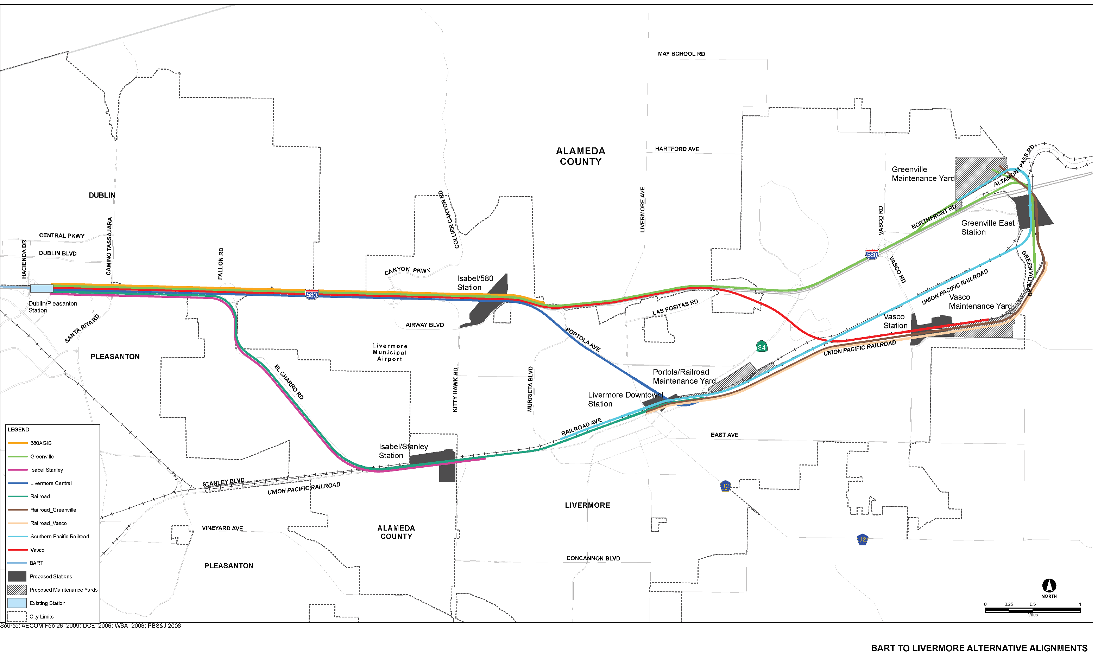
BART to Livermore Alternatives
San Jose
Freeway Alignments
Downtown Alignments

Slide 7
2. Available Modeling Tools

Slide 8
Several tools available for BART forecasts
Metropolitan Transportation Commission
  This work done prior to significant improvements
    Conversion to activity-based model
    Detailed transit network
  Excluded ridership markets outside Bay Area
  Less local detail
Alameda County Travel Model
  Replicated older MTC trip-based model
  Additional nested logit mode choice options
  Includes adjacent county

Slide 9
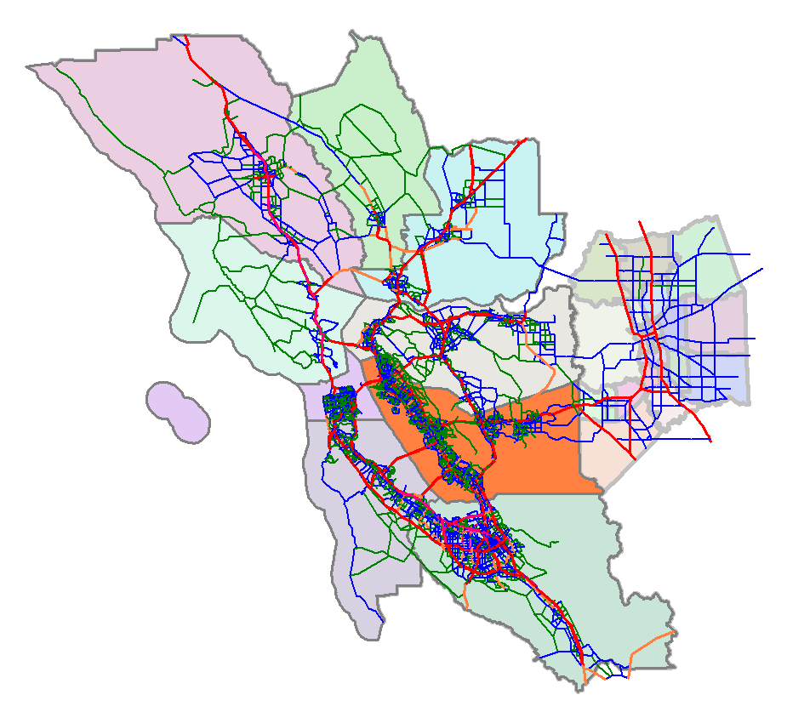
Alameda County Travel Model
San Joaquin County
Santa Rosa
MTC Model Area
Vacaville
Stockton
San Francisco
Livermore
Alameda County
San Jose

Slide 10
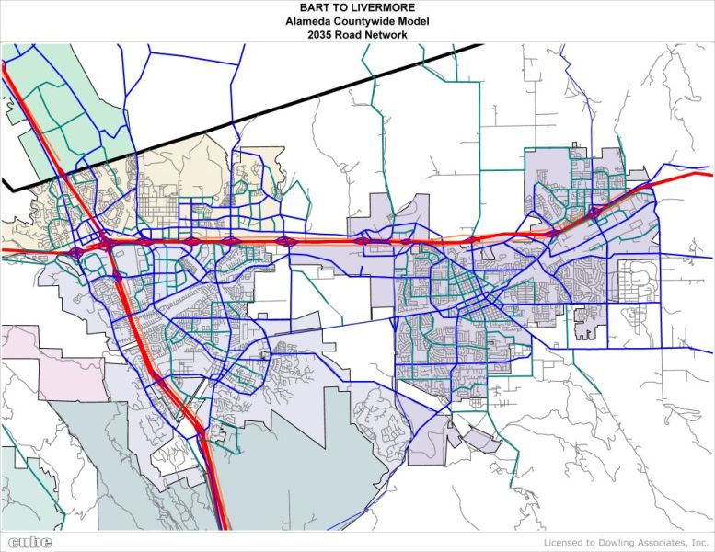
Model Road Network

Slide 11
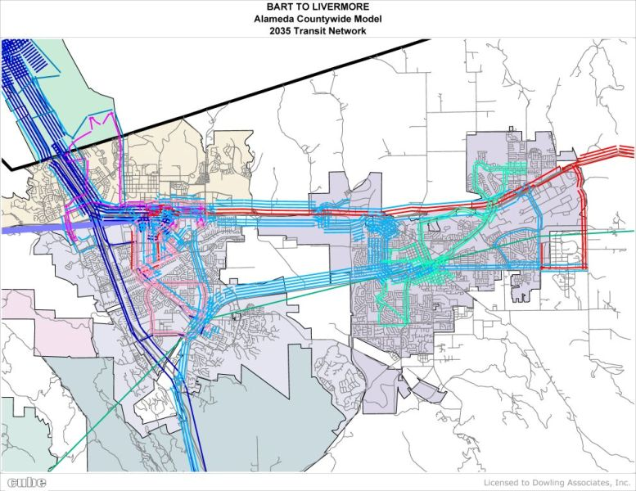
Model Transit Network

Slide 12
3. Problems Encountered

Slide 13
BART Extension Ridership Issues
“Build” vs. “No Build”
  Minimal increase
Unrealistic station parking demands
Transit assignment
  “All or nothing” park-and-ride
Auto assignment
  No park-and-ride vehicles included

Slide 14
Minimal Ridership Increase
In model, new stations did not provide significant PNR travel time benefit compared to existing stations
Existing Station

Slide 15
Excess Park-and-Ride Demand
Standard model used fixed park-and-ride access time
  2 to 8 minutes based on existing calibration
“Best path” transit park-and-ride calculations assign all demand from San Joaquin County to same station
  Parking demand >10,000 for maximum 4,500 spaces
Manual adjustments to parking access time only moved problem from one station to another

Slide 16
4. Parking Constraint Approach

Slide 17
Iterative Transit Parking Approach
Dynamic parking access times
  Time between vehicle at station and passenger on platform
  Increase based on demand
Mode Choice
  Equilibrate to parking access time
“Dynamic” park-and-ride assignment
  10 increments reacting to parking access times
Divert remaining excess parking demand
  Shift trips back to auto mode for assignment

Slide 18
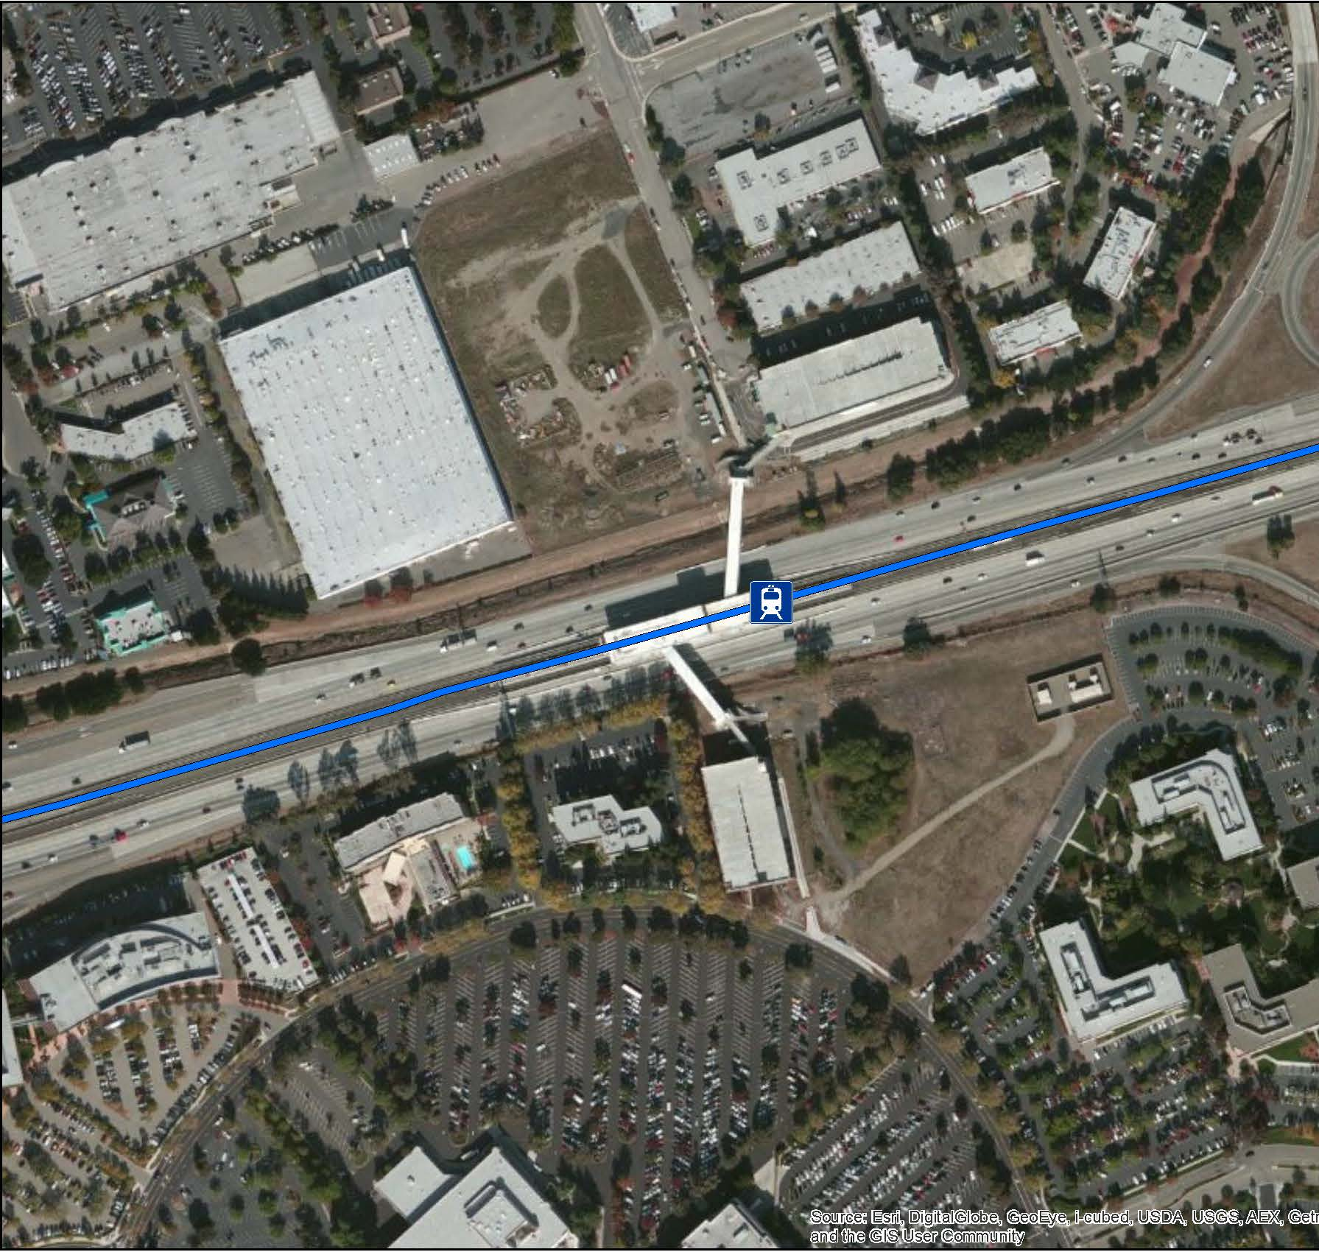
Dynamic Parking Access Times
Delay rather than absolute parking constraint
  On-street, private lots
2 minute minimum
Add one minute for each 1,000 demand over 2,000
Example: Demand of 8,500 = 8.5 minutes access time

Slide 19
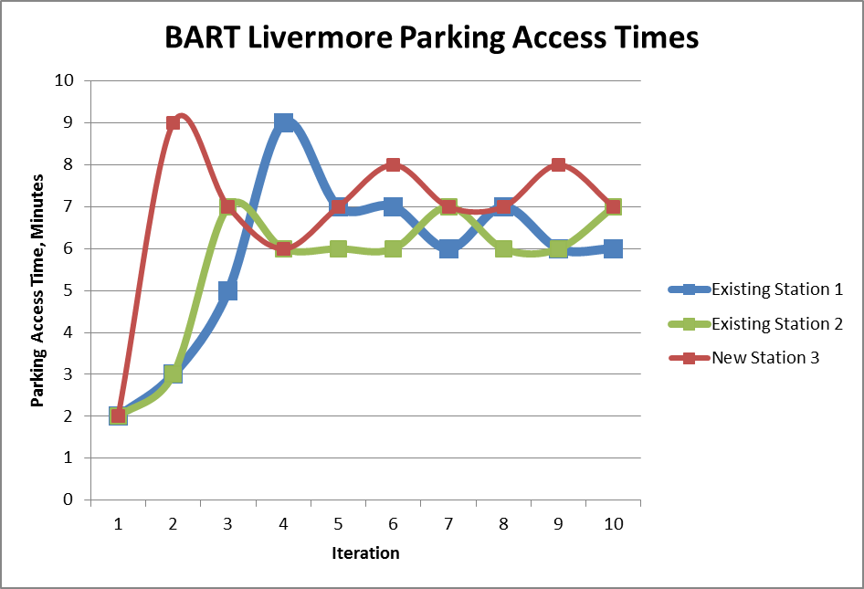
Mode Choice Equilibration
Rerun transit paths, mode choice, transit assignment
Adjust parking access times before each iteration
Method of Successive Averaging (MSA) for parking access times to dampen oscillations

Slide 20
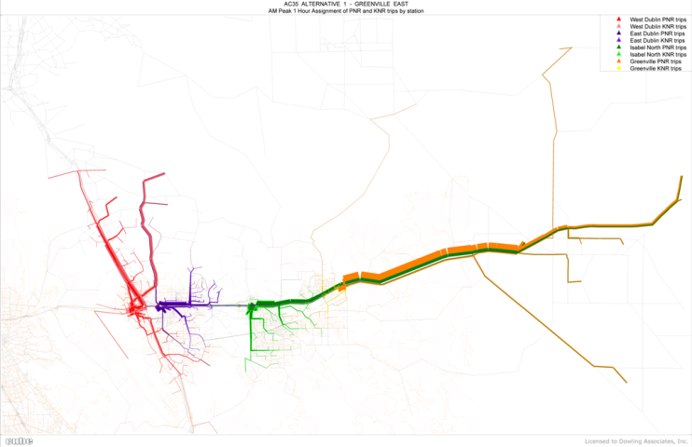
Incremental Park-and-Ride Assignment
Split peak period demand into 10 time slices
After each time slice, recalculate parking demand and parking access times
Input to next time slice
Example: San Joaquin demand from east split among several stations (green and orange)
Automated in Voyager
  Write PNR file

Slide 21
Account for all auto trips
Retrofit model to convert transit park-and-ride access trips to assignable vehicle trips
Certain stations would have absolute parking constraints
  Excess parking demand converted to vehicle trips from origin to ultimate destination
  Added to vehicle trip assignment
Accounting for all auto trips made a difference in VMT comparison of alternatives

Slide 22
5. Next Time!

Slide 23
What we would do differently next time
Improve dynamic parking access time calculation
  Collect data on parking time vs. demand
  Customize curve for each station area
Integrate mode choice equilibration and incremental parking assignment in same run
Test multi-path transit assignment
  Still may need equilibration

Slide 24
Acknowledgments
Client: BART
Prime Consultant: CDM Smith
  Bill Hurrell, Project Manager
Key Staff
  Completed as Dowling Associates prior to merger with KAI
  Neelita Mopati, model programming
  Antonios Garefalakis (now DKS Associates), model runs
  Damian Stefanakis, Project Principal

