Slide 1
South Jersey as Captured through the Lens of SJTPO's Recent Household Travel Survey
15th TRB National Transportation Planning Applications Conference
Sunday, May 17
South Jersey Transportation
Planning Organization

Slide 2
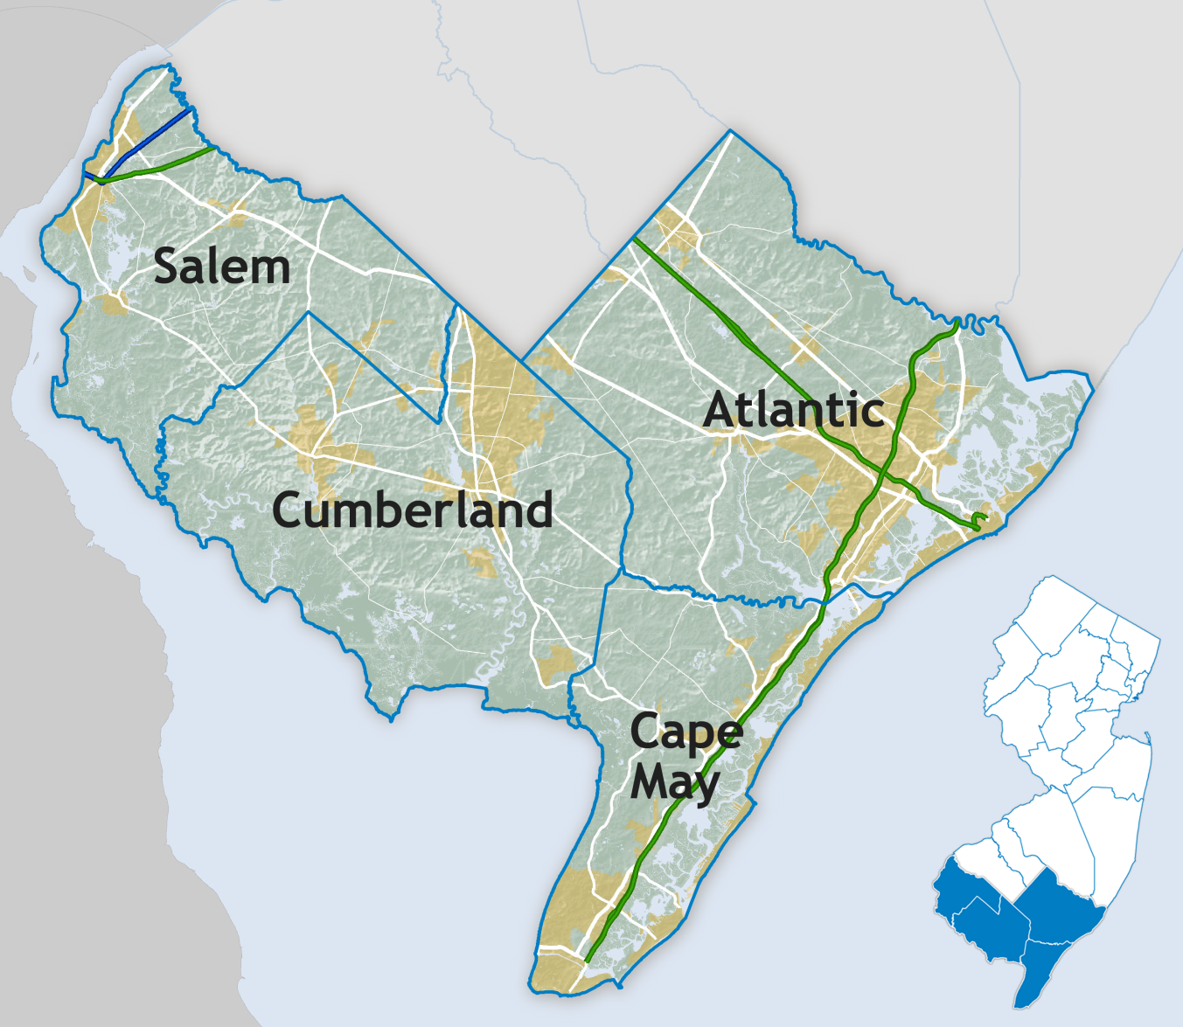
Background
55
47
“The Friendly MPO”
Notes:
About the MPO: we do the federally-funded transportation projects for South Jersey. Our planning region is comprised of Atlantic, Cape May, Cumberland, and Salem counties.
Federal programs such as Surface Transportation Program, Highway Safety Improvement Program, and the Congestion Mitigation and Air Quality Improvement Program
We work closely with constituent cities and counties on developing transportation projects.
Four-county region, highly seasonal, with large seasonal variation in population (transition to next slide)

Slide 3
Background
Atlantic and Cape May Counties:
Year-round population | Summer weekday | Summer weekend
1,440,000
1,079,000
372,000
Source: SJTPO Demographic Forecast Report, November 2011
Notes:
Year-round population of the entire region is 600,000. However, the shore counties, Atlantic and Cape May, have large seasonal populations as well.
Summer population, including visitors and residents of beach houses, can grow by 1 million.

Slide 4
Background
TIP developed in collaboration with subregions
Impact of projects on air quality must be modeled
Region must conform to 2008 NAAQS ozone standard
Notes:
What was our motivation for conducting a new household travel survey?
All projects and programs, along with funding for next 10 years, goes into the TIP. Updated every two years.
Some TIP projects may add more vehicle emissions. For example, building a new road, adding capacity to a road.
The MPO must demonstrate that new emissions will not cause region to exceed emission budgets established by NJDEP. This process is called Air Quality conformity. We must show that we conform to the air quality standards.

Slide 5
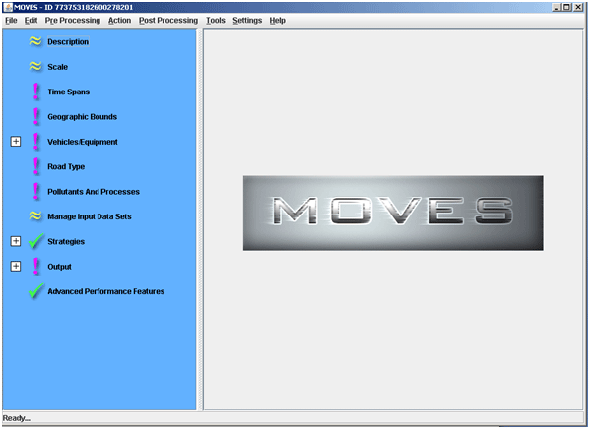
Background
Clean Air Act Amendments (1990)
Ozone standard (2008)
SJTPO in non-attainment for ozone
Must demonstrate that TIP projects will not cause region to exceed ozone standard
MOVES software used to model emissions
Notes:
This process was established by the Clean Air Act amendments in 1990. Since then, standards for different air pollutants have been introduced. In 2008, the ozone standard was established, and the South Jersey region was found to exceed the standard.
Because we’re non-attainment, we must demonstrate that our new transportation projects will not cause air quality to decline. To do this, we have to model regional emissions using the US EPA’s MOVES software. MOVES stands for Motor Vehicle Emission Simulator.

Slide 6
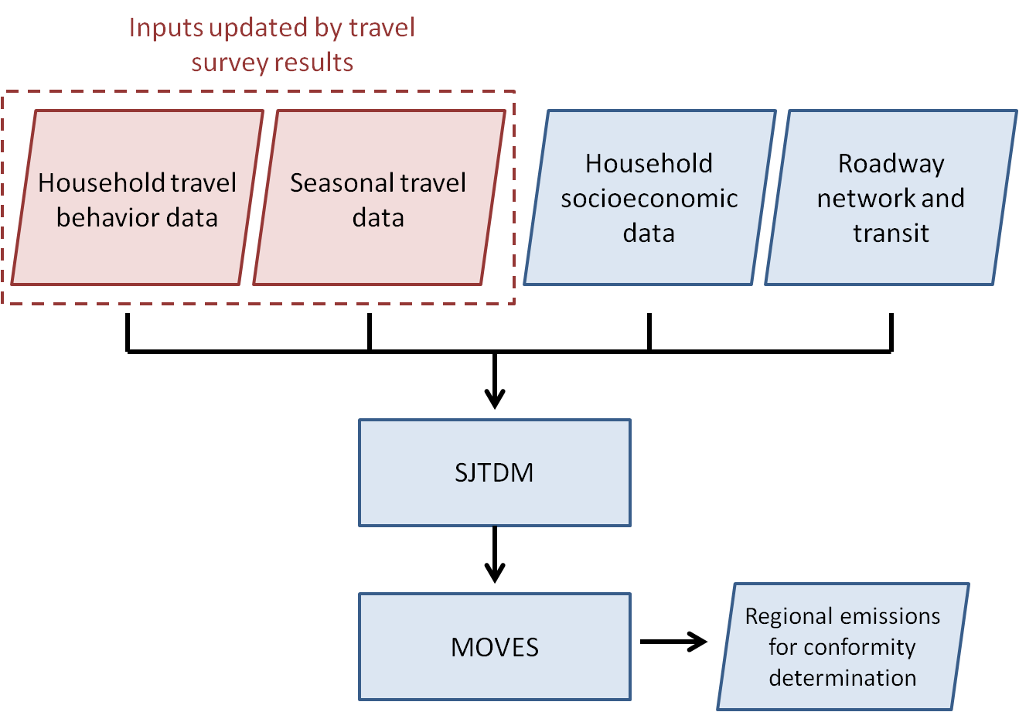
Background
Notes:
Where does the travel survey fit into the air quality process? Inputs for the travel demand model.
Highlighted here in red are the inputs to the air quality process that come from the household travel survey.
TDM has special recreational trip module for seasonal shore trips. It’s important that a survey update seasonal travel inputs as well.
Additional input data comes from the Census, and the projects from our Transportation Improvement Program are also modeled. All this goes into the South Jersey Travel Demand model, which projects travel in the region through the year 2040 based on these inputs. This is then passed into the EPA’s MOVES software.

Slide 7
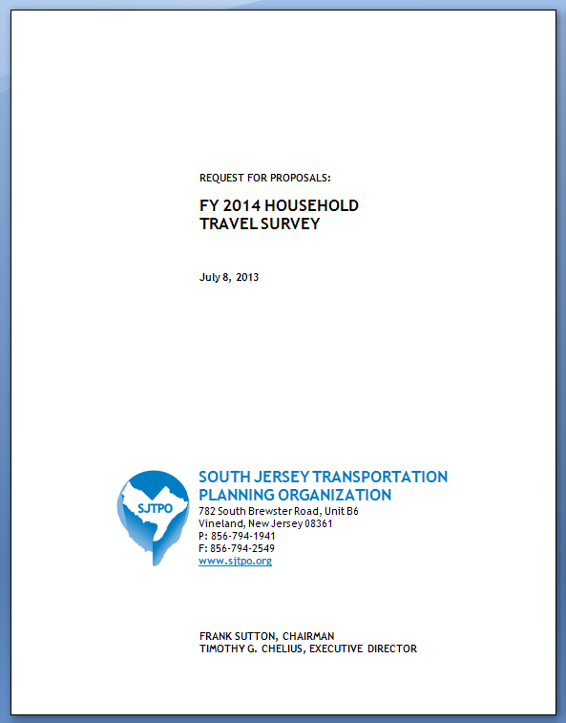
Background
Last survey conducted in 2000
SJTDM must be kept up-to-date
New survey must:
Have sample size large enough to account for different household types
Recruitment plan for hard-to-reach households
Collect seasonal travel data
Report requirements for SJTDM recalibration
Notes:
Because our last survey was conducted back in the year 2000, and because our travel model is to be kept up-to-date, we decided to conduct a new survey.
A lot has changed since 2000, and changes in travel behavior could be captured by a new survey.
We issued an RFP in July of 2013 for a survey to be conducted in spring of 2014. The new survey was scoped out to meet our travel modeling needs. (read bullet points).

Slide 8
Background
Survey team:
Notes:
We received a number of excellent proposals, and selected Westat as the survey consultant. URS provided travel modeling technical assistance, and Texas Transportation Institute provided survey peer review.

Slide 9
Survey Funding/Incentives Research
SJTPO Survey offered $10 cash incentive to all households.
Design Task: Peer Survey on Incentives
Did you offer incentives?
What was your survey funding source?
Sample: 19 MPOs/COGs that conducted or sponsored household travel surveys
10 offered incentives
Diversity of funding sources
Notes:
One potential issue that came up early on was funding a survey incentive.
Survey response rates are generally very low unless some financial incentive is offered. The issue was raised as to whether or not we can use federal funding to pay households for the survey.
We did a survey of our own to find out. 19 other MPOs were contacted, 10 of whom used survey incentives, some of which used federal funding.
So there was precedent for funding survey incentives with federal planning funds.

Slide 10
Survey - Design
Address-based sample frame
Covering 4 counties of South Jersey
Surveyed February – May 2014
Household travel survey PLUS recreational add-on
Mixed mode data collection
Mail
Web
Telephone
1,850 Households surveyed
Mailed letters to 75,000 Households
Recruited 3,123 Households
Notes:
The study was conducted in the spring of 2014 in the four counties of South Jersey.
An address-base sample design was used for the South Jersey HTS. A total of 75,000 addresses were mailed letters of invitation to participate in the study and two reminder post cards.
In addition to the HTS, each HH completing the travel day retrieval survey was also asked to respond to a brief survey about recreational trips to the Jersey Shore.
This was a mixed mode data collection that focused on web participation while providing telephone and mail back options.

Slide 11
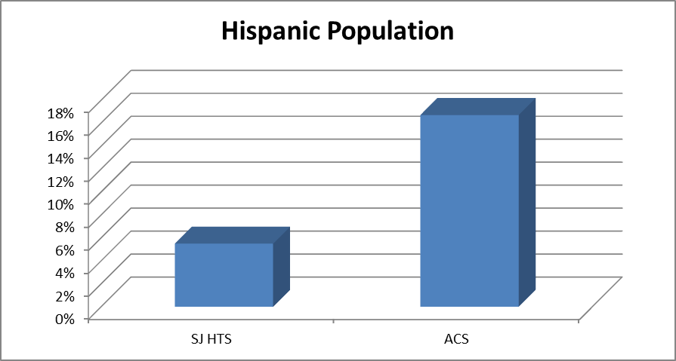
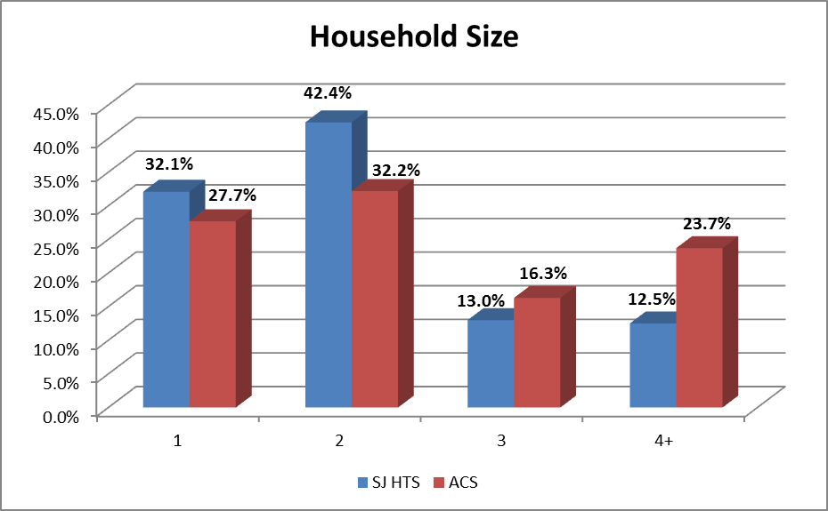
Survey - Challenges Faced
Hard-to-survey populations
Larger households
Hispanic households
Item non-response
Income
Notes:
Some of the challenges faced included reaching hard-to-reach populations. Hispanic and Latino households accounted for 6% of the survey sample, but make up 18% of the region. The survey website was translated into Spanish, but very few households actually took the survey in Spanish.
Large households were also under-represented. Completing the travel survey is more of a burden on large households, as there are more trips to report.
Additionally, many households were hesitant to share their household income, which is used to weight the results.

Slide 12
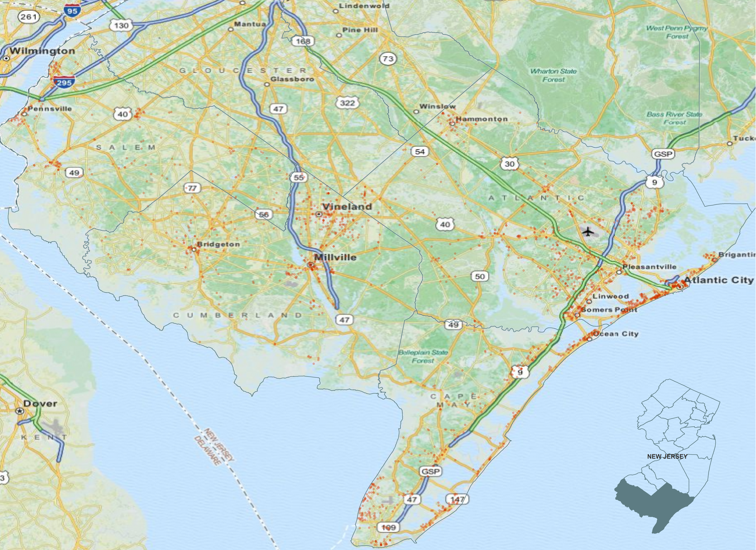
Survey - Results
Participating households
Notes:
Picture here are the surveyed household. Each red dot represents a household. The survey sample was spread evenly across the four-county region.

Slide 13
Survey - Results
1,850 Households / 3,907 Persons
12,219 Trips
6.6 Trips per HH
3.13 Trips per Person
Notes:
A total of 1850 households were surveyed, including 3907 individuals in those households. Of these, 12 thousand trips were reported.
The purpose of each trip was recorded, along with the mode of travel, and the length of the trip.
On average, each household made 6.6 trips per day.
Of those surveyed, about half were employed, and 20% were retired. Employment status is one of the main predictors of travel behavior.

Slide 14
Survey - Results
Notes:
More results – 87% of trips were made by car, either as a driver or as a passenger. Transit accounted for only 2% of surveyed trips.
The majority of trips were single-occupant vehicles, with 59% of travel parties being just one person.

Slide 15
Recreational Survey
Purpose: Capture details about recreational travel to shore and casinos
Questions:
Frequency of travel to shore and casinos
Purpose of travel to shore and casinos
Trip details (overnight, party size)
Administration
After reporting travel diary details
Asked of those reporting by phone or web (not mail)
1,420 of 1,850 HH completed Shore Survey
Notes:
Because a large part of summer travel demand is recreational trips, the survey included a separate recreational travel survey as well. Each household was asked about how many trips they make to shore destinations each summer, along with their mode of travel, how many people they brought, how long they stayed, and other details.
14 hundred of the households completed the additional recreational survey.

Slide 16
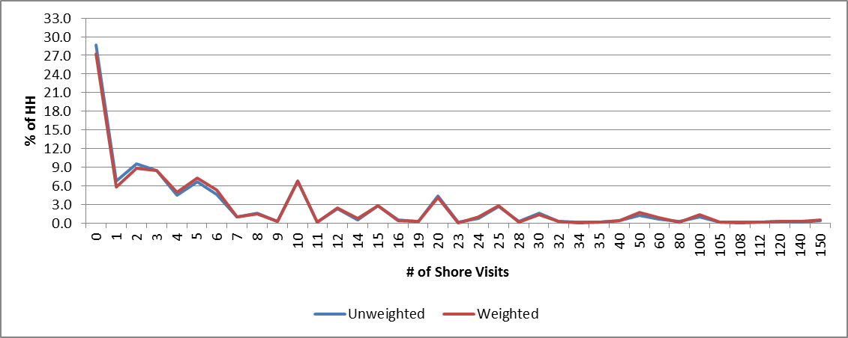
Recreational Survey – Shore Visits
618 of 1,420 HH live at shore year-round (43%)
Of the 802 HH not living at the shore:
7,492 visits to the shore / 9.34 visits per HH
Notes:
Some results from the recreational survey. Pictured here are the number of shore visits made by each household.
Of the 14 hundred households completing the recreational survey, 600 lived at the shore all year, so they don’t count. Of those not living at the shore, the average household made 9.34 trips each year. Three-quarters of SJPOT-region households make at least one shore trip each summer.

Slide 17
Recreational Survey – Shore Visits
Overnight vs. Day Trips
Notes:
Pictured here are the number of day trips and overnight trips. Households with children are more likely to make day trips. High-income households are more likely to stay overnight.

Slide 18
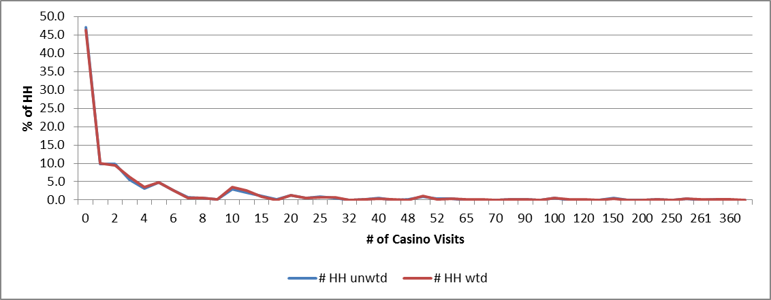
Recreational Survey – Casino Visits
668 of 1,420 HH do not visit Casinos (43%)
Of the 752 HH visiting Casinos:
6,565 visits to the shore / 8.73 visits per HH
Notes:
More results from the recreational survey. Pictured here are the number of casino visits made by households. 43% do not visit casinos. Of those that do, they make an average of 8.73 trips each summer.

Slide 19
Recreational Survey – Casino Visits
Notes:
Households with retirees visit casinos the most, while households with children and low-income households visit casinos less frequently.
Perhaps surprisingly, high-income households visit casinos less than middle-class households.

Slide 20
Findings
SJTPO region is complicated!
Modeling updates required strong survey sample size and design
Traditional one-day diary
Recreational survey
Survey results captured recent increase in unemployment
Recreational survey captured good variation in shore and casino visits; useful for model update
Notes:
Finally, to summarize some of the key findings provided by Westat. The SJTPO region is apparently very complicated.
The design of the survey was highly influenced by travel model requirements. Both the traditional travel diary and a supplementary recreational survey were needed.
The survey captured the recent increase in unemployment, and the corresponding effect on travel behavior.
Finally, the recreational survey was found to be a success, and should provide the data we need to update the shore trips in the travel model.

Slide 21
THANK YOU!
Andrew Tracy, SJTPO
David Heller, SJTPO
Tushar Patel, AECOM
Stacey Bricka, TTI
Susan Swain, Westat
Visit us at:
sjtpo.org
Notes:
The survey final report is up on our website, sjtpo.org, if you’d like to see it.

